Slide 1

Progress of Space Science Missions in China
Xiaolong DONG
National Space Science Center
Chinese Academy of Sciences
(CAS-NSSC)
March 26, 2019
Space Science Week 2019
Washington DC, USA

Slide 2

Table of Contents
Structure of Chinese Space Program
Strategic Priority Program on Space Science
Highlights of Science Missions 2011-2017
Strategic Priority Program on Space Science (2018-2022)
Summary

Slide 3
Table of Contents
Structure of Chinese Space Program
Strategic Priority Program on Space Science
Highlights of Science Missions 2011-2017
Strategic Priority Program on Space Science (2018-2022)
Summary

Slide 4
Structure of Space Programs
in China
Field | Program (Civil Part) | Agencies in Charge | Role of CAS
Space Applications | National Civil Space Infrastructure 3 series: Ocean, Meteorology, Land Surface (7 constellations: GEO and LEO) Specific series: Physical field, atmospheric composition, ocean surveillance | CNSA | Contribution of Payloads
 | High Resolution Earth Observation System | CNSA | Contribution of payloads; Application system.
Lunar and Deep Space Missions | Lunar missions (Chang-E Program) | CNSA | Ground system; VLBI; Scientific research; Payload system.
 | Martian Missions
Manned Space Flight Program |  | CMSEO | Scientific and application system
Space Science | Strategic Priority Program on Space Science | CAS | Full responsibility

Slide 5
Table of Contents
Structure of Chinese Space Program
Strategic Priority Program on Space Science
Highlights of Science Missions 2011-2017
Strategic Priority Program on Space Science (2018-2022)
Summary

Slide 6
Strategic Priority Program on Space Science
Space science program initiated and proposed by CAS, based on a series strategic planning research during 2006-2010
Make new scientific discoveries
Lead the development of space technologies
Play a strategic role of space science in the nation’s development
Approved by Chinese government in March, 2011
Including:
Series space science missions
Intensive study of candidate missions
Pre-study of future mission concepts and enabling technologies

Slide 7
Themes of Space Science
Theme 1: How did matter originate, how does it evolve and move?
How did life originate and how does it evolve？
What are the law of matter motion and the law of life activity in space environment?
How did the universe originate and how does it evolve？
Title
Theme 2: What is the relationship between solar system and human being?
What is the origin and evolvement of solar system, and its relationship with the sun?
How does the earth system evolve?
What is the nature of solar activity?

Slide 8
Table of Contents
Structure of Chinese Space Program
Strategic Priority Program on Space Science
Highlights of Science Missions 2011-2017
Strategic Priority Program on Space Science (2018-2022)
Summary

Slide 9




Two Themes of Space Science
Theme 1: How did matter originate, how does it evolve and move?
How did life originate and how does it evolve？
What are the law of matter motion and the law of life activity in space environment?
How did the universe originate and how does it evolve？
Title
Theme 2: What is the relationship between solar system and human being?
What is the origin and evolvement of solar system, and its relationship with the sun?
How does the earth system evolve?
What is the nature of solar activity?

Slide 10
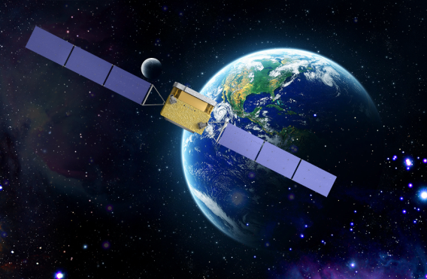

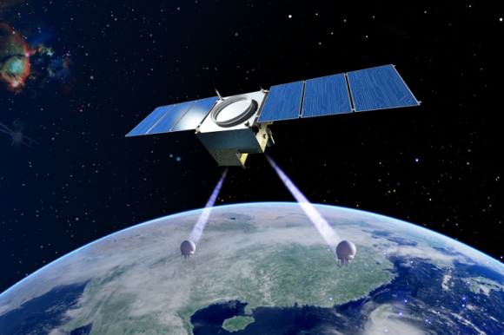
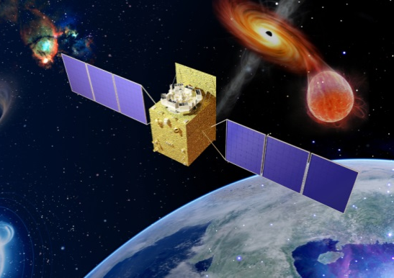
Strategic Priority Program
on Space Science（2011-2017）
DArk Matter Particle Explorer
(DAMPE)
Strategic Priority Program on Space Science
（2011-2017）
ShiJian-10
(SJ-10)
Black hole, dark matter
Test of the laws of quantum mechanics
Kinetic properties of matter
Rule of life activity in the space environment
QUantum Experiments at Space Scale (QUESS)
Hard X-ray Modulation Telescope
(HXMT)

Slide 11
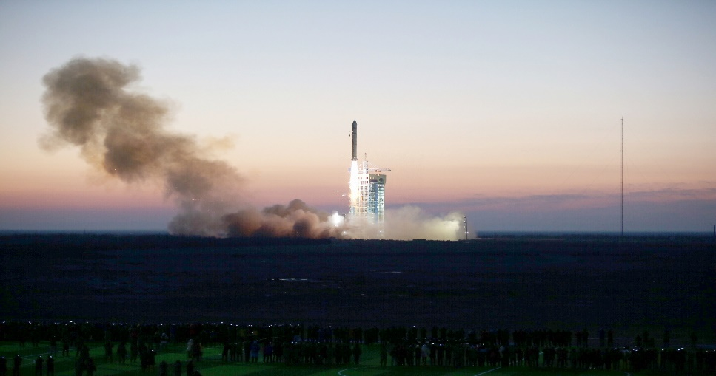
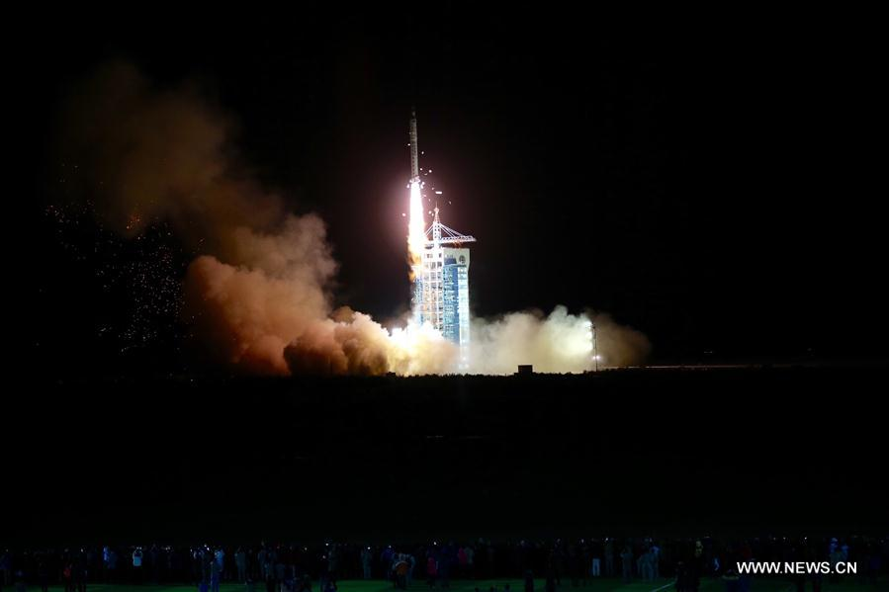
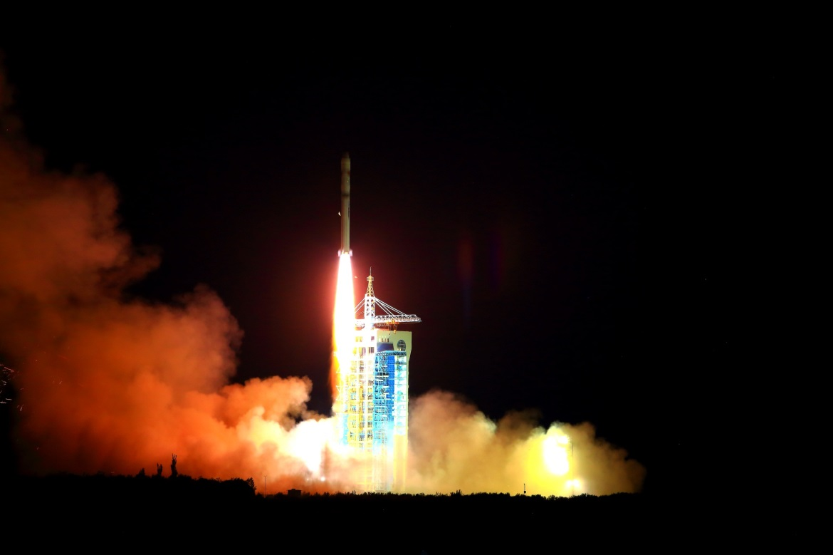
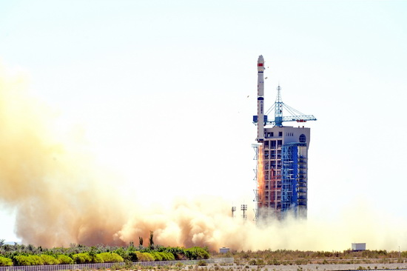
4 Missions Launched and Operated
DAMPE, Dec.17, 2015
SJ-10, Apr. 6, 2016
QUESS, Aug. 16, 2016
HXMT, Jun. 15, 2017

Slide 12

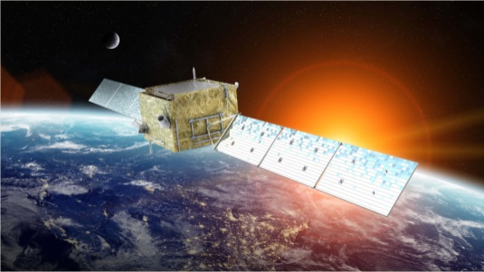
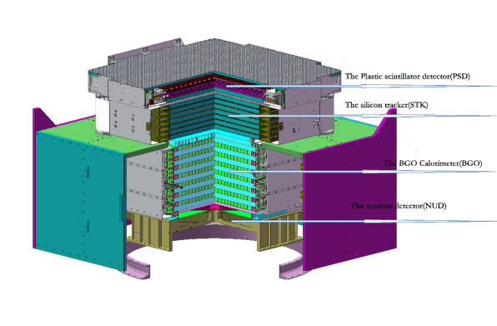
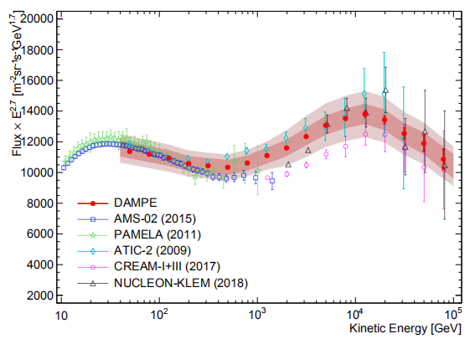
DAMPE
Scientific objectives
Indirect detection of dark matter particles
Origin and propagation of cosmic rays
High-energy gamma-ray astronomy
DAMPE has been in space for more than 3 years, and recorded more than 5.6 billion cosmic rays events (as of Feb. 28, 2019)
Direct detection of a break in the TeV electron spectrum (2017, Nature)
Detection of a spectral break at ~10 TeV in the proton spectrum
DAMPE has been approved to extend its scientific operation for 2 more years to collect more data to scrutinize the TeV window of the Universe
Electrons
Protons
Preliminary
530 days of data
2.8×10⁹ events
1.5×10⁶ e+e- (>25 GeV)

Slide 13
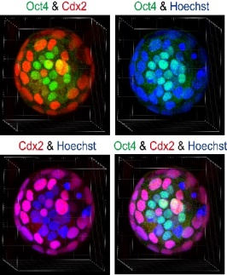
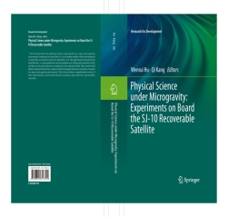
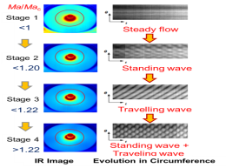
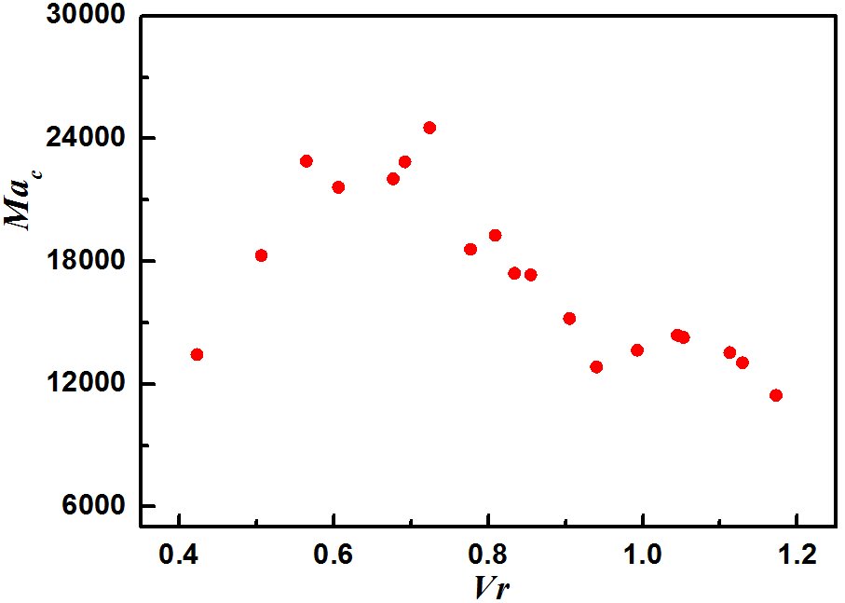
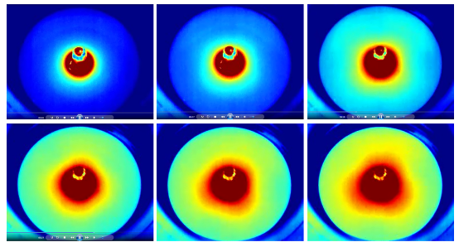
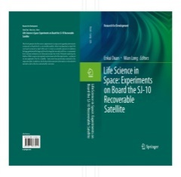
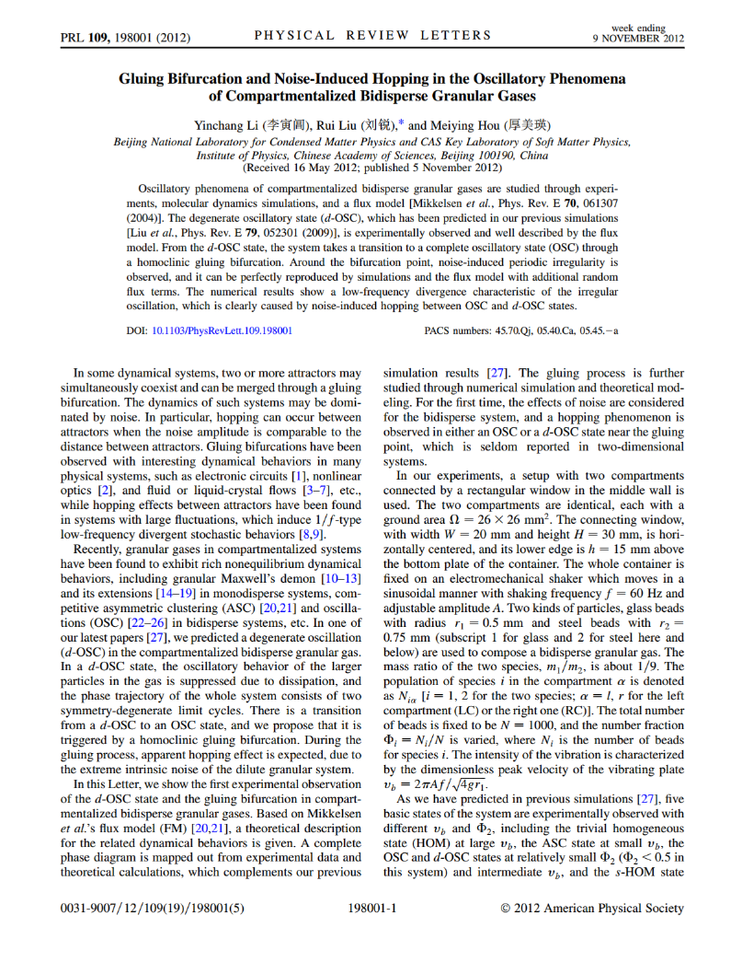
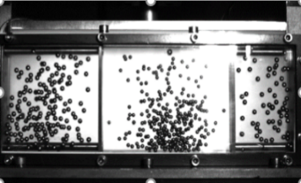
SJ-10
15 experiments were conducted for the first time
Development of mammalian preimplantation embryo under microgravity
2016.4.6 launching
2016.4.18 return
2016.4.25 extension
Surface wave of thermocapillary convection in An Open Annular Pool
Papers published
JFM：2.893
POF: 2.279
IJHMT：3.458
ETFS：2.830
MST：1.118
Volume effect
Experimental study on particle motion behavior

Slide 14

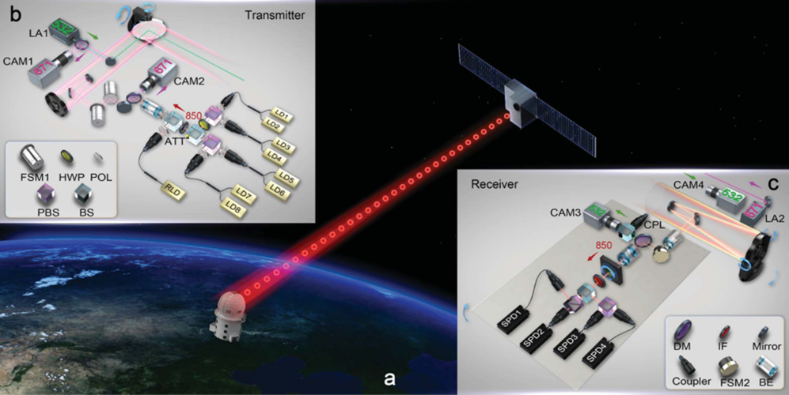
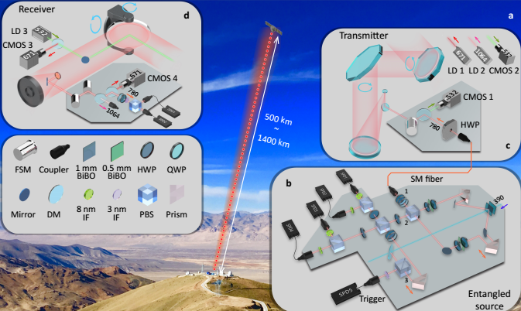
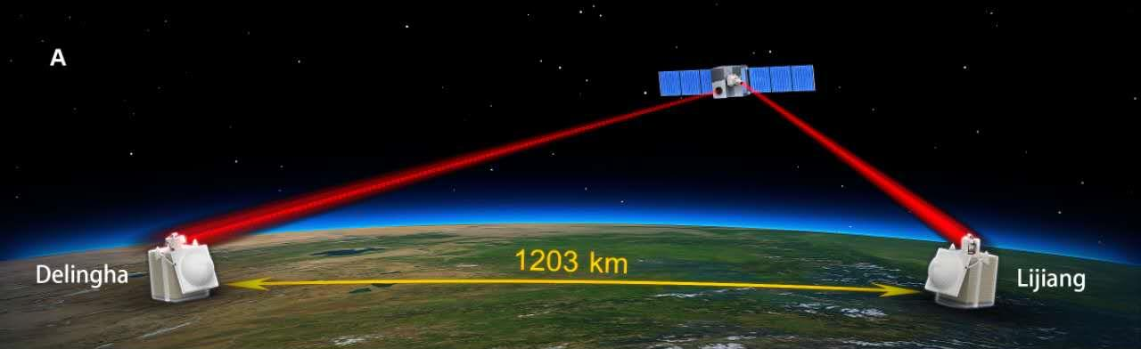
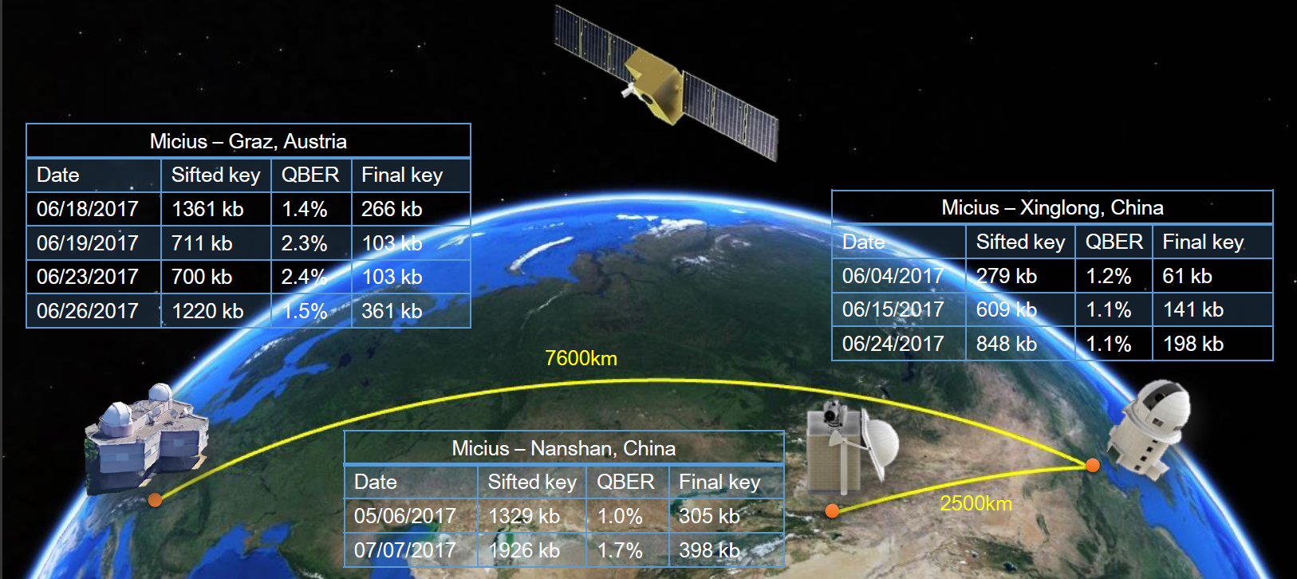
QUESS
Operated well in space for 2 yrs+ since Aug 2016
Satellite-to-ground quantum key distribution was accomplished for the first time (Nature,2017)
Ground-to-satellite quantum teleportation was accomplished for the first time (Nature,2017)
Satellite-ground and ground-satellite entanglement distribution over 1200 kilometers was accomplished for the first time (Scince,2017)
Intercontinental quantum key distribution was accomplished between China and Austria
Notes:
I

Slide 15
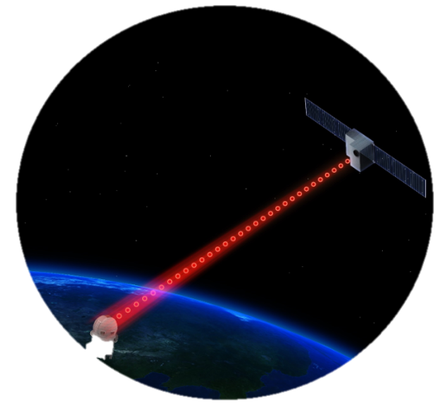
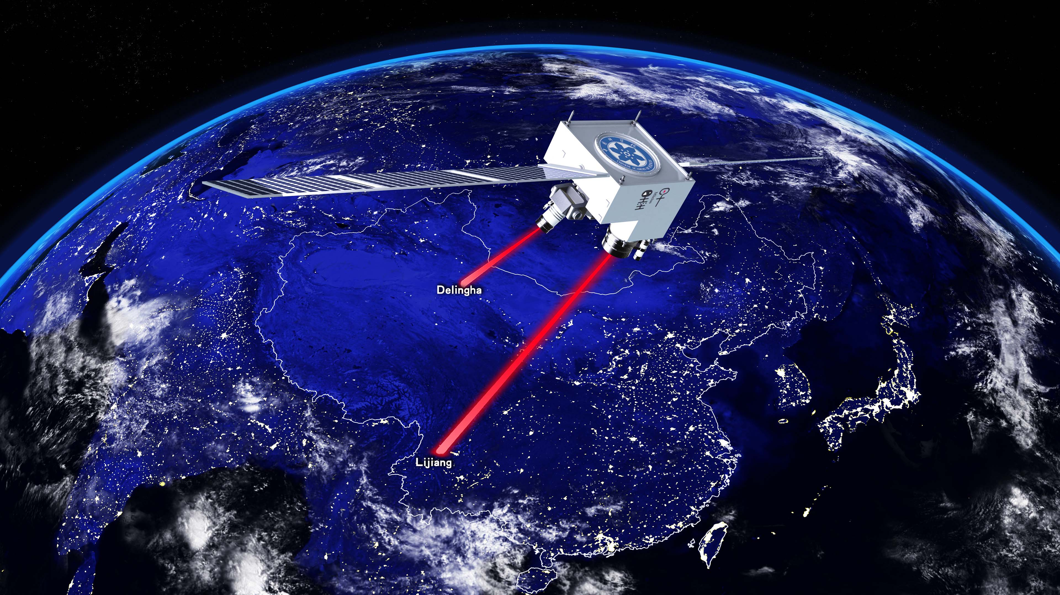

2 more year extension of QUESS
Getting approved to be extended for another 2 yrs:
Space Quantum Key Distribution and Its Application：Satellite-relayed intercontinental QKD, High speed satellite-to-ground QKD, Miniaturization technique of space QKD ground station
Quantum experiment based on quantum entanglement distribution: Entanglement-based QKD, Remote state preparation with the distributed entanglement
Expanded application of space quantum communication：Secure time-frequency transmission, Testing a gravitationally induced quantum decoherence model

Slide 16

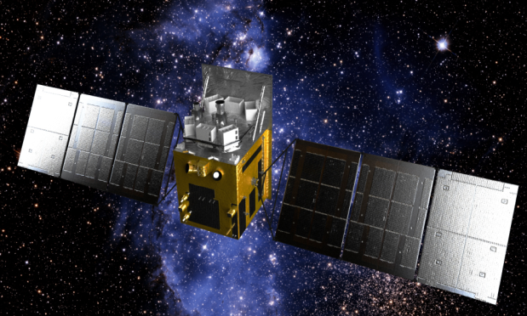
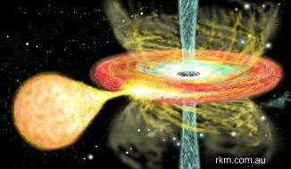
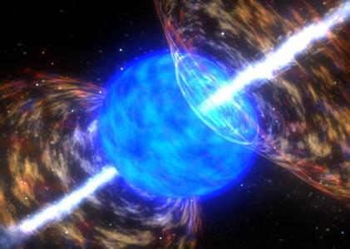
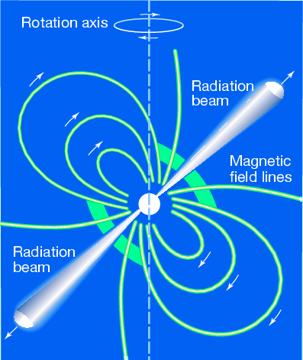
HXMT
The 1st X-ray observatory of China!
Sciences：BHs, NSs, XRBs, Pulsars, RBs…
Observation modes
Survey observation for new transients
Pointed observation of known sources
Gamma-ray monitoring (0.2-5 MeV)
Features:
Large effective area
High timing resolution
Wide energy band (1 keV- 250 keV)

Slide 17
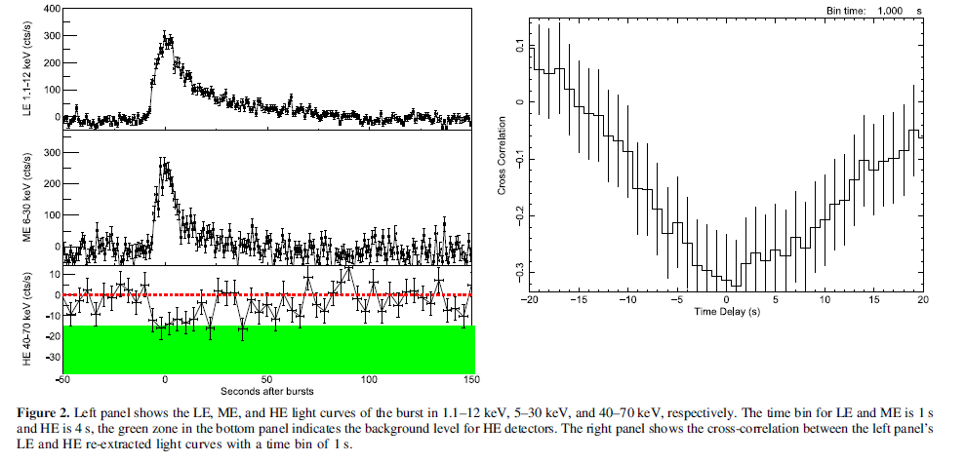
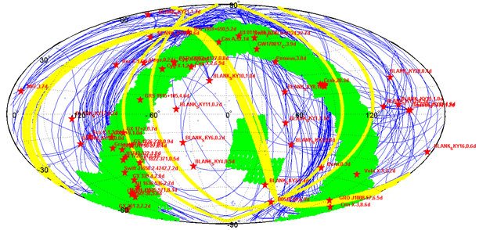
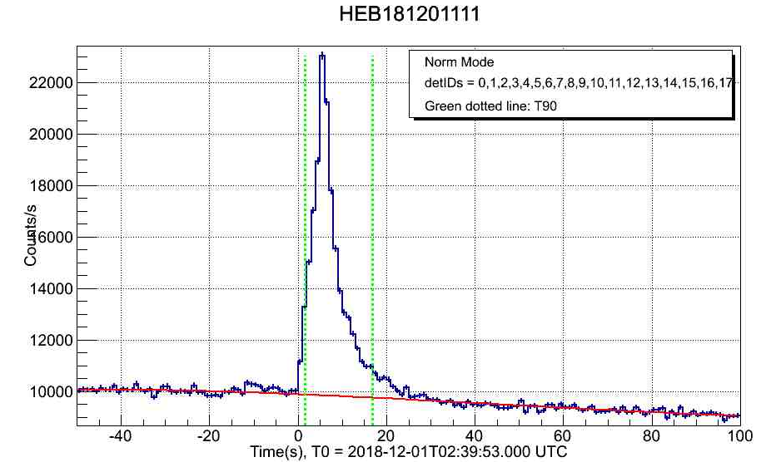
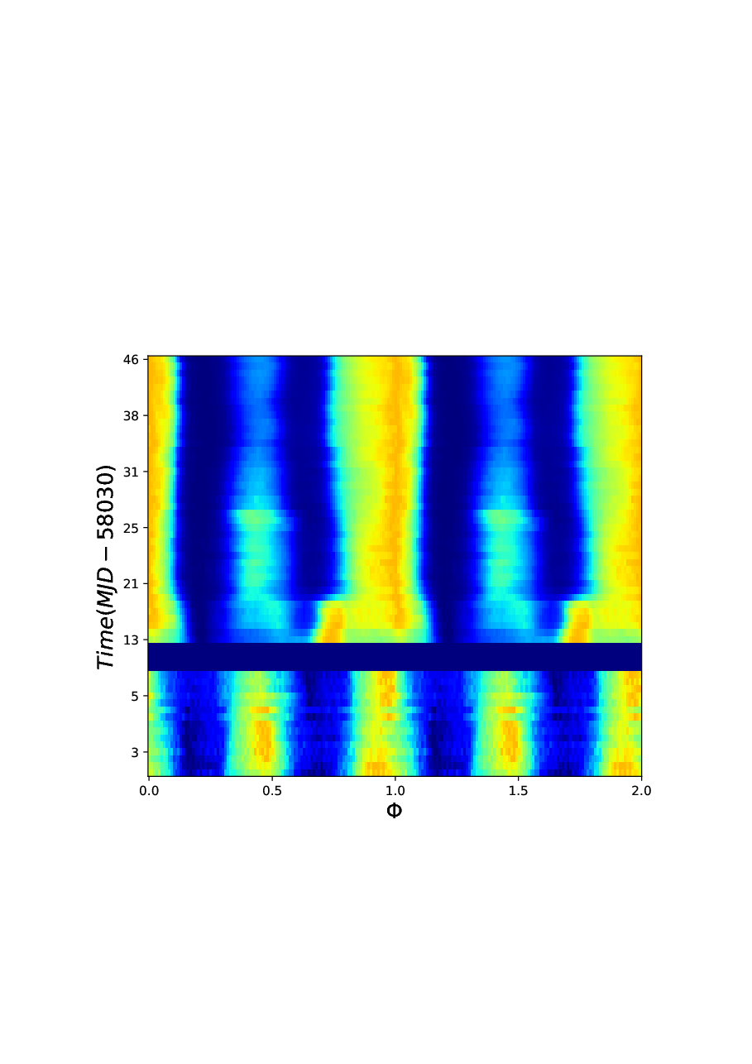
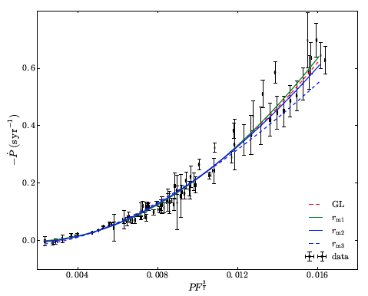
HXMT
(1)
(2)
4U 1636-536
Total observation map of Insight-HXMT: X-ray binaries ~11 Ms, Scan Survey ~5 Ms.
MAXI J1535-571
X-ray binaries:
(1) MAXI J1535-571: black hole system, QPO observed first time up to 100 keV.
(2) 4U 1636-536: neutron star system, corona cooling revealed first time with single short type-I X-ray burst
(3) Swift J0243.6+6124: neutron star spin evolution of the ultra-luminous X-ray source in the Milky Way
GRB 181211
Swift J0243.6+6124
(3)
77 gamma-ray bursts detected in 2018; 8 first reported by Insight-HXMT

Slide 18
Table of Contents
Structure of Chinese Space Program
Strategic Priority Program on Space Science
Highlights of Science Missions 2011-2017
Strategic Priority Program on Space Science (2018-2022)
Summary

Slide 19
Two Themes of Space Science
Theme 1: How did matter originate, how does it evolve and move?
How did life originate and how does it evolve？
What are the law of matter motion and the law of life activity in space environment?
How did the universe originate and how does it evolve？
Title
EP
GECAM
Theme 2: What is the relationship between solar system and human being?
What is the origin and evolvement of solar system, and its relationship with the sun?
How does the earth system evolve?
What is the nature of solar activity?
ASO-S
SMILE

Slide 20
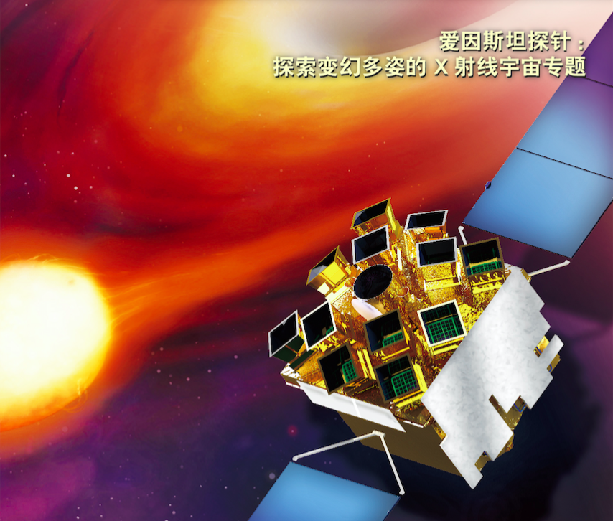
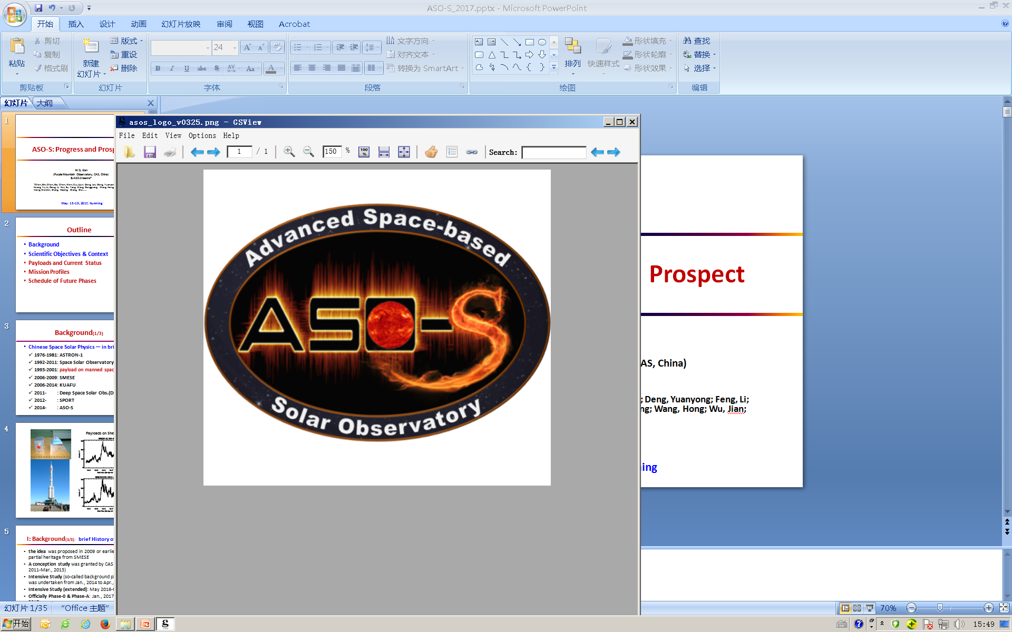
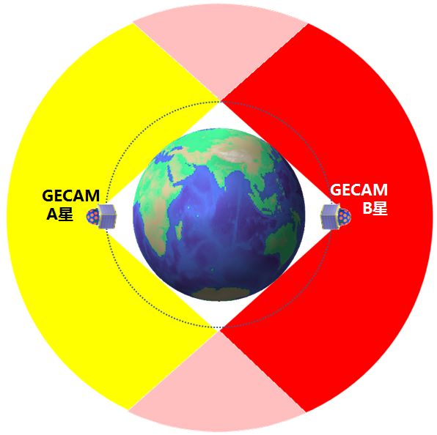
Strategic Priority Program on Space Science (2018-2022)
Strategic Priority Program on Space Science
（2018-2022）
1. Einstein Probe (EP)
2. Advanced Space-borne Solar Observatory (ASO-S)
Time-domain astronomy
Relationship of solar magnetosphere and eruption
Interaction of solar wind and magnetosphere
The electromagnetic counterpart of gravitational waves
3. Solar wind Magnetosphere Ionosphere Link Explorer（SMILE）
4. Gravitational wave high-energy Electromagnetic Counterpart All-sky Monitor (GECAM)

Slide 21
Strategic Priority Program on Space Science (2018-2022)
Category | Missions
Space Science Missions in Implementation | Solar wind Magnetosphere Ionosphere Link Explorer (SMILE)
 | Einstein Probe (EP)
 | Advanced Space-borne Solar Observatory (ASO-S)
 | Gravitational wave high-energy Electromagnetic Counterpart All-sky Monitor (GECAM)
Intensive Study of Candidate Missions | Major candidate missions | enhanced X-ray Timing and Polarimetry mission (eXTP)
 |  | Mid-to-high Orbit Quantum Satellite
 |  | Taiji Program
 | Other candidate missions
Pre-study of Future Mission Concepts and Enabling Technology | Space Science Mission Concept Study
 | Advanced Research of Space Science Missions and Payload technology
 | Data Analysis Research

Slide 22

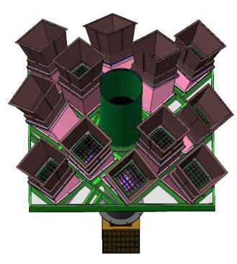
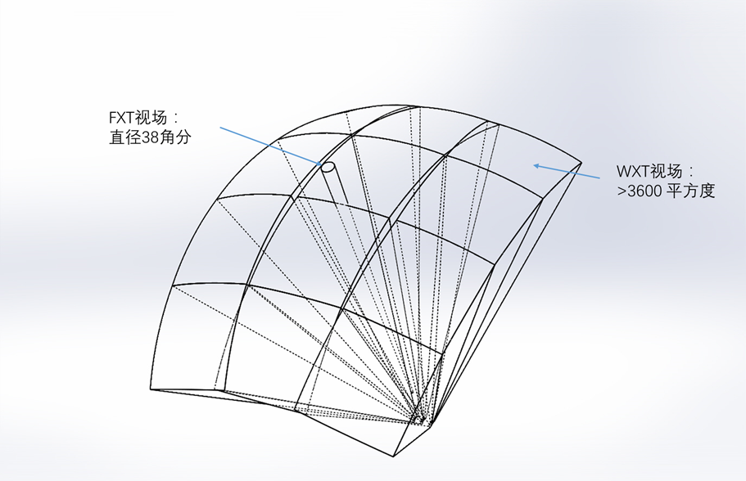
1. Einstein Probe (EP)
EP: A time-domain astronomy mission
Scientific Objectives:
discover and study the high-energy transients and variable objects in soft X-ray band
Demography, origin and evolution of black hole population
How gravitational waves are produced, and their effects?
Life cycle of the first generation of stars, re-ionization
How supernovae explode?
Payloads
Wide-field X-ray Telescope (WXT)
Follow-up X-ray Telescope (FXT)
fields of view
FXT
WXT modules

Slide 23



Mission Profile
Specifications:
Orbit: 600 km, 30°
Attitude Control: 3-axis stabilized
Mass: <1250 kg
Lifetime: 3 yrs
Rocket: CZ-2C
Officially approved in Dec. 2017
Now in Phase B
Planned launch time: 2022
International Cooperation
ESA: Invest >10M Euro in-kind contribution to payload (MoO)
MPE (Germany): Hardware contribution
French Space Agency: VHF system（TBD）

Slide 24
EP International Collaborations
FXT: Mirror Assembly and Electron Diverter
WXT: Testing of Optics and Detectors
Ground Station Support & Science Exploitation
~5 Detector modules & 1 CAMEX test module for the FXT camera
A detector module comprises a PNCCD sensor and front-end readout ASICs (CAMEX type) mounted on a rigid-flex PCB board
VHF system for “alter” downlink

Slide 25
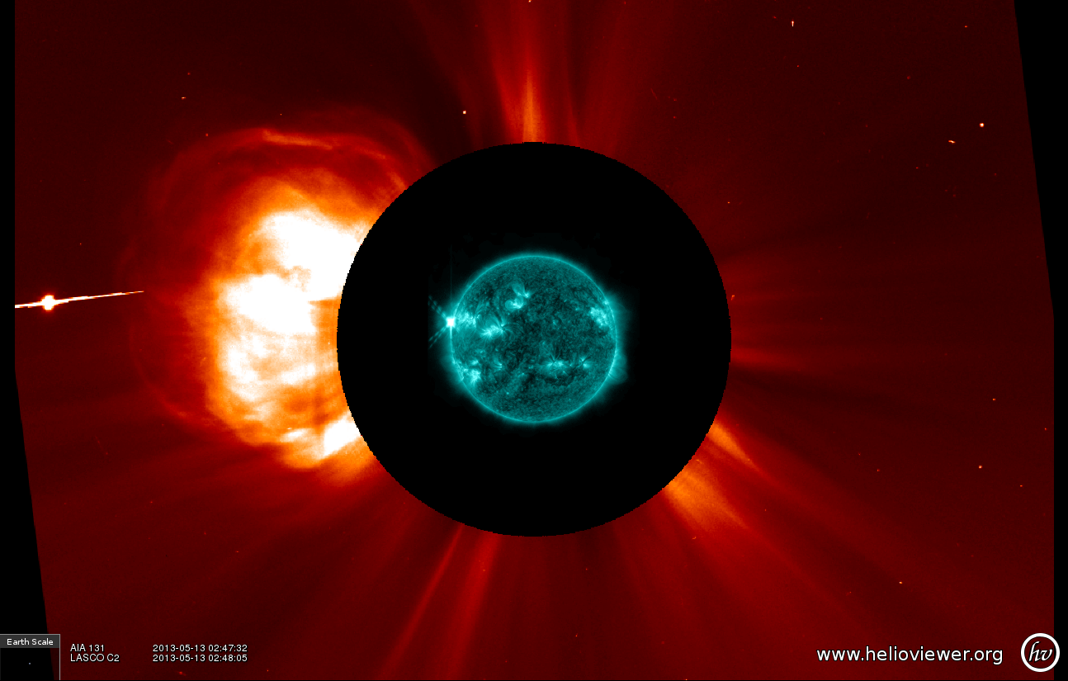
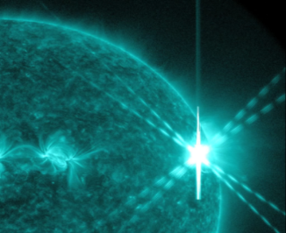
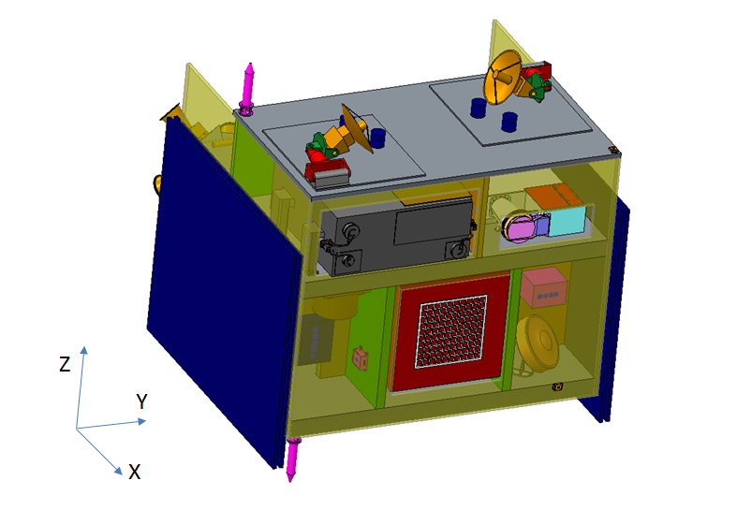
2. Advanced Space-borne Solar Observatory (ASO-S)
Scientific Objectives
Relationship between solar magnetic field and solar flares
Relationship between solar magnetic field and CMEs
Relationship between solar flares and CMEs
CME
flare
Payloads
Full-Disc Vector Magnetograph (FMG)：solar magnetic field
Hard X-ray Imager (HXI)：solar flare
Lyman-alpha Solar Telescope(LST): CME
LST
FMG
HXI

Slide 26
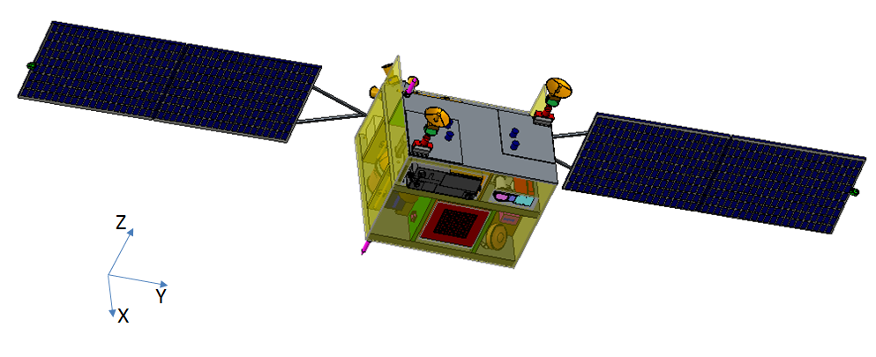
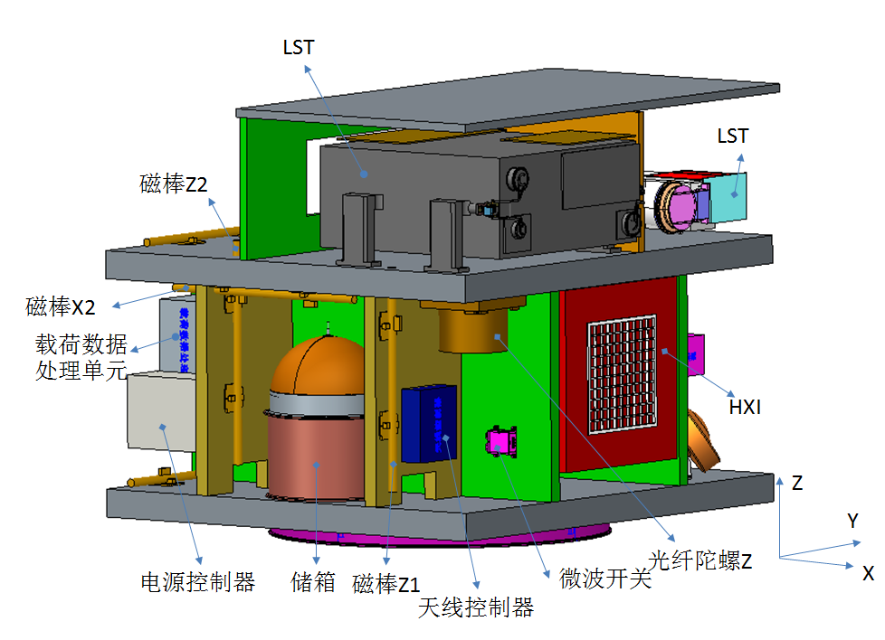
Mission profile
Orbit: 720 km, sun-synchronous,
98.2°
Attitude Control: 3-axis stabilized
Mass: <1000 kg
Power: < 770 W
Lifetime: 4 yrs
Launcher: CZ-2D
Officially approved in Dec. 2017
Now in Phase B
Planned launch time: 2021
FMG

Slide 27
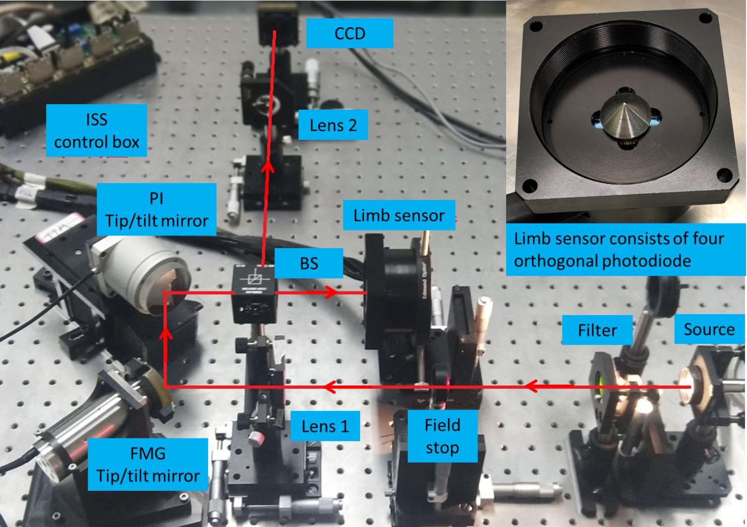
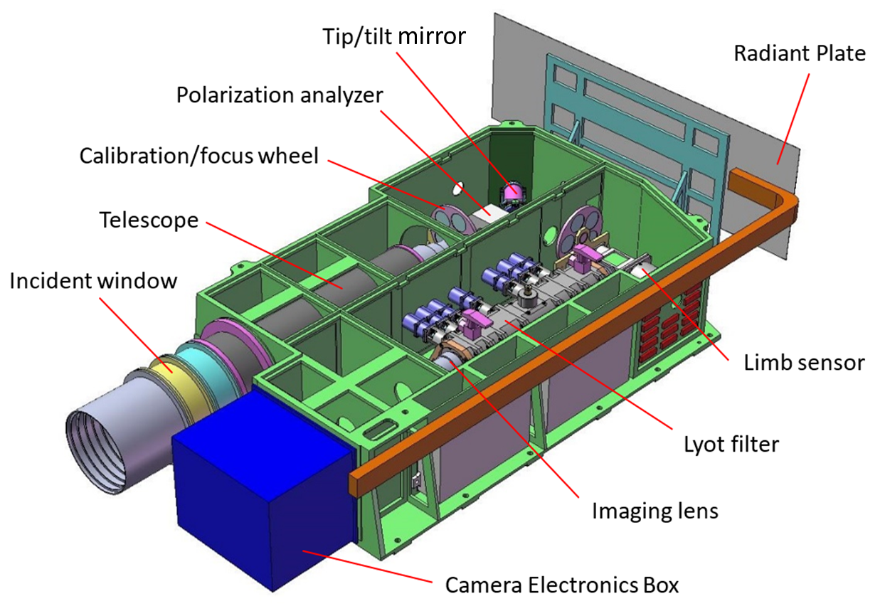
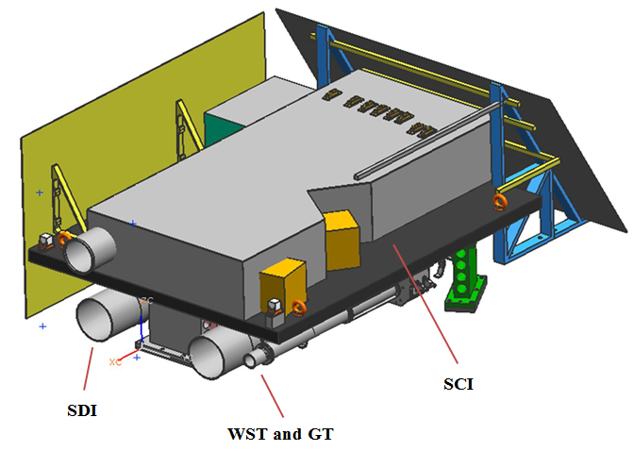
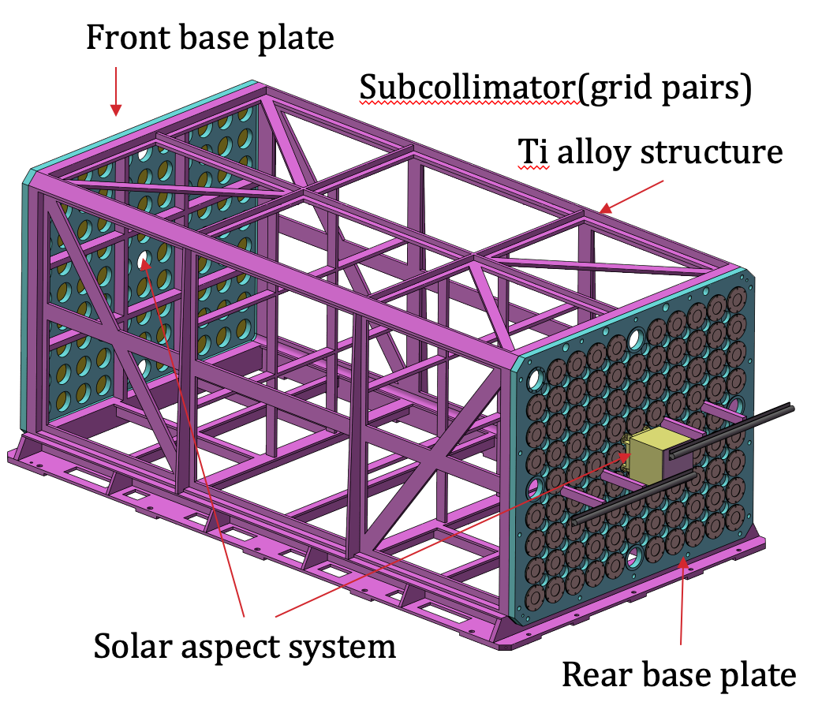
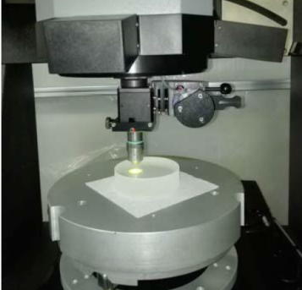
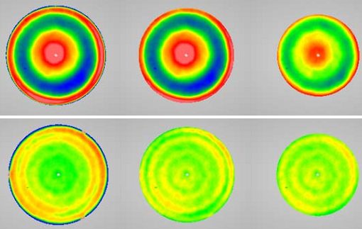
Progress
Payload Prototype completed:
FMG
LST
Surface Super-polishing M1 mirror: RMS<0.3nm

Slide 28
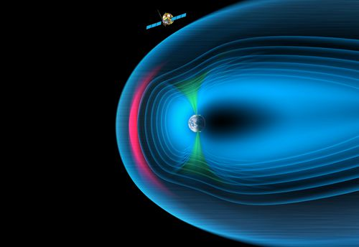
3. Solar wind Magnetosphere Ionosphere Link Explorer (SMILE)
CAS-ESA Joint Mission
Science Objectives
Determine when and where transient and steady magnetopause reconnection dominates
Define the substorm cycle, including timing and flux transfer amplitudes
Define the development of CME-driven storms, including whether they are sequences of substorms
Scientific Significance
Imaging of the interaction between solar wind and magnetosphere for the first time

Slide 29




Payloads
Soft X-ray Imager (SXI)
Ultra-Violet Imager (UVI)
Light Ion Analyzer (LIA)
MAGnetometer (MAG)
SXI
UVI
LIA
MAG
The payloads and satellite will be provided by scientists and industry from both Europe and China.

Slide 30

SMILE International Collaborations

Slide 31

Mission Profile
Orbit：5000km@perigee
19 R_{e}@apogee
Mass: <2200kg
Lifetime：3 years
Now in Phase B
Planned Launch time: 2023

Slide 32















Progress
SMILE was adopted on March 5, 2019 by ESA

Slide 33



4. Gravitational wave high-energy Electromagnetic Counterpart
All-sky Monitor (GECAM)
Sciences: All-time all-sky monitor for GWGRB, GRB…
Independent confirmation of GW event
Accurate localization, host galaxy, redshift
Astrophysical content of the GW source
GW+EM, Cosmology, fundamental physics
Payloads: 25 GRD, 8 CPD for each satellite
FOV： 100% all-sky
Sensitivity：~2×10⁻⁸ erg/cm²/s
Energy band：6keV~5MeV

Slide 34


Mission Profile
Specifications:
A pair of satellites in the same orbit with opposite phase
Orbit: 600 km, 29°
Attitude Control: 3-axis stabilized
Mass: 170 kg/satellite
Lifetime: 3 yrs
Planned launch time: 2020
Joint observation with LIGO & Virgo when they reach the design sensitivity
GECAM-A
GECAM-B
GECAM satellite

Slide 35







Progress
Completed design phase and turned to Phase C in March 2019
Key Technologies: Sealing and long-term stability of lanthanum bromide (LaBr₃) crystal for gamma ray detector (GRD) was verified
Random/Sinusoidal
Impact
Noise test
Thermal vacuum
Thermal cycle
Irradiation
Key Technologies Test and Verification

Slide 36




SPP II Implementation Plan
A
Phase B
Phase C
Phase D
Phase E
GECAM
Phase A
Phase B
Phase C
Phase D
Phase E
ASO-S
Phase A
Phase B
Phase C
Phase D
Phase E
EP
A
Phase B
Phase C
Phase D
Phase E
SMILE
2017 2018 2019 2020 2021 2022 2023 2024
Notes:
GECAM 2020年10月具备发射条件
ASO-S 2021年9月具备发射条件
EP 2022年9月具备发射条件
SMILE2023年11月具备发射条件

Slide 37





Strategic Priority Program on Space Science (2018-2022)
1. enhanced X-ray Timing and Polarimetry mission（eXTP)
Intensive Study of Candidate Missions
(background missions)
2. Taiji Program
3. MEO-to-GEO Quantum Satellite
4. Small Bodies Sample Return Mission
5. Ultra-long Wavelength Astronomical Observation Array
6. Other Candidate Missions (Space weather, Earth Science

Slide 38

1. enhanced X-ray Timing and Polarimetry mission (eXTP)
Science objectives
Unprecedented capabilities to study:
1 singularity (black hole),
2 stars (neutron star or quark star)
3 extremes (gravity, density, magnetism)
~ 4.5 ton，Low equatorial orbit (550 km)
Payload | Configu-ration | Optics | Detector
Spectroscopic Focusing Array | 9 Telescopes | Nickel replica | SDD
Large Area Detector | 40 Modules | MCP Collimator | SDD
Polarimetry Focusing Array | 4 Telescopes | Nickel replica | GPD
Wide Field Monitor | 6 Cameras | 1.5 Coded Mask | SDD

Slide 39

















International Collaboration
About 20 European countries and 100 international institutions involved in the mission (science community, engineering consortium)
Now in Phase A+
Budget of CAS for eXTP development through Phase B was approved

Slide 40
2. Taiji Program
Scientific Objectives
Observe Gravitational Wave from mergence of binary black holes or great massive celestial bodies in space
Technologies
Ultra precise & key techniques
Pico-meter measurement within millions of kilometers
Sub-femto g drag-free technology
Ultra complex & key techniques
Strong confusion of GW signals
Strong couplings of subsystems

Slide 41

Roadmap of Taiji Program

Slide 42

3. MEO-to-GEO Quantum Satellite
Scientific Objectives
Develop key technologies and MEO-to-GEO quantum satellite, to accomplish ~10000km all-day quantum communication, and build global quantum network
Explore new methods of testing the unification of Quantum Mechanics and General Relativity
Expands space quantum science from LEO to deeper space
Focus on all-day quantum communications research and fundamental problems

Slide 43







4. Advanced Study of Sample Return Mission to Small Bodies
Science Goal
The 1st 10 Ma history of the solar system
Candidate Targets
E-type asteroids (formed closest to the Sun)
Sampling Way
Touch-and-go, Rotating brush/inserting tube
Sampling technique
Multi-site
Rough surface
Sample capsule
Parachute experiments
grappler
(drop from ~30 km)

Slide 44




5. Ultra-long Wavelength Astronomical Observation Array
Opening up a new window in electromagnetic spectrum for astronomy
Consists of 1 mother satellite and 5~8 daughter satellites
In lunar circular orbit of 300 km, forming an interferometer array
Payloads: Low Frequency Imaging Spectrometer(LFIS)
High Frequency Spectrometer(HFS)
HFS 30-120 MHz global spectrum
LFIS 1-30 MHz sky image
……
Mother satellite
Daughter satellites
Inter-Sat communication and data transmission

Slide 45
Table of Contents
Structure of Chinese Space Program
Strategic Priority Program on Space Science
Highlights of Science Missions 2011-2017
Strategic Priority Program on Space Science (2018-2022)
Summary

Slide 46
Summary
Strategic Priority Program on Space Science getting into Phase II, 4 missions are implementation;
Major candidate missions under-study
More international collaborations are encouraged.

Slide 47

Thanks for Your Attention!

