Slide 1
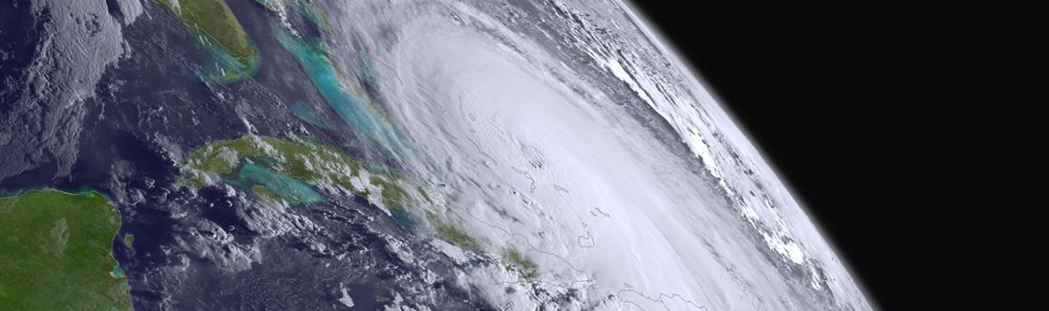
NESDIS International Cooperation
Satellite and Information Service
Stephen Volz, Ph.D., Assistant Administrator for Satellites and Information Services, National Oceanic and Atmospheric Administration
March 26, 2019
Notes:
This presentation is generally organized to walk through the earth observation system and the importance of each aspect of the entire end to end process. The entire chain is constantly evolving and including and incorporating more partners from international to interagency to commercial.

Slide 2
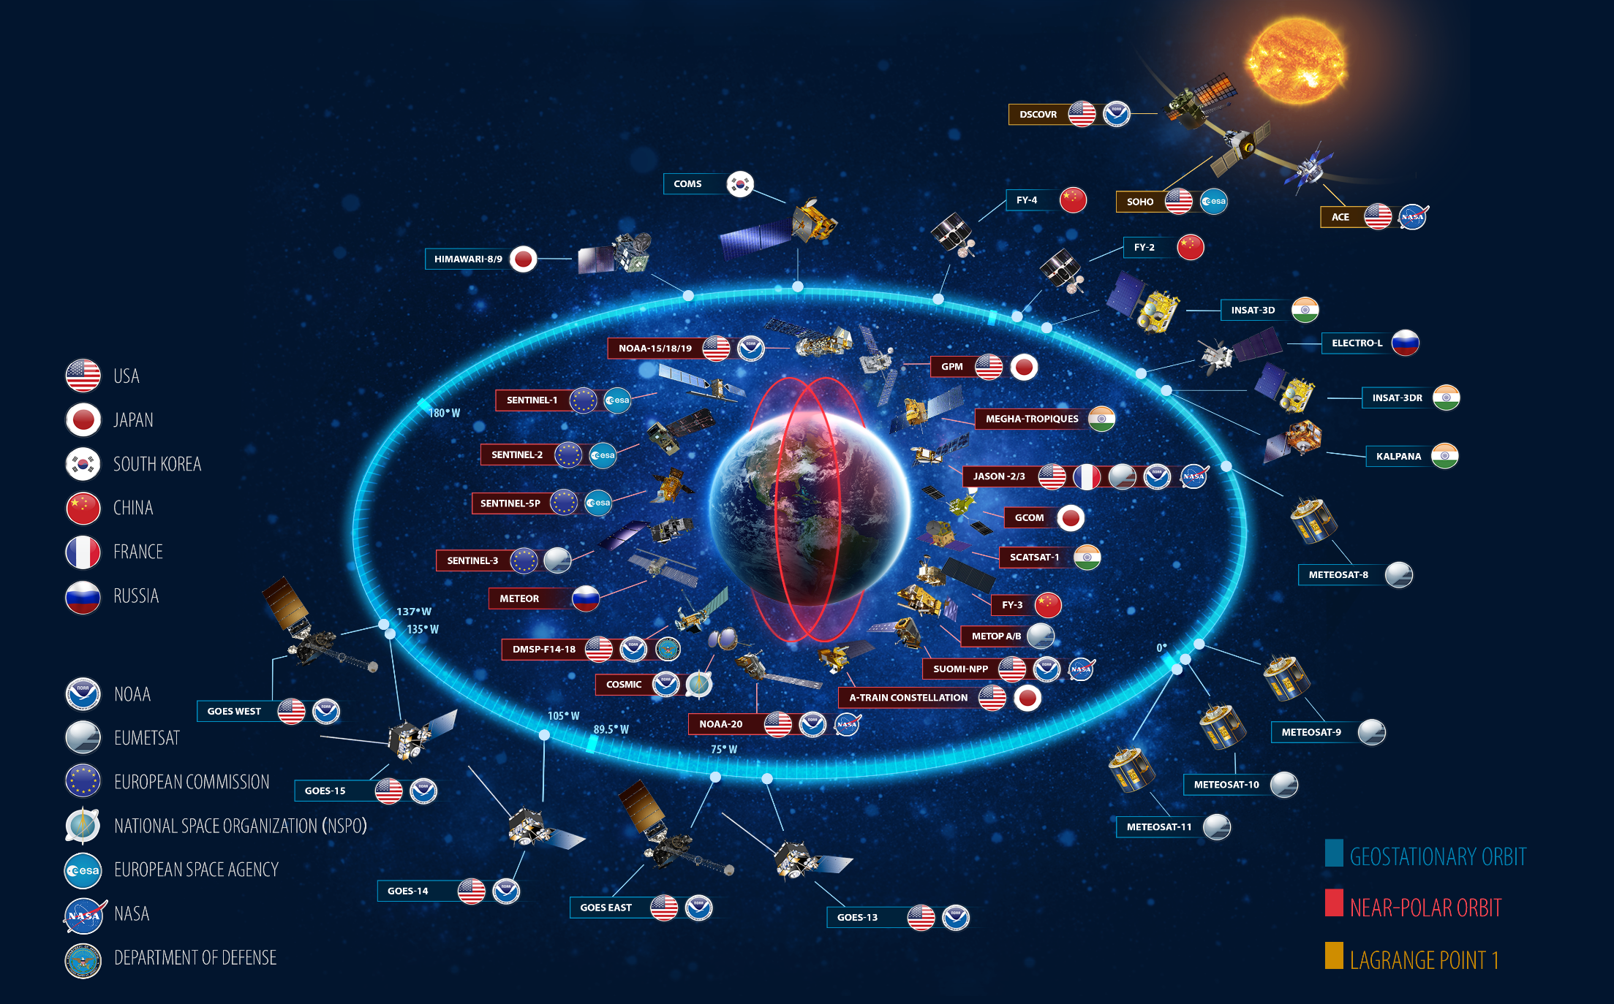
International Partnerships are an Essential Part of NOAA’s Observing System
Notes:
40+ years of leadership in operational Earth observations
Government Cooperation: with NASA for research and observations; with DOD for observations; leading international partners (EUMETSAT, JMA, WMO) on data exchange, standards and model development
Industry Cooperation: all observations conducted with private sector expertise; Multi $B “Weather Enterprise” founded on NOAA deliveries
Longstanding and consistent stakeholder support: Congress, National Academies, Weather Enterprise
Agile leadership for the future, including Increased
Government Cooperation: Closer NOAA-NASA cooperation for operational exploitation of research missions; increasing partnerships for operational access to their data (EC, EUMETSAT, ISRO, JMA); strengthening relationships with DOD
Industry Cooperation: Achieving a sustainable and productive relationship between NOAA and the continuously evolving commercial sector; technology infusion to improve mission cost effectiveness
Differentiate between NOAA-20 and JPSS-1 since the satellite is listed as NOAA-20 in this diagram.
Through the Group on Earth Observations (GEO), a partnership with 100 governments and 93 international organizations, NOAA collaborates globally to foster earth observation data sharing

Slide 3
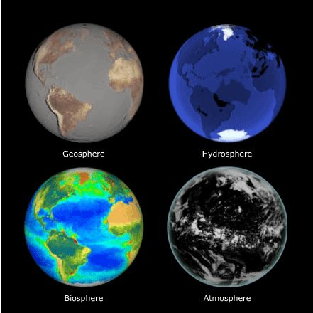
What are the challenges to producing an integrated observing system?
Requirements
Standards
Calibration and Validation
Information Security
Observation Requirements
Observation Standards
Measure-ments
Data
Interoperability
Common Models
Resolution
Secure Ingest
Pipeline Resiliency
Inter-calibration
Metadata STandards
Information Security
Calibration & Validation
Notes:
While the previous slide is about how International partnerships are essential for NOAA’s observing system; this shows the importance of identifying commonality between NOAA’s system and global operators and user requirements, standards, challenges, etc.
Pivot to the importance of the supra-national observing system based on commonality and integration; also predicated on common challenges, as technology evolves, while also maintaining existing systems
Leverages international bi-lateral and multi-lateral relationships, industry relationships and interagency partnership.

Slide 4
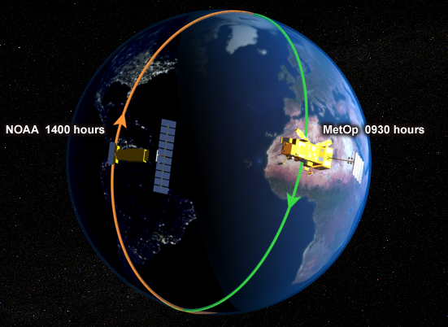
International Partnership Success: Metop-C
EUMETSAT launched Metop-C, a new polar-orbiting satellite, on November 6, 2018
Metop satellites monitor the “mid-morning” orbit, while NOAA’s polar-orbiting satellites, NOAA-20 and Suomi NPP, provide observations in the “mid-afternoon” orbit
NOAA supplied 4 of the 13 instruments on Metop-C
NOAA is still receiving data from Metop-A and Metop-B, launched in 2006 and 2012 respectively. These satellites, including Metop-C, are flying POES era instruments.
NOAA JPSS and Metop each provide just under 50% of the data that goes into our Numerical Weather Prediction models
NOAA and EUMETSAT polar-orbiting satellites pass over the same location at different times of the day.
Notes:
Importance of bi-lateral relationships to develop and operate legacy observation platforms and next gen platforms and instruments to ensure continuity of observations for operational users
Focus on how historic partnerships are leveraged for future close international collaboration on an integrated architecture
METOP-C example of close historical partnership with EUMETSAT and importance of METOP as part of numerical weather prediction models. – shows how integrated we are with international partners

Slide 5
Space Weather Observing System
plus in situ obs from multiple sensors

Slide 6
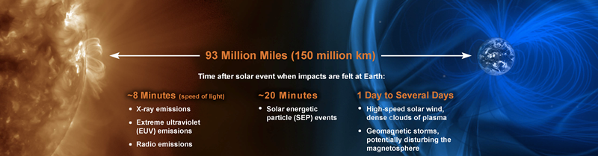
The Future Space Weather System includes both Research & Operational satellites
NOAA-ESA Enhanced space weather observation system: L1 & L5
Possible future areas of cooperation between NOAA & ESA include: Data sharing, instrument collaboration, ground system resources, and scientific exchange
NOAA-NASA Observations from L1 Partnership on SWFO-L1 Mission
NOAA & NASA will partner with NOAA’s SWFO-L1 flying as a rideshare with NASA’s Interstellar Mapping and Acceleration Probe (IMAP) to L1
NOAA and NASA will create an integrated program office to ensure the success of the SWFO Program
Notes:
Future opportunities to continue to evolve observation platforms, instruments and ground systems in coordination with international partnerships
SpWx example as both an interagency partnerships as well as an international one

Slide 7
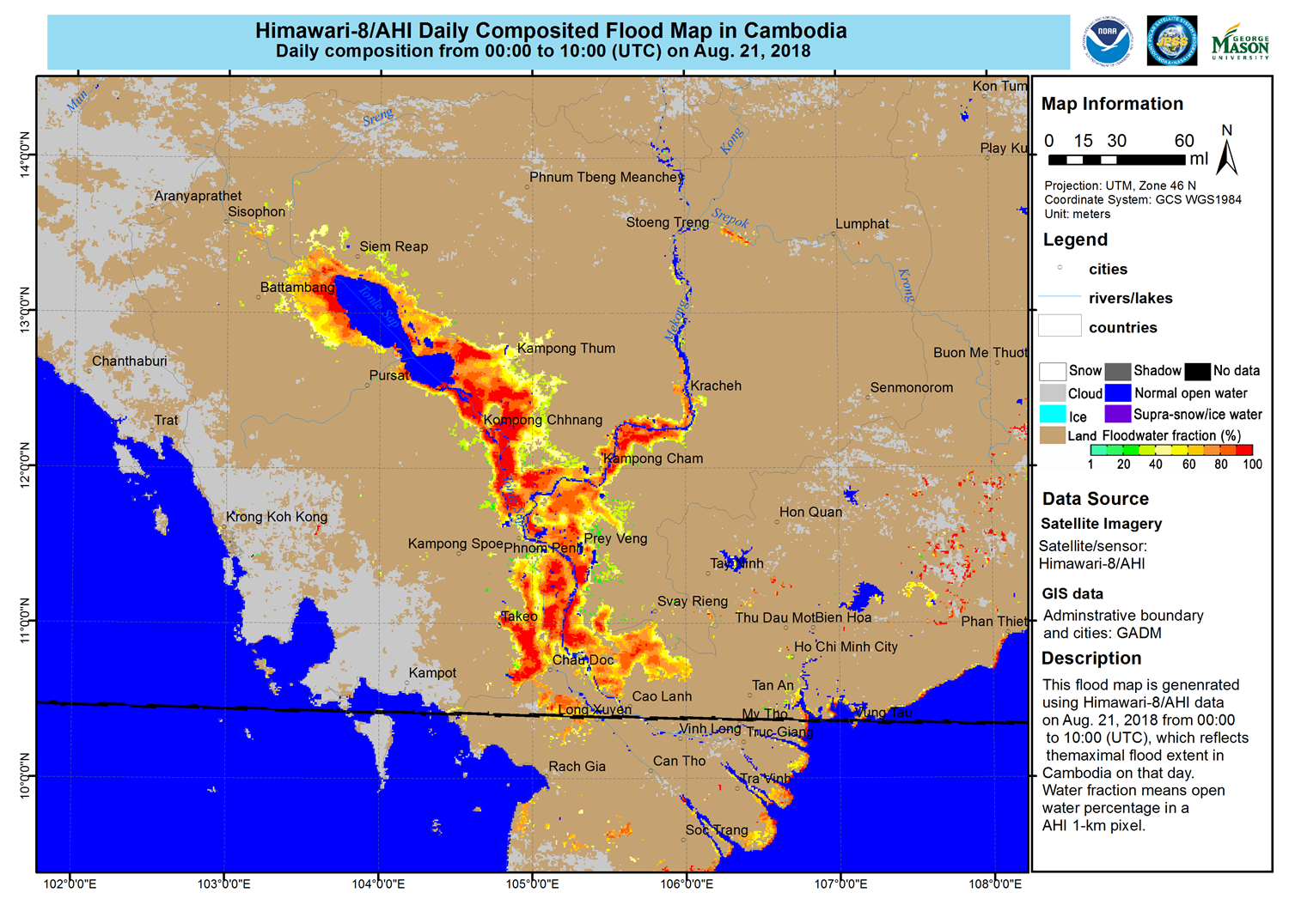
Partnerships Enhance the value of both systems: LEO/GEO Data Fusion
New generation of operational polar and geostationary satellites are now providing new capabilities for disaster support, including flood mapping
Under the CEOS and CGMS initiative, NOAA is partnering with both JMA and CMA to produce consistent GEO/LEO integrated flood maps for our hemispheric regions and provide products in near real time
Work is already underway within NOAA to merge VIIRS ocean color products from Suomi-NPP and NOAA-20 platforms and create daily gap-filled ocean color products
Plans are in place to generate ocean color products consistent with those from VIIRS as from OLCI on Sentinel-3
Flood mapping product in southeast Asia
Notes:
As we look at downstream applications and data products we also must focus, no only on integrated up-stream systems but looking towards integrated products as well.
Highlight not only bi-lateral relationships but also the importance of multi-lateral organizations as a forum to promote cooperation and common

Slide 8
Secure Ingest Gateway Pilot (SIGP)
EXTERNAL DATA SOURCES
USERS
NESDIS initiated the SIGP project to establish standard enterprise secure methods for receiving data from NOAA external partners or other sources
To take advantage of the available quality external data, NOAA must develop new multi-mission enterprise science algorithms
This will allow NOAA efficiently bring in data from partners and commercial sector in a cost-effective manner
Real-Time Operational User Data Flow
NOAA Sources (satellites, radar, etc.)
Secure Ingest
International
Non
Real-Time Operational User Data Flow
Non-Real-Time Operational User Data Flow
Other Partners
Commercial
Notes:
With greater volumes of data and form more sources, incl. international & commercial sources, there are additional requirements leveraged on us to ensuring reliable and resilient data as the output
SIGP is an example of several processes that have to occur to ensure the continuity and reliability of the;
Cloud technology is another, which includes leveraging the commercial sector as well which is why establishing common IT security standards is critical to ensure as technology evolves it does so in a way for us to address security concerns.

Slide 9
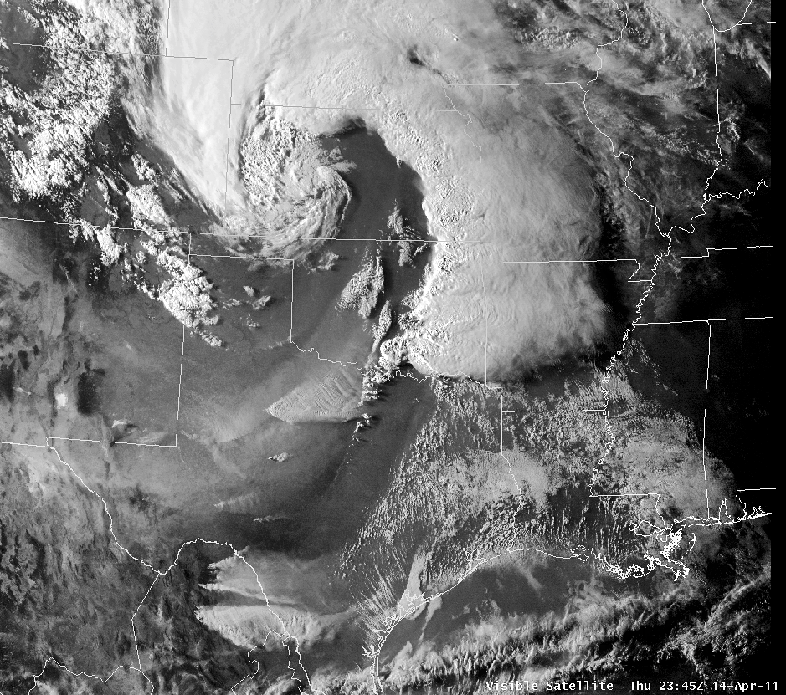
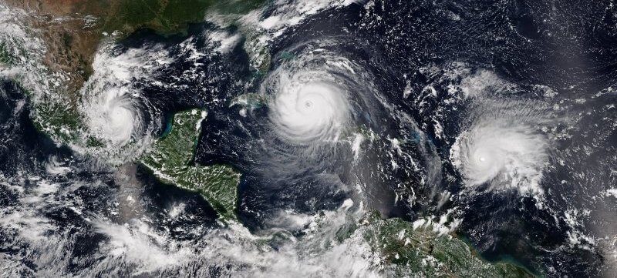
New Capabilities Possible and Under Consideration
LEO
Next generation & additional sounders, including smallsats
Higher density GNSS-RO
Interagency weather observations
GEO
Diverse quality imaging from three locations (east, west, center)
Includes mixture of qualities, taskable update rates, and spectrum content (including hyperspectral)
Higher quality lightning mapper in center
Space Weather
Operational and improved on-Earth-Sun-Axis solar observation
Off-axis solar observation and situ space weather
Tundra and Alternative Orbits
Extension of real-time imagery collection at high Latitudes
Extend GEO belt to Alaska and all arctic
Notes:
As we look towards how to satisfy our observation and data requirements we are trying to look at the next generation of observation architecture, which includes interagency (DOD) and international partners.

Slide 10
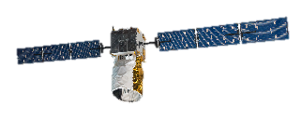
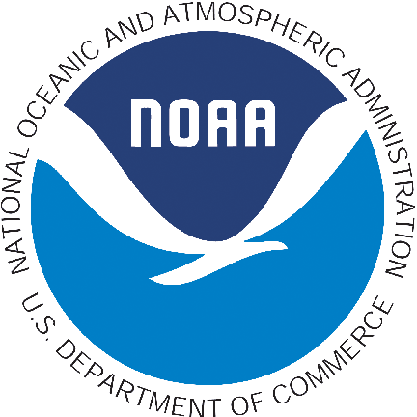

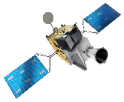

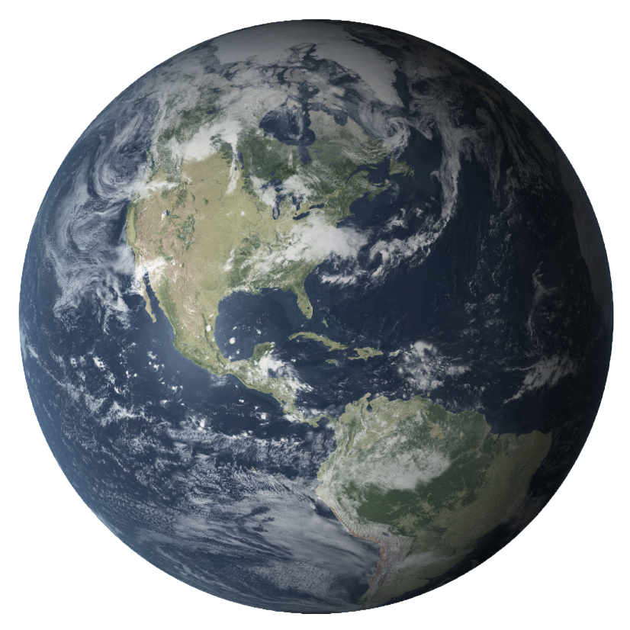

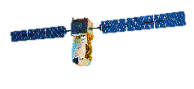
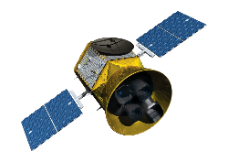
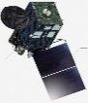
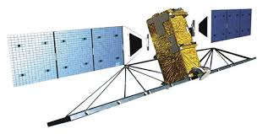
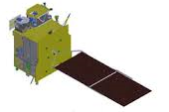
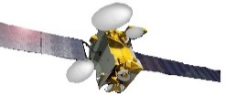
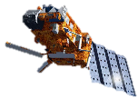
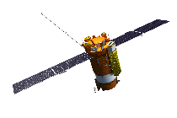
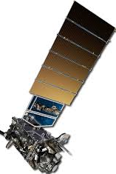
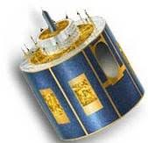
Integrated Hybrid Architecture
Tundra
SENTINEL
Comprehensive SWX – L1
JASON
Sounder 1330
HIMAWARI
(JAPAN)
140° E
Hosted Imager West
Wind LIDAR
Hosted Instrument of Opportunity
Radarsat
GEO-KOMPSAT
(SOUTH KOREA)
128° E
Sounder 0530
US Gov Center GEO
“SuperGOES”
Hosted Imager East
EPS-SG-A
EPS-SG-B
MTG-S
(EUMETSAT)
Tundra

Slide 11

Hot Issues for NESDIS
Defining and financing the next generation satellite observing system
Maintaining and growing commercial and international partnerships to deliver a resilient and high-performing observing system
Reliable secure Ingest of partner data
Exploiting IT advances in data analytics, and efficient movement to the cloud
Incorporating AI into weather forecasts and data products
Develop robust methodology to estimate economic and societal impact assessments for future observing system options

Slide 12
THANK YOU
Satellite and Information Service
Stephen Volz, Ph.D., Assistant Administrator for Satellites and Information Services, National Oceanic and Atmospheric Administration
March 26, 2019

