Slide 1

Thomas H. Zurbuchen, Ph.D.
Associate Administrator
Science Mission Directorate
@Dr_ThomasZ
March 26, 2019

Slide 2


Slide 3
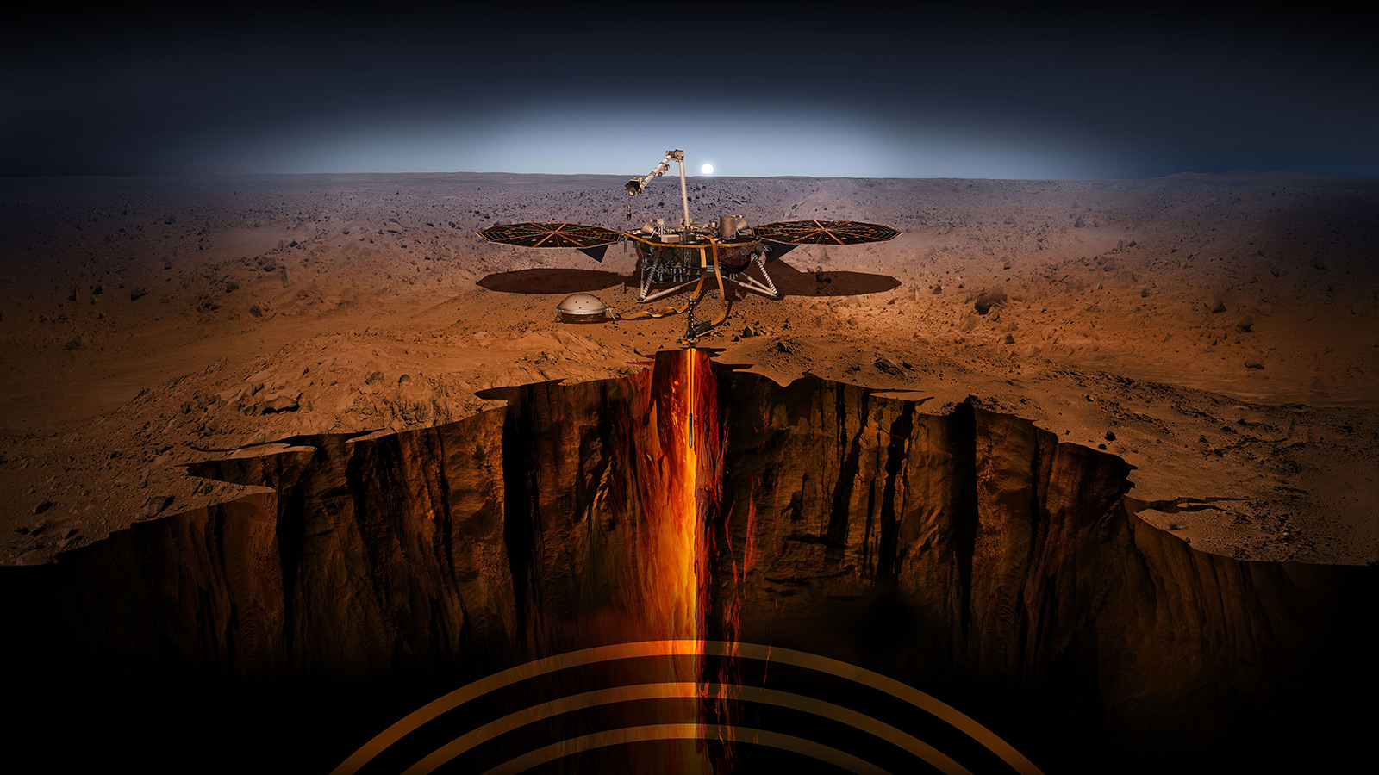
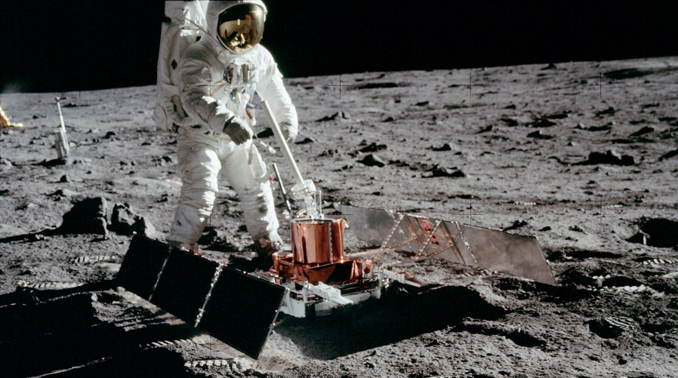
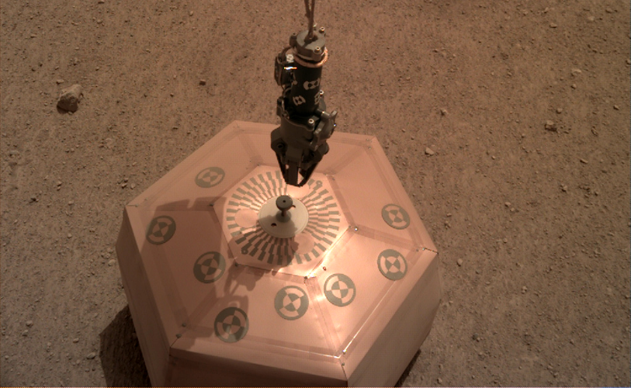
Jul. 20 1969 – Buzz Aldrin with the Passive Seismic Experiment – first seismometer placed on Moon’s surface
InSight
Dec. 19, 2018 – InSight seismometer on Martian surface – first time a spacecraft robotically placed a seismometer onto surface of another planet

Slide 4
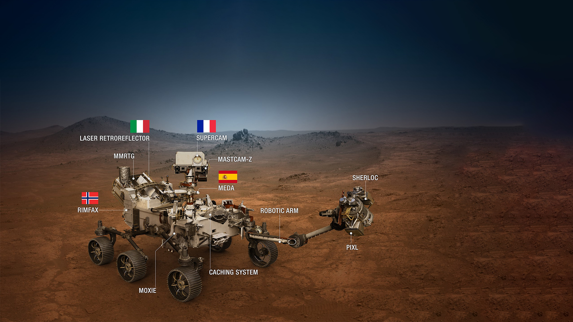
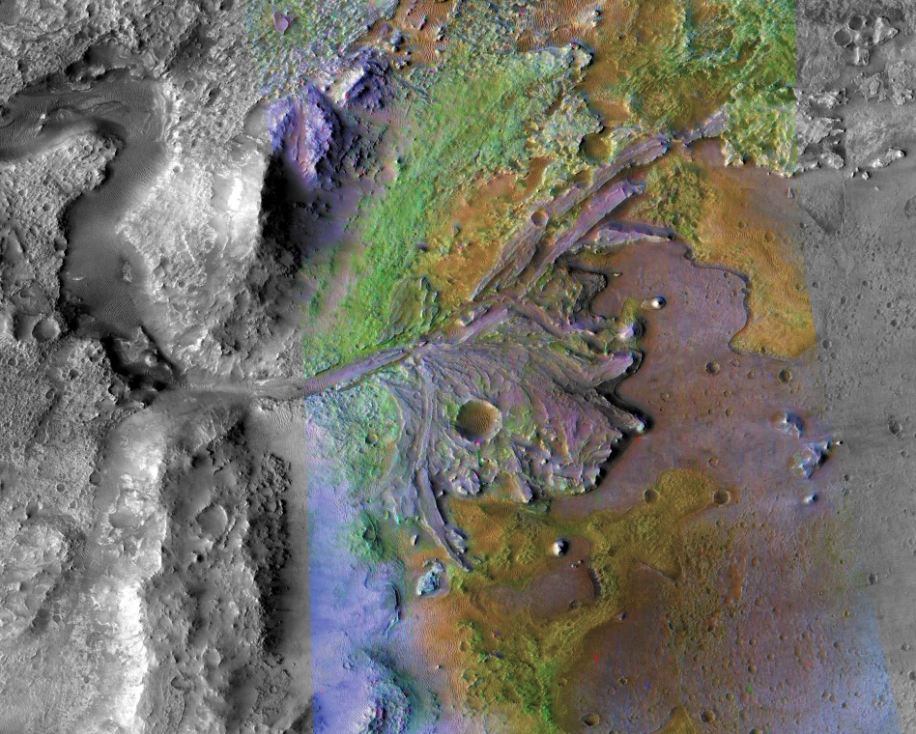
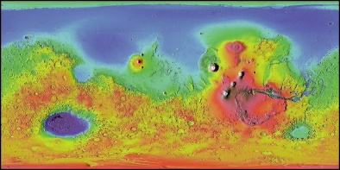
MARS 2020
Nov. 19 - NASA Announced landing site for Mars 2020 Rover mission as Jezero Crater

Slide 5
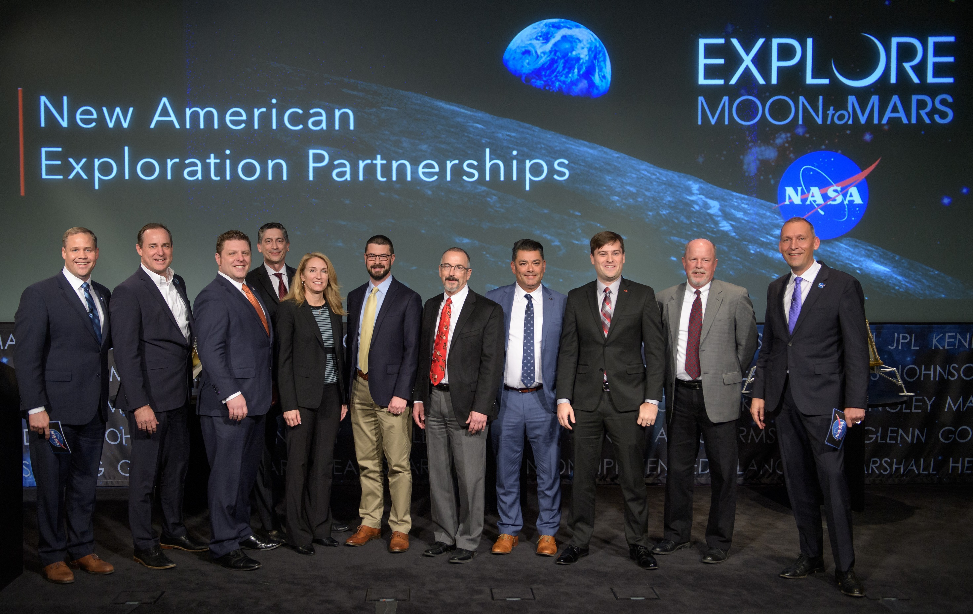

Slide 6
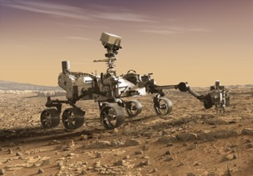
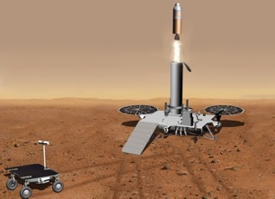
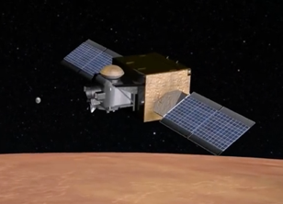
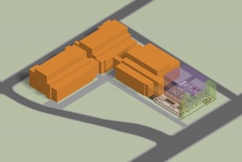
Mars Sample Return (MSR) Concept
Mars Sample Return Notional Elements
Future Work
Sample Caching Rover
(Mars 2020)
Sample acquisition and caching
Sample Retrieval Lander*
Fetch Rover
Orbiting Sample container
Mars Ascent Vehicle
Earth Return
Orbiter**
Capture/Containment Module
Earth Return Module
Comm Relay for MSR
Mars Returned Sample Handling
Sample Receiving Facility
Curation
Sample science investigations
2020 NET 2026 NET 2026 2031
Flight Elements
Ground Element
*NASA-led
**ESA-led per April 2018 Statement of Intent

Slide 7


with us

