Slide 1
Data Citation and Data Attribution A View from the Data Center Perspective
Bruce E. Wilson
Group Lead, Client & Collaboration Technologies Oak Ridge National Laboratory
Adjunct Professor of Information Sciences University of Tennessee For presentation at: Developing Data Attribution and Citation Practices and Standards Workshop August 22-23, 2011 Berkeley, CA USA

Slide 2
My Data Center Perspectives
ORNL DAAC (NASA biogeochemical dynamics/ecology)
Data Observation Network for Earth (DataONE)
Private industry (material sciences/catalysis)
ORNL IT Division & Library
ARM Archive (DOE)
National Biological Information Infrastructure
USA National Phenology Network

Slide 3
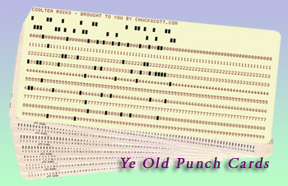
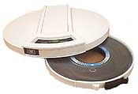
I didn’t know I was a data person
Format migration
??

Slide 4
Data Center Incentives for Attribution
Ensure data generators get credit for their work
Ensure data center gets credit for hosting data
Understand what data is/is not being used
Identifiers help find more examples

Slide 5
ORNL DAAC Citation Example
Cite this data set as follows:
Gu J. J., E. A. Smith, and H. J. Cooper. 2006. LBA-ECO CD-07 GOES-8 L3 Gridded Surface Radiation and Rain Rate for Amazonia: 1999. Data set. Available on-line [http://www.daac.ornl.gov] from Oak Ridge National Laboratory Distributed Active Archive Center, Oak Ridge, Tennessee, U.S.A. doi:10.3334/ORNLDAAC/831.
Key points:
Names those who created the data set
Tells where to find the data
Persistent identifier

Slide 6
Data Center Roles/Responsibilities
Be agile, but take the long view.
Provide stability
Use persistent identifiers
Technical, social, organizational sustainability
Encourage use
Make it easy for users
COinS simplifies loading into bibliographic tools
http://ocoins.info/
Examples in documentation
Work on challenges
What does the identifier point to?
Handle continuous data, subsetting, on demand data
Scalability of the data management process

Slide 7
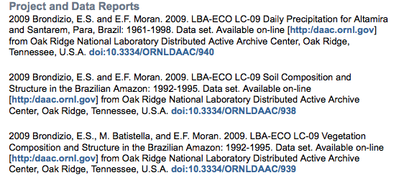
Examples of Citation Use
http://en.wikipedia.org/wiki/Dynamic_global_vegetation_model
http://blog.andersonruhoff.com/2010/03/three-lba-eco-data-sets-released.html
Document describing a proposed reforestation project http://cdm.unfccc.int/UserManagement/FileStorage/DJISYMVG9RKHTCPU53X4BZA0NW8O2L
http://www.indiana.edu/~anthro/people/faculty/brondizio.html
Changing Climates, Earth Systems and Society
By John Dodson

Slide 8
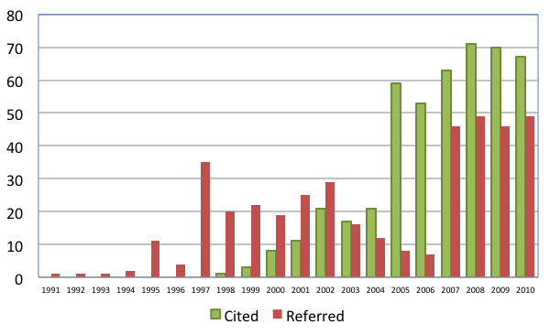
Growth in “Cited” versus “Referred”
ORNL DAAC requests that data be cited in list of references; some authors “refer” to data in text or acknowledgements
Number
Courtesy of Bob Cook, ORNL DAAC
Note: Multiple weeks of effort/year by ORNL Library and ORNL DAAC staff to assemble and manage this information.
Cited: The ORNL DAAC data set is in the bibliography, in the requested format
Referred: We infer, from the text of the article, that one or more ORNL DAAC data sets were used in the work.

