Slide 1
Microsoft Academic Search: An Overview and Future Directions
Lee Dirks
Director, Portfolio Strategy
Microsoft Research Connections
Developing Data Attribution and Citation Practices and Standards
An International Symposium and Workshop
Berkeley, CA | August 22-23, 2011

Slide 3
MSR Academic Search data comes from open access repositories, publishers, and web crawls
Currently 27M papers across 14 domains
100M papers in the queue, across 20+ domains
More improvements to come…

Slide 4
MAS Architecture
Online Store
Index
UI
Visualization
API
WP7 App
Offline Database

Slide 5
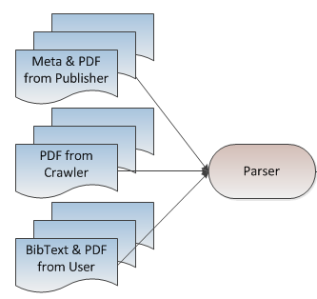
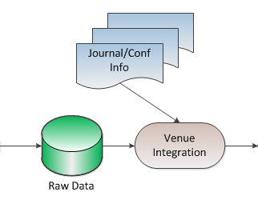
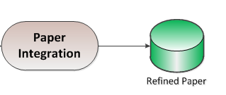
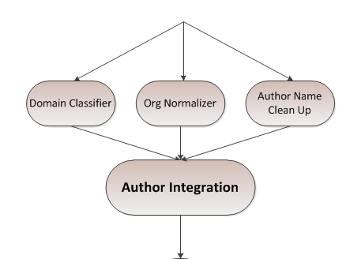
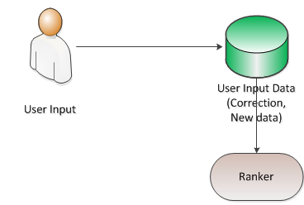
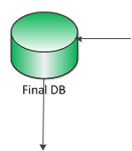
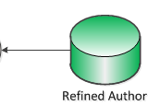
MAS Workflow

Slide 6
Update Frequency
48 hours
Pipeline updates (new data, changes from users)
Weekly
New PDFs, updates from conferences, journals, urgent code changes
Monthly
Reference scans, new data from publishers, homepage updates
Every 3 Months
New domain expansions, major features

Slide 7
Public API
Application Programming Interface
Supports queries against all academic entities and their basic info
With the API, you can
Work with others to share info
Help users to build useful clients
All openly available to everyone
Targeting the academic community
API is available for non-commercial use only
API details at http://academic.research.microsoft.com/About/Help.htm#5

Slide 8
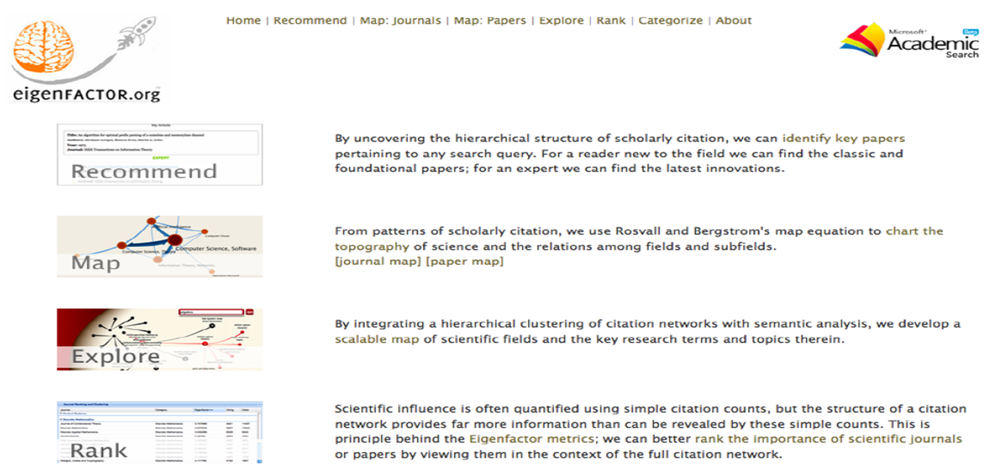

Slide 9
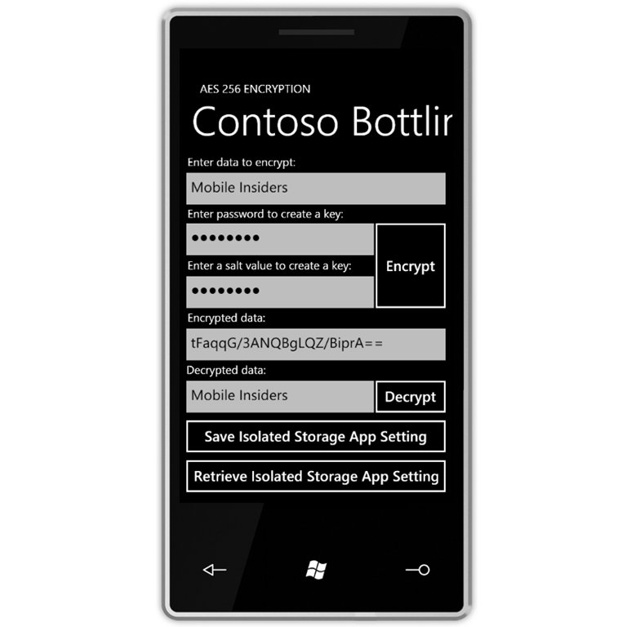
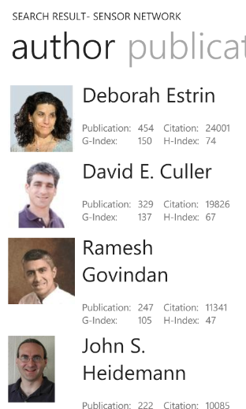
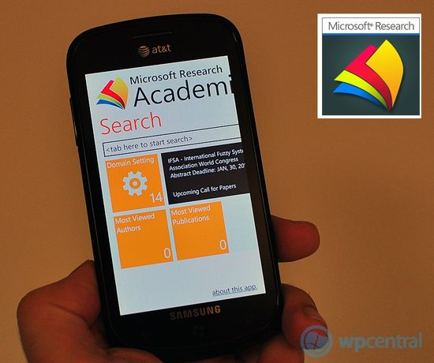
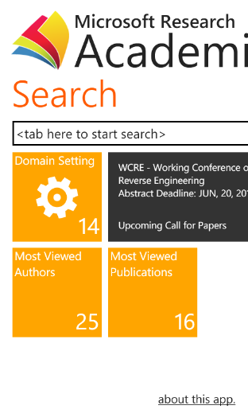
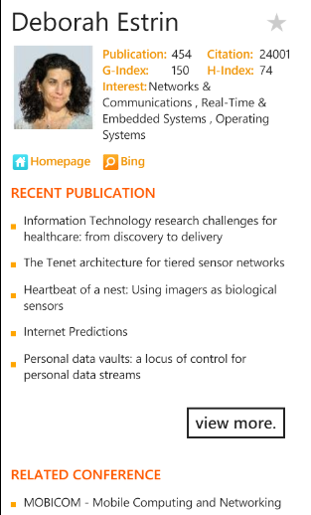
Windows Phone 7 – MAS Application
Available at http://windowsphone.com/s?appid=6662ae9f-869e-e011-986b-78e7d1fa76f8

Slide 10
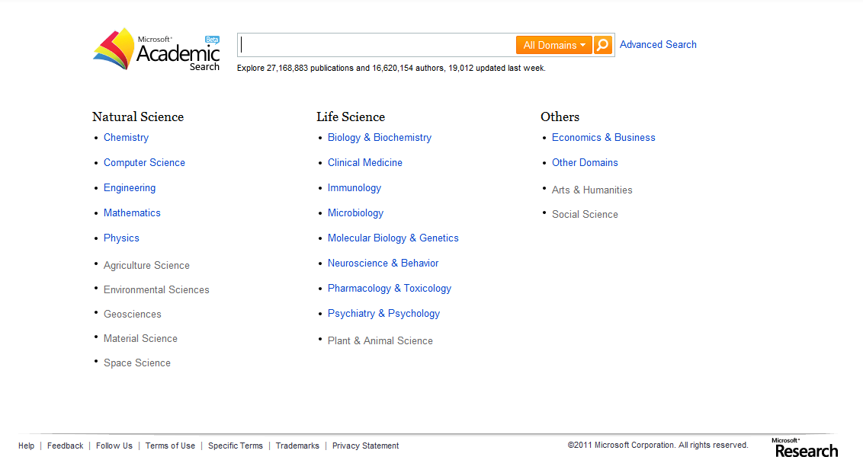

Slide 11
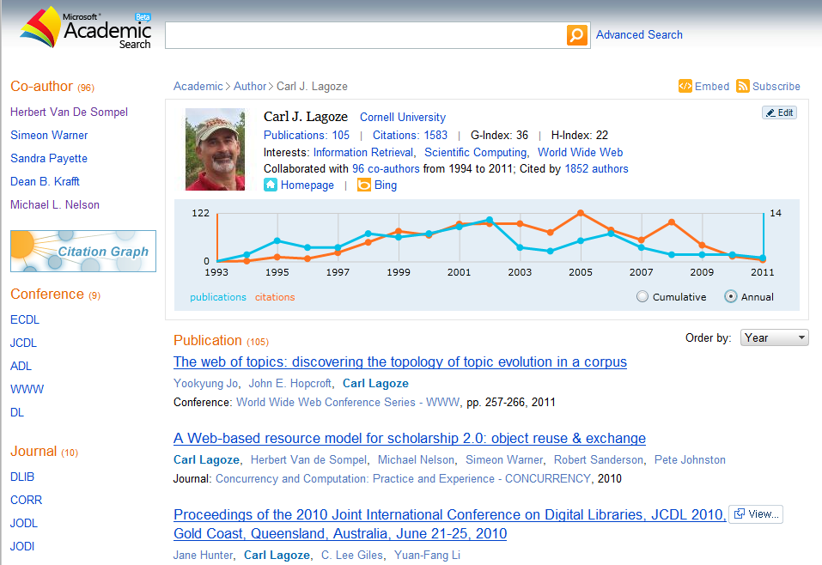

Slide 12
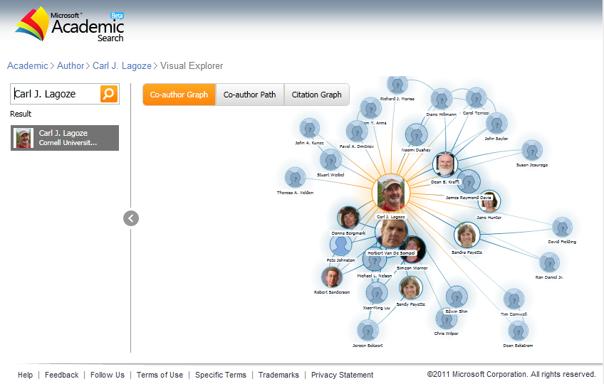

Slide 13
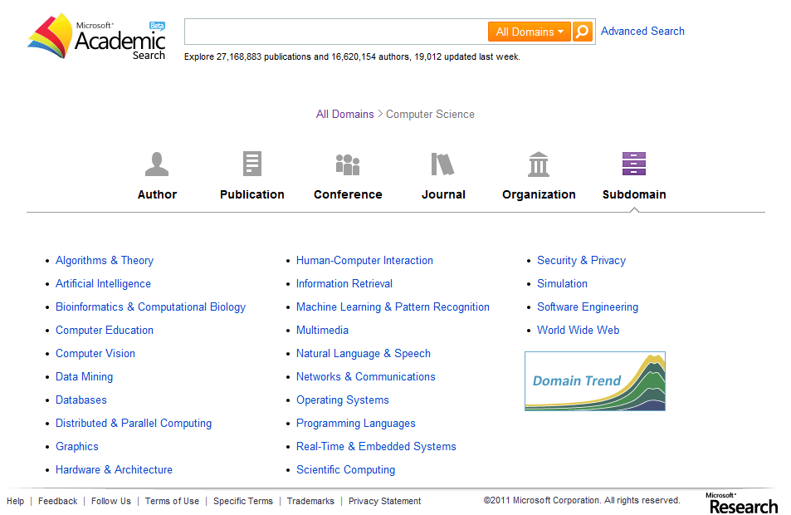

Slide 14
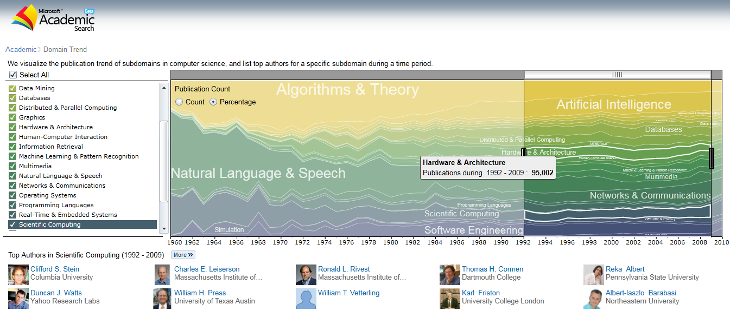

Slide 15
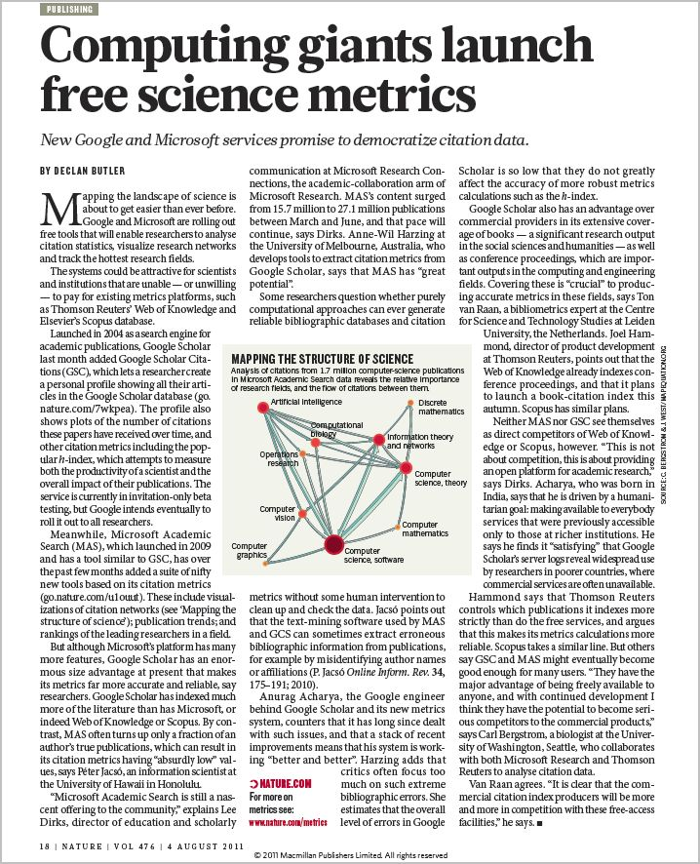
4 August 2011 | Nature 476, 18 (2011)
(doi:10.1038/476018a)
“…Meanwhile, Microsoft Academic Search (MAS), which launched in 2009 and has a tool similar to Google Scholar, has over the past few months added a suite of nifty new tools based on its citation metrics (go.nature.com/u1ouut). These include visualizations of citation networks (see 'Mapping the structure of science'); publication trends; and rankings of the leading researchers in a field.”

Slide 16
Next up…
Growth
Domain Coverage
Extensibility
Partnerships
Usage Scenarios (including data citation)
Research Projects
Our Commitments
MAS is a web service for researchers, by researchers.
We intend to be an open platform for the community, and we want to commit to the community to keep this service open, transparent, and a “sandbox” available to researchers for exploration and experimentation.
We are very interested to evolving this service to better represent how science/academia works. As protocols and/or standards emerge, we hope to embody these as part of MAS moving forward.
(Associate Member)
(Founding Sponsor)

Slide 17
Thank you!
Lee Dirks
Director, Portfolio Strategy
Microsoft Research | Connections
ldirks@microsoft.com or scholar@microsoft.com
URL – http://www.microsoft.com/scholarlycomm/
Facebook: Scholarly Communication at Microsoft

Slide 18
Notes:
© 2010 Microsoft Corporation. All rights reserved. Microsoft, Windows, Windows Vista and other product names are or may be registered trademarks and/or trademarks in the U.S. and/or other countries.
The information herein is for informational purposes only and represents the current view of Microsoft Corporation as of the date of this presentation. Because Microsoft must respond to changing market conditions, it should not be interpreted to be a commitment on the part of Microsoft, and Microsoft cannot guarantee the accuracy of any information provided after the date of this presentation. MICROSOFT MAKES NO WARRANTIES, EXPRESS, IMPLIED OR STATUTORY, AS TO THE INFORMATION IN THIS PRESENTATION.

