Slide 1
Lessons Learned from Bioinformatics
Notes:
Favorite definition of “bioinformatics” is “getting new science out of other people’s data
successful at exploiting other people’s data, in a wide variety of forms, from raw data repositories to much more highly curated ones
Biomedicine is different, in the culture of data sharing, of annotation and in the direct consequences of scientific activity on human health and disease.
concrete specifics which might be useful, giving some insight into the culture of this scientific community.

Slide 2
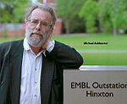
Semantic Annotation in Genome-scale biology
Gene Ontology arose “organically”
Scientific need: do homologous genes in different organisms have the same function?
Coordination among NIH funded model organism databases. Needed a vocabulary of function
Scientific champion: Michael Ashburner
Widely respected biologist
Surprisingly broad and scientifically significant application
Notes:
Like other domains, we have good repositories of raw data (like Genbank) and publications (like PubMedCentral),
something that is perhaps unique to biomedicine: semantic annotation, using Semantic Web technologies (those URIs and triples discussed by David Weinberger this morning.
We have a big problem – genes do not respect disciplinary boundaries.
Used to be able to keep up by focusing on my domain, but genes are studied in many contexts, and I need to get info from all of them.

Slide 3
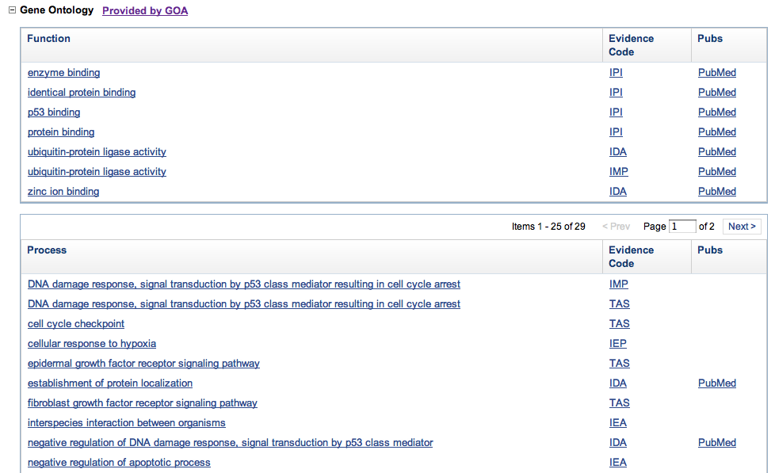
Example annotation
Notes:
Annotation from published literature to formal representations. Less broad use to annotate datasets, but some interesting pilots for that.
Note evidence codes, which describe the class of support for claim
Link to pubs, too.
Extensive, detailed, integrated from many sources, aligned to clear meanings

Slide 4
Each GO term has context
Notes:
NOT (very) messy. Carefully constructed (community process) ontology, expert annotation based on literature and standards.
Separate curation (development of the shared meanings) vs. annotation (creating formal representations of the semantic content of scientific publications)

Slide 5
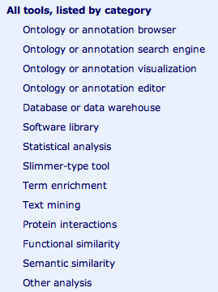
Many unexpected applications
Originally, compare function across organisms
Genome-scale data challenges community
Hundreds of genes per experiment
Individual genes studied in many contexts
Enrichment for GO terms very helpful
Inspired many extensions

Slide 6
NIH funded national centers
Notes:
If you add up the NCBO & the model organism centers (not ontology or methods research) NIH has spent more than $100 million in the last 10 years.

Slide 7
BioCuration Society
Notes:
Not in libraries, but enough demand that there is now a professional society, with a conference, journal, educational materials, etc.

Slide 8
Lots of need
Notes:
No shortage of good jobs, around the world.

Slide 9
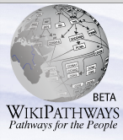
Looking ahead
Annotation work is difficult to do well, expensive, behind rate of publication
Mostly PhD scientists, trained on the job
Community processes critical
Many experiments with alternative approaches:
Commercial suppliers
Annotations as products
Publishers
Text mining / automated methods
Crowdsourcing

