Slide 1
Continuing Education for Digital Curation
Nancy McGovern, MIT Libraries
Symposium on Digital Curation in the
Era of Big Data, July 19, 2012

Slide 2
Topics
Big data considerations
Building Blocks
Parsing the problem
Observations

Slide 3
Big Data Considerations
Define – “volume, velocity, variety” AMS May 2012
Systems (and people) find scale, speed, and complexity challenging – big data includes all
We have building blocks for continuing education – some things apply, some things need to be added
Digital community is trying to and needs to move beyond its comfort zone to address big data
Think creatively about the ways our community can be helpful and focus on strengthening those skills

Slide 4
Building Blocks
Curriculum Initiatives
Digital Preservation Management (DPM) – programs
Digital Preservation Outreach and Education – trainers
ARL/DLF e-science Institute – strategic agendas
Digital Curation Curriculum (DigCurr) – competencies

Slide 5
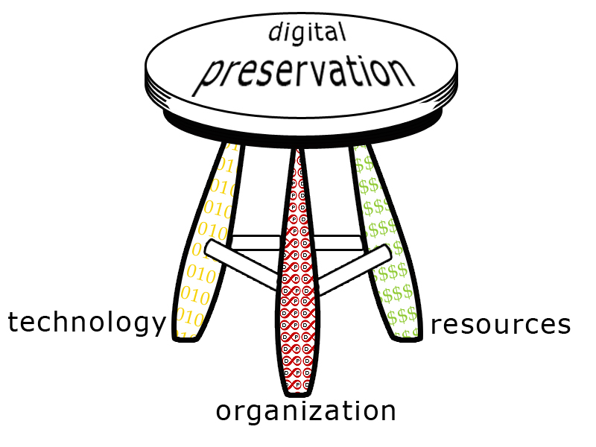
DPM Three-Legged Stool
(how?)
(how much?)
(what?)
Big data: infrastructure, applications, skills, attitude, fragmentation, valuation
holistic combination of skills
http://dpworkshop.org

Slide 6
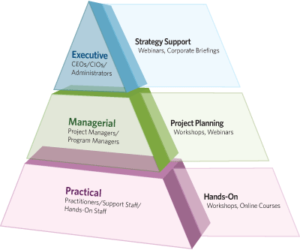
DPOE Pyramid
Curriculum Levels: content appropriate to audiences
http://www.digitalpreservation.gov/education/

Slide 7
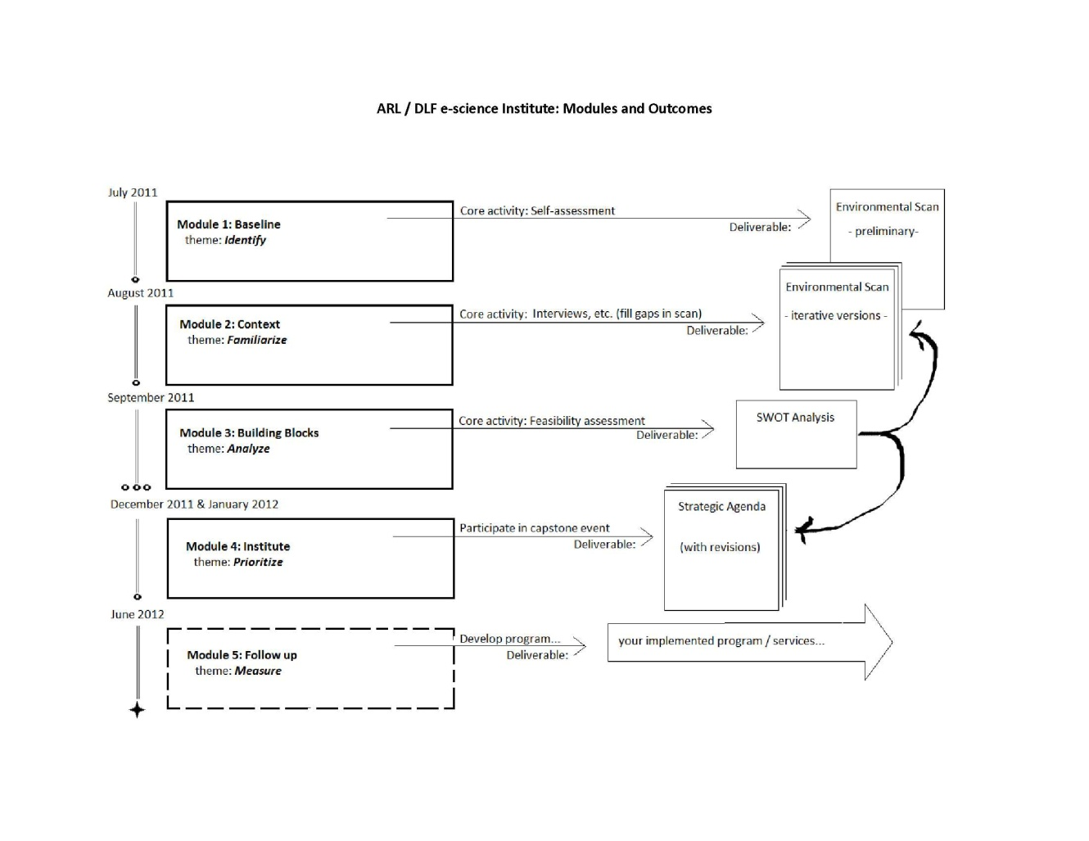
e-science Institute Stages
Informed decision making and adaptive management
http://www.arl.org/rtl/eresearch/escien/escieninstitute/index.shtml

Slide 8
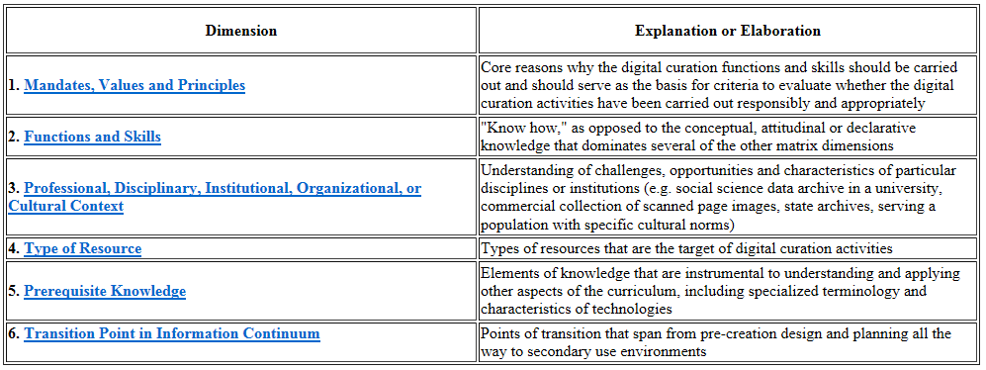
DigCCurr Matrix
Competencies for Curators
http://www.ils.unc.edu/digccurr/digccurr-matrix.html

Slide 9
Parsing the Problem
Scope
understand research outcomes and domains
Skills Acquisition
developmental stages, job titles vs. descriptions
Training Outcomes
after training, who will be able to do/know what?
Instructors
train, nurture, assess, enable

Slide 10
Scope
Research Data
analysis ===========> findings
experiments ===========> observations
instruments ===========> data
Research Domains
Variations in nature of and requirements for research data across domains
DIPIR Project – dipir.org
Practices in social science, zoology, archaeology

Slide 11
Skills Acquisition
DPM Program Stages
Skills Development
Acknowledge
Act
Consolidate
Institutionalize
Externalize
Interest
Self-study or Course(s)
Credential
Specialization
Instruction / Mentoring

Slide 12
Training Outcomes
Different audiences need different outcomes
- e.g., technical expertise
 | Organizational | Technological
Executive | Fund | Invest
Managerial | Plan | Select/Adminster
Operational | Use | Coordinate/Build

Slide 13
Develop Instructors
Anchor
Utility
Topical

Slide 14
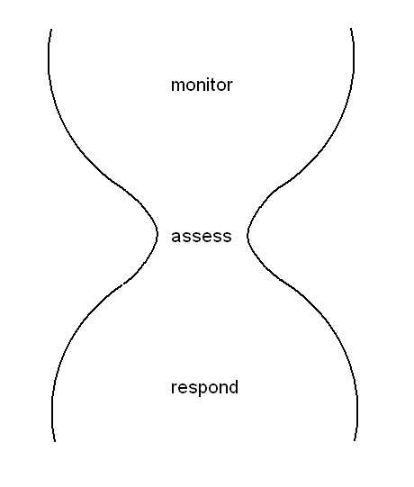
Technology Response Model
everyone
specialists
organizations, individuals
Raise awareness, increase understanding, supplement curriculum
McGovern, 2009: http://discovery.ucl.ac.uk/18017/

Slide 15
Observations
Our community might:
develop a leadership program for digital curation
establish a mentoring program
promote core concepts for curriculum
provide a space for sharing curriculum
coordinate academic and continuing curriculum
sustain a train-the-trainer program
measure outcomes
launch a community technology response service

Slide 16
ANADP
Aligning National Approaches to DP (ANADP)
Educational Alignment Opportunities:
Develop accredited curriculum, providers, and metrics
Address supply and demand (trainers)
Engage with employers and professional bodies
Improve cooperation in defining skill-sets
Provide hands-on experience
Confer about curricula internationally, apply nationally
Extend training outside the community, including public
ANADP release date: next week – we hope!
http://www.educopia.org/events/ANADP/Volume

Slide 17
Thank you

