Slide 1
Lessons About Sustainability Learned from the Open Science Data Cloud
Robert Grossman
University of Chicago &
Open Cloud Consortium

Slide 2
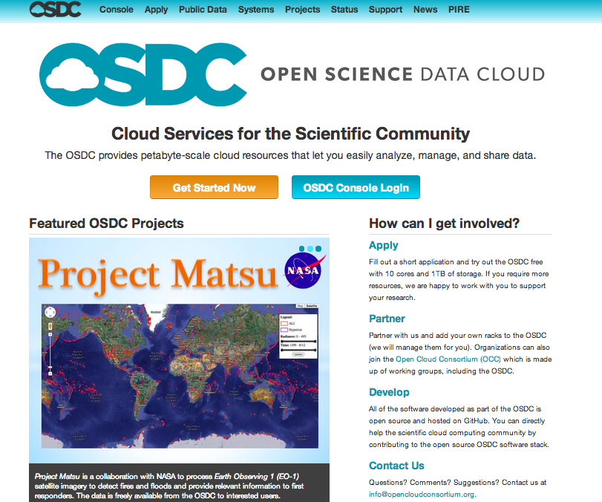
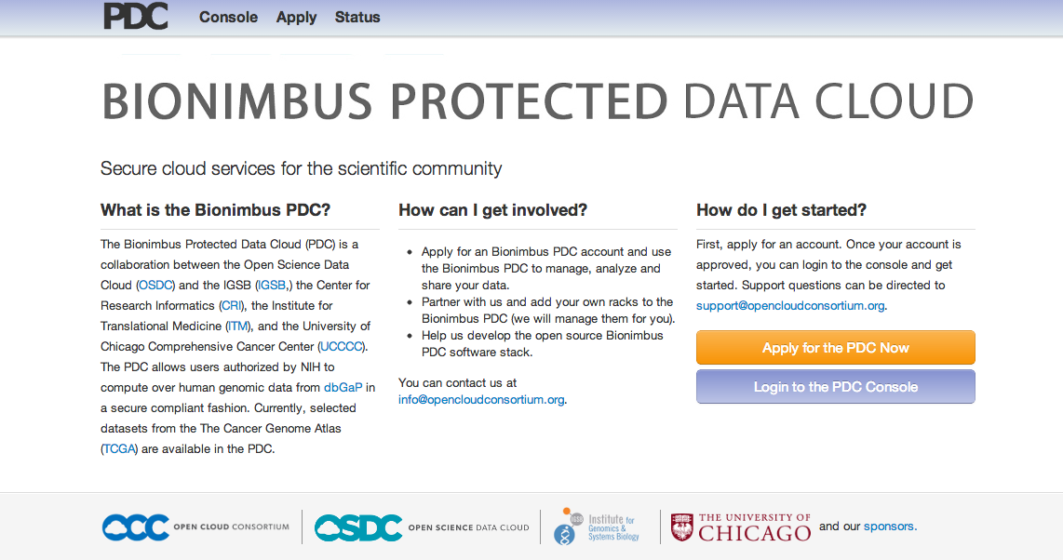
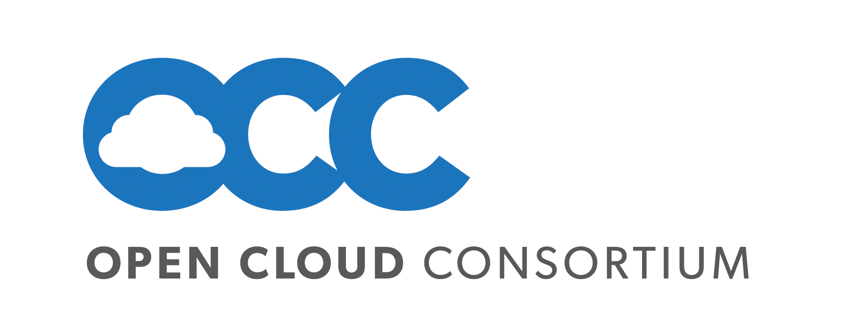
500 users that compute over data
150 active each month
Users utilize between 1000 – 100,000+ core hours per month
Same open source software stack
Open Science Data Cloud
Operated by NFP Open Cloud Consortium
6 PB (pan science)
Started in 2009
Bionimbus Protected Data Cloud
Operated by University of Chicago
1+ PB controlled access cancer data
Started in 2013

Slide 3
Useful Models Today
Organizations and projects can contribute through a “condo model”
Modest fees can be charged on those communities that can pay, including commercial entities.
PIs can add charges in their grants for data infrastructure, which are paid when they contribute their data to the infrastructure.
PIs can add charges in their grants which are paid when they make significant use of data infrastructure.
PIs can add charges in their grants to contribute cap exp to publically funded repositories and infrastructure
Federal agencies can provide grants to support publicly funded data infrastructure
There are very important differences between small, medium and large scale data infrastructure.

Slide 4
Lessons Learned / Principles
Pay in at constant cap exp, despite the fact that no one wants to pay and that there is an expectation that data infrastructure should be free.
Permanent IDs with queryable metadata are essential.
Portability of data and data environment (at scale) is critical so researchers can liberate their data.
Peering of Tier 1 data repositories and infrastructure and interoperability of public data infrastructure is critical, but don’t get ahead of reference implementations.
Essential to keep costs down:
Efficiency gained through medium scale infrastructure
Open source software
Use of infrastructure management and automation tools
Misconceptions about the costs / tradeoffs of public cloud infrastructure.

