Slide 1


Department of Energy:
Fusion Energy Sciences
Sean M. Finnegan
Program Manager, Fusion Energy Science
Presented to NRC
Plasma Science Committee
July 10, 2014

Slide 2


The world fusion science landscape will look considerably different in a decade (1 of 3)
ITER will begin operations in the next decade
Fabrication activities for U.S. commitments are rapidly increasing so as to meet ITER need dates as the international project moves through this critical maturation period.
The US research effort has to effectively reap maximal benefit from ITER with a world-leading workforce
FES supports a broad, impactful program in experiment, theory, and computation at labs, universities and industry. FES focuses on ITER-related burning plasma science but invests in broader research as well. The portfolio supports the research of over 350 graduate students in fusion and the plasma sciences. Still, to get to where we need to be in a decade, we need to make better use of our larger lab facilities to the benefit of our university programs and the nation.

Slide 3
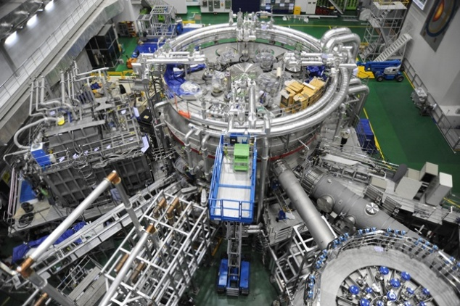

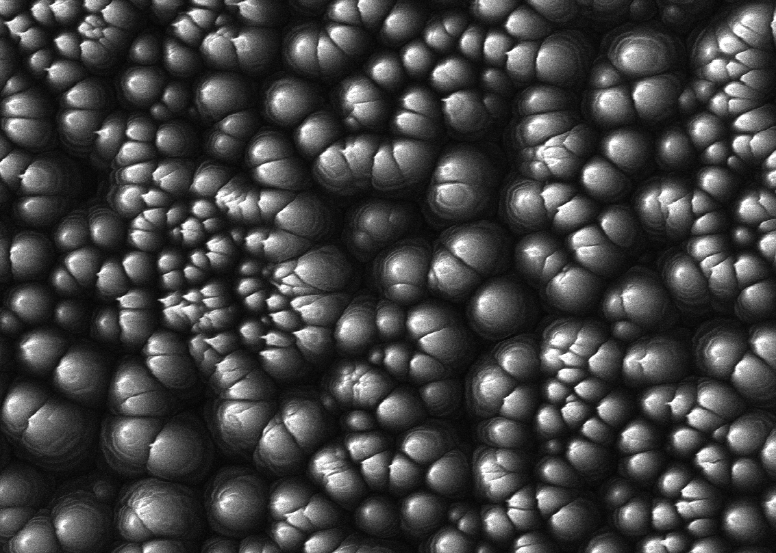
The world fusion science landscape will look considerably different in a decade (2 of 3)
    There will be mature, cutting-edge research facilities around the globe addressing the needs of ITER and looking beyond
    FES continues to invest in international partnerships. The administration point of view is that these partnerships must lever a strong domestic program. New endeavors launched will have significant university participation, including leadership.
Fusion materials science will be an increasing focus globally
The FY 2015 budget has elements that will be key to determining how research should proceed to close gaps in fusion materials science. A leading example is its support of continued strong operation on DIII-D and ramped up operation on NSTX-U (after completion of its upgrade construction). This pair of facilities is well suited to identify many of the requirements for a fusion nuclear science program, as well as to answer questions important for ITER. Both programs are also well aligned with the scientific interests of universities in computational and experimental magnetic fusion research.

Slide 4
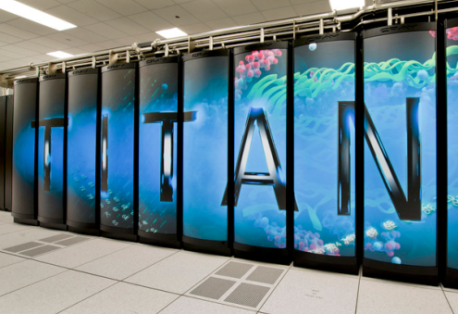
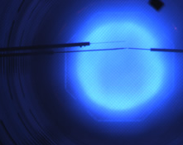
The world fusion science landscape will look considerably different in a decade (3 of 3)
    Fusion will increasingly take advantage of massively parallel computing
    The FY 2015 budget continues to make focused investments in advanced scientific computing in partnership with ASCR, and in experimental validation of theory. The SciDAC and Theory programs focuses on burning plasma science and ITER. Plasma research at universities continues to strengthen the foundations of the science of magnetic confinement, numerical simulation science, and experimental validation & verification.
    Leverage will become increasingly important in the fusion and plasma sciences with tough budgets
    ITER represents the height of leveraging capabilities internationally.
    The HEDLP program maintains a cross-SC partnership with BES at LCLS (SLAC) for first-of-a-kind science.
    International partnerships will target high-leverage opportunities that build on US strengths.
    The general plasma science portfolio has a strong partnership with NSF that is effective in doing great science and in developing early career plasma scientists.
    FES materials scientists are leading users of HFIR, another BES facility.
    Fusion computing leverages partnership with ASCR through the SciDAC program.

Slide 5
FY 2015
Congressional Budget Request
$416M

Slide 6
At a Glance: FES at $416M in FY 2015
Total FES program
ITER Construction: $150,000K
Science: $154,321K
Major Tokamak Research
  DIII-D
  NSTX
  C-MOD
  Theory & SciDAC
Small/intermediate-Scale Magnetic Fusion Energy
  Experimental Plasma Research
  Madison Symmetric Torus
Enabling R&D
  Plasma Technology
  Advanced Design
  Materials
International Collaborations
High Energy Density Laboratory Plasmas
General Plasma Science
Major Tokamak Research and Operations, Theory, Simulation
Without ITER
Facility Operations: $89,719K
DIII-D
NSTX Upgrade
C-MOD
GPE/GPP/Infrastructure
EPR & MST
Hatched areas indicate project and operations expenses

Slide 7
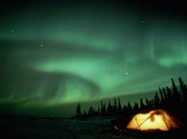
Organizing along scientific topical lines can help align community interests with national mission needs
Burning Plasma Science
Foundations
Long Pulse
High Power
New budget structure being developed in FES
Focusing on domestic capabilities; major and university facilities in partnership, targeting key scientific issues. Theory and computation focus on questions central to understanding the burning plasma state
Challenge: Understand the fundamentals of transport, macro-stability, wave-particle physics, plasma-wall interactions
Building on domestic capabilities and furthered by international partnership
Challenge: Establish the basis for indefinitely maintaining the burning plasma state including: maintaining magnetic field structure to enable burning plasma confinement and developing the materials to endure and function in this environment
ITER is the keystone as it strives to integrate foundational burning plasma science with the science and technology girding long pulse, sustained operations.
Challenge: Establishing the scientific basis for attractive, robust control of the self-heated, burning plasma state
Discovery Science
Plasma Science Frontiers and Measurement Innovation
General plasma science, non-tokamak and non-stellarator magnetic confinement, HEDLP, and diagnostics
7

Slide 8
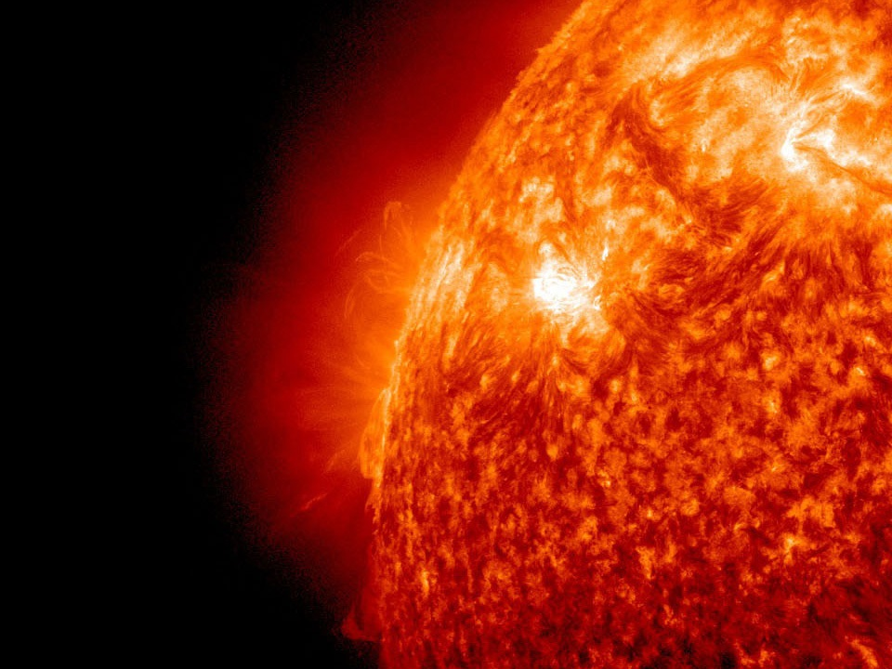
“All fusion reactors require a burning plasma. The key challenge is to confine the hot and dense plasma while it burns.”
Burning Plasma: Bringing a Star to Earth, p. 1
National Research Council

Slide 9
Burning Plasma Science
Foundations
Advanced Tokamak (DIII-D, C-Mod) & Spherical Tokamak (NSTX)
  Highly collaborative; strong university partnerships
  High scientific complementarity between these facilities
  High potential for growing student engagement on our nation’s major fusion science experimental facilities
Theory and Simulation
  US strength in engaging with experiment to develop predictive understanding
  Essential if high-risk gaps in fusion are to be closed
  Leverages DOE investments in leadership-class computing resources
9

Slide 10
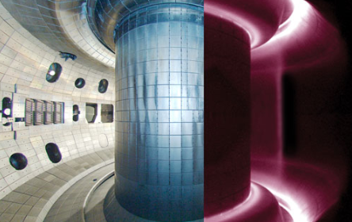
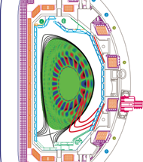
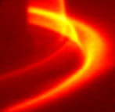
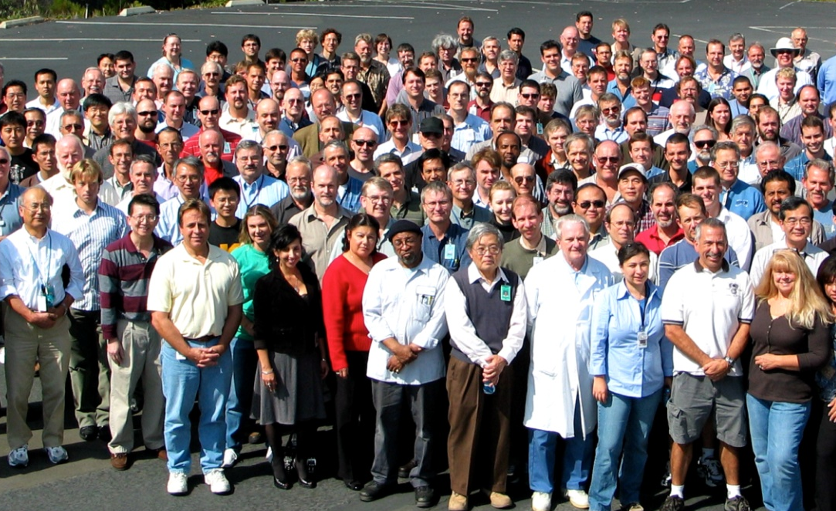
The DIII-D tokamak: Overview
  The DIII-D facility (General Atomics)
Located: General Atomics, San Diego California
The DIII-D user facility:
Is the largest magnetic fusion research experiment in the U.S.
Confines plasmas at temperatures relevant to burning plasma conditions.
Studies stability, confinement, and other properties of fusion-grade plasmas under a wide variety of conditions
Research goal: to establish the scientific basis for the optimization of the tokamak approach to magnetic confinement fusion.
research concentrates on the development of the advanced tokamak concept, in which active control techniques are used to manipulate and optimize the plasma to obtain conditions scalable to robust operating points and high fusion gain for ITER and future fusion reactors.
Near-term targeted efforts address scientific issues important to the ITER design.
Longer-term research is focused on advanced scenarios to maximize ITER performance.
Supports: approx. 20 graduate students and 14 Postdocs

Slide 11
DIII-D National Fusion Facility
Research | FY ‘14 Current | FY’15 CONG Request
DIII-D | 30,998 | 32,038
    FY 2015 budget highlights
    Research: Conduct experiments to address milestones on the ITER disruption mitigation system, transport models and performance in ITER-like conditions, and integrated core-edge scenarios.
    Facility Operations: 15 weeks of operation, and support for some high-priority facility upgrades and system refurbishments.
Operations | FY’14 Current | FY’15 CONG Request
DIII-D | 43,960 | 37,385
The DIII-D research goal is to establish the scientific basis for the optimization of the tokamak approach to magnetic confinement fusion. This includes addressing near-tern scientific issues for ITER and advanced operating scenarios, and is important for the mission of a future Fusion Nuclear Science Facility.

Slide 12
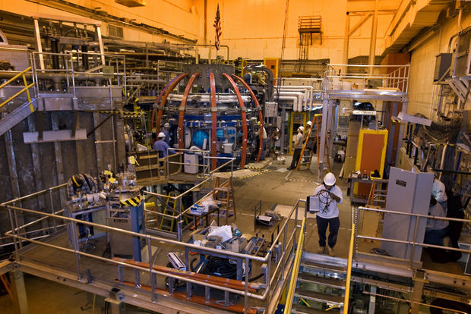
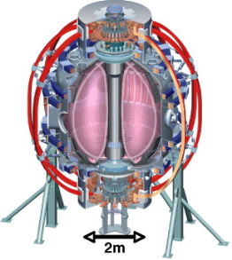
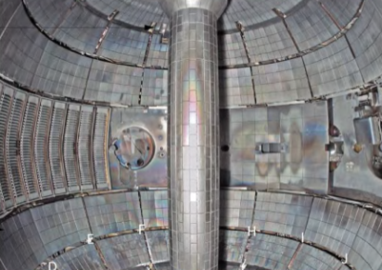
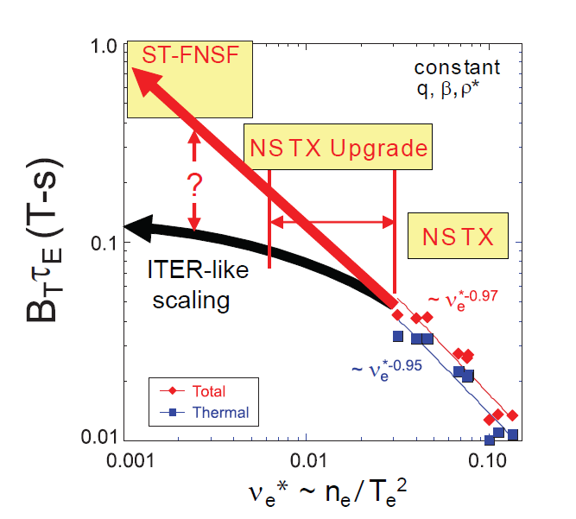
National Spherical Torus Experiment Upgrade (NSTX-U): Overview
  The NSTX-U facility (PPPL)
Located: Princeton Plasma Physics Laboratory, Princeton, New Jersey
The NSTX user facility:
Is a spherical torus confinement configuration.
Confines plasma with pressure that is high compared to the magnetic field energy density
Upgrade is currently underway and will be completed early in FY 2015.
The upgrades will enable:
Doubling of the magnetic field and plasma current
Increase in the plasma pulse length from 1 to 5 seconds, making NSTX the world’s highest-performing spherical torus.
Together, these upgrades will support a strong research program to develop the improved understanding of the spherical torus configuration required to broaden scientific understanding of plasma confinement, and maintain U.S. world leadership in fusion research.
Supports: approx. 31 graduate students and 16 Postdocs

Slide 13
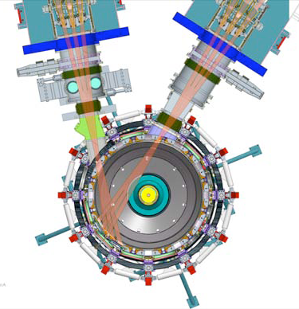
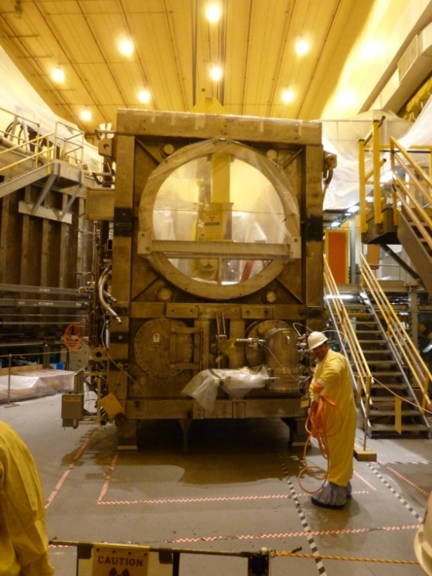
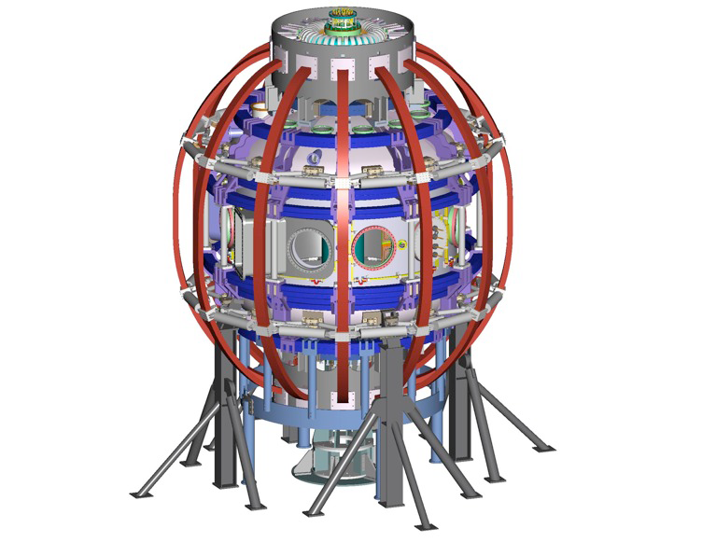
NSTX: Upgrade project is going well
Second NBI
Existing NBI
top view
Beam box = 40 tons
Lid = 14 tons
Upgrades:
New solenoid, Inner TF bundle, TF joint, OH & Inner PF coils
Reinforced umbrella structure
Existing outer poloidal magnetic field coils – 6 total
Upgraded TF coil support structure
New PF coil support structure
Existing outer TF coils
Also… modify coil power system, protection system & ancillary support systems
13

Slide 14
NSTX-U
Research | FY’14 Current | FY’15 CONG Request
NSTX | 22,056 | 26,000
  FY 2015 budget highlights
    NSTX Upgrade Project: On track for project completion by or ahead of the agreed-upon baseline.
    NSTX Facility Operations and Research: Funding is ramped up to prepare the power supplies, diagnostics, auxiliary heating systems, etc., for rapid resumption of research operations upon project completion and to support 18 weeks of operation for the NSTX-U research program.
Operations | FY’14 Current | FY’15 CONG Request
NSTX | 16,600 | 33,884
Construction Projects | FY’14 Current | FY’15 CONG Request
NSTX Upgrade | 23,700 | 3,470
The NSTX program will contribute to science important for ITER and deepening understanding of plasma confinement, control, and optimization. This includes being used to evaluate the potential of the ST for achieving the high plasma performance required for a Fusion Nuclear Science Facility.

Slide 15

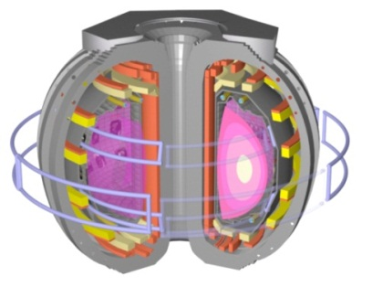


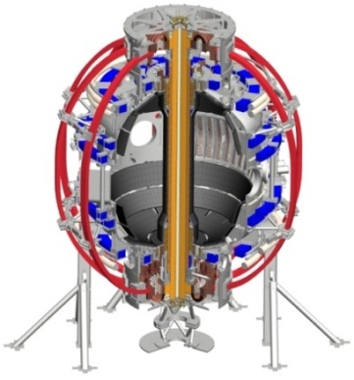
DIII-D and NSTX are a scientifically powerful pair
Core Contributions
Key Physics Parameters
Transport in ITER burning plasma regime
Advanced scenarios
Aspect ratio
Normalized size
Collisionality
High β
Dynamics and control of self-sustained plasmas
Rotational shear
Electron gyroradius
Sub- versus super- Alfvénic energetic ions
T_{e} / T_{i}
Fast ion parameter space overlaps and extends beyond ITER in V_{fast}/V_{alfven} and β_{fast}/β_{tot}
Power and particle exhaust
Together, these facilities provide access to an extended range of key physics parameters
15

Slide 16
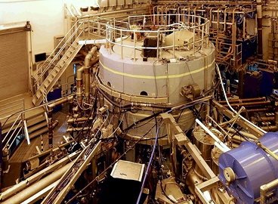

Alcator C-Mod FY 2015 research and facility operations plans
Operations | FY’14 Current | FY’15 CONG Request
Alcator C-Mod | 14,050 | 11,855
    FY 2015 budget highlights
    Research: Focus experiments on addressing high-priority issues of ITER-relevant boundary and divertor physics, including disruption studies.
    Facility Operations: 5 weeks of operation, and support for near-term facility upgrades and system refurbishments that will impact the research program in FY 2015 and FY 2016.
Research | FY’14 Current | FY’15 CONG Request
Alcator C-Mod | 7,890 | 6,145
16

Slide 17
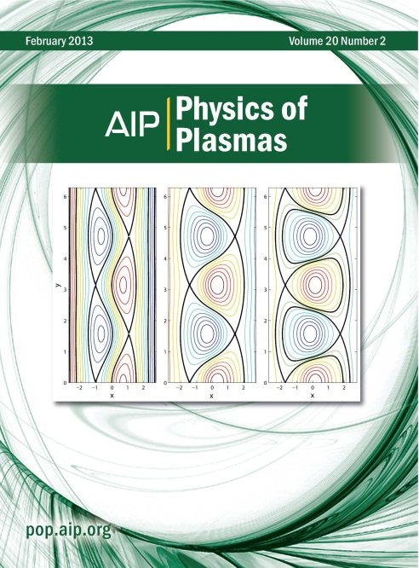
Theory program advances fundamental science of magnetic confinement
 | FY’14 Current | FY’15 CONG Request
Theory | 24,029 | 21,170
  The MFE Theory program:
Focuses on fundamental plasma science of magnetic confinement with emphasis on burning plasma science
Supported areas include macroscopic stability, confinement and transport, interaction of RF waves with plasmas, energetic particle physics, and plasma boundary physics
  Efforts range from small single-investigator grants, mainly at universities, to large coordinated teams at national laboratories, universities, and private industry
  Provides theoretical underpinning for advanced simulation codes (SciDAC) and Supports validation efforts at major experiments
  In FY 2015:
Continued support for ongoing research including efforts addressing high-priority issues for ITER and burning plasma
Coordination between theory and experiment leading to model validation will be emphasized, particularly in areas where the resolution of essential physics issues is urgently needed before first plasma in ITER
17
Involves approximately 46 graduate students, 14 postdocs

Slide 18
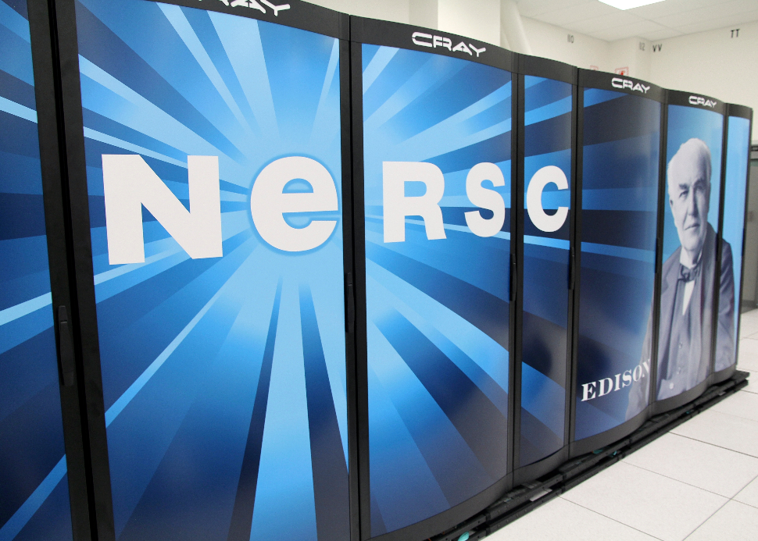
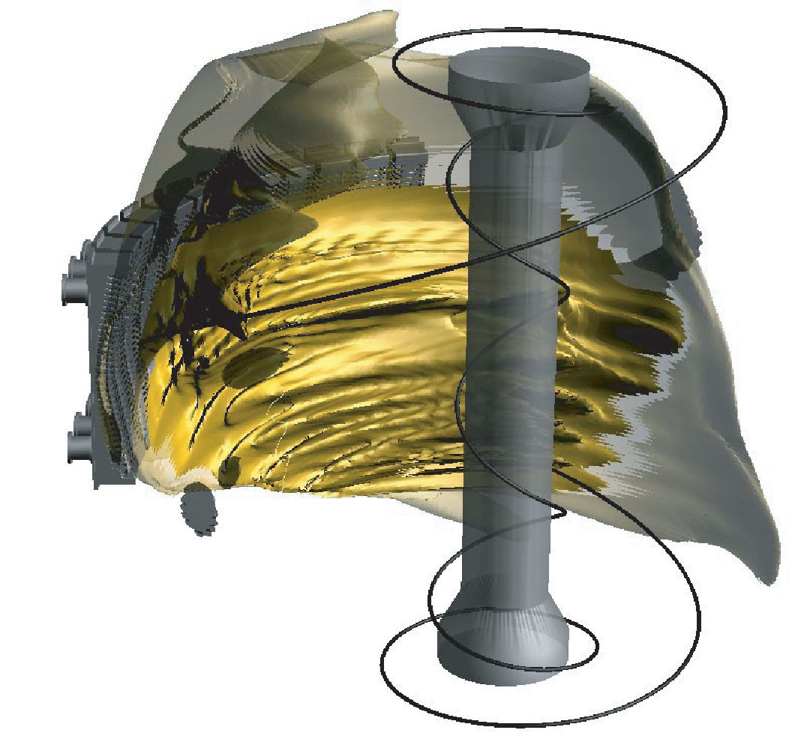
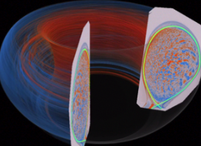
SciDAC program advances fusion science through high performance computing
 | FY’14 Current | FY’15 CONG Request
SciDAC | 9,375 | 7,000
  The FES SciDAC program:
The FES Scientific Discovery through Advanced Computing (SciDAC) program advances scientific discovery in fusion plasma science by exploiting SC leadership class computing resources and associated advances in computational science
Highly collaborative program, leverages strengths of FES and ASCR
  In FY 2015:
The FES SciDAC centers will continue to contribute to the FES goal of developing a predictive capability for fusion plasmas
  Milestones:
Extend PIC gyrokinetic plasma turbulence codes to simulate 3-D resonant magnetic field perturbations for suppressing edge-localized instabilities on ITER
Release new version of continuum reaction-diffusion plasma facing components simulation code
18
Supports: At least 7 graduate students, 9 postdocs

Slide 19
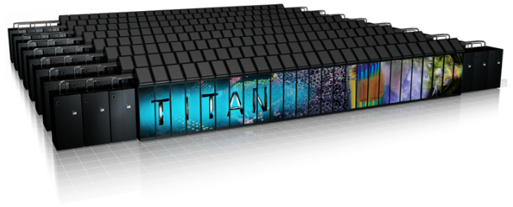
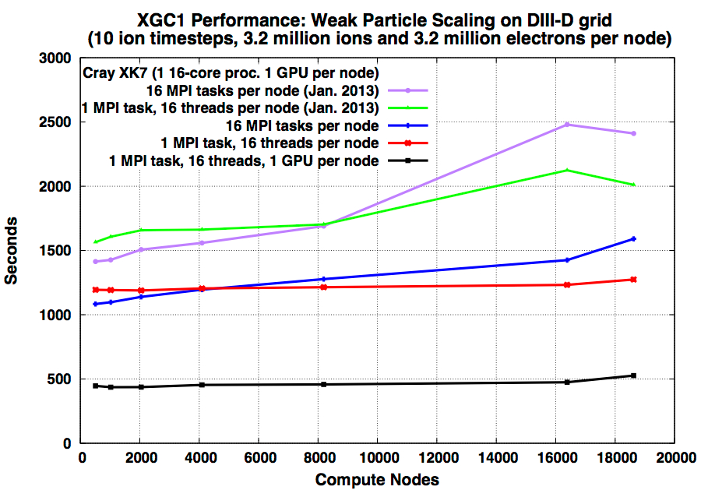
Highlight: FES-ASCR partnership advancing state of the art fusion modeling
the Science:
New version of XGC1 using both multi-core CPUs and GPU on Cray XK7 (Titan) achieves 4X speedup for target problem size over earlier code using just multi-core CPUs.
Performance improvements enabled excellent scalability to over 16,000 nodes (over 256,000 processor cores) on Titan and on IBM Blue Gene/Q (Mira) for a range of problem sizes
Initial un-optimized performance
the Impact:
The physics of the edge plasma is one of the highest priority research areas for the success of ITER, as the edge affects the fusion efficiency in the core plasma and the degradation of the reactor wall in critical ways.
XGC1 makes efficient use of leadership class computing for full ITER scale simulation
Performance after SUPER optimizations (CPU only)
(4x improvement using SUPER & GPUs)
Maximum # of Titan cores
19

Slide 20
Burning Plasma Science
Long Pulse
Long-Pulse Tokamaks & Long-Pulse Stellarators
  Using partnerships on international facilities where US expertise is valuable and desired
  Creating opportunities for continued US leadership this decade in areas critical to fusion science
  Generate access for our scientists and students to what are becoming leading research endeavors around the globe
Materials and Fusion Nuclear Science
  Investments will enable US leadership in fusion nuclear materials science and plasma-material interactions
20

Slide 21

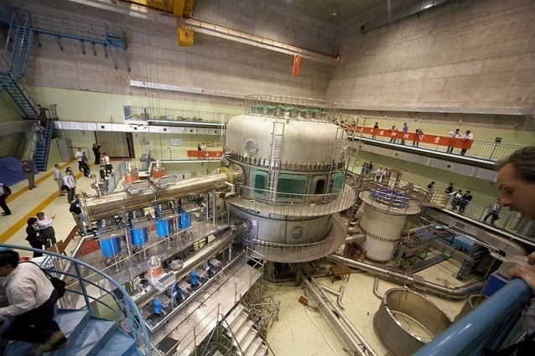
International collaboration teams will continue work in FY 2015
Research | FY’14 Current | FY’15 CONG Request
International Research | 9,954 | 8,545
  The International Collaboration program:
In addition to their work on domestic facilities, U.S. researchers participate in experiments at facilities in Europe, Japan, Russia, China, South Korea, and India. Collaborations focus on facilities in China (EAST), Korea (KSTAR), United Kingdom (JET), Germany (Wendelstein 7-X), and Japan (Large Helical Device)
Carried out under international bi-lateral agreements
  In FY 2015:
Continue support for two U.S. research teams led by MIT and General Atomics on EAST and KSTAR
Continued support for ongoing collaborations with Wendelstein 7-X, led by PPPL and including ORNL, LANL, and U of Wisconsin
  Milestones:
Complete the design of the scraper element for the W7-X steady-state divertor, to enable exploration of the edge magnetic configuration
Scientific collaborations on EAST and KSTAR will continue
US domestic facilities are vital to leverage these collaborations
21
Involves: approx. 2 graduate students and 3 postdocs

Slide 22
Enabling R&D
 | FY’14 Current | FY’15 CONG Request
Plasma Technology | 12,922 | 11,910
Advanced Design Studies | 1,400 | 1,500
Materials Research | 9,969 | 8,550
Total, Enabling R&D | 24,291 | 21,960
  FY 2015 budget highlights
    Plasma Technology: Research on fueling, heating, chamber technologies for fuel cycle development, and safe operation of future facilities.
    Advanced Design Studies: Identify ways to address the gaps in materials and nuclear science research and help crystallize the FNSF concept.
    Materials Research: Elucidate the complicated response of materials under extreme fusion conditions and provide critical data for future fusion devices.
The Enabling R&D subprogram addresses scientific challenges by developing and continually improving the hardware, materials, and technology incorporated into existing and next-generation fusion research facilities, allowing the exploration of new scientific regimes, including long pulses.
Involves: approx. 41 graduate students and 23 postdocs

Slide 23
Burning Plasma Science
High Power
US Contributions to the international ITER Project
  U.S. ITER Project requirements and plans
  Concerns and approach regarding the international project
23

Slide 24
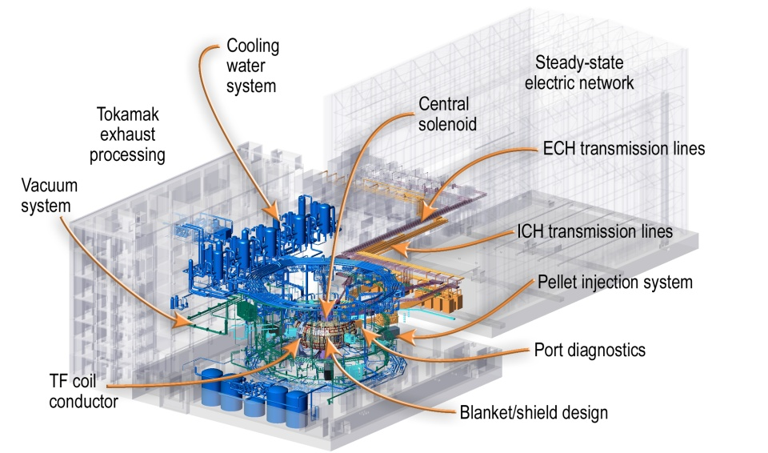
About 80% of US ITER funding is for in-kind hardware contributions built in U.S.
In-kind hardware contributions
managed at U.S. ITER Project Office (at Oak Ridge National Laboratory)
24

Slide 25
The state of play of the international ITER project prompts the Administration to slow the pace of contributions, but still meet the project’s needs for FY 2015
Project construction | FY ‘14 Current | FY’15 CONG Request
U.S. ITER | 199,500 | 150,000
Funding is provided for critical path items. Funding also provided for U.S. ITER Project Office operations and the U.S. cash contribution ($40M)
The funding request for the U.S. ITER Project is driven by our best understanding of the ITER construction schedule, and the view that the U.S. cannot simply write a blank check given the project’s performance. The requested level of funding will allow the U.S. to meet its obligations on critical path items and will mitigate risk to the U.S. if the schedule continues to slip.
The U.S. ITER Project Office focus is on delivering toroidal field conductor to the toroidal field magnet fabricator, drain tanks for tokamak cooling water, and hardware for the steady-state electrical network. In addition, the U.S. ITER Project Office starts fabrication of the first central solenoid module, completes various design reviews for the vacuum auxiliary system, and awards subcontracts for diagnostic design work.

Slide 26
The Administration has expressed its great unease with the status and progress of the international ITER Project and is working to right the ship
Stance: The U.S. has indicated to all the Members its high level of unease concerning the Project’s progress. Factors informing this judgment include the ITER Management Assessment Report, the Lehman Review, and on-the-ground observations enabled by US participation in leadership committees and the US IPO’s engagement with the IO and the other Domestic Agencies.
Responses: The U.S. is responding in a number of ways, including analysis of project execution between U.S. ITER and the IO and other Domestic Agencies, and discussions at high political levels.
Reforms: In concert with the new ITER Council Chair, the U.S. has introduced reforms to the way the Council performs. With insistence from the US on acting on all of the recommendations of the Management Assessment, the ITER Council has adopted them all

Slide 27
Actions taken by the Council, and developing a Corrective Action Plan
Actions by the Council: The Council Chair sought, and obtained, the formation of three working groups to: (1) develop a process for leadership succession, (2) identify ways to improve IO-Domestic Agency interactions, and (3) evaluate senior leadership performance
Developing a Corrective Action Plan: There are 8 recommendations in the MA that the IO must respond to (the others are Council actions on leadership evaluation and succession planning, already taken). The Council has adopted all of the MA recommendations and demanded IO action
  Initial response by the IO: In the IO’s first response presented at the February Council meeting, the Council accepted 3 of the responses proposed by the IO, and sent the remainder back for further development
  Council Chair response: The Council Chair prescribed an outline of actions on the remaining five, and the IO has indicated its intent to act accordingly. We expect to hear from the IO its proposed plans for these remaining five actions
  Outcome sought: When the 8 proposed actions by the IO in response to the MA are adopted by the Council, this will constitute the IO’s Corrective Action Plan. Goal is to receive an acceptable plan that will be formally approved by written procedure by the Council as soon as possible

Slide 28
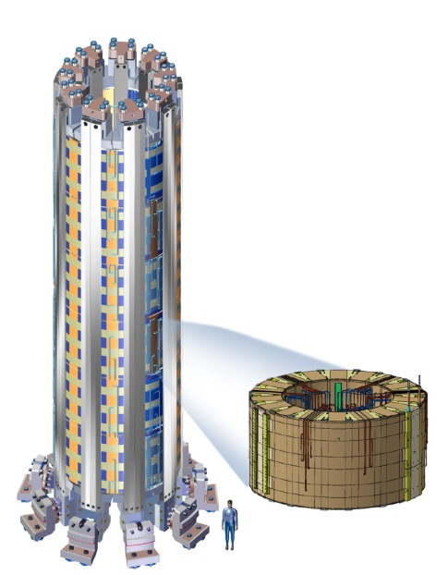
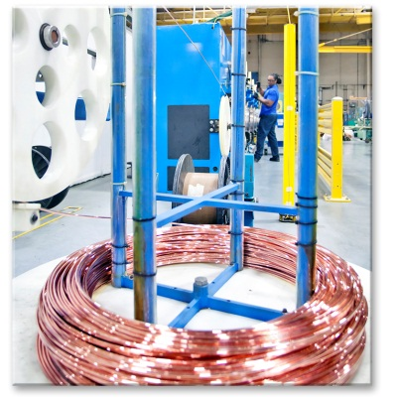
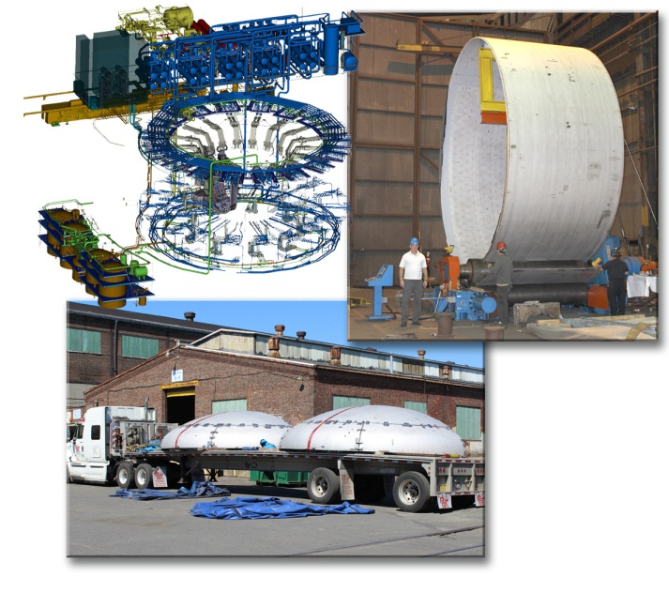
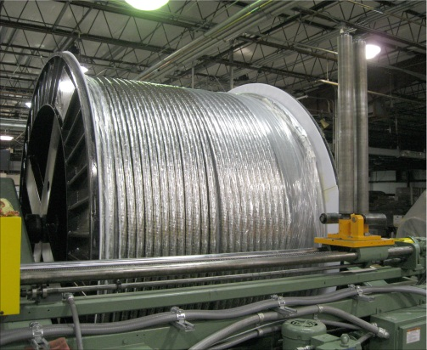
US fabrication of ITER in-kind hardware components is advancing
Central Solenoid
Toroidal Field Conductor
Tokamak Cooling Water System
4 miles of niobium-tin superconducting strand
1,000 metric ton magnet induces magnetic flux change needed to:
Initiate plasma
Generate and maintain plasma current
22 miles of piping, 230 pieces of equipment, drain tanks
Classified as “safety important” for confinement of radioactivity
This will be the most powerful pulsed superconducting electro-magnet in history
(5.5 Gigajoule stored energy capacity, 13 Tesla)
Completed batch of production cable
General Atomics
Luvata, OST, NE Wire, High Perf Magnetics
AREVA, Joseph Oat

Slide 29
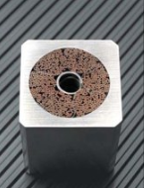
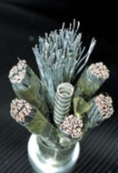
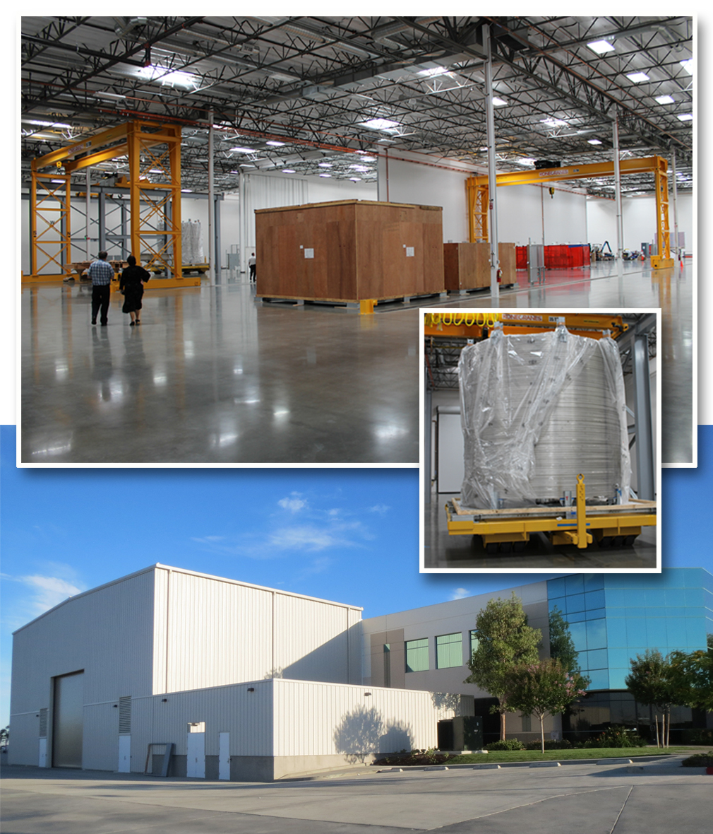
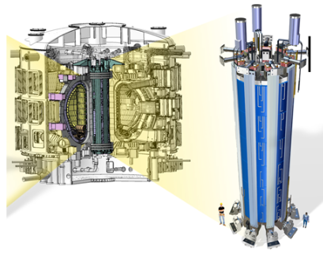
Central solenoid fabrication is making progress
Technical problems with conductor were resolved with U.S. project management leadership
910 meter dummy conductor.
General Atomic’s new central solenoid module fabrication facility in Poway, CA, is preparing for tooling stations. The large crates contain dummy conductor for the mock-up module.
6 independent coil packs
100 tons/pack
29

Slide 30
Discovery Plasma Science
Plasma Science Frontiers
  General plasma science portfolio: FES stewardship of non-MFE plasma science areas
  High energy density laboratory plasma research: matter at extreme conditions
  Small/intermediate-scale MFE experimental research: platforms for verification & validation, study plasma self-organization
Measurement Innovation
  High-impact R&D on new plasma diagnostic techniques
30

Slide 31
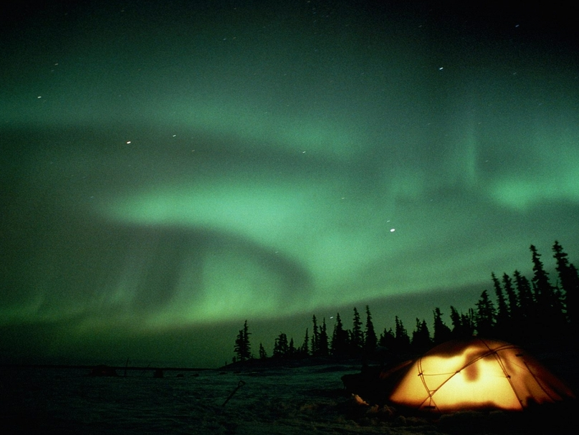
“Plasma science raises and answers scientific questions that contribute to our general understanding of the world around us. Unraveling the complex and sometimes strange behavior of plasmas is in itself an important scientific enterprise.”
Plasma Science: Advancing Knowledge in the National Interest, p. 11
National Research Council

Slide 32






Slide 33
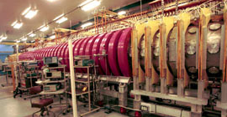
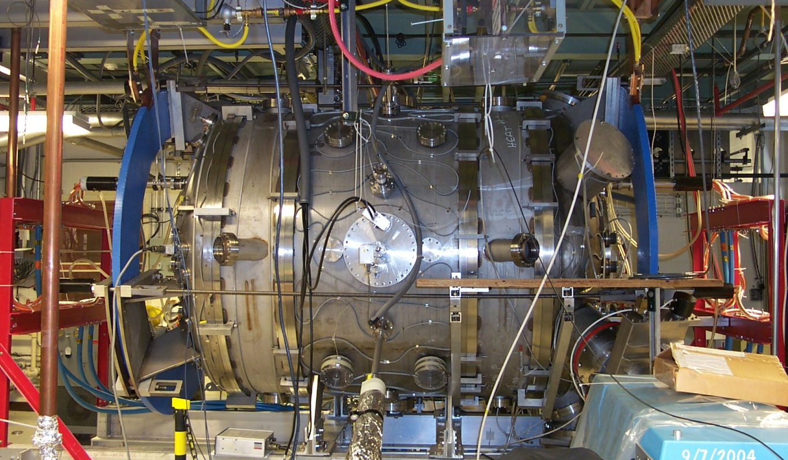
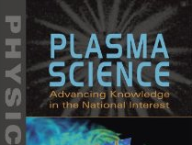
General Plasma Science Program
 | FY’14 Current | FY’15 CONG Request
General Plasma Science | 15,000 | 15,500
  The General Plasma Science’s program:
The General Plasma Science (GPS) program addresses outstanding questions related to fundamental plasma properties and processes through discovery-based investigations in basic and low-temperature plasma science
Major components of the program include: the NSF/DOE Partnership in Basic Plasma Science and Engineering; research at DOE national laboratories; multi-institutional collaborative centers, and small- to medium-scale plasma user facilities
Large Plasma Device @ UCLA Basic Plasma Science Facility
  In FY 2015:
Magnetic Recconnection Experiment (MRX) @ PPPL
NSF/DOE Partnership – annual competitive review of single-investigator-scale research at universities and industries
Prioritize portfolio: Review of centers and intermediate-scale facilities which expand experimentally accessible parameters and provide broad access to users
“There are important basic plasma problems at intermediate scale that cannot be addressed effectively either by the present national facilities or by single investigator research.”
- Conclusion, p. 214
National Research Council
  Milestones:
Initiate the process of identifying new small- to medium-scale general plasma science facility
33
Supports: approx. 77 graduate students, 35 postdocs

Slide 34
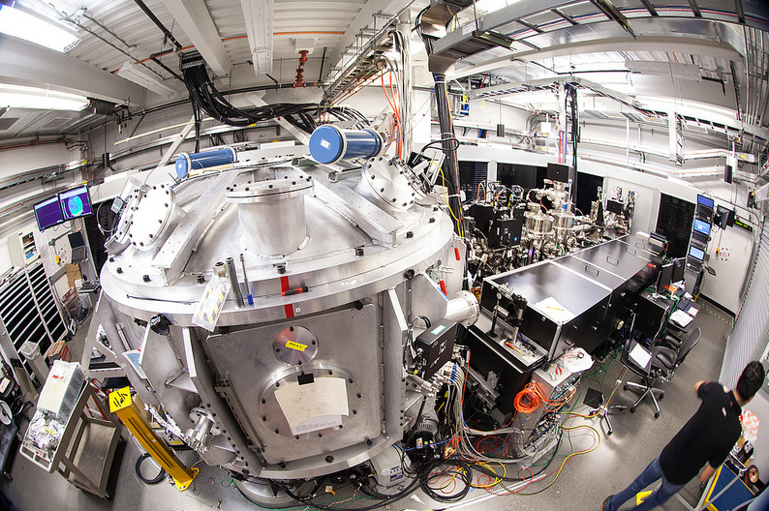
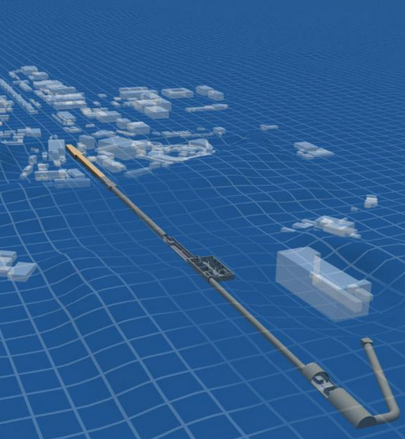
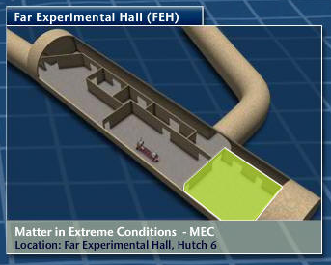
High Energy Density Laboratory Plasmas
 | FY’14 Current | FY’15 CONG Request
HEDLP | 17,315 | 6,700
  The HEDLP program:
The MEC provides scientific users with access to HED regimes uniquely coupled with a high-brightness x-ray source,
High Energy Density (HED) physics is the study of ionized matter at extremely high density and temperature, approximately 100 billion Joules per cubic meter
Supports the Matter at Extreme Conditions (MEC) end station of LCLS user facility at SLAC, enabling experiments at the frontier of high energy density physics, laboratory astrophysics, laser-particle acceleration, and nonlinear optical science
The operation of MEC as a stand-alone experiment makes it unique among LCLS experimental hutches.
  In FY 2015:
Continued support for MEC beam-line science team at SLAC
Support external HED science users at MEC
There is no support for the SC/NNSA joint HEDLP program, but some work will continue through forward funding
  Milestones:
Complete phase two of short-pulse laser upgrade to deliver 200TW peak power on target
34
Involves: approx. 46 graduate students, 17 postdocs

Slide 35
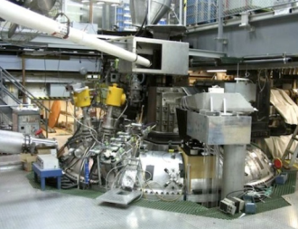
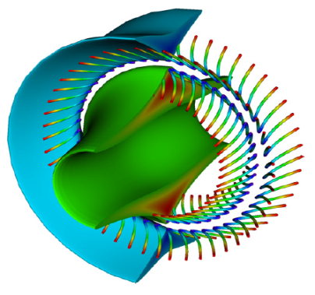
Experimental Plasma Research (EPR)
& Madison Symmetric Torus (MST)
 | FY’14 Current | FY’15 CONG Request
MST | 5,700 | 5,900
Experimental Plasma Research | 10,500 | 10,750
    FY 2015 budget highlights
    EPR: Examine range of magnetic confinement concepts to establish scientific connections and help establish experimentally validated predictive capability.
    MST: Measure the scaling of tearing mode fluctuations with current and temperature and support the validation of nonlinear MHD codes.
EPR provides data in regimes of relevance to mainline magnetic confinement and materials science efforts, supports validation and verification efforts, and contributes to discovery science. MST increases fundamental understanding of the RFP configuration and has an important place in V&V and discovery science.
Supports: about 60 graduate students

Slide 36
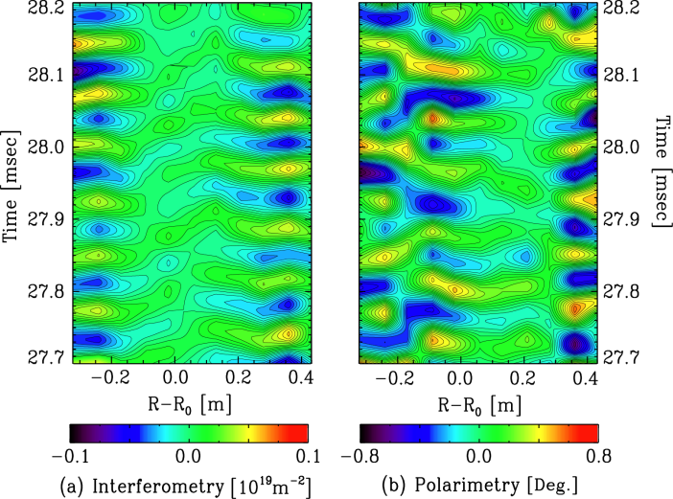
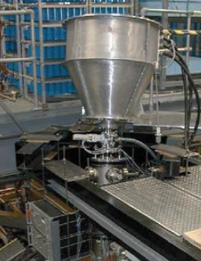
Diagnostics
 | FY’14 Current | FY’15 CONG Request
Diagnostics | 3,500 | 3,575
  FY 2015 budget highlights
  Diagnostics: Efforts will continue on developing innovative techniques to address current and emerging measurement needs in the FES program. A community-informed planning activity will be undertaken to assess the need for long pulse, plasma control, disruption, and burning plasma diagnostics.
Faraday-Effect Polarimetry
Heavy Ion Beam Probe (HIBP)
Diagnostics, the scientific instruments used to make detailed measurements of the behavior of plasmas, are key to advancing our ability to predict and control the behavior of fusion plasmas.
Diagnostics Involves: approx. 12 graduate students, 2 postdocs

Slide 37
Proposed budget restructuring for Fusion Energy Sciences
OBJECTIVES
Construct new budget categories that help tell the story for the FES program
Refocus the perspective as we enter the “burning plasma era” with ITER
37

Slide 38
Comparison of budget categories
Existing categories
Proposed new categories
SCIENCE
DIII--D Research
C-Mod Research
International Research
Diagnostics
Other (HBCU, Education, Outreach, Reserves, etc.)
SBIR/STTR
NSTX Research
Experimental Plasma Research
High Energy Density Lab Plasmas
MST Research
Theory
SciDAC
Fusion Simulation Program
General Plasma Science Research
FACILITY OPERATIONS
DIII--D Operations
C-Mod Operations
NSTX Operations
NSTX Upgrade MIE
Infrastructure/GPP/GPE
ITER Line Item
BURNING PLASMA SCIENCE: FOUNDATIONS
Advanced Tokamak
Spherical Tokamak
Theory & Simulation
GPE/GPP/Infrastructure
BURNING PLASMA SCIENCE: LONG PULSE
Long Pulse: Tokamaks
Long Pulse: Stellarators
Materials and Fusion Nuclear Science
BURNING PLASMA SCIENCE: HIGH POWER
Line Iterm: US Contributions to ITER Project
DISCOVERY PLASMA SCIENCE
Plasma Science Frontiers
Measurement Innovation
SBIR/STTR and Other
ENABLING R&D
Plasma Technology
Advanced Design Studies
Materials Research
38

Slide 39
At a glance: FES at $416M in FY 2015
Burning Plasma Science: Foundations
Advanced Tokamak
Spherical Tokamak
Theory & Simulation
GPE/GPP/Infrastructure
Total, Burning Plasma Science: Foundations
Burning Plasma Science: Long Pulse
Long Pulse: Tokamak
Long Pulse: Stellarators
Materials & Fusion Nuclear Science
Total, Burning Plasma Science: Long Pulse
Burning Plasma Science: High Power
MIE: US Contributions to ITER Project
Total, Burning Plasma Science: High Power
Discovery Plasma Science
Plasma Science Frontiers
Measurement Innovation
SBIR/STTR & Other
Total, Discovery Plasma Science
Total, Fusion Energy Sciences
Total FES program
Without ITER

Slide 40
Programmatic and Policy Updates

Slide 41
Full funding is required for the Office of Science
Congressional directive
  “…none of the funds made available under the heading ‘Department of Energy—Energy Programs—Science’ may be used for a multiyear contract, grant, cooperative agreement, or Other Transaction Agreement of $1,000,000 or less unless the contract, grant, cooperative agreement, or Other Transaction Agreement is funded for the full period of performance as anticipated at the time of award.” [FY 2014 Appropriation Act]
Current policy
  Any grant or cooperative agreement whose total amount is less than $1M must be fully obligated in the year awarded, starting in FY 2014
Impact of the transition to full funding
  Office of Science memo (Jan 30, 2014): “The Office of Science anticipates that applications for new and renewal grants and cooperative agreements will be made at reduced success rates over the next three to five years. After the transition period, success rates should return to historic norms.”
  FY 2014 FES Enacted Budget largesse is being used for this transition

Slide 42
Status of recent solicitations
Solicitation | Status | Announced $ | FES POC
Theoretical Research in Magnetic Fusion Energy Science | 11 awards | $3,800,000 | J. Mandrekas
NSTX Collaboration (non-lab) | 11 awards | $2,000,000 | S. Eckstrand
MEC Optical-Only Experiments | 2 awards | Experimental shot time | S. Finnegan
SBIR/STTR Phase II | 6 awards | $6,000,000 | B. Sullivan
Early Career Research Program | 3 awards | $1,750,000 | N. Podder
SBIR/STTR Phase I | 11 awards | $1,650,000 | B. Sullivan
NSF-DOE Partnership in Basic Plasma Science and Engineering | Award info not yet public (167 proposals reviewed) | $2,600,000 | A. Satsangi & GPS Team
FES-ASCR SciDAC Partnership in Multi-scale Integrated Modeling | Award info not yet public | $1,250,000 | J. Mandrekas
Theoretical Research in Magnetic Fusion Energy Science | Review in Progress | $3,200,000 | J. Mandrekas
Collaborative Research in Magnetic Fusion Energy Sciences on Long-Pulse International Stellarator | Proposals due: Sept. 22 | $500,000 | S. Barish
High-Energy-Density Laboratory Plasma Science (SC/NNSA Joint Program) | Proposals due: Oct. 1 | NNSA: $4,000,000 FES: $0 | S. Finnegan

Slide 43
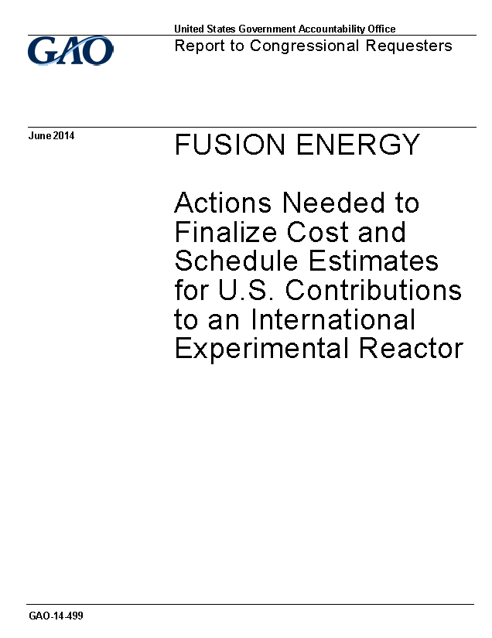
GAO assessment of ITER Project
    House-Senate request to Government Accountability Office
    (May 2013)
  What is the current cost and schedule for completion of ITER? Do experts believe this cost and schedule are realistic given the technical challenges of the fusion energy project?
  Could U.S. deliverables be delayed or adjusted without compromising this schedule? How do U.S. deliverables related to the timely completion of the construction?
  Are there strategies or alternatives to reduce the cost of the U.S. deliverables?
    Status:
  Final report delivered June 5, 2014

Slide 44
Plan for integrated fusion simulations
FY 2014 Appropriations Act directive
  “Not later than 180 days after enactment of this Act, the Department shall submit to the Committees on Appropriations of the House of Representatives and the Senate a plan with research goals and resource needs to implement a Fusion Simulation program.”
Approach
  FES will prepare and submit a plan for an integrated fusion simulation program
  A meeting with ASCR leadership was recently held to discuss possible ASCR participation
  The plan will be consistent with the ten-year FES strategic plan

