Slide 1
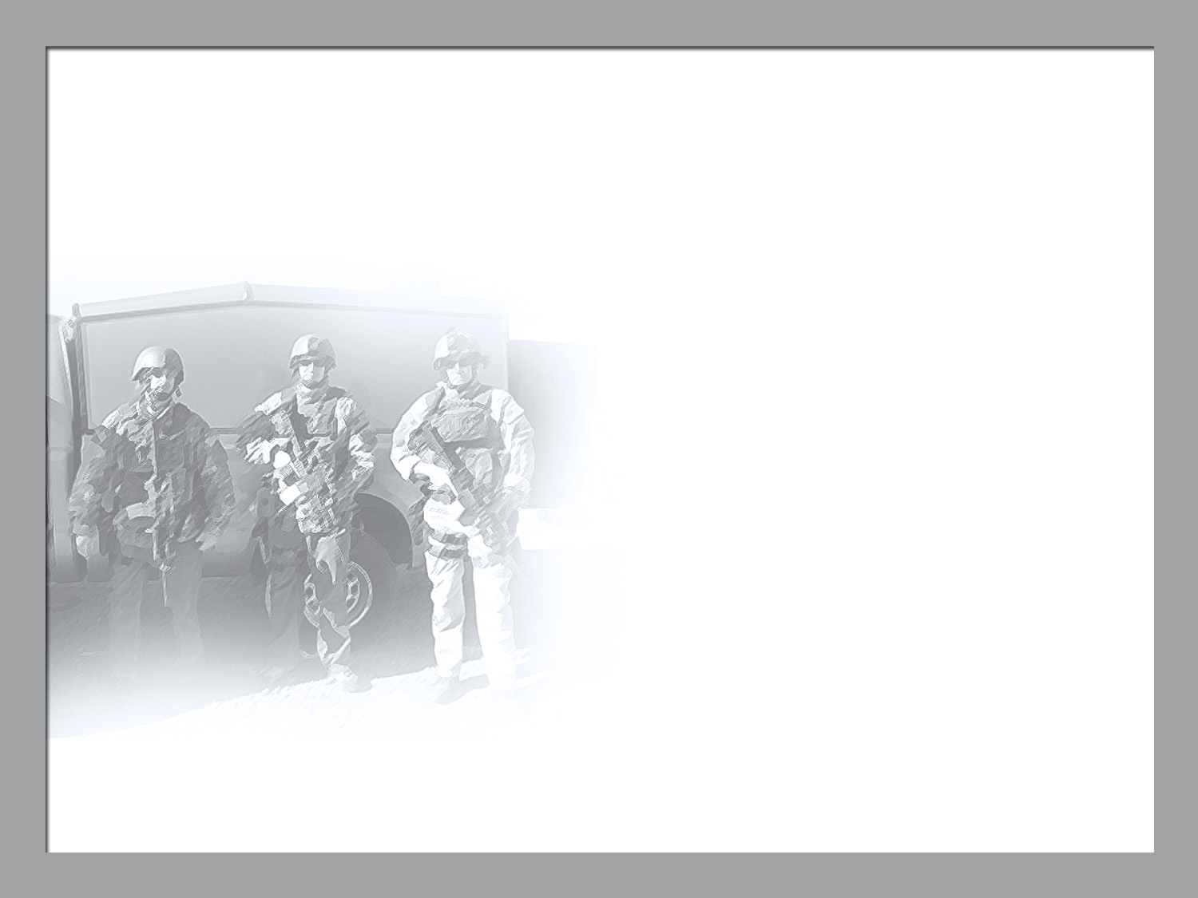

NATIONAL NUCLEAR SECURITY ADMINISTRATION OFFICE OF DEFENSE PROGRAMS
High Energy Density Physics in the NNSA
Presented to:
National Academy of Sciences
NRC Plasma Science Committee
Washington, DC
Presented by:
Kirk Levedahl, PhD
Program Manger in the NNSA Office of Inertial Confinement Fusion
July 11, 2014

Slide 2
The ICF Program is a critically important element of NNSA’s Stockpile Stewardship Program (SSP)
Ensure that the Nation’s nuclear weapon stockpile remains
safe, secure, and effective without nuclear testing
Last underground test occurred more than 20 years ago (9/23/1992)
Our confidence relies in large measure on assessments of issues that are informed by computer models validated against experimental data.
ICF Program provides unique and extreme High Energy Density (HED) environments for model validation and testing of the scientific credibility of the scientists we rely upon for stockpile assessments.

Slide 3
ICF Program has 5 principal elements
Develop a robust burning plasma platform for SSP (Ignition is the first major step)
Obtain fundamental physical properties of materials and plasmas in HED environments (in collaboration with Science Campaigns)
Provide experimental data for computer model validation in the HED regime (in collaboration with the Advanced Scientific Computing Campaign)
Develop and advance capabilities in HED Science
Strengthen the HED community and grow the next generation of stewards

Slide 4
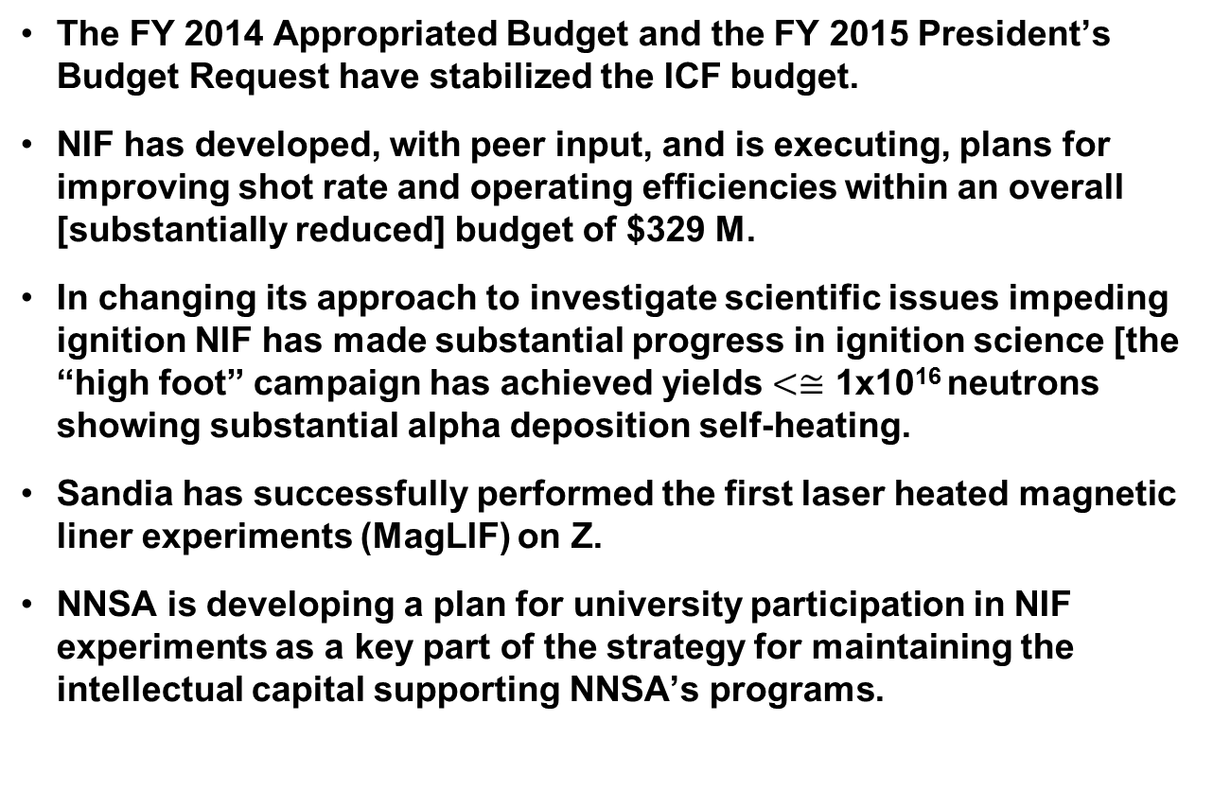
The NNSA HED Science Program for Stockpile Stewardship is now healthy

Slide 5
NIF SHOT RATE IMPROVEMENT
Increase the time available for shot operations in the facility
During operations under the National Ignition Campaign beginning in 2009 until now, NIF was limited to one shot each day executed during the night shift in order to provide time for facility improvements and equipment installation and 10–12 weeks per year were dedicated to major facility upgrades. With the new emphasis on experimental productivity, NIF will make more time available for shot operations, increasing the number of hours each day during which shots will be executed and increasing the number of shot weeks per year.
Reduce the time and effort needed to execute each shot
NIF has identified process improvements and hardware upgrades that can significantly reduce the time required to prepare each shot for execution. Furthermore, better scheduling can minimize diagnostic exchanges and NIF can interleave the use of the two NIF target positioners to decrease shot set-up time.
NIF will also allocate blocks of time to its users, incentivizing users to improve efficiency in order to maximize the return of experimental data.
Continue to improve the cost-effectiveness of NIF and the experimental programs
NIF has already achieved substantial cost efficiencies as part of the transition to the $329M budget for FY2014. This transition included a significant staff reduction and was managed by implementing process improvements, deferring experimental capabilities and reducing operational availability. Improved operational efficiency has already offset much of this reduced availability.
Further cost efficiencies can be achieved by continuing these process improvement efforts. The resulting cost savings will be invested in a balance of engineering and technology

Slide 6
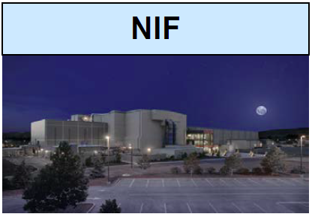
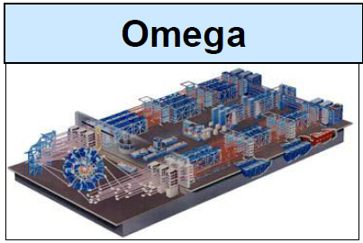
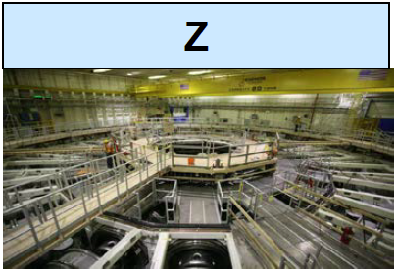
ICF facilities provide unprecedented environments for national security and fundamental science
60% of the ICF Program budget is applied
to facility operations at NIF, Z, and Omega
Research on indirect
drive ignition
Laser plasma
instabilities
Hydrodynamic
instabilities
Radiation
hydrodynamics
Materials at extreme
conditions
Research on polar
drive ignition
Diagnostics
development
Open science platform
Focused experiments
on scientific issues
for ICF
Platform development
for NIF experiments
Research on
magnetically-driven
ICF
Dynamic material
properties – including
Pu
Radiation effects
Radiation
hydrodynamics
Radiation transport

Slide 7
Budget Trends for the NNSA ICF Program

Slide 8
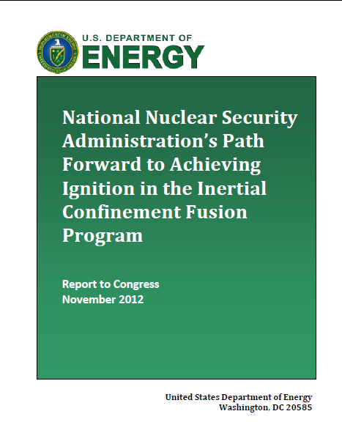
In FY 2015 we will review progress on the ICF program path forward towards ignition.
Path Forward report laid out implementation for work in five areas:
Indirect Drive
Polar Drive
Magnetically-Driven ICF
Diagnostics
Targets

Slide 9
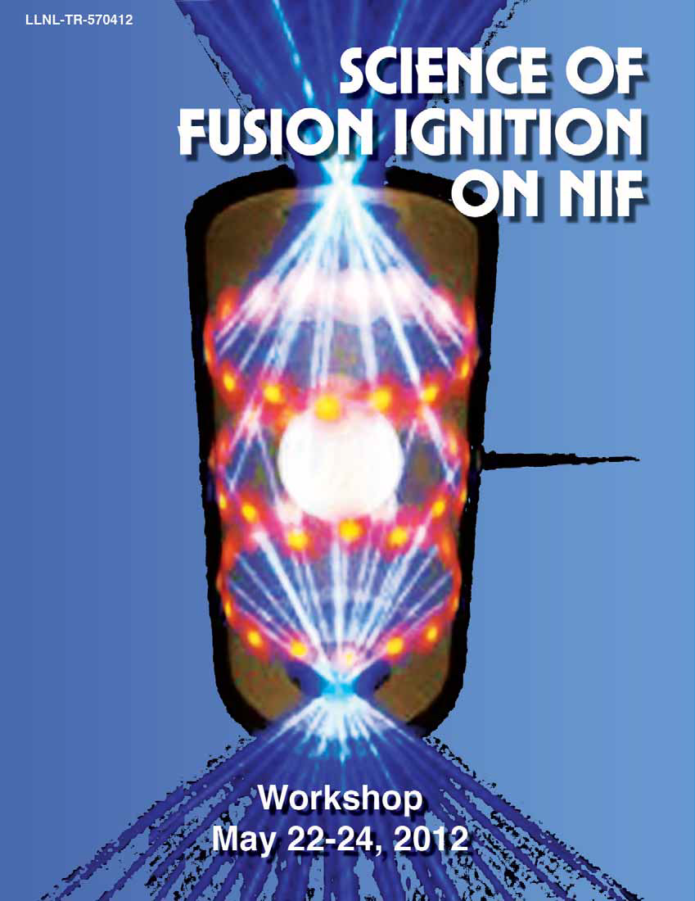
The NIF Indirect Drive Ignition approach has been focused on illumination of underlying physics issues
Primary focus in FY 2014 has been on understanding and controlling capsule implosion symmetry.
New x-ray sources developed for radiographic measurements demonstrate that implosion symmetry does not meet ignition requirements.
Lower convergence higher adiabat implosions being pursued to establish “known knowns.”
Platforms (diagnostics, targets, operating protocols) to support a campaign of experiments using three shocks being qualified
Two recent experiments with yields >9x10¹⁵ neutrons.
Mix experiments have been executed
E.g. C (n,γ) reaction produces 4.1 Mev gamma that can provide a measure of rho-R of ablator material mixed into dense fuel regions.
CD mix experiments have been conducted
~120 scientists from around the world met to identify key missing understanding & path to resolve

Slide 10
HED Weapons science workshop (June 23-27, 2014 at LLNL)
Classified workshop
Over 150 attendees
Workshop report to be published similar to the “San Ramon” report
Numerous exciting opportunities identified.

Slide 11
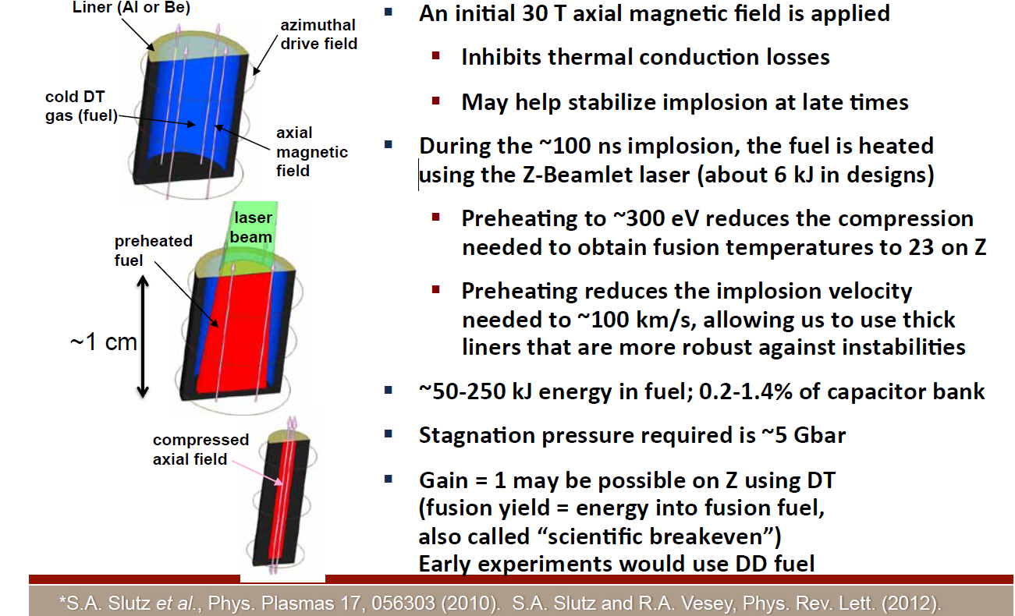
Sandia has executed initial Magnetic Liner Fusion (MagLIF) experiments

Slide 12
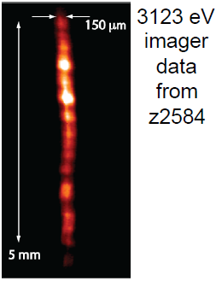
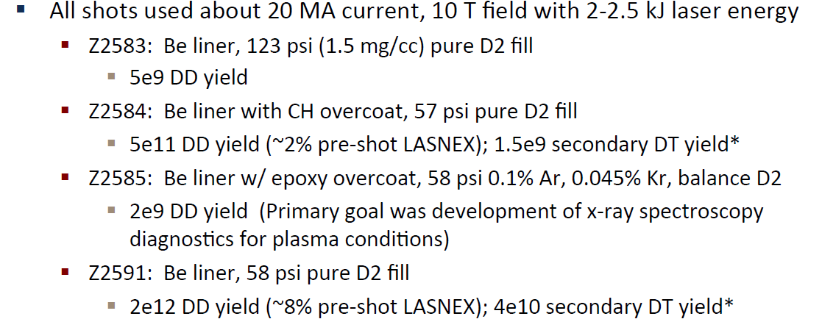
Preliminary MagLIF results encouraging but demonstrate issues with laser heating

Slide 13
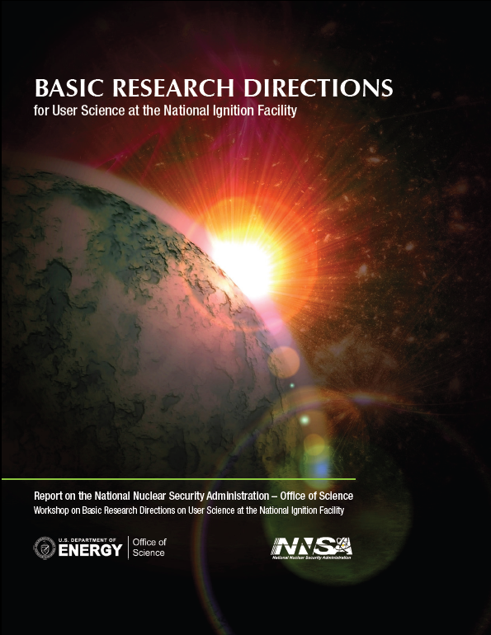
NNSA/Office of Science collaboration in HED science is critical to our program
Workshop Report on Basic Research Directions at the NIF
Science of Fusion Ignition on NIF
Active User Groups for Omega (of course), Z and NIF.
Selections made from the FY 2011 solicitations for the JPHEDLP and SSAA centers & contracts let
New Solicitation for the JPHEDLP has been released and announced

Slide 14
ICF budget justification relies on demonstrated relevance to current & future stockpile needs and continuous progress
ICF facilities are providing data today that address long standing questions in the weapons program
ICF provides the only path to a laboratory burning plasma platform and, when achieved, will add a significant new tool for SSP
Significant progress continues to be made in understanding the physics and technology limiting the indirect drive approach to ignition
Alternate approaches to ignition are advancing and provide robustness to single point failure
The Path Forward describes a consensus plan for future activity

Slide 15
Issues
Now that we have effective and improving shot rate and data return from NIF and now that we have effective peer review of science on NIF, what is our sustainable long term program?
How do we make progress towards ignition?
How do we sustain support for HED science?
How do we provide support for academic users for NIF and Z?

Slide 16
Summary
Support of the stockpile stewardship program is highest priority
Ignition science is a principal goal of the ICF Program, and our understanding is increasing rapidly.
Alternate concepts to the mainline indirect drive approach are advancing.
HED facilities are operating well and are oversubscribed (by a lot)
Vibrant HED community is recognized to be critical to the success of SSP
ICF is an exciting grand challenge endeavor and remains a leading attractor for talent and the next generation of stewards

