Slide 1


Steering Committee:
Moses Chan, Penn State (chair)
Frank Gasparini, University at Buffalo
Bill Halperin, Northwestern University
Eckhard Krotscheck, University at Buffalo
Yoonseok Lee, University of Florida
Jeevak Parpia, Cornell University
August 7-9, 2015
University at Buffalo
http://sites.psu.edu/qfs2015/

Slide 2
GRAND CHALLENGES IN QUANTUM FLUIDS AND SOLIDS
Workshop Motivation
The study of quantum fluids and solids (QFS) has and continues to play a pivotal role in the development of key concepts and ushering paradigm shifts in quantum many body physics in the condensed phases. This workshop aims to build a roadmap to meet the grand challenges of the field and to facilitate the interaction among the QFS and neighboring communities for concerted studies of the many exciting phenomena emerging across these disciplines.
Attendance
68, multi-generational ( with 18 post-docs and graduate students)
and multi-national ( US, Canada, UK, France, Germany, Japan, Korea and China)

Slide 3
Program
SESSION I: Superfluid Helium as Model Systems for Quantum Information
and Quantum Computation, Quantum Gases
*Electrons on Helium Surface: Steve Lyon (docent)
M.I. Dykman , Paul Leiderer, Johannes Pollanen, and David Schuster
Micromechanical Oscillators: John Davis (docent) [ Keith Schwab]
Keith Schwab and Eddy Collin
Gold Gases: Jason Ho (docent)
Wolfgang Ketterle, Brian Demarco and David Weiss
SESSION II: One and Two Dimensional Helium Systems
*2D 3He and 4He Films: John Saunders (docent)
Hiroshi Fukuyama and Jan Nyeki
1D Helium Systems: Adrian Del Maestro (docent)
Guillaume Gervais, Peter Taborek and Junko Taniguichi
*Superflow in Solid Helium: E. Kim (docent)
Bob Hallock, John Beamish and A. Kuklov

Slide 4
SESSION III: Quantum Turbulence and Emergent Phenomena
Quantum Turbulence: George Pickett (docent)
Daniel Lathrop, A. Golov, V.B. Eltsov and Wei Guo
Emergent Phenomena: Frank Gasparini (docent)
Eckhard Krotscheck, Humphrey Maris and Andrey Vilesov
SESSION IV: Superfluid He-3 [Bill Halperin]
Topological Order and Majorana Fermion: Jim Sauls (docent)
Sukbum Chung, A. Vorontsov, and Takeshi Mizushima
Experimental Search for Majorana Fermion in He-3: Bill Halperin (docent)
Ryuji Nomura, Seamus Davis and John Saunders
Effects of Disorder and Confinement: Yoonseok Lee (docent)
Vladimir V. Dmitriev, Richard Haley and Jeevak Parpia
SESSION V: Roadmap to Meet Grand Challenges
Summary of Scientific Opportunities: Yoonseok Lee (docent)
Wolfgang Ketterle, Tony Leggett, David Lee and George Pickett
Outreach to Stakeholders: Bill Halperin (Coordinator)
John Beamish, Frank Gasparini, Bob Hallock and Jeevak Parpia,

Slide 5
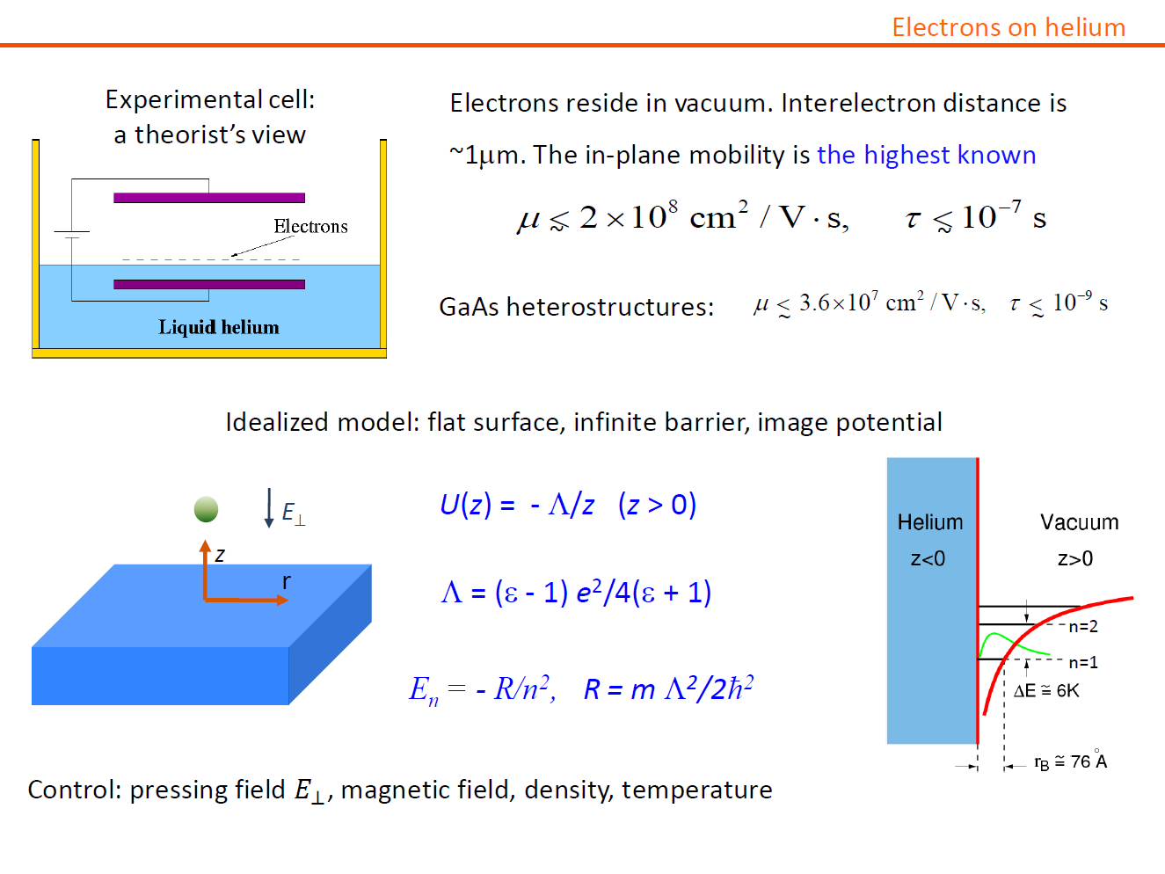

Slide 6
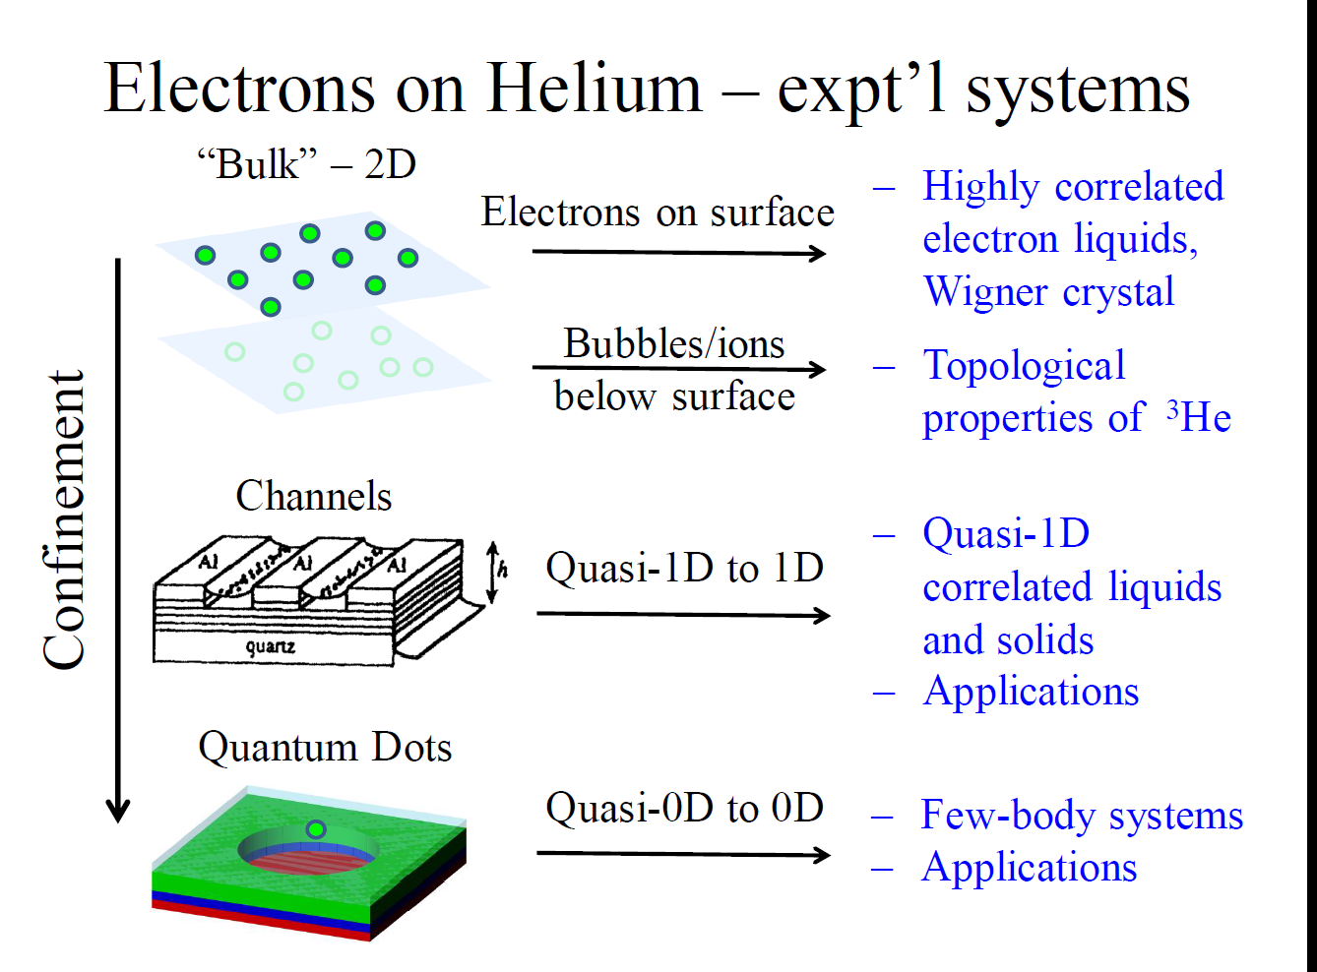

Slide 7
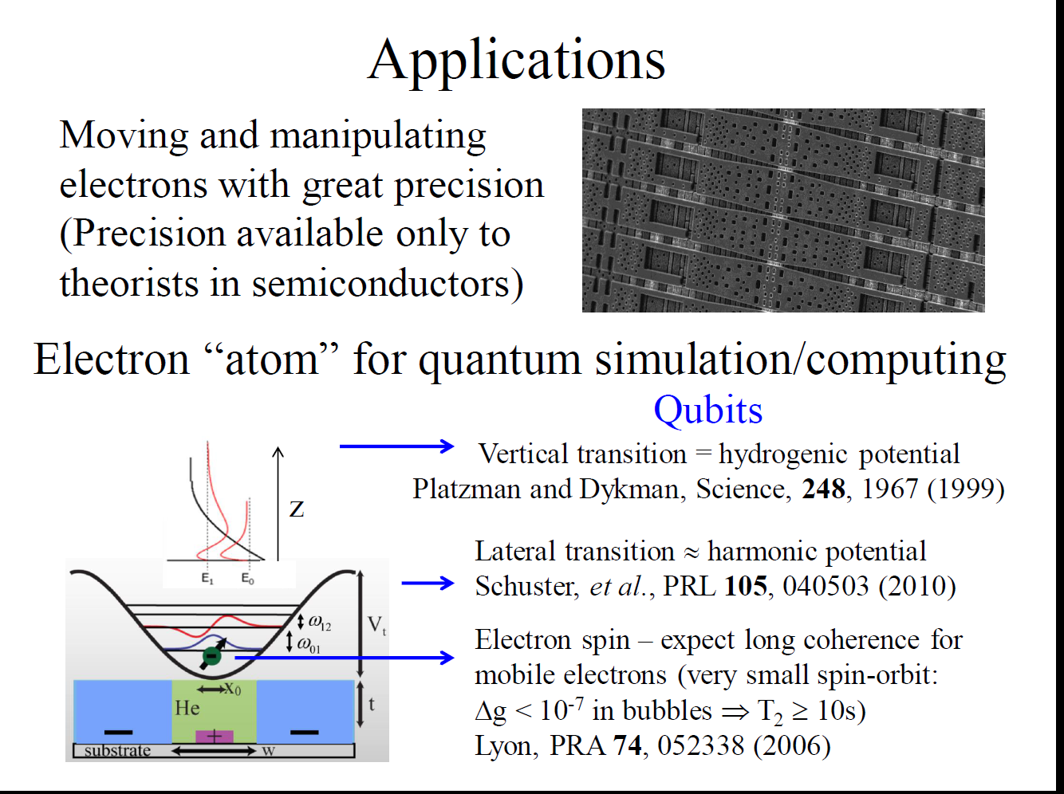

Slide 8
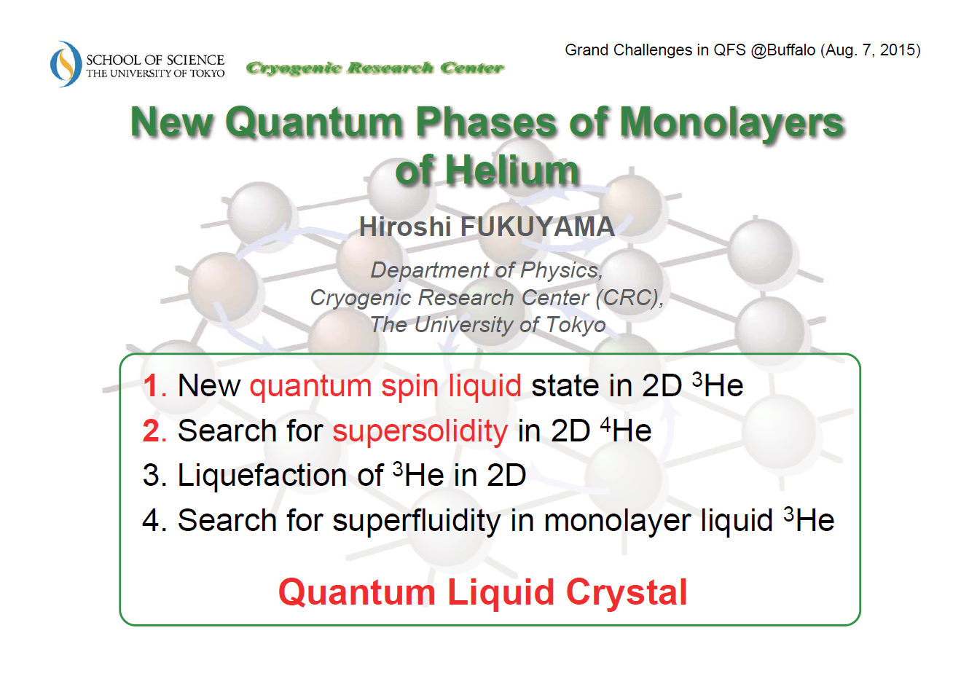

Slide 9
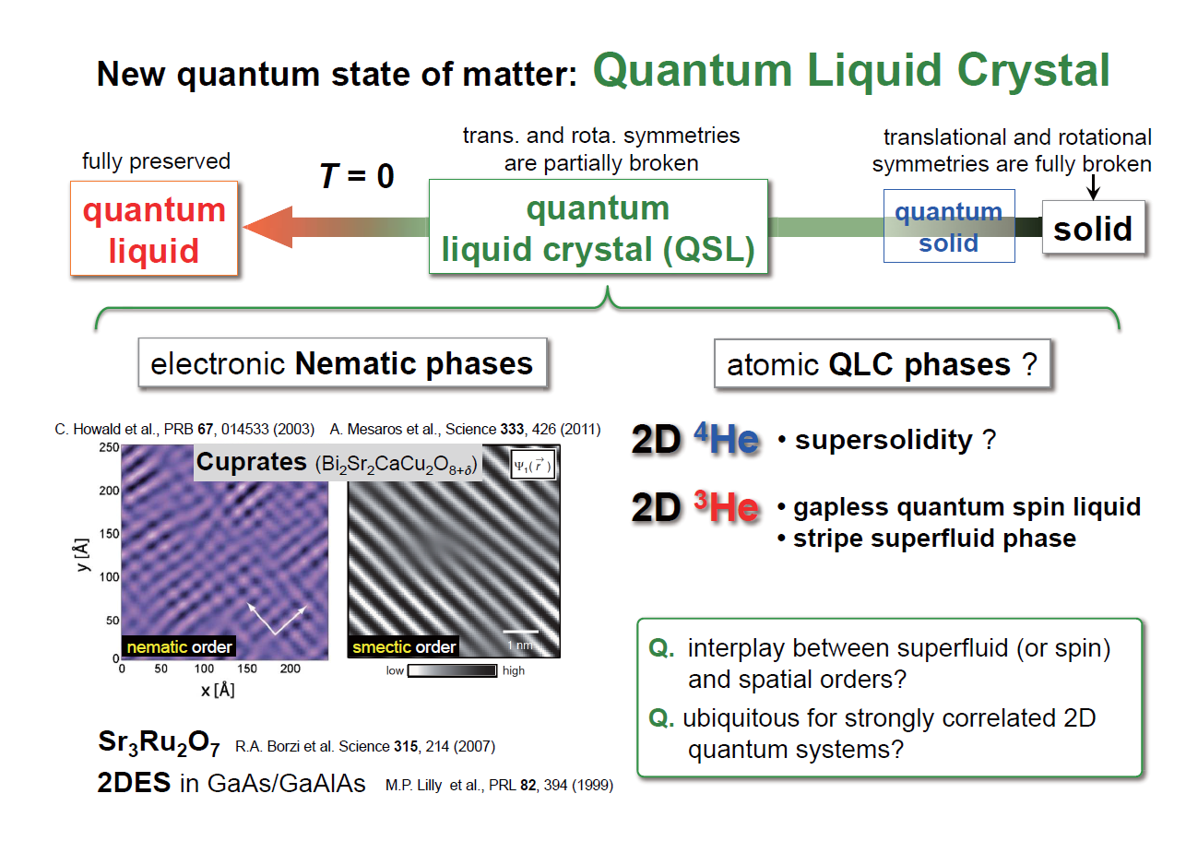

Slide 10
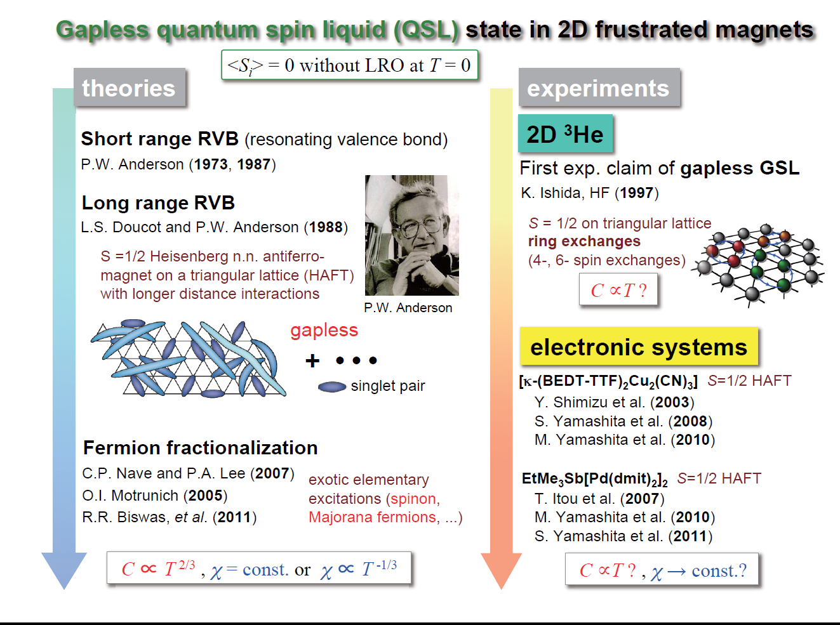

Slide 11
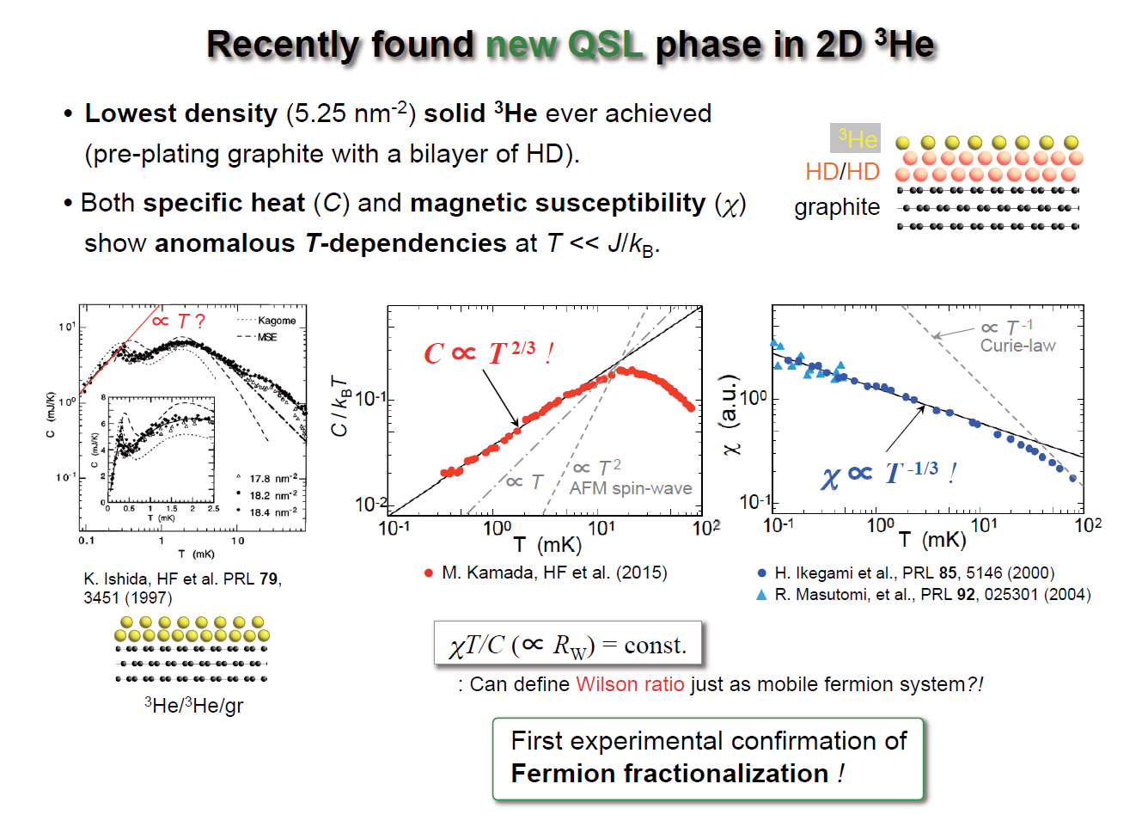

Slide 12
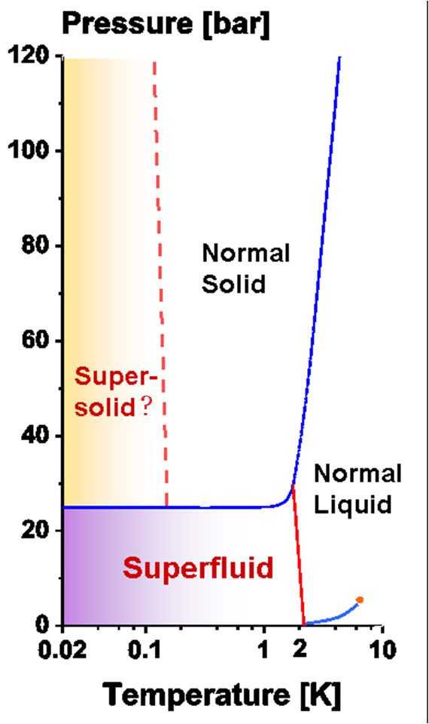
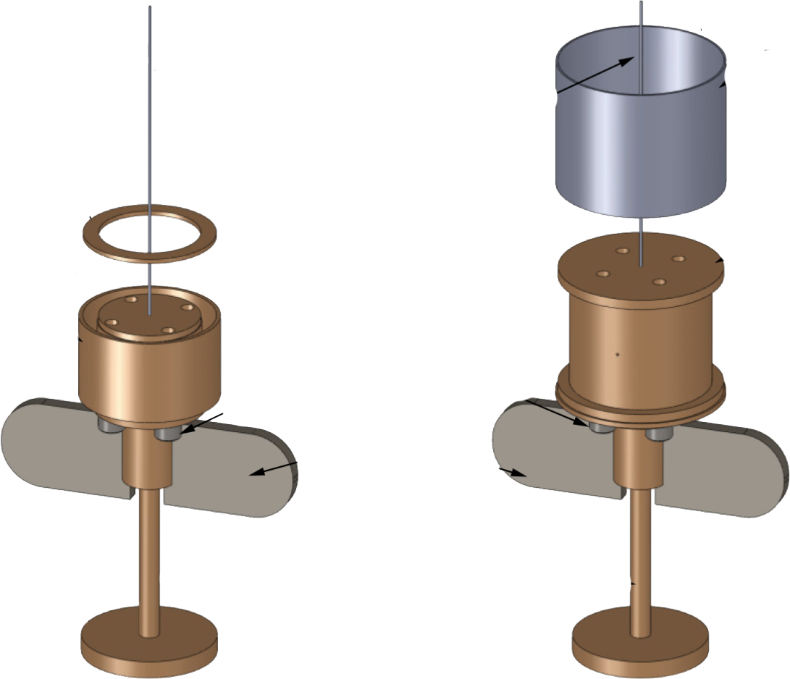
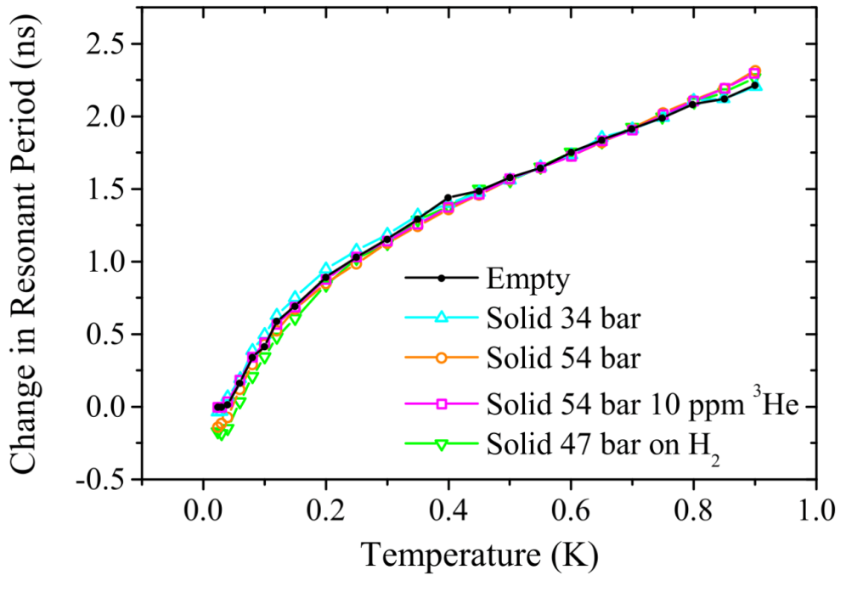
Supersolidity in ⁴He ?
Torsional oscillator experiments between 2004 and 2012
reported possible evidence of superfluid-like behavior
in solid helium.
Measurements since 2012 in carefully designed and
rigid TOs show that superfluid fraction,
if present is less than 1x10⁻⁵
?
So is this the end of supersolid?

Slide 13
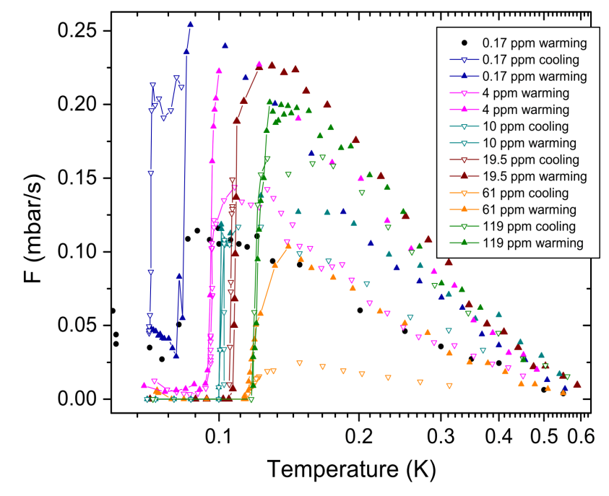
Superfluid fountain effect showing
mass flow through solid helium
samples
X
X
T1, P1
T2, P2
Superfluid in
porous Vycor
C1
TC
C2
Solid Helium,
~ 100 mK
120
96
4 cm
72
Mass flow (ng/sec)
UMass Sandwich
48
24
Vekhov and Hallock, PRL 113, 035302 (2014)
0
T(K)

Slide 14
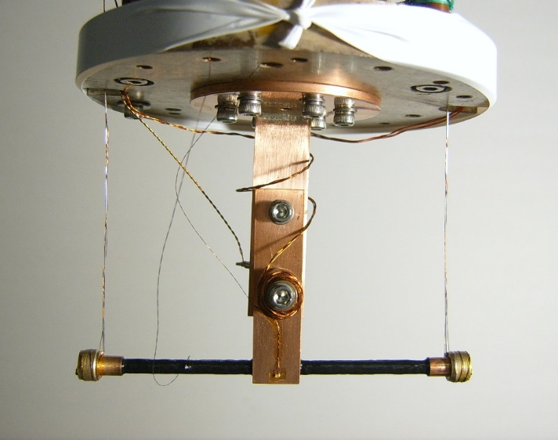
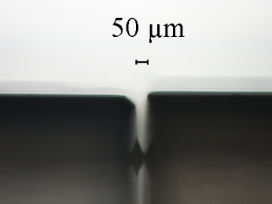
Penn State (thin) Sandwich
T ³
Vycor
Reproducible superfluid-like mass flow seen from 50 mK
until the melting T. T³ dependence is seen.
Note: superfluid density of liquid ⁴He shows T⁴ dependence.
Flow rate decreases with pressure but measureable up to 31 bar.
Flow rate is ~ 100 times larger than that found at Umass.
Space for bulk
solid ⁴He

