Slide 1


NSF Division of Materials Research (DMR) Update FY2017
Linda S. Sapochak
Division Director
National Academies’ CMMR Committee Meeting
March 6-7, 2017

Slide 2
Presentation Outline
NSF Organization and Changing Leadership
DMR Staff, Programs, Budget
Program Updates
Program Highlights
Strategic Research Directions
DMR “Partnership” Activities
National Academies’ CMMR Committee Meeting March 6-7, 2017

Slide 3
National Science Foundation
France Córdova
National Science Board
Director and
Deputy Director
Office of Diversity & Inclusion
Office of the General Counsel
Office of the
Inspector General
>$7.3 B FY16
Office of Integrative Activities
Office of International Science & Engineering
Biological
Sciences
Computer &
Information
Sci &Eng
Engineering
Geosciences
Office of Legislative & Public Affairs
$724M
$935M
$916M
$1.26B
Mathematical
& Physical
Sciences
Social,
Behavioral,
& Economic
Sciences
Education
& Human
Resources
Budget, Finance, & Award Management
Information
& Resource
Management
$1.35B
$272M
$884M
National Academies’ CMMR Committee Meeting March 6-7, 2017
Notes:
Numbers acquired from EIS BEP module (NSF Official Data)

Slide 4
Mathematical and Physical Sciences
MPS
Assistant Director (Acting)
James S. Ulvestad
Office of Multidisciplinary Activities
$1.35B
(FY 16 budget)
$35 M
Astronomical Sciences
Director (Acting)
Ralph A. Gaume
Chemistry
Director
Angela Wilson
Materials Research
Director Linda S. Sapochak
$247 M $246 M $310 M
Mathematical Sciences
Director
Michael Vogelius
Physics
Director
C. Denise Caldwell
ONE OF THE LARGEST DIVISIONS IN THE ENTIRE NSF
$277 M
$234 M
National Academies’ CMMR Committee Meeting March 6-7, 2017
Notes:
Updated

Slide 5
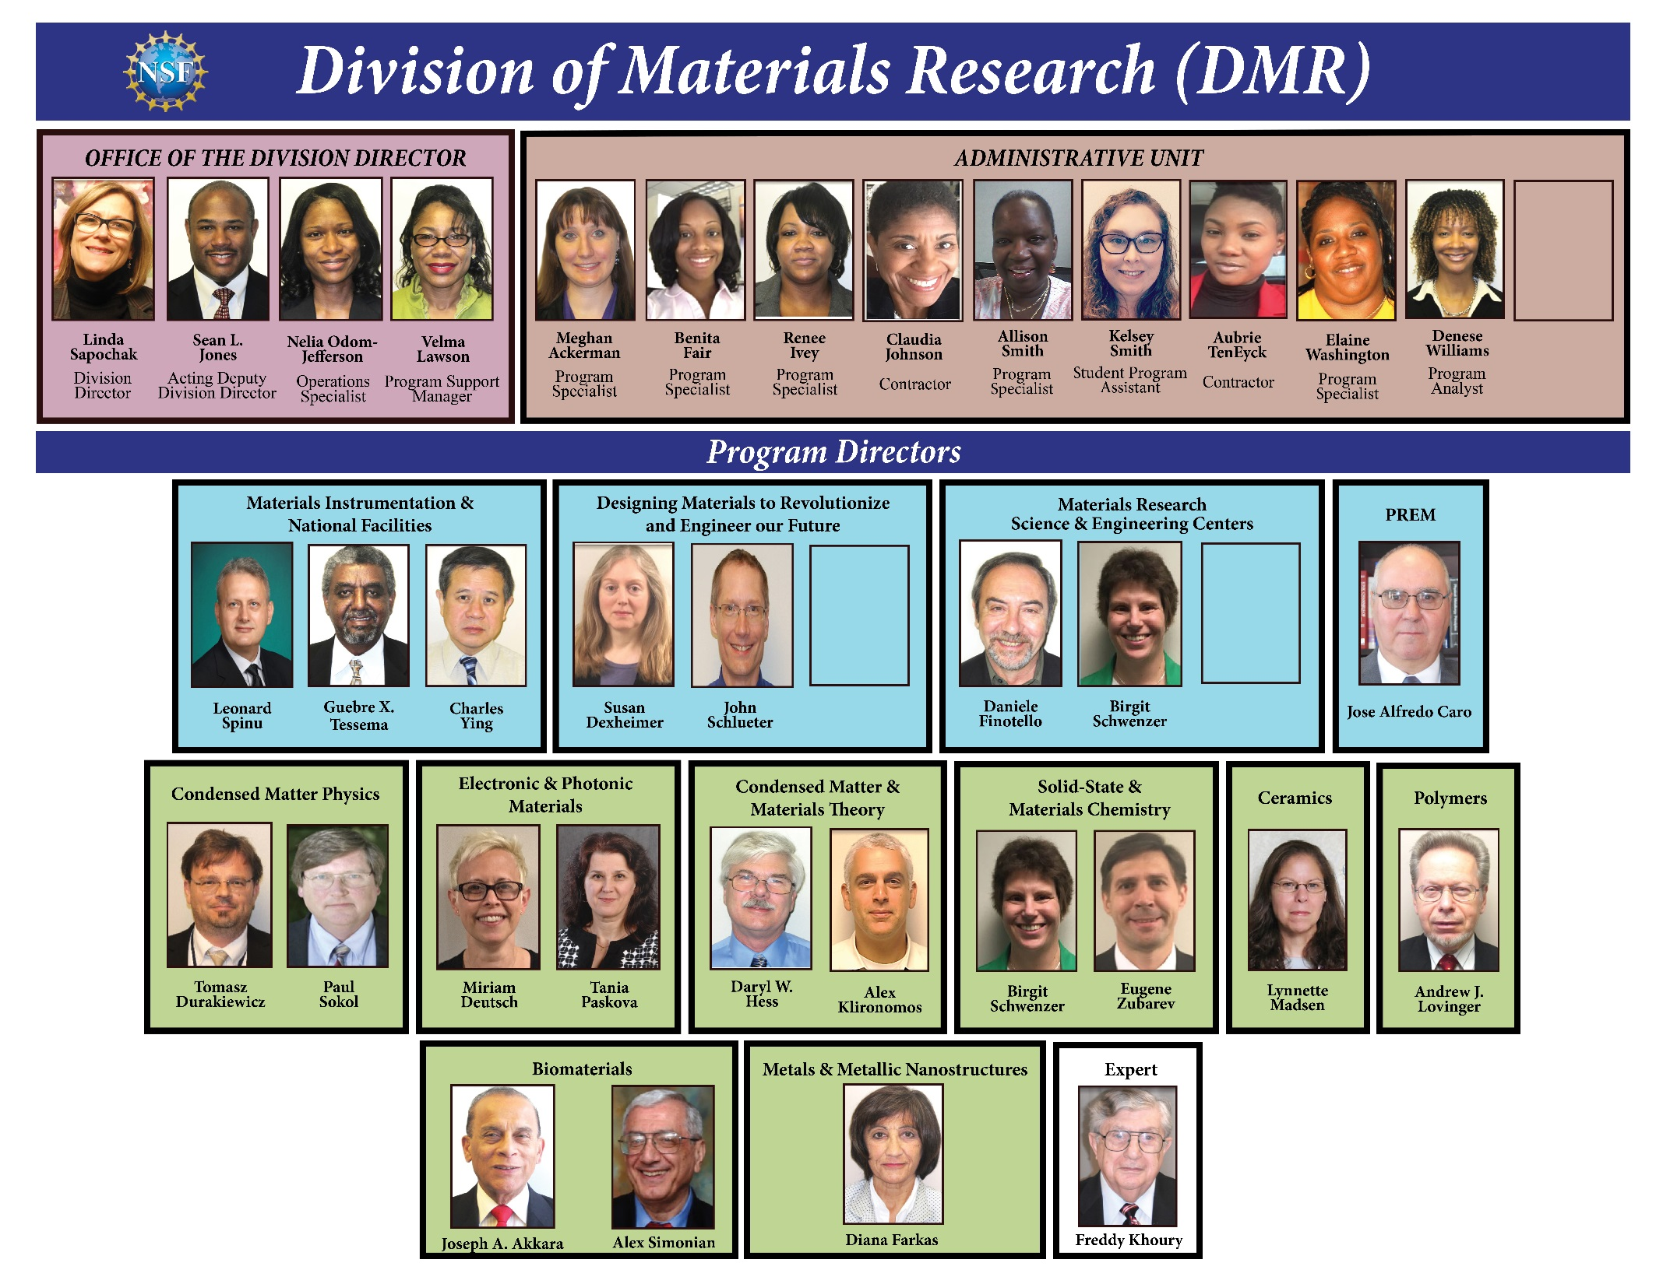
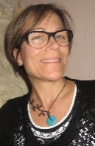

Data Science
50:50 Permanent:Rotator

Slide 6
DMR Budget
FY15 $307M
FY16 $310M
FY17E $310M
FY18 ???????
Initiatives Relevant to DMR
CIF21 - Cyberinfrastructure Framework for 21st Century
UtB – Understanding the Brain
SusChEM - Sustainable Chemistry, Eng, and Materials
INFEWS - Innovation at the Nexus of Food, Energy, and Water
MGI - Materials Genome Initiative
Advanced Manufacturing
Mid Scale Instrumentation
OP – Optics & Photonics
BioMaps – Interface of the Biological, Mathematical and Physical Sciences & Eng
National Academies’ CMMR Committee Meeting March 6-7, 2017

Slide 7
Program Updates
National Academies’ CMMR Committee Meeting March 6-7, 2017

Slide 8

DIVISION OF MATERIALS RESEARCH (DMR)
Topical Materials Programs
Centers & Teams
National Facilities & Instrumentation Program
Biomaterials
Ceramics
Electronic & Photonic Materials
Metals and Metallic Nanostructures
Polymers
Condensed Matter & Materials Theory
Condensed Matter Physics
Solid State and Materials Chemistry
Materials Research Science & Engineering Centers (MRSEC)
Cornell High Energy Synchrotron Source (CHESS)
National High Magnetic Field Laboratory (NHMFL)
Center for High Resolution
Neutron Scattering (CHRNS)
National Nanotechnology
Coordination Network (NNCI)
Materials Innovation Platforms (MIP)
Partnerships in Research & Education in Materials (PREM)
Cross-Cutting Activities
Diversity
International
Education
Designing Materials to Revolutionize & Engineer our Future (DMREF)
National Academies’ CMMR Committee Meeting March 6-7, 2017

Slide 9
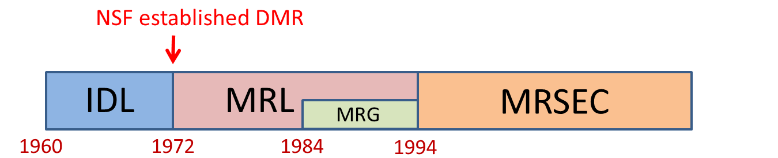
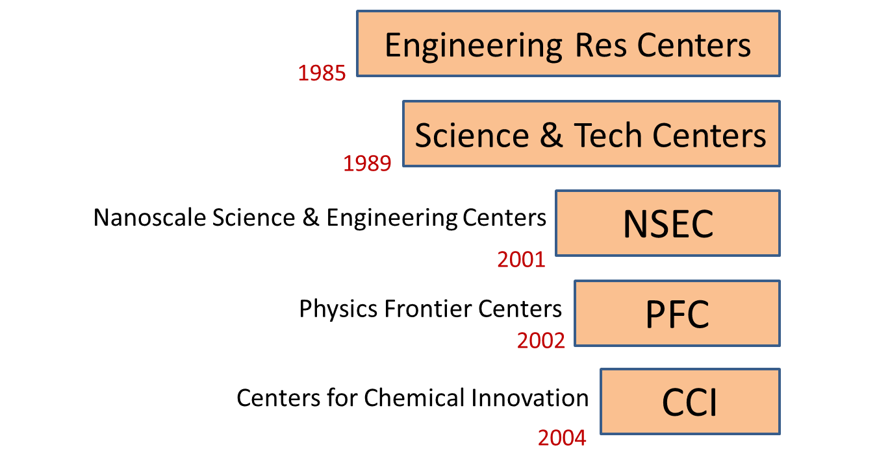
MRSEC & Other NSF Centers
2011
CEMRI
IDL/MRL University | Year Initiated
Cornell | 1960
Pennsylvania | 1960
Northwestern | 1960
Chicago | 1961
Harvard | 1961
MIT | 1961
Pennsylvania State | 1974
Ohio State | 1982
National Academies’ CMMR Committee Meeting March 6-7, 2017

Slide 10
MRSEC Evaluation
COV is deeply concerned regarding the sizes of awards. ………….It was also commented that the buying power of awards has diminished to the point where most graduate students are partially supported on multiple grants.
National Research Council (NRC) Report (The National Science Foundation's Materials Research Science and Engineering Program, Looking Back, Moving Forward, noted that the effectiveness of MRSECs was reduced in recent years as a result of increasing requirements without a commensurate increase in resources. The report continued by stressing that increasing the mean grant size is necessary to allow the program to fulfill its important mission goals.
COV encourages DMR to consider exploring ways to level the playing field for new MRSEC proposals while maintaining the highest quality scientific standards and expectations on broader impact.
Strategic planning in the MRSEC program office should help guide the portfolio development.
DMR’s RESPONSE
Limit IRGs to a maximum of 3; increase funding per IRG.
Suggested research areas of interest that would broaden the DMR/MRSEC research portfolio.
Removed sections of the proposal that could only be completed by existing re-competing.
Better emphasized/focused the role of research and the potential societal benefits at the Preliminary proposal stage.
National Academies’ CMMR Committee Meeting March 6-7, 2017

Slide 11
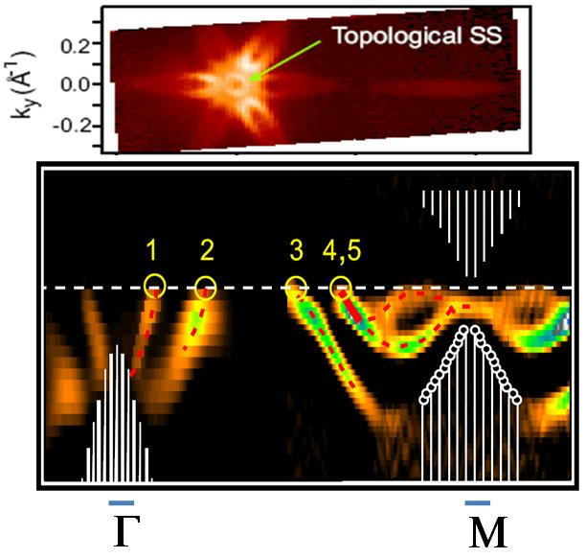
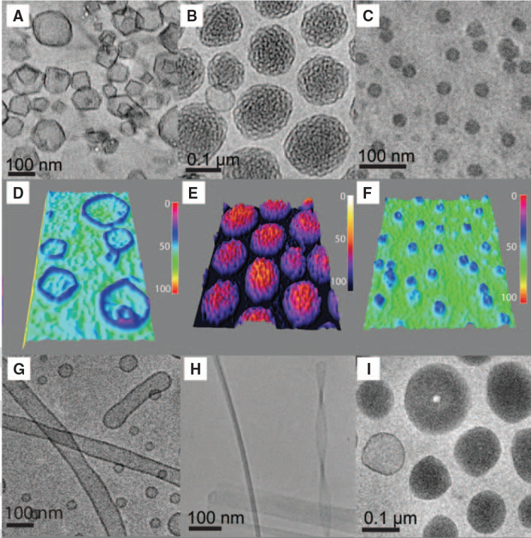
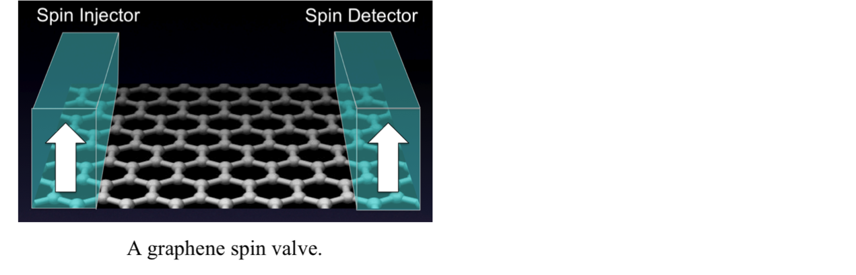
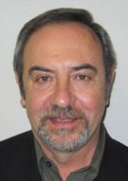



Materials Research Science & Engineering Centers (MRSEC)
FY17 competition began EARLY.
Pre-proposals received on 7/1/2016. 75 pre-proposals (206 IRGs)
Full proposals (by invitation) due 12/2/2016. 18 full proposals (43 IRGs)
Reverse Site Visit Invitations sent out 2/14/2017. 10 with 26 IRGs
RSVs start April-May, 2017.
Princeton MRSEC: 3D Topological Dirac Insulator with a Quantum Spin Hall Phase
Dan Finotello
Birgit Schwenzer
Miriam Deutsch
Susan Dexheimer
U Penn MRSEC: Self-assembly of Janus-dendrimers into Uniform Dendrimersomes
Ohio State MRSEC: World Record Performance of Graphene Spin Valves
National Academies’ CMMR Committee Meeting March 6-7, 2017
Notes:
NSF received 80 MRSEC preliminary proposals including 221 IRGs by the July 1, 2016 submission deadline. After checking for compliance with the solicitation and the NSF Grant Proposal Guide, five preliminary proposals were Returned Without Review (RWR)
The remaining 75 MRSEC preliminary center proposals include 206 IRGs; The IRGs were separated into 7 interdisciplinary topical panels and reviewed by 100 individuals. Overall a total 885 reviews were submitted corresponding to an average of 4.3 reviews per IRG.
The MRSEC Program recommended inviting 18 Full Proposal Submissions including 43 of 206 IRGs
After careful evaluation of 252 IRG separate reviews (nearly 6 reviews per IRG) provided by 121 reviewers, the MRSEC program recommended that 10 MRSEC proposals that include 26 IRGs (out of 43 submissions) should be invited for the April/May 2017 reverse site visits (RSV); 6 MRSECs have 3 IRGs while 4 MRSECs have 2 IRGs.

Slide 12
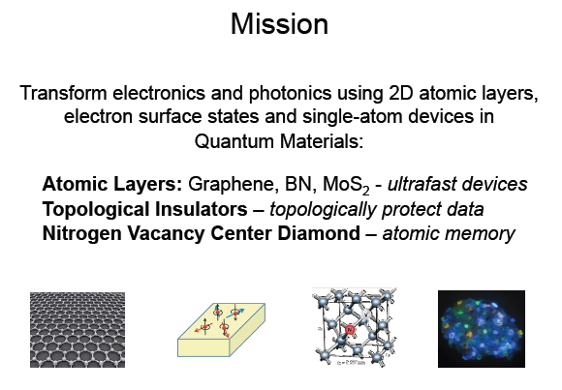
STC: CIQM Center for Integrated Quantum Materials
Harvard, MIT and Howard
Director: Robert Westervelt
PO: Dan Finotello
National Academies’ CMMR Committee Meeting March 6-7, 2017
Notes:
The carbon atoms in graphene form an 2D crystal of record strength, only 1 atom thick, which promises ultrafast atomic-scale devices.
In a topological insulator, electrons move along the surface with their spin locked at right angles to their momentum, topologically protecting data.
A diamond nitrogen-vacancy (NV) color center acts as an atomic memory site that can store a bit of information on a spin for > 1 ms at room temperature. In addition, an NV center is an ultra-sensitive magneto-sensor with ultra-high spatial resolution.
Color centers of different types in diamond - nitrogen is yellow, boron is blue and hydrogen is violet. These color centers will provide new approaches to atomic scale memory and sensing.

Slide 13

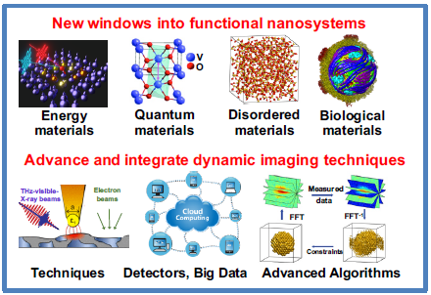
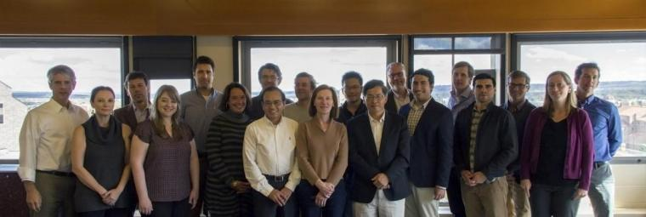






STC on Real-Time Functional Imaging
http://strobe.colorado.edu
Director: Margaret Murnane
Frederic Ives Medal / Quinn Prize
highest award of the Optical Society:
“for pioneering and sustained contributions to ultrafast science ranging from femtosecond lasers to soft x-ray high-harmonic generation to attosecond studies of atoms, molecules and surfaces.”
Vision: Transform imaging science and technology of functioning nano-systems
Advance dynamic nano-imaging methods using electrons, X-rays and nano-probes
Integrate these imaging methods to collectively provide new windows into functional nanosystems
Collaborate to address important scientific and technological challenges
PO: Charles Ying
National Academies’ CMMR Committee Meeting March 6-7, 2017
Notes:
This NSF Science and Technology Center, DMR-1548924, was established on October 1, 2016., together with 3 other centers: Center for Bright Beams (CBB) at Cornell University (managed by PHY), Center for Cellular Construction (CCC) at the University of California - San Francisco (managed by BIO/DBI), and Center for Engineering MechanoBiology (CEMB) at the University of Pennsylvania (managed by ENG/CMMI).
Science and Technology Center on Real-Time Functional Imaging is also called STROBE. Obviously, STROBE is not an acronym.
STROBE is directed by Margaret Murnane at the University of Colorado – Boulder. The Deputy Director is John Miao at UCLA.
The last bullet means collaboration among the center participants and also with domain scientists. The latter reflects a brief that the STC cannot do everything itself and its impacts would be greater through colloaboration.

Slide 14
Designing Materials to Revolutionize & Engineer our Future (DMREF)
Build the fundamental knowledge base needed to progress towards designing and making a material with a specific and desired function or property from first principles.
Accelerate materials discovery and development.
Collaborate and iterate “close the loop” between theory and experiment.
Aspire to enable “data-driven” materials research.
Synthesis
Experiment
Theory
DATA
Funding rate is ~12%.
John Schlueter
Susan Dexheimer
National Academies’ CMMR Committee Meeting March 6-7, 2017
Notes:
114 Projects
423 PIs, 64 women, 45 EPSCoR
$132 M total investment
525 Publications, 2392 Citations, 120 pubs w/ 2+ PIs, 30 w/ 3+ PIs

Slide 15
FY17 DMREF Solicitation Goes Biennial
NSF Solicitation 16-613
Major Changes: Biennial, Guidelines for Renewals, Target Areas
Submission Window: January 3-17, 2017
Awards are expected to range from $250,000 - $400,000 per year for a duration of 3 or 4 years, totaling $750,000 to $1,600,000.
Estimated number of awards: 20 - 25, depending on availability of funds
Total anticipated funds: $29.4 M
GOALI proposals may be submitted to the DMREF Solicitation
National Academies’ CMMR Committee Meeting March 6-7, 2017

Slide 16
NSF’s Big Ideas
Proposals that align with NSF’s Big Ideas are encouraged, but not required.
Shaping the New Human Technology Frontier
Harnessing Data
Quantum Leap
Understanding the Rules of Life
Navigating the
New Arctic
Windows on the
Universe
National Academies’ CMMR Committee Meeting March 6-7, 2017

Slide 17


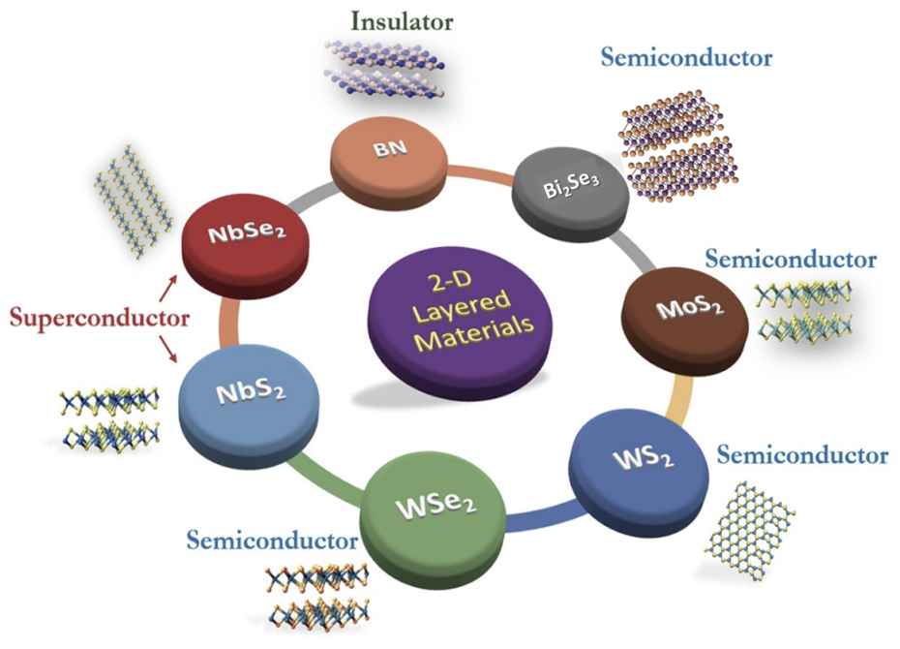
Director: Joan Redwing
2D chalcogenide monolayers, surfaces and interfaces are emerging as a compelling class of systems with transformative new science that can be harnessed for novel device technologies in next-generation electronics.
Focus: 2-dimensional chalcogenide materials for future electronics
e.g., Can theory model growth kinetics and guide materials synthesis?
Fundamental growth processes of 2D systems
Conformal and uniform coverage of 2D systems
Large area growth
Hybrid MBE
Chalcogenide MOCVD
CVT, Bridgman
In-situ measurement
insights into growth
STM/AFM
ARPES
4-probe
Raman, PL
DFT
Reactive FF
Monte Carlo
Phase field
characterization & interpretation
Find the 2DCC at www.mip.psu.edu

Slide 18



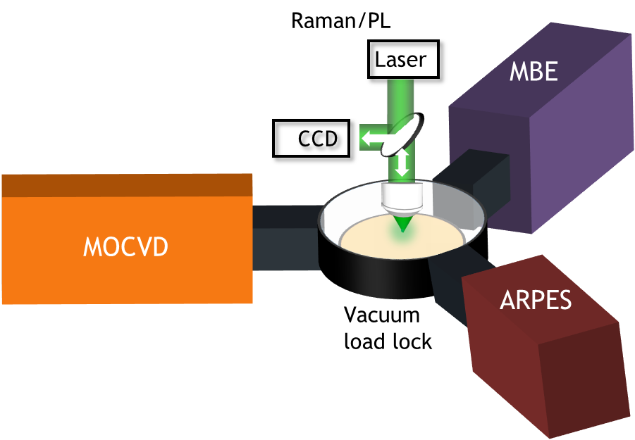
Oxide-based multi-layer structures with a range of 2D material systems such as oxides, chalcogenides and graphene for novel electronic and magnetic functionality. Major bulk crystal growth effort.
Focus: interfacial materials, combining oxides & 2D materials, for valleytronics & spintronics
e.g., Can we design and create new interfacial materials by “breaking” Gibbs’ & Pauling’s rules?
Director: Darrell Schlom
(Congratulations Darrell, NAE member!)
High-pressure 300+ ATM (supercritical fluid) floating-zone growth
Mass spectrometry and computed tomography during bulk crystal growth
Integrated MOCVD + MBE + ARPES
High sensitivity, high dynamic range pixel array detector for quantitative mapping of E and B fields with sub-nm resolution
Stable cryo-stages for STEM and STEM-EELS at 20 K and 80-1200 K
www.paradim.org
Notes:
MRS Fall Meeting, Boston
Nov. 27 – Dec. 3, 2016

Slide 19
Topical Materials Research Programs
Biomaterials
Ceramics
Electronic & Photonic Materials
Metals and Metallic Nanostructures
Polymers
Condensed Matter & Materials Theory
(Computational & Data-Driven Materials Research)
Condensed Matter Physics
Solid State and Materials Chemistry
FY2017 Solicitations for “open” unsolicited proposals windows
FY17 (51 proposals), previous 3-yr. ave. (147)
FY17 (202), previous 3-yr. ave. (287)
Submission constraints
3 strikes and “out”on resubmissions.
Reduce multiple submissions in DMR .
CMMT includes CDMR, with more emphasis on programs working together.
Encouraging the best ideas rather than all the “reviewable ones” .
National Academies’ CMMR Committee Meeting March 6-7, 2017

Slide 20
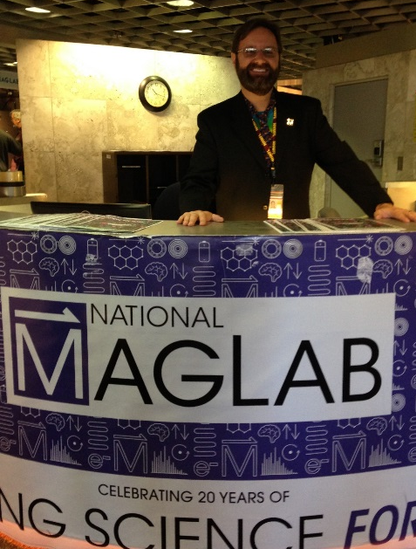
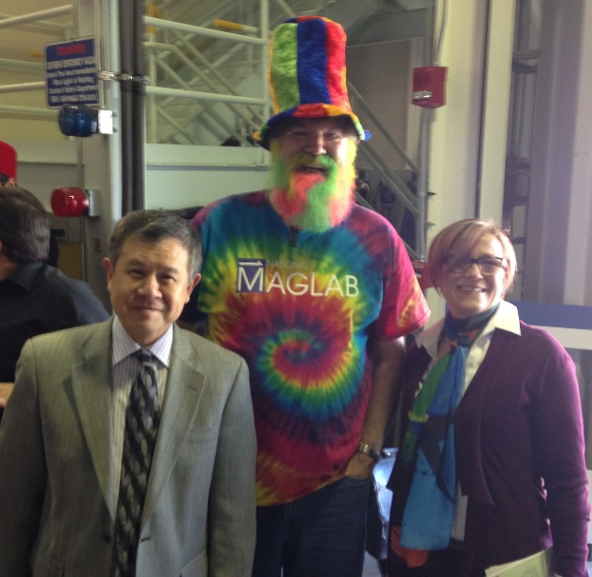
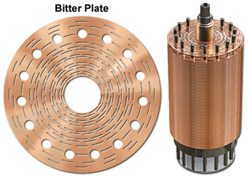
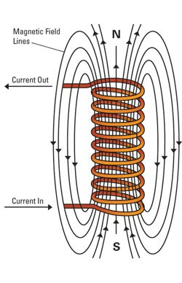
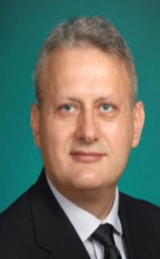

National Facilities and Instrumentation (NaFI): National High Magnetic Field Laboratory
Renewal proposal received in June 2016.
Site-visit review in October 2016.
Quantum Materials and Magnet Development major science drivers influenced by user community and NAS study.
High Priority, but budget cuts will impede sufficient investment.
2022 MRFEC opportunity; threshold lowered to $70M. Workshop being planned – need for ultra-high magnetic fields for a “quantum leap”. (Led by Phuan Eng/Princeton for Fall 2017).
France Cόrdova will visit MagLab this month!
Leonard Spinu
Charles Ying
National Academies’ CMMR Committee Meeting March 6-7, 2017

Slide 21
Program Highlights
National Academies’ CMMR Committee Meeting March 6-7, 2017

Slide 22




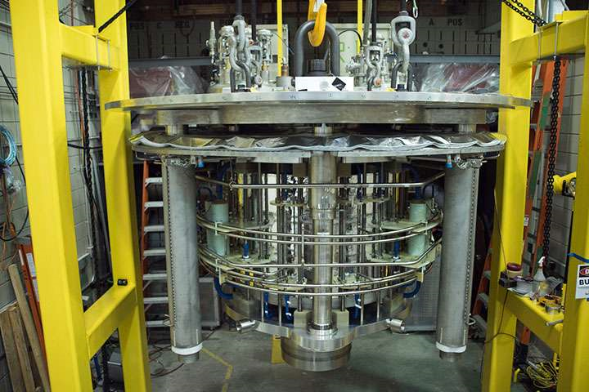
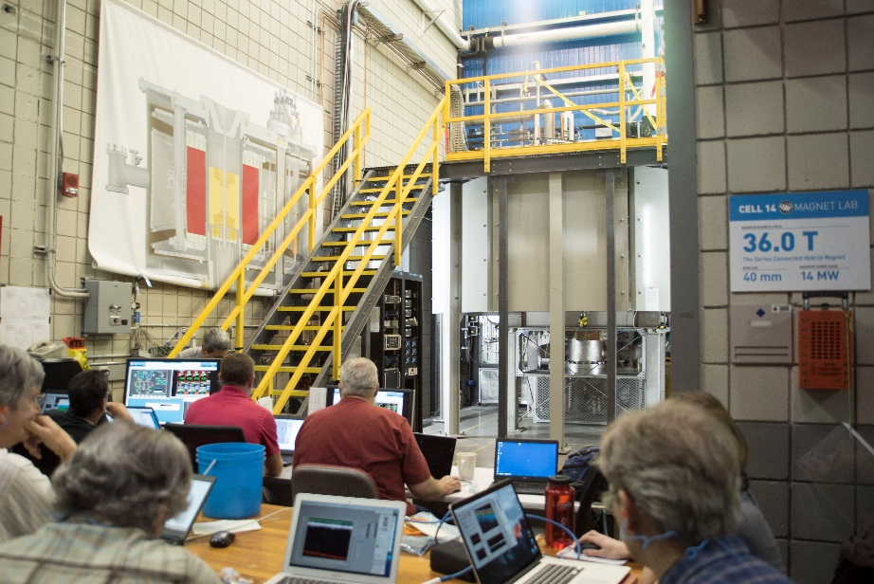
DMR-Supported MagLab Makes New World Record!
Strongest magnet (36 T) in the world for NMR spectroscopy.
Decade of planning, designing and building through DMR - Mid-Scale Instrumentation Program investments of $14.8M.
Revolutionary Technology Development - series connected hybrid magnet reaches very high magnetic fields which remain stable and homogeneous.
Boosted NMR sensitivity for study of a wider range of elements.
“Opens a door of discovery” making the highest magnetic fields available to not only physicists, but to chemists and biologists.
National Academies’ CMMR Committee Meeting March 6-7, 2017

Slide 23
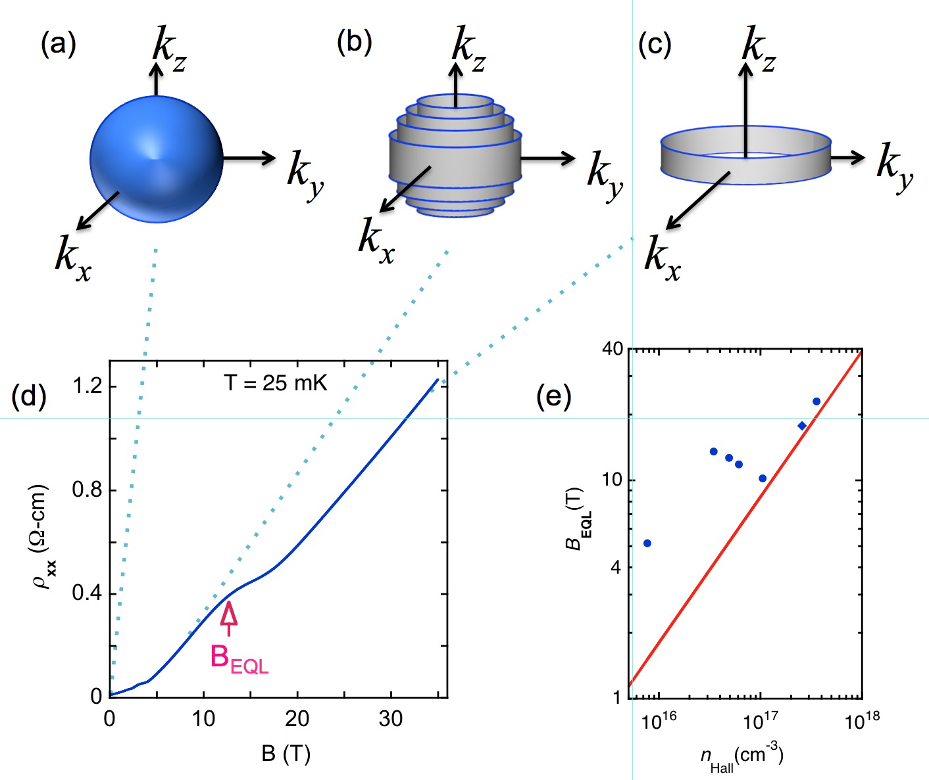
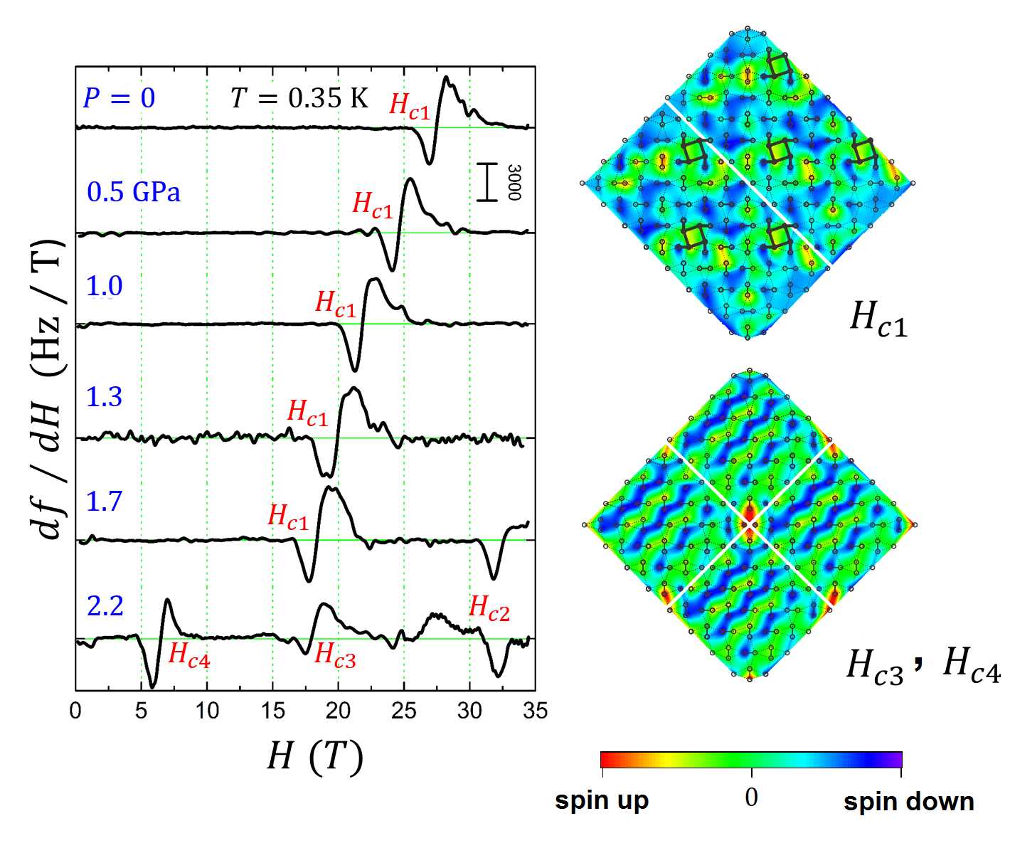
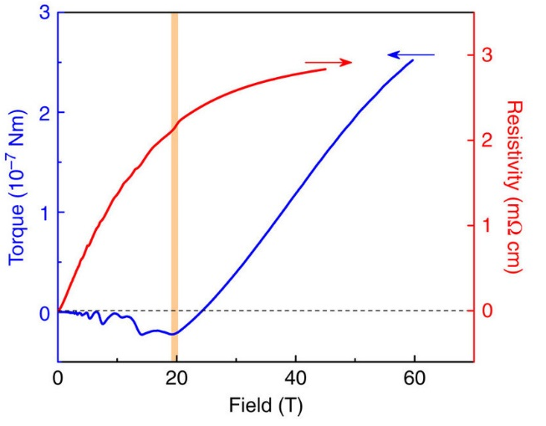
National High Magnetic Field Laboratory
Extreme Quantum Limit
of Electrons
in Strontium Titanate
Crystallization of Spin
Superlattices with
Pressure and Field
Magnetic Torque Anomaly
in the Quantum Limit
of Weyl Semimetals
A. Bhattacharya¹, B. Skinner^{1,2}, G. Khalsa³, A. Suslov ⁴
1. Argonne National Laboratory; 2. MIT; 3. NIST; 4. MagLab
Nature Commun. 7, 12974 (2016). DOI: 10.1038/ncomms12974.
P. J.W. Moll¹, A.C. Potter¹, N. L. Nair¹, B. J. Ramshaw^{2,3}, K. A. Modic^{2,3}, S. Riggs^{2,3}, B. Zeng^{2,3},
N.J. Ghimire², E.D. Bauer², R. Kealhofer¹, F. Ronning², J.G. Analytis¹
1. UC-Berkeley, 2. LANL, 3. MagLab
Nature Commun. 7, 12492 (2016), doi:10.1038/ncomms12492
S. Haravifard¹, D. Graf², A.E. Feiguin³, C.D. Batista⁴, J.C. Lang5, D.M. Silevitch⁶, G. Srajer⁵, B.D. Gaulin⁷, H.A. Dabkowska⁷, T.F. Rosenbaum⁶
Duke Univ.; 2. MagLab and FSU; 3. Northeastern Univ.; 4. Univ. of Tenn.; 5. ANL; 6. California Inst. of Tech.; 7. McMaster Univ.
Nat. Commun. 7, 11956 (2016). doi:10.1038/ncomms11956.
National Academies’ CMMR Committee Meeting March 6-7, 2017
Notes:
Extreme Quantum Limit of Electrons in Strontium Titanate
Anand Bhattacharya1, Brian Skinner1,2, Guru Khalsa3, Alexey Suslov4
1. Argonne National Laboratory; 2. MIT; 3. NIST; 4. National High Magnetic Field Laboratory
Research supported by the NSF and DOE [A. Bhattacharya & B. Skinner (DoE BES DE-AC02-06CH11357); B. Skinner (DoE BES DE-SC0001088)]
Left Figure Captions:
a) The Fermi sphere that describes the energy of the electrons in strontium titanate (STO) is (b) transformed by magnetic fields into Landau levels. (c) In the extreme quantum limit (EQL) at high magnetic fields, only one, the lowest Landau level, is occupied by electrons. (d) Magneto-resistance of STO, showing the transition to the EQL at the magnetic field, B_{EQL} , (e) which depends on the electron density in the sample.
Narrative:
A collaborative work of scientists from Argonne National Laboratory (ANL), MIT and NIST recently probed for the first time the extreme quantum limit (EQL) state in lightly-doped bulk strontium titanate (STO) crystals by going to very low temperatures (20 mK) and using a suite of the wide range of magnets available at the NHMFL’s DC Field Facility.
When an electronic system is subjected to a high magnetic field such that the cyclotron energy of the electrons becomes much larger than the Fermi energy, the system enters EQL which is a new kind of quantum state. The nature of the EQL state has been debated theoretically for over half a century. However, experiments to measure its properties have been hard to achieve since for a typical electronic material the magnetic fields required to see this state are so large that they would naturally occur only inside neutron stars. This research elucidates the properties of the EQL state using the NHMFL's high steady field capapabilities.
The STO crystals grown at ANL expressly for this experiment has the unusual property of allowing electricity to flow even though its electrons are extremely sparse and slow moving. The slow motion of the electrons makes them susceptible to magnetic forces. A crystal placed in the intense magnetic field was cooled down almost to absolute zero, and electrons formed the extreme quantum limit state. It was found that at these conditions the usual "sea" of free-flowing electrons dries up into dense, isolated "puddles”.
The combination of very low temperatures produced by dilution refrigerators and high magnetic field available at the NHMFL was essential for observing the extreme quantum limit of the electron system and for making the precise measurements of the electron properties of this extreme quantum state.
The results were published in Nature Communications. The paper acknowledges NSF support for NHMFL.
Bhattacharya, A.; Skinner, B.; Khalsa, G.; Suslov, A., Spatially inhomogeneous electron state in the extreme quantum limit of strontium titanate, Nature Communications 7, 12974 (2016). DOI: 10.1038/ncomms12974.
_______________________________________________
Magnetic Torque Anomaly in the Quantum Limit of Weyl Semimetals
Philip J. W. Moll1, Andrew C. Potter1, Nityan L. Nair1, B. J. Ramshaw2,3, K. A. Modic2,3, Scott Riggs2,3, Bin Zeng2,3,
Nirmal J. Ghimire2, Eric D. Bauer2, Robert Kealhofer1, Filip Ronning2, James G. Analytis1,
1University of California at Berkeley, 2. Los Alamos National Laboratory, 3. MagLab
Research funded by the NSF (NSF DMR-1157490); Office of Naval Research (No. N00014-15-1-2674),;Gordon and Betty Moore Foundation’s EPiQS Grant (GBMF4374),
Center Figure Caption:
The low-field magnetic torque (blue data) follows conventional oscillatory behavior up to the quantum limit (vertical orange bar). Above the quantum limit, the torque changes sign and grows dramatically. In contrast to the torque, note that there is no change in behavior of the magnetoresistance (red data) in the quantum limit beyond the last quantum oscillation.
Narrative:
A collaborative work of US (University of California at Berkeley, Los Alamos National Laboratory and NHMFL) and German (Max Planck Institute, Dresden) scientists provided recently a direct experimental method to identify and distinguish Weyl and Dirac fermions both from each other and from conventional electron behavior.
Weyl and Dirac semimetals are part of newly discovered quantum materials that are three dimensional analogues of graphene with exotic properties derived from the topological nature of their energy bands. The importance of topological materials was recognized by the 2016 Nobel Prize in Physics awarded to David Thouless, Duncan Haldane and Michael Kosterlitz ”for theoretical discoveries of topological phase transitions and topological phases of matter”.
Electrons in Weyl and Dirac systems behave as massless quasi-particles because they exhibit linear energy-momentum dispersion relationships. The research interest is fuelled by the technological potential of topological materials in devices exploiting the relativistic nature of the electrons, such as ultra-high mobilities, and the massless behaviour of charge carriers. Given the wealth of novel phenomena observable in these materials, it is important to find clear experimental signatures that can help identify new compounds as topological semimetals.
In this study a response in the magnetic properties of NbAs at high magnetic fields that is a clear signature of its topological nature was discovered. In materials with a significant fraction of Weyl electrons at the Fermi level, the Weyl electrons dominate the magnetic response, giving rise to a sign reversal in the magnetic torque at high magnetic fields. In fact, even if the background magnetization is dominated by magnetic order or strong diamagnetism from large numbers of trivial electrons, the torque anomaly will still be visible in high magnetic fields. High-field torque measurements thus provide a robust, direct and effective experimental tool to identify new topological materials, and to distinguish experimentally between Weyl and Dirac fermions. Resistance and torque measurements of single crystal NbAs were performed in both pulsed and DC magnetic fields.
In order for the torque anomaly to be observed, the experiment must access very high magnetic fields that go beyond the quantum limit of the material. This study was made possible by using the NHMFL's 45 T hybrid DC magnet (resistivity) and 65 T pulsed magnet (torque).
The results were published in Nature Materials. The paper acknowledges NSF support for NHMFL.
P.J.W. Moll, A.C. Potter, N.L. Nair, B.J. Ramshaw, K.A. Modic, S. Riggs, B. Zeng, N.J. Ghimire, E.D. Bauer, R. Kealhofer,.F. Ronning, and J.G. Analytis, “Magnetic torque anomaly in the quantum limit of Weyl semimetals,” Nature Communications 7, 12492 (2016), doi:10.1038/ncomms12492
_____________________
Crystallization of Spin Superlattices with Pressure and Field
S. Haravifard1, D. Graf2, A.E. Feiguin3, C.D. Batista4, J.C. Lang5, D.M. Silevitch6, G. Srajer5, B.D. Gaulin7, H.A. Dabkowska7, T.F. Rosenbaum6
Duke University; 2. MagLab and Florida State University; 3. Northeastern University; 4. University of Tennessee; 5. Argonne National Lab; 6. California Institute of Technology; 7. McMaster University
Research supported by NSF (DMR-1157490, DMR-1206519, DMR- 1339564); DOE (NNSA DE-NA0001979, NEAC02-06CH11357); Duke Endowment);
Right Figure Captions:
Pressure-driven tuning of bosonic crystal states in layered model magnet SrCu2(BO3)2. (Left) Tunnel-Diode Oscillator measurements for a series of pressures. (Right) Simulations of bosonic crystal profiles at magnetization plateaus, as a function of spin interactions
Narrative:
Recent results obtained at the NHMFL's DC Field Facility in the area of quantum magnets have provided an innovative approach to the creation of quantum condensates and crystals.
In quantum mechanics, particles are classified based on their intrinsic spin: half-integer-spin fermions and integer-spin bosons. Under the right environmental conditions, bosonic particles can either condense into a single collective state, or form bosonic crystalline superstructure patterns. Scientists show how the combination of cryogenic temperatures, high magnetic fields and high pressures reveals the complex interplay of competing quantum interactions, leading to emergence of a sequence of tunable bosonic superstructure patterns in model magnetic materials.
Quantum particles interacting collectively can form liquids and solids that have unusual properties such as flowing without friction or resistance to disruption of their ordered, frozen state even under a changing magnetic field. Discovery of the new bosonic superstructure crystals open the tantalizing prospect of finding other emergent exotic phases of matter including the supersolid phase, a hybrid state where a solid crystal appears to move like a superfluid.
The authors of this work have performed magnetization measurements on a Cu-based model layered spin system at magnetic fields up to 35 Tesla at temperatures below 500 mK and with applied pressures exceeding 2 GPa to probe the new collective states that emerge under these conditions. The experimental results, complemented by theoretical simulations, demonstrate that the interplay between competing spin interactions and the crystalline lattice contribute to the emergence of new magnetization plateaus associated with fractional crystallization of bosons in ordered superstructure patterns, leading to new quantum phases (Figure 1).
Bosonic crystals emerge through a quantum phase transition where magnetic field tunes the density of bosons and hydrostatic pressure regulates the underlying interactions. The NHMFL provides researchers with unique capabilities to simultaneously collect data at magnetic fields more than 500,000 times the earth’s field, under pressures more than 20,000 times atmospheric pressure, and at temperatures near absolute zero, enabling discovery of the formation of new types of bosonic crystal patterns.
The results were published in Nature Materials. The paper acknowledges NSF support for NHMFL.
S. Haravifard, D. Graf, A.E. Feiguin, C.D. Batista, J.C. Lang, D.M. Silevitch, G. Srajer, B.D. Gaulin, H.A. Dabkowska, T.F. Rosenbaum. Crystallization of spin superlattices with pressure and field in the layered magnet SrCu2(BO3)2. Nat. Commun. 7, 11956. doi:10.1038/ncomms11956.

Slide 24
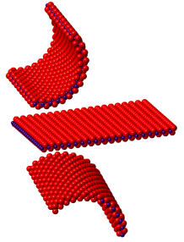
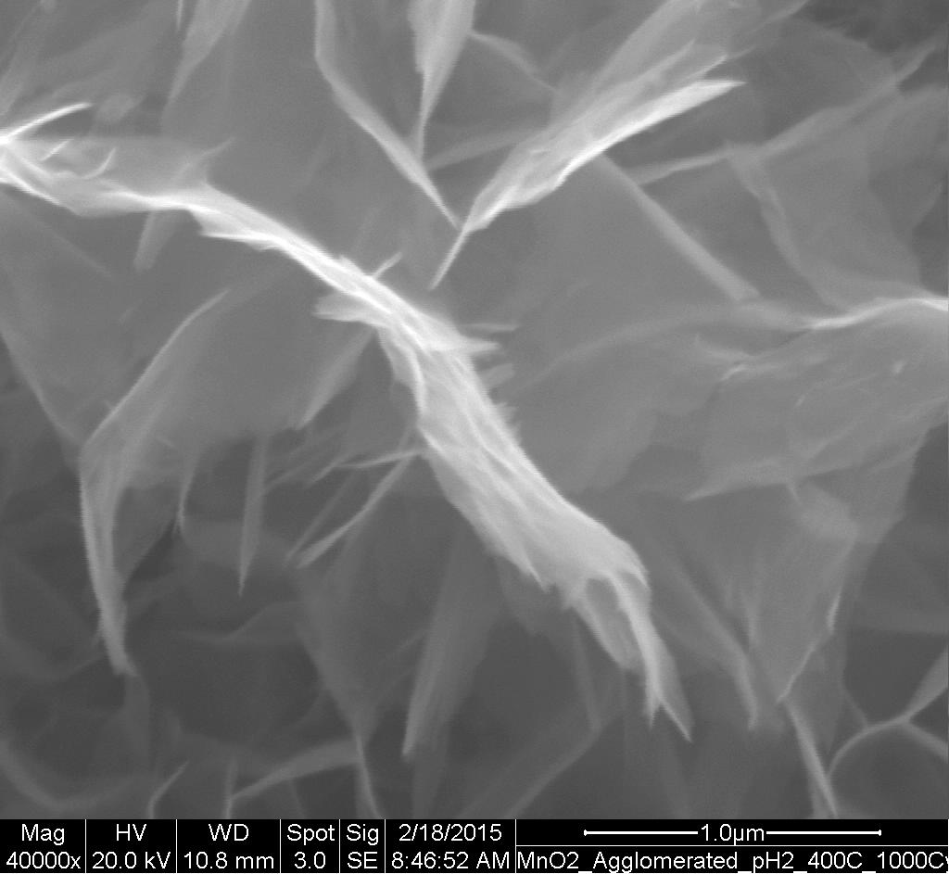

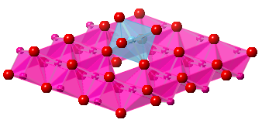
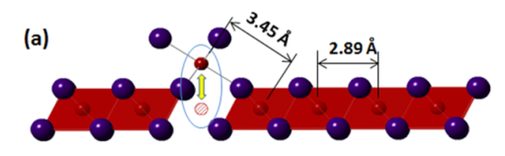
Defects in 2-D ceramic nanosheets quantified using synchrotron radiation Scott T. Misture, Alfred University, DMR 1409102
Outcome: Partial reduction of MnO₂ nanosheets yields intentionally-formed defects that increase the electrical charge storage capacity by a factor three (to 320 F/g) vs. H_{x}MnO₂.
1st quantitative link of defects to electrochemical charge storage, where the improved capacitance is a result of “surface Frenkel” defects that form in the MnO₂ nanosheets.
Impact: Demonstrates that defect engineering is feasible, thus enabling design of properties at two levels: nanoscale for surface area and quantum confinement, and atomic scale defects for functionality.
Explanation: Alkali-ion intercalation is improved dramatically, as is the charge transfer and cycling fade, when defects are introduced.
Exfoliation of layered oxides
Bottom-up
assembly
+
1μm
Introduce controlled defects
Quantify Mn defects:
Charge of Mn defect: X-ray absorption studies at CHESS
Geometry of defects: X-ray pair distribution functions using APS
P. Gao, et al., Nat. Commun. 8, 14559 doi:10.1038/ncomms14559 (2017).
National Academies’ CMMR Committee Meeting March 6-7, 2017
Notes:
The aim is to understand electrochemical intercalation (of H ions, Na ions, etc.) in oxide nanosheets where the exceedingly thin 2-D layers provide a fundamentally different intercalation host than a bulk particle. We show for the first time that defects in MnO2 nanosheets improve not only the charge storage capacity but also markedly decrease the charge transfer resistance. The capacity increases from about 150 F/g to over 300 F/g when we reduce the nanosheets intentionally to form out-of-plane Mn ions that we term “surface Frenkel” defects. The charge transfer resistance is reduced from about 50 ohms for the ‘perfect’ nanosheets to below 5 ohms for the defective nanosheets. The latter is commercially feasible, while the former is not. The X-ray PDF is essentially a radial distribution function – peak locations indicate interatomic distances and intensities reflect the numbers of pairs scattering, so even qualitative analysis of the data confirms the out-of-plane Mn ions at the sheet surfaces, while X-ray absorption spectroscopy gives reliable quantification of the Mn oxidation states.

Slide 25
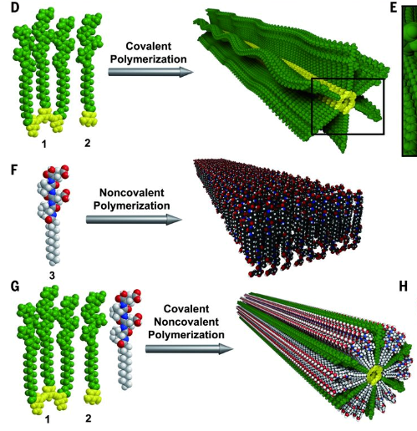
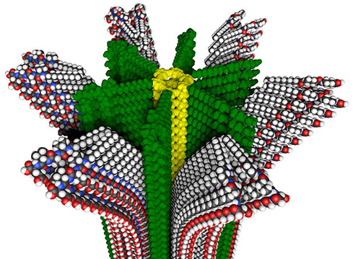
UNIQUE KIND OF POLYMER WITH
REMOVABLE SUPRAMOLECULAR COMPARTMENTS
Sam Stupp (Northwestern U.), DMR-1508731
Science 351, 497 (2016). https://news.northwestern.edu/stories/2016/01/new-polymer.html
First-ever combination of covalent and non-covalent polymerizations leading to reversibly self-assembled hybrid materials.
The polymer has internal compartments -- one rigid, the other soft.
The soft material can respond to stimuli and be repeatedly removed and regenerated.
APPLICATION POTENTIAL: Delivery of chemicals/drugs followed by regeneration; smart patches; polymer fibers that contract and expand the way muscles do; self-repairing constructs; dynamically responsive materials.
National Academies’ CMMR Committee Meeting March 6-7, 2017

Slide 26
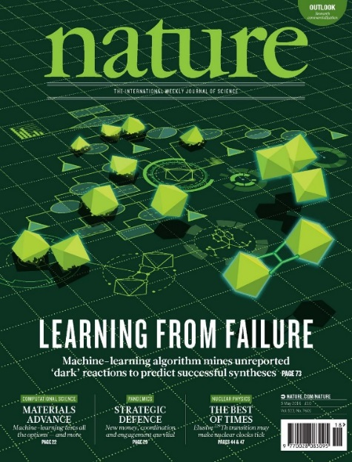
(Machine) Learning From Failure
Can we predict synthesis routes to new crystals?
Created database 3995 failed reactions
http://darkreactions.Haverford.edu
Trained an SVM (support vector machine) model
Success rate advantage
model vs. human → 8%
Collaboration between solid-state chemist, theoretical chemist and computer scientist.
PI: Alex Norquist, Haverford College
Developed a “decision-tree” model of the SVM model
“Rules” for reaction formation
Insights into the chemistry
A kind of “Closing the loop”
National Academies’ CMMR Committee Meeting March 6-7, 2017
Notes:
http://darkreactions.Haverford.edu
89% vs. 78% success rate for target compound
Did your experiment fail? Don’t bin the data just yet — they could be useful. Chemists in the United States say that they have created a machine-learning algorithm that beats humans at predicting ways to make crystals, by training it on data both from successful experiments and from trials that didn’t work. The team terms these failures ‘dark reactions’, because they are either never written down or are recorded only privately in laboratory notebooks.

Slide 27
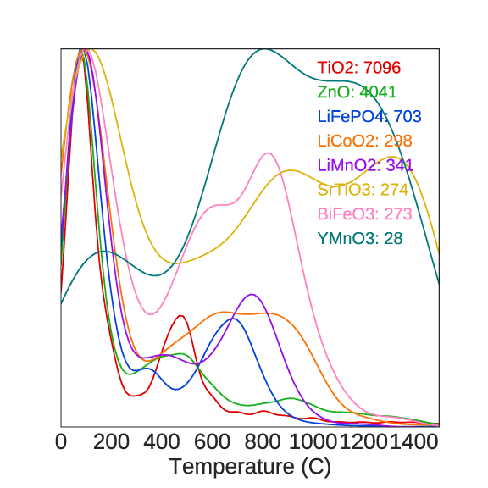
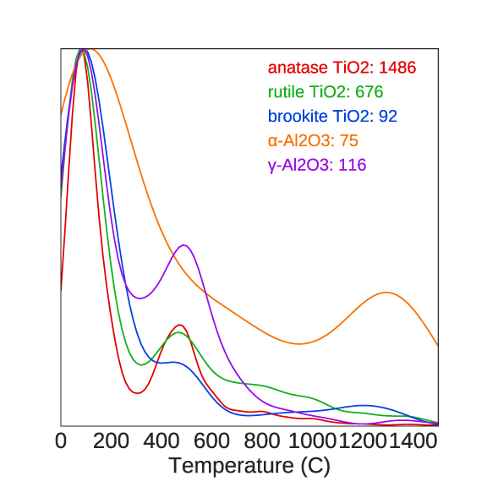
Text Extraction and Data Mining at Scale Elsa A. Olivetti Massachusetts Institute of Technology Award #1534340
Developed an automated, large scale platform to extract desired text from scientific journal articles.
From a corpus of ~400,000 inorganic materials science papers -extracted and analyzed synthesis recipes.
High throughput data mining of the obtained synthesis features subsequently enables us to investigate large scale trends in materials synthesis across thousands of papers at once.
Correlate insights with intrinsic and extrinsic materials properties.
Formulate robust relationships between synthesis conditions and the materials they produce.
Ultimately-correlations will allow development of novel recipes for the synthesis of current and emerging materials.
(a)
(b)
National Academies’ CMMR Committee Meeting March 6-7, 2017
Notes:
Distribution of temperatures at which each material was synthesized, for:
(a) various technologically relevant oxides, and
(b) different phases of two select materials
Legend numbers indicate how many scientific journal articles are represented in each curve and is dependent on data availability

Slide 28
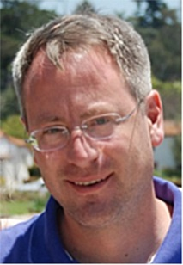
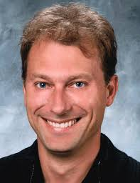
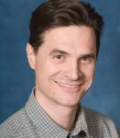
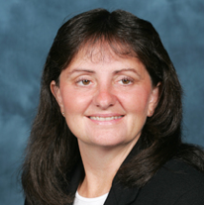
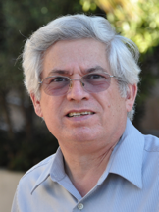
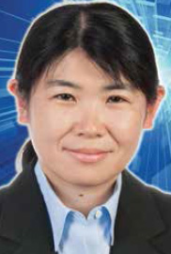
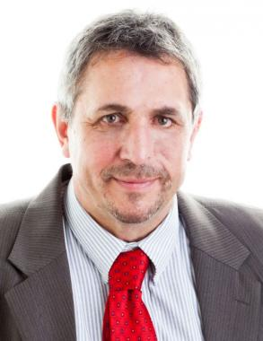

DMREF: GOALI: High Temperature Alloys
https://www.youtube.com/watch?v=deKomQdWd9Y
Search: “materials ready for take off”
National Academies’ CMMR Committee Meeting March 6-7, 2017

Slide 29
Strategic Research Directions
National Academies’ CMMR Committee Meeting March 6-7, 2017

Slide 30




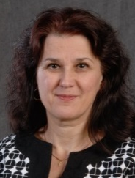

DMR – Looking Forward
Sustainable Material Development
Materials Information Platforms
Quantum Leap
Soft matter/ biomaterials?
Andy Lovinger
Alex Klironomos
Tomasz Durakiewicz
Charles Ying
MGI & Advanced Manufacturing Programs and Activities
Daryl Hess
Susan Dexheimer
Cyberinfrastructure and Data-Driven Materials Research
Miriam Deutsch
Tania Paskova
John Schlueter
Susan Dexheimer
Daryl Hess
Alex Klironomos
National Academies’ CMMR Committee Meeting March 6-7, 2017

Slide 31
MGI: Key Challenges
Leading a culture shift in materials research to encourage an integrated team approach.
Integrating experiment, computation, and theory.
Making digital data accessible.
Creating a world-class materials workforce that is trained for careers in academia or industry.
Whitepaper
Strategic Plan
5-year Highlights
www.whitehouse.gov/mgi
National Academies’ CMMR Committee Meeting March 6-7, 2017

Slide 32
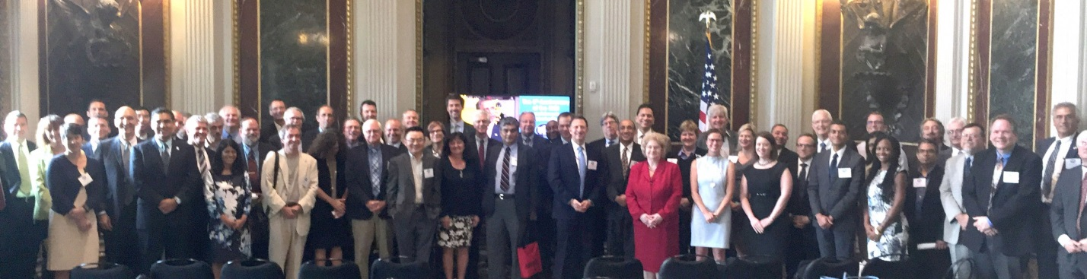
MGI Fifth Anniversary
White House - August 2, 2016
The First Five Years of the Materials Genome Initiative:
Accomplishments and Technical Highlights
The Materials Genome Initiative (MGI) has sparked a paradigm shift in the way that materials are discovered, developed, and deployed. By emphasizing computationally-led and data-driven research, MGI is accelerating the pace at which fundamental discoveries are made and transitioned to American manufacturing.
https://mgi.nist.gov/sites/default/files/uploads/mgi-accomplishments-at-5-years-august-2016.pdf
National Academies’ CMMR Committee Meeting March 6-7, 2017

Slide 33
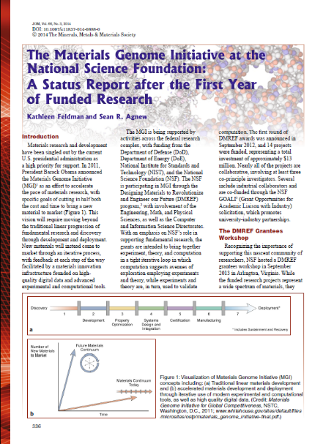
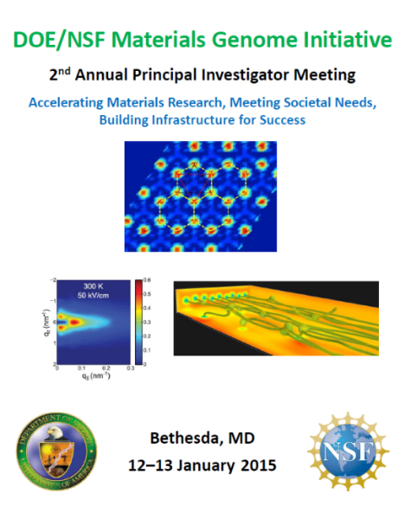
Annual MGI PI Meeting
September 8-9, 2013
NSF PIs
45 Participants
January 12-13, 2015
DOE & NSF PIs
160 Participants
January 11-12, 2016
DOE, NSF, NIST PIs
192 Participants
JOM 2014, 66(3), 336
www.orau.gov/mgi2016
www.orau.gov/mgi2016
The next MGI PI meeting is tentatively scheduled for January 2018.
Inclusion of more federal agencies.
Representation from industrial partners.
Educational session for students and post-docs.
National Academies’ CMMR Committee Meeting March 6-7, 2017

Slide 34
MGI-II Workshop
MGI-I Workshop held Dec 13-15, 2012 (NSF)
De Pablo et al., Current Opinion in Solid State and Materials Science (2014) 18, 99.
May 18-19, 2017 workshop being overseen by Daryl Hess/CMP/DMR.
National Academies’ CMMR Committee Meeting March 6-7, 2017

Slide 35
Advancing MGI: Additional FY18 Objectives
Enhanced communication with MGI partners
FIMAR
MGI.gov website
Data science workshop
Connect with CIF21 projects
Coordinate with NIST
Incorporate ACI and DMS
Harnessing the Data Revolution
Develop expectations for DMREF Data Management Plans
Training Next Generation in MGI mindset
Perhaps TMS and/or Cornell Studies
Advancing along Materials Continuum
Connection to Advanced Manufacturing Centers
Connection with Applied Science/Engineering Agencies (DoD, NASA)
I-corps
National Academies’ CMMR Committee Meeting March 6-7, 2017

Slide 36
FY 17 Opportunities in Computation & Data for Materials Research
Building and using a materials innovation cyberinfrastructure
Computation and Data Enabled Science and Engineering (CDS&E)
Adventurous and Innovative Research Using Computation and Data
Data Infrastructure Building Blocks
(DIBBs)
Data-centric cyberinfrastructure to accelerate collaborative and interdisciplinary
Research
Software Infrastructure for Sustained Innovation (SI2)
Scientific Innovation Transformed into Sustainable and Reusable Software
Opportunities to Revolutionize How Materials Research is Done
to Accelerate Discovery and Innovation
Collaboration→ Computational Materials Scientists, Chemists, Cyberinfrastructure Experts, Engineers, Physicists, …

Slide 37


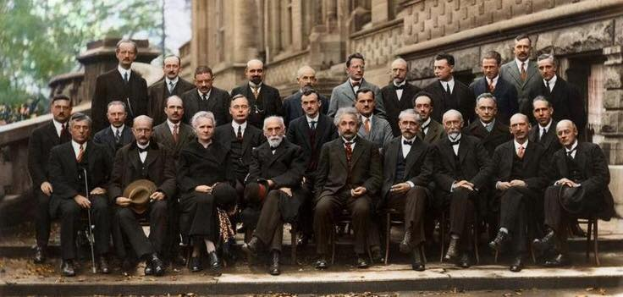
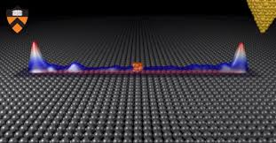
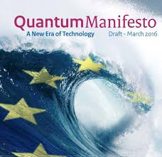

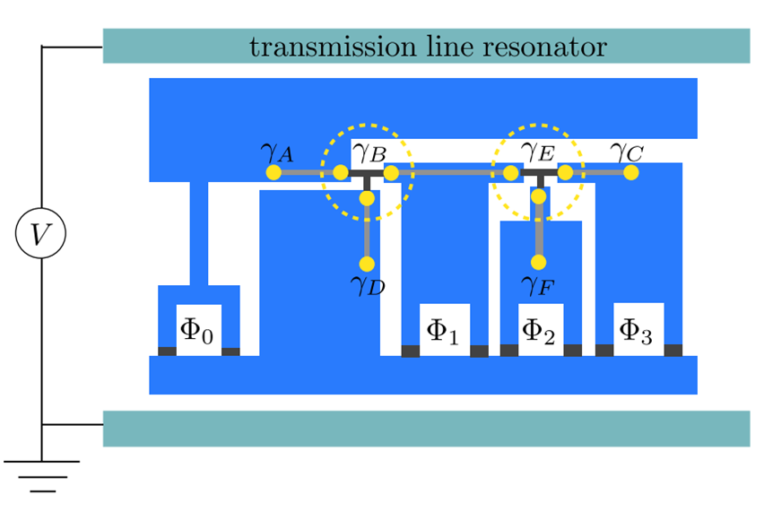
QUANTUM LEAP Leading the Next Quantum Revolution
One of 10 Big Ideas announced by NSF in March 2016:
A plan to build on the First Quantum Revolution in early 20th century and prepare for the Second one exploiting quantum phenomena like superposition, entanglement, and squeezing to enable the next wave of precision sensors and more efficient computation and simulation and communication
EU, Netherlands, UK, China, Japan, Canada… investing in development of quantum technologies.
NSF would support research that addresses the manipulation of quantum states and the control of material light interactions involving physicists, mathematicians, and engineers. There will be strong connections to industry, other federal agencies, and international partnerships.
National Academies’ CMMR Committee Meeting March 6-7, 2017
Notes:
Notes: the top picture shows the 1927 Solvay conference participants (Marie Curie, Hendrik Lorentz, Albert Einstein in front row).
Middle: the experimental confirmation of Majorana modes at the ends of a nanowire in proximity of superconducting substrate – possibly a key to future quantum computing.
Bottom: Scheme for Braiding – manipulation of Majoranas for quantum computing.

Slide 38
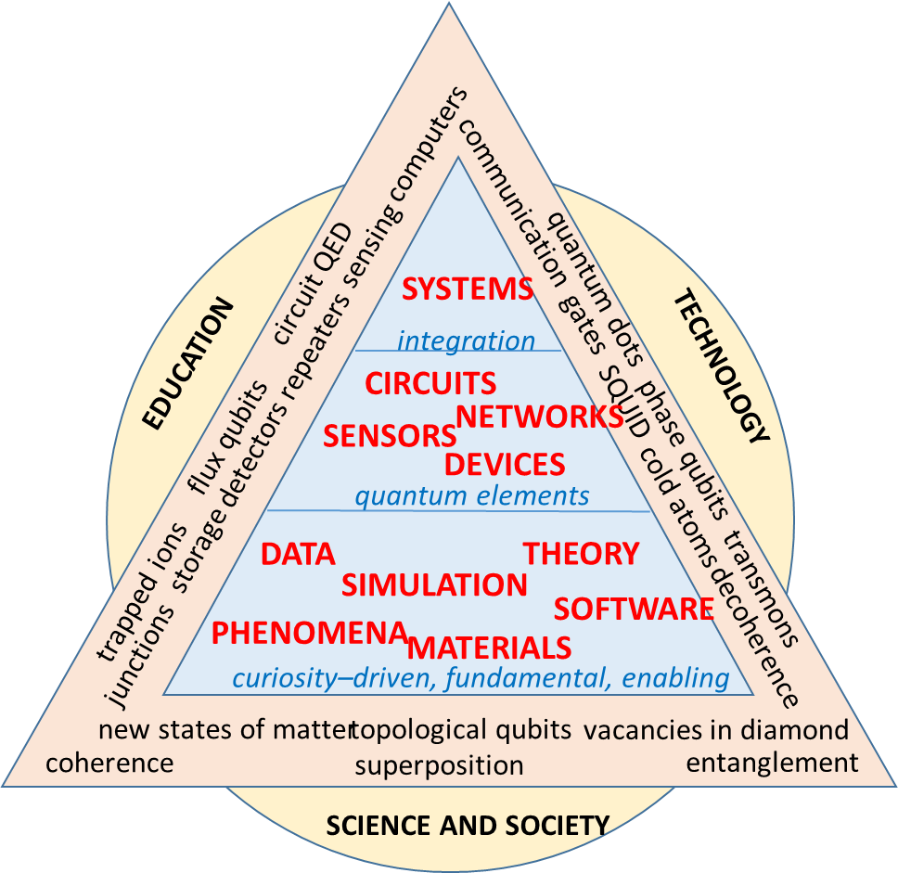
QUANTUM LEAP Leading the Next Quantum Revolution
Quantum Leap Strategies:
Beyond Core – Development of programs for high-risk/high-payoff interdisciplinary projects that promote convergence
Transformative Midscale Projects and Infrastructures – Empower U.S. researchers to significantly advance the Quantum Leap.
Strategic Partnership - Promote strategic mutually productive partnerships among academia, the private sector, other U.S. Government agencies and National Labs, and international researchers and organization.
Mentored Workforce - Develop programs that grow, educate and train, and retain a new generation of well-mentored workforce.
National Academies’ CMMR Committee Meeting March 6-7, 2017
Notes:
The Pyramid shows: QUANTUM FUNDAMENTALS: Advance fundamental understanding of uniquely quantum phenomena and their interface with classical systems under broad range of conditions.
QUANTUM ELEMENTS: Quantum metrology and control - Transform our ability to measure, model, control, and exploit QP in single and multi-particle systems.
QUANTUM SYSTEMS: Co-design and quantum platforms - Explore hardware and software development needed for controllable and scalable quantum information processing.
QUANTUM WORKFORCE: Train a new generation of scientists, engineers, and educators for a transdisciplinary, globally competitive workforce in Quantum Science and Engineering.

Slide 39

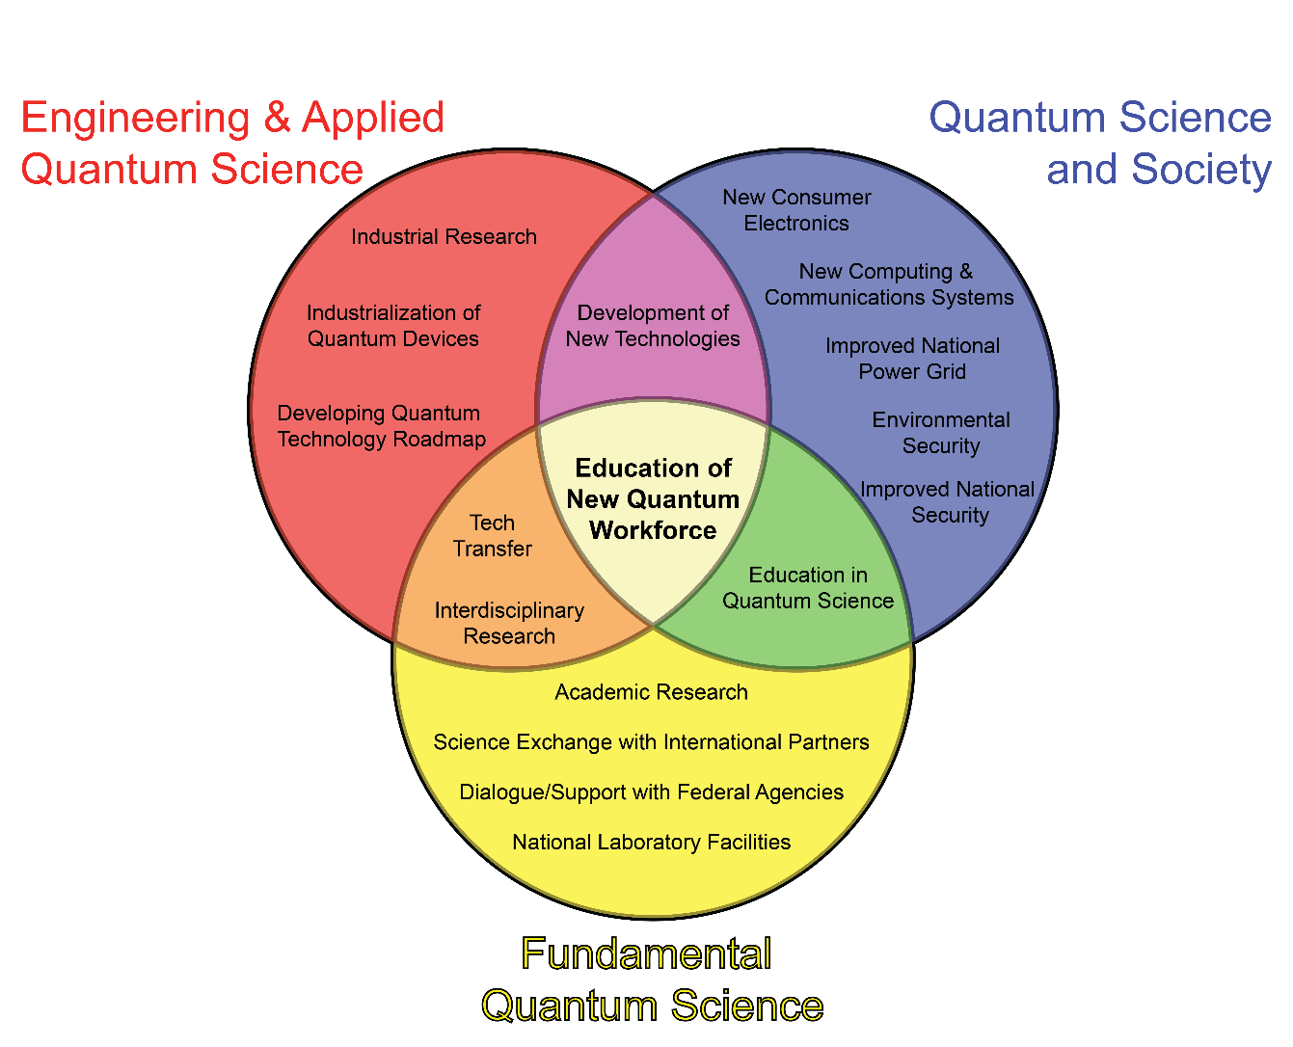
QUANTUM LEAP NSF/DOE Summer School on Quantum Science
Summer School, FY17
Sources of funding | NSF: $700k DOE/BES: $300k
Organizing Team | Joe Checkelsky (MIT) Natalia Drichko (JHU) Liang Fu (MIT) Kyle Shen (Cornell) Jun Zhu (Penn State)
Locations and Dates | Tentative Location and Dates JHU: June 5-16, 2017 Cornell : June 18-30, 2018 Penn State: June 9-21, 2019 University of Colorado: 2020
Rationale | Train transdisciplinary workforce for the second quantum revolution driven by convergence of multiple disciplines
Participants | 50 Graduate Students and early-career Postdocs
National Academies’ CMMR Committee Meeting March 6-7, 2017
Notes:
Convergence of Fundamental, Applied, and Societal aspects of Quantum Science. At the nexus of these is the education of a New Quantum Workforce. Two weeks of intensive program include two talks in the morning and interactive activities in the afternoons.

Slide 40
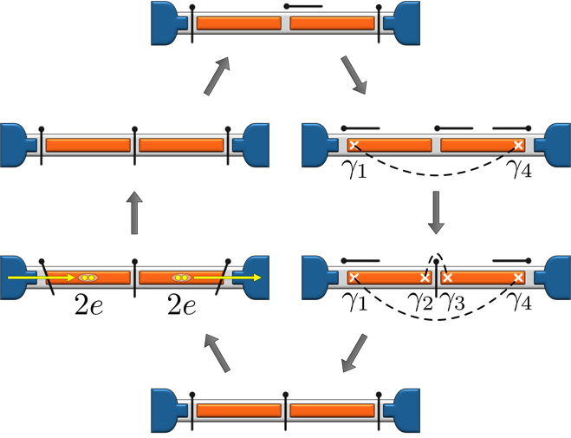
Funding Opportunity – A “Quantum Leap” Demonstration of Topological Quantum Computing
QUANTUM LEAP
Dear Colleague Letter NSF 17-053
Goal: To challenge researchers to propose transformative research leading to the successful experimental demonstration of a topological qubit based on braiding anyon world lines or other known or creative new mechanisms enabling viable topological quantum computing.
Mode: whitepaper leading to EAGER proposal
Level of support: up to 300k$ over 2 years
Key contacts:
CMP: Tomasz Durakiewicz, tdurakie@nsf.gov
CMMT: Daryl Hess, dhess@nsf.gov
EPM: Miriam Deutsch, mdeutsch@nsf.gov
Announced: Feb 6, 2017
Example of proposed experiment to demonstrate Majorana “fusion” – A key ingredient for fault-tolerant quantum computations; D. Aasen et al., Phys. Rev. X 6, 031016 (2016)
Shown: sets of semiconducting wires coated with a superconducting island and bulk superconductor that are bridged by a gate-tunable “valves.”
National Academies’ CMMR Committee Meeting March 6-7, 2017
Notes:
By Feb 28 : 7 whitepapers recieved on : braiding, fusion, nanowire networks coupled to superconudctors, Josephson junction / topological insulator sandwiches, magnetic tunnel junctions, graphene etc.

Slide 41
DMR “Partnership” Activities
“DMR takes very seriously our mission in serving the U.S. public to advance materials research frontiers and develop the workforce for our nation. This is an important job which is not possible without a strong partnership with all of you from the research communities.” L. Sapochak, DMR Newsletter 2017
Professional Society Conference Activities.
Special presentations
Speed Coaching
DMR Website.
Continual improvement
Webinars.
In Discussion.
Division Workshops.
e.g. Ultra-high magnet field needs for quantum leap.
DMR Newsletter.
Going out this week!
Division Studies.
e.g. Frontiers of Materials Research: A Decadal Survey, is being supported by the DMR and the Department of Energy, Office of Basic Energy Sciences to help us understand the changing landscape and future needs of materials research in the context of the U.S. and international efforts in important emerging research areas.
National Academies’ CMMR Committee Meeting March 6-7, 2017

Slide 42
THANK YOU!
lsapocha@nsf.gov
Ideas? Questions? Concerns?
Please feel free to contact me directly!
National Academies’ CMMR Committee Meeting March 6-7, 2017

