Slide 1
Risks and Harm: In the context of sexuality and health research with LGBT youth
Brian Mustanski, Ph.D.
www.impactprogram.org
National Research Council Workshop on Proposed Revisions to the Common Rule in Relation to the Behavioral and Social Sciences
March 21-22, 2013

Slide 2
Overview
Need for research on “risky” and “sensitive” behaviors with youth
Need for research with youth populations that are vulnerable experience health disparities.
Implications of avoiding such research
What are the risks (and benefits) associated with this social and behavioral research?
Is this research minimal risk as currently (un)defined.
Case study of Project Q2

Slide 3
Need for research on “risky” and “sensitive” behaviors with youth
Adolescent health risk behaviors, specifically substance use, conduct problems, and sexual risk-taking, are primary contributors to direct and indirect causes of morbidity and mortality^{[1-3]}.

Slide 4
Implications of avoiding research on risky behaviors among youth
74 CDC endorsed evidence-based HIV prevention programs (including 17 for youth), there are none for adolescent MSM and only one “good-evidence” behavioral intervention for emerging adult MSM^{[4,5]}.
Most prevention funders require evidence of program effectiveness; the absence of such research on adolescent MSM effectively eliminates major sources of programmatic funding for this high risk group.
Researchers shy away from research on adolescent MSM because of the belief (experience) that they could not receive IRB approval. IRB decisions are often motivated by value-laden concepts absent supportive evidence.

Slide 5
What are the risks in social and behavioral research with youth in this area?
The Society for Adolescent Medicine (SAM)^{[6]} reviewed the literature in this area and concluded the primary risks are:
Promoting or inducing unhealthy behavior (e.g., initiating sex after answering a survey of sexual behavior) is sometimes raised as a potential risk, but the SAM review of the literature dismissed this notion.
Loss of privacy or confidentiality (ANPRM data security rules address this).
Negative psychological reaction to participation.

Slide 6
Psychological Risks
Sometimes used by IRBs as rationale for study to be deemed greater than minimal risk.
We will be asking you personal questions about your sex
life, mental and emotional health, any alcohol or drugs
you may have used, and potentially criminal behavior.
Although this information is confidential, some of these
issues could make you feel uneasy or embarrassed. If
there are questions you do not want to answer, you do not
have to do so. You can stop taking part at any time. A
staff member will be available if you want to talk about
anything that comes up during the interview. We will
also refer you to counseling services if you want.

Slide 7
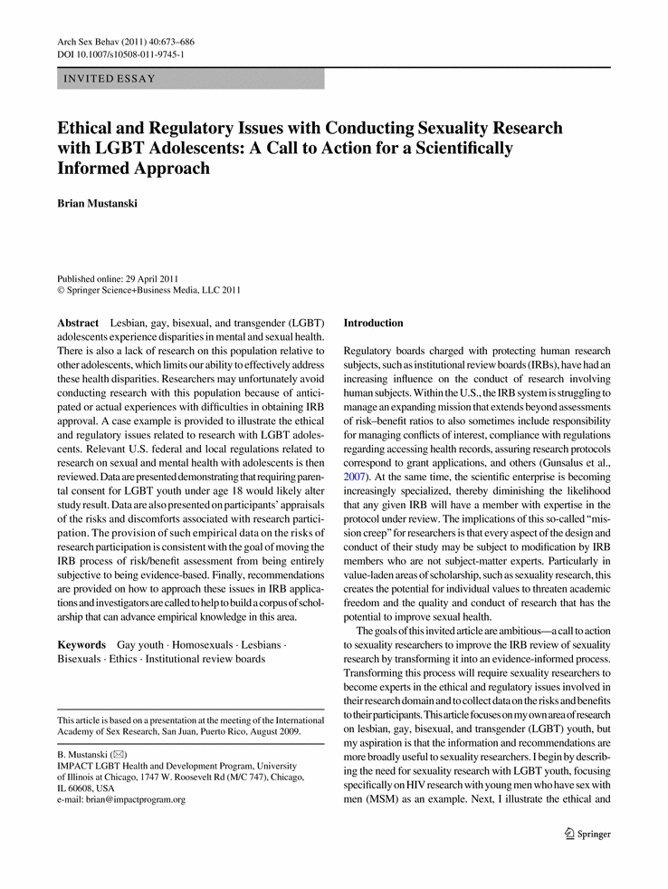
What are the risks of a negative psychological reaction to social and behavioral research?

Slide 8
Funding: American Foundation for Suicide Prevention (waves 1-4), William T Gran Foundation (waves 4, 5, 6), David Bohnett Foundation (wave 5), NIMH (males: waves 7, 8), Northwestern (females waves 7, 8).
Aim: To understand factors that increase risk for mental health problems, substance use, and HIV among LGBT youth. Increase understanding of the development of sexual orientation.
Longitudinal (8 waves over 4 years) with CASI self-report and structured psychiatric interviews.
Target sample 250 in age range 16-20 at baseline

Slide 9
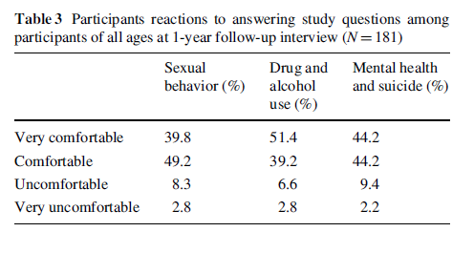
What is the participants experience?
Project Q2 4th wave interview asked, ‘‘We are trying to understand what it is like to participate in one of our research studies. How did you feel answering the questions about…”
Notes:
Across these three domains, approximately 90% of
participants said they were‘‘very comfortable’’or‘‘comfortable’’
and at most 3% of participants described themselves as ‘‘very
uncomfortable.’
Comparisons regarding comfort across the three domains
suggest that these participantsweremost comfortable answering
questions about substance use comparedtoquestions about
sexual behavior and mental health and suicide, v2(2)=8.01,
p[.05, although these differences were relatively minor and
comfort was high across all three domains.

Slide 10
Consistently low reports of distress
Our findings of very few participants who report being uncomfortable answering these questions is consistent with past research:
Fendrich et al. (2007): adult men who have sex with men answering questions about sexual behavior and substance use^{[7]}
Jacomb et al. (1999): adults participating in a mental health survey^{[8]}
Jewkes et al (2012): adults in study of HIV and gender-based violence in South Africa^{[10]}.
Langhinrichsen-Rohling et al. (2006): adolescents answering questions on drug use, suicidal behavior, and physical and sexual abuse^{[9]}.
Kuyper et al (2012): youth completing measures on sexuality^{[11]}.

Slide 11
Is this research minimal risk?
Subpart D governs research with children, and the minimal risk standard (defined in Subpart A) determines what kinds of research can be conducted.
§46.408: Waiver of parental permission can be issued when research risks are minimal (or only a slight increase over minimal) and
The research could not practically be carried out without the waiver (§46.116d)
Parental permission is not a reasonable requirement (e.g. runaway, abused children) (§46.408c).

Slide 12
Minimal Risk
Project Q2
“Did you feel like answering any of these questions made you more uncomfortable than a typical visit to your physician, doctor, psychologist, or counselor.’’
54% “No, it was more comfortable answering these questions”
35% “About the same”
11%, ‘‘Yes, more uncomfortable answering these questions”
Is being uncomfortable a risk?
27% of children sometimes feel scared or afraid in their daily lives^{[12].}
What are routine experiences in medical and psychological procedures?
Routine medical and psychological procedures involving children include blood draws, screening for mental health problems, indications of abuse or neglect as well as tests to assess cognitive, social, academic, behavioral and emotional functioning. Questions about substance use, depression, and sexuality are part of routine medical and psychological examinations for children beginning in early adolescence^{[13]}.
Notes:
The applicationofourfindings that themajority
of participants were more comfortable participating in our
study than a typical visit to their doctor is complicated by the fact
that the standard is not explicit in term of the probability and
magnitude of harm being greater for the majority of participants,
most participants, a substantial proportion, or any participants.
It could be argued that research participants do not have the
knowledge and training tomake risk comparisons,which iswhy
these determinations are delegated to IRBs. This may be true,
but nevertheless information from participants can be used to
inform the deliberations of IRBs when making determinations
about discomfortandrisks.

Slide 13
Problems applying minimal risk standards to research with youth
2 IRBs (University of Illinois at Chicago [UIC] and a Community Based Organization [CBO])
8/06- Submission to CBO IRB (primary data collection site)
9/06- Submitted to UIC for Departmental Review
9/06- IRB approval by CBO
6 months and 4 rounds of review with UIC
Much of it had to due with determining the “risks” of the study, until they ultimately decided it was “only a slight increase over minimal risk” without articulating what these risk were.
3/07- UIC IRB approved with CoC
4/07- CBO IRB approval of amended protocol (month 10)…the work can begin

Slide 14
Benefits of research participation
45 CFR 46 specifies that a basic element of informed consent includes ‘‘A description of any benefits to the subjects or to others which may reasonably be expected from the research.”
“Benefit” is not clearly defined.
NIH Intramural Protocol Review Standards states that ‘‘A research benefit is considered to be something of health-related, psychosocial, or other value to an individual research subject [direct benefit], or something that will contribute to the acquisition of generalizable knowledge [social benefit].’’

Slide 15
Benefits of Research Participation
R01DA025548
 | Age: 16-17 (n=52) |  | Age: 18-20 (n=221)
 | Mean | SD | Mean | SD
It made me feel like part of something important | 1.6 | 0.7 | 1.8 | 0.8
It made me feel like I am helping my community | 1.8 | 0.7 | 1.7 | 0.8
It helped me to have someone to talk to about my experiences | 1.8 | 0.8 | 2.0 | 0.9
It made me feel like I am helping other young men like myself | 1.8 | 0.8 | 1.8 | 0.8
It gave me the opportunity to meet successful LGBT adults | 2.0 | 0.9 | 2.0 | 0.9
It helped to know people care about other young men like myself | 1.6 | 0.7 | 1.8 | 0.8
Answering the questions helped me reflect on who I am | 1.8 | 0.8 | 1.8 | 0.9
Participating in Crew 450 made me feel supported | 1.6 | 0.8 | 1.8 | 0.9
Participating in Crew 450 helped me to think about my behavior | 1.8 | 0.9 | 1.7 | 0.9
Scale: 1=Strongly Agree; 2 = Agree; 3 = Neutral; 4 = Disagree 5=Strongly Disagree
No significant differences between age groups for any item (p>.05)

Slide 16
Thank you funders and project staff!
Contact Information:
Brian@northwestern.edu
www.impactprogram.org
Notes:
Include those that are appropriate for the particular project

Slide 17
Citations
Blum RW. Young people: Not as healthy as they seem. Lancet. Sep 12 2009;374(9693):853-854.
Feigelman W, Gorman BS. Prospective predictors of premature death: Evidence from the National Longitudinal Study of Adolescent Health. J. Psychoactive Drugs. Sep 2010;42(3):353-361.
Eaton DK, Kann L, Kinchen S, et al. Youth risk behavior surveillance - United States, 2011. Morbidity and Mortality Weekly Report: Surveillance Summaries. 2012;61(4):1-162.
CDC. Compendium of Evidence-Based HIV Prevention Interventions. 2012; http://www.cdc.gov/hiv/topics/research/prs/evidence-based-interventions.htm. Accessed 07/09/2012.
Kegeles SM, Hays RB, Coates TJ. The Mpowerment Project: A community-level HIV prevention intervention for young gay men. Am. J. Public Health. 1996;86:1129-1136.
Santelli JS, Smith Rogers A, Rosenfeld WD, et al. Guidelines for adolescent health research. A position paper of the Society for Adolescent Medicine. J. Adolesc. Health. 2003;33:396-409.
Fendrich M, Lippert AM, Johnson TP. Respondent reactions to sensitive questions. Journal of Empirical Research on Human Research Ethics. 2007;2:31-37.
Jacomb PA, Jorm AF, Rodgers B, Korten AE, Henderson AS, Christensen H. Emotional response of participants to a mental health survey. Soc. Psychiatry Psychiatr. Epidemiol. 1999;34:80-84.
Langhinrichsen-Rohling J, Arata C, O'Brien N, Bowers D, Klibert J. Sensitive research with adolescents: just how upsetting are self-report surveys anyway? Violence Vict. 2006;21:425-444.
Jewkes R, Sikweyiya Y, Nduna M, Shai NJ, Dunkle K. Motivations for, and perceptions and experiences of participating in, a cluster randomised controlled trial of a HIV-behavioural intervention in rural South Africa. Cult. Health Sex. 2012;14:1167-1182.
Kuyper L, de Wit J, Adam P, Woertman L. Doing more good than harm? The effects of participation in sex research on young people in the Netherlands. Arch. Sex. Behav. 2012;41:497-506.
Wendler D, Belsky L, Thompson KM, Emanuel EJ. Quantifying the federal minimal risk standard: Implications for pediatric research without a prospect of direct benefit. JAMA. 2005;294:826-832.
Secretary’s Advisory Committee for Human Research Protections (SACHRP). Meeting presentations and reports from April 18–19; November 1. 2005; http://www.hhs.gov/ohrp/archive/sachrp/index.html.

