Slide 1
CENTER FOR RESEARCH ON FAMILIES
SALLY I. POWERS, DIRECTOR
Consent Processes for Longitudinal Research with
‘Rich” Behavioral & Biospecimen Data
from Multiple Family Members
Workshop on Proposed Revisions to the Common Rule in Relation to the Behavioral and Social Sciences
National Research Council
Board on Behavioral, Cognitive, and Sensory Sciences
March 21, 2013
Sally I. Powers
powers@psych.umass.edu

Slide 2
CONSENT PROCESS & SPECIAL POPULATIONS
CENTER FOR RESEARCH ON FAMILIES
My research focus:
> 30 years studying effects of social stress on the emergence and course of depression throughout childhood, adolescence and adulthood
Primary social stressor: Conflict in families & close relationships
Adolescents (14 – 17 yrs) and parents
Emerging adult (18-19 yrs) dating couples
Newlywed couples
New parents, fetus, infant (0 – 12 mths)

Slide 3
Consent Issues Relevant to Type of Data
CENTER FOR RESEARCH ON FAMILIES
“Rich” data with limitless analysis possibilities
Biospecimen
Behavioral
Interdependent data involving individuals in relationships
Longitudinal follow-up
Risk research: mental health data ranging from subclinical to clinical severity; social & physical development data

Slide 4
Consent Issues Relevant to Special Populations
CENTER FOR RESEARCH ON FAMILIES
Underage subjects
Future use when adult
Longitudinal follow-up when adult
Adolescents with legal adult status
Emergent clinical disorders
Notes:
Leave to last; covered well in Roxane’s and Celia’s presentation

Slide 5
RICH DATA:
CENTER FOR RESEARCH ON FAMILIES
Biospecimen or behavioral data, which can be re-coded, re-assayed, or re-tested to yield new information not proposed in the original study.
Distinct from secondary analysis of large survey datasets, which reanalyze existing coded information.

Slide 6
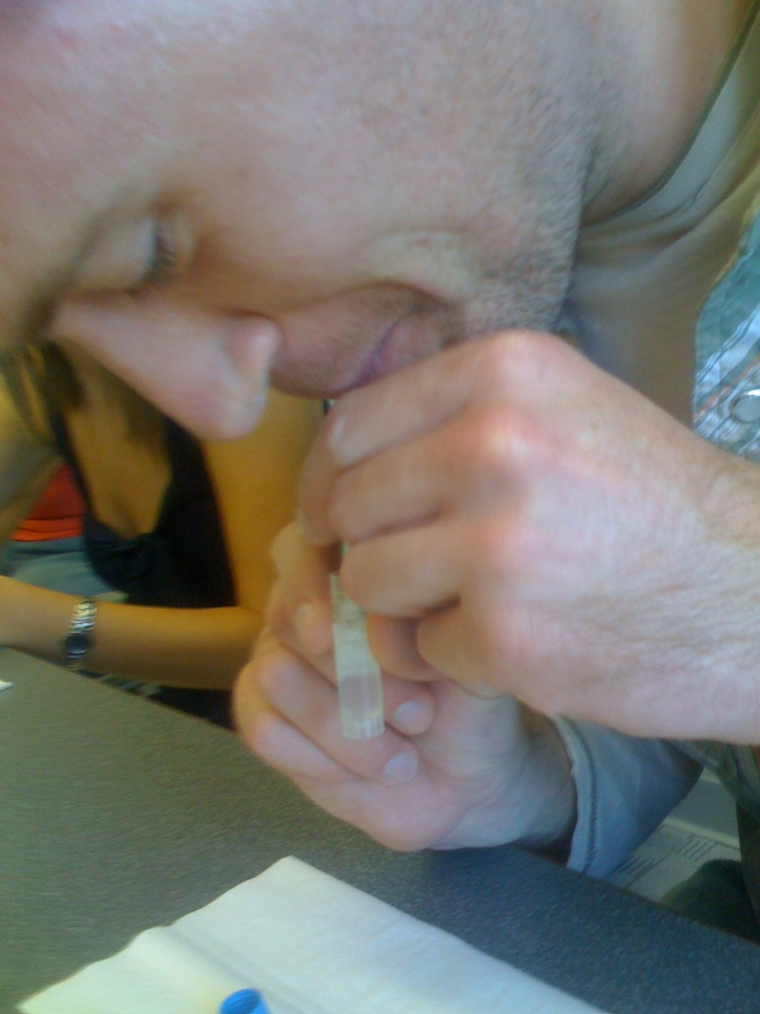
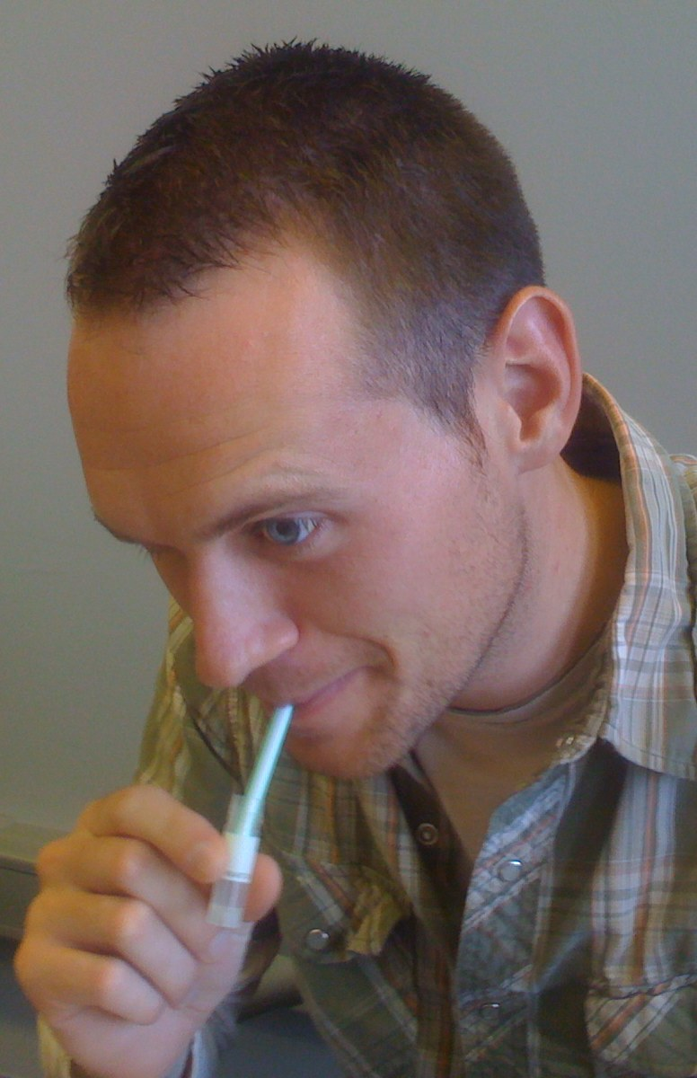
RICH DATA: SALIVA BIOSPECIMENS
CENTER FOR RESEARCH ON FAMILIES

Slide 7
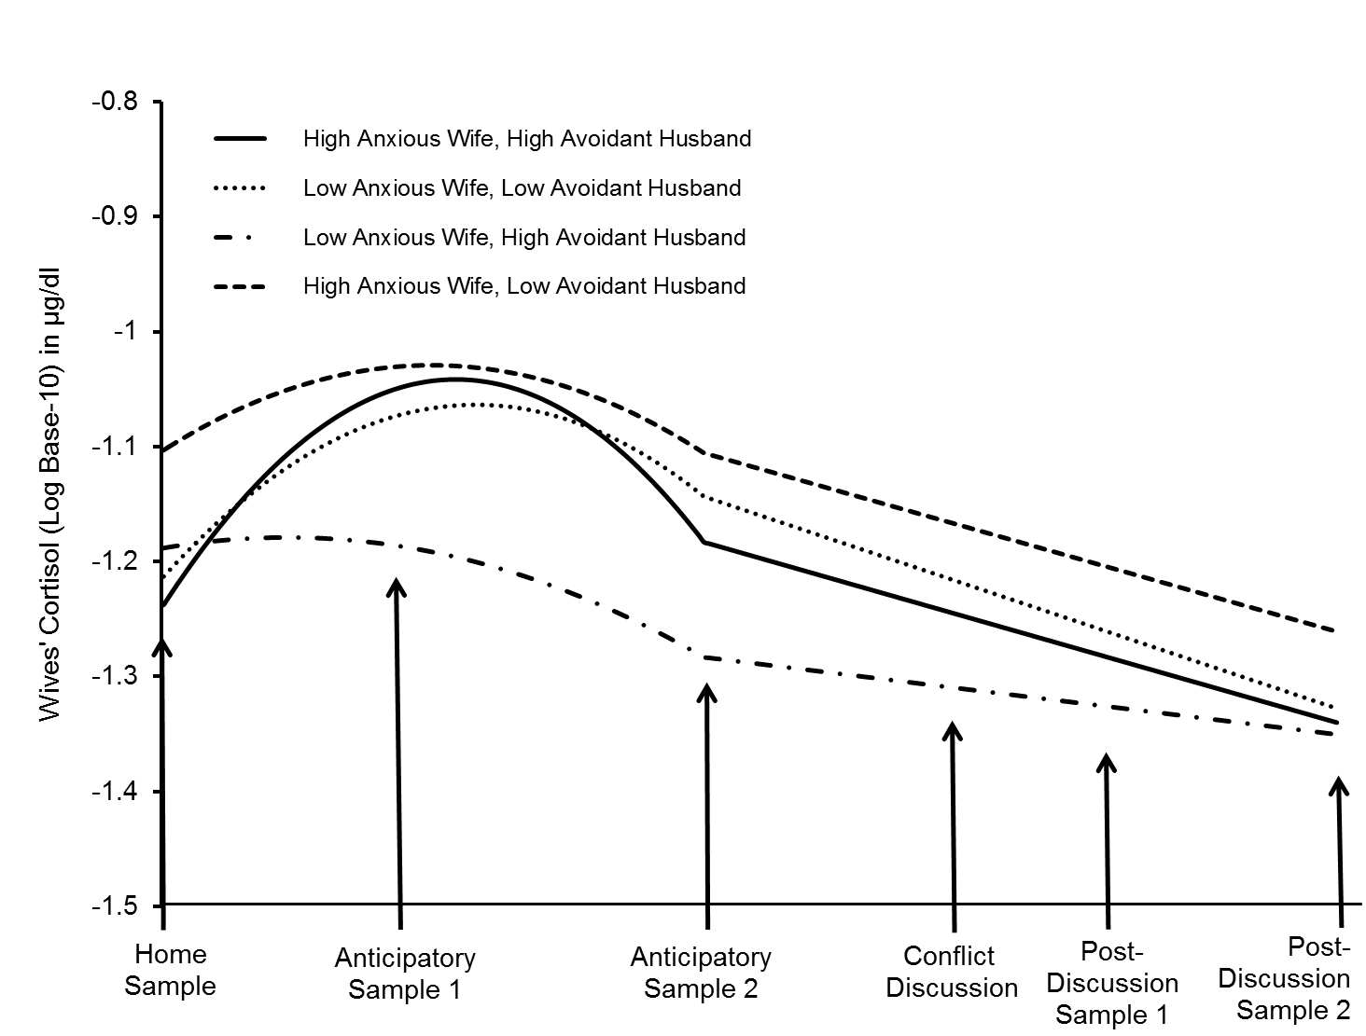
Saliva sampling throughout couple conflict
CENTER FOR RESEARCH ON FAMILIES
Interdependent data
Beck et al., 2013

Slide 8
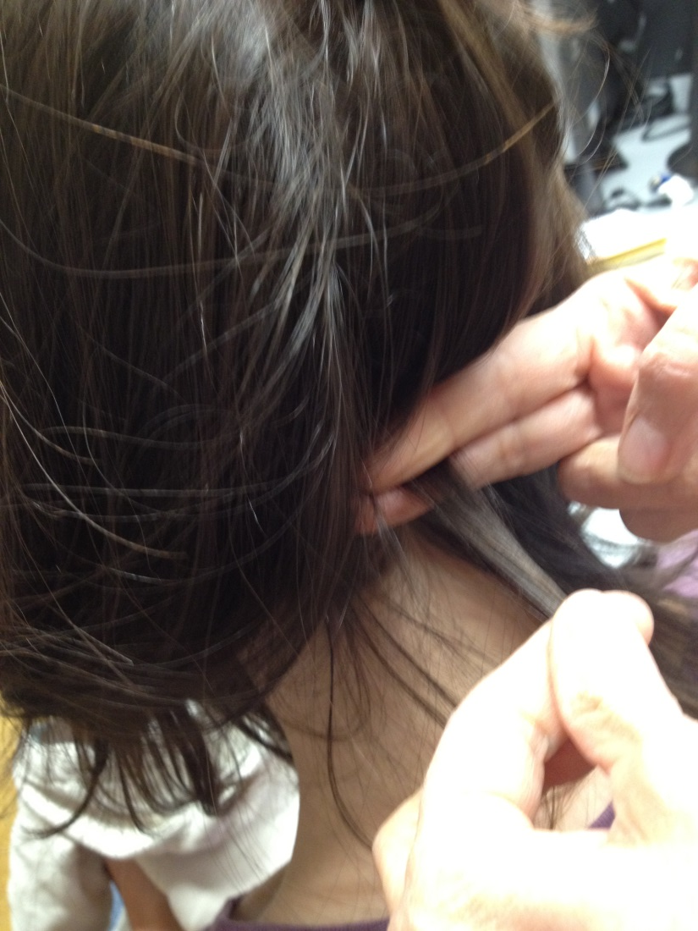
RICH DATA: HAIR BIOSPECIMENS
CENTER FOR RESEARCH ON FAMILIES

Slide 9
RICH DATA: CURRENT SALIVA ANALYTES
CENTER FOR RESEARCH ON FAMILIES
DNA analysis
Estradiol
Estriol
Estrone
Interleukin-1 Beta
Interleukin-6
Melatonin
Neopterin
Nerve Growth Factor
Progesterone
Secretory Immunoglobulin A
Serum IGF-1
Testosterone
TNF-a
Total Protein
Transferrin & Blood Cont.
17a-Hydroxyporgesterone
Aldosterone
Alpha-Amylase
Androstenedione
Beta-Endorphin
C-Reactive Protein
Chromogranin A
Corticotropin-Releasing Hormone
Cortisol
Cotinine
Dexamethasone
DHEA
DHEA-S
http://www.salimetrics.com/analytes

Slide 10
RICH BIOSPECIMEN DATA:
CENTER FOR RESEARCH ON FAMILIES
What are the changes being considered for new uses of existing biospecimens?
Current: de-identified biospecimens may be used without re-consent; identified biospecimens require re-consent or prior consent
Proposed: Prior consent required whether de-identified or not, but consent is for ‘open-ended’ use.
How might the changes affect my research?
All longitudinal research is identifiable by its nature.
We receive prior consent for broad areas of testing, rather than completely ‘open-ended’ use.
Some participants are concerned about open-ended use
Regardless of participants’ concern, we can assume that all biospecimens may become identifiable in the future.

Slide 11
RICH BEHAVIORAL DATA:
CENTER FOR RESEARCH ON FAMILIES
Proposed changes to the Common Rule address issues with biospecimen data, but should I suggest that we should consider rich behavioral (videotaped) data similarly.
If behavioral data is not considered and we have no guidelines of proper consenting for future use, IRB decisions will vary widely from site to site on whether re-consent is necessary.
Notes:
VIDEO DATA

Slide 12
RICH BEHAVIORAL DATA: CONFLICT VIDEOS
CENTER FOR RESEARCH ON FAMILIES
Multiple behavioral coding schemes
Original coding: submission
Later coding to contrast with a different sample: secure base (attachment behaviors)

Slide 13
RICH BEHAVIORAL DATA: CONFLICT VIDEOS
CENTER FOR RESEARCH ON FAMILIES
Working with computer scientists to amplify minute color changes, allowing us to analyze cardiovascular stress reactions to family conflict

Slide 14
RICH BEHAVIORAL DATA
CENTER FOR RESEARCH ON FAMILIES
Do proposed changes for biospecimens work for rich (videotaped) behavioral data?
Current:
Identified biospecimens require re-consent or prior consent for future use
Is there a consistent common rule for video data?
Proposed:
Biospecimens will require prior consent whether de-identified or not, but consent is for ‘open-ended’ use.
I suggest that this standard is acceptable for video data, but not biospecimen data.

Slide 15
Consent Issues Relevant to Type of Data
CENTER FOR RESEARCH ON FAMILIES
“Rich” data with unknown possibilities
Biospecimen
Behavioral
Interdependent data involving individuals in relationships
Longitudinal follow-up
Risk research: mental health data ranging from subclinical to clinical severity; social & physical development data

Slide 16
INTERDEPENDENT LONGITUDINAL DATA
CENTER FOR RESEARCH ON FAMILIES
Do proposed changes address longitudinal follow-up of rich, interdependent relationship data?
Clear: re-consent is necessary for new data from original participant
Unclear: IRBs differ on whether investigators can re-contact participants for new study, using contact info from original study
We obtain consent in our original studies for follow-up through multiple contact sources (specific friends, parents, online sources)
Special case of interdependent data

Slide 17
Consent Issues Relevant to Type of Data
CENTER FOR RESEARCH ON FAMILIES
“Rich” data with unknown possibilities
Biospecimen
Behavioral
Interdependent data involving individuals in relationships
Longitudinal follow-up
Risk research: mental health data ranging from subclinical to clinical severity; social & physical development data

Slide 18
MENTAL, SOCIAL & PHYSICAL DATA
CENTER FOR RESEARCH ON FAMILIES
Normal life is somewhat uncomfortable.
Mental health symptoms
Stressful life experiences
Adolescent social activities
Adolescent pubertal changes
Current ‘warnings’ are unnecessarily disturbing, limiting potentially beneficial research.
Minimal risk

Slide 19
Consent Issues Relevant to Special Populations
CENTER FOR RESEARCH ON FAMILIES
Underage subjects
Future use when child is an adult
Longitudinal follow-up when the child is an adult: Harvard Three Generational Study
Adolescents with legal adult status: Prenatal depression in teenage mothers; appropriate access to research and parenting interventions
Emergent clinical disorders

