Slide 1

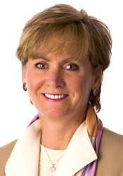
Community Affairs Signature Program
Campbell’s Healthy Communities
Kim Fortunato
Director, Community Affairs
President, Campbell Soup Foundation
Campbell Soup Company
Notes:
Company Purpose: Real food that matters for life’s moments
Community Affairs at Campbell encompasses several programs including employee engagement, The Campbell Soup Foundation, Disaster Relief, Social Innovation, and our Signature program, Campbell’s Healthy Communities which is what I will primarily focus on for the purpose of today’s presentation.

Slide 2
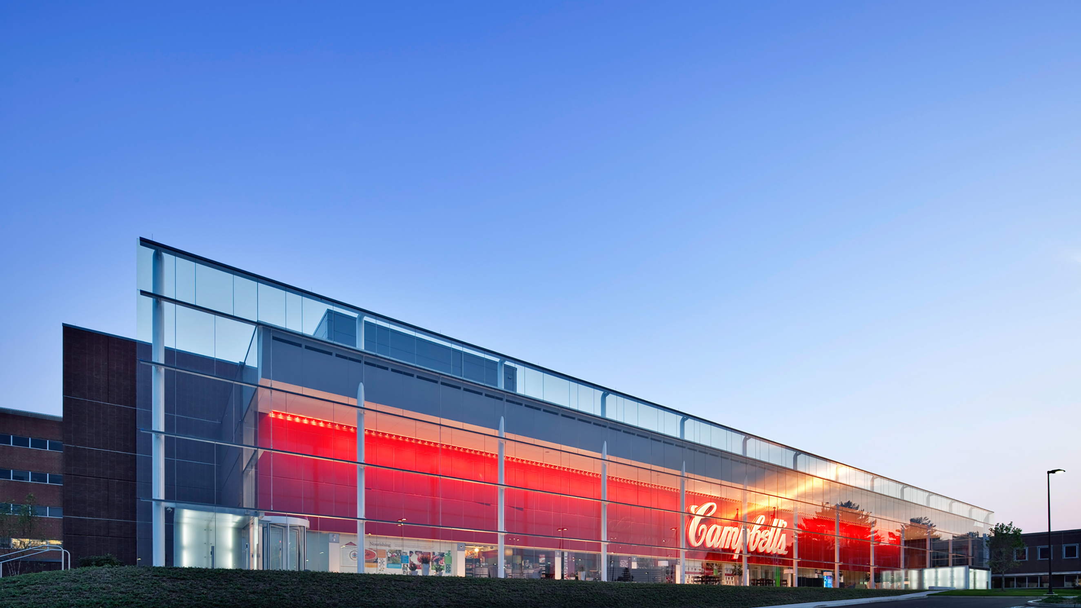

Collective Impact
| Common agenda | Shared measurement systems | Mutually reinforcing activities | | Continuous communications | Backbone leadership organization |
Common Agenda
Measurably improve the health of young people in our hometown communities
2
Notes:
The Campbell story: Campbell has been in Camden for 149 years; it is our WHQ and we are committed to our community. In 2011 we made a long term financial commitment to a signature program because there was a significant need in the community for healthier living; it is the right thing to do, aligns with our company purpose and business strategies and carries on our legacy as an anchor institution in Camden, NJ
Working with a commitment to the CI framework has always been and remains a criteria for funding.
What differentiates Campbell, is that we are not only the funder of the collective, we were the primary backbone leader of the work for the first 5 years, and indeed, continue to play a shared BB role.
We believe that true social transformation requires a cross sectorial approach… no single organization – or funder – can create change on complex social issues.
We also recognize that community health will improve when it is addressed by bold, data-driven local partnerships.
Now let me site a few examples of partnerships that are focused on summer programming:

Slide 3




Our strategy
Physical Activity/ Access
Food Access
Nutrition Education
Public Will
System Change, Policy Work, and Process Improvement
Notes:
All of our program partners support at least 2 of the above strategies… 1 embraced by all is the commitment to public will – co-creating with our community.
Get Moving Camden – is a program at Hopeworks, a local organization training kids in technology, mapping, and web design.
They created and revised a digital mobile interactive map of green spaces for exercise and then
Got teams of youth out in the community to make social media posts about exercising in green spaces right in Camden
Hopeworks employed more than 8 youth to bring healthy eating + exercise together at various community events

Slide 4
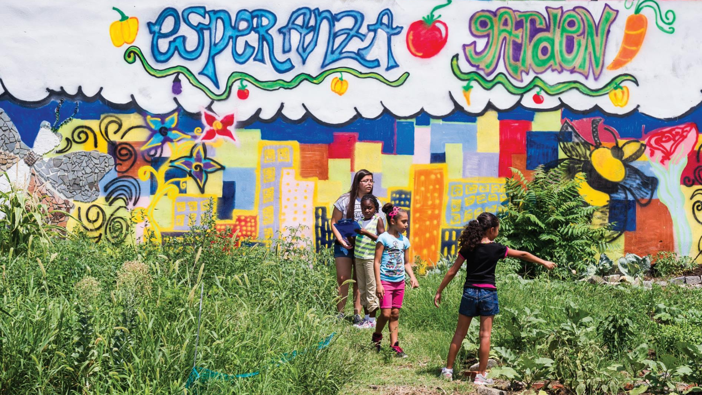
4
Notes:
The Food Bank of South Jersey (FBSJ) partners with Center For Environmental Transformation to conduct the Youth Nutrition Outreach Training Program (YNOT), a signature youth training program.
The youth are trained in nutrition education, recipe development, food safety, cooking techniques, and public speaking.
The students could speak about the nutrition facts in the produce they were selling which helped boost sales.
Students who graduated are now eligible to assist with additional community activities and receive a small stipend from FBSJ.

Slide 5

Notes:
FBSJ led six sessions of hands on cooking with the Cooking Matters class this past summer. Cooking Matters is a program we fund through the school year, and is so popular, we extended funding through the summer.
The class began with discussions on knife and kitchen safety and introduced fun food activities and recipes.
The students built confidence in their new skills through active class participation which helped enable positive behavior changes.

Slide 6
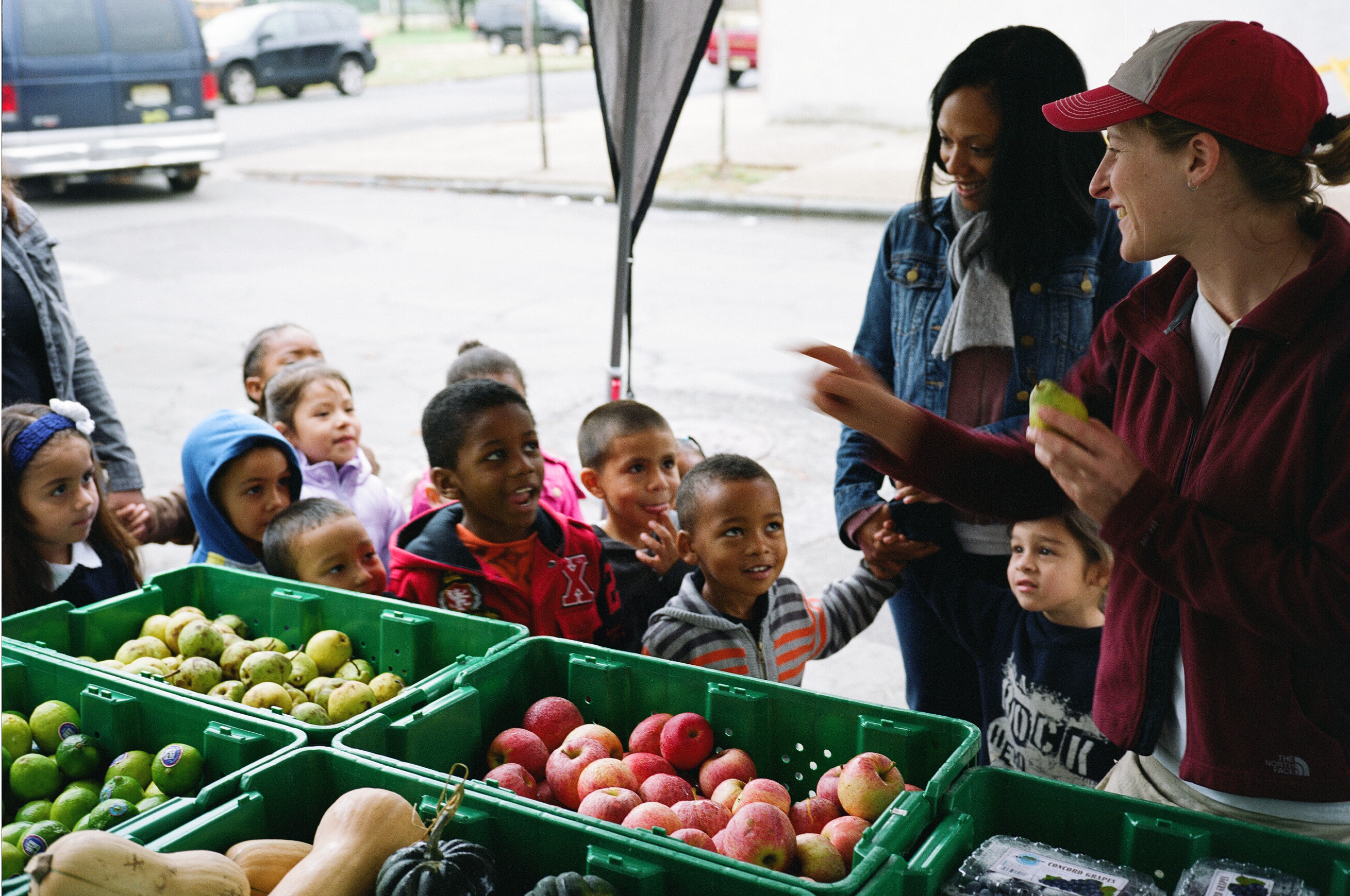
Notes:
Through the Food Bank of S Jersey’s Summer Meals program, children receive breakfast, lunch and snacks for 10 weeks during the summer.
Through the summer of 2018 the Food Bank of South Jersey served over 140,000 meals across four counties.

Slide 7
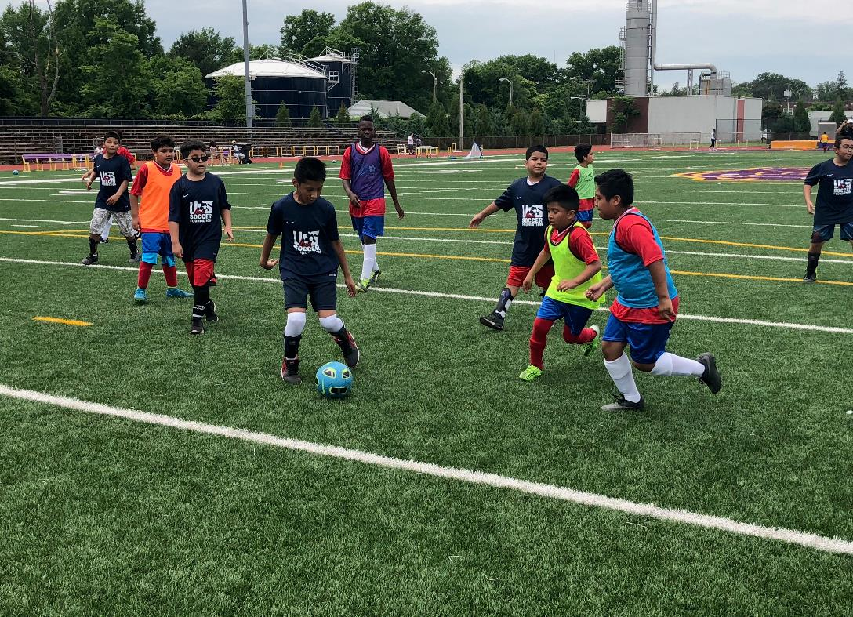
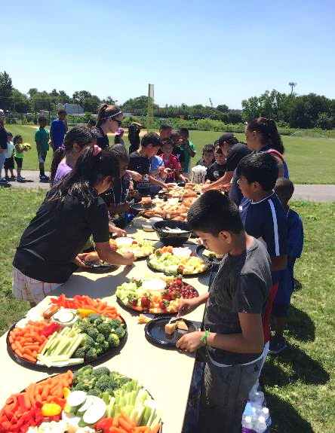
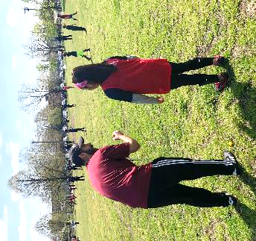
Notes:
We fund the YMCA to support the development of places to play, places to grow, and places to learn.
Goal - is to ensure that children in underserved communities have easy and affordable access to quality soccer programs that support their physical and personal development.
Soccer for Success – an after school and summer model, introduces youth ages 6-14 to the sport of soccer, while also providing them and their families with the tools they need to make healthy lifestyle decisions. Focus extends to topics including nutrition education, food access, physical activity, healthy living.

Slide 8

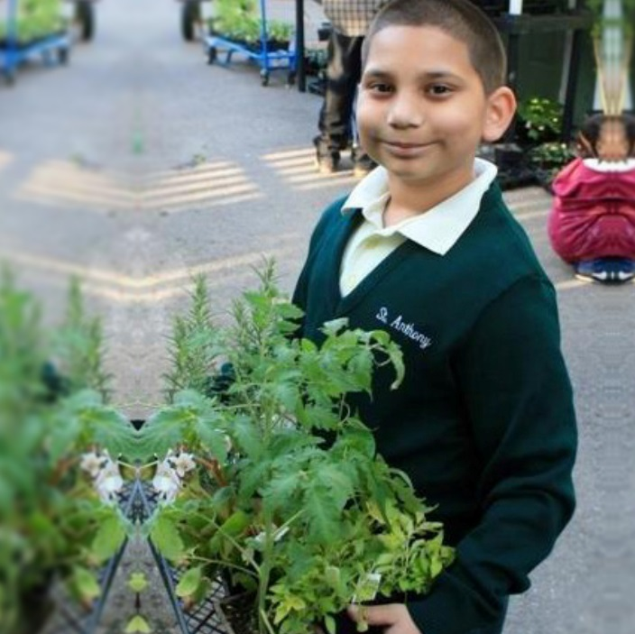
Notes:
These values were created 7 years ago but reflect our newly designed Campbell Values: Own it like a founder, Dare to Disrupt, Do Right Be Real, Seek the Power of Different

