Slide 1
A PowerPoint Presentation
Yahoo’s WebscopeTM Data Sharing Program
PRESENTED BY Firstname Lastname⎪ August 25, 2013
Ron Brachman, Chief Scientist and Head, Yahoo Labs
April 11, 2014
© Yahoo, Inc.

Slide 2
A reference library of interesting and scientifically useful datasets
Available globally for non-commercial use by academics and scientists at research labs affiliated with an accredited university
Reviewed to conform to Yahoo’s data protection standards
Data Review Committee ensures strict user privacy controls are in place
Data is anonymized by utilizing a permuter code
Statistics
# of datasets | 50
# of datasets downloaded (since 2006) | 6,368
# of academics | 3,962
# of universities | 1,411
# of countries | 96
Notes:
Reviewed by the Data Review Committee
reviewed to conform to Yahoo’s data protection standards

Slide 3
Categories of Data
Language and Content
Graph and Social Data
Ratings, Recommendation and Classification Data
Advertising and Market Data
Competition Data
Computing Systems Data
Image Data
50 Webscope datasets available
New datasets are continuously being added by Yahoo Labs scientists
Publications attributed to Webscope datasets are listed on the website
Notes:
We have 7 categories of datasets

Slide 4
Language and Content Data
Can be utilized to research information retrieval and natural language processing algorithms.
9 of the 21 datasets created from Yahoo Answers
Example: L16 - Yahoo Answers Query to Questions, 1.5MB
This dataset may be used by researchers to validate algorithms to predict searcher satisfaction with existing community-based answers. It may also enable researchers to validate algorithms to predict query clarity and query-question match.

Slide 5
Graph and Social Data
Can be utilized to research matrix, graph, clustering, and machine learning algorithms.
5 of the 8 datasets created from Yahoo Instant Messenger
Example: G5 - Yahoo Messenger User Communication Pattern, 32MB
This dataset may be used by researchers to validate claims on social networking theory and corroborate their assumptions/analysis against a real time social network graph consisting of a small subset of Yahoo Messenger users.

Slide 6
Ratings, Recommendation and Classification Data
Can be utilized to research collaborative filtering, recommender systems and machine learning algorithms.
Example: R1-Yahoo Music User Ratings of Musical Artists, 423MB
This dataset may be used by researchers to validate recommender systems or collaborative filtering algorithms. The dataset may serve as a test bed for matrix and graph algorithms including PCA and clustering algorithms.
Publications attributing Webscope dataset:
Visualizing head-to-tail affinities in large networks
Finding Similar Music Artists for Recommendation

Slide 7
Advertising and Marketing Data
Can be utilized to research behavior and incentives in auctions and markets.
Example: A1-Yahoo Search Marketing Advertiser Bidding Data, 81MB
This dataset may be used by economists or other researchers to investigate the behavior of bidders in this unique real-time auction format.
Publications attributing to this dataset:
Strategic Bidder Behavior in Sponsored Search Auctions
Comparing Different Yahoo Sponsored Search Auctions: A Regression Discontinuity Design Approach
An Empirical Analysis of Return on Investment Maximization in Sponsored Search Auctions
Equilibrium Bids in Sponsored Search Auctions: Theory and Evidence

Slide 8
Competition Data
These types of datasets were utilized in a competition event with academics and researchers.
Example: C15 - Yahoo Music user ratings of musical tracks, albums, artists and genres, 1.5GB
The novel features of this dataset will make it a subject of active research and a standard in the field of recommender systems. In particular, the dataset is expected to ignite research into algorithms that utilize hierarchical structure annotating the item set.

Slide 9
Computing Systems Data
These types of data can be used to analyze the behavior and performance of different types computer systems architectures, including distributed systems and networks.
Example: S1-Yahoo Sherpa database platform system measurement, 33K
This dataset can be used to analyze and simulate the bottlenecks experienced in a real cloud database system under load.

Slide 10
Image Data
This type of data can be used to analyze images and tags and is useful for image processing research.
Example: I2 - Yahoo Shopping Shoes Image Content, 131MB
This dataset helps academic machine learning and computer vision researchers come up with more accurate object recognition algorithms.

Slide 11
Big Data:
The 3 largest Webscope datasets are
L19 - Yahoo News extracted metadata: noun phrases and their context, version 1.0 (206 GB)(Hosted on AWS)
L20 - Yahoo Answers browsing behavior, version 1.0 (166 GB) (Hosted on AWS)
L11 - HTML Forms Extracted from Publicly Available Webpages, version 1.0 (133GB) (Hosted on AWS)

Slide 12
Distribution channels:
Webscope datasets range in size from 2.3K to 206 Gbytes
Datasets as large as 102MB are hosted on Yahoo servers and the data is delivered by download link
Datasets larger than 102MB are hosted on Amazon Web Services (AWS) cloud
Requestors need to provide their AWS canonical id#, when requesting the data (prompted on the Webscope request form)
Yahoo provides the instructions to download from AWS
No cost to requestors to download datasets from AWS
Can download the data from AWS and/or work with the data in AWS cloud without downloading to local machines
AWS can host datasets as large as 5 terabytes, for future needs of large Webscope datasets

Slide 13
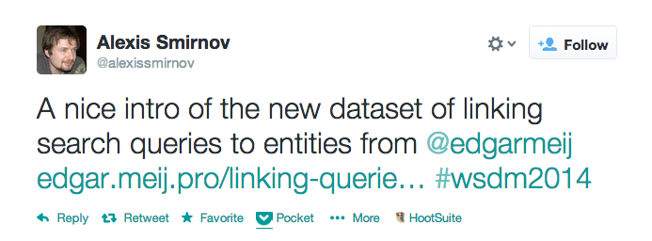
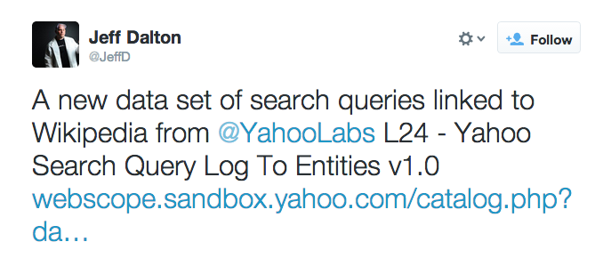
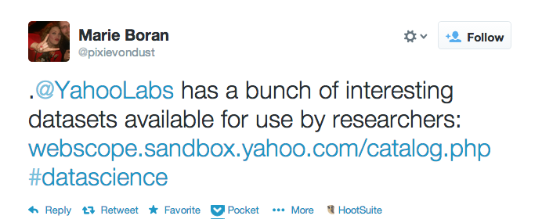
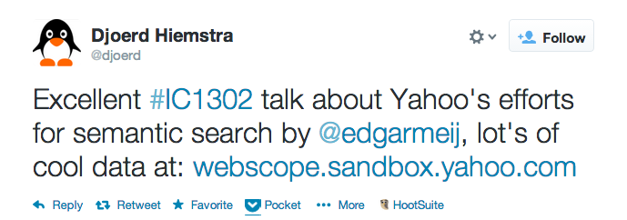
What people are saying about Webscope…..

Slide 14
Here’s how to access the data: http://webscope.sandbox.yahoo.com/ Please attribute back to Webscope, Yahoo Labs. We hope to see your published paper on our Webscope website. Enjoy the data!

