Slide 1
Experience with a First MOOC on Data Science
Bill Howe, PhD
Associate Director
University of Washington eScience Institute

Slide 2
The next few minutes
A three-university partnership in Data Science
Also: The UW eScience Institute
Report from a first Data Science MOOC

Slide 3
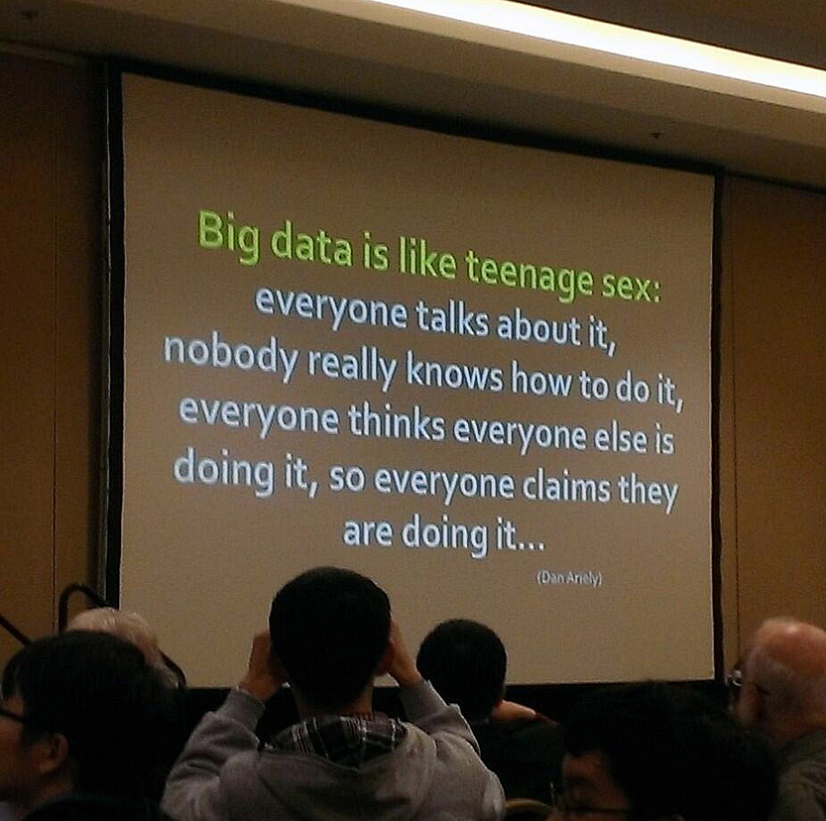
What is data science?
Impact

Slide 4
Theory (last 2000 yrs)
Experiment (last 200 yrs)
Simulation (last 50 yrs)
Data-Driven Discovery (last 5 yrs)
2008-present
Notes:
Observe the world vs. Observe the data
Instruments vs. Algorithms

Slide 5
A 5-year, $37.8 million cross-institutional collaboration to create a data science environment
Notes:
Institutional change rather than specific research projects

Slide 6
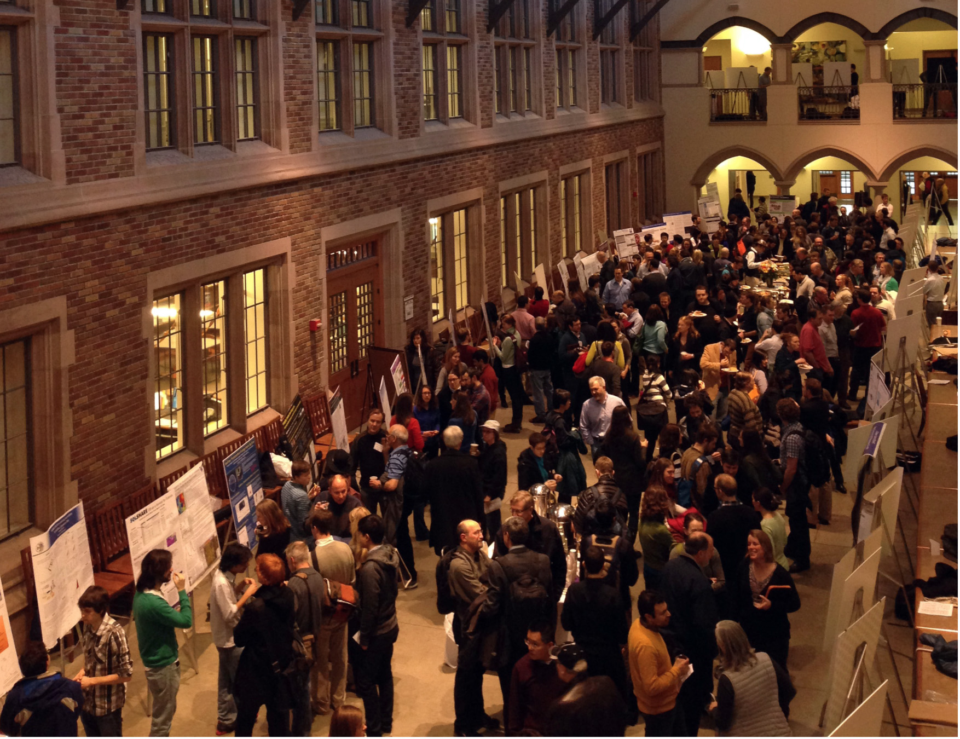
Data Science Kickoff Session:
137 posters from 30+ departments and units

Slide 7
Establish a virtuous cycle
6 working groups, each with
3-6 faculty from each institution

Slide 8
UW Big Data Education Efforts
 | Students |  |  |  | Non-Students
 | CS/Informatics |  | Non-Major |  | professionals | researchers
 | undergrads | grads | undergrads | grads
UWEO Data Science Certificate
IGERT: Big Data PhD Track
CS Courses
Bootcamps and workshops
Intro to Data Programming
Data Science Masters (planned)
MOOC: Intro to Data Science
Incubator: hands-on training

Slide 9
Personal ulterior motives
Capitalize on interest in data science to get students thinking about important problems in science
“The greatest minds of my generation are figuring out how to make people click on ads” -- Jeff Hammerbacher
Experiment with reorganizing diverse material into a single course
Databases, Stats/ML, Visualization
Lift core concepts in data management into the forefront of the data science discussion

Slide 10
Notes:
So in part as an attempt to relate “eSciene” and “data science,” and in part to make sure the idea of data science wasn’t completely taken over by the machine learning people, we ran a massively open online course last Spring called Introduction to Data Science
We taught Scalable Databases, MapReduce, Statistics, Machine Learning, Visualization

Slide 11
Participation numbers
“Registered”: 119,517 totally irrelevant
Clicked play in first 2 weeks: 78,589
Turned in 1st homework: 10,663
Completed all assignments: ~9000 typical attrition for a MOOC
“Passed”: 7022
Forum threads: 4661
Forum posts: 22,900
Fairly consistent with Coursera data across “hard” courses

Slide 12
This Course
tools
abstractions
desktop
cloud
hackers
analysts
structs
stats

Slide 13
tools
abstr.
What are the abstractions of data science?
“Data Jujitsu”
“Data Wrangling”
“Data Munging”
Translation: “We have no idea what this is all about”
Assignment:
Twitter sentiment analysis from scratch
Notes:
“Data Jujitsu”
“Data Wrangling”
“Data Munging”

Slide 14
tools
abstr.
What are the abstractions of data science?
matrices and linear algebra?
relations and relational algebra?
objects and methods?
files and scripts?
data frames and functions?
Assignment:
In-database analytics
Linear algebra in SQL
Notes:
My claim: Relational Algebra is at least as important as Linear Algebra
So we include assignments on in-database analytics. Liner algebra expressed in SQL.

Slide 15
desk
cloud
Not all data fits in memory, but you wouldn’t know this to look at a typical “data science” syllabus
Assignment:
Amazon Web Services assignment for 10k students
600GB social network dataset hosted on AWS’ dime
Processed using Pig + Elastic MapReduce
Students asked Amazon for, and received, free credits to complete the assignment (~$10)
~2k students completed the assignment
Notes:
Our collaborators tell us that loading data into memory with R is the major bottleneck.
It actually changes the science they can do:
I would say that we can start answering questions about macro-ecology (study of relationships between organisms and their environment at large spatial scales).

Slide 16
hackers
analysts
US faces shortage of 140,000 to 190,000 people “with deep analytical skills, as well as 1.5 million managers and analysts with the know-how to use the analysis of big data to make effective decisions.”
-- Mckinsey
Assignment:
Peer-graded visualization in Tableau, R, or Python

Slide 17
An opportunity…
hackers
analysts
1980s - 2000s
“Good at math” → Wall Street
Core discipline doesn’t matter
2010 - beyond
“Good at data” → Anywhere you want
Core discipline doesn’t matter
“Every job is becoming data science”
-- Peter Norvig, Google

Slide 18
Three types of tasks:
stats
structs
1) Preparing to run a model
2) Running the model
3) Interpreting the results
“80% of the work”
-- Aaron Kimball
Gathering, cleaning, integrating, restructuring, transforming, loading, filtering, deleting, combining, merging, verifying, extracting, shaping, massaging
Assignment: Twitter sentiment analysis from scratch
“The other 80% of the work”

Slide 19
structs
stats
“The intuition behind this ought to be very simple: Mr. Obama is maintaining leads in the polls in Ohio and other states that are sufficient for him to win 270 electoral votes.”
Nate Silver, Oct. 26, 2012
Nate Silver
fivethirtyeight.com
source: randy stewart
“…the argument we’re making is exceedingly simple. Here it is: Obama’s ahead in Ohio.”
Nate Silver, Nov. 2, 2012
fivethirtyeight.com
“The bar set by the competition was invitingly low. Someone could look like a genius simply by doing some fairly basic research into what really has predictive power in a political campaign.”
Nate Silver, Nov. 10, 2012
DailyBeast
Notes:
In november 2012, Nate Silver predicted the electoral college map precisely.
He’l be the first one to tell you that the methods used were straightforward: Look at what worked in the past, and use it to predict the future. In this case, the average of state polls have historically done a great job – this is what Nate Silver used.
Perhaps two important takeaways:
1) simple methods and good data are powerful – the right answer does not depend on sophisticated techniques.
2) Most of Silver’s effort went into communicating his results: creating data products such as maps, carefully modeling the uncertainty (which can and did require some mathematical sophistication), and blogging about his reasoning.
Simple methods, and the importance of communication: these themes will come up over and over.

Slide 20
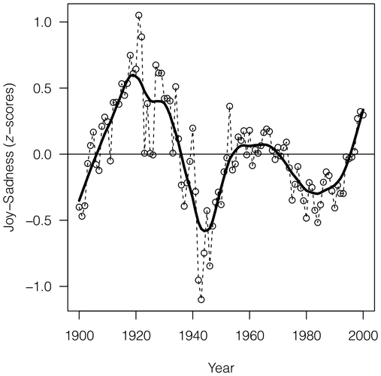
Acerbi A, Lampos V, Garnett P, Bentley RA (2013) The Expression of Emotions in 20th Century Books. PLoS ONE 8(3): e59030. doi:10.1371/journal.pone.0059030
structs
stats
Reources:
Google n-grams
WordNet mood scores
Notes:
Researchers were able to chart historical periods of positive and negative moods through literature. Values above zero indicate generally "happy" periods, and values below the zero indicate generally "sad" periods.

Slide 21
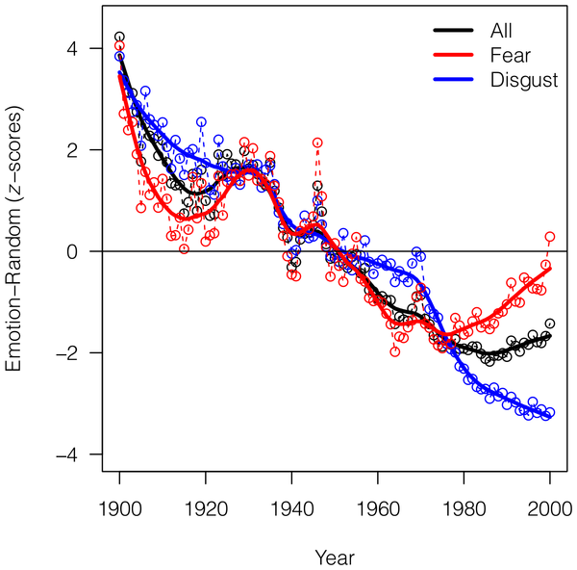
Acerbi A, Lampos V, Garnett P, Bentley RA (2013) The Expression of Emotions in 20th Century Books. PLoS ONE 8(3): e59030. doi:10.1371/journal.pone.0059030
structs
stats
Reources:
Google n-grams
WordNet mood scores

Slide 22
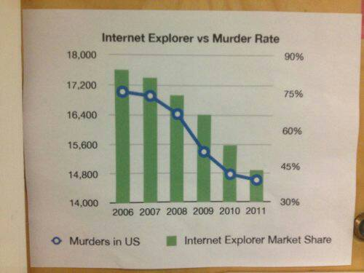
Responsible use of stats and viz…
structs
stats
Notes:
some emphasis on multiple hypothesis testing, effect size instead of significance, sanity checking

Slide 23
Syllabus
Data Science Landscape (~1 week)
Data Manipulation at Scale
Relational Databases (~1 week)
MapReduce (~1 week)
NoSQL (~1 week)
Analytics
Statistics Pearls (~1 week)
multiple hypothesis testing, effect size, bayesian, bootstrap
Machine Learning Pearls (~1 week)
evaluation / overfitting, boosting / bagging, trees / forests, gradient descent
Visualization (~1 week)
Graph Analytics (~1 week)
Guest Lectures
Notes:
Emphasize practical methods over breadth of coverage
For example: random forests aren’t sexy, but they are a favorite method in kaggle competitions. And they don’t require a deep stats background to learn what they are, how they work, and why they work
For example: “practical bullshit detection” was a theme: errors from multiple hypothesis testing, spruious correlations from large datasets, publication bias, fraud detection

Slide 24
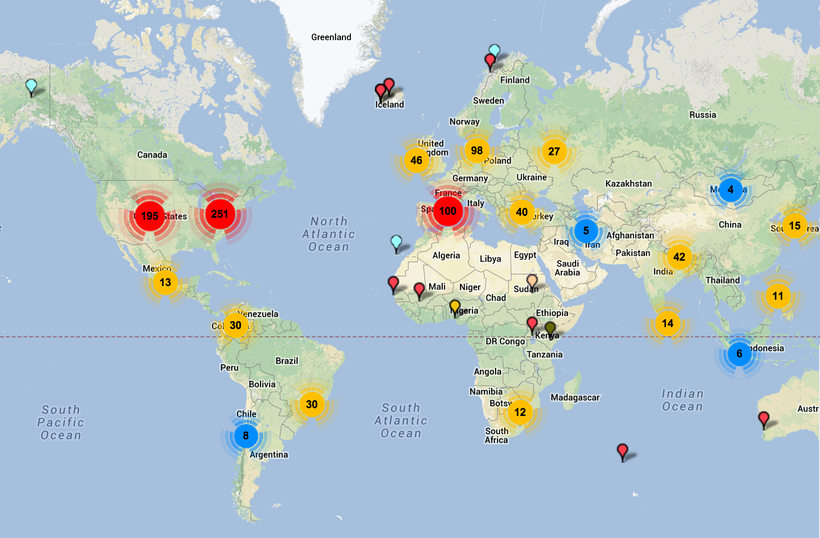
Who took the course?

Slide 25
Who took the course?

Slide 26
Who took the course?

Slide 27
Who took the course?

Slide 28
Who took the course?

Slide 30
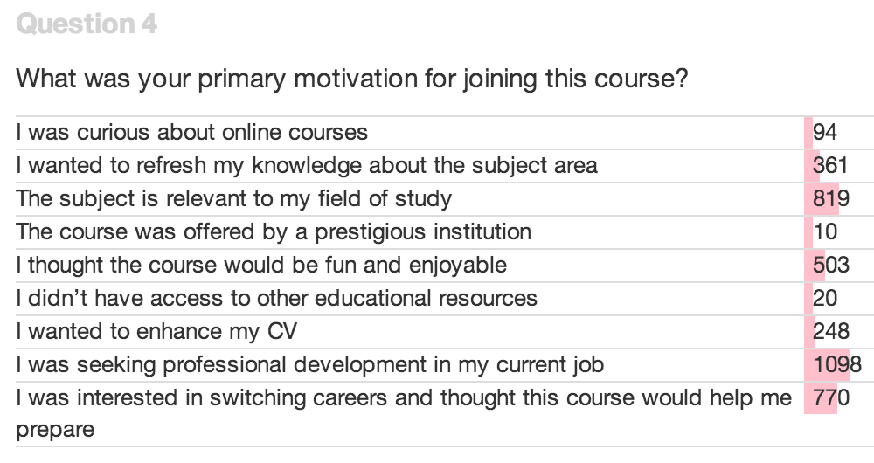

Slide 31
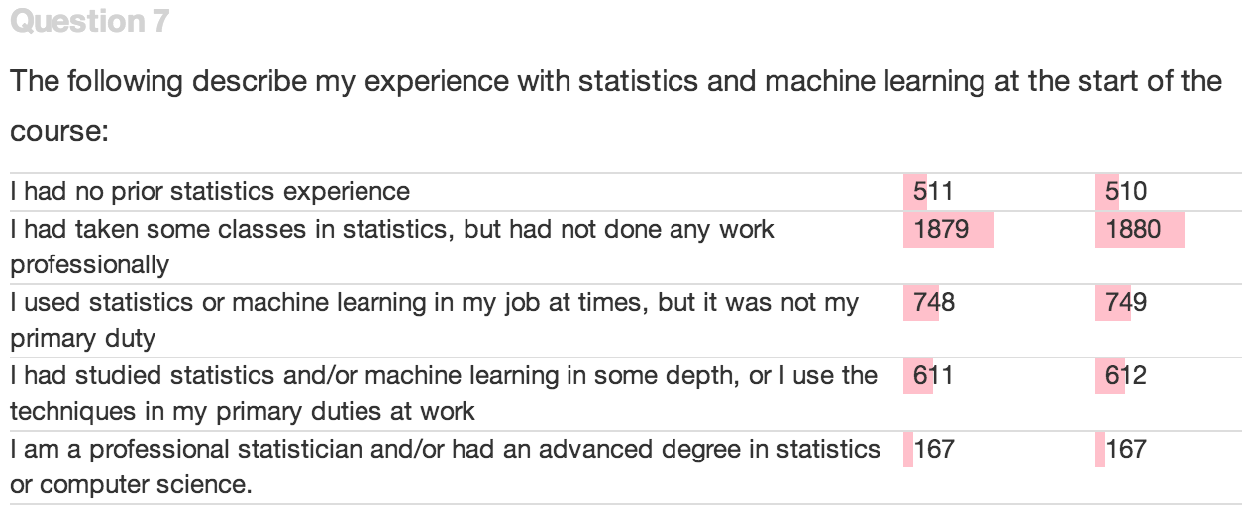

Slide 32
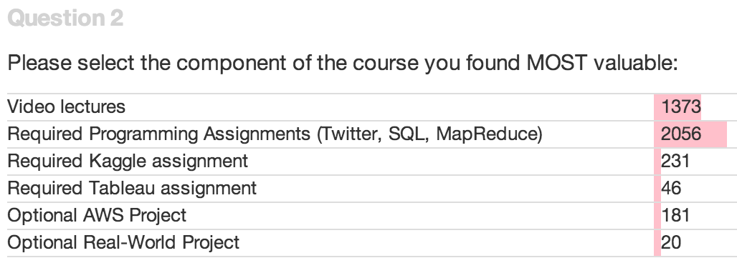

Slide 33
Attrition, video lectures
Number of students watching videos by segment, ordered by time

Slide 34
Attrition, assignments
Number of students completing assignments by part

Slide 35
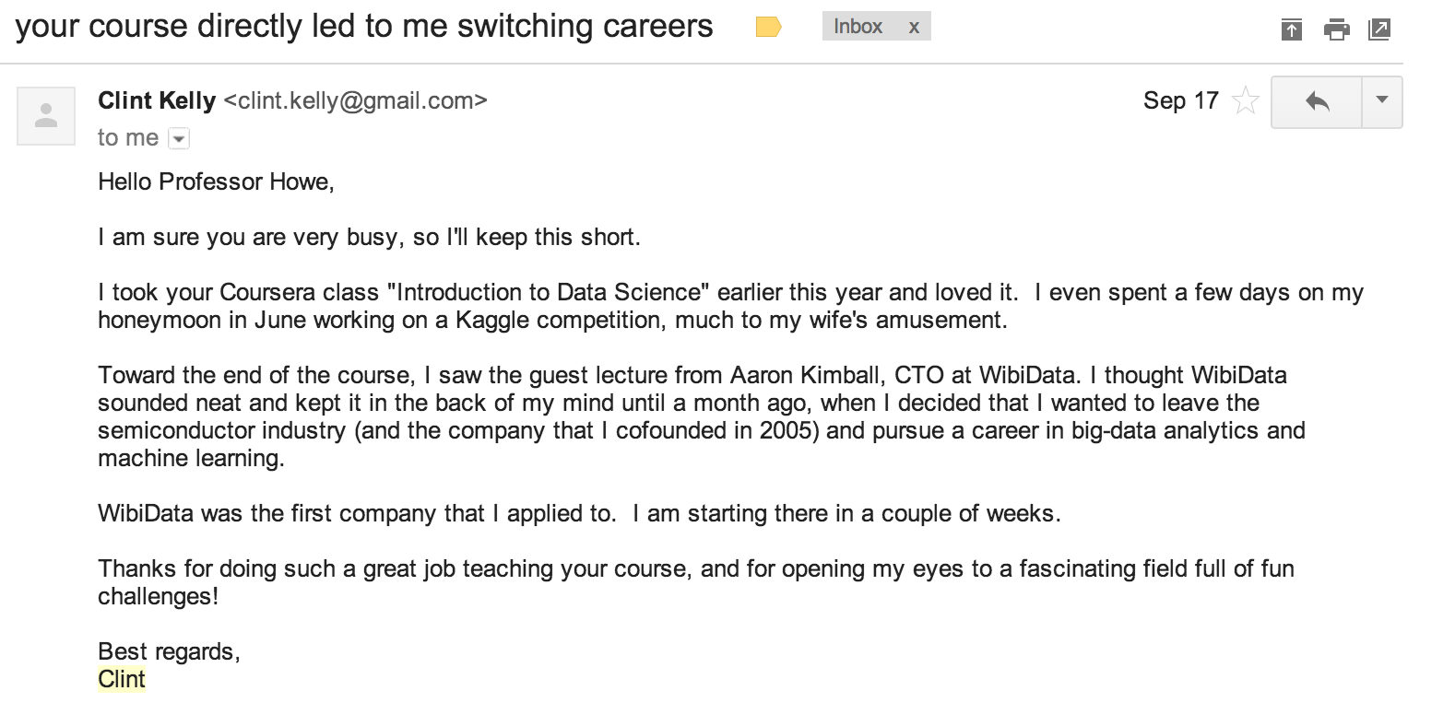
“I even spent a few days on my honeymoon in June workng on a Kaggle competition, much to my wife’s amusement”
“your course directly led to me switching careers”
Notes:
I received hand-written thank you cards

Slide 36
http://escience.washington.edu
billhowe@cs.washington.edu
MOOC “Introduction to Data Science:”
https://www.coursera.org/course/datasci
Certificate program:
http://www.pce.uw.edu/courses/data-science-intro

Slide 37
Where my time went
Lectures: 20 hours of content, maybe 300 hours total
Brand new material
This is obvious, but I was still surprised by how much I rely on classroom discussion. Making every point explicit, up front, and no adaptivity took a ton of time
Discussion forum: Several times / day, most days
Homeworks: Auto-grading and peer assessment 60 hours
Mostly working through TAs
Some pestering of Coursera
Announcements, website, TA meetings, fixing typos, schedule spreadsheet, stress, etc. 50 hours?

Slide 38
Basement Studio
Notes:
“Why is he wearing ths same shirt?”
“Is it just me or are his hands freakishly large?”
2 am

Slide 39
Video

