Slide 1
Big Data
What is it?
Why is it important?
How should we train for it?
Raghu Ramakrishnan
Technical Fellow, Microsoft
Head, Big Data Engineering
Head, Cloud Information Services Lab

Slide 2
Data is Now a Core Asset
Ability to cost-effectively do things we couldn’t dream of before
    More data: more is observable, measurable
    Less cost: Capture, storage, compute
    Easier: Rent-and-go with cloud services
    Scalable analytic tools: Get more out of data
  Biggest bottleneck: Trained people!

Slide 3
Big Data Applications

Slide 4
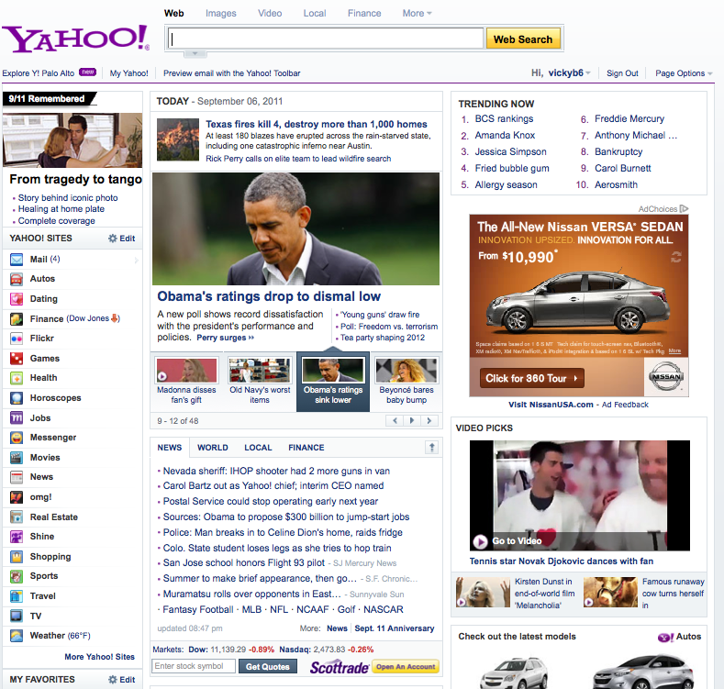
Web Scale
1.5+M read rps
4 Key Platforms
~2B User Ids
10,000+ servers
10 Geo Zones
~750M Uniq Users*
175+M Users in US
285+M Mail users
102B emails/month
40+ Countries
13+B Ad serves/day
11B visits/month
All Data from July/Aug. Worldwide unless indicated to the contrary
* Yahoo!-branded sites
4
4/11/2014
Notes:
4

Slide 5
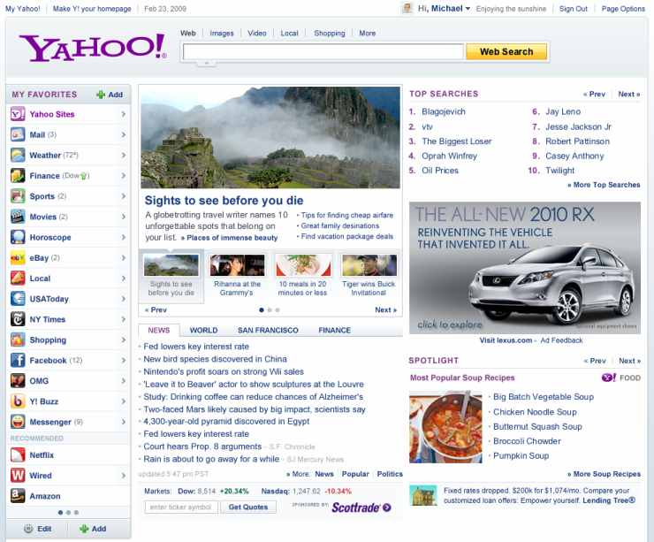
Content Optimization http://visualize.yahoo.com
Key Features
Package Ranker (CORE) Ranks packages by expected CTR based on data collected every 5 minutes Dashboard (CORE) Provides real-time insights into performance by package, segment, and property Mix Management (Property) Ensures editorial voice is maintained and user gets a variety of content Package rotation (Property) Tracks which stories a user has seen and rotates them after user has seen them for a certain period of time
Key Performance Indicators
Lifts in quantitative metrics Editorial Voice Preserved
Recommended links
News Interests
Top Searches
+79% clicks
vs. randomly selected
+300% clicks
vs. one size fits all
+43% clicks
vs. editor selected
Notes:
5
Instant My! add from D White

Slide 6
CORE Modeling Overview
Online Learning
Online regression models,
time-series models
Model the temporal dynamics
Provide fast learning for per-item models
Offline Modeling
Exploratory data analysis
Regression, feature selection,
collaborative filtering (factorization)
Seed online models & explore/exploit
methods at good initial points
Reduce the set of candidate items
Data streams
Hadoop pipelines
PNUTS NoSQL Store
Near real-time user feedback
Hadoop
Pig (SQL)
Explore/Exploit
Multi-armed bandits
Find the best way of collecting real-
time user feedback (for new items)
Large amount of
historical data
(user event streams)

Slide 7
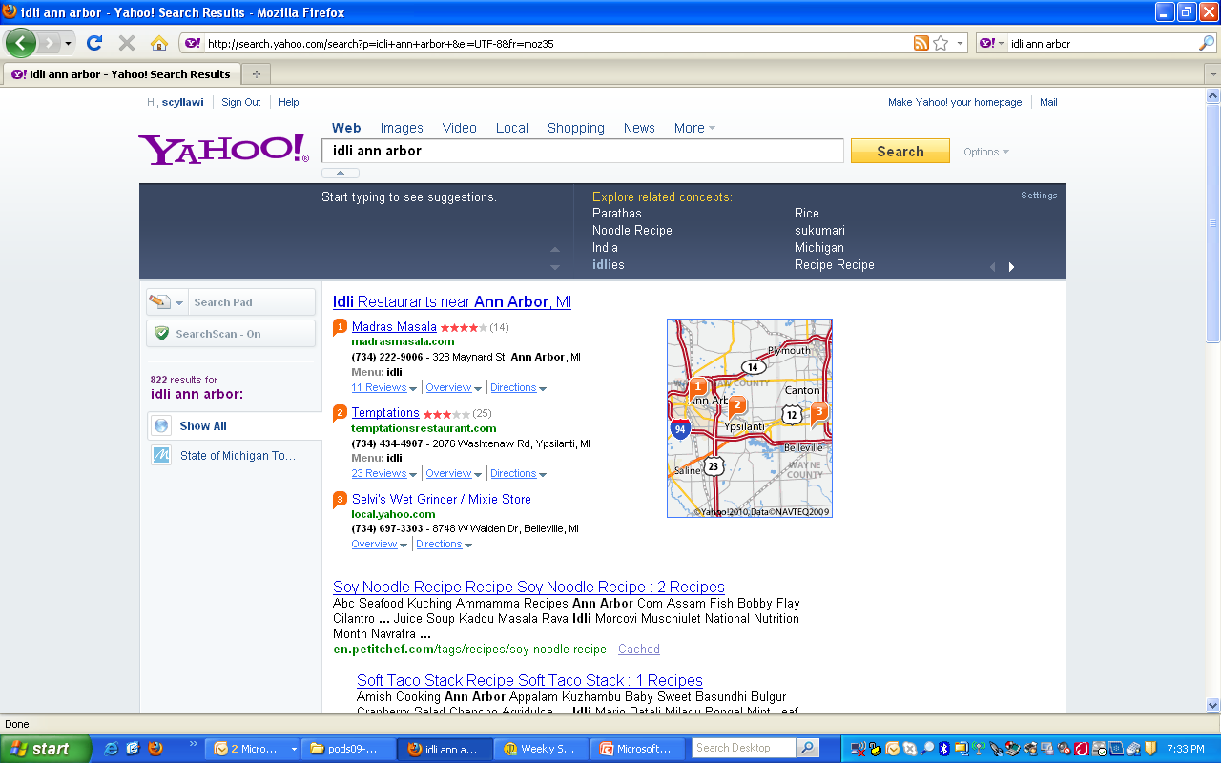
Notes:
Extracted metadata affects search ranking

Slide 8
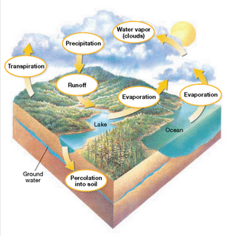
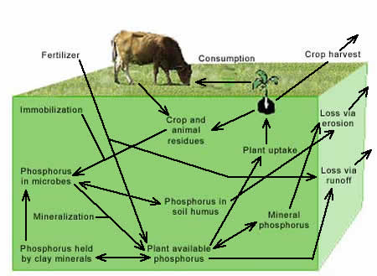
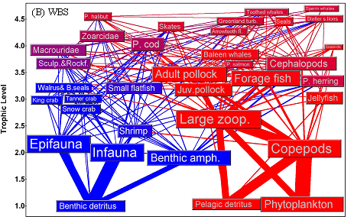
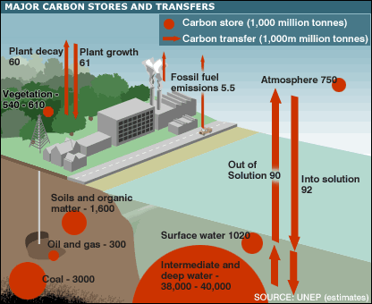
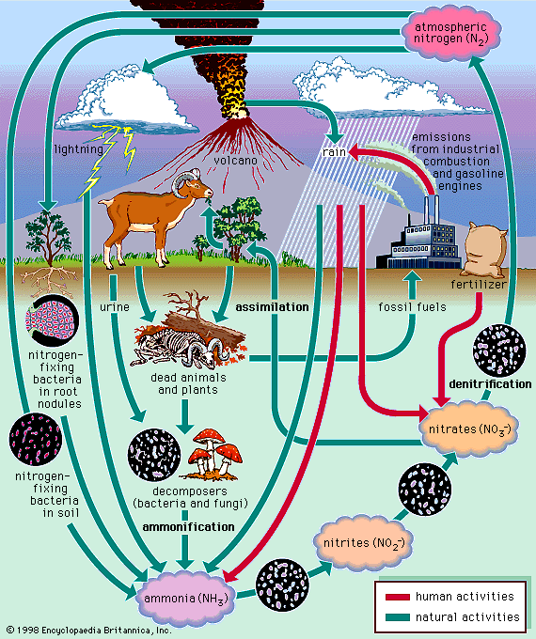
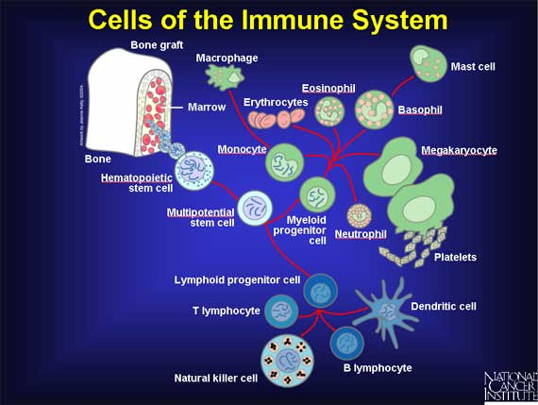
Earth’s (life) support systems
Ecology is the scientific study of interactions among organisms and their environment
Hydrology
Farming
Fisheries
Carbon
Nitrogen
Immune system
(Slide courtesy Drew Purves, MSR)

Slide 9
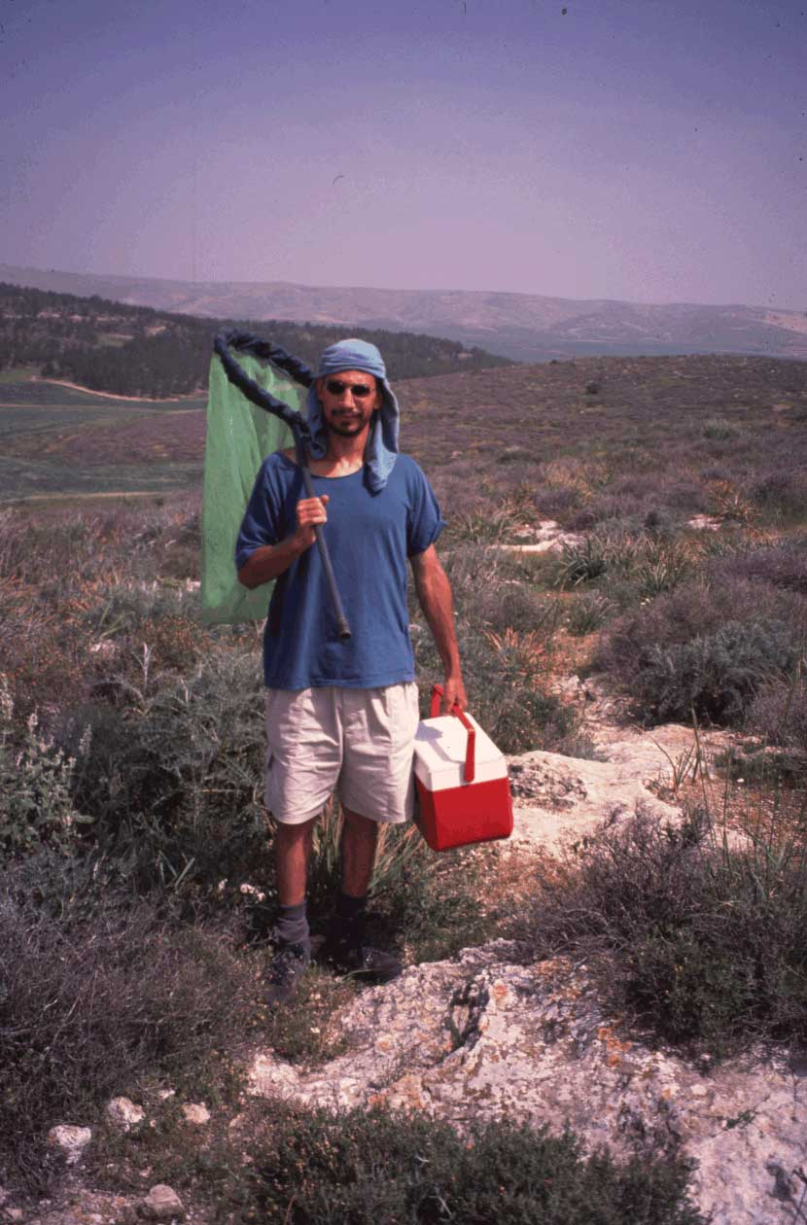
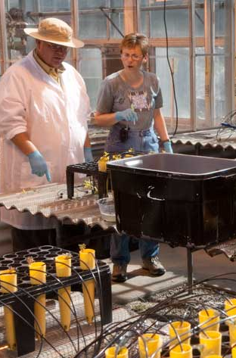

Traditional ecology
Field work
Experiments
Theorizing
(Slide courtesy Drew Purves, MSR)

Slide 10
Some huge questions we can’t answer
Will forests accelerate or slow climate change?
What would we do if a new disease hit wheat? Or the pollinators died out?
How can we feed 9+ billion humans, with less water, less oil and less phosphorous?
How can we safely genetically engineer crops?
How can we optimize supply chains to minimize environmental impact?
Is there enough to water for both agriculture, and industry, in the future?
How many species are there on Earth? How can we predict them?
Will the world become more fire prone as the climate changes?
(Slide courtesy Drew Purves, MSR)

Slide 11
Enter a new kind of ecology?
Traditional Ecology | “Joined up” Ecology
Qualitative insights | Quantitative predictions
Driven by academic curiosity | Driven by society’s needs
Fragmented into subdisciplines, divorced from other fields of study | Integrated across subdisciplines, and with other fields of study
Divorced from policy | Connected to policy
Huge shortage of all data | Huge abundance of some data, huge shortage of other data
Computation and statistics an afterthought – a necessary evil! | Computational techniques and statistics central – and exciting!
A disparate set of software tools | An interoperable suite of software tools
(Slide courtesy Drew Purves, MSR)

Slide 12
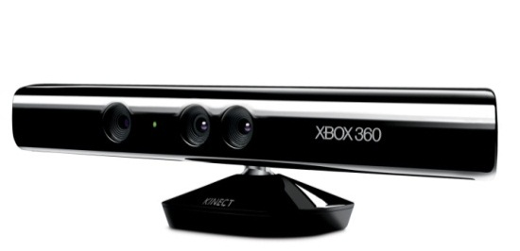
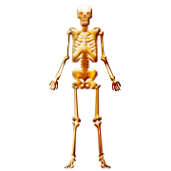
Data Created by People—Kinect
The Kinect is an array of sensors.
  Depth, audio, RGB camera…
SDK provides a 3D virtual skeleton.
  20 points around the body.
  30 frames per second.
Inexpensive and ubiquitous.
  Between 60-70M sold by May 2013.
(Slide courtesy Assaf Schuster, Technion)

Slide 13
Telemetry
Data: Time series of logs from user activity and system probes (live and historical archives)
  CTP (Customer Touch Points) data
  STP (System Touch Points) data
Goal:
  Determine possible causes of outages, particularly the long ones
  Predictive and forensic
Planned steps:
  Identification of the team that can resolve an outage
  Visualization of time series to understand long outages that are difficult to resolve
  Discover and learn patterns associated with outage trends and use them to predict outages

Slide 14
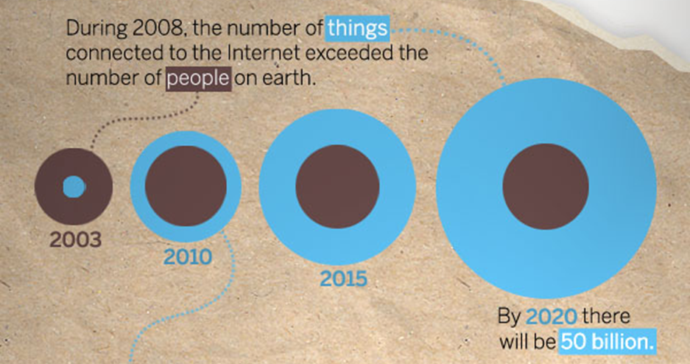
IoT: Connected Devices, Continuous Observations, Instantaneous Action, Rich History
http://blogs.cisco.com/news/the-internet-of-things-infographic/
Gartner: 50 billion intelligent devices by 2015 and 275 Exabytes per day of data being sent across the Internet by 2020
Notes:
2008: more things than people
2020: 50 billion

Slide 15
Big Data Links
H.V. Jagadish et al., CACM (to appear)
  Big Data and its Technical Challenges
D. Agrawal et al., CACM 56(6):92-101 (2013)
  Content Recommendation on Web Portals
Gary Marcus, New Yorker
  April 3 2013 http://www.newyorker.com/online/blogs/elements/2013/04/steamrolled-by-big-data.html
  May 23 2013 http://www.newyorker.com/online/blogs/culture/2012/05/google-knowledge-graph.html
Alan Feuer, NYT, Mar 23, 2013
  http://www.nytimes.com/2013/03/24/nyregion/mayor-bloombergs-geek-squad.html?pagewanted=all&_r=0
Quentin Hardy, NYT, Nov 28, 2012
  http://bits.blogs.nytimes.com/2012/11/28/jeff-hawkins-develops-a-brainy-big-data-company/
Steve Lohr, NYT, Feb 11, 2012
  http://www.nytimes.com/2012/02/12/sunday-­review/big-­datas-­impact­‐in‐the-world.html
Economist, Nov 2011
  http://www.economist.com/blogs/dailychart/2011/11/big‐data‐0
Forbes special report on Big Data, February 2012
  http://www.forbes.com/special‐report/data-driven.html
T. Hey et al., (Eds) (2013)
  The Fourth Paradigm: Data-­Intensive Scientific Discovery.
J. Manyika et al., McKinsey Global Institute, May 2011
  Big Data: The Next Frontier for Innovation, Competition, and Productivity.
NPR, Nov 2011
  http://www.npr.org/2011/11/30/142893065/the‐search‐for‐analysts-to-make-sense-of-big-data

