Slide 1
Can Knowledge Bases Help Accelerate Science?
Christopher Ré
Stanford University
Lots of help from Shanan Peters (Wisc) and Ce Zhang

Slide 2
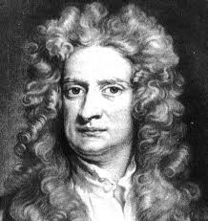
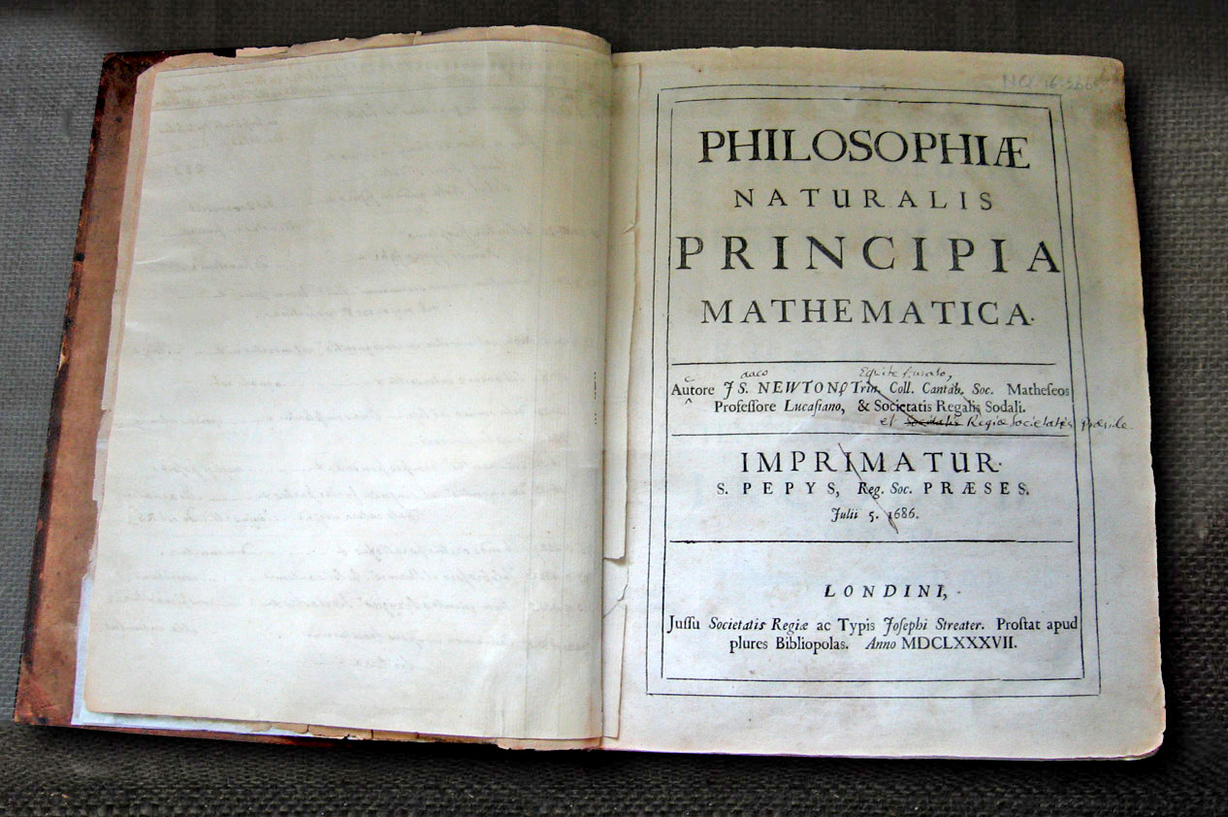
Newton
Principia Mathematica

Slide 3
Turns out,
Newton was not alone

Slide 4

Millennia of Knowledge in Libraries

Slide 5
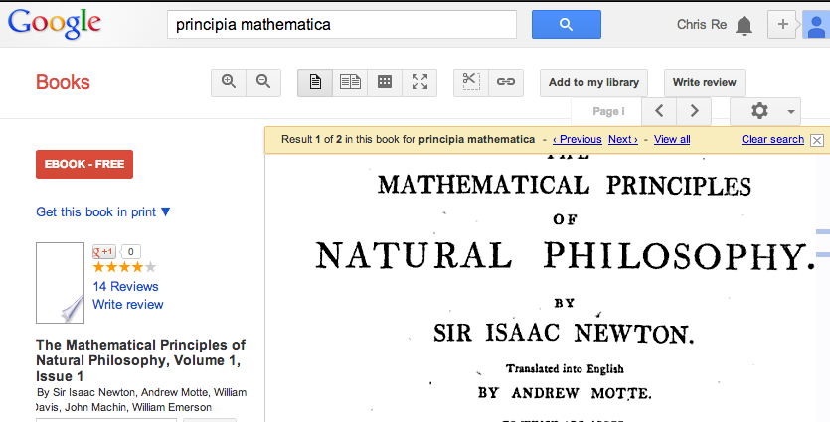
Now: freely available & digital

Slide 6
The world’s scientific knowledge is accessible.

Slide 7

But we’re still human …
Notes:
http://blogs.telegraph.co.uk/culture/markmason/100054373/how-many-books-will-you-read-in-your-lifetime/

Slide 8
The world’s scientific knowledge is accessible, but not readable.

Slide 9
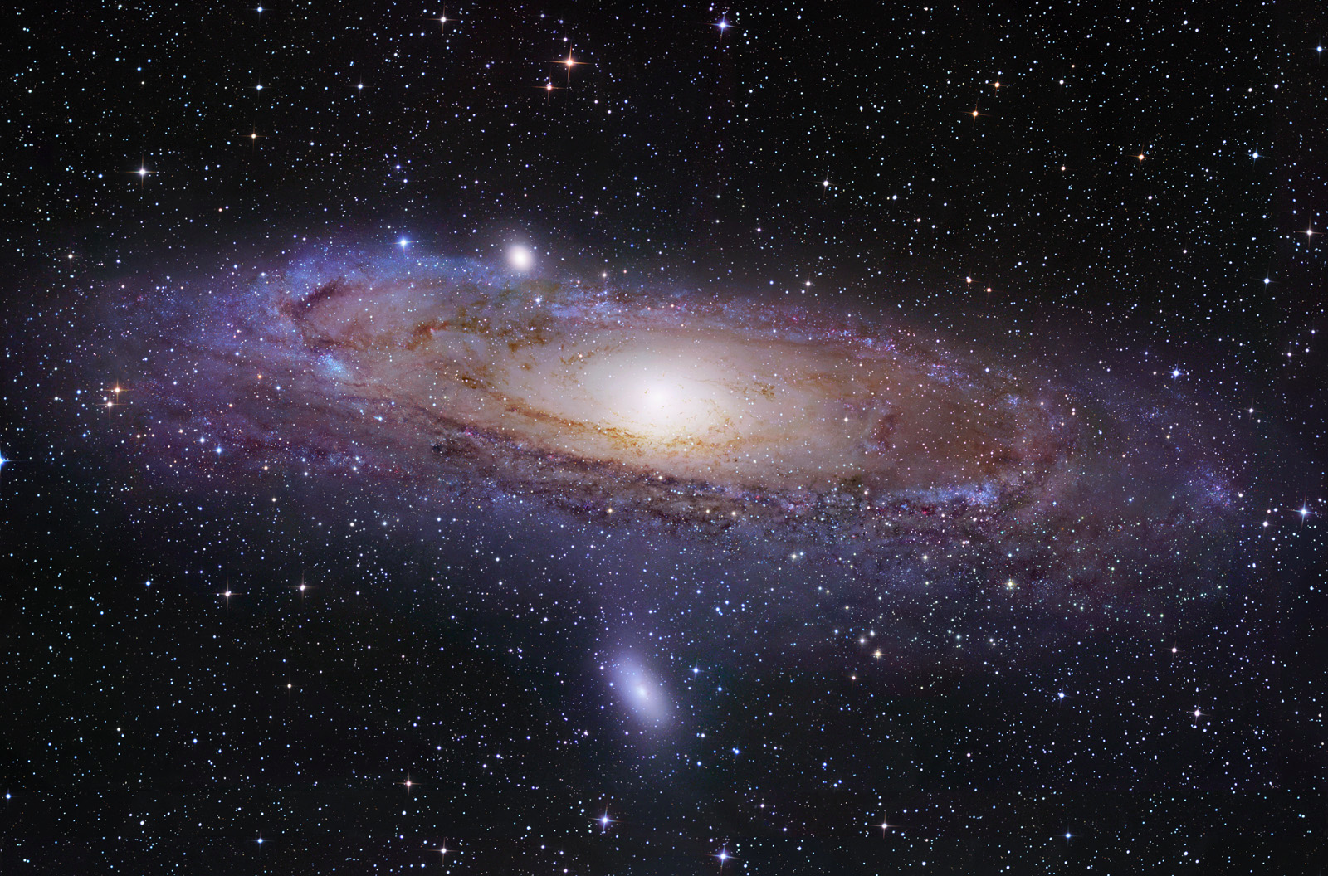
Visible (4%)
Dark Energy/Matter
(96%)
Dark Data:
the great unseen mass of data

Slide 10

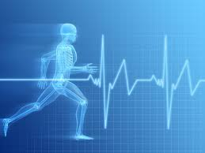

Today, some pressing problems require
macroscopic knowledge
Climate & Biodiversity
Financial Markets
Health

Slide 11
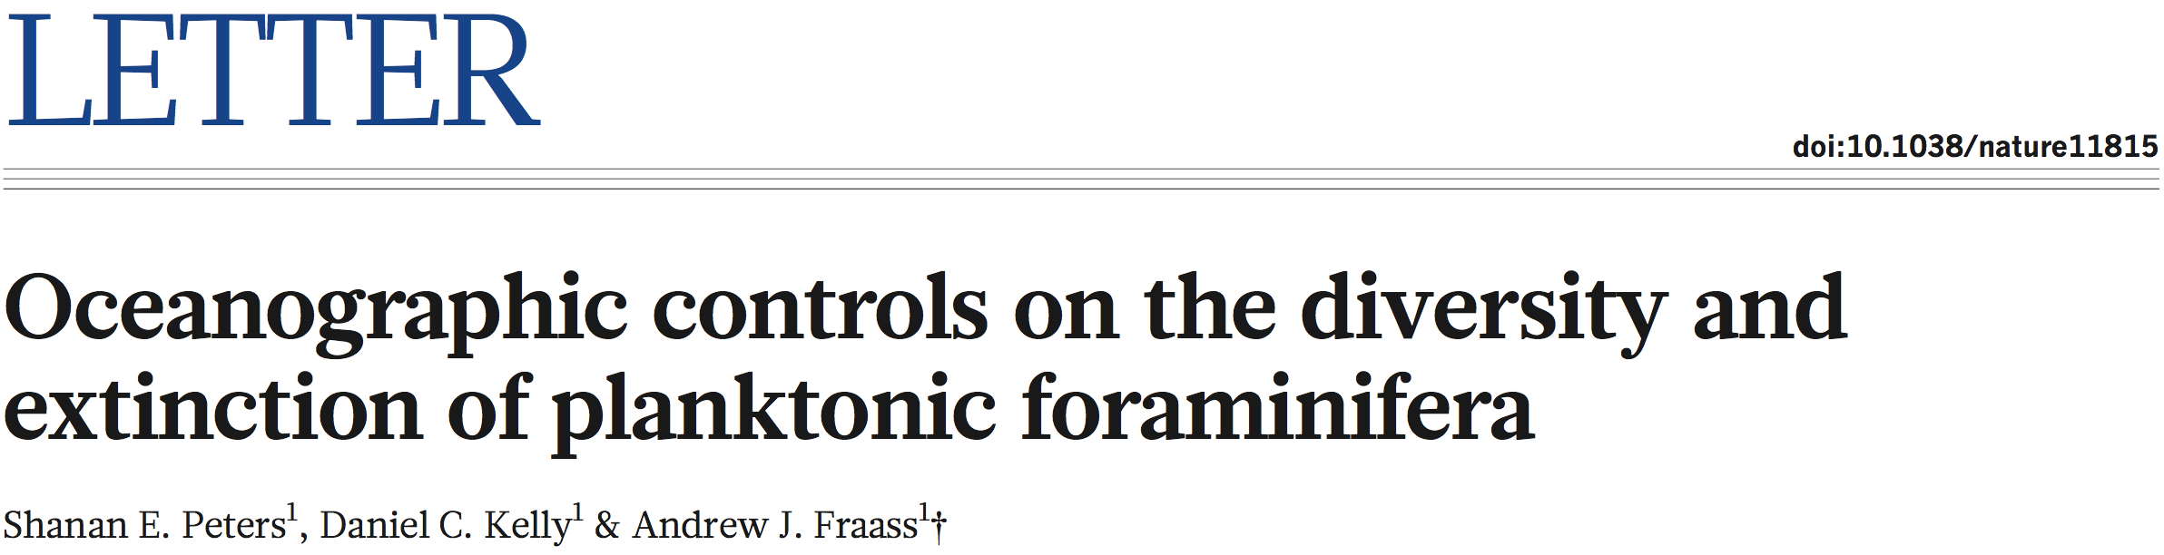
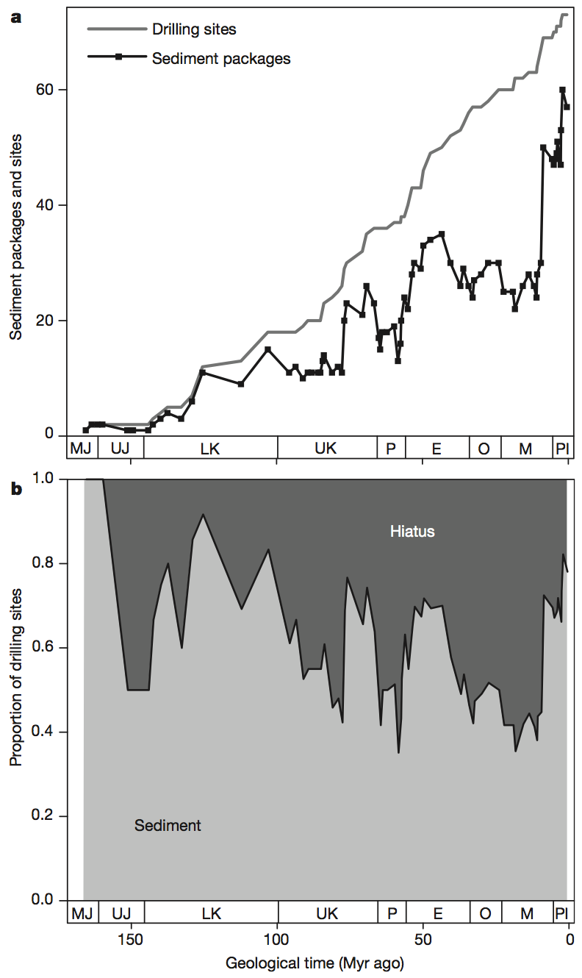
Examples
Manually
Constructed!
“Here we use macrostratigraphic data from the Atlantic Ocean basin to show that changes in global species diversity and rates of extinction among planktonic foraminifera have been linked to tectonically and climatically forced changes in ocean circulation and chemistry from the Jurassic period to the present.”

Slide 12
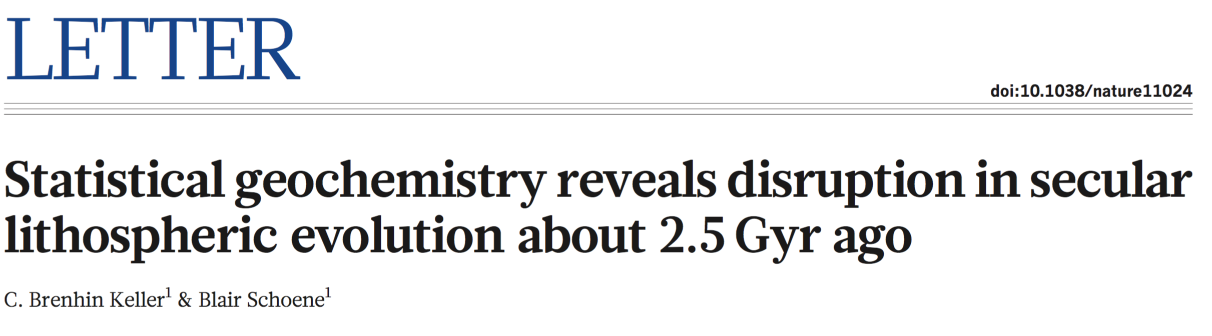
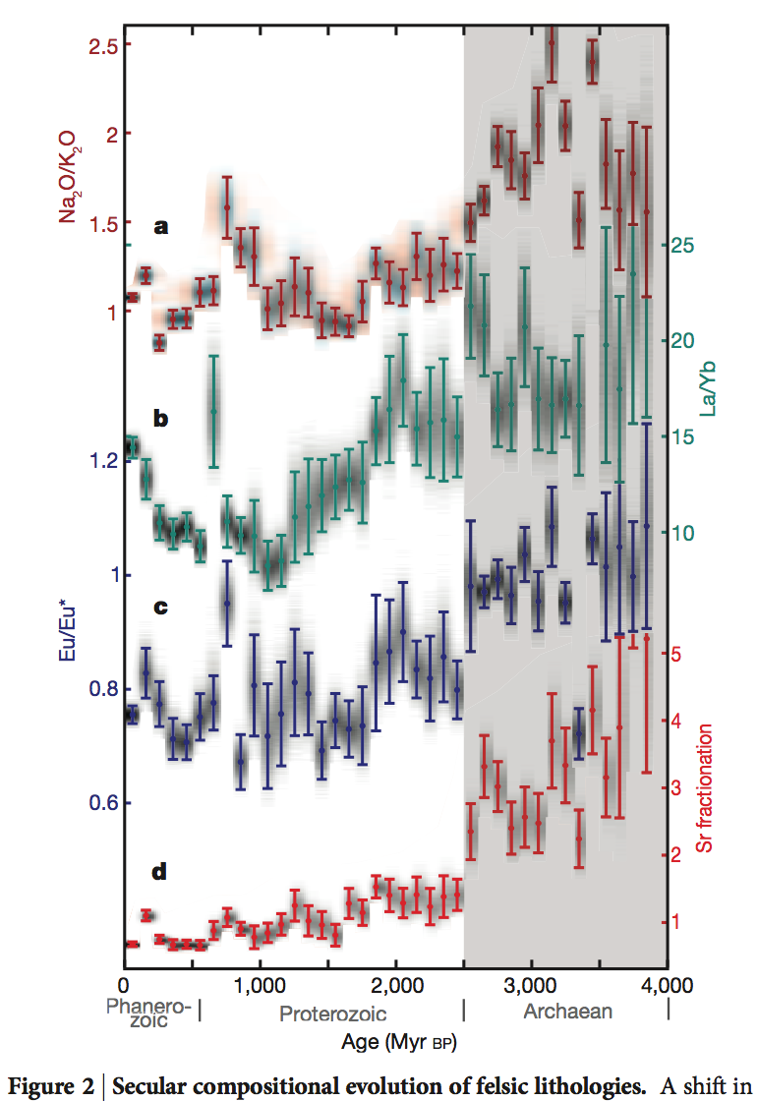
Examples
Manually
Constructed!
“Here we apply statistical sampling techniques to a geochemical database of about 70,000 samples from the continental igneous rock record to produce a comprehensive record of secular geochemical evolution throughout Earth history.”

Slide 13
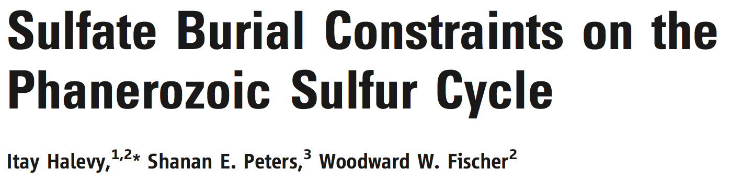
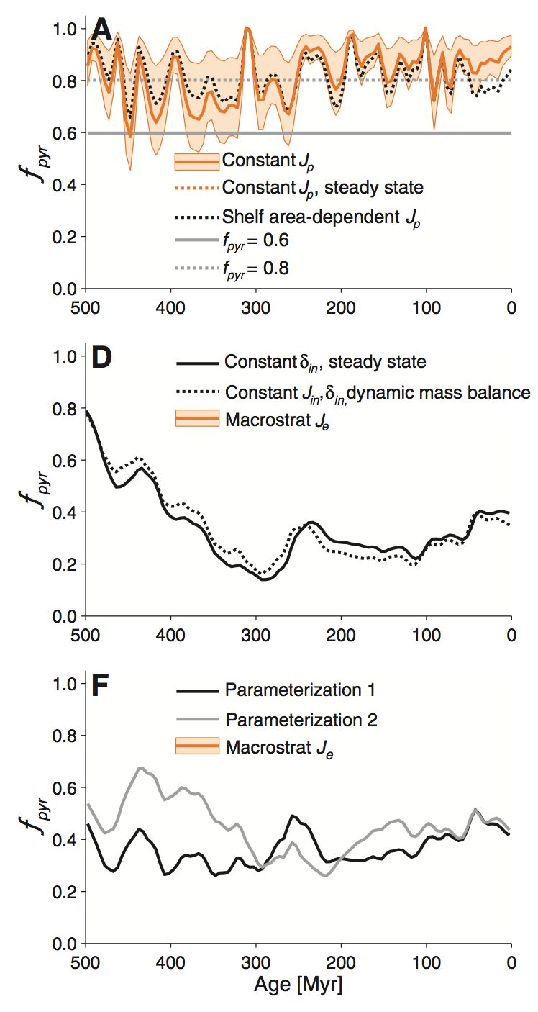
Examples
Manually
Constructed!
“We quantified sulfate burial over Phanerozoic time, using a comprehensive macrostratigraphic database, which includes 23,843 lithostratigraphic rock units in 949 geographic locations across North America and the Caribbean.”

Slide 14
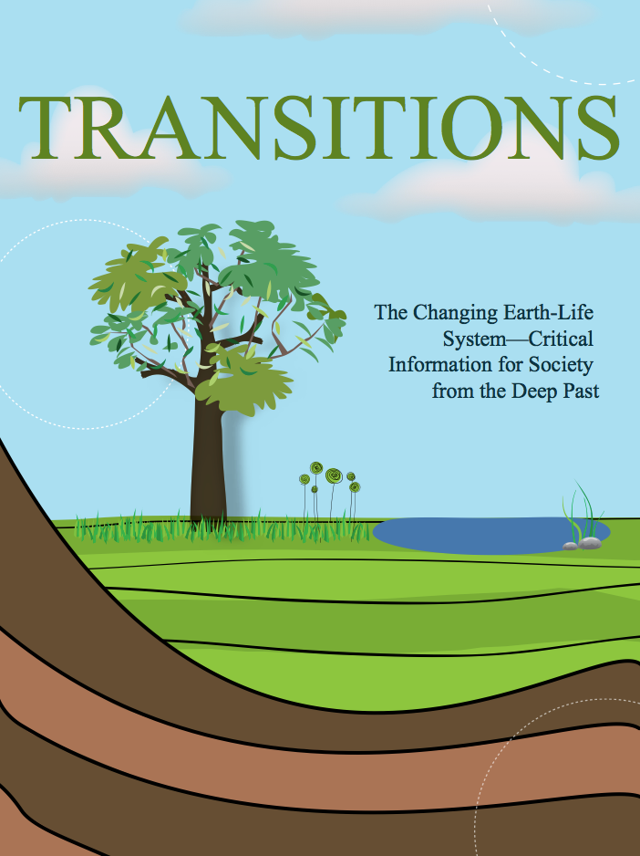
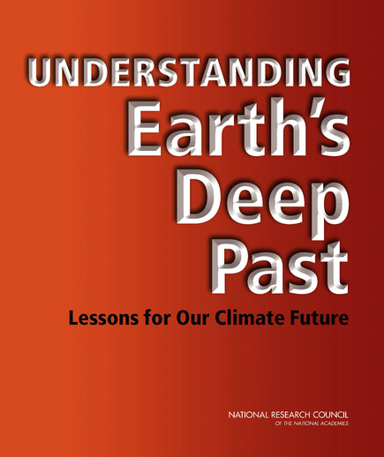

“Sample-based data and their synthesis are
the only way to address many important questions"
Problem: Manually constructing synthetic databases usually exceeds time frame of grant or Ph.D.

Slide 15
Could we build a machine to read for us?

Slide 16
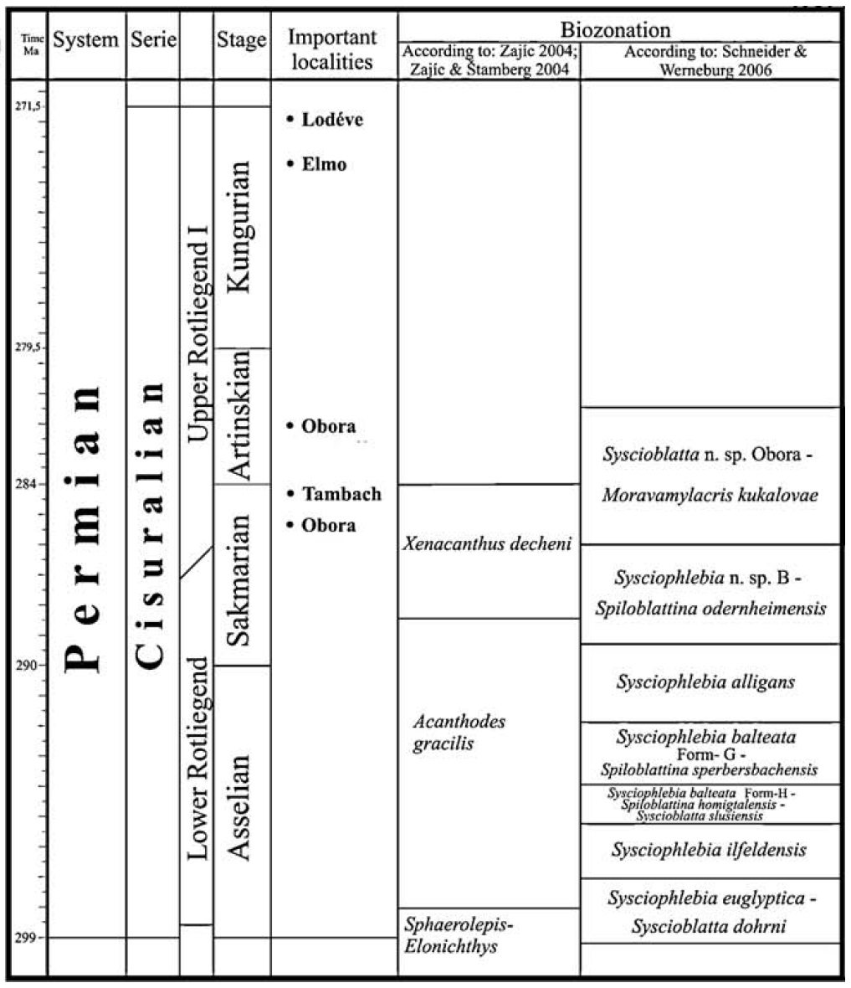
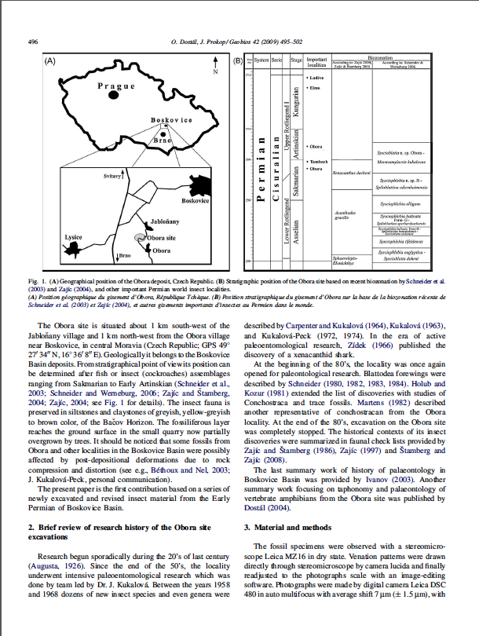
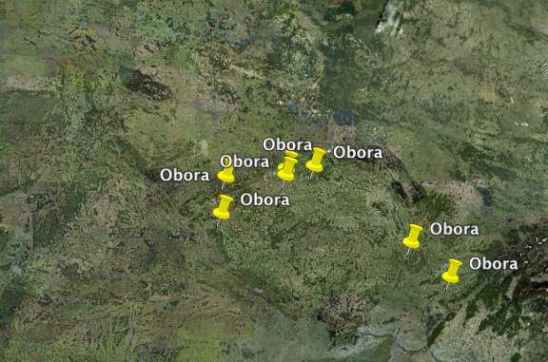
Data are buried in tables, but not in a self-contained way
Appear
(Location,Genus)
Obora
Moravamylacris
?

Slide 17
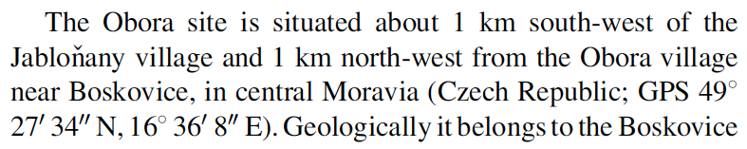
Data are buried in tables, but not in a self-contained way
Appear
(Location,Genus)
Obora
Moravamylacris
?

Slide 18




Machines that can
read may be coming.

Slide 19

PaleoDeepDive
Shanan Peters (Geo) and Miron Livny (CS)
DeepDive.Stanford.edu (Ce Zhang et al.)

Slide 20
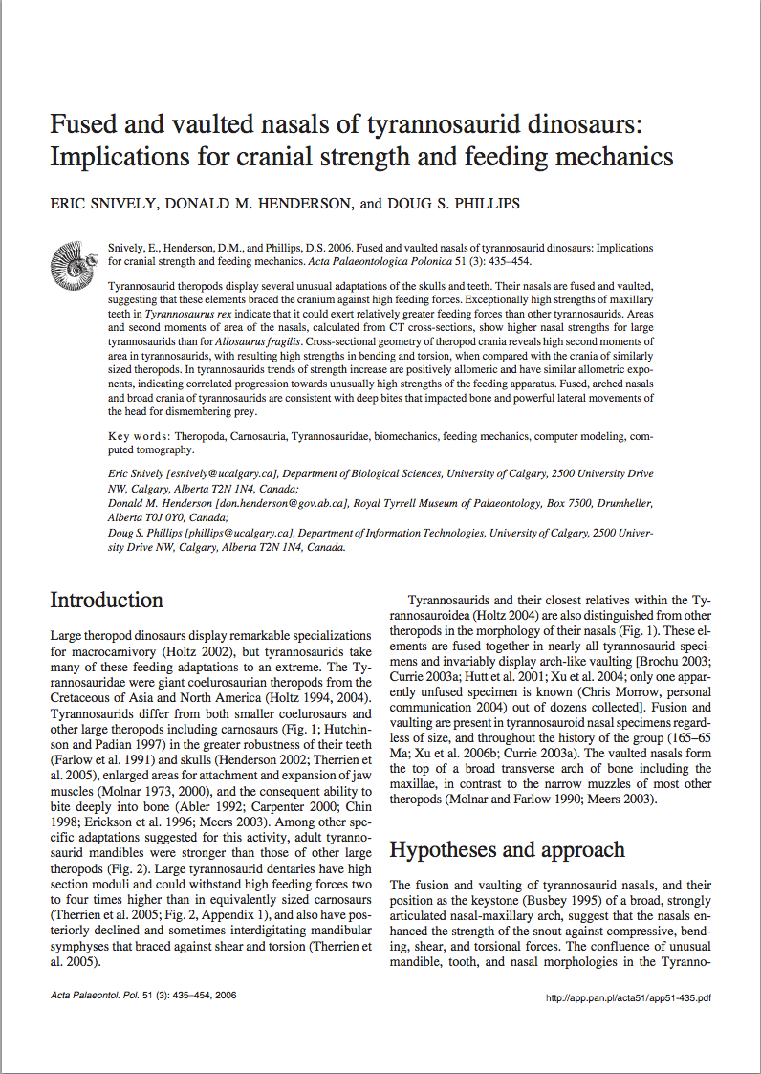
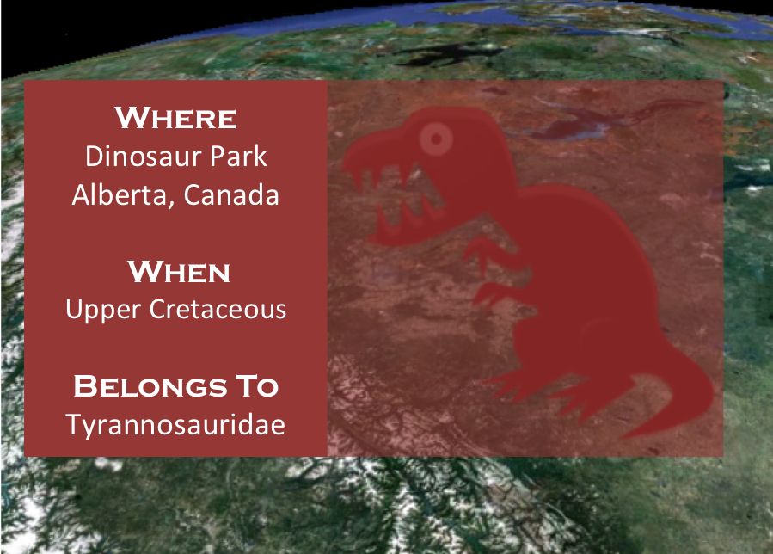
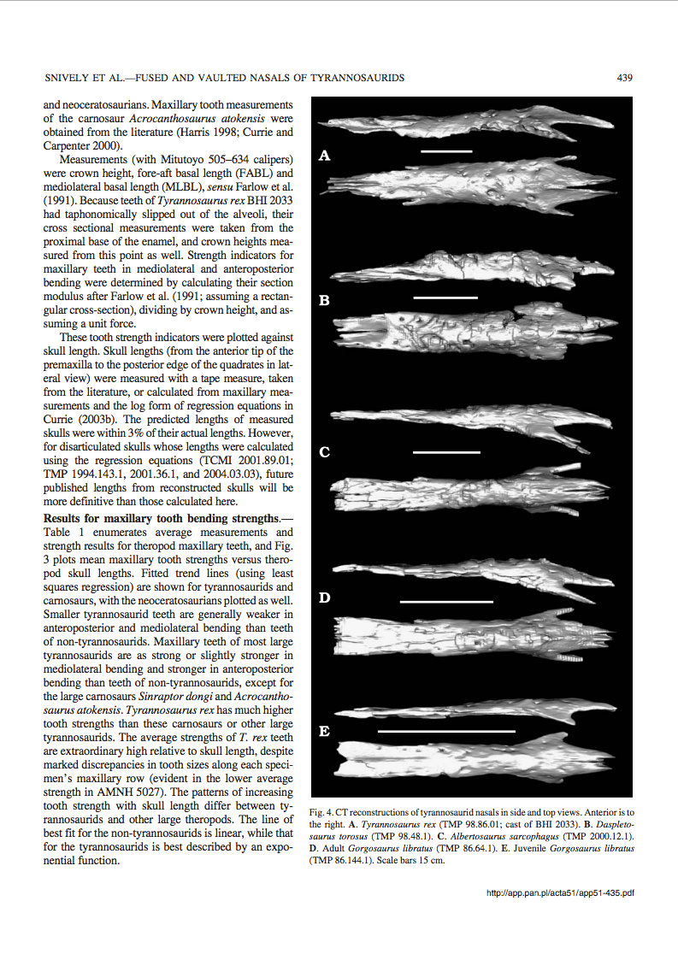
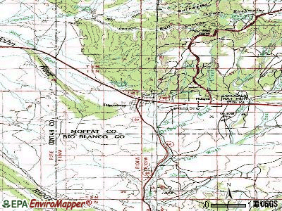
PaleoDeepDive
The Goal
Extract paleobiological facts to build higher coverage fossil record.
T. Rex are found dating to
the upper Cretaceous.
Statistical Inference
Appears(“T. Rex”, “Cretaceous”)
Tasks
Every character, word, part of speech is a variable
Statistical Inference on billions of variables.

Slide 21



PaleoDB
PaleoDeepDive
Human-created
Machine-created
329 volunteers
10x documents.
100x extractions.
13 years
46K documents
191 Papers,
21 Nature/Science
Preliminary Precision
Preliminary
Precision
PaleoDB Volunteers: 0.80
PaleoDeepDive: 0.93
See youtube video for more info
Notes:
http://paleodb.org/bridge.pl?a=publications

Slide 22
Challenges for Geo with
synthetic knowledge bases.
Challenges for CS with
synthetic knowledge bases.

Slide 23
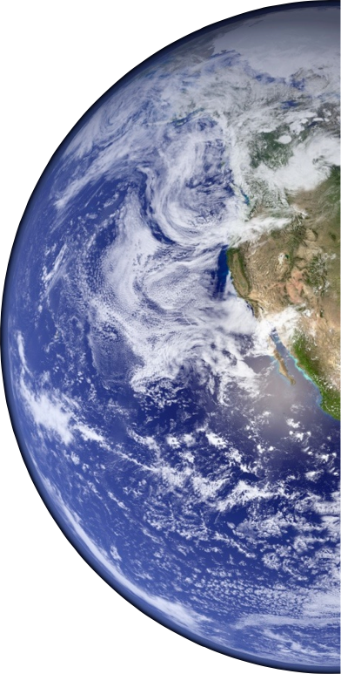
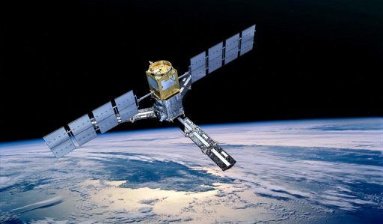
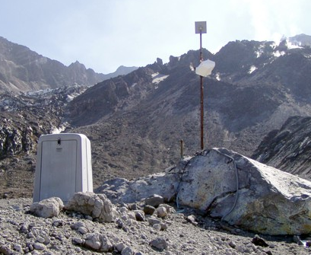
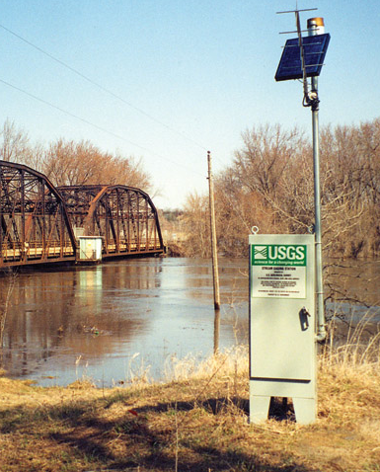
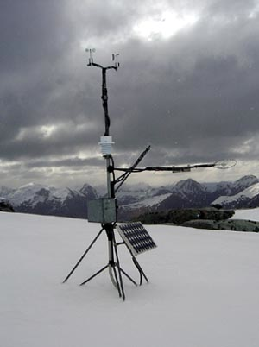
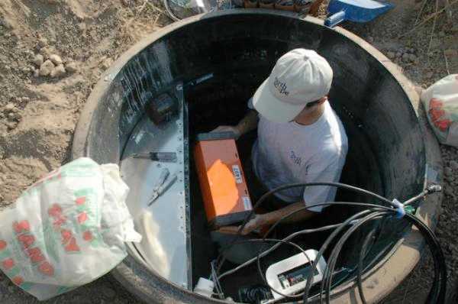
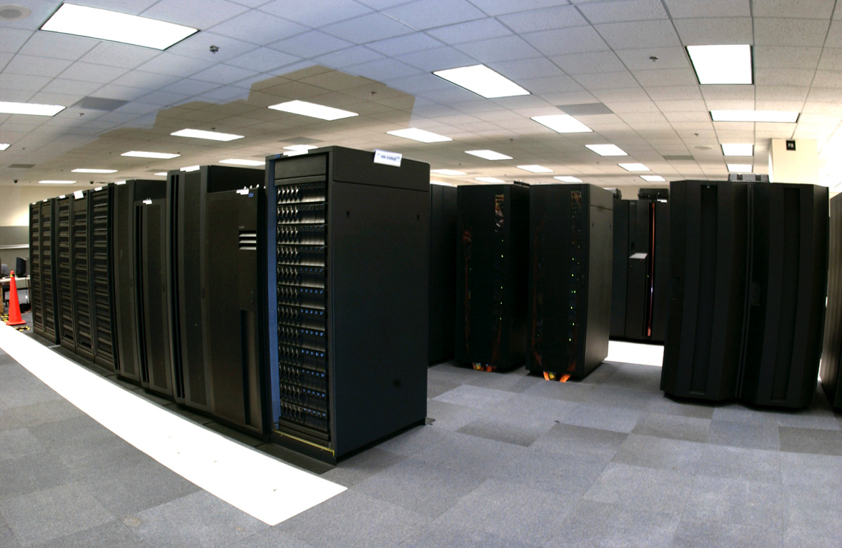
Sensor-based
instrument-gathered data
curated data structures, national data centers
student training is
data-analysis focused

Slide 24
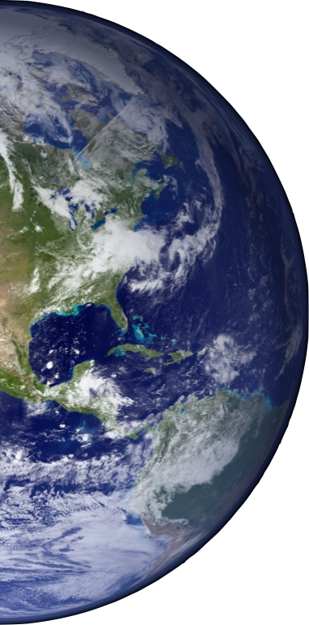
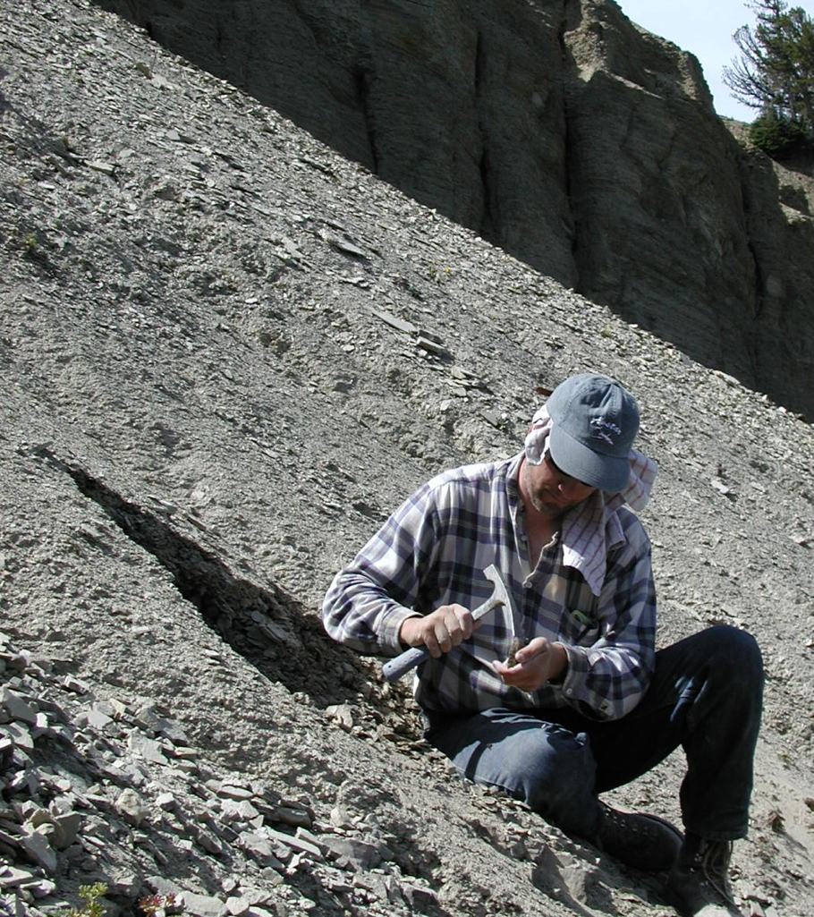
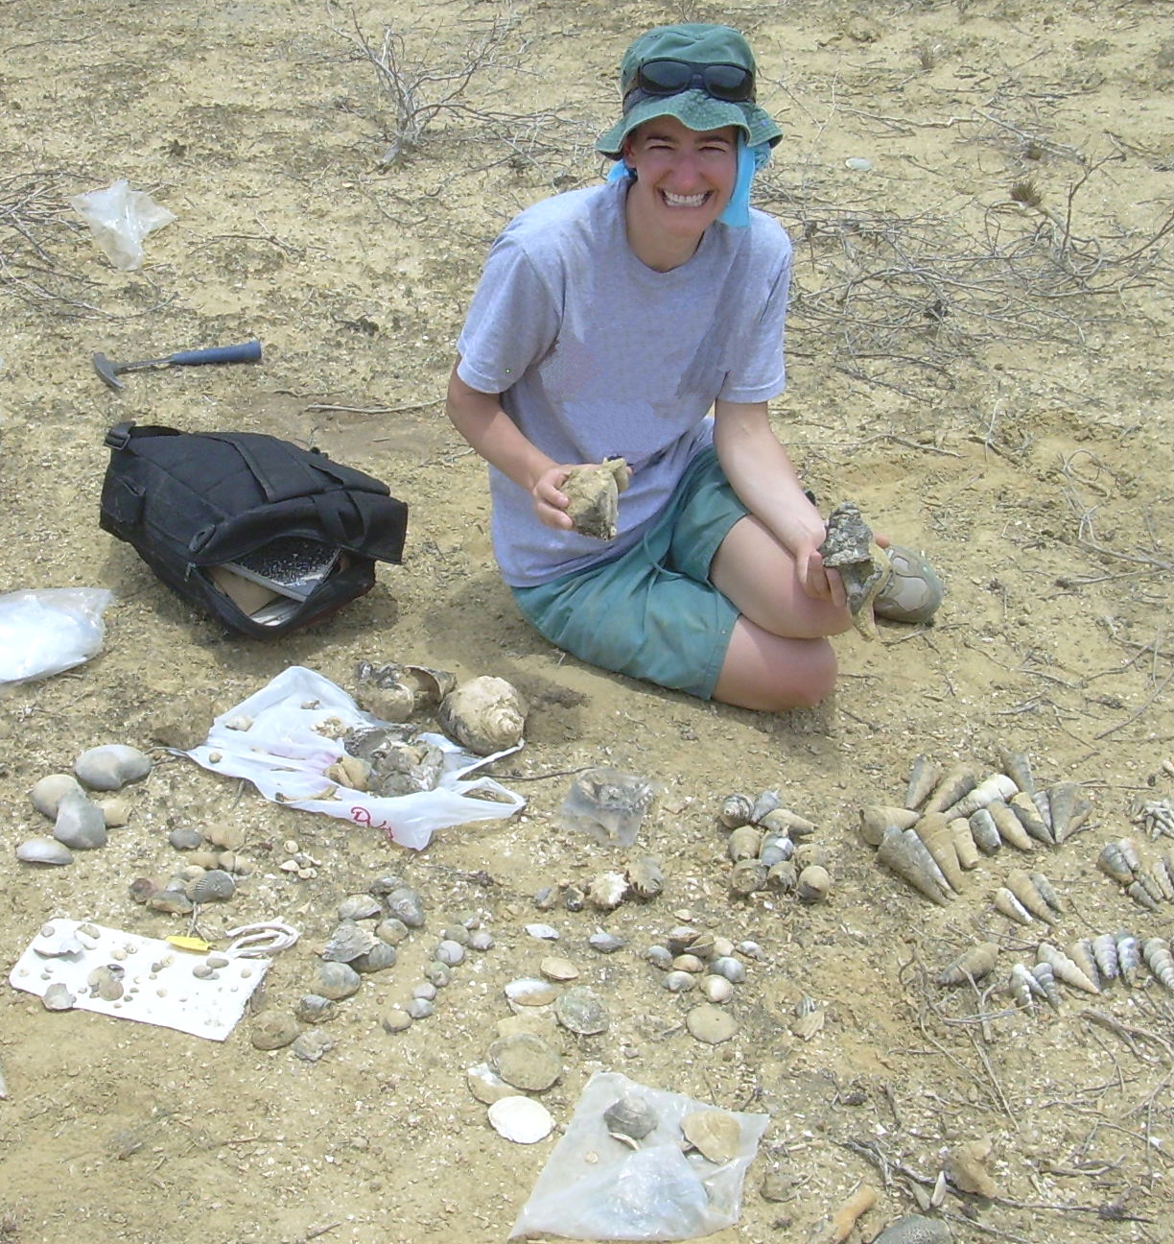
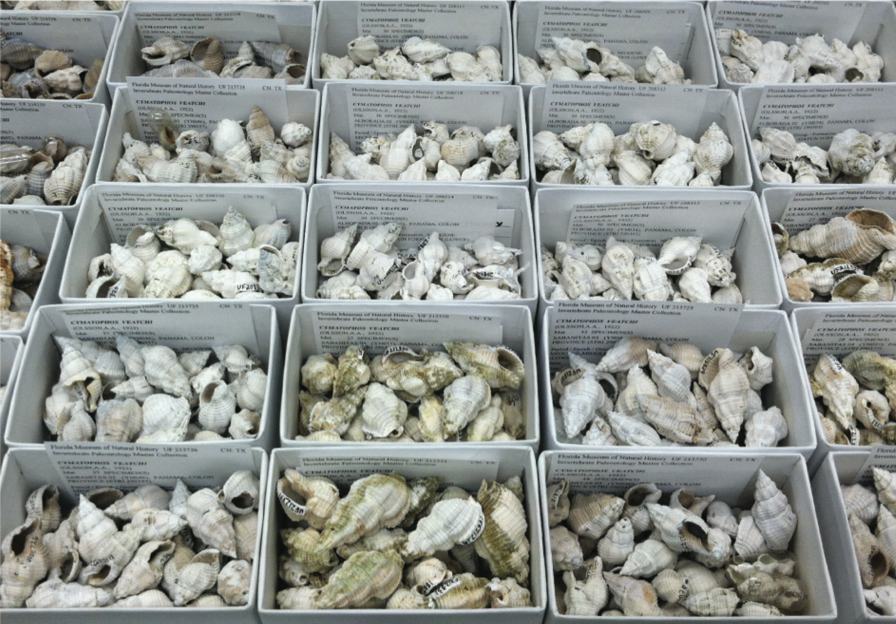
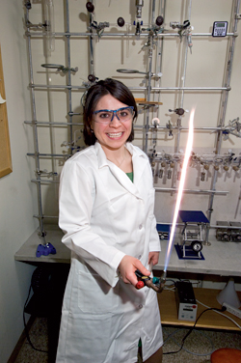
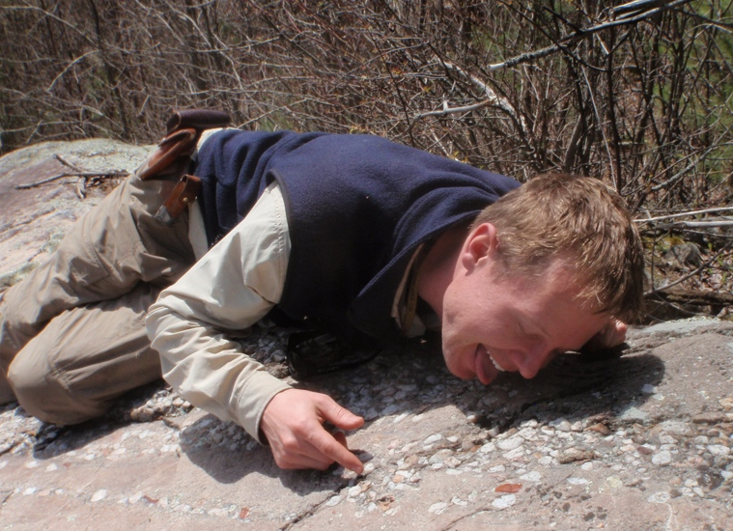
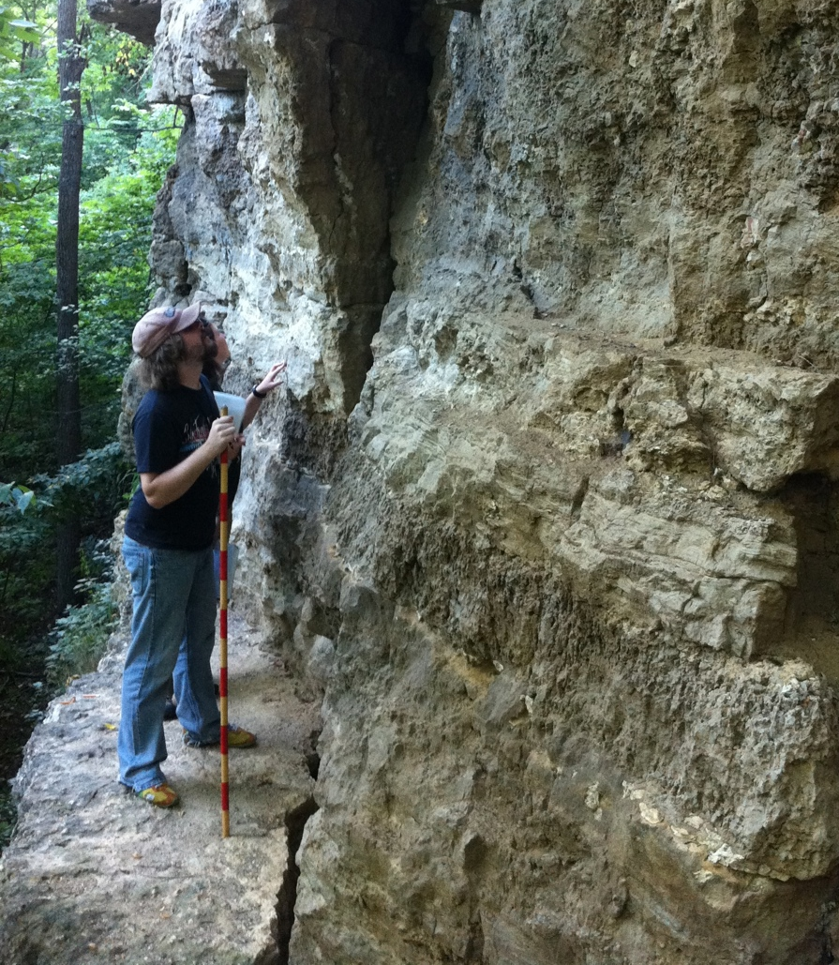
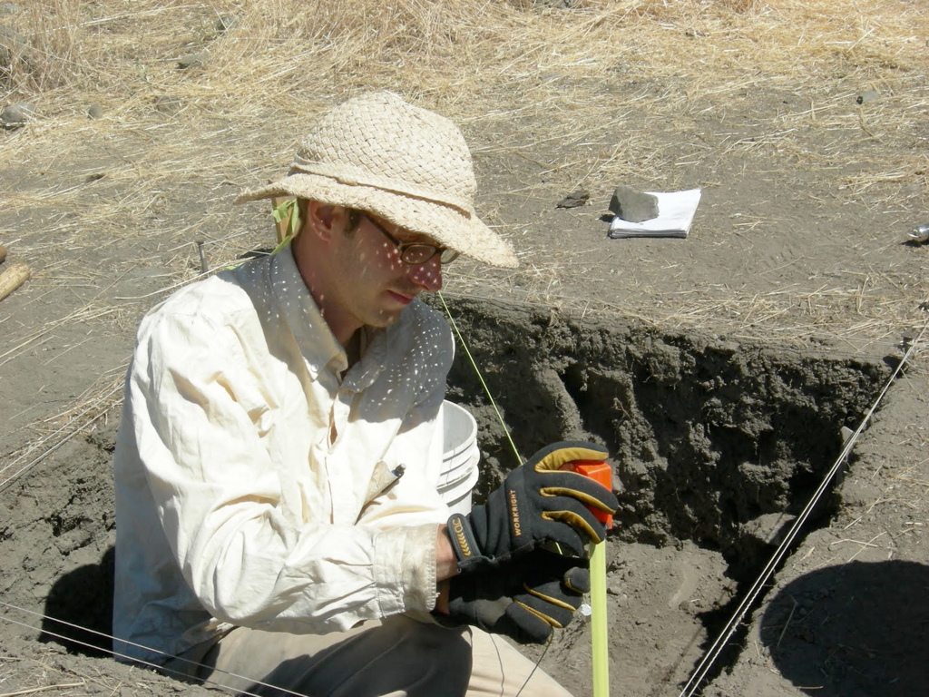
human-gathered data
Sample-based
no universal data structure, individually managed
student training is
data-generation focused

Slide 25
Many students not taught how to ask questions with synthetic datasets
Already some schools (Chicago).
Paleo Course at Stanford this year.

Slide 26
Students lack CS & Data Management Skill
Wait for them to grow up
90% of students take a CS class at Stanford.

Slide 27
Skeptical of even human-generated synthetics.
Wait for them to die?
Statistical thinking is taking hold

Slide 28
Challenges for Geo with
synthetic knowledge bases.
Challenges for CS with
synthetic knowledge bases.

Slide 29
Challenge: the right level of abstraction?
[CIDR13, SIGMOD14]

Slide 30
http://deepdive.stanford.edu/
Think about features, not algorithms.
What you want, not how to get it.

Slide 31
PaleoDeepDive: It’s all features!
Task
Every character, word, part of speech is a variable
Statistical Inference on billions of variables.
User tells us things like:
- (incomplete) dictionaries of places,
How to resolve places to lat-longs,
words that indicate a relationship,.
How does a user do it?

Slide 32
Users: Features & Transformation
(SQL+Python+Scala+Java)
This is actual code.
deepdive.inference.factors: {
smokesFactor.input_query:
"SELECT people.* FROM people"
smokesFactor.function:
"Imply(people.smokes, people.has_cancer)"
smokesFactor.weight: "?(people.gender)”}
If person smokes, influences “have cancer”
Likelihood may depend on gender.
No reference to algorithms: Just features. DD does the rest. (All code open sourced)

Slide 33
How do you debug? Calibration plots.

Slide 34


Meaningful probability, not just scores
BelongsTo(Taxon, Taxon)
(Autoceta, Cetacea)
(Aulophyseter, Hoplocetinae)
(Acantharodeia, Dasypodidae)
(Acdestis, Caenolestidae)
(Castoridae, Boreofiber)
Actual
Ideal

Slide 35
Candidates for
improvement
Output
to users
Goal
Notes:
Latest Paleodump: https://www.assembla.com/code/paleodeepdive/subversion/nodes/38/trunk/paleodumps/Jan4/

Slide 36
Suggests it may be possible to think about features not algorithms using probabilities

Slide 37
Challenge: Supporting Feature Engineering.
[CIDR13, VLDB13, SIGMOD14,NIPS12]

Slide 38

Feature Engineering: A Key Challenge
Good features allow a simple model to beat a complex model. [Halevy et al. 09]
Observed what we call E3 cycle [CIDR13, Vision]
Grunt-work
data munging
Features from data
Explore
Extract
E3 Cycle
Evaluate
Evaluate quality against data
Claim: Getting through this cycle quickly is the key.
Notes:
43, 44

Slide 39

swank.stanford.edu

Slide 40
Conclusion
Machines that can
read may be coming.
Science with synthetic data is an emerging challenge for CS and Domains

