Slide 1

Discussions of Emery Brown’s Talk on
STATISTICS AND BIG DATA CHALLENGES IN NEUROSCIENCE
Xihong Lin
Harvard T.H. Chan School of Public Health
Harvard Faculty of Arts and Sciences

Slide 2
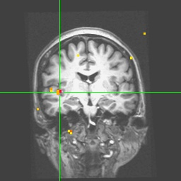
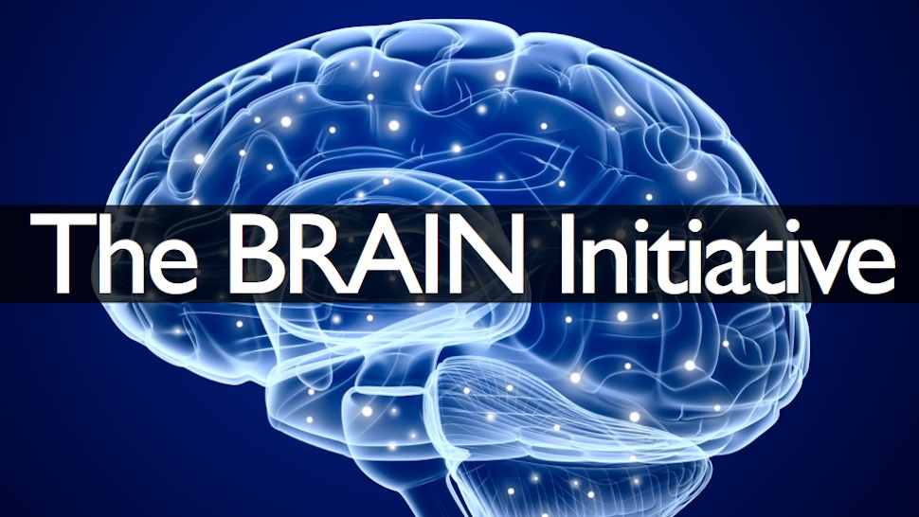
Neuroimaging
While House 100 Million Brain Mapping Project
(2013)

Slide 3
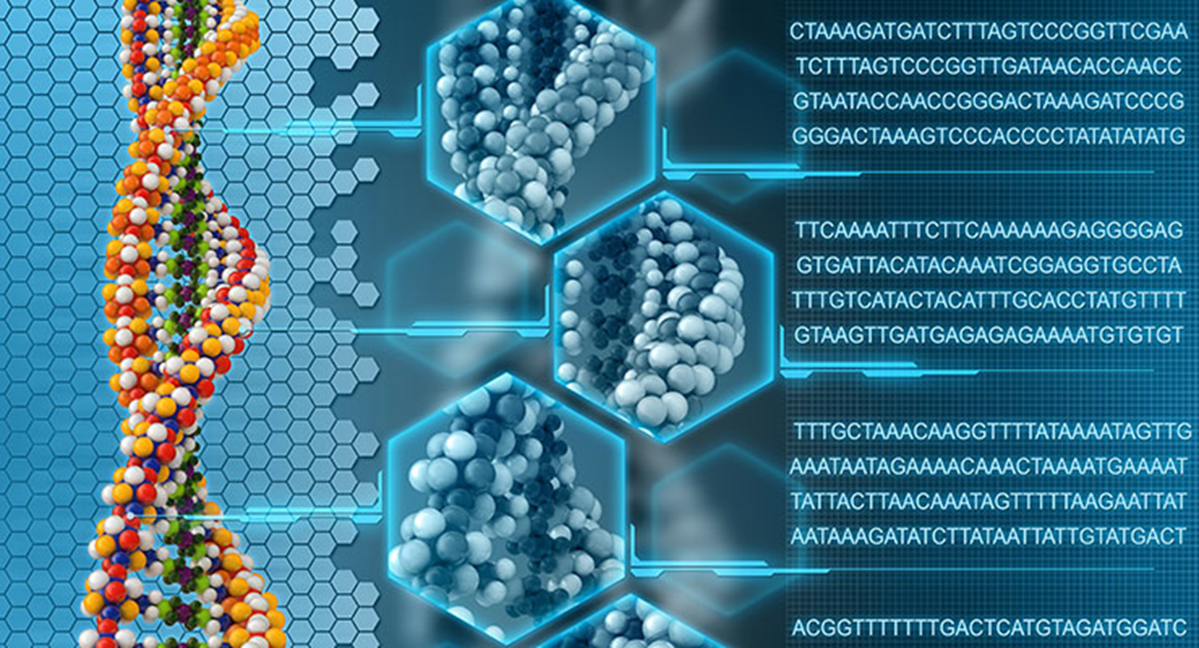
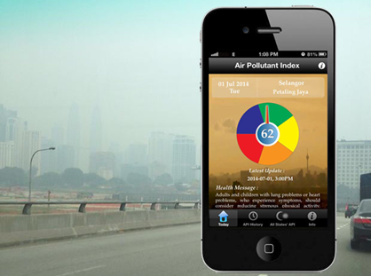
Big Data: Genome, Exposome and Phenome
Whole Genome Sequencing
Smartphone Data
Neuroimaging

Slide 4
Connected Health
Genomics
Clinical EMR
Causes of
Diseases
Smart
Phone
Data
Precision
Prevention
& Precision
Medicine
Data Science
Environment
Health
Policy
Lifestyle

Slide 5
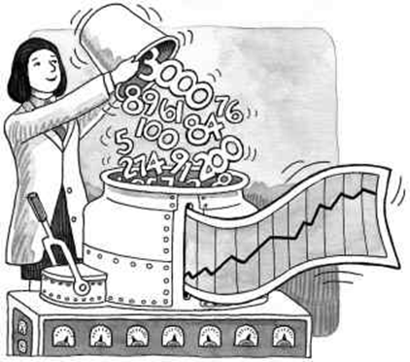
The Value of Big Data: The Analytics
Core of Data Science
The goal is Inference
Statistics
Computer Science
Informatics
Transform data into knowledge: Inference

Slide 6
Position Statisticians in Big Data
Statistician must intellectually be engaged as scientists.

Slide 7

60-Year Success: Biostatistics Culture
Engage in cutting-edge science
Let scientific collaboration
drive method development
Let substantive scientists be strong advocates for biostatisticians
Better Research
Better Prevention and Treatment
Better Health

Slide 8
More Partnership and Advocates in Big Data
Statisticians
Informaticians
/Computer Scientists
Substantive Scientists

Slide 9
Statistical Inference in Big Data
Demonstrate the value of inference: better and more new scientific discoveries.
Incorporate domain science knowledge in developing practically powerful and effective inference procedures.
Inference: Estimation, confidence statement.
Make inference procedures scalable to big data and tangible to emerging data science platforms (cloud computing)

Slide 10
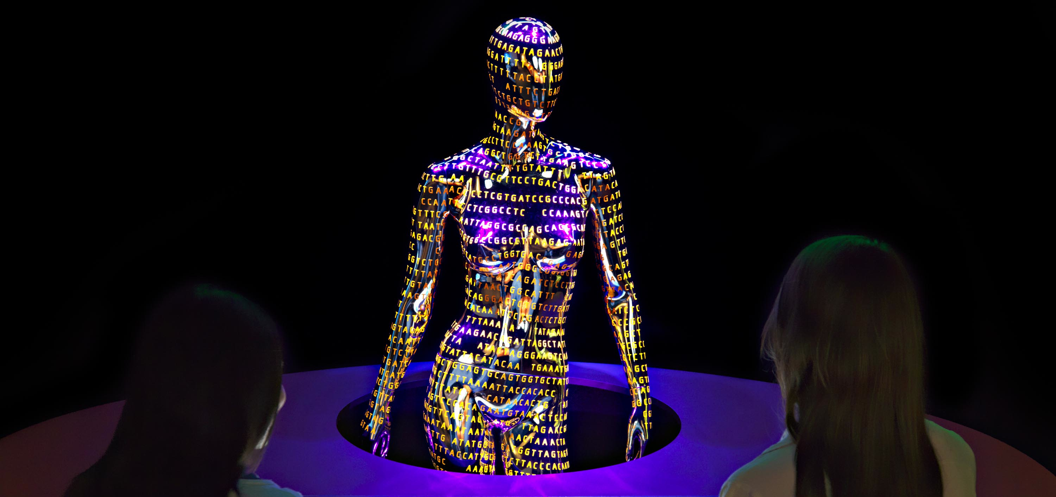
Whole Genome Sequencing Studies (WGS)
Challenges and Opportunities

Slide 11
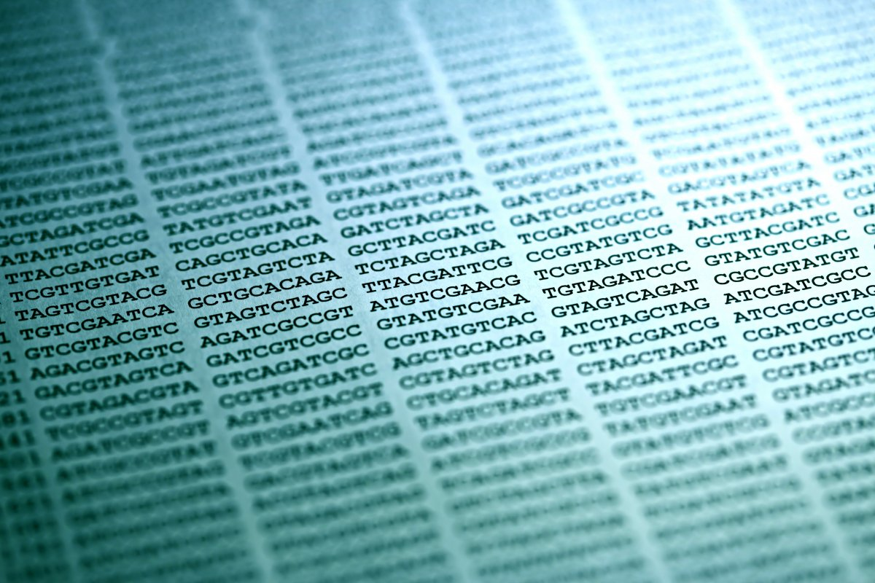
Whole Human Genomes
Each Whole Human Genome
Contains 3 Billion Basepairs

Slide 12
WGS Covers 100% of the Genome
GWAS Common Variants
<10%
Rare Variants
>90%

Slide 13
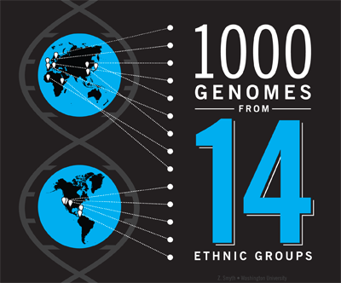


1000 Genomes
N=1000
GSP(NHGRI)
N=200,000
2008
2016
WGS Timeline
2015
TOPMed (NHLBI)
N=75,000
Notes:
Animate this one using flyin

Slide 14
TopMed WG Sequences (Jan 2016, N=15,000)
44% of SNPs Seen in Single Persons
Frequency | # SNPs (% Total)
Singletons | 60.6M (44%)
Doubletons | 19.2M (14%)
Doubletons - .1% | 32.0M (23%)
.1% - 1% | 13.6M (9.8%)
1 - 10% | 7.2M (5.2%)
> 10% | 5.7M (4.1%)
Courtesy of Abecasis

Slide 15
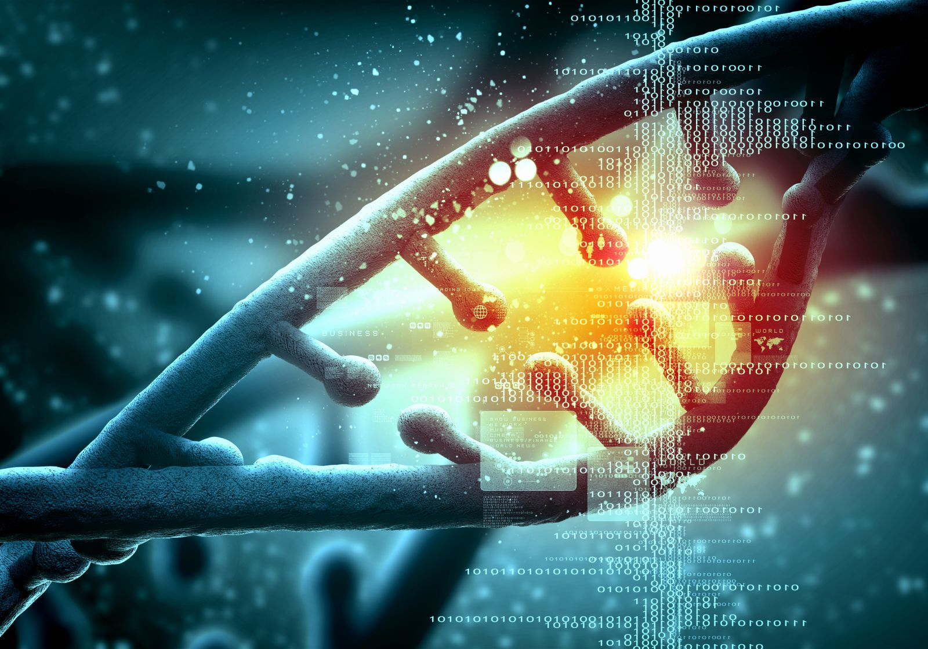
How Big are the WGS Data?

Slide 16

GSP: 3.0 x 10¹⁶ Sequenced Bases (N=200,000)
On the same scale as the number of grains
of sand in a large beach

Slide 17
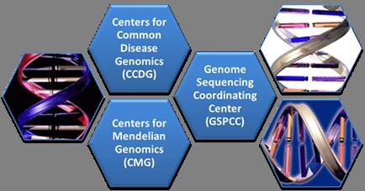
NHGRI Genome Sequencing Program (GSP)
(Budget=416M)
4 Centers for Complex Disease Genomics
(Baylor, Broad, NY, Wash U)
4 Centers for Mendelian Disease Genomics
(Baylor, Broad, U Wash, Yale)
3 Analysis Centers
              (Harvard, Stanford, Vanderbilt)

Slide 18
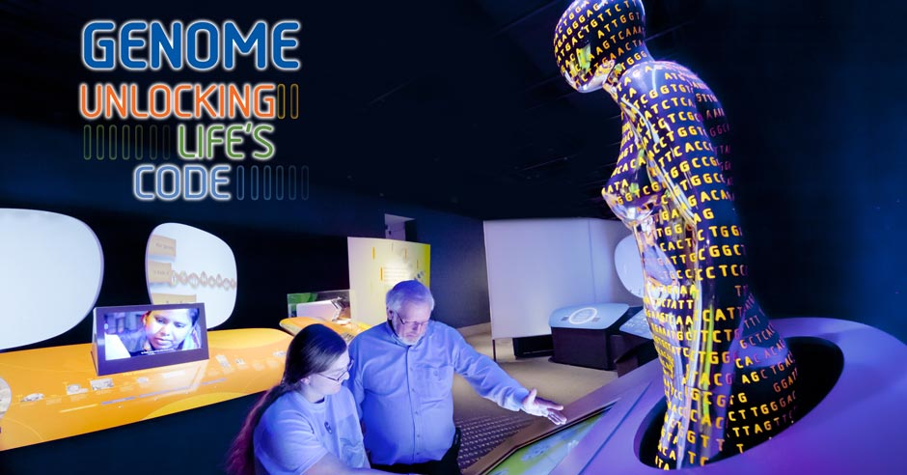
First Goal of WGS Analysis:
Signal Detection
Scan the genome to identify genetic regions or constructs associated with diseases/traits

Slide 19

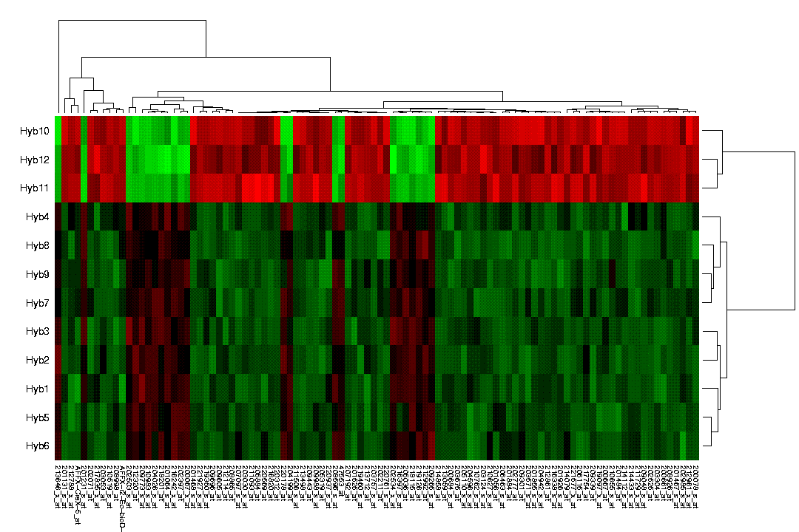
Analytic Challenges in WGS
2005
2015
Small n, Large p
Large n, Huge p
p increases with n
Methods need to be scalable to big WGS

Slide 20
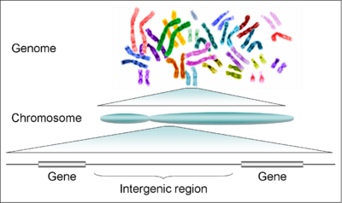
Analytic Challenges in WGS
Signals are weak
and sparse
Inference: Test for
high-dimensional weak and sparse alternative
Gain power by incorporating bioinformatic information of functionality of variants, e.g., ENCODE.
Analysis units and sizes not well defined:
Non-coding regions
Notes:
Enter one bullet a time.

Slide 21
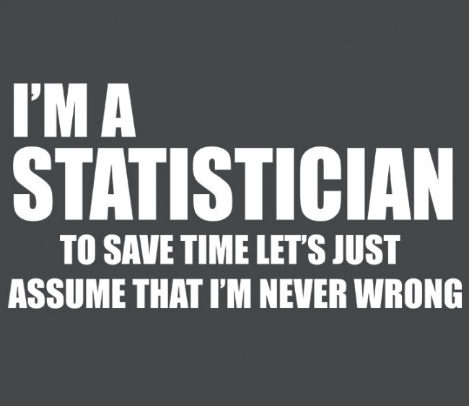

Statisticians + Computational Biologists
= Path to WGS Analysis

Slide 22
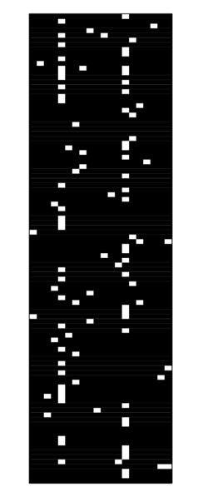

Very Sparse Genotype Matrix in Region (X)
n=500, d=100 SNPs in a gene
CHRNA3

Slide 23

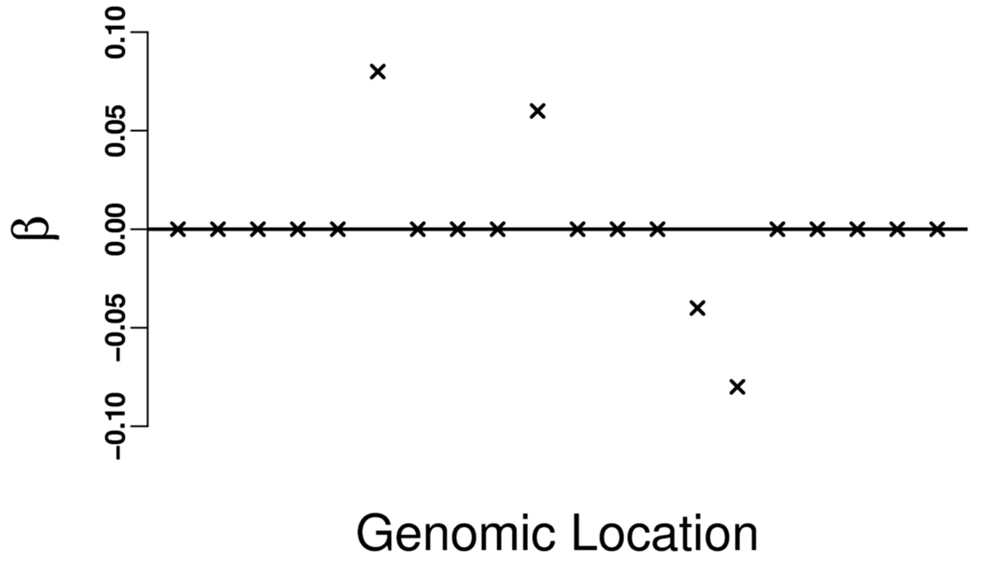

Challenges in Rare Variant Analysis of WGS Data
Simple single SNP analysis does not work
Need to perform region-based inference
Estimation is very difficult
CHRNA3

Slide 24
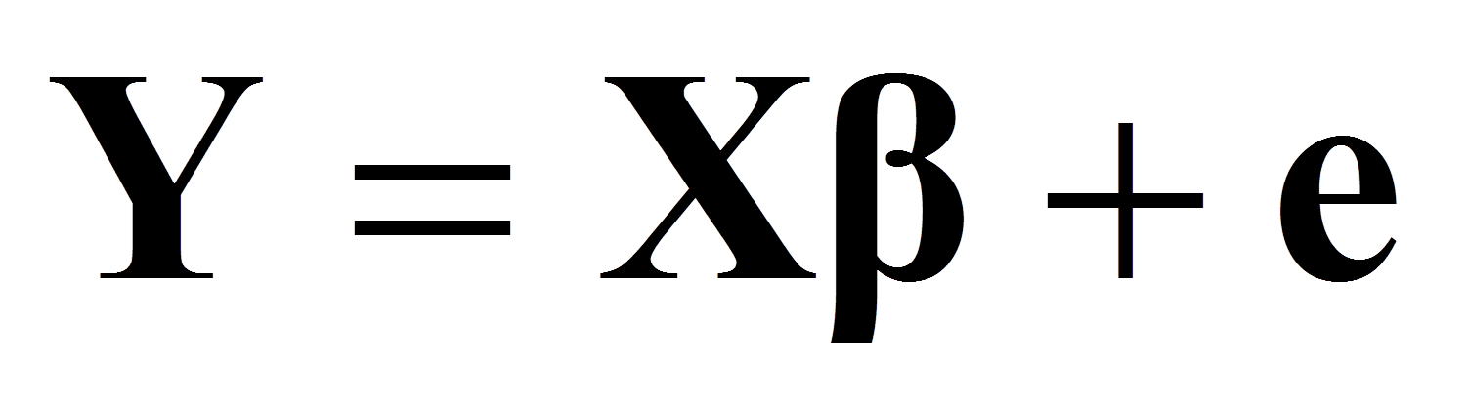
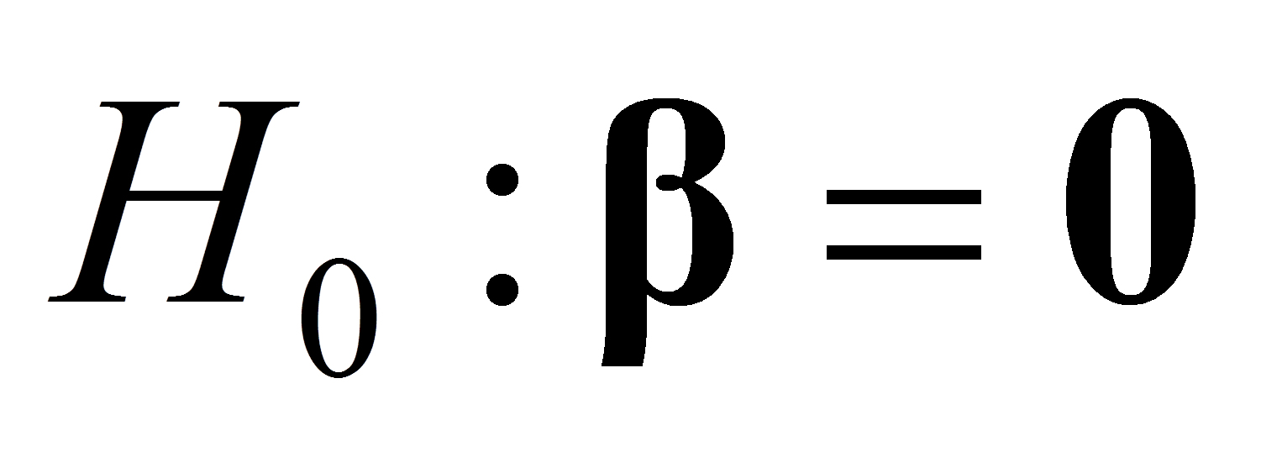
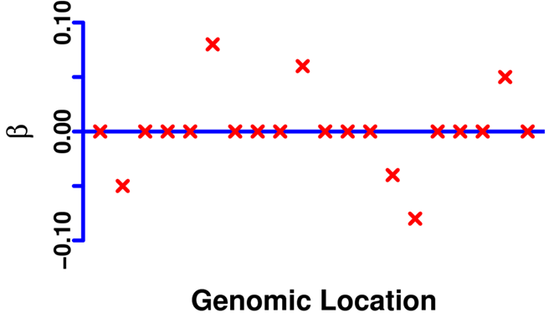
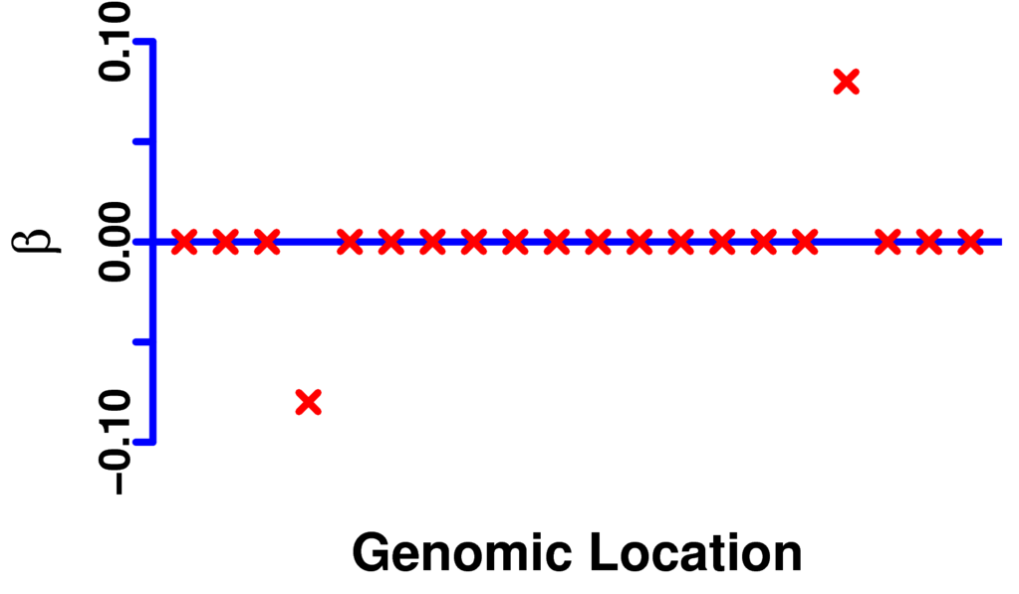
Test for Dense & Sparse High-Dimensional Alternatives
Model:
Dense Alternative
Sparse Alternative
Sequencing Kernel Association Test (SKAT)
Wu, Lee, et al, 2011, AJHG.
Generalized Higher Criticism:
Murkerjee, et al, Ann. Stat, 2015
Barnett, et al 2016 (JASA), in press.

Slide 25
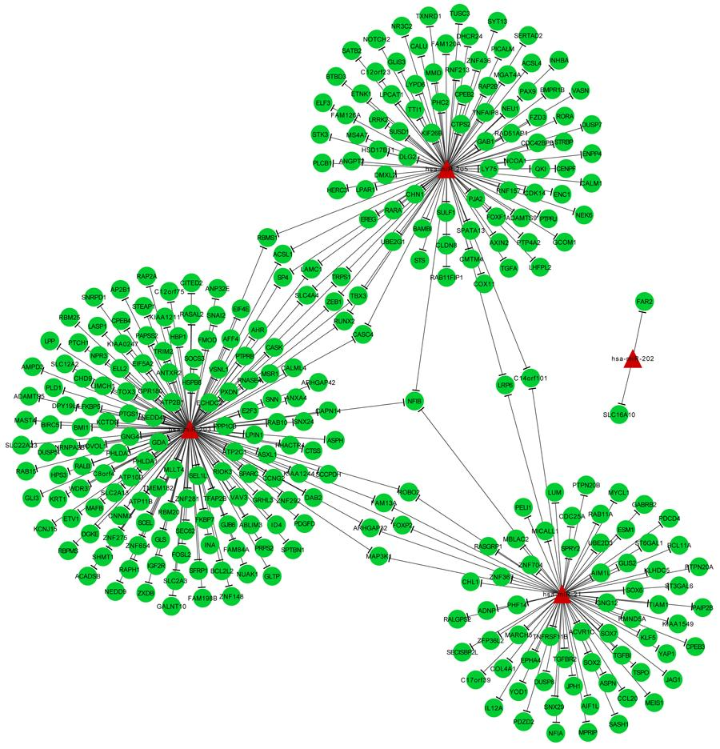

Causal Inference In Network-Based Intervention
Construct Social Networks Using Cell Phone Records
5 min
3 min
7 min
15 min (3 calls)
Network of HIV Infection
Jukka-Pekka (JP) Onnela

Slide 26
HIV Infection: # of People Infected
Traditional Random Intervention
Before
After
Victor DeGruttola and JP Onnela

Slide 27
HIV Infection: # of People Infected
Network Based Intervention
Biotatisticans + Computer Scientists
= Powerful Innovative Ideas
Before
After
Victor DeGruttola and JP Onnela

Slide 28
Statistical Challenges in Network-Based Intervention Studies
  How to design network-based studies?
    Random sampling is not effective
    Biased sampling
  Causal inference for network-based studies
    The Stable Unit Treatment Value Assumption (SUTVA) (subjects are independent) is violated.
    Need causal inference in the presence of interference

Slide 29
A Few Final Words of Statistics in Big Data
Promote research on study design
Promote statistical inference
  Motivated by cutting-edge science
  Integrating domain science
  With realistic assumptions
  Beyond estimation
  Scalable
Promote collaboration between statisticians and computer scientists/informaticians.

Slide 30
Data Science Research Computing Infrastructure
  Cloud computing (e.g S10 grants for Big Data?).
  Resource sharing:
    Promote and support scalable statistical software development
    Develop efficient data sharing and storage strategies
    Promote data sharing beyond genetic data (dbGAP and NIH Data Common)

Slide 31
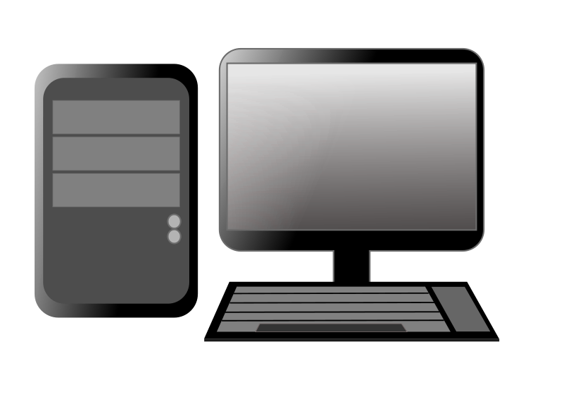
Traditional Computing Cluster
NO Sharing of Infrastructure
Computer
Storage

Slide 32
Cloud Data Processing
Advantage #1: Elasticity

Slide 33
Cloud Data Processing
Advantage #1: Elasticity

Slide 34
Cloud Data Processing
Advantage #1: Elasticity

Slide 35
Cloud Data Processing
Advantage #2:
Data Sharing ≠ Data Copying

