Slide 1
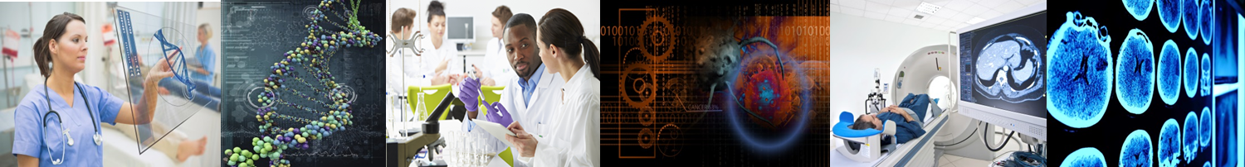
Data Science Community: Biomedicine
Michelle Dunn
Senior Advisor for Data Science
Office of the Associate Director for Data Science (ADDS)
◆ National Academies  December 14, 2016 

Slide 2
Data Science
is increasingly necessary
for biomedical science

Slide 3
Five Trends and Associated Needs

Slide 4
Event
Clarity about their niche
Need
Departments created
1
Development of Biomedical Data Science as a field

Slide 5
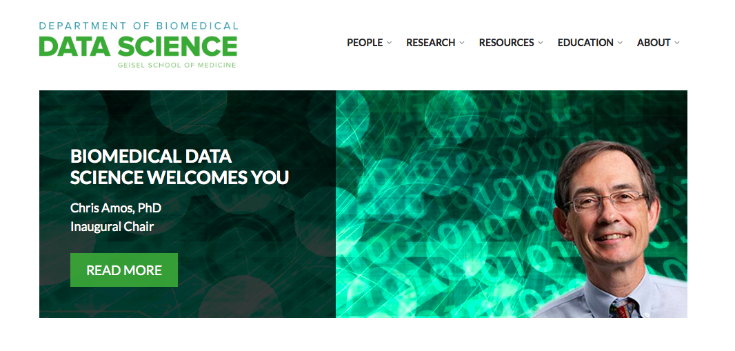
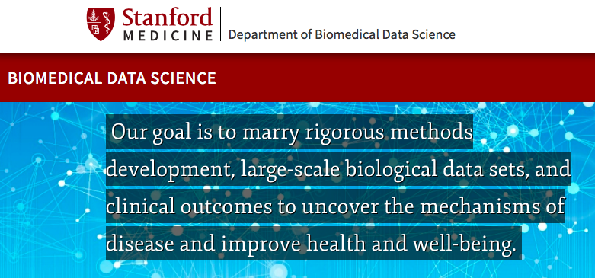
The Department “begins to define a new amalgam: a coherent, unified academic discipline that can provide the basis for addressing the next generation of computational challenges in biomedicine.”

Slide 6
Event
Clarity about their niche
Need
Departments created
1
Development of Biomedical Data Science as a field

Slide 7
Event
Need
BD2K funds programs
Discussion about core competencies
FY15: 6
FY16: 10
FY17: TBD
2
Creation of Biomedical Data Science Training Programs

Slide 8

















Slide 9
Courses Required for Biomedical Data Science Specialization
Prob& Stat, Intro CS/bioinformatics: Nearly All
Machine Learning: Most
Algorithms, Advanced Modeling: Half
Data visualization, Data Management: Some
Reproducibility, Experimental Design, Privacy/Ethics: A couple

Slide 10
Event
Need
BD2K funded programs
Discussion about core competencies
FY15: 6
FY16: 10
FY17: TBD
2
Creation of Biomedical Data Science Training Programs

Slide 11
Event
Discussion and adoption
Need
2016 Convergence report
3
Recognition of Data Science as integral to Biomedical Research

Slide 12
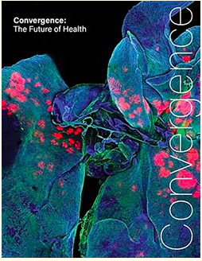
This report argues that truly major advances in the fight against cancer, dementia and diseases of aging, still rampant infectious disease, and a host of other pressing health challenges will only come from a novel research strategy that integrates biomedical knowledge with advanced engineering skills and expertise from physical, computational, and mathematical sciences, an approach known as Convergence.

Slide 13
Event
Need
New funding programs citing need for data science along with data generation
Knowledge of best practices
3
Recognition of Data Science as integral to Biomedical Research

Slide 14


Responsibilities of the PMI Cohort Program Coordinating Center include:
creating and hosting data access and analysis tools in a secure computing environment
FOA: New Technologies and Novel Approaches for Large-Scale Recording and Modulation in the Nervous System,
For applications “expected to integrate appropriate domains of expertise including … computational modeling and statistical analysis.”

Slide 15
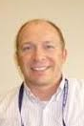
Pilot to Spread Best Practices
Benchmarking Causal Inference Methods
Ken Wilkins (NIDDK)

Slide 16
Event
Need
2016 Convergence report
Discussion and adoption
New funding programs citing need for data science along with data generation
Knowledge of best practices
3
Recognition of Data Science as integral to Biomedical Research

Slide 17
Event
Need
MOOCs & short courses in biomedical data science developed
Integration into training programs
4
Increased Demand for Training in Data Science by Biomedical Scientists

Slide 18
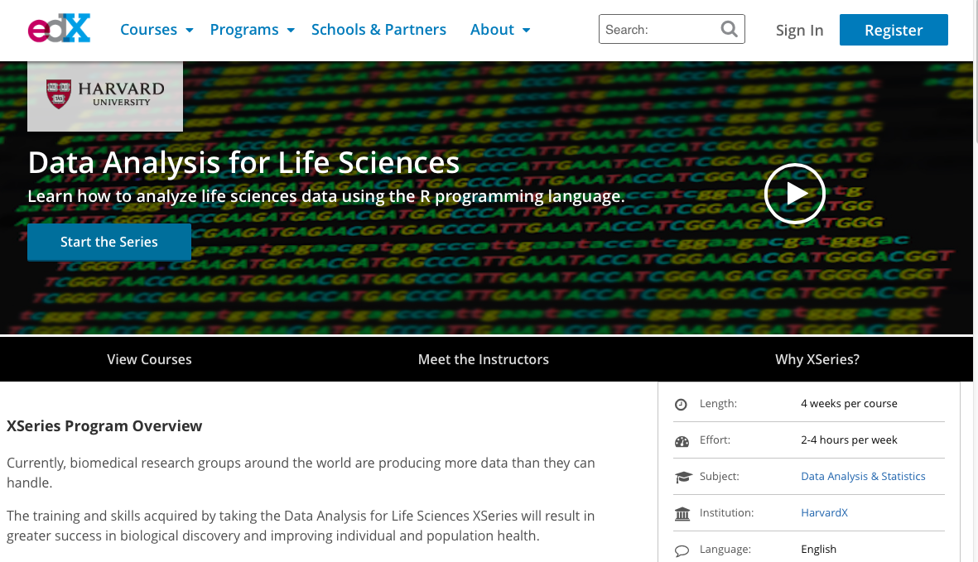

Slide 19
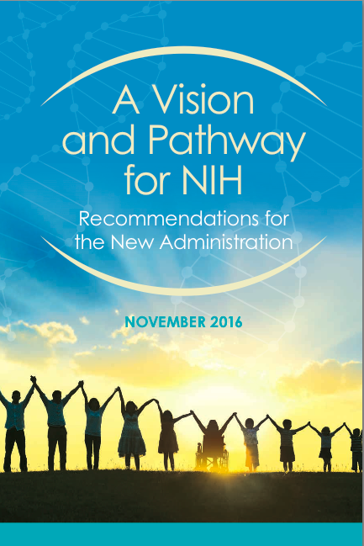
Transform the training of scientists and physician researchers to prepare them for 21st century science.
Promote development of transdisciplinary, quantitative, team-based active learning curricula
Periodically convene leaders of these curricula to share best practices and to rigorously evaluate the programs

Slide 20
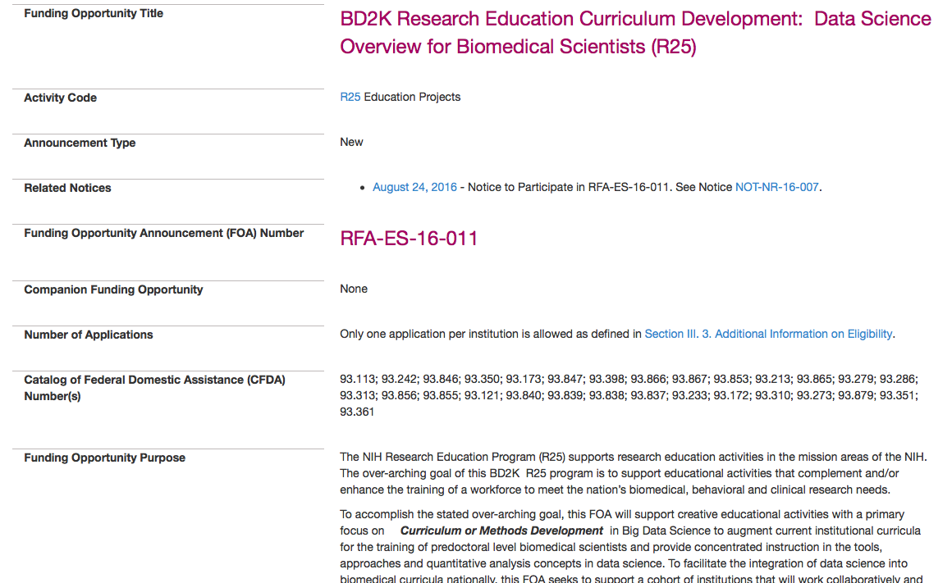
“augment current institutional curricula for the training of predoctoral level biomedical scientists and provide concentrated instruction in the tools, approaches and quantitative analysis concepts in data science.”

Slide 21
Event
Need
MOOCs & courses funded in biomedical data science developed
Integration into training programs
4
Increased Demand for Training in Data Science by Biomedical Scientists

Slide 22
Event
Need
Increased funding (BD2K)
Continued leadership
Community of funders
Community within NIH
Integration of DS within ICs
5
Data Science at NIH: increased visibility and impact

Slide 23
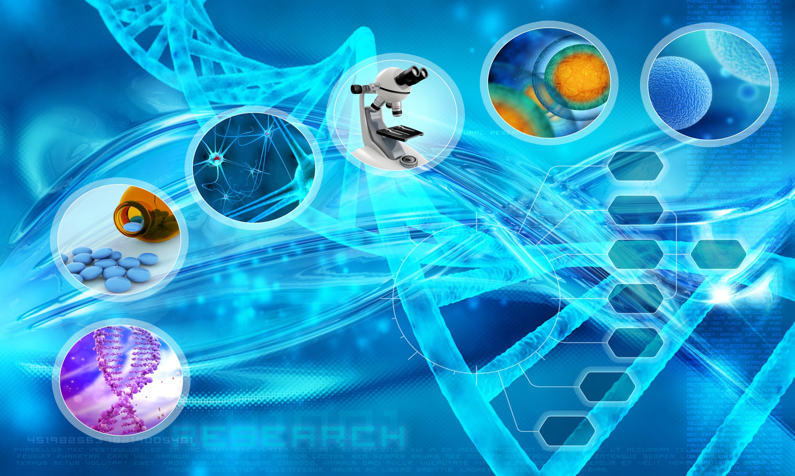

Data Science at NIH
Data Science at NIH
◆ https://datascience.nih.gov
◆ bd2k@nih.gov
◆ @NIH_BD2K
◆ #BD2K
michelle.dunn@nih.gov

Slide 24

NIH has a long history of bi-partisan support and stands ready to work with the incoming Administration to improve people's health and reduce the burden of disease through biomedical research.

Slide 25
New Workforce Development Efforts
Integrating Data Science into Biomedical Training
Curriculum Development Awards
Meetings to facilitate collaborative development of data science curriculum
Fundamentals of Data Science lecture series
Building Collaborations
RoAD Trip
Innovation Lab and QuBBD program
Developing Career Paths
National Academies of Science Roundtables on Training
For more info, see
BigDataU.org

