Slide 1

What’s Wrong With this Picture?
Teaching and/or Research in the Social Sciences
Matthew Connelly, Columbia University

Slide 2
The Landscape of
Social Science Teaching
Lectures and seminars rather than labs
Books rather than articles
Collaboration and co-authorship can be unusual, and risky

Slide 3
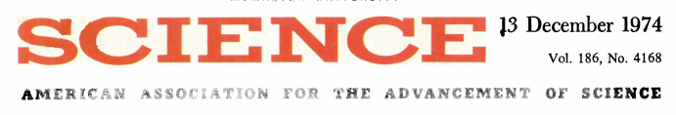
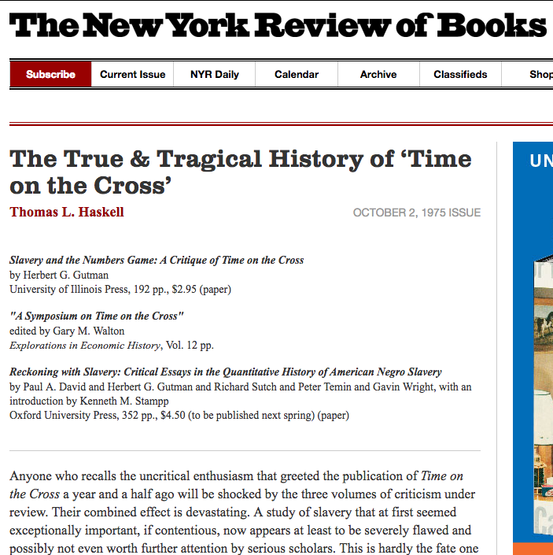
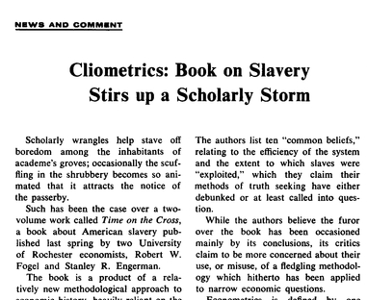
Lessons of the Past: The Rise and Demise of Cliometrics

Slide 4
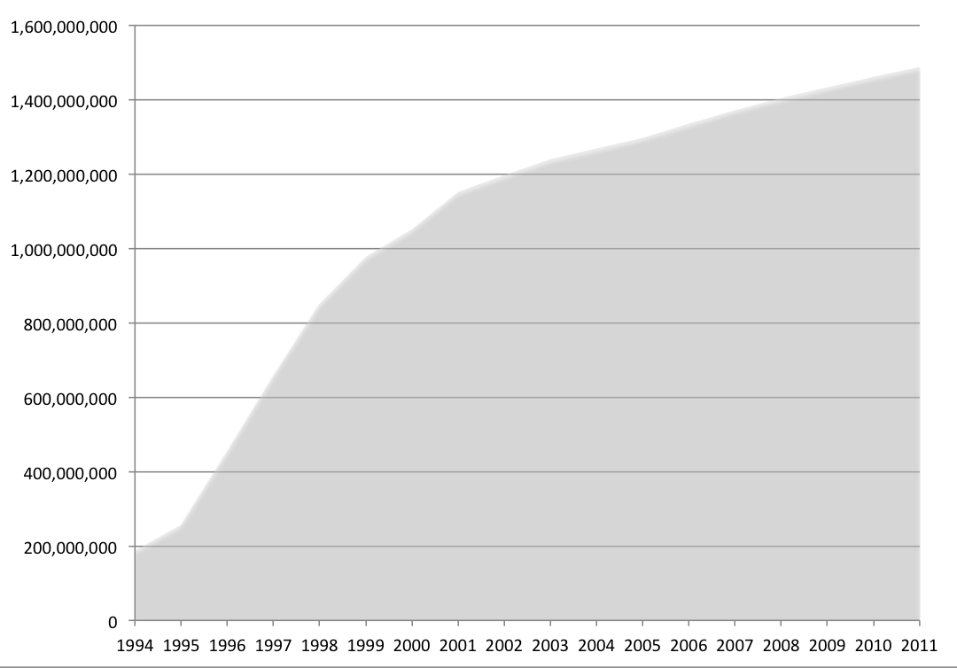
Big (Textual)
Data:
Cumulative Number of Pages Declassified

Slide 5
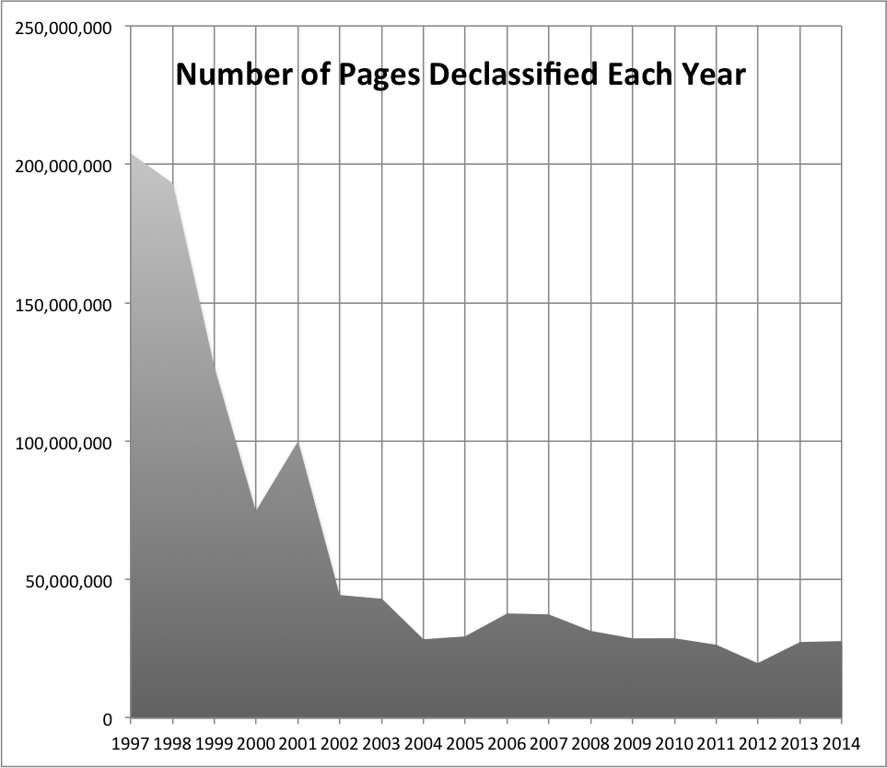
Missing Data

Slide 6
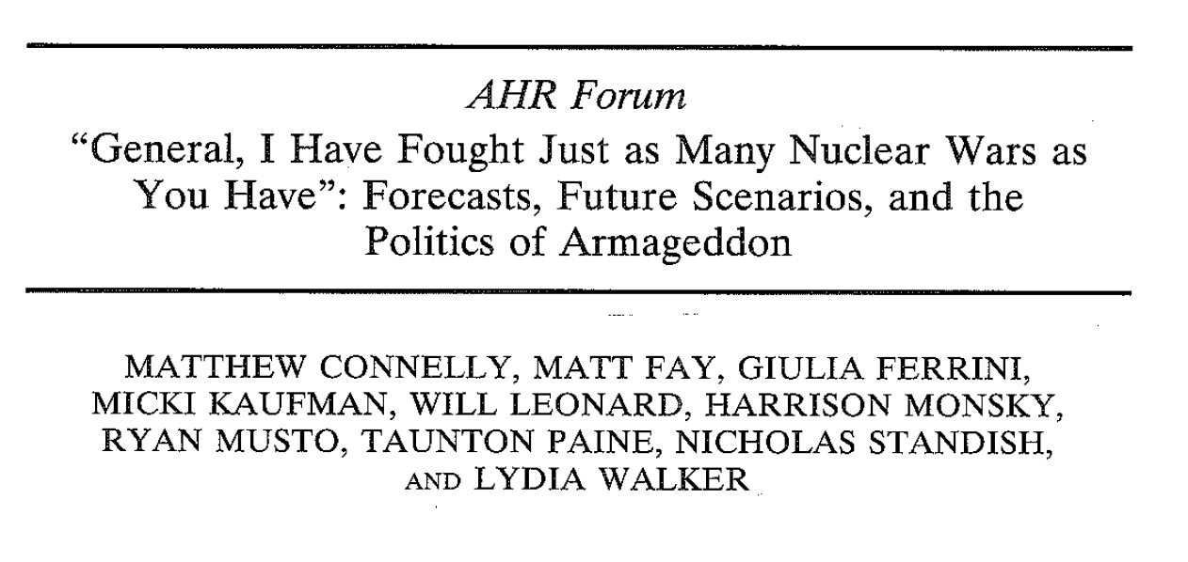
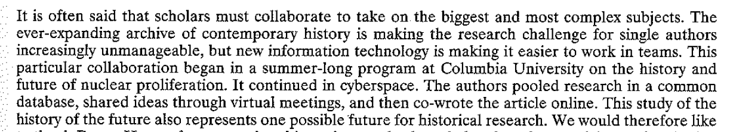

Slide 7
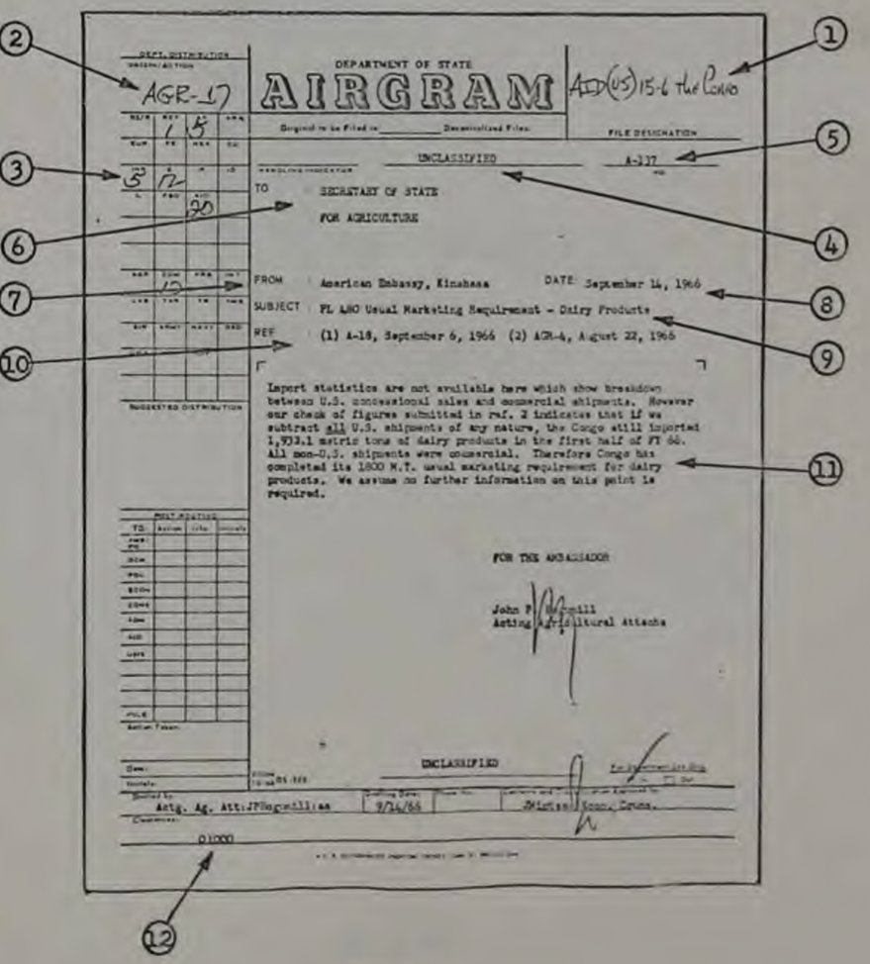
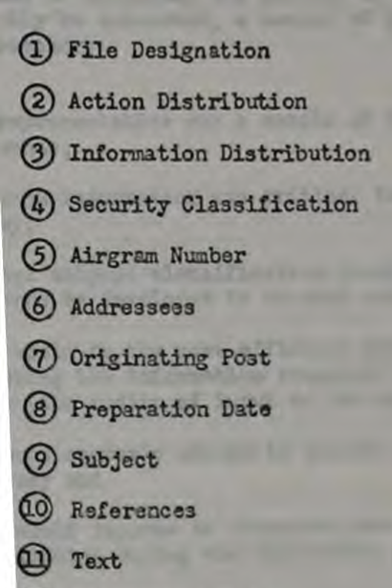
State Department Cables: The First Electronic Records System Was Designed to Capture Metadata and Stop Unauthorized Leaks
It Failed: Ironically, electronic records make massive “Wikileaks” possible.

Slide 8
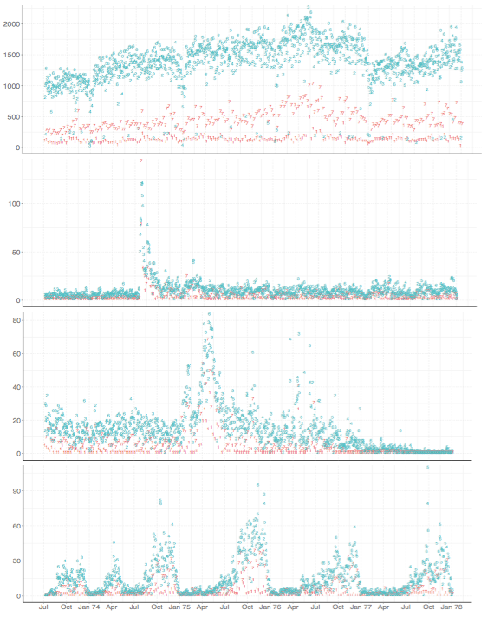
Automatically Identifying and Rank Ordering Events Through Traffic Analysis
With 1.9 million cables we want to find statistical change points corresponding with different kinds of events like…
This
(Cyprus coup)
This
(Fall of Saigon)
And this
(UN General Assembly Sessions)

Slide 9
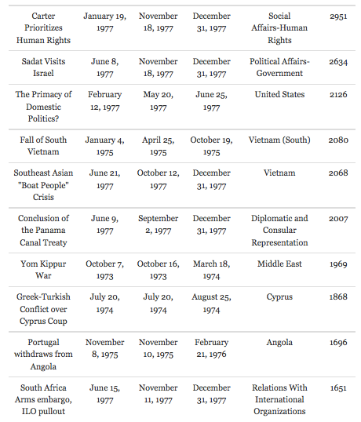
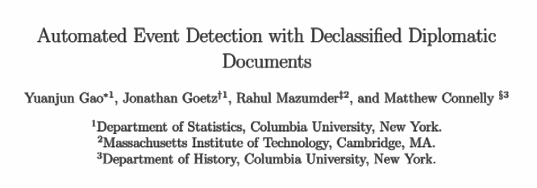
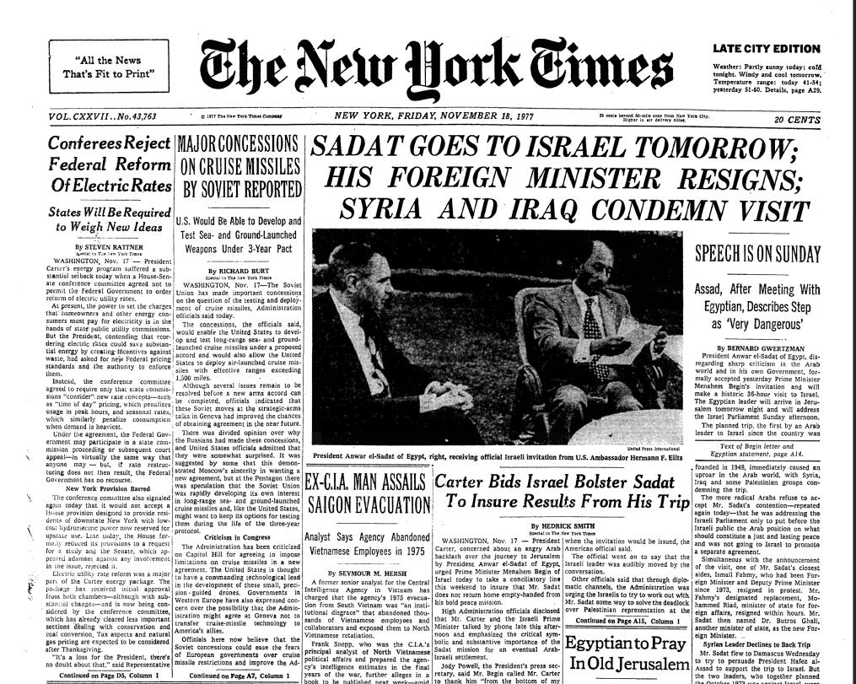

Slide 10

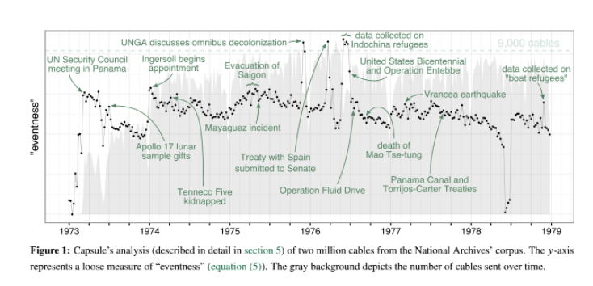
Discovering More Obscure Events Through Topic Modeling

Slide 11
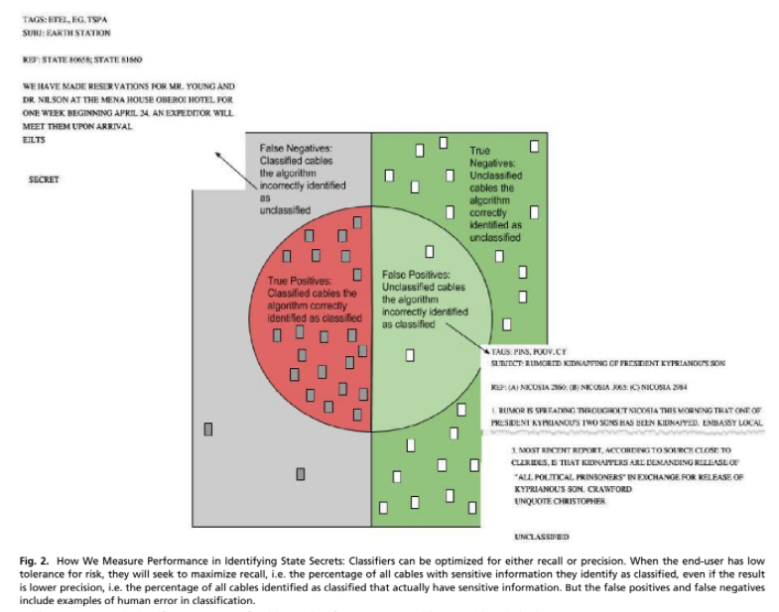
Using Machine Learning to Identify Patterns and Anomalies in Official Secrecy

Slide 12
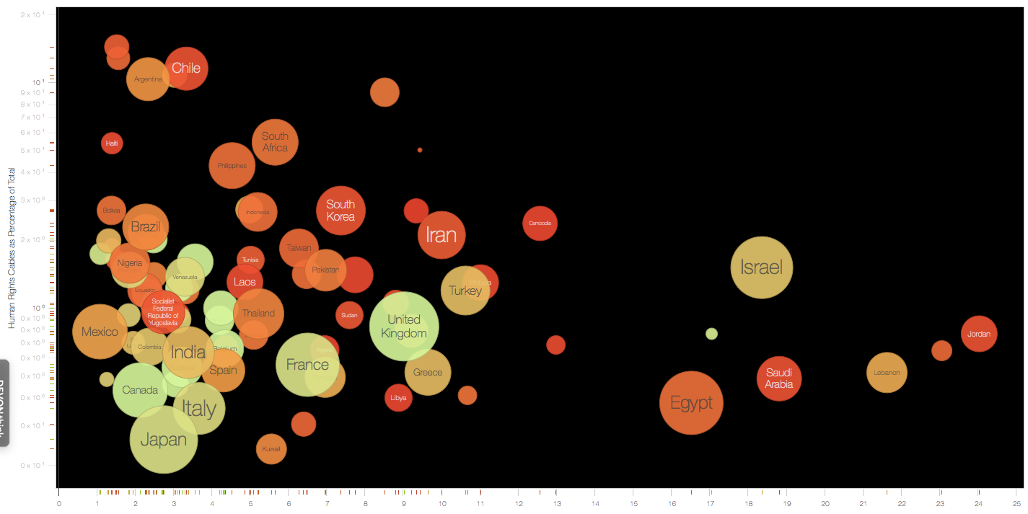
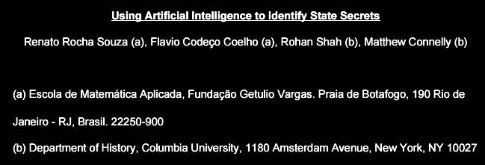

Slide 13

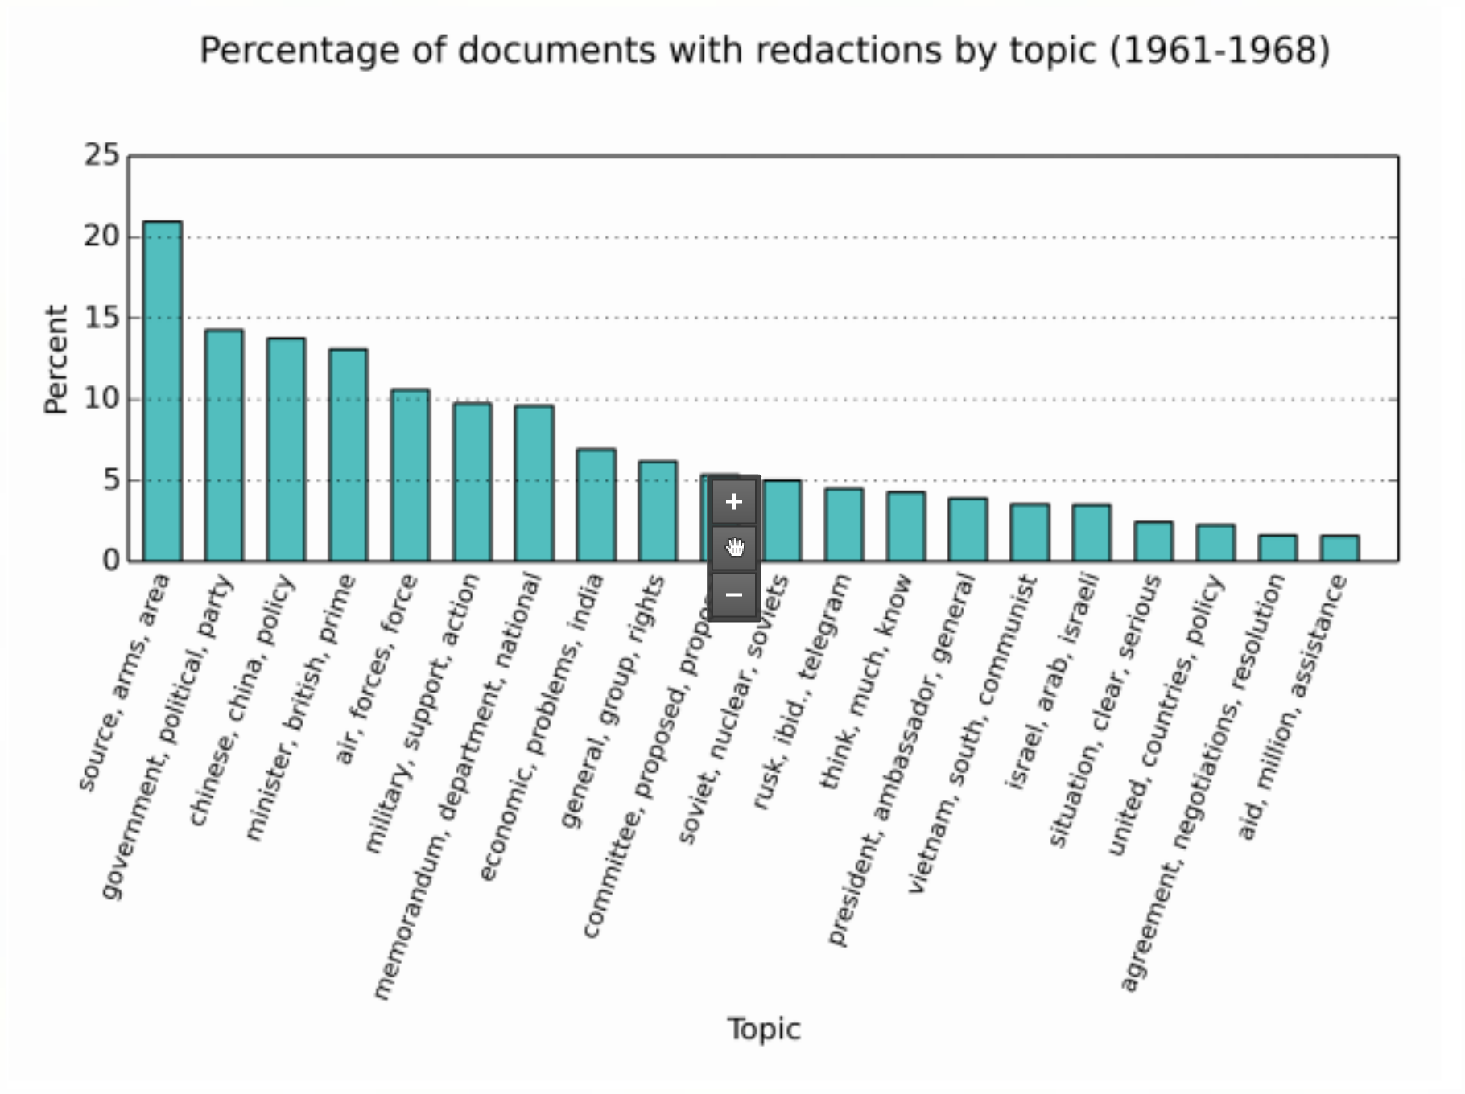
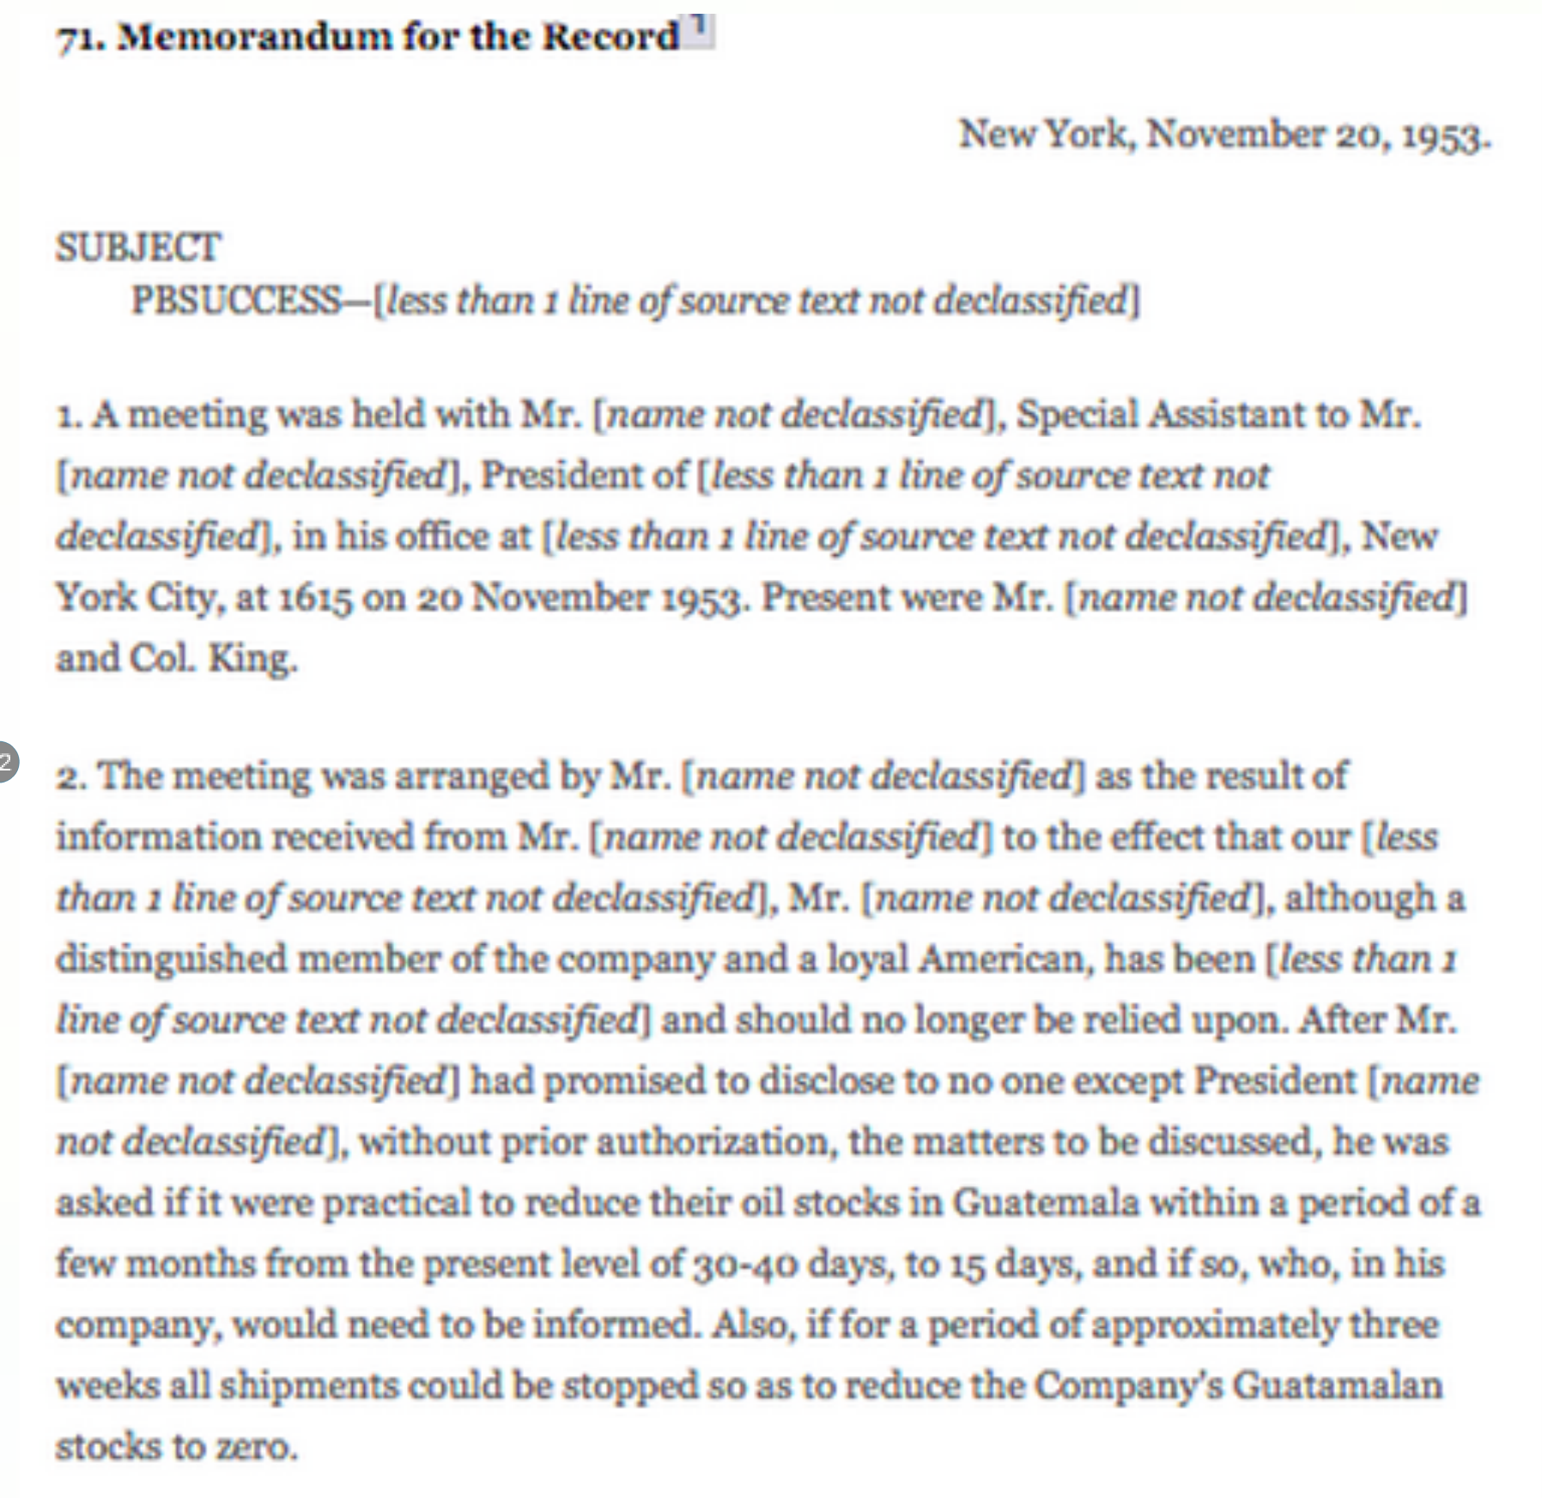

Slide 14
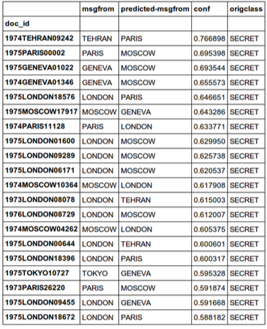
When Diplomats Go “Off Topic”
R 131637Z JUL 73
FM AMEMBASSY LONDON
TO SECSTATE WASHDC 2588
INFO AMEMBASSY ISLAMABAD
AMEMBASSY NEW DELHI
AMEMBASSY TEHRAN
S E C R E T LONDON 08078
LIMDIS
TAGS: PFOR, AF, PK, IR
SUBJECT: AFGHAN KING'S VIEWS ON IRAN AND PAKISTAN
1. ON JULY 11 FCO SOUTH ASIA DEPT. HEAD CHALMERS GAVE
US (AND VISITING MADRAS CONGEN PALMER) HIGHLIGHTS OF
LONG DISCUSSION HE HAD HAD WITH KING ZAHIR AT AIRPORT
PRIOR TO KING'S DEPARTURE. DISCUSSION CENTERED ON
RELATIONS WITH IRAN AND PAKISTAN.
2. KING SAID SHAH WAS NICE FELLOW BUT HE TENDED TO
SEE WORLD ENTIRELY WITH IRAN AS THE CENTER. SHAH ALWAYS
LECTURED KING ON SOVIET THREAT. KING'S STANDARD REPLY
IS THAT AFGHANISTAN HAS PECULIAR GEOGRAPHIC POSITION AND
IS POOR. AS LONG AS THESE FACTS UNCHANGED, AFGHAN
POLICY CANNOT CHANGE. NEVERTHELESS, SHAH KEEPS PREACHING
SAME GOSPEL.
3. KING SAID SHAH IS A PROUD MAN AND PAKISTANIS KNOW
IT. THEY PLAY UP MARTIAL IMAGE OF IRANIAN MILITARY IN
ORDER TO GET ACCESS TO IRANIAN ARMOURY, IF NOT ALSO
SOLDIERY, IN TIME OF CONFLICT. IN TRUTH, KING COM-
MENTED, IRANIANS ARE NOT MUCH AS FIGHTERS. IF HE WERE
TO BRING DOWN SAY 3,000 OF HIS PATHANS AGAINST IRANIAN
ARMY SOMETIME, WORLD WOULD BE TREATED TO IMPRESSIVE
VIEW OF IRANIAN RETREAT. IN MEANTIME HE WAS KEEPING AN
EYE ON SITUATION.
4. CHALMERS WAS IMPRESSED BY KING'S CANDIDNESS AND
PERSPICACITY.
ANNENBERG

Slide 15
History Lab
http://history-lab.org/
Email
info@history-lab.org

