Slide 1
Columbia Collaboratory
Kathleen McKeown
Columbia University
Data Science Institute

Slide 2
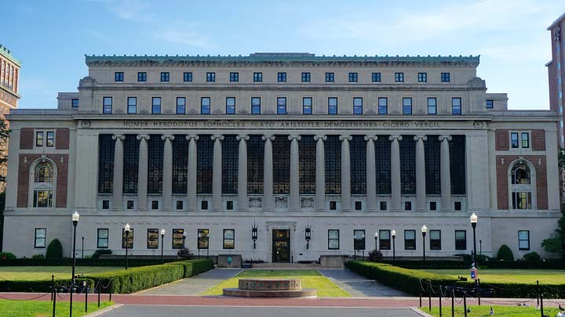
Background
Taskforce of Deans
and Data Science
Directorate
discuss what is
needed across
university

Slide 3
Collaboratory
Team taught classes across schools
Enables pairing of data scientists with discipline specialists
Funding for course development and deployment
Designed by Patricia Culligan, Associate Director, DSI and Richard Witten, Advisor to the President of Columbia

Slide 4
Request for proposals
18 received
Four funded
Three additional pilots
New 2017 RFP out now

Slide 5
Suite of classes
Points Unknown: New Frameworks for Investigation & Creative Expression through Mapping
  Journalism, Graduate School of Architecture, Planning and Preservation
Programming, Technology and Analytics Curriculum for Columbia Business School
  Business School and School of Engineering
Computational Literacy for Public Policy
  School of International and Public Affairs, School of Engineering
Analysis to Action: Harnessing Big Data for Action in Public Health
  School of Public Health

Slide 6
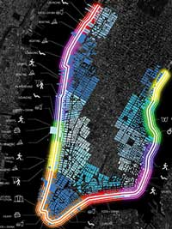
Points Unknown:
New Frameworks for Investigation & Creative Expression through Mapping
Location shapes the news: spatial processes
are at the foundation of reporting
Urban planning, and urbanism is optimized
only in the context of spatial analytics and
its digital underpinnings.
To be “digitally literate” in this context is to
understand how data defines and is part of
the infrastructure of the city.

Slide 7
The Course
One year development
Will offer formal training in spatial data analysis and visualization
Five week module, 4 hour sessions
  Will include visits to newsrooms to see mapping practices
  Basic mapping techniques, geo-referencing, creating new spatial data, raster data, web mapping
  Integration of narrative and spatial practices
Transitioned to a core course

Slide 8

Programming, Technology and Analytics Curriculum for Columbia Business School
Tech workers have moved from the back
office to the C-suite
A new series of courses will prepare students
to succeed in a data-intensive world
    Programming; gathering, managing and interpreting data
Industry-specific electives such as digital advertising and sports analytics

Slide 9
Suite of Classes
Intro to Python, Intro to Databases, Digital Literacy, Data Analytics in Python
Quantitative Pricing & Revenue Analytics, Internet & Online Advertising, Sports Analytics, Business Analytics, Online Markets
Collaboration between Business students and engineering students on projecs

Slide 10
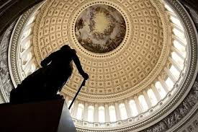
Computational Literacy for Public Policy
Enable public policy master’s students to perform rudimentary data analysis
Some degree of computational literacy as a baseline requirement for any policy maker
Prepare policy makers and decision experts who are “bi-cultureal”

Slide 11
The Course
Goal: define a solvable problem, identify the data needed to solve it and either develop initial program or collaborate with data scientist
Computer Science for Policy
  Algorithmic thinking, python, machine learning, communication to non-technical policy experts
Capstone workshop: a project in policy requiring coding

Slide 12

Analysis to Action: Harnessing Big Data for Action in Public Health
Will guide students to use big data for simulation and predictive purposes
Dynamic visualization through a language shared by population health scientists, practitioners, advocates, and policymakers

Slide 13
The Course
Bio-statistics, epidemiology, social and behavioral science, health policy and management, health communications
Train students in the visual and documentary translation of data to non-scientific audiences
Tableau desktop

Slide 14
Pilot: Data, Past, Present and Future
Undergraduate course taught by historian and applied mathematician
Core curriculum of knowledge every citizen needs to understand the role of data in our lives for the next century.
Seminar form: a combination of directed readings, discussion, and practice among advanced students

Slide 15
The Course
Technical track and humanist track
Intro: Data Science Today
    Boyd, Danah, and Kate Crawford. 2012. "Critical questions for big data: Provocations for a cultural, technological, and scholarly phenomenon." Information, Communication & Society 15.5: 662-679.
Making sense of data: early cultural and mathematical explorations; Laplace, Gauss, Legendre
    Desrosieres, Alain. "Judges and Astronomers" in The Politics of Large Numbers: A History of Statistical Reasoning. Cambridge, Mass.: Harvard University Press, 1998, ch 2.
State statistics, average "men" and social mathematics
    Adolphe Quetelet, “Preface” and “Introductory,” A Treatise on Man (1842),
    Desrosieres, Alain. "Averages and the Realism of Aggregates"
Data, science and eugenics: "statistics" and the birth of p-values
    Stephen J. Gould, Mismeasure of Man, ch. 3
    Desrosieres, Alain. "Correlation and the Realism of Causes,"

Slide 16
In Sum
A mix of approaches
Variety in how much programming the students do
Variety in needs for the discipline
    Visualization vs python
Common theme: communication

