Slide 1
Aviation Industry Quality Oversight of Critical Titanium Engine Components
Tim Mouzakis: FAA, Engine & Propeller Directorate
Andy Woodfield: GE Aviation
Presented at the Workshop on Subsea Bolts Performance and
Critical Drill-Through Equipment Fasteners
April 11, 2017

Slide 2
Selected comments from Monday PM
… Details during audits have become very important …
… Weak reporting of incidents (failure or not) when not mandated …
… Learning from failures and near-failures …
… True failure rate not known …
… Improved understanding of failures will require better failure analysis and reporting/sharing
… Probabilistic component of performance requires understanding of distributions and how they aggregate

Slide 3
Outline
Background
    Premium Quality Ti Melting
    Ti Melt Inclusion Types
Jet Engine Titanium Quality Committee
    Purpose
    Operations
    Statistics
    Improvements
    Initiatives
    Reporting
Other Related FAA Initiatives
Summary
JETQC Presentation at the Workshop on Subsea Bolts Performance and Critical Drill-Through Equipment Fasteners (April 11, 2017)

Slide 4
Premium Quality Ti Melting: Pre-1990
  Multiple in-service engine shut-downs from Ti melt-related inclusions
  Some were uncontained component failures
Premium Quality (PQ) melt practice
  2XVAR (Double Vacuum Arc Remelt) or 3XVAR
    3XVAR predominant PQ melt practice by late ‘80’s
Quality inspection
  Billet immersion ultrasonic inspection
    Typically to a #3 FBH (47 mils) standard in 80’s
    Largest billet sizes to an even larger standard
JETQC Presentation at the Workshop on Subsea Bolts Performance and Critical Drill-Through Equipment Fasteners (April 11, 2017)

Slide 5
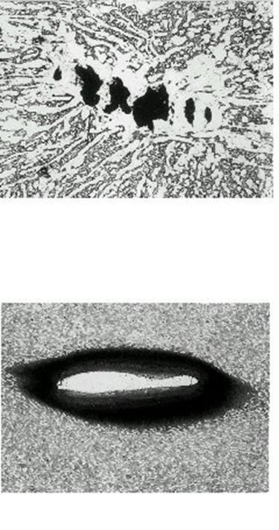
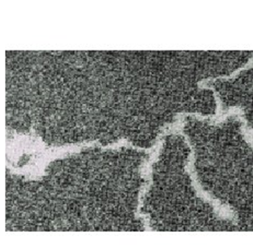
Ti Melt Related Inclusions
Alpha stabilized:
  Hard alpha inclusions (high hardness /
  low ductility)
    Premature failure concern
  Type II inclusions (Al segregation,
  hardness << hard alpha)
    One premature in-service failure
Beta stabilized:
  High density inclusions
    No known in-service failures
    Some reduction in fatigue capability
Hard Alpha
Type II Alpha
HDI
JETQC Presentation at the Workshop on Subsea Bolts Performance and Critical Drill-Through Equipment Fasteners (April 11, 2017)

Slide 6
JETQC Background
JETQC = Jet Engine Titanium Quality Committee
Formed in 1990 under auspices of Federal Aviation Administration (FAA)
  In response to 1989 Sioux City DC10 accident attributed to a hard alpha inclusion
Purpose:
  Share PQ Ti inclusion data -> early warning system
    Quarterly Industry PQ data compiled annually and reported back to all Ti alloy suppliers
    Individual Ti alloy supplier proprietary information is protected
  Compiled data (frequency / size) used for probabilistic rotor design
JETQC Presentation at the Workshop on Subsea Bolts Performance and Critical Drill-Through Equipment Fasteners (April 11, 2017)

Slide 7
JETQC Participation
  Federal Aviation Authority (FAA)
  Current PQ Ti suppliers provide Ti alloy inclusion data
  ATI TIMET
  Arconic VSMPO
  Current US and EU engine producers
  GE Honeywell MTU Pratt & Whitney
  Rolls-Royce Safran Williams International
  JETQC membership is currently expanding
  New suppliers
  New engine producers
JETQC Presentation at the Workshop on Subsea Bolts Performance and Critical Drill-Through Equipment Fasteners (April 11, 2017)

Slide 8
JETQC-001 Specification
Defines:
Reportable OEM covered specifications
    >100 specifications, > 10 alloys
Ti supplier reporting requirements (billet, bar, plate) (near-miss)
    Quarterly, inclusions reported immediately to the affected OEM
OEM reporting requirements (component) (near-miss or failure)
    When found
Standard format for inclusion reporting and volumes … near-miss/failure rate
    Inclusion characterization: sonic and chemical & root cause assessment / confidence
Format for inclusion reporting back to the industry
    Volume, # of inclusions / types, location in heat, root cause assessment
New membership
    Suppliers, OEMs
JETQC Presentation at the Workshop on Subsea Bolts Performance and Critical Drill-Through Equipment Fasteners (April 11, 2017)

Slide 9
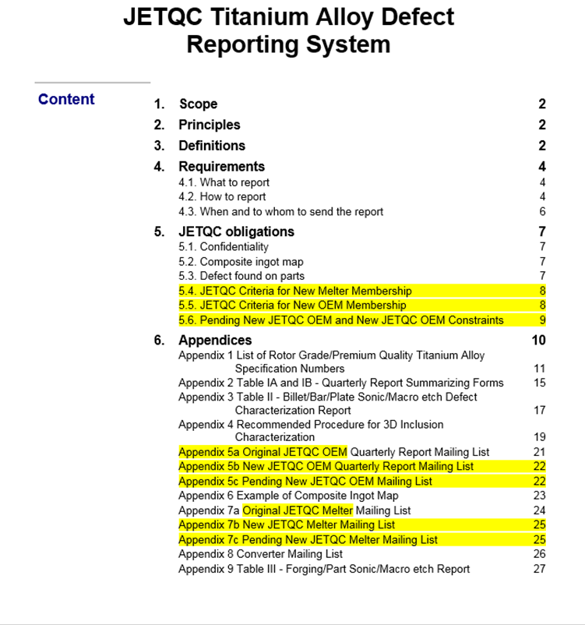
JETQC-001 Specification
JETQC Presentation at the Workshop on Subsea Bolts Performance and Critical Drill-Through Equipment Fasteners (April 11, 2017)

Slide 10
Hard Alpha Inclusion Statistics
~100x reduction in rate since JETQC formation
JETQC Presentation at the Workshop on Subsea Bolts Performance and Critical Drill-Through Equipment Fasteners (April 11, 2017)

Slide 11
Typical PQ Titanium Process Map
Hearth Melt:
Electron Beam
Plasma Arc
Vacuum Arc
Remelt
Raw Materials
Ti sponge
Master alloy
Elementals
Revert (chip/solids)
Ti dioxide
HM+VAR
Vacuum Arc
Remelt
Vacuum Arc
Remelt
Vacuum Arc
Remelt
3XVAR
Forging
Inspection:
Ultrasonic
Macroetch
Billet
Conversion
Billet
Inspection
Ultrasonic
Component
Forging
JETQC Presentation at the Workshop on Subsea Bolts Performance and Critical Drill-Through Equipment Fasteners (April 11, 2017)

Slide 12
PQ Process Improvements (Post-1990)
Ti sponge manufacturing processes
Input raw materials/control
Hearth melt processes
Electrode conditioning/processing
Shop floor layout and housekeeping
Personnel training and increased level of awareness
Training and hazard reviews
Billet / forging inspection sensitivity
JETQC Presentation at the Workshop on Subsea Bolts Performance and Critical Drill-Through Equipment Fasteners (April 11, 2017)

Slide 13
Proactive Initiatives
Hard alpha survey
>100 sources identified
HDI survey
>30 sources identified
Sharing of inclusion sources
Annually via industry statistics summary
Hard alpha characterization methods
FAA program to create standards + industry round-robin
OEM hazard reviews / training at Suppliers
Annual OEM oversight of PQ Ti suppliers
JETQC Presentation at the Workshop on Subsea Bolts Performance and Critical Drill-Through Equipment Fasteners (April 11, 2017)

Slide 14
JETQC: Takeaways
Oversight by regulating body … FAA
Industry definition of problem: Ti melt inclusions … flight safety
Measure/Publish problem/near-miss/no problem rates … process improvement
Proactive industry initiatives … drive process improvement
Protect company proprietary information … establish trust
Encourage global participation … entire industry assessment
JETQC Presentation at the Workshop on Subsea Bolts Performance and Critical Drill-Through Equipment Fasteners (April 11, 2017)

Slide 15
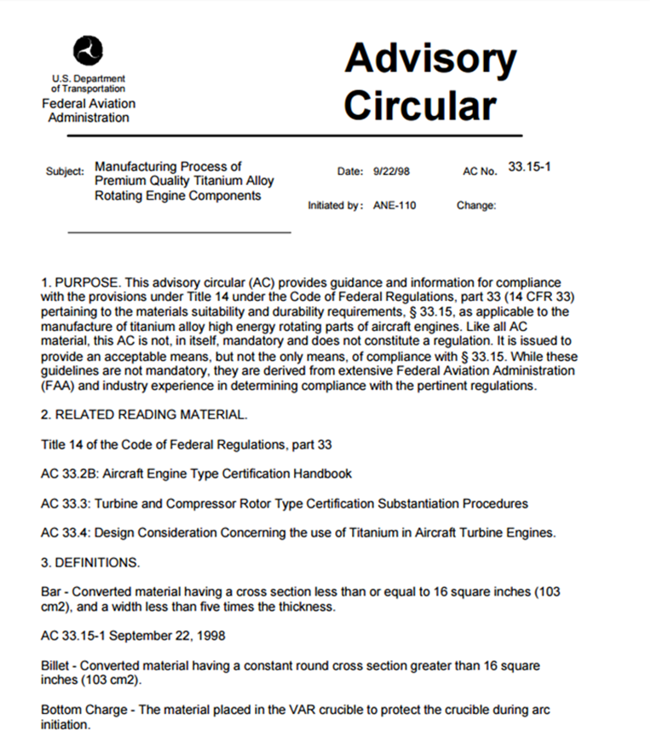
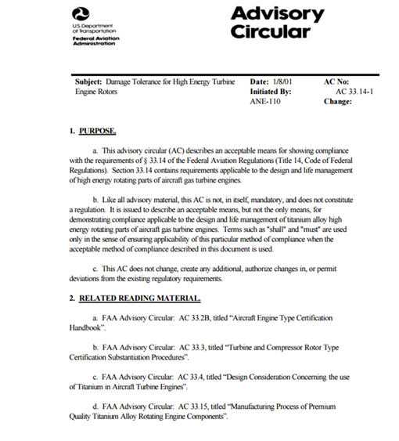
Other Related FAA Initiatives
Rotor Integrity Sub-Committee (RISC)
  Probabilistic design methods for PQ rotor materials
Advisory Circulars
  AC 33.15-1: Manufacturing Process of Premium Quality Titanium Alloy Rotating Engine components
  AC 33.14-1: Damage Tolerance for High Energy Turbine Engine Rotors
JETQC Presentation at the Workshop on Subsea Bolts Performance and Critical Drill-Through Equipment Fasteners (April 11, 2017)

Slide 16
Summary
JETQC formation: ~100x reduction in PQ Ti inclusion rate
  Tremendous effort by suppliers to identify/eliminate potential inclusion sources
  JETQC melt-related inclusion surveillance has promoted a reduced frequency
JETQC Approach
  FAA + PQ Ti suppliers + OEMs
  Specification … reporting … statistics … spotlight effect
  Process improvements, including NDE -> probabilistic design update
  Proactive initiatives
  Global expansion … comprehensive industry status
JETQC Presentation at the Workshop on Subsea Bolts Performance and Critical Drill-Through Equipment Fasteners (April 11, 2017)

Slide 17
Acknowledgements
FAA
Suppliers
Engine producers
JETQC Presentation at the Workshop on Subsea Bolts Performance and Critical Drill-Through Equipment Fasteners (April 11, 2017)

