Slide 1
Teaching Reproducible Data Science
lessons learned from a course at UC Berkeley
Fernando Pérez
fernando.perez@berkeley.edu

Slide 2
Reproducible Research
An article about computational science in a scientific publication is not the scholarship itself, it is merely advertising of the scholarship. The actual scholarship is the complete software development environment and the complete set of instructions which generated the figures.
Buckheit and Donoho, WaveLab and Reproducible Research, 1995

Slide 3
The course: STAT 159/259
Schedule: 2 Lectures (80 min), 1 lab (2 h)
Prerequisites: foundations in computation, probability and statistical modeling
Enrollment: 50 undergrads, 10 grads
Graduate Student Instructor: Eli Ben-Michael, Stats PhD student
Grading: weekly readings, quizzes, homework and 3 projects.
http://bit.ly/stat159-f17

Slide 4
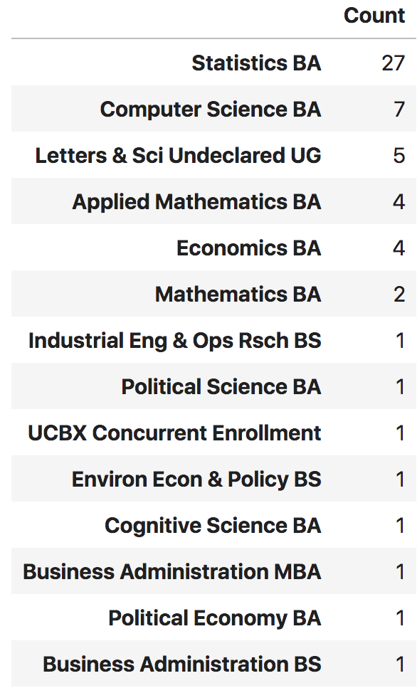
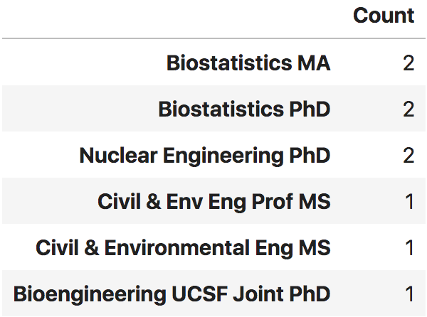
Student makeup
Undergraduates
Graduates

Slide 5
Goals
What?
Core ideas: data access, computation, statistical analysis and publication.
Why?
An essential concern of modern computational research.
Social and scientific implications of lack of reproducibility.
Frame the problem in terms practical, ethical and epistemological.
How?
Skills and habits necessary to make a practice of reproducibility.
An everyday practice, not a “publication time” concept.

Slide 6
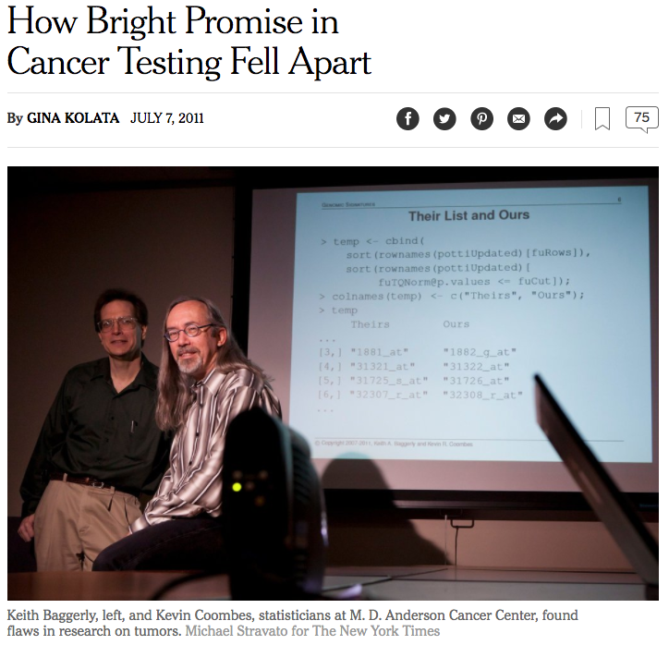
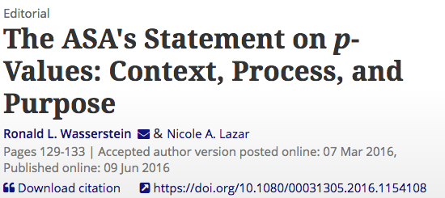
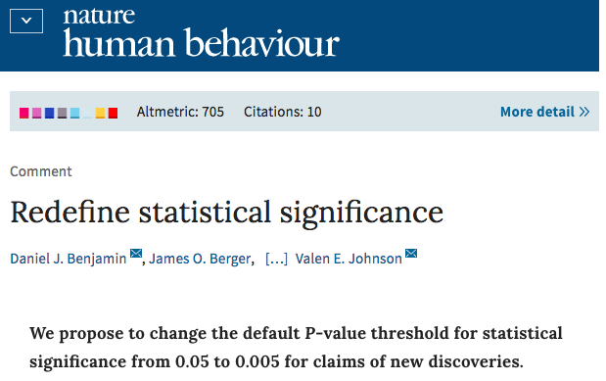
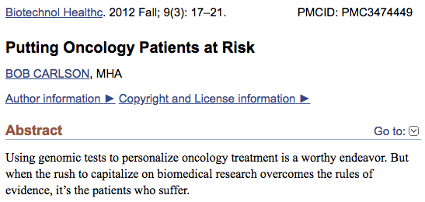
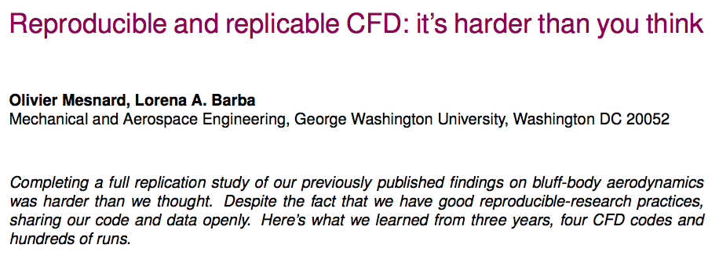
Ideas: readings

Slide 7
Core skills
Version control: Git and GitHub
Programming: Python
Process automation: Make
Data analysis: Numpy, Pandas, Matplotlib, NLTK, Scikit-Learn, …
Documentation: Sphinx
Software testing: PyTest
Continuous Integration: Travis
Reproducible containers: Binder

Slide 8
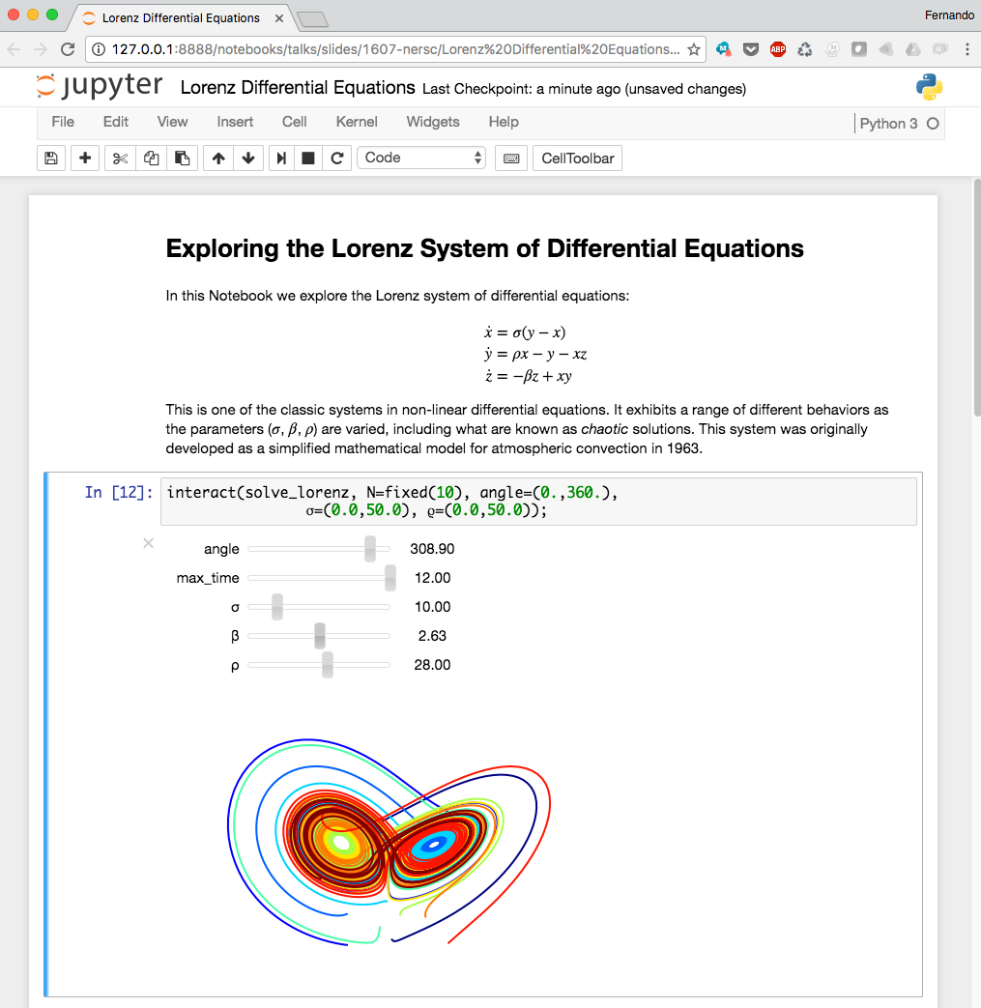
The IPython/Jupyter Notebook
Rich web client
Text & math
Code
Results
Share, reproduce.

Slide 9
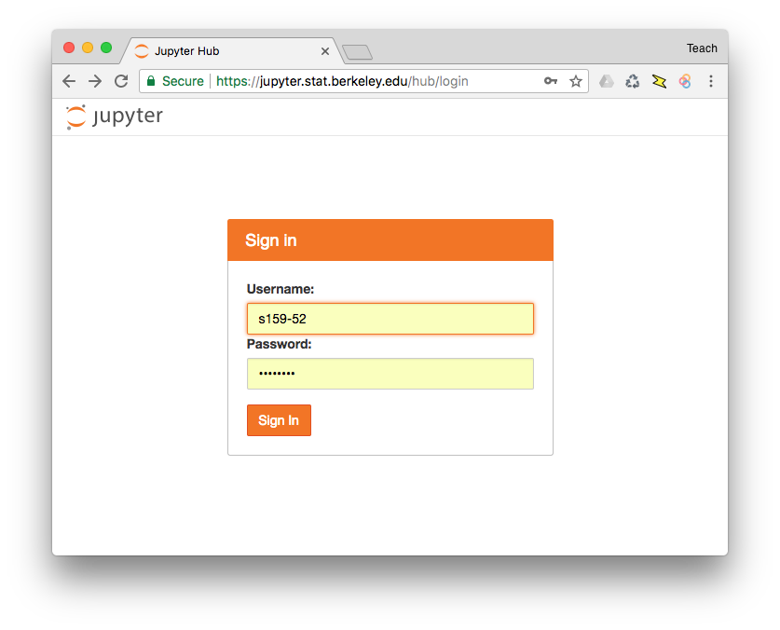
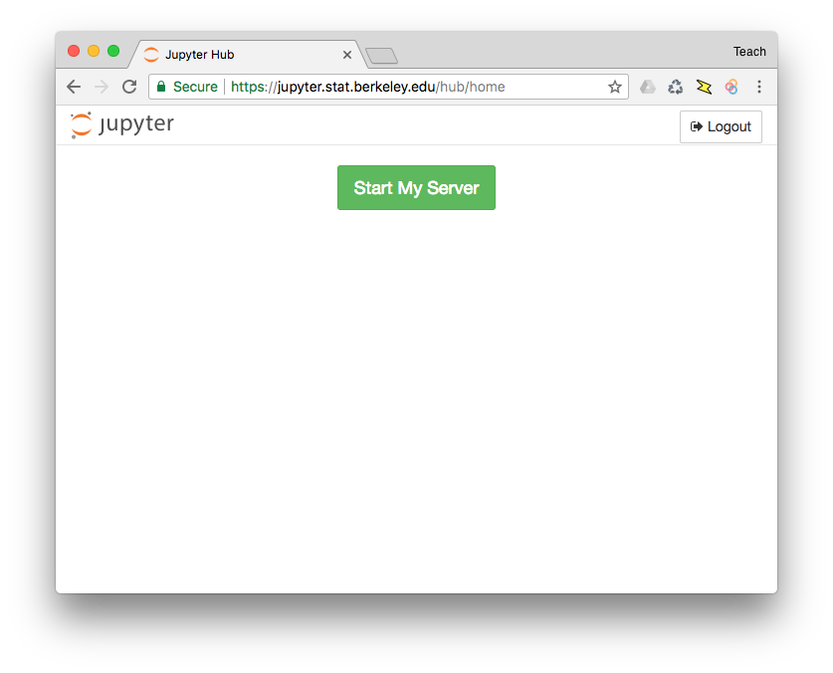
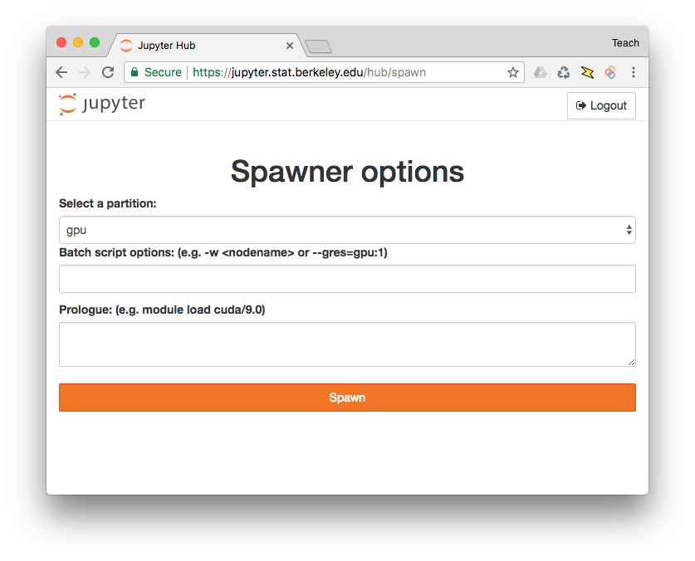
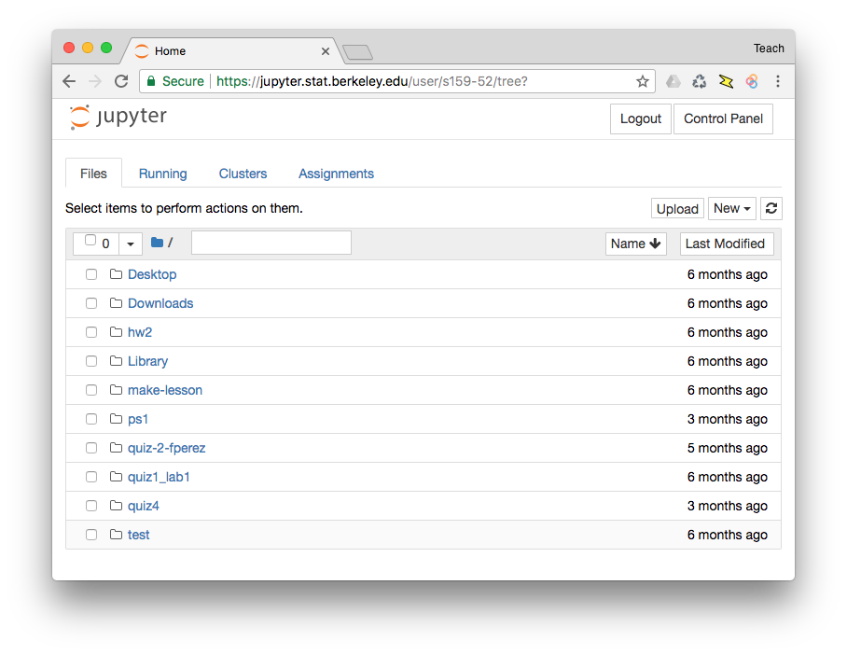
Work environments
Personal Installation
Hosted Installation

Slide 10
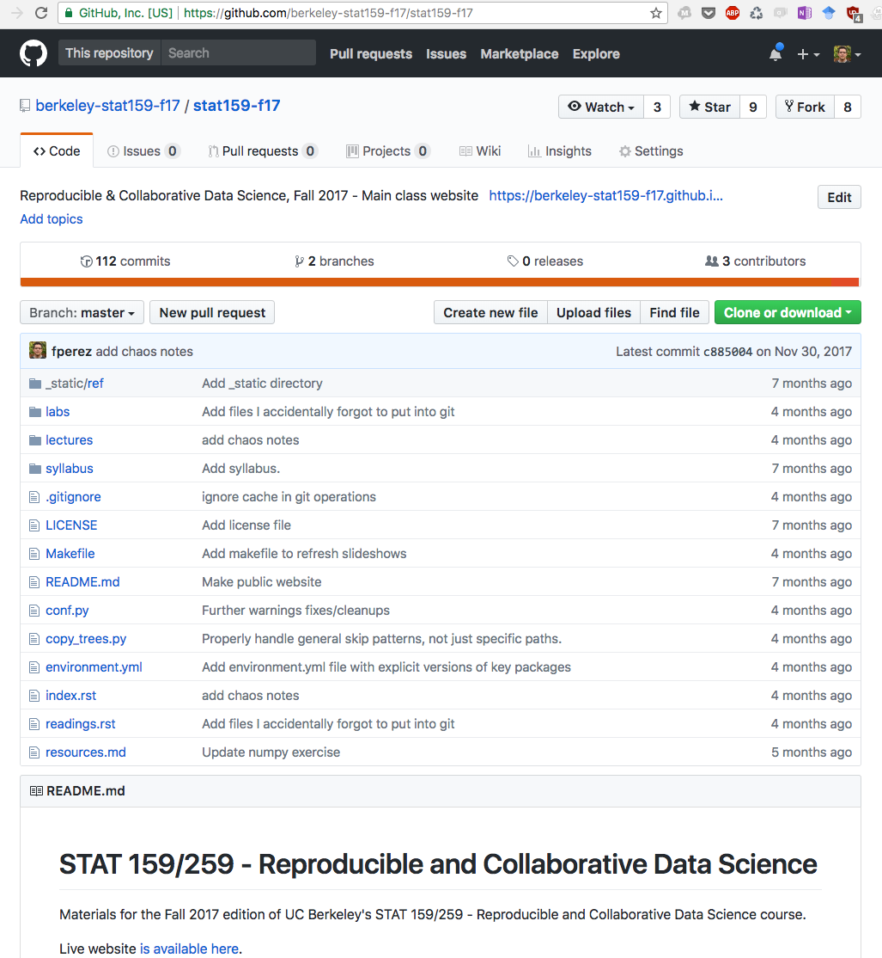
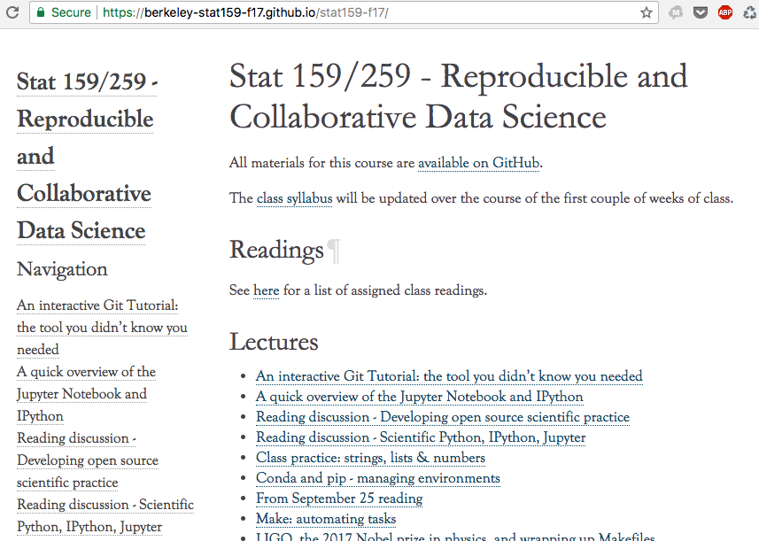
Git and Python workflow everywhere

Slide 11
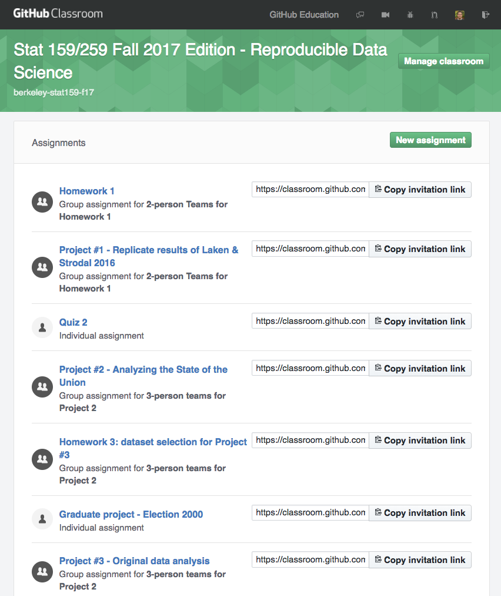
Computational hygiene: a daily habit

Slide 12
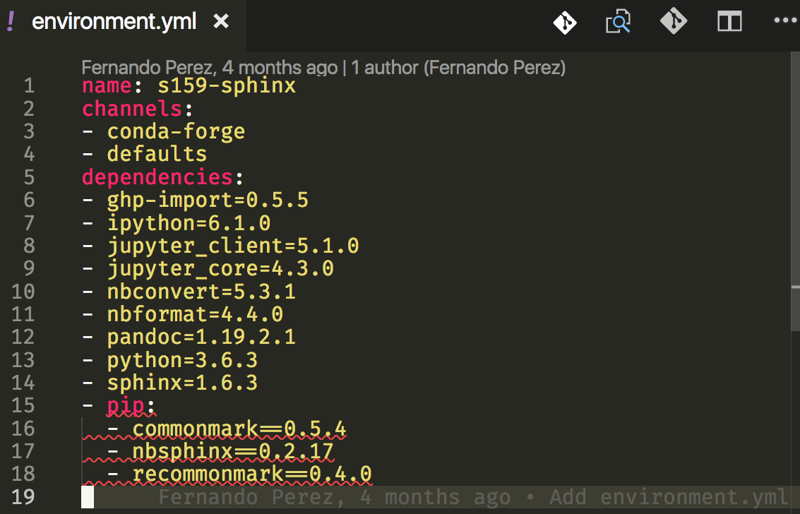
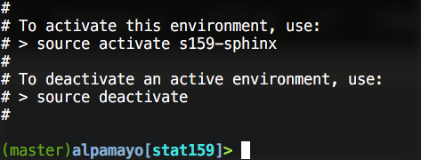
Explicit dependency management

Slide 13
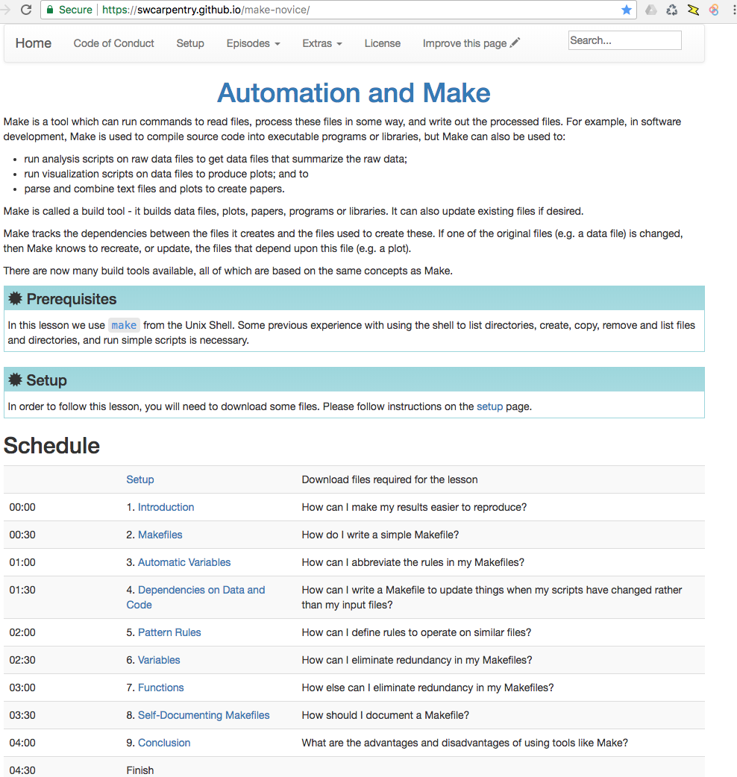
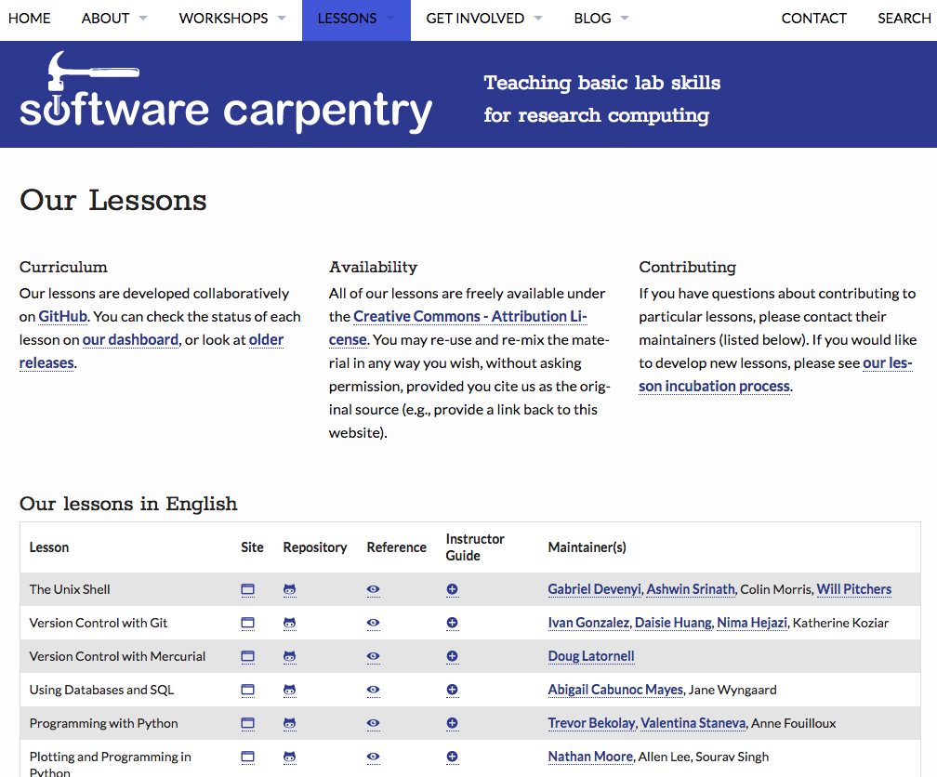
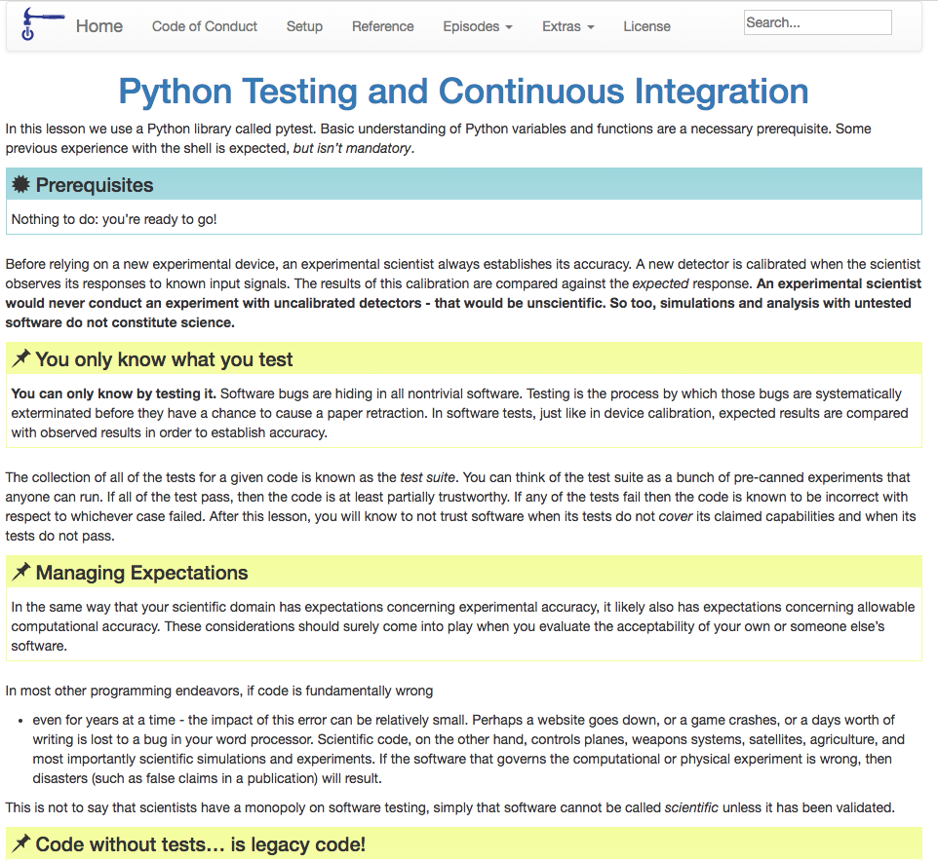
Automation and Testing: SW Carpentry

Slide 14
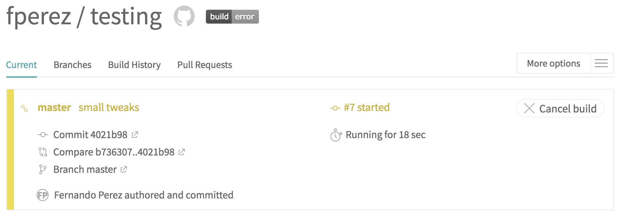
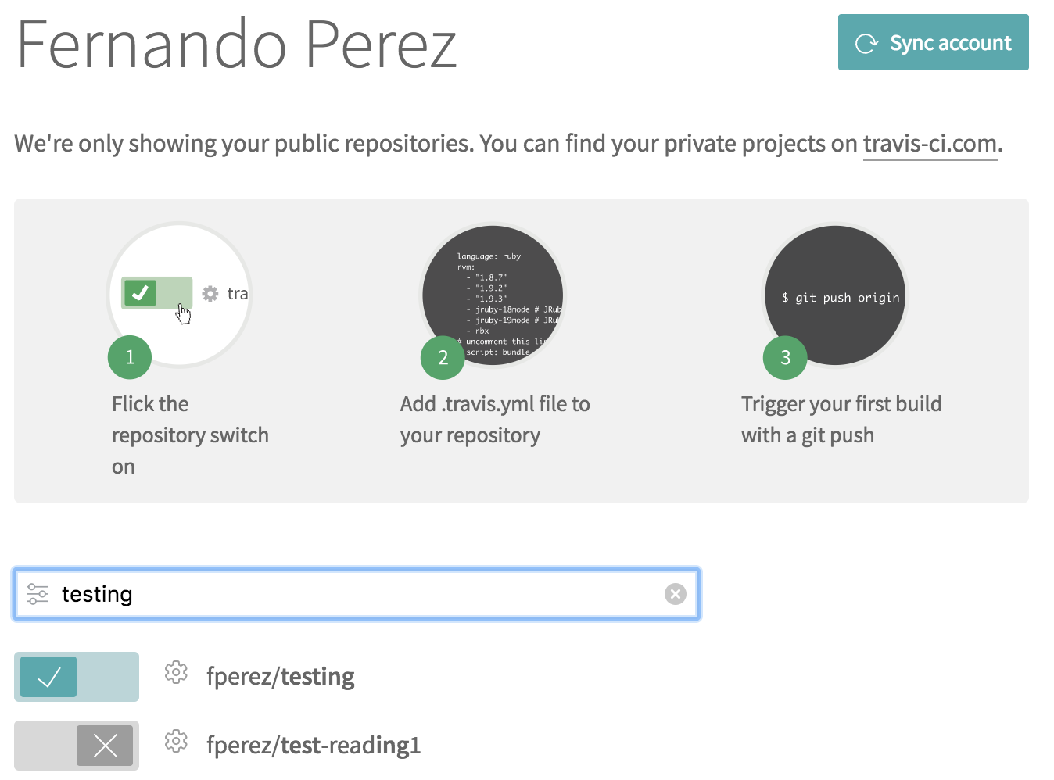
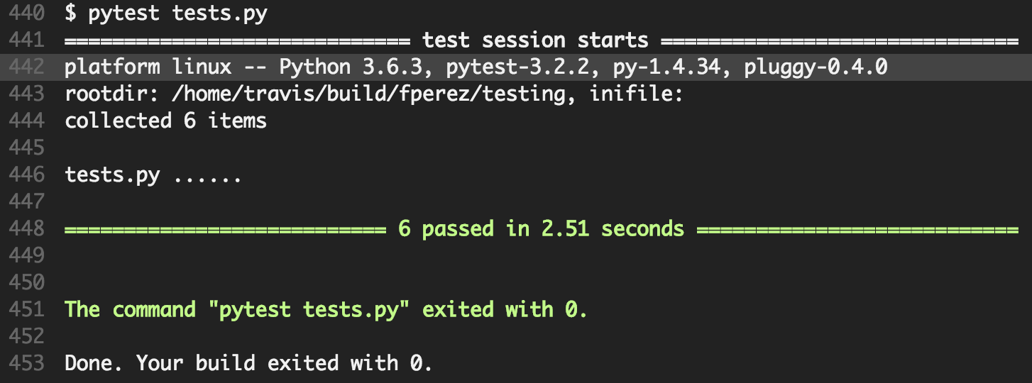
Continuous Integration with Travis

Slide 15
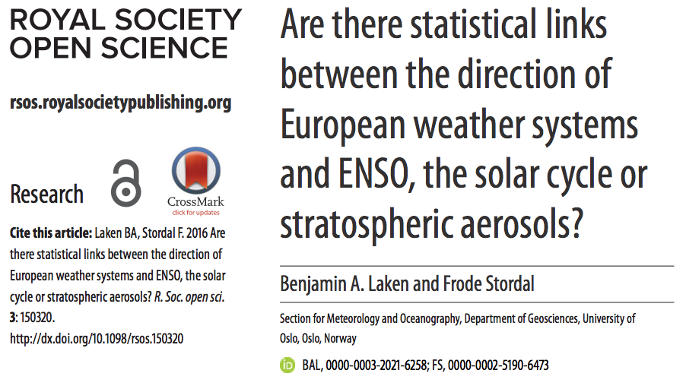
Project 1: real-world replication

Slide 16
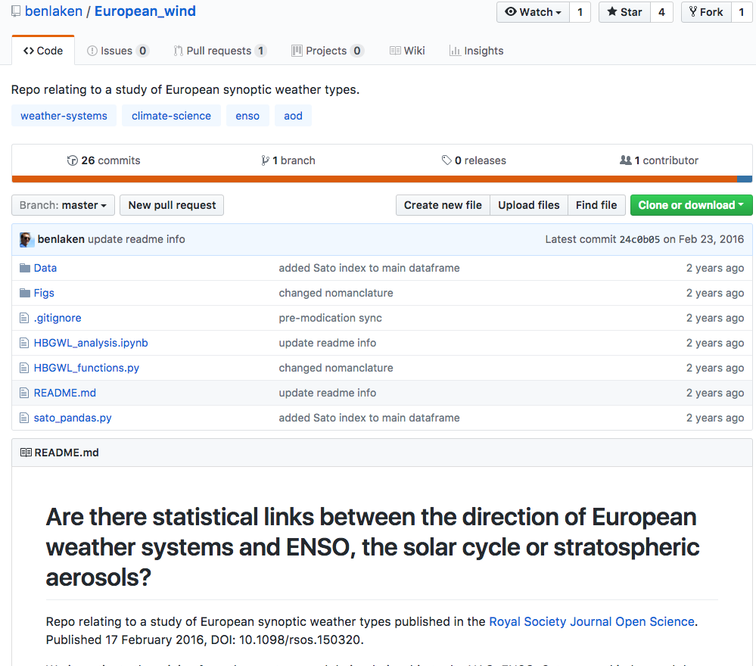

Slide 17
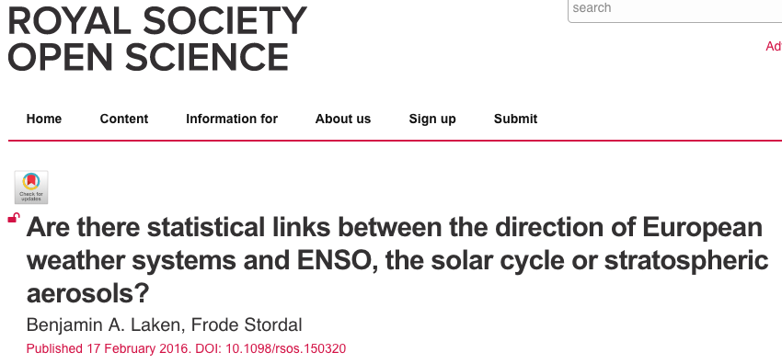
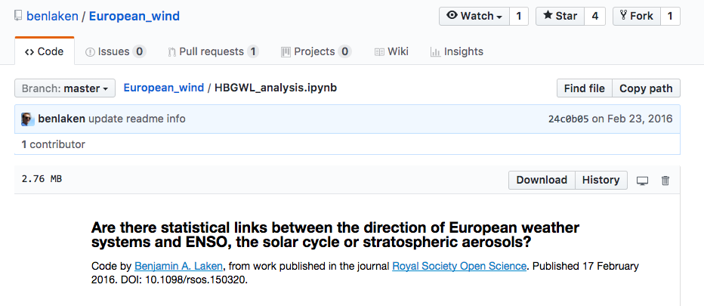
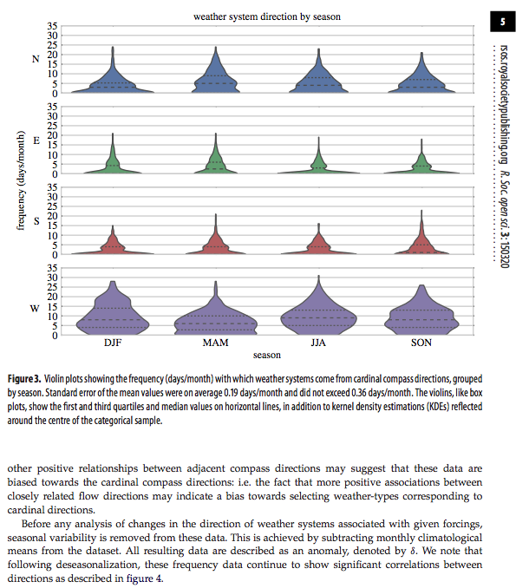
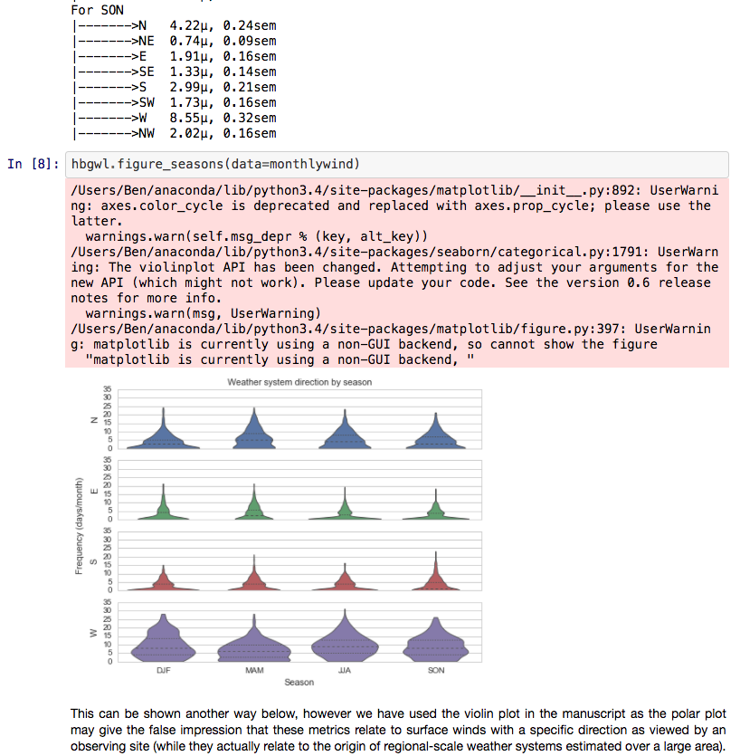

Slide 18
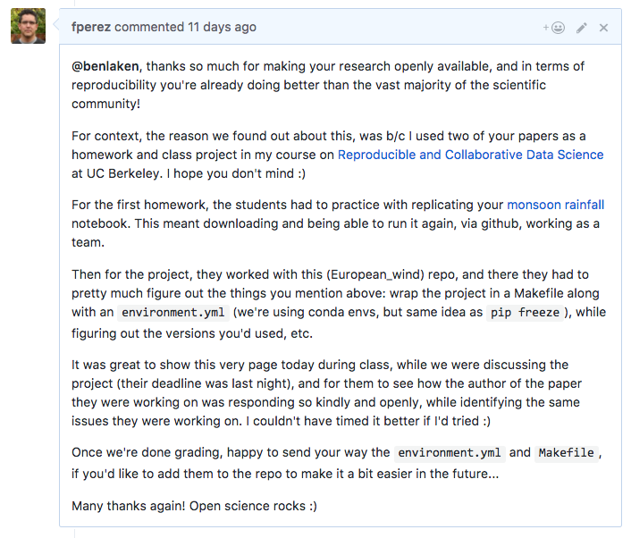
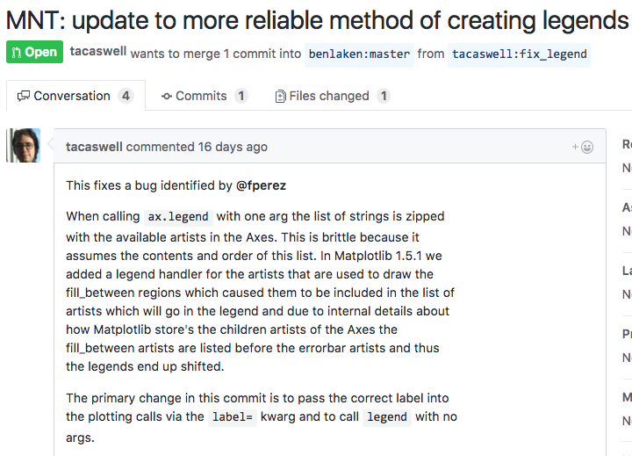
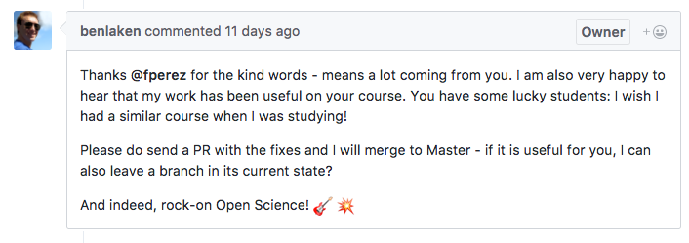

Slide 19
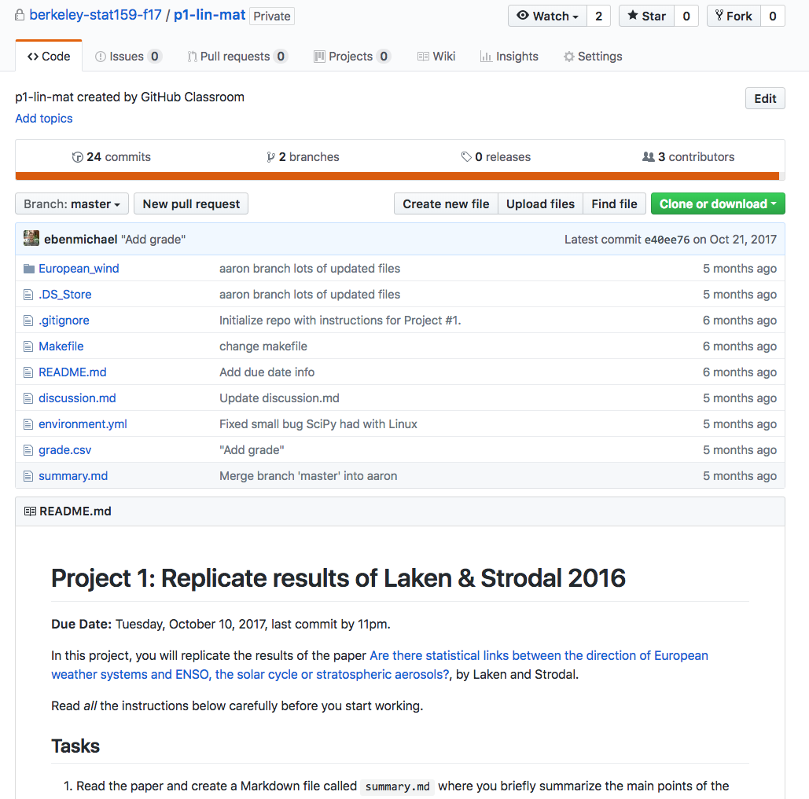
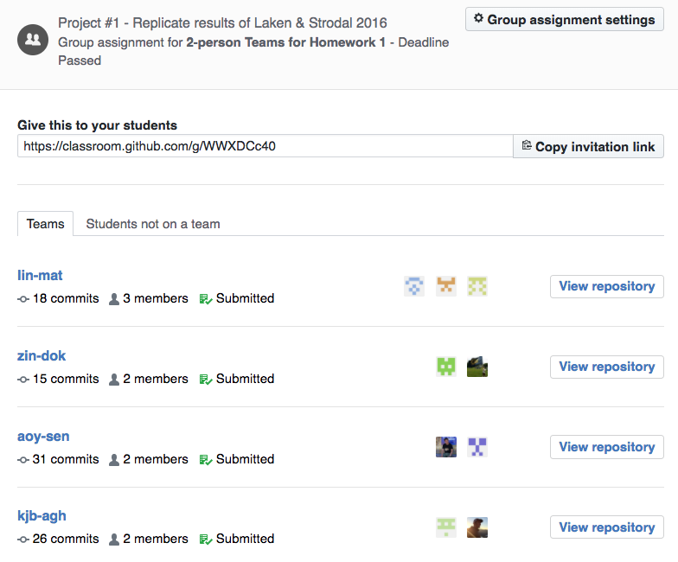
GitHub Classroom

Slide 20
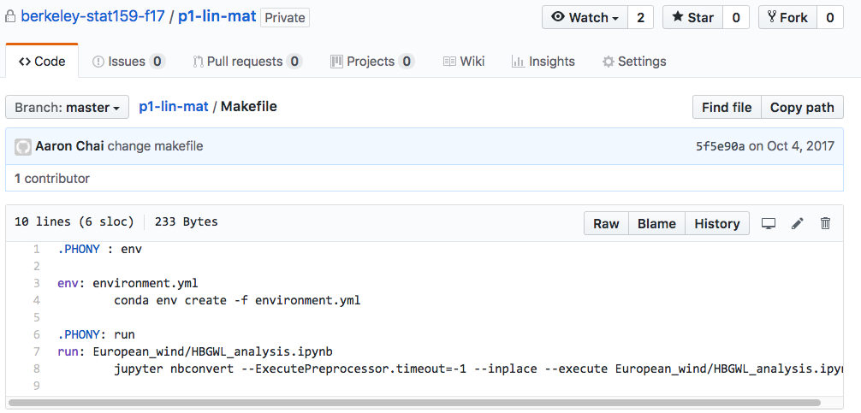
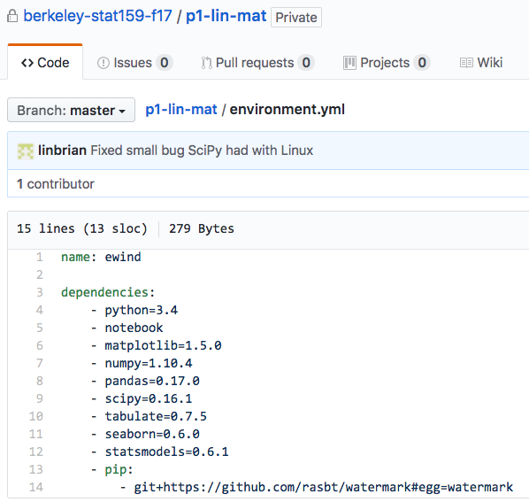
Standard workflow: Makefile and environment.yml

Slide 21
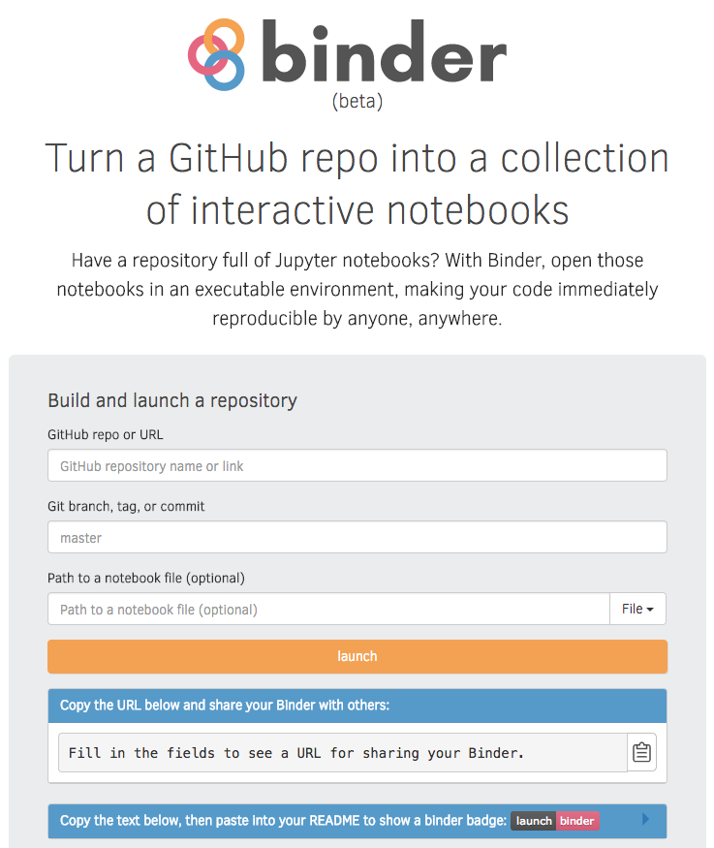
mybinder.org: shareable reproducibility
+
Origins
Explicit Dependencies
+
github.com/freeman-lab

Slide 22
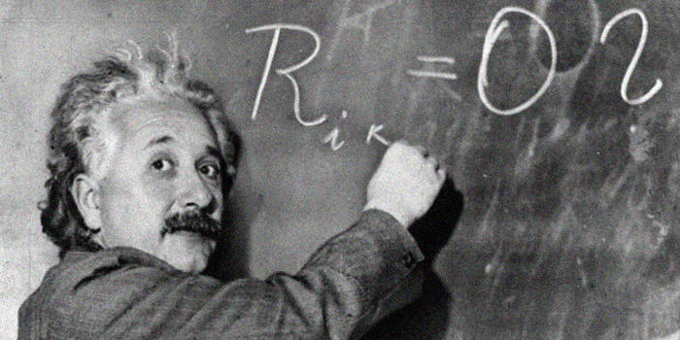
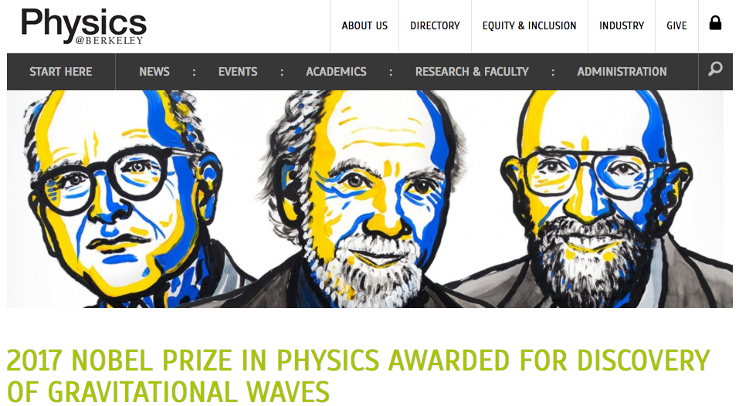
A long time ago in a galaxy far, far away…
Einstein’s Field Equations of General Relativity, Annalen der Physik, 1916

Slide 23
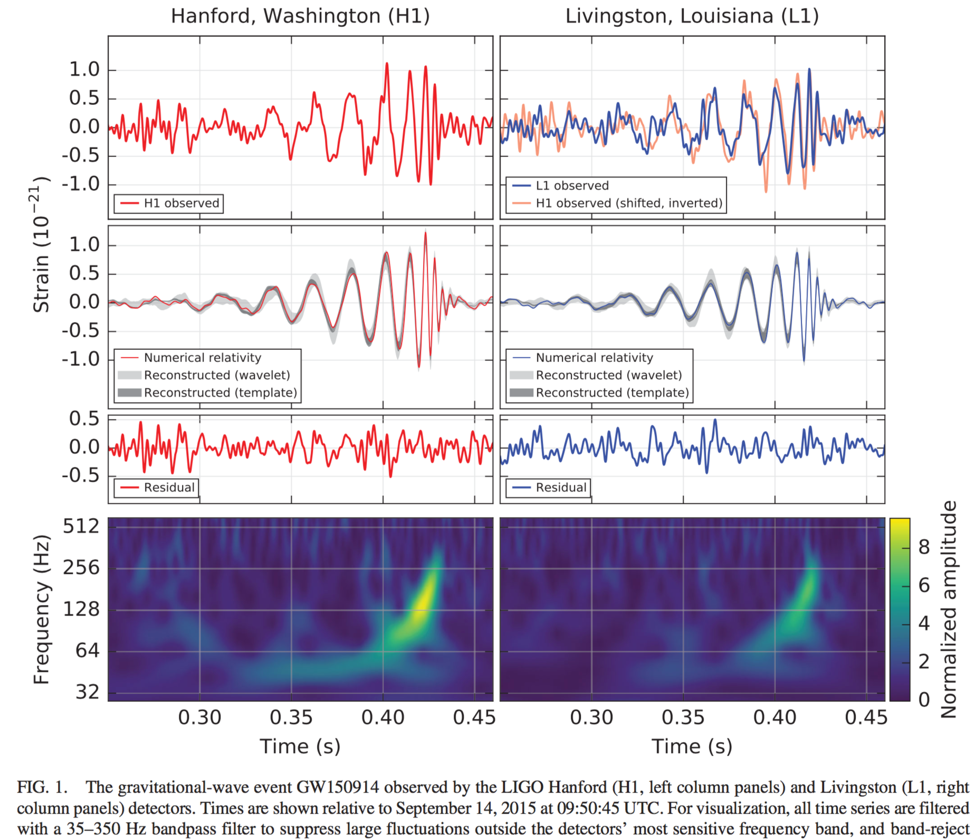
September 14, 2015

Slide 24
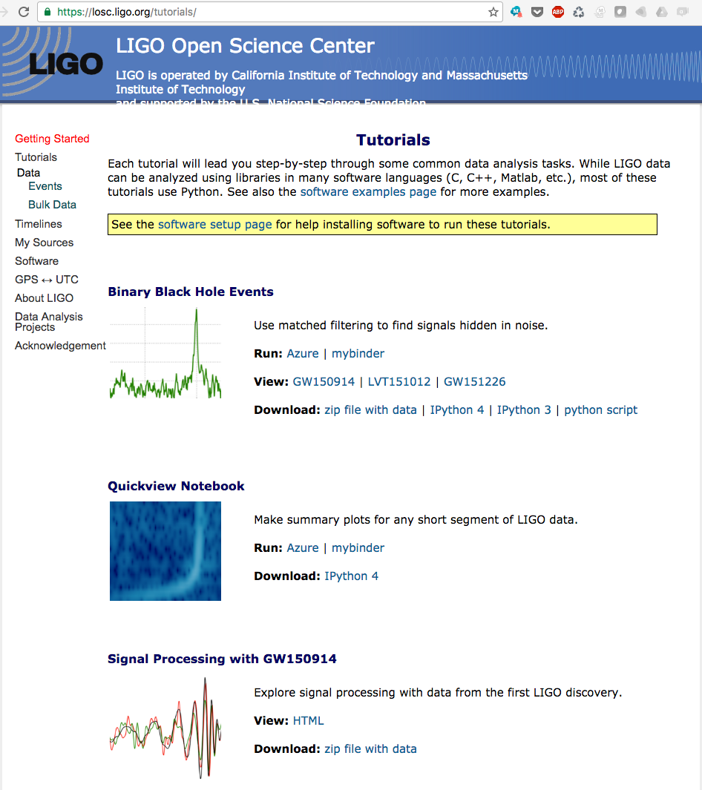
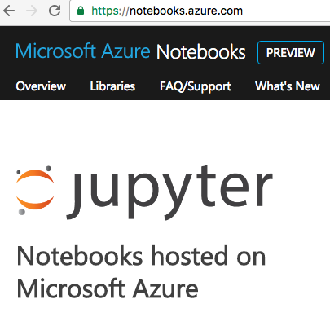
LIGO: Open Science with Jupyter

Slide 25
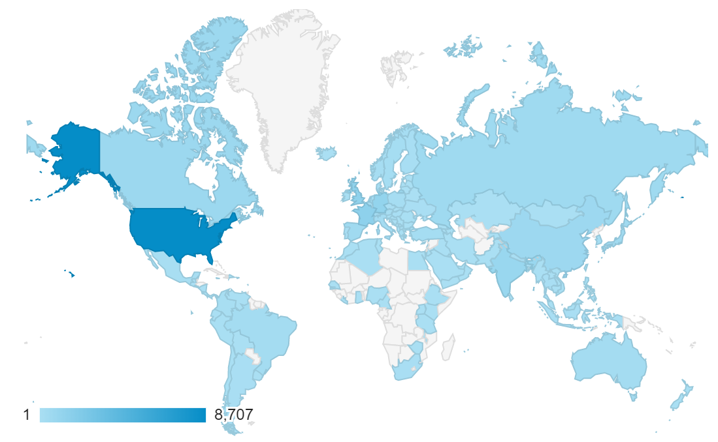
Binder: reproducible, executable scholarship
from averaging ~150 people per week to averaging ~2,900 people per week
Berkeley: Yuvi Panda, Chris Holdgraf
Cal Poly: Carol Willing
Simula: Min Ragan-Kelley
Jessica Zosa-Forde, Tim Head

Slide 26
Project 3: original analysis
Data: included in repo or linked if too large.
Clean, tested code.
Analysis notebooks and supporting code
Break down your analysis into as many notebooks as is reasonable for convenient reading and execution.
Main narrative notebook: summarizes and discusses results.
Reproducibility support: Makefile and environment.yml
Good repository practices: README.md, LICENSE, .gitignore.
Use Victoria Stodden's ENABLING REPRODUCIBLE RESEARCH: LICENSING SCIENTIFIC INNOVATION.
A “Standard Playbook”

Slide 27
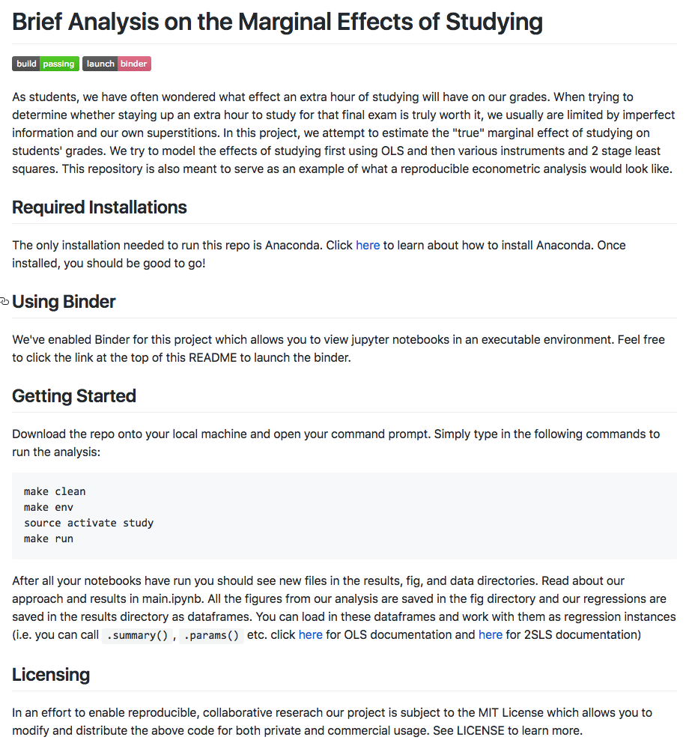
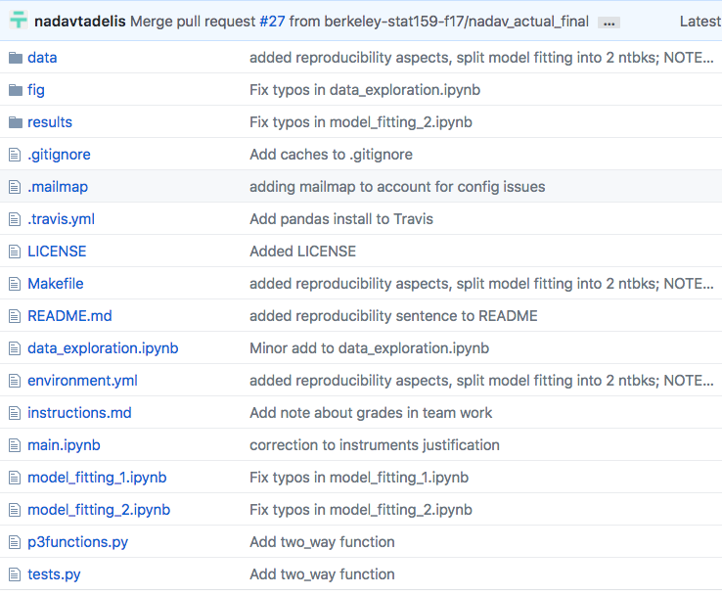

Slide 28
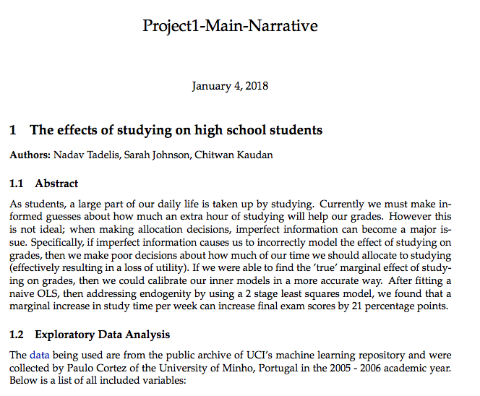
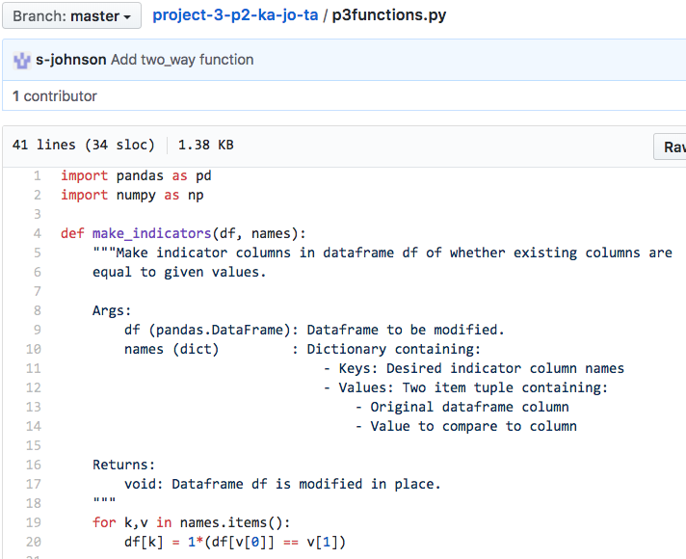
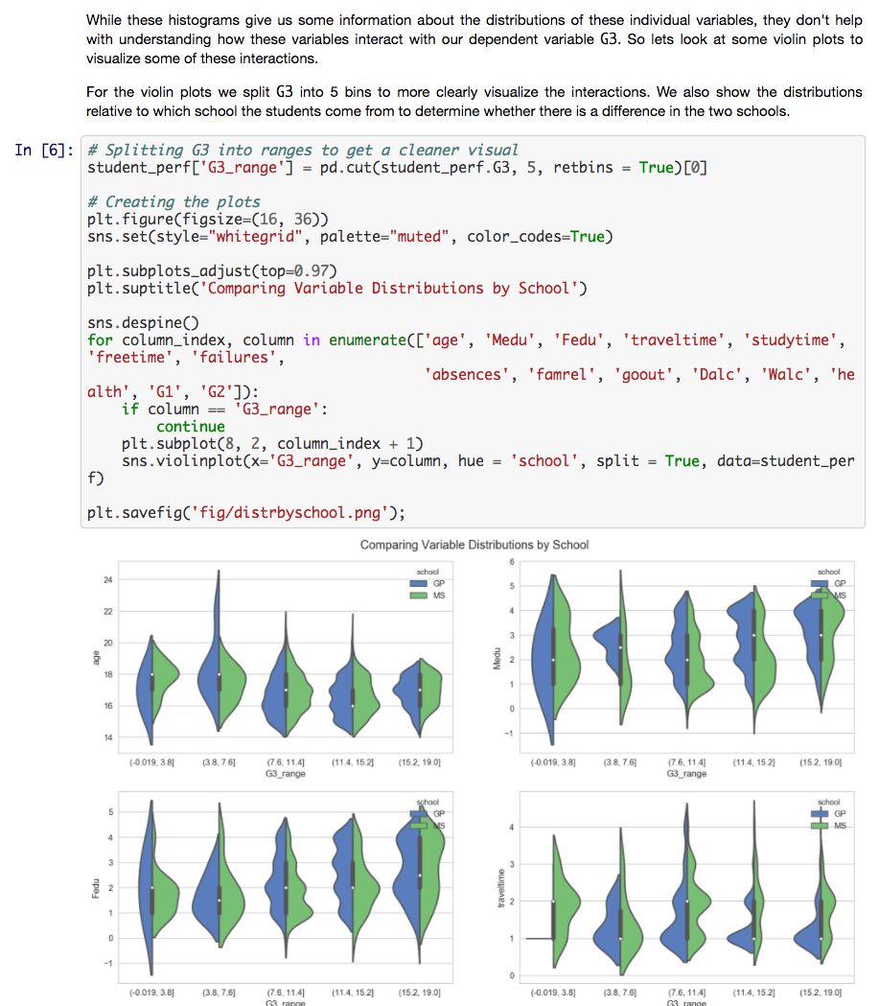
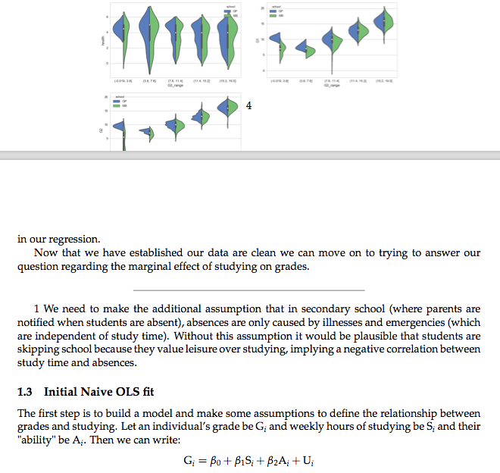
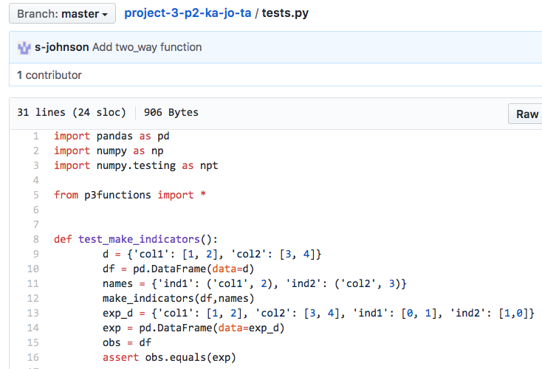
Code and tests
Analysis notebooks

Slide 29
Berkeley’s Data Science Courses
http://data8.org
Freshmen & upper division
Interactive textbooks: Jupyter Notebooks
Course deployment: JupyterHub
http://ds100.org

Slide 30
Data 8 & Data100: massive uptake
D8 Sp18: ~1,100 students
First class was yesterday!
D100 Sp18: ~650 students

Slide 31
Fastest growing courses in Berkeley history
Thanks to: Yuvi Panda (DSEP), Ryan Lovett (Statistics), DSEP team

Slide 32
Berkeley in a few years…

Slide 33
Student feedback
New open source contributor
Undergraduate research project
Journalist who now is applying to Data Science graduate programs

Slide 34
In summary
Actionable “template” for reproducible research.
They can later modify our approach, but they have a starting point.
Good coverage of the tools and skills
But some students struggled seeing the forest for the trees.
Very heterogeneous group in terms of computational background.
“broad” instead of “deep”:
shallow statistical detail, but issues applicable to virtually any discipline.
Working with real-world problems and data:
Great experience, but ironically, hard to replicate again (Laken’16 is now fixed!)

Slide 35
Thank You!

