Slide 1

National Academies of Science
Committee on the Assessment of Technologies for
Improving Fuel Economy of Light-Duty Vehicles – Phase 3
  Bill Charmley, Director
  Assessment and Standards Division
  National Vehicle and Fuel Emissions Laboratory
  Office of Transportation and Air Quality
  July 16, 2018

Slide 2
Outline
Introduction to OTAQ and NVFEL
The Committee’s Charge is Vitally Important
NAS Recommendations Inform EPA’s Work
EPA’s recent work
Recommendations
Conclusions
Appendix: EPA publications and reports citations

Slide 3
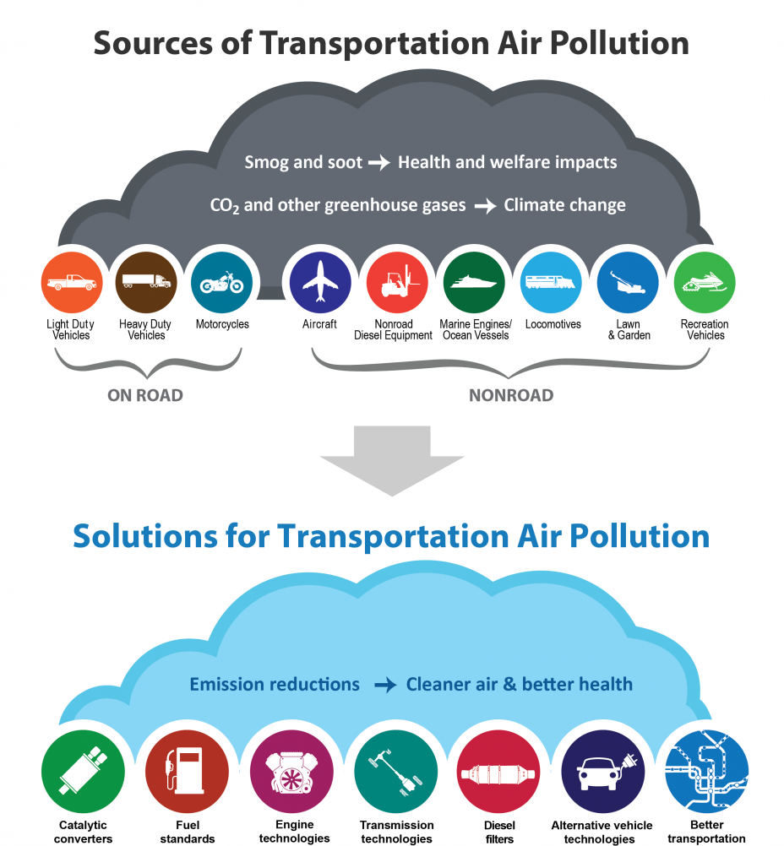
EPA’s Mission
To protect human health and the environment.
Office of Transportation and Air Quality
To protect human health and the environment
by reducing air pollution and greenhouse gas emissions
from mobile sources and the fuels that power them,
advancing clean fuels and technology,
and encouraging business practices and travel choices
that minimize emissions.

Slide 4
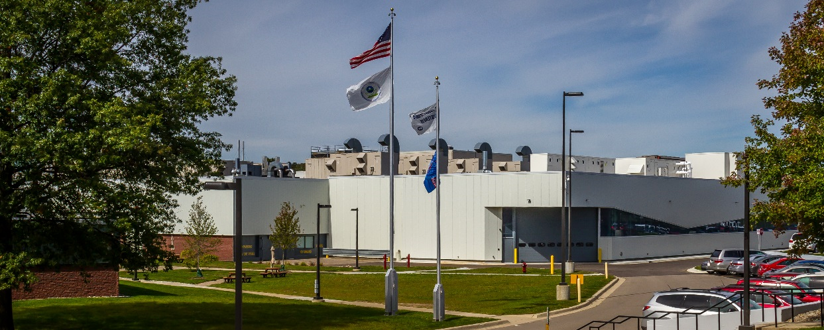
EPA’s National Vehicle and Fuel Emissions Laboratory
State of the art, ISO 14001 certified, national laboratory responsible for testing, certification, and research on air emissions from a wide range of transportation sources
Tests cars, trucks and engines to ensure they meet emissions standards throughout their useful lifetime
Researches and performs testing to inform new and updated emissions standards for air pollutants
Develops and implements test methods for measuring emissions from vehicles and engines
Assesses promising emissions reduction technologies
Benchmark for all other automotive emissions labs world-wide: ISO/IEC 17025 accredited – the gold standard for data quality
Ann Arbor, MI
Light-duty chassis testing
Heavy-duty chassis testing
Engine emissions testing
Portable emission measurement systems
Fuels and chemistry analysis

Slide 5
This NAS Committee’s Charge is Vitally Important
2025-2035 is a critical time frame for the transportation sector, especially the light-duty sector
The industry, marketplace, and consumers will be changing rapidly – how will this impact Federal and state policies?
For EPA, what will this mean for emissions, air quality, the climate, the environment, and public health?
OTAQ is a resource for this Committee
  For the 2010 and 2015 report committees, OTAQ provided ~20 technical presentations as well as data, reports, and assessments

Slide 6
NAS Recommendations Inform EPA’s Work
EPA followed through on many recommendations from the 2015 NAS Report. Examples:
Full vehicle simulations and teardown cost analysis (Recommendation 8.3): “The committee notes that the use of full vehicle simulation modeling in combination with lumped parameter modeling and teardown studies contributed substantially to the value of the Agencies’ estimates of fuel consumption and costs, and it therefore recommends they continue to increase the use of these methods to improve their analysis.”
  EPA has continued cost teardown studies of fuel efficient technologies, including diesel engines, updated turbo-downsized engine, 8-speed transmissions, CVTs, high-efficiency gearbox, mild hybrids, cost updates to past teardowns
  EPA has continued to enhance the ALPHA full-vehicle simulation model
Engine maps (Recommendation 2.1): “For spark ignition engines these [full vehicle] simulations should be directed toward the most effective technologies that could be applied by the 2025 MY to support the midterm review of the CAFE standards. The simulations should use either engine maps based on measured test data or an engine-model-generated map derived from a validated baseline map in which all parameters except the new technology of interest are held constant.”
  EPA/NVFEL has performed benchmarking testing on more than 30 vehicles and all completed test results are publicly available
  See next slides for vehicle listings, and Appendix for publication citations; benchmarking data packets available at:
  https://www.epa.gov/vehicle-and-fuel-emissions-testing/benchmarking-advanced-low-emission-light-duty-vehicle-technology#test-data
Manufacturer Learning-by-doing Cost Reductions (Recommendation 7.2): “The Agencies should also continue to conduct and review empirical evidence for the cost reductions that occur in the automobile industry with volume, especially for large-volume technologies that will be relied on to meet the CAFE/GHG standards.”
  EPA commissioned a Learning literature review and assessment. Peer-reviewed report: https://nepis.epa.gov/Exe/ZyPDF.cgi?Dockey=P100PUSX.PDF

Slide 7
EPA’s Recent Work
NVFEL benchmarking testing of 30 vehicles across wide range of powertrains & segments
  Provides critical up-to-date engine and transmissions inputs for vehicle simulation modeling; all data are publicly available
In-house full-vehicle simulation modeling (ALPHA)
In-house technology/cost optimization modeling (OMEGA)
Cost teardown studies of key technologies
Updated baseline vehicle fleet to MY2016 (MY2017 update ongoing)
Continued studies of VMT rebound effect
Consumer issues:
  Role of fuel economy in purchase decisions
  Consumer satisfaction with fuel efficient technologies
  (research through professional auto reviews and Strategic Vision data of new car owner surveys)
  Consumer willingness to pay (WTP) for vehicle attributes
  (commissioned study through RTI, with subject matter expert Dr. David Greene)
  Potential tradeoffs
  Affordability
  Energy paradox (or “energy efficiency gap”)

Slide 8
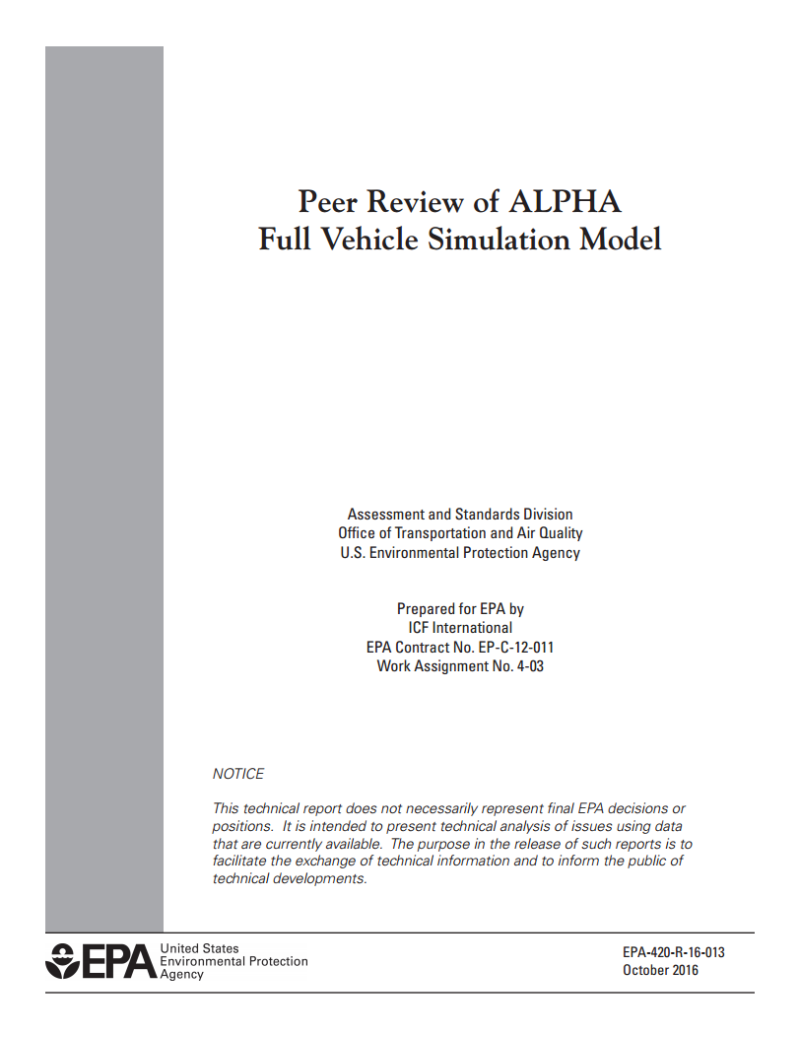
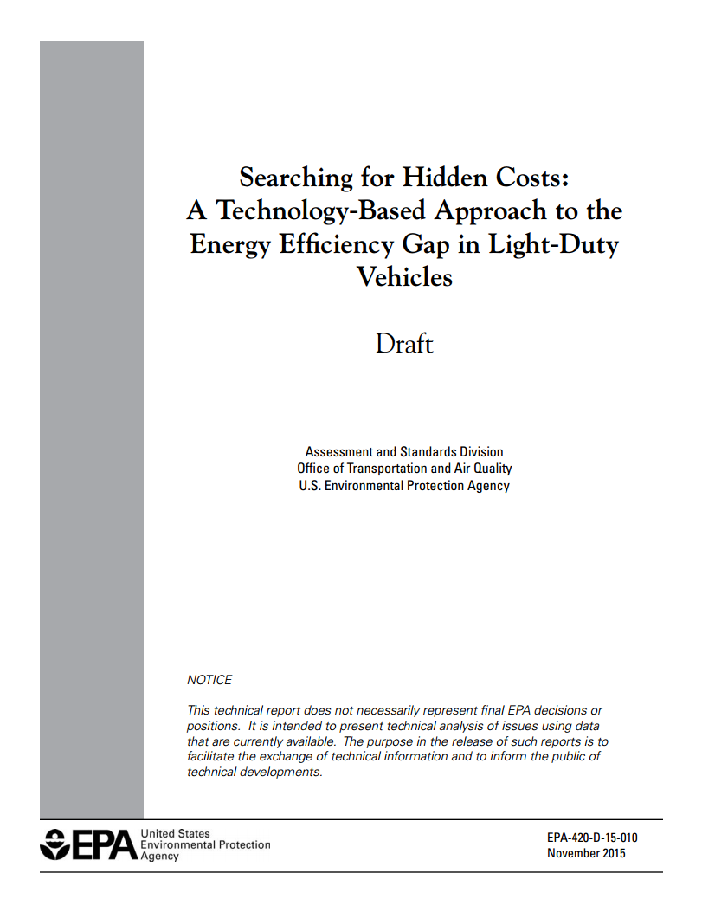
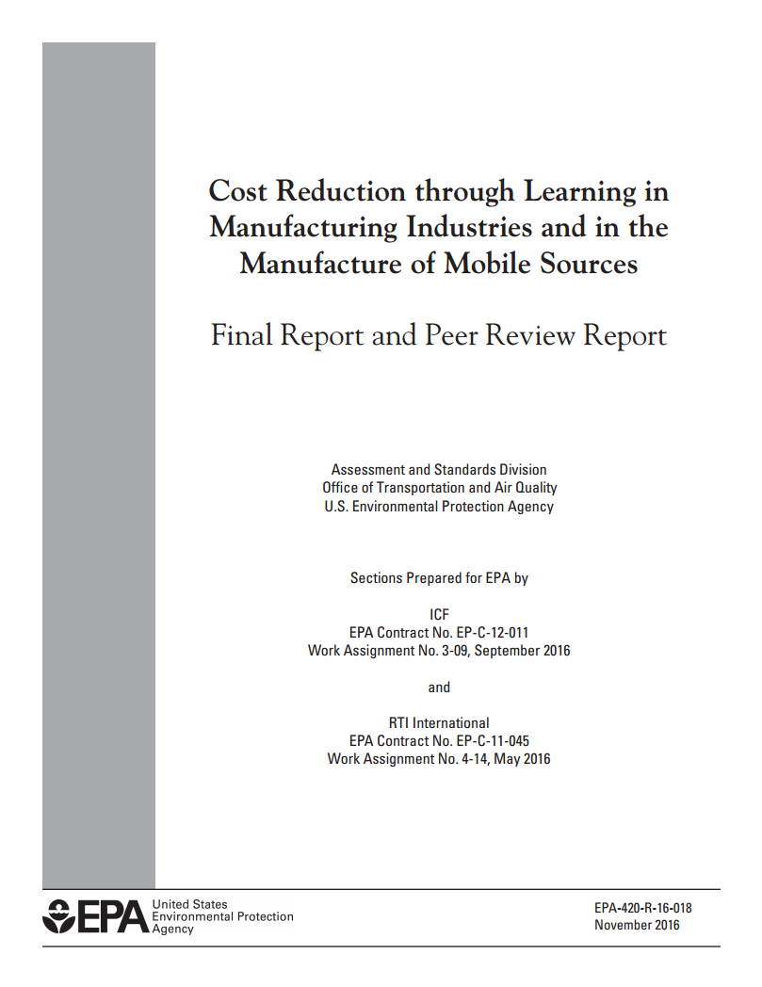
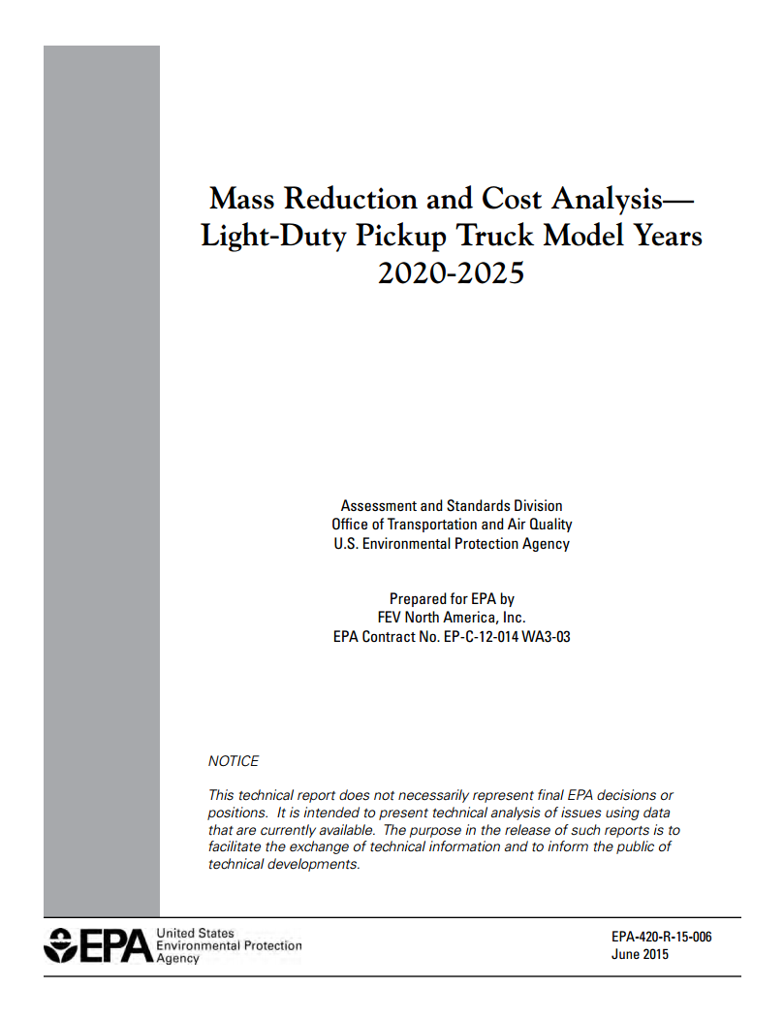
EPA Technical Information Available to the Public
Wide range of peer-reviewed publications and presentations:
Technical reports
Publications, including more than 30 SAE papers since 2013
Technical conference presentations
8

Slide 9
EPA continually assesses latest developments
In addition to our own research, EPA keeps abreast of latest developments through review of hundreds of papers/reports in the literature, attending technical conferences, and stakeholder dialog. Example conferences attended by EPA staff in recent years:
Aachen Colloquium, 2015 & 2016
Advanced Automotive Battery Conference, 2014-2017
Allied Social Sciences Association Annual Conference, 2014-2018
Asilomar Transportation and Energy Conference, 2015 & 2017
ASME ICE Fall Technical Conference, 2014-2017
Association of Environmental & Resource Economists Conference, 2015-2017
Automotive World Megatrends Fuel Economy Detroit, 2014, 2016 & 2017
Autonomous and Connected Detroit, 2017
Clemson University Global Tire Conference, 2017
CTI Symposium USA: Automotive Transmissions, HEV and EV Drives, 2014-2018
DOE Annual Merit Review , 2014-2018
DOE Cross Cut Lean Exhaust Emissions Reduction Simulation, 2014-2017
Electric Vehicle Symposium (EVS29 & 30), 2016 & 2017
ETH Conference on Combustion Generated Nanoparticles, 2017 & 2018
FKFS Progress in Vehicle Aerodynamics , 2017
Global Automotive Lightweight Materials - Detroit Conference, 2014, 2015 & 2017
Great Designs in Steel, 2014-2018
International Energy Economics Association meeting, 2014
ITB Advanced Thermal Management, 2017-2018
Mathworks Automotive Conference, 2014-2018
North American Automotive Metals Conference, 2015
SAE Government-Industry Meeting, 2014 - 2018
SAE High-Efficiency IC Engine Symposium, 2016-2018
SAE Hybrid & Electric Vehicle Technologies Symposium, 2015-2018
SAE Light-duty Emissions Control Symposium, 2014 & 2017
SAE North American International Powertrain Conference, 2015-2017
SAE Thermal Management Systems Symposium , 2015 & 2016
SAE World Congress, 2014-2018
Society for Benefit-Cost Analysis Annual Conference, 2015-2018
Society of Plastics Engineers AutoEPCON, 2017
The Battery Show Europe, 2018
The Battery Show, North America Conference, 2014-2018
Transport Canada eTV Forum, 2016
Transportation Research Board Annual Meeting, 2014-2018
TU Automotive Detroit 2018, 2018
U. Michigan Transportation Economics, Energy, & Environment, 2014-2017
U. Michigan Transportation Research Institute Powertrain Conference, 2017 & 2018
U. of Michigan/MSU/W. Michigan University Environmental and Energy Economics Day, 2014-2017
Vienna Motor Symposium, 2015-2018
Wards Auto Outlook Conference, 2017

Slide 10
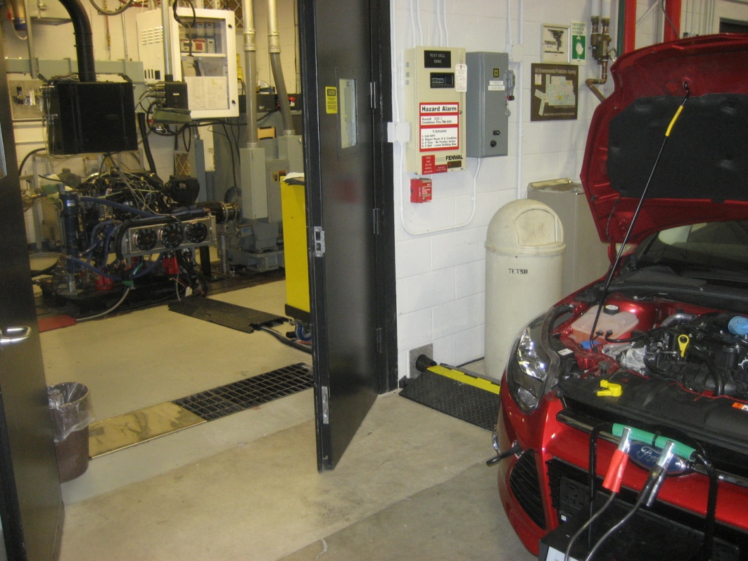
EPA In-depth Evaluation of Advanced Powertrains
Technology Effectiveness: Gasoline Engine Benchmarking Turbocharged engines 1.6L Ford EcoBoost –2013 Ford Focus (Euro) 1.6L Ford EcoBoost – 2013 Ford Escape 1.6L PSA Valvetronic turbo – 2012 Peugeot 2.7L V6 EcoBoost (2015 Ford F150)F150) 1.5L I4 (2016 Honda Civic) 2.5L I4 Skyactiv-G (Mazda CX-9) Applied publicly available engine maps: 1.0L I3 EcoBoost (2014 Ford Fiesta) (more efficient than the 2013 Ford 1.6L EcoBoost) 2.0L I4 (VW) with and without Miller cycle operation 1.4L I4 (VW) – from a copyrighted 2016 Ricardo Report Naturally aspirated engines 2.5L I4 Ecotec engine - 2013 GM Malibu 2.5L I4 Skyactiv – 2014 Mazda 6 2.0L I4 Skyactiv – 2014 Mazda 3 (13:1 CR) 2.0L I4 Skyactiv – 2014 Mazda 3 (14:1 CR – Euro) 4.3L V6 Ecotec3 with cylinder deac - 2014 GM Silverado 1500 2WD 2.5L I4 Toyota TNGA – 2018 Toyota Camry (in-process) Applied publicly available maps: 2.5L I4 TNGA prototype engine (from Toyota Aachen paper) Cylinder deactivation 4.3L V6 Ecotec3 with cylinder deac - 2014 GM Silverado 1500 2WD 6.2L V8 GM – 2011 Tula demonstration of ‘dynamic skip fire’ in GMC Denali 1.8L I4 VW – 2015 Tula demonstration of ‘dynamic skip fire’ in VW Jetta (in-process) Applied publicly available data: Tula ‘Dynamic Skip Fire’ I4 turbocharged and V8 naturally aspirated engines Other EPA testing & modeling Prototype Mazda SkyActiv with 14:1 CR + Cooled EGR and high energy ignition GT-Power modeling of cooled-EGR and Variable Nozzle Turbocharger/Variable Geometry Turbocharger (VNT/VGT)
2015 Ford F150 2.7L EcoBoost Engine
Current Production Engine, 24-bar BMEP, Turbocharged GDI with DCP
US EPA - Office of Transportation and Air Quality

Slide 11
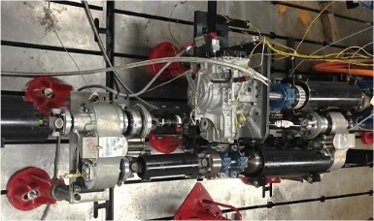
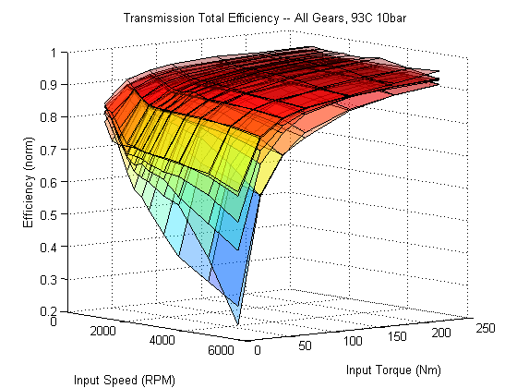
Technology Effectiveness: Transmission Benchmarking
Benchmarked key transmissions to obtain efficiency and operational maps
      GM 6T40 6-speed automatic transmission (AT) from 2013 MY Malibu
      2014 GM Silverado 6-speed
      FCA 845RE 8-speed AT from 2014 Ram 1500 Pickup Truck
      Jatco CVT8 transmission
      2016 Honda CVT
Applied transmission maps provided by industry
          DCT 6-speed
          DCT 7-speed
          CVT
          Jatco CVT7
          Jatco CVT8
          Toyota CVT
Benchmarked several vehicles to characterize transmission shift schedules,
torque convertor lock-up, and vehicle controls
      2013 GM Malibu – 6-speed AT
      2014 Dodge Chargers – 5-speed AT & 8-speed AT
      2015 Volvo S60 – 8 speed AT
      Ford F150 and GM Silverado – 6-speed
      Ram 1500 HFE – 8 speed AT
      2016 Honda CVT
      More than a dozen other late model vehicles (next slide)
Transmission Benchmarking and Resultant Torque/Speed/Efficiency Curve

Slide 12
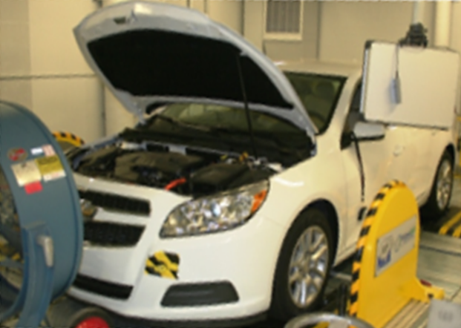
Technology Effectiveness: Gasoline and Diesel Vehicle Benchmarking
Benchmarked Vehicles With Naturally Aspirated Engines
  2013 Chevrolet Malibu (base)
  2013 Chevrolet Malibu Eco
  2013 Chevrolet Volt
  2013 Mercedes E350
  2013 Altima SV
  2014 US Mazda 6
  2014 US Mazda 3
  2014 Dodge Charger 5-spd
  2014 Dodge Charger 8-spd
  2014 RAM 1500 HFE
  2014 Chevy Silverado 1500 2WD
  2016 Chevrolet Malibu
  2018 Toyota Camry TNGA
  2011 GMC Denali (GM 6.2L V8 with Tula ‘Dynamic Skip Fire’)
  Applied publicly available data:
  Tula 'Dynamic Skip Fire' on V8 naturally aspirated
Planned Future Vehicles
2019 Chevrolet Silverado (5.3L with DFM cylinder deac)
2018 Mazda 6 (2.5L I4 with cylinder deac)
Benchmarked Vehicles With Turbo Engines
  2013 Escape
  2013 Focus (Euro)
  2014 RAM 1500 EcoDiesel
  2015 Ford F-150 (6-speed)
  2017 Ford F-150 (10-speed)
  2015 Volvo S60 T5
  2016 Acura ILX
  2016 Malibu 1.5L turbo
  2016 Honda Civic 1.5L turbo
  2016 Mazda CX-9 2.5L turbo
  2015 VW Jetta (VW 1.8L I4 with Tula ‘Dynamic Skip Fire’ in-process)
  Applied publicly available data:
  Tula 'Dynamic Skip Fire' on I4 Turbocharged
Planned Future Vehicles
2018 Jeep Wrangler (2.0L I4 with eTorque)
2019 Infiniti QX50 (2.0L I4 with variable CR)
2019 Mazda 3 (2.0L SkyActiv X SPCCI)
Vehicle Dyno Testing

Slide 13
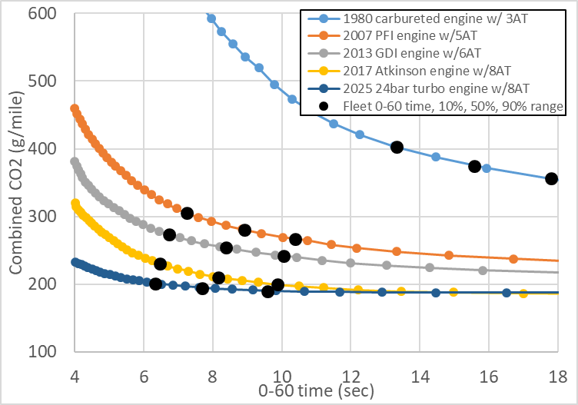
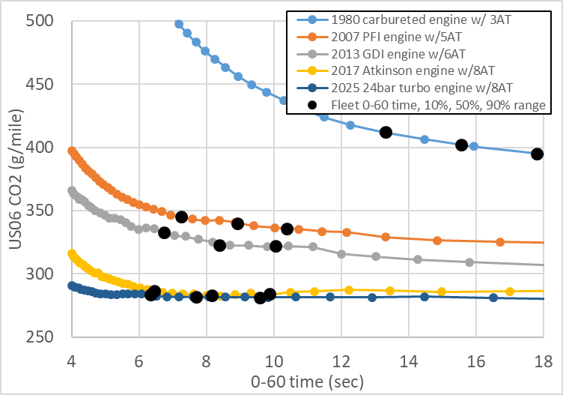
EPA Investigation on Power/Fuel Economy Tradeoffs
ALPHA full vehicle simulation was used to determine 0-60 acceleration performance and CO₂ emissions for a generic vehicle with five different powertrains:
1980 carbureted engine + 3AT
2007 PFI engine + 5AT
2013 GDI engine + 6AT
2017 TC engine + 8AT
Future (2025) TC engine + adv 8AT
Engine power was swept, keeping other parameters constant.
The tradeoff (percent change in CO₂ per percent change in acceleration time) was examined, over 0-60 times of fleet in the year indicated.
Caveat: This simplified analysis assumes only changes to engine power, and not other vehicle parameters.
Published in part in: Moskalik, A., Bolon, K., Newman, K., and Cherry, J. (2018) "Representing GHG Reduction Technologies in the Future Fleet with Full Vehicle Simulation," SAE Technical Paper 2018-01-1273, doi:10.4271/2018-01-1273.
Publication of further results in process.
Combined FTP-HW Cycle
Comb. Cycle Data: Powertrain | 0-60 average | CO₂ @ 0-60 av. | Slope, 10th-90th % | (%∆ CO₂)/ (%∆ 0-60)
1980 carbureted | 15.57 | 375 | -10.5 | -0.43
2007 PFI | 8.91 | 281 | -12.1 | -0.37
2013 GDI | 8.39 | 254 | -9.3 | -0.30
2017 Atkinson | 8.16 | 210 | -9.1 | -0.35
2025 24bar turbo | 7.69 | 195 | -3.4 | -0.14
Combined cycle tradeoffs change only slightly over 1980-2017, but may be much “flatter” in the future, indicating that increasing performance has less effect on CO₂.
US06 (more aggressive cycle)
US 06 Data: Powertrain | 0-60 average | CO₂ @ 0-60 av. | Slope, 10th-90th % | (%∆ CO₂)/ (%∆ 0-60)
1980 carbureted | 15.57 | 402 | -3.8 | -0.15
2007 PFI | 8.91 | 340 | -2.9 | -0.07
2013 GDI | 8.39 | 323 | -3.3 | -0.08
2017 Atkinson | 8.16 | 283 | -0.7 | -0.021
2025 24bar turbo | 7.69 | 282 | -0.6 | -0.017
US06 tradeoffs are generally much flatter, and tradeoffs may be approaching zero for more the aggressive US06 cycle.

Slide 14
EPA Uses Detailed Benchmark Data and Models to Project Longer-term (2025+) Potential for Next-Generation Internal Combustion Engines and Vehicles
Effect on CO₂ Depends on Factors
  Engine size v. vehicle loading
  Implementation & architecture
  (e.g., I4, V6 etc.)
  Implementation of strategies
  (e.g., cylinder deacFC fly zone)
  Other elements in powertrain (e.g., where transmission allows engine to operate)
Reference: EPA Presentation at SAE 2018 High Efficiency IC Engine Symposium, D. Barba, April 2018
deacFC - Full Continuous cylinder deactivation
deacFC - Full Continuous cylinder deactivation

Slide 15
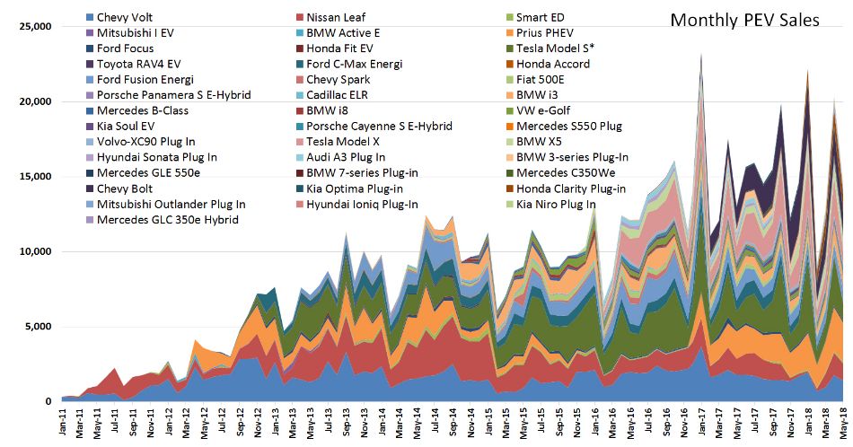
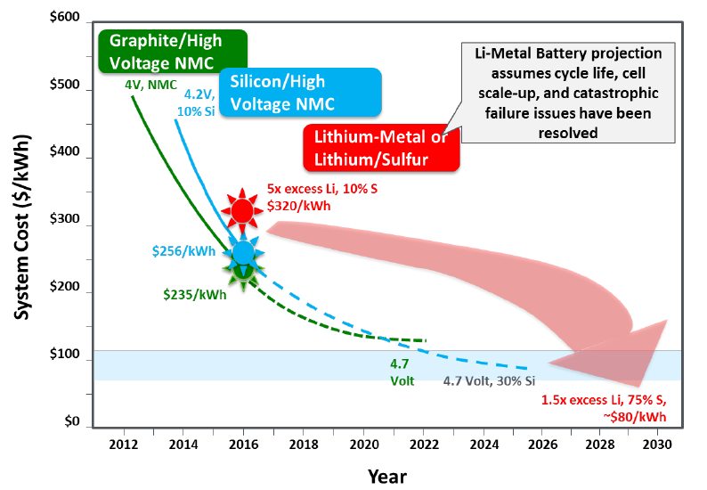
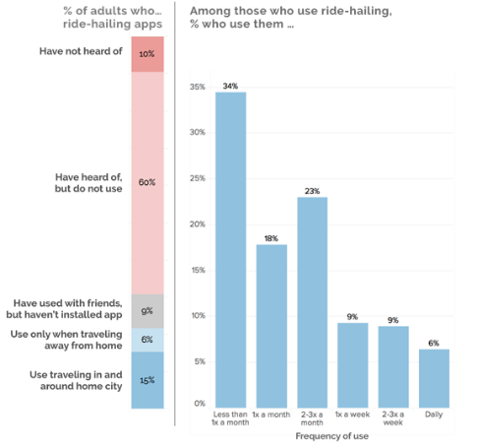
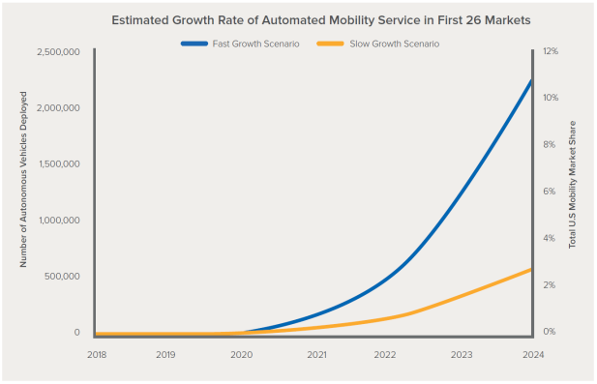
Emerging Trends in . . .
PEVs
Energy Storage
Argonne National Laboratory
Batteries and Electrification R&D Overview, US DOE Office of Energy Efficiency and Renewable Energy, Steven Boyd, June 18, 2018
Shared Mobility
Automation
Clewlow, Regina R. and Gouri S. Mishra (2017) Disruptive Transportation: The Adoption, Utilization, and Impacts of
Ride-Hailing in the United States. Institute of Transportation Studies, University of California, Davis, Research
Report UCD-ITS-RR-17-07
Walker, Jonathan and Charlie Johnson. Peak Car
Ownership: The Market Opportunity of Electric
Automated Mobility Services.
Rocky Mountain Institute, 2016.
http://www.rmi.org/peak_car_ownership

Slide 16
Emerging Trends Will Impact Energy Use and the Environment
Vehicle Efficiency
Shared Mobility
Vehicle optimization, drive smoothing, and decision-making protocols
System-wide factors such as connectivity, routing, and travel demand
Shared mobility’s influence on right-sizing, mode-shifting, peak travel
The built environment’s influence on a transforming transportation system
Fuel choices and refueling infrastructure
Fuels and
Electrification
System Effects
CAVs
and the
Environment
Built
Environment
Analytical work to date shows a wide range of estimates
of potential environmental impacts from new mobility
Source: Simon K.; Alson, J; Snapp, L; Hula, A. “Can Transportation Emission Reductions be Achieved Autonomously?” Environ. Sci. Technol., 2015, 49 (24), pp 13910–13911.

Slide 17
Recommendations from EPA/OTAQ
What areas of technical and policy matters does EPA suggest the Committee focus on for the 2025-2035 time frame?
How and when will the transportation paradigm shift?
        When will EVs reach a tipping point in market acceptance for consumer market?
        Will shared mobility enhance or replace transit? Under what conditions?
        When will automated mobility services capture the US mobility market?
What are the energy and environmental impacts of such a shift?
        With the emergence of autonomous vehicles, what factors will be important to address to have a positive environmental result?
        What does the fleet makeup in 2030-2035 mean for criteria pollutants?
      How can we best assess this future?
        How can we use data to more quickly model the rapidly emerging changes in transportation?
      What is the most effective framework for future GHG standards?
        Test procedures and fuels established in 1975 do not capture real world driving and/or changes to low carbon fuels -- future vehicle ownership and/or mobility scenarios will most likely not be represented by the FTP and Highway test cycles
              In its 2015 report the NAS recommended the application of 5-cycle testing to better represent real-world driving
        Are there aspects of the current GHG regulations and test procedures that could better incentivize reducing “real-world” emissions over reducing emissions on the test cycles?
        What other regulatory frameworks might be available to reduce GHG emissions under changing ownership and mobility solutions?
    NAS recommendations on strengths & weaknesses of EPA’s methodologies and approaches, areas where EPA should focus

Slide 18
Conclusions
EPA appreciates the Committee members’ commitment to this effort, and stands ready to assist in any way that would be most valuable for the Committee.
As we’ve done for past NAS Committees, EPA would be glad to assist the Committee in understanding any of our technical work in more detail, including an open invitation to visit NVFEL for further technical dialog.
The Committee’s report expected to be issued in 2020-2021 will be valuable in informing U.S. transportation environmental policies for the 2025-2035 timeframe.

Slide 19
Appendix:
EPA Publications and Reports

Slide 20
SAE Papers
2013 SAE Paper Citations
Sciance, F., Nelson, B., Yassine, M., Patti, A. et al., "Developing the AC17 Efficiency Test for Mobile Air Conditioners," SAE Technical Paper 2013-01-0569, 2013, https://doi.org/10.4271/2013-01-0569.
Dagci, O., Pereira, N., and Cherry, J., "Maneuver-Based Battery-in-the-Loop Testing - Bringing Reality to Lab," SAE Int. J. Alt. Power. 2(1):7-17, 2013, https://doi.org/10.4271/2013-01-0157.
Lee, B., Lee, S., Cherry, J., Neam, A. et al., "Development of Advanced Light-Duty Powertrain and Hybrid Analysis Tool," SAE Technical Paper 2013-01-0808, 2013, https://doi.org/10.4271/2013-01-0808.
Lee, S., Lee, B., McDonald, J., Sanchez, L. et al., "Modeling and Validation of Power-Split and P2 Parallel Hybrid Electric Vehicles," SAE Technical Paper 2013-01-1470, 2013, https://doi.org/10.4271/2013-01-1470.
Lee, S., Lee, B., McDonald, J., and Nam, E., "Modeling and Validation of Lithium-Ion Automotive Battery Packs," SAE Technical Paper 2013-01-1539, 2013, https://doi.org/10.4271/2013-01-1539.
Caffrey, C., Bolon, K., Harris, H., Kolwich, G. et al., "Cost-Effectiveness of a Lightweight Design for 2017-2020: An Assessment of a Midsize Crossover Utility Vehicle," SAE Technical Paper 2013-01-0656, 2013, https://doi.org/10.4271/2013-01-0656.
2014 SAE Paper Citations
Hula, A., Alson, J., Bunker, A., and Bolon, K., "Analysis of Technology Adoption Rates in New Vehicles," SAE Technical Paper 2014-01-0781, 2014, doi:10.4271/2014-01-0781.
Lee, S., Cherry, J., Lee, B., McDonald, J. et al., "HIL Development and Validation of Lithium-Ion Battery Packs," SAE Technical Paper 2014-01-1863, 2014, doi:10.4271/2014-01-1863.
2015 SAE Paper Citations
Newman, K., Kargul, J., and Barba, D., "Development and Testing of an Automatic Transmission Shift Schedule Algorithm for Vehicle Simulation," SAE Int. J. Engines 8(3):2015, doi:10.4271/2015-01-1142.
Newman, K., Kargul, J., and Barba, D., "Benchmarking and Modeling of a Conventional Mid-Size Car Using ALPHA," SAE Technical Paper 2015-01-1140, 2015, doi:10.4271/2015-01-1140.
Stuhldreher, M., Schenk, C., Brakora, J., Hawkins, D. et al., "Downsized Boosted Engine Benchmarking and Results," SAE Technical Paper 2015-01-1266, 2015, doi:10.4271/2015-01-1266.
Moskalik, A., Dekraker, P., Kargul, J., and Barba, D., "Vehicle Component Benchmarking Using a Chassis Dynamometer," SAE Int. J. Mater. Manf. 8(3):2015, doi:10.4271/2015-01-0589.
Safoutin, M., Cherry, J., McDonald, J., and Lee, S., "Effect of Current and SOC on Round-Trip Energy Efficiency of a Lithium-Iron Phosphate (LiFePO4) Battery Pack," SAE Technical Paper 2015-01-1186, 2015, doi:10.4271/2015-01-1186.
Newman, K., Dekraker, P., Zhang, H., Sanchez, J. et al., "Development of Greenhouse Gas Emissions Model (GEM) for Heavy- and Medium-Duty Vehicle Compliance," SAE Int. J. Commer. Veh. 8(2):2015, doi:10.4271/2015-01-2771.
2016 SAE Paper Citations
Kargul, J., Moskalik, A., Barba, D., Newman, K. et al., "Estimating GHG Reduction from Combinations of Current Best-Available and Future Powertrain and Vehicle Technologies for a Midsized Car Using EPA’s ALPHA Model," SAE Technical Paper 2016-01-0910, 2016, doi:10.4271/2016-01-0910.
Moskalik, A., Hula, A., Barba, D., and Kargul, J., "Investigating the Effect of Advanced Automatic Transmissions on Fuel Consumption Using Vehicle Testing and Modeling," SAE Int. J. Engines 9(3):2016, doi:10.4271/2016-01-1142.
Newman, K., Doorlag, M., and Barba, D., "Modeling of a Conventional Mid-Size Car with CVT Using ALPHA and Comparable Powertrain Technologies," SAE Technical Paper 2016-01-1141, 2016, doi:10.4271/2016-01-1141.
Ellies, B., Schenk, C., and Dekraker, P., "Benchmarking and Hardware-in-the-Loop Operation of a 2014 MAZDA SkyActiv 2.0L 13:1 Compression Ratio Engine," SAE Technical Paper 2016-01-1007, 2016, doi:10.4271/2016-01-1007.
Stuhldreher, M., "Fuel Efficiency Mapping of a 2014 6-Cylinder GM EcoTec 4.3L Engine with Cylinder Deactivation," SAE Technical Paper 2016-01-0662, 2016, doi:10.4271/2016-01-0662.
Newman, K. and Dekraker, P., "Modeling the Effects of Transmission Gear Count, Ratio Progression, and Final Drive Ratio on Fuel Economy and Performance Using ALPHA," SAE Technical Paper 2016-01-1143, 2016, doi:10.4271/2016-01-1143.
Lee, S., Schenk, C., and McDonald, J., "Air Flow Optimization and Calibration in High-Compression-Ratio Naturally Aspirated SI Engines with Cooled-EGR," SAE Technical Paper 2016-01-0565, 2016, doi:10.4271/2016-01-0565.
2017 SAE Paper Citations
Dekraker, P., Stuhldreher, M., and Kim, Y., "Characterizing Factors Influencing SI Engine Transient Fuel Consumption for Vehicle Simulation in ALPHA," SAE Int. J. Engines 10(2):2017, doi:10.4271/2017-01-0533.
Dekraker, P., Kargul, J., Moskalik, A., Newman, K. et al., "Fleet-Level Modeling of Real World Factors Influencing Greenhouse Gas Emission Simulation in ALPHA," SAE Int. J. Fuels Lubr. 10(1):2017, doi:10.4271/2017-01-0899.
Schenk, C. and Dekraker, P., "Potential Fuel Economy Improvements from the Implementation of cEGR and CDA on an Atkinson Cycle Engine," SAE Technical Paper 2017-01-1016, 2017, doi:10.4271/2017-01-1016.
Lee, S., Cherry, J., Safoutin, M., and McDonald, J., "Modeling and Validation of 12V Lead-Acid Battery for Stop-Start Technology," SAE Technical Paper 2017-01-1211, 2017, doi:10.4271/2017-01-1211.
Stuhldreher, M., Kim, Y., Kargul, J., Moskalik, A. et al., "Testing and Benchmarking a 2014 GM Silverado 6L80 Six Speed Automatic Transmission," SAE Technical Paper 2017-01-5020, 2017, doi:10.4271/2017-01-5020.
2018 SAE Paper Citations
Dennis Robertson, Graham Conway, Chris Chadwell, Joseph McDonald, Daniel Barba, Mark Stuhldreher, Aaron Birckett, "Predictive GT-Power Simulation for VNT matching on a 1.6 L GDI Turbo Engine," SAE Technical Paper 2018-01-0161, 2018, doi:10.4271/2018-01-0161.
Mark Stuhldreher, John Kargul, Daniel Barba, Joseph McDonald, Stanislav Bohac, Paul Dekraker, Andrew Moskalik, "Benchmarking a 2016 Honda Civic 1.5-liter L15B7 Turbocharged Engine and Evaluating the Future Efficiency Potential of Turbocharged Engines," SAE Technical Paper 2018-01-0319, 2018, doi:10.4271/2018-01-0319.
SoDuk Lee, Jeff Cherry, Michael Safoutin, Anthony Neam, Joseph McDonald, Kevin Newman, "Modeling and Controls Development of 48V Mild Hybrid Electric Vehicles," SAE Technical Paper 2018-01-0413, 2018, doi:10.4271/2018-01-0413.
SoDuk Lee, Jeff Cherry, Michael Safoutin, Joseph McDonald, Michael Olechiw , "Modeling and Validation of 48 V Mild Hybrid Lithium-ion Battery Pack," SAE Technical Paper 2018-01-0433, 2018, doi:10.4271/2018-01-0433.
Kevin Bolon, Andrew Moskalik, Kevin Newman, Aaron Hula, Anthony Neam, Brandon Mikkelsen, "Characterization of GHG Reduction Technologies in the Existing Fleet," SAE Technical Paper 2018-01-1268, 2018, doi:10.4271/2018-01-1268.
Andrew Moskalik, Kevin Bolon, Kevin Newman, Jeff Cherry, "Representing GHG Reduction Technologies in the Future Fleet with Full Vehicle Simulation," SAE Technical Paper 2018-01-1273, 2018, doi:10.4271/2018-01-1273.
Paul Dekraker, Daniel Barba, Andrew Moskalik, Karla Butters, "Constructing Engine Maps for Full Vehicle Simulation Modeling ," SAE Technical Paper 2018-01-1412, 2018, doi:10.4271/2018-01-1412.
Graham Conway, Dennis Robertson, Chris Chadwell, Joseph McDonald, John Kargul, Daniel Barba, Mark Stuhldreher, "Evaluation of Emerging Technologies on a 1.6 L Turbocharged GDI Engine," SAE Technical Paper 2018-01-1423, 2018, doi:10.4271/2018-01-1423.

Slide 21
Additional publications and reports
“Searching for Hidden Costs: A Technology-Based Approach to the Energy Efficiency Gap in Light-Duty Vehicles,” Helfand et al. (2016), Energy Policy 98: 590-606
The Energy Efficiency Gap in EPA’s Benefit-Cost Analysis of Vehicle Greenhouse Gas Regulations: A Case Study,” Journal of Benefit-Cost Analysis, 2015, doi:10.1017/bca.2015.13, Gloria Helfand and Reid Dorsey-Palmateer
“Critical factors affecting life cycle assessments of material choice for vehicle mass reduction,” Troy Hottle, Cheryl Caffrey, Joseph McDonald, Rebecca Dodder. Transportation Research Part D 56 (2017) 241-257.
“Can Transportation Emission Reductions be Achieved Autonomously?” Simon K.; Alson, J; Snapp, L; Hula, A. Environ. Sci. Technol., 2015, 49 (24), pp 13910–13911.
Mass Reduction and Cost Analysis—Light-Duty Pickup Truck Model Years 2020-2025 (EPA-420-R-15-006, June 2015)
The Rebound Effect from Fuel Efficiency Standards: Measurement and Projection to 2035 (EPA-420-R-15-012, June 2015)
Light-Duty Automotive Technology, Carbon Dioxide Emissions, and Fuel Economy Trends Report
GHG Emission Standards for Light-Duty Vehicles: Manufacturer Performance Report

