Slide 1


Desiging the Microbial Research Commons
National Academy of Sciences, Washington DC, USA, 8-9 October 2009
S
T
R
A
I
N
I
N
F
O
N
E
T
reducing microbial data entropy

Slide 2
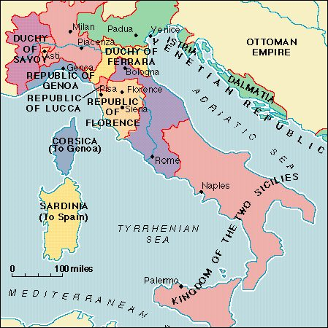
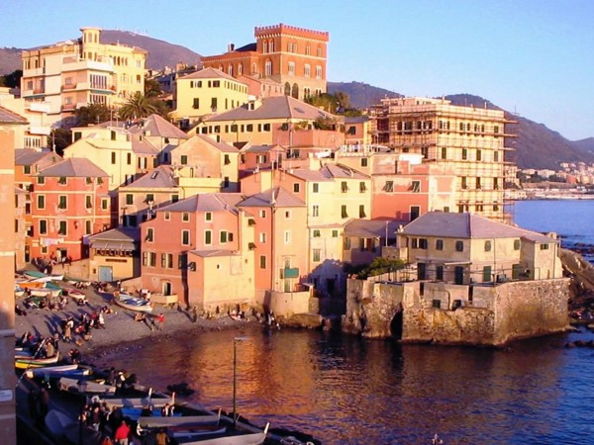




Slide 3
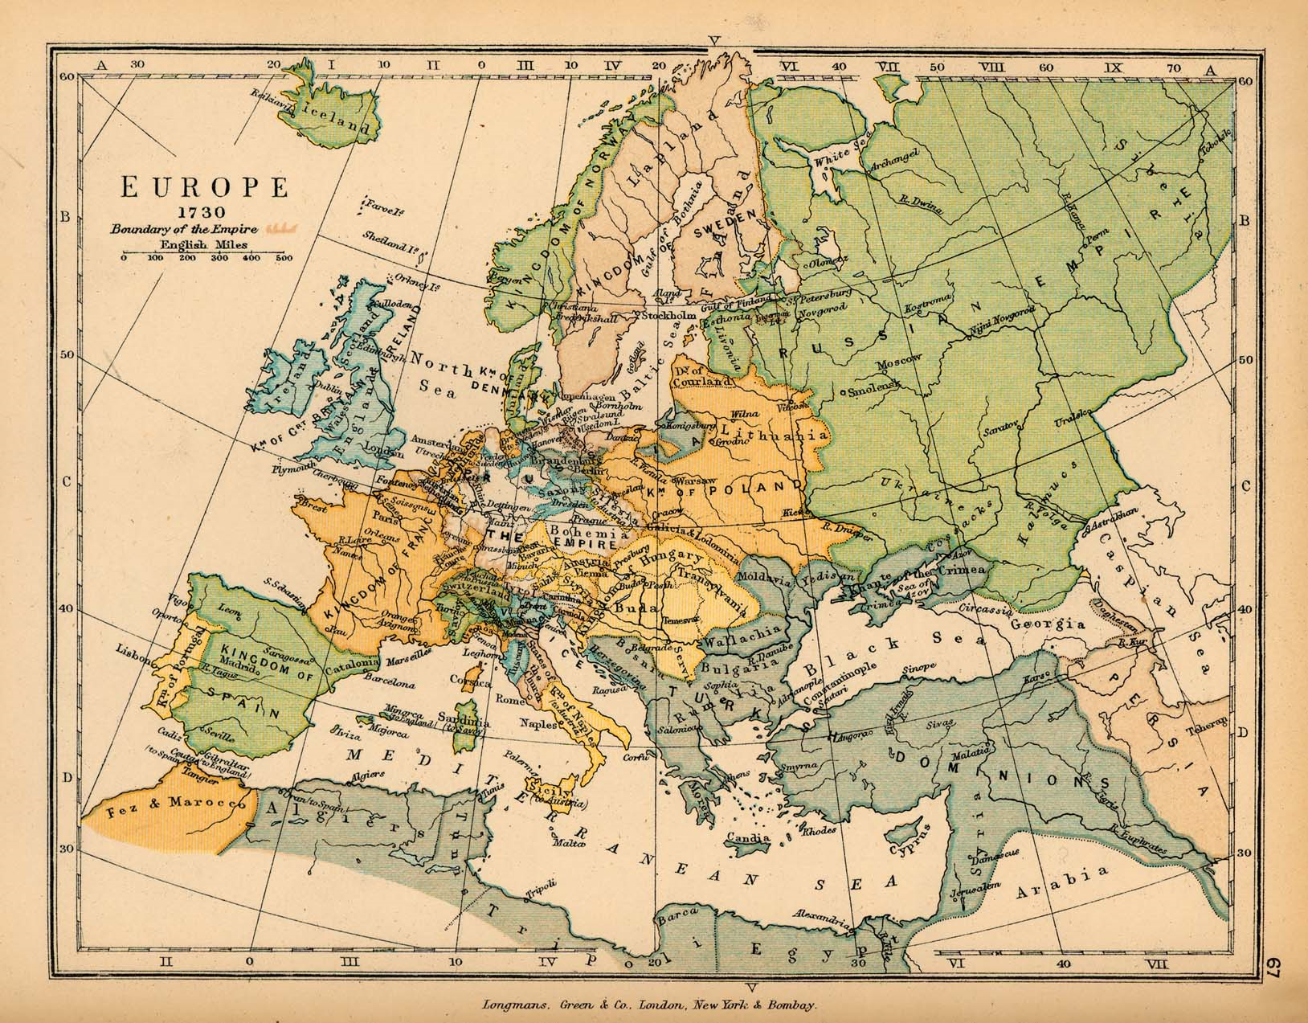

Slide 4
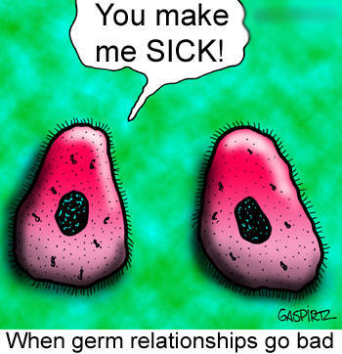

Slide 5
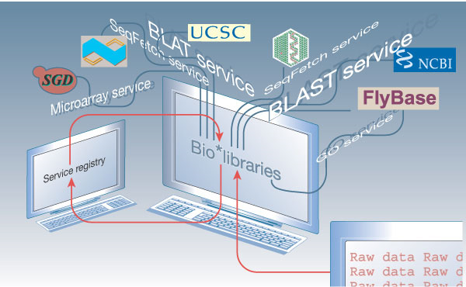
From: Lincoln Stein (2002). Creating a bioinformatics nation. Nature 417, 119-120.

Slide 6
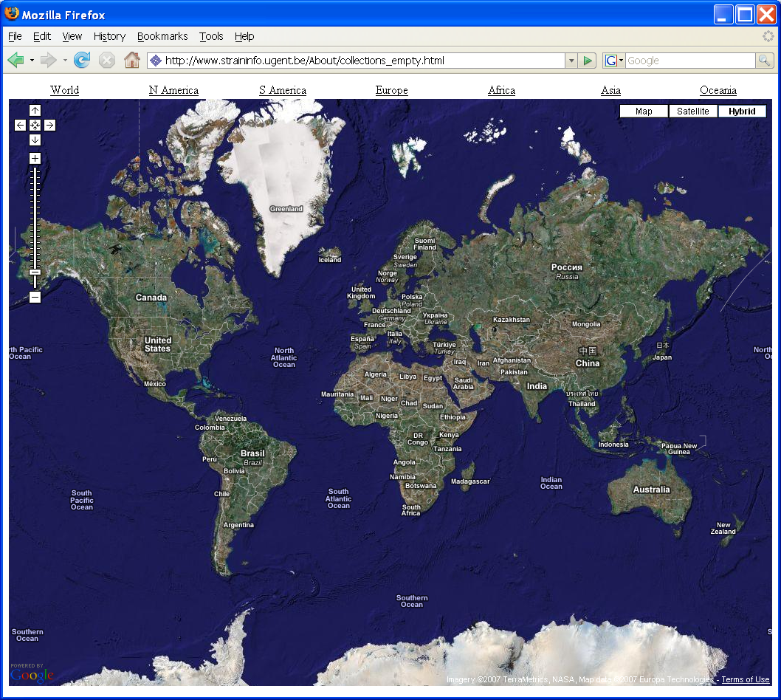


need to find all the 16S rRNA genes of the Pseudomonas strains isolated from soil

Slide 9


need to find all the 16S rRNA genes of the Pseudomonas strains isolated from soil

Slide 10










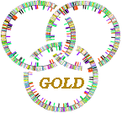

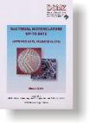







Integration strategy
?

Slide 11
Integration strategy

Slide 12

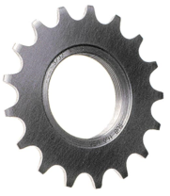

Integration strategy

Slide 13
Integration strategy
specimen
knuckle
sequence
knuckle
literature
knuckle
taxonomy
knuckle

Slide 14
Integration strategy
specimen
knuckle
sequence
knuckle
literature
knuckle
taxonomy
knuckle

Slide 15
Knuckles-and-nodes
source: Stein L.D. (2003). Integrating biological databases. Nat Rev Genet 4(5), 337-45.

Slide 16
Whole genome strains
Bacteria
360/685 (53%)
origin
of life
Archaea
43/53 (81%)
25/95 (26%)
sequence change
Eukarya

Slide 17

The perpetual beta
BETA

Slide 18
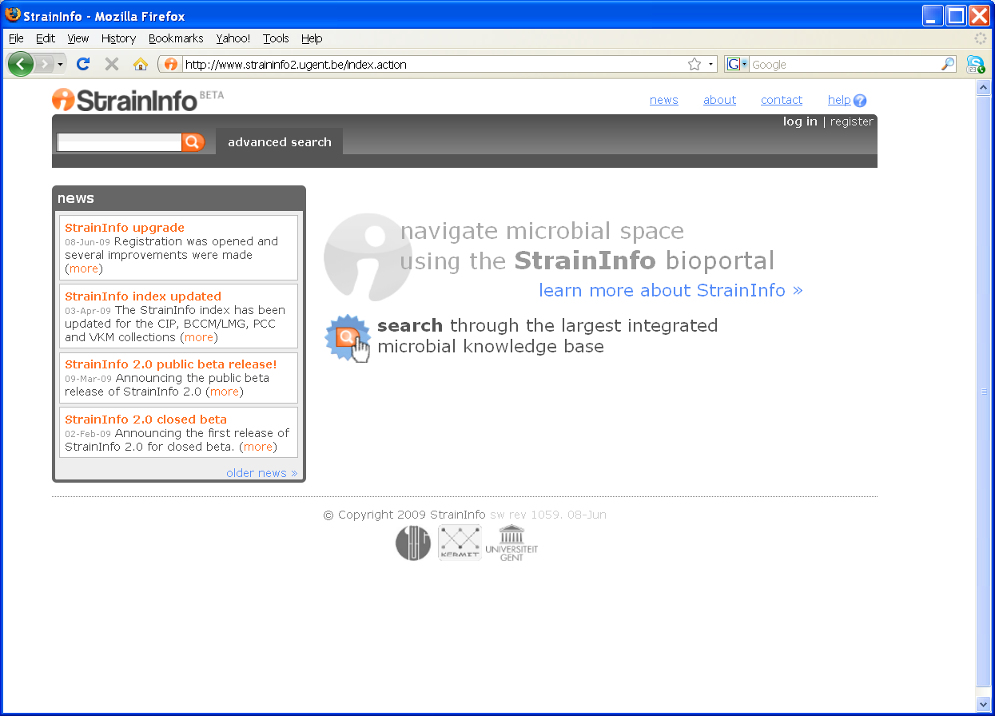
Smart search
SmartSearch: enter
strain numbers
taxonomic names
INSDC accession numbers

Slide 19
Smart search
LMG 6923

Slide 20
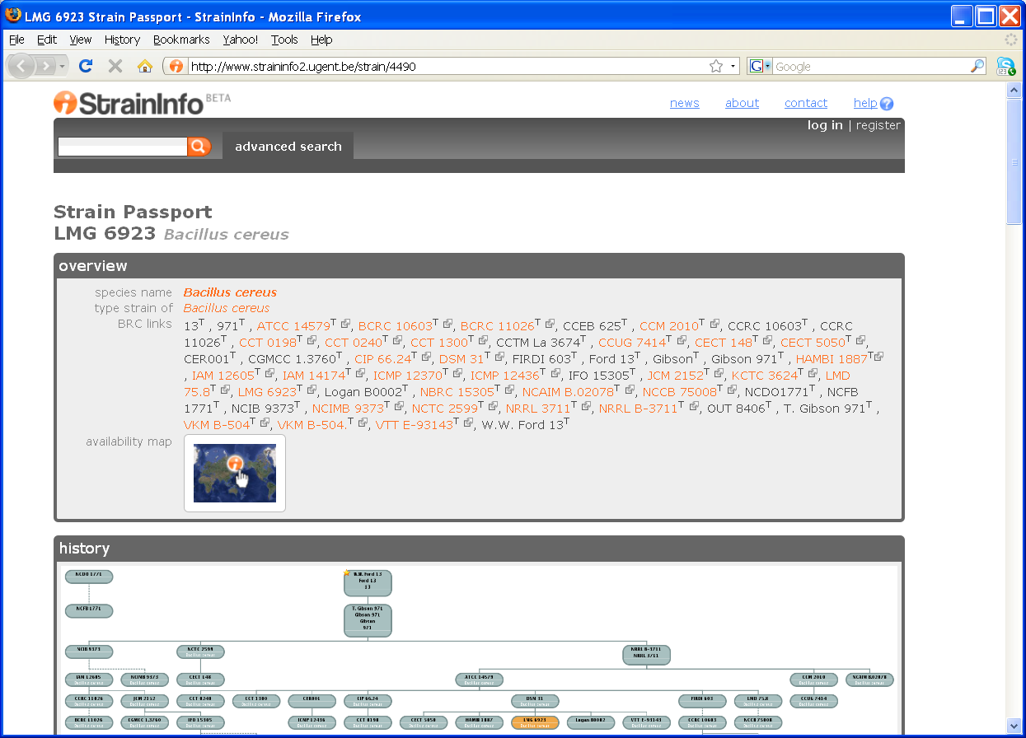
Strain passport

Slide 21
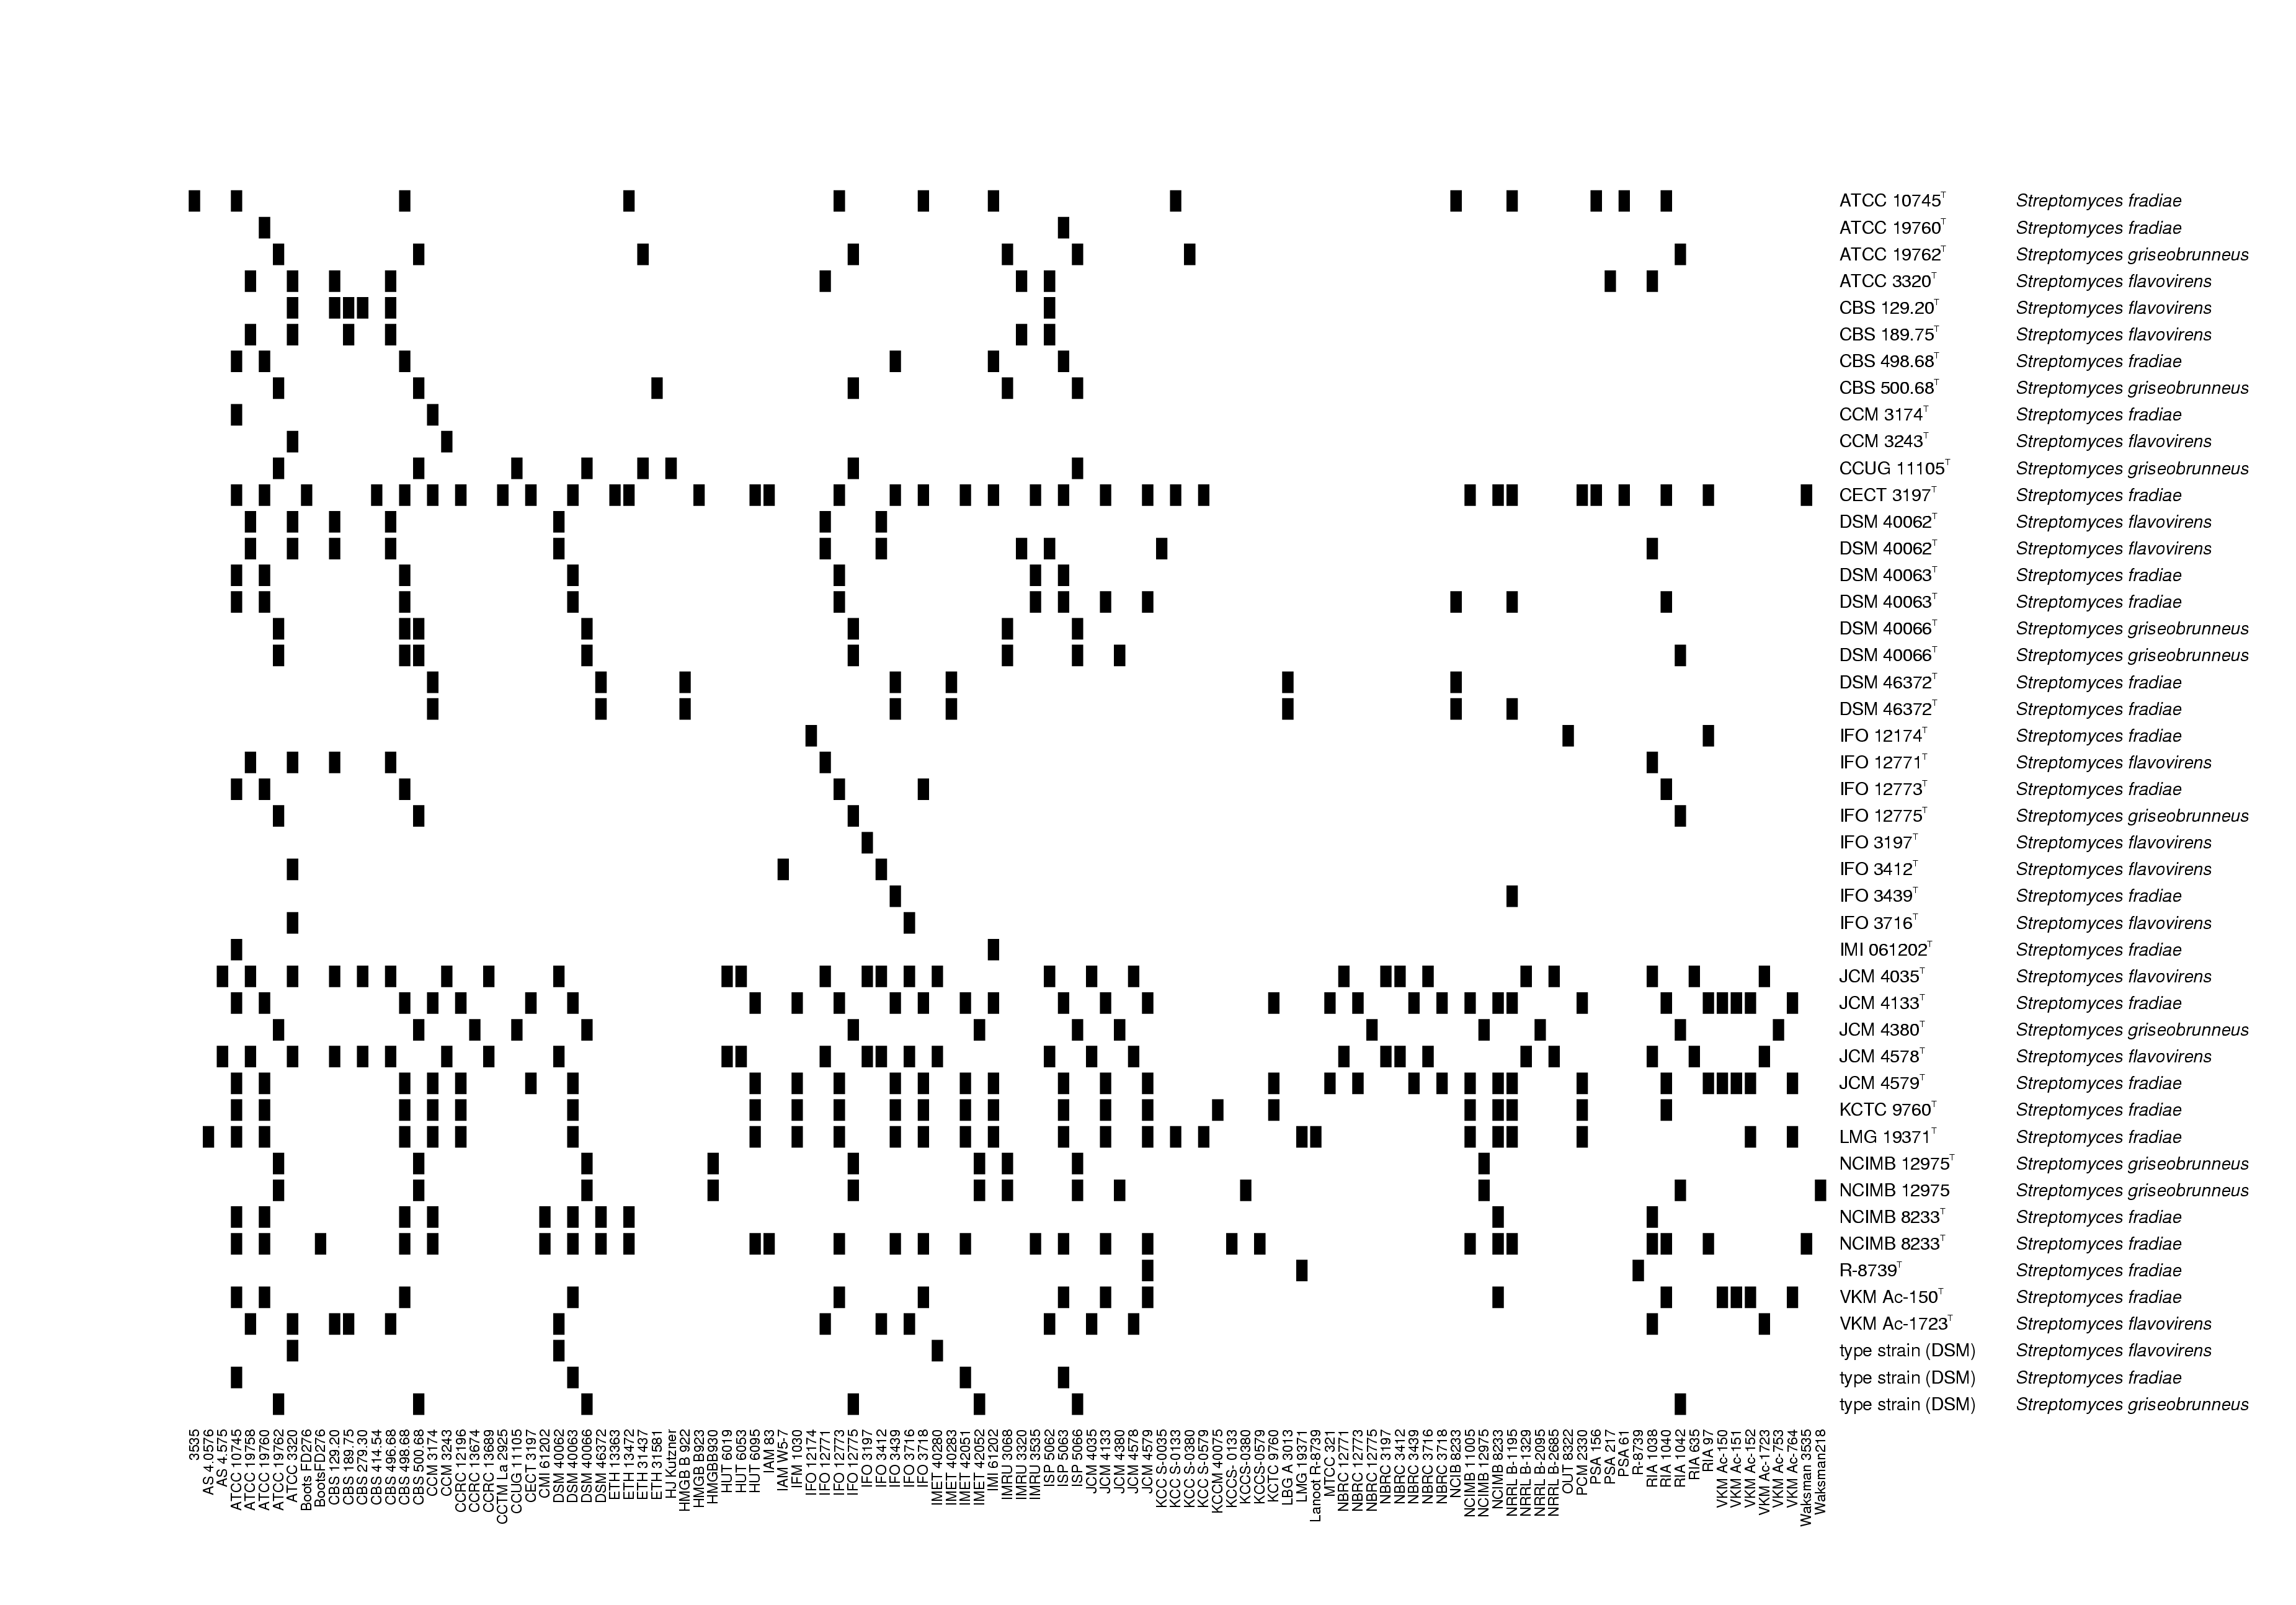
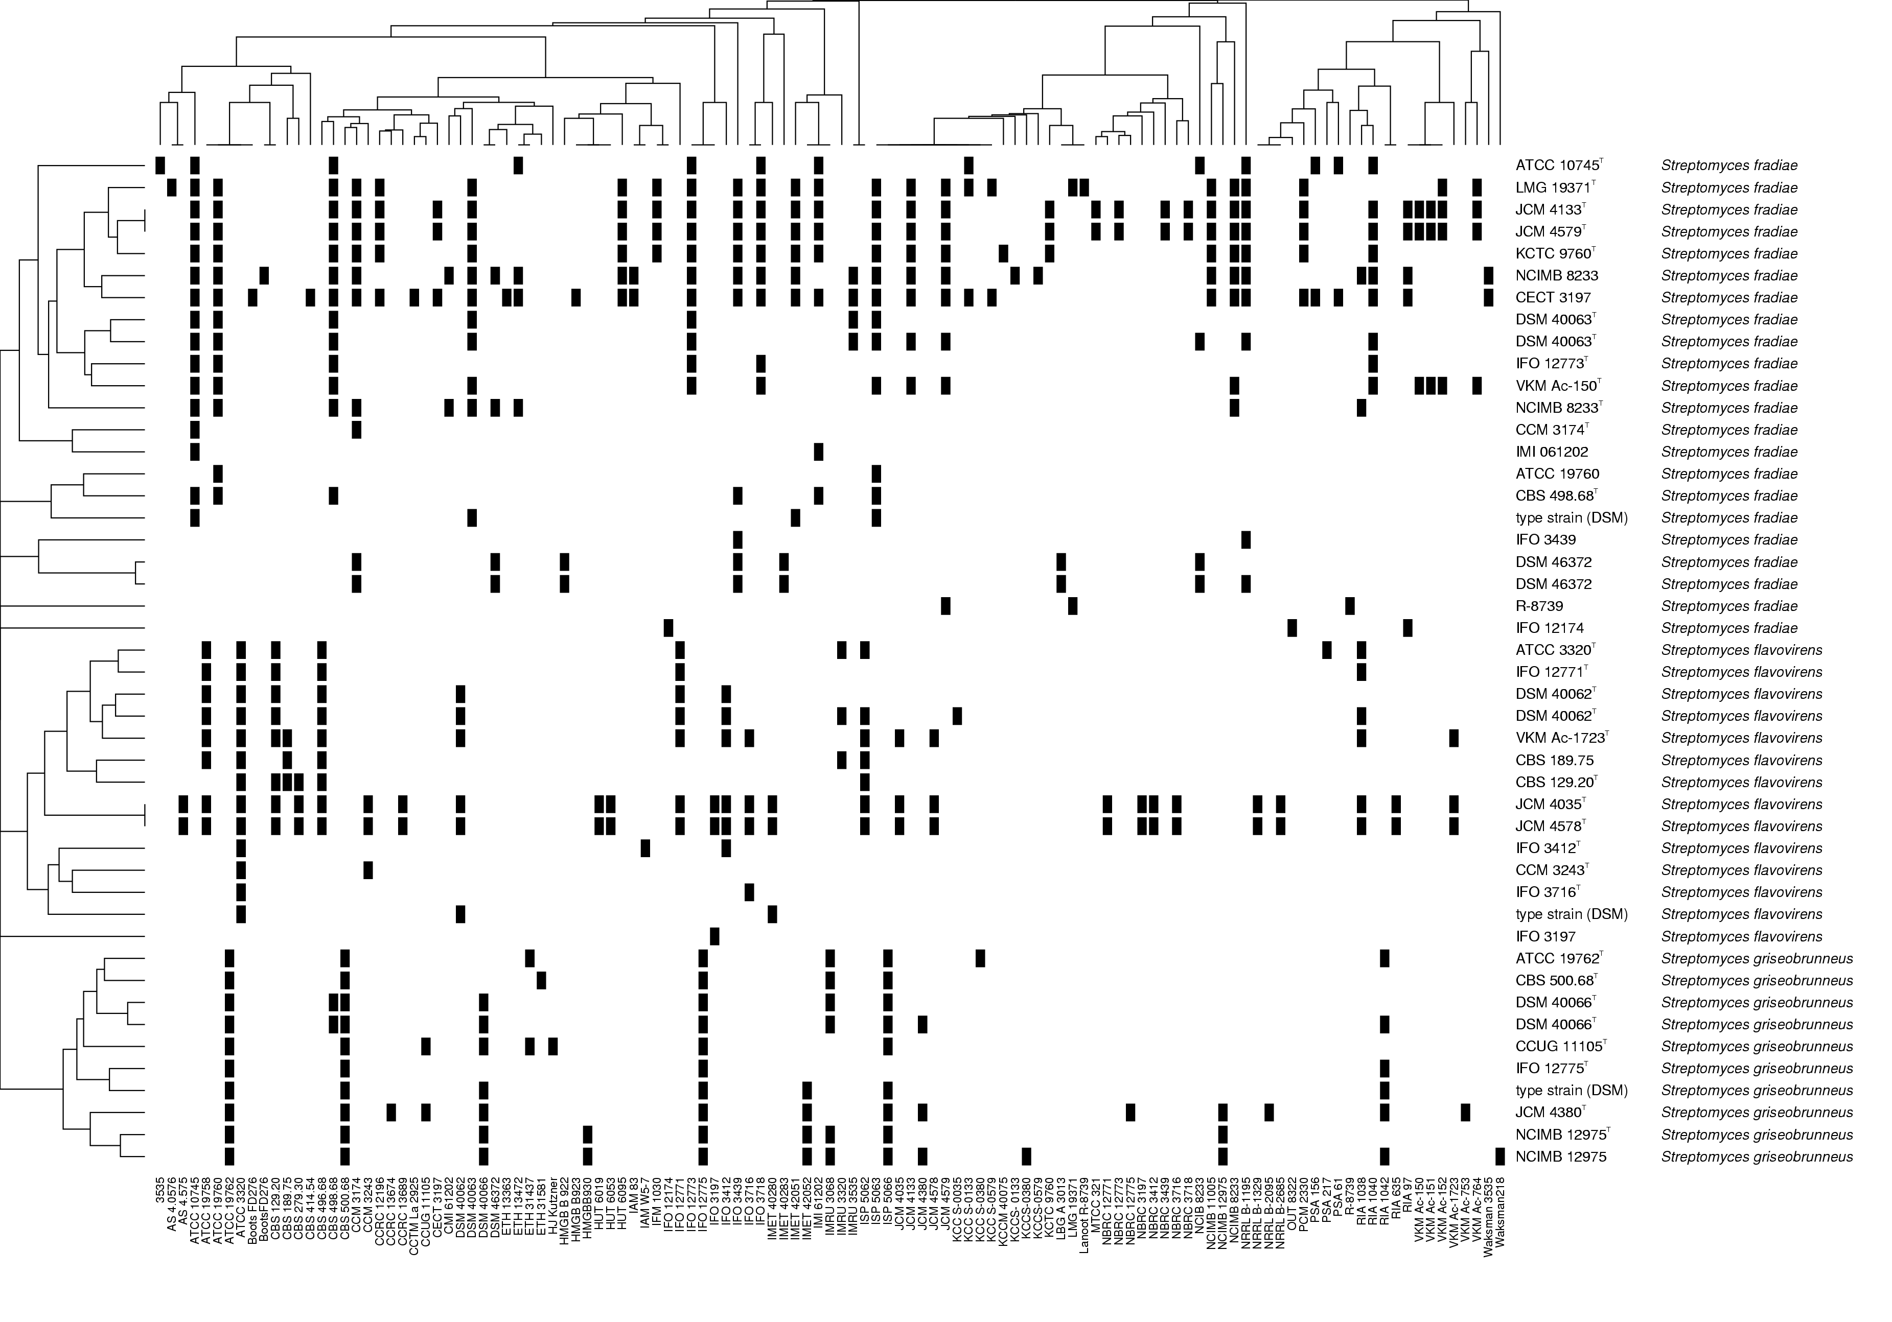
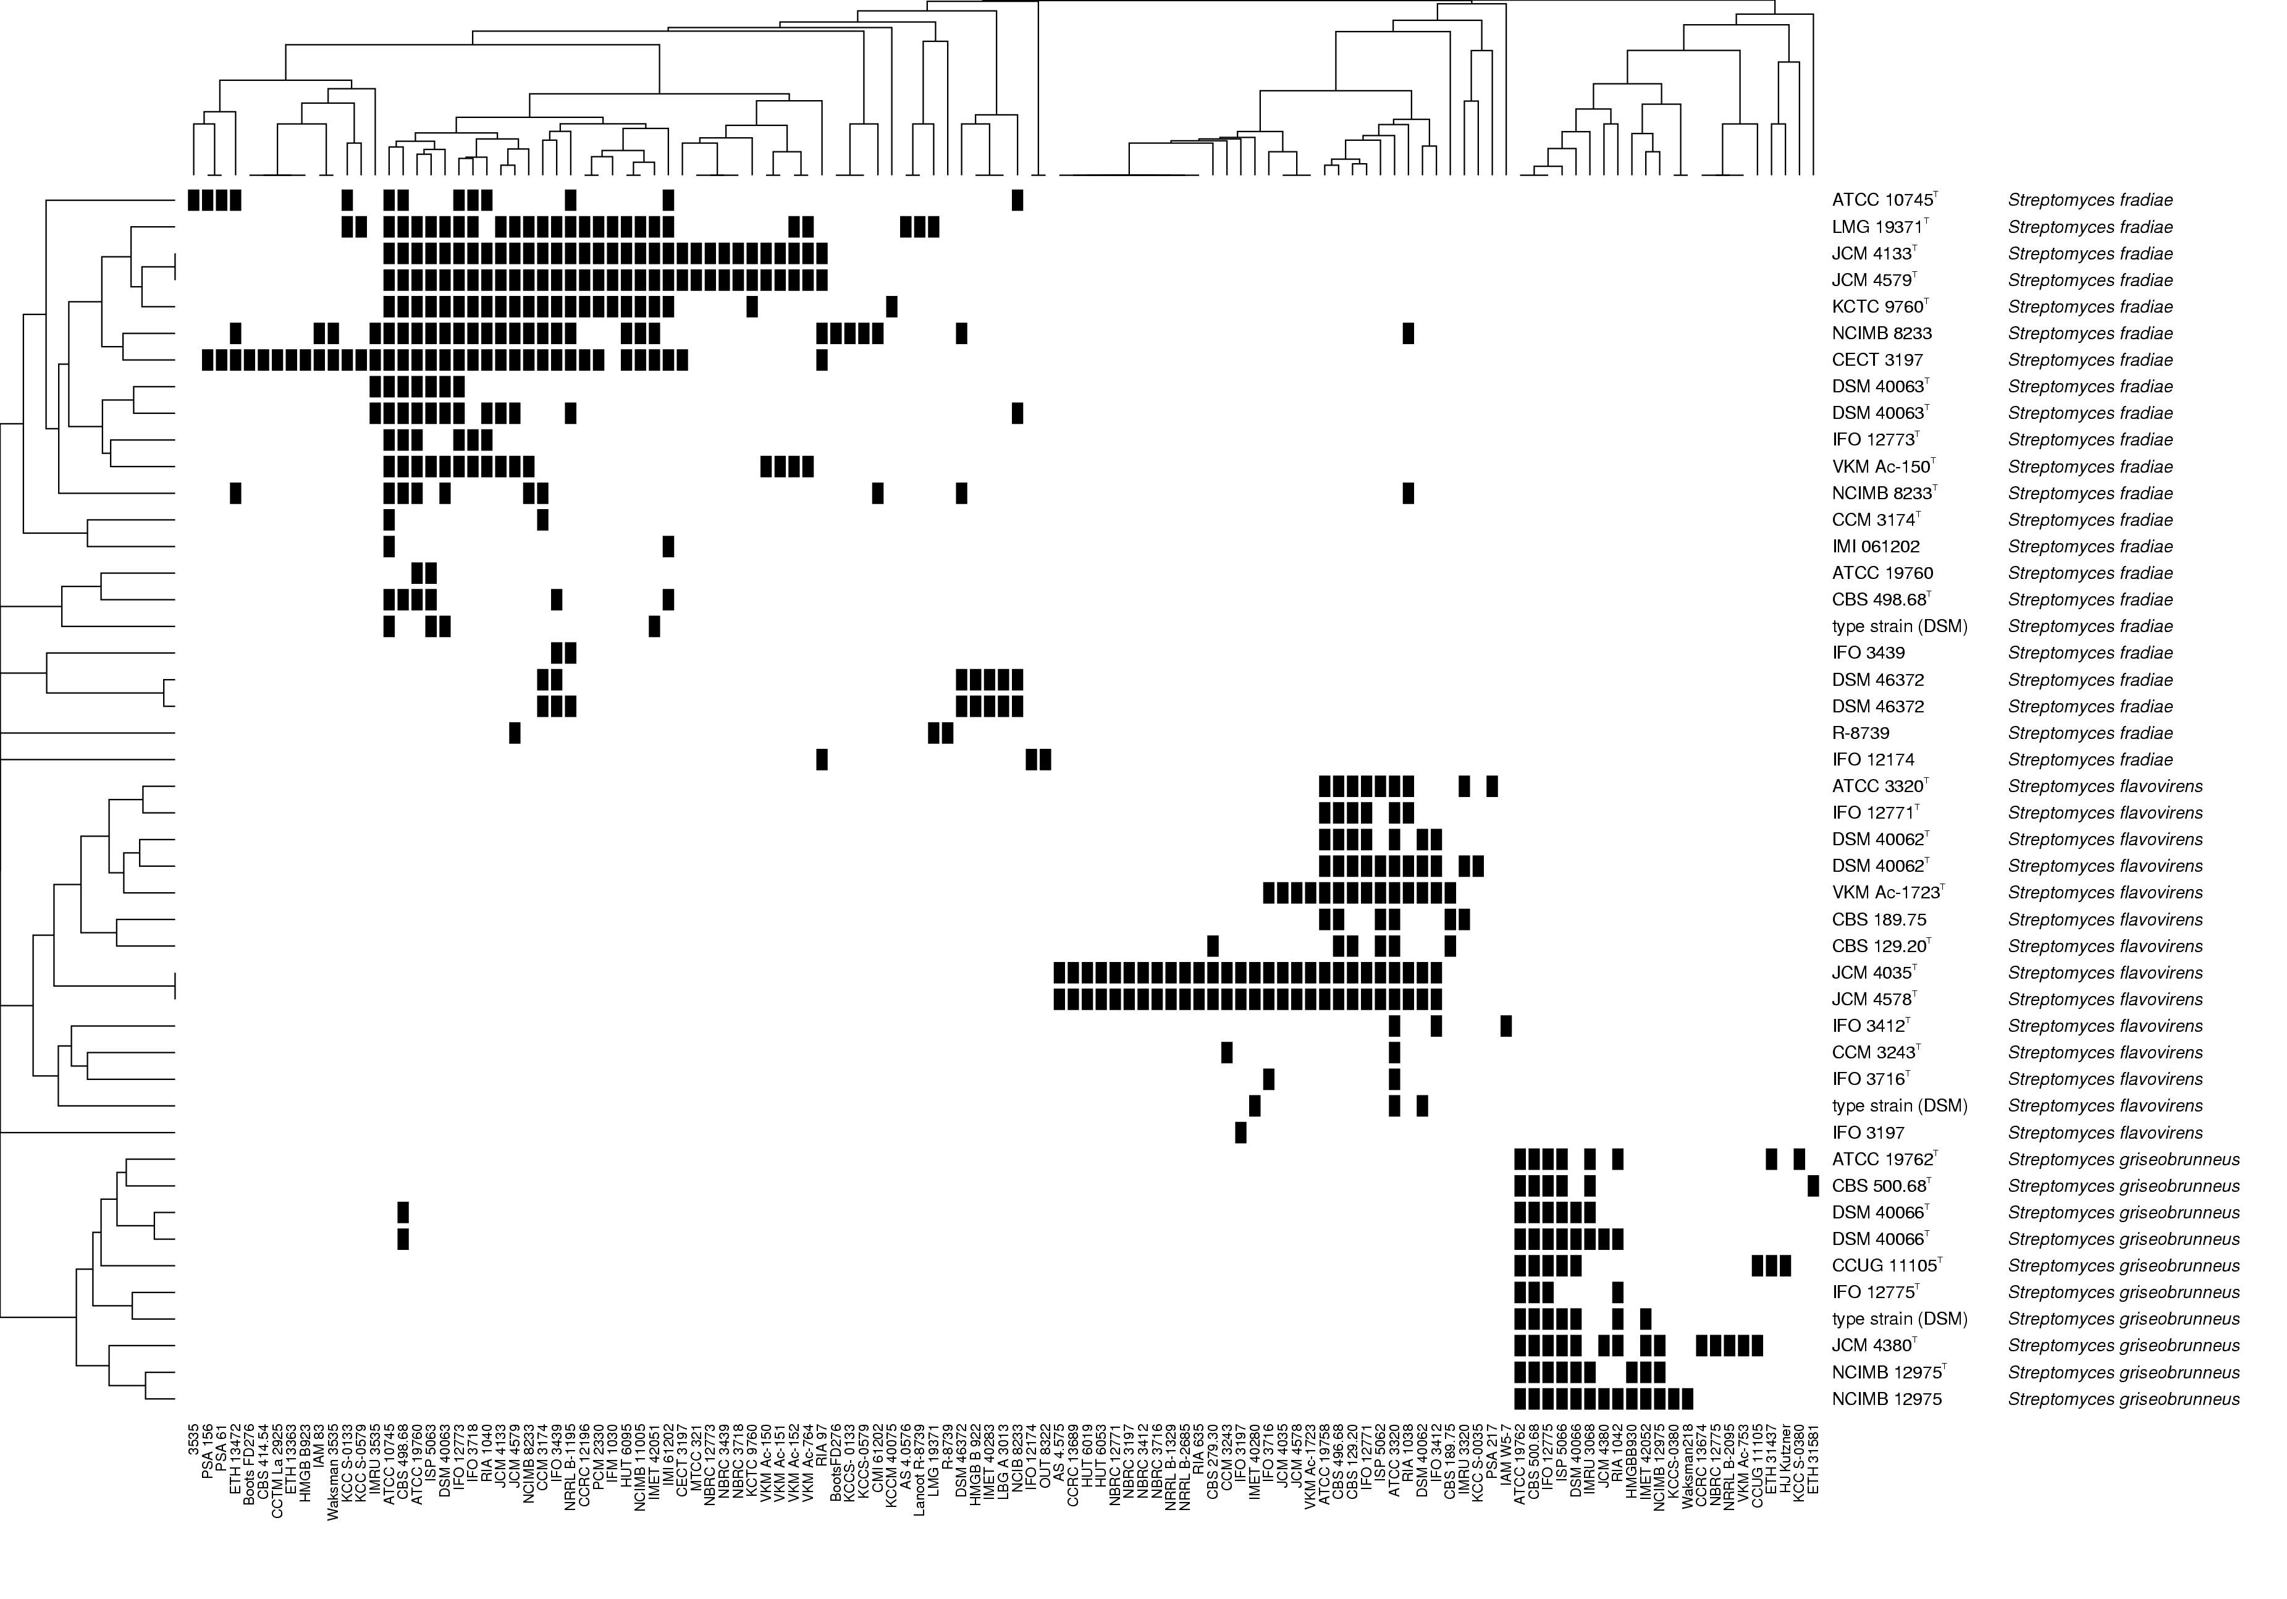
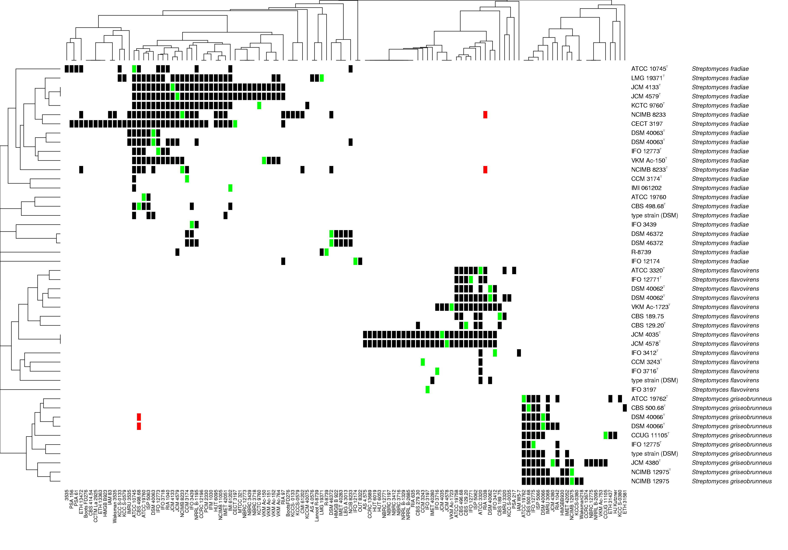
Cross-checking
error in NCIMB 8233^{T}
RIA 1038 → RIA 1040
"GARBAGE IN GARBAGE OUT" PRINCIPLE
error in DSM 40066^{T} CBS 498.68 → CBS 500.68

Slide 22
Strain passport

Slide 23
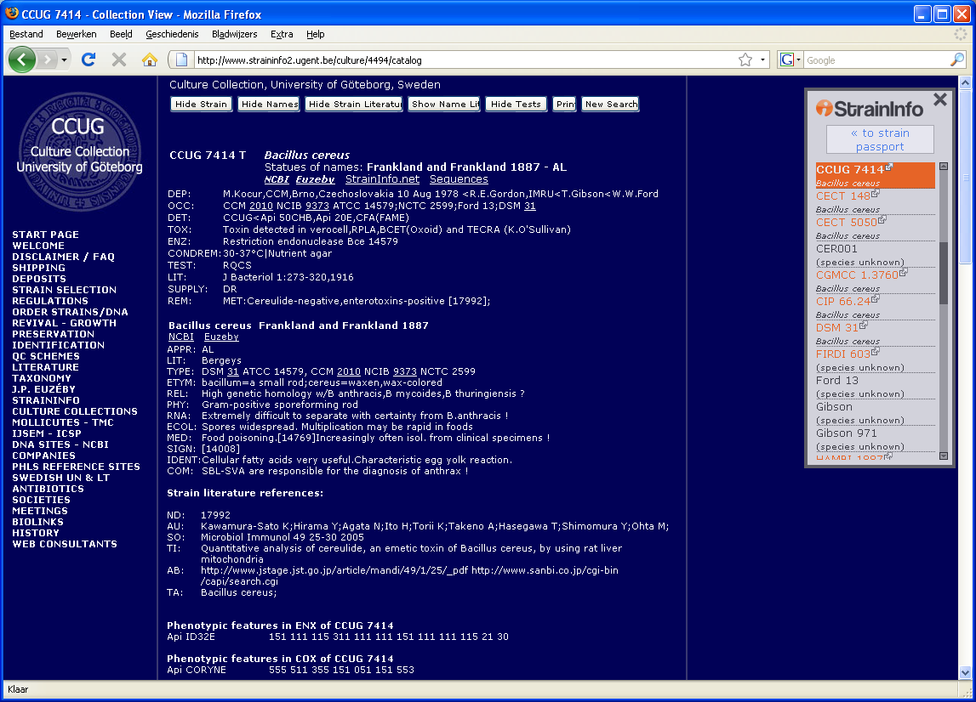
Strain browser
Permanent URL
based on culture ID
guaranteed link, even if BRC changes online catalog

Slide 24
Strain browser

Slide 25
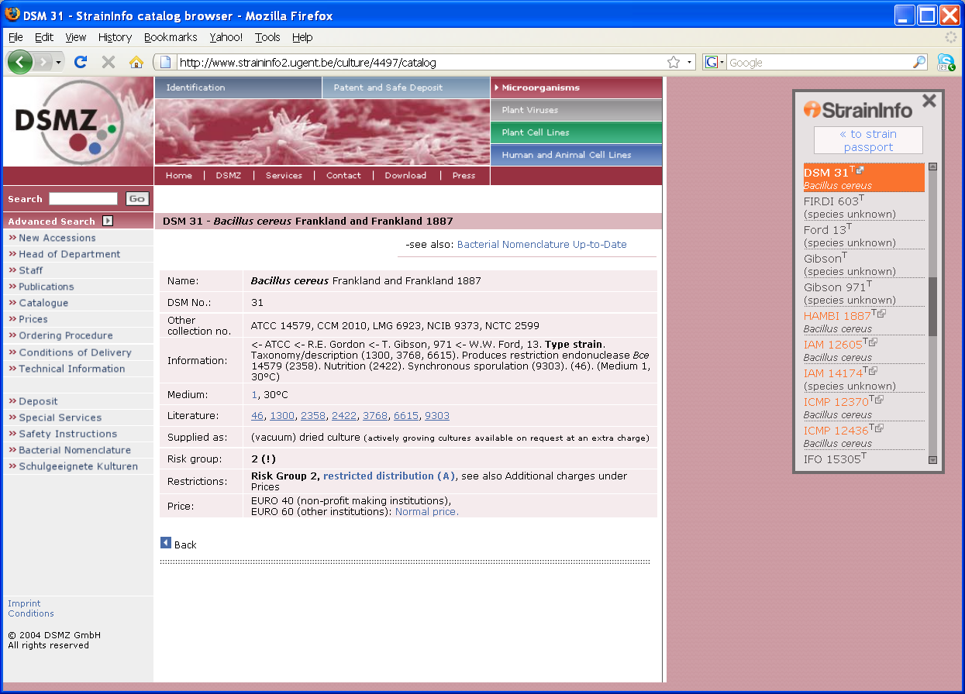
Strain browser

Slide 26
Strain browser

Slide 27
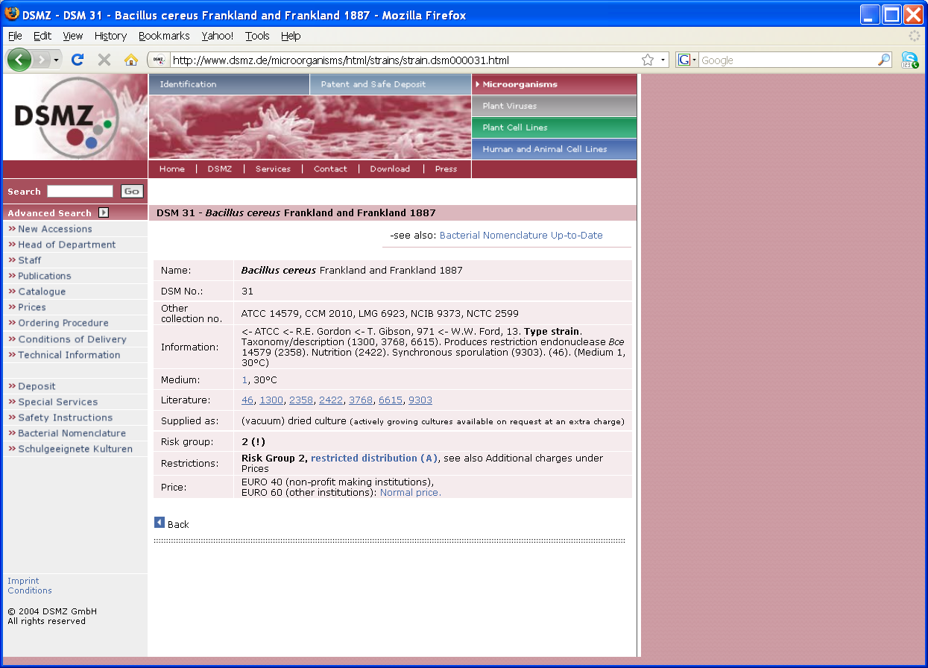
Original online catalog

Slide 28
Strain passport

Slide 29
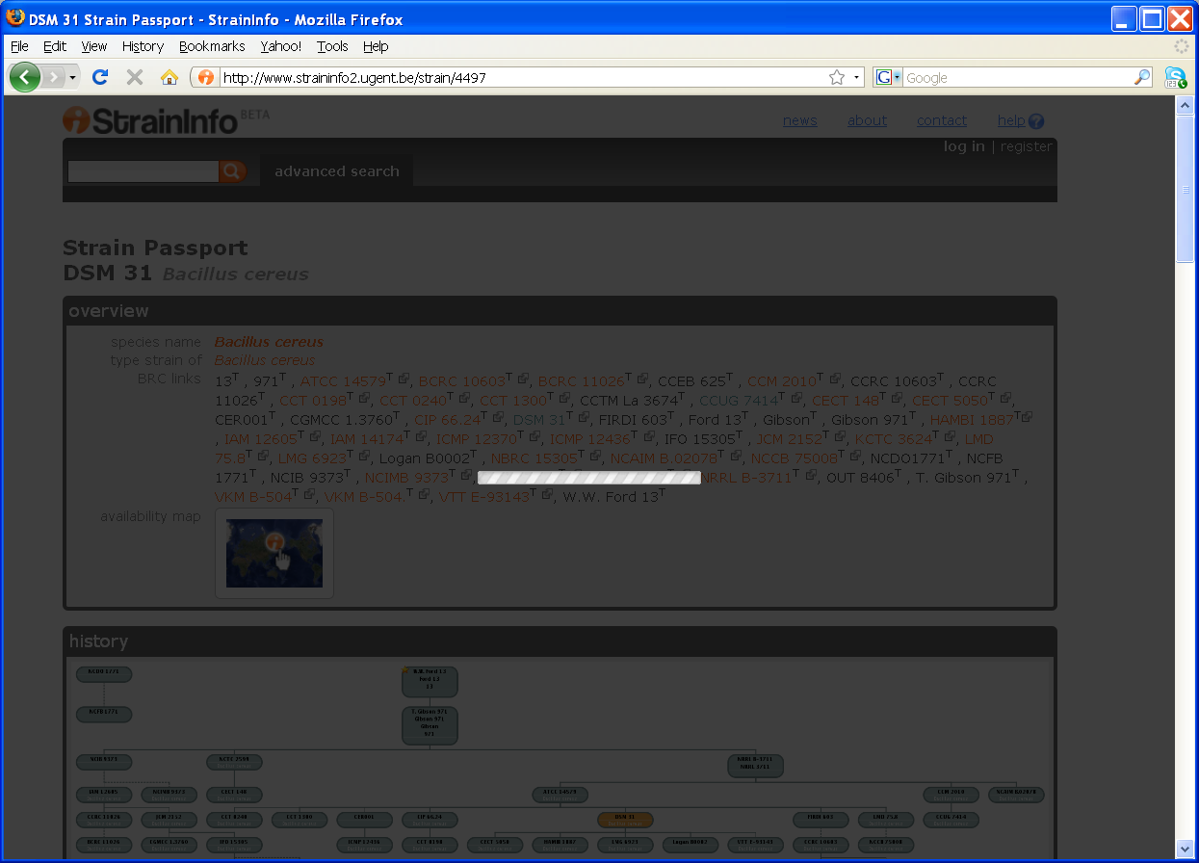
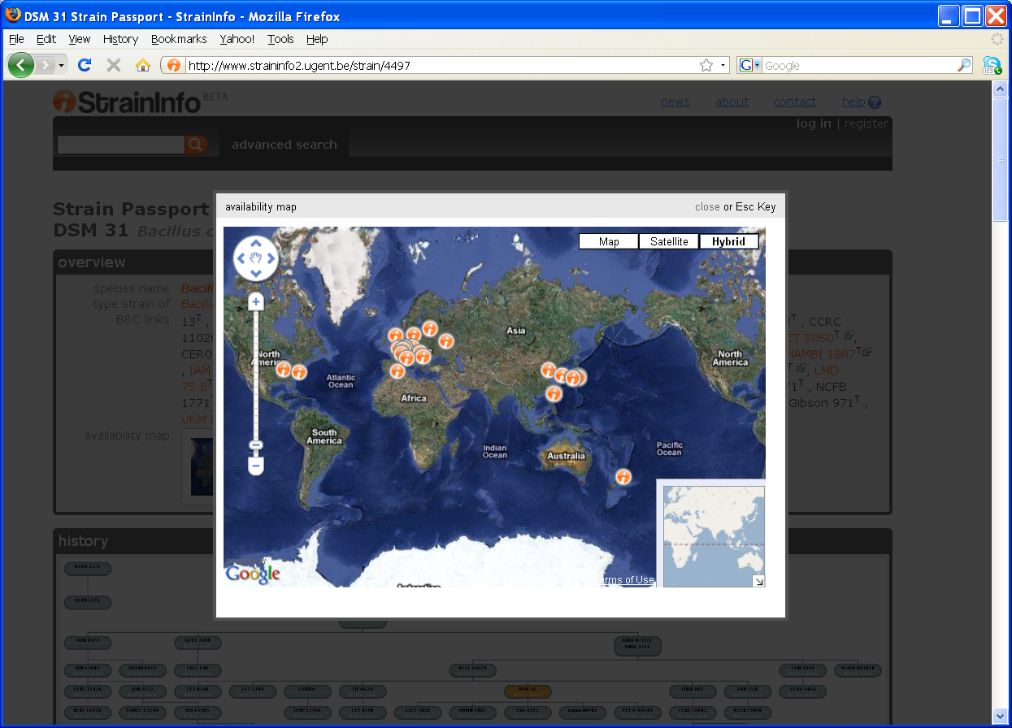
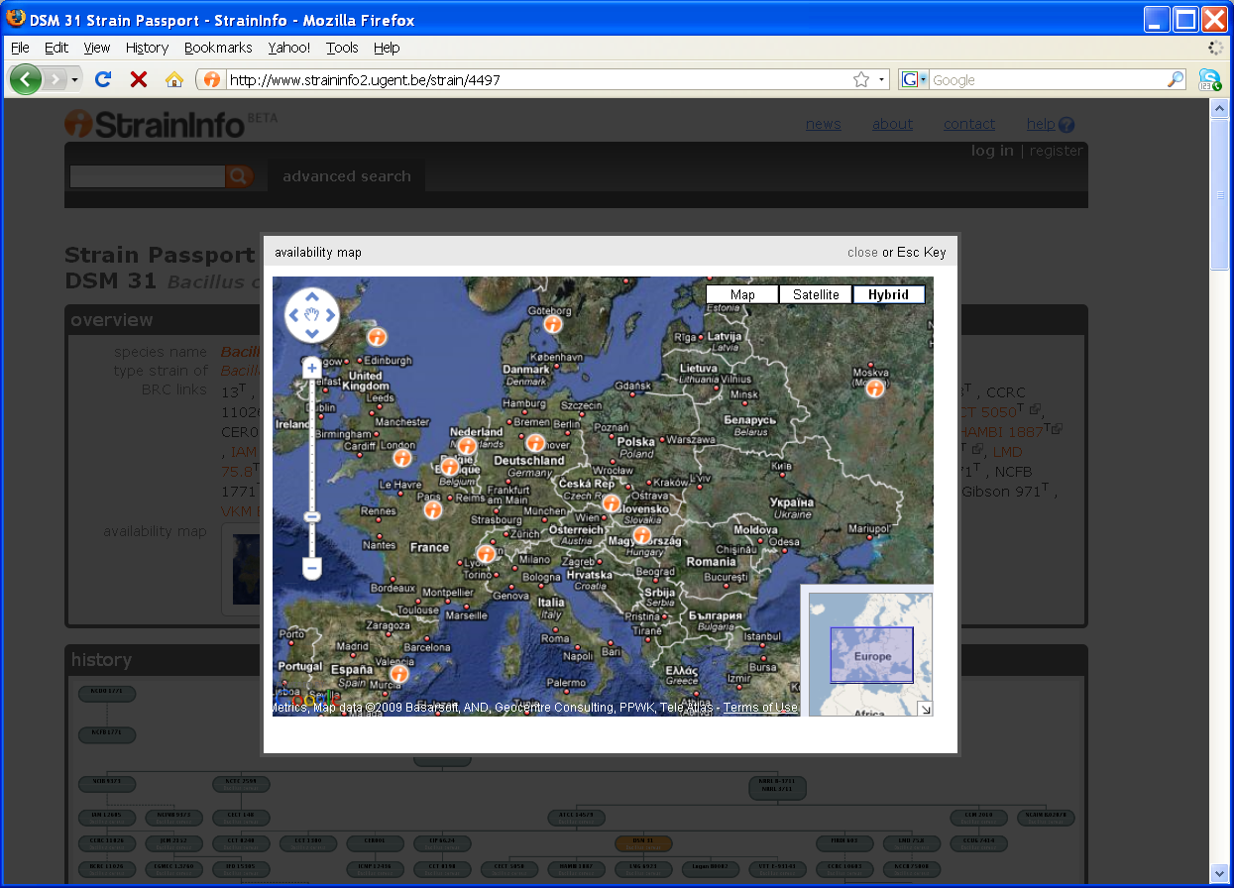
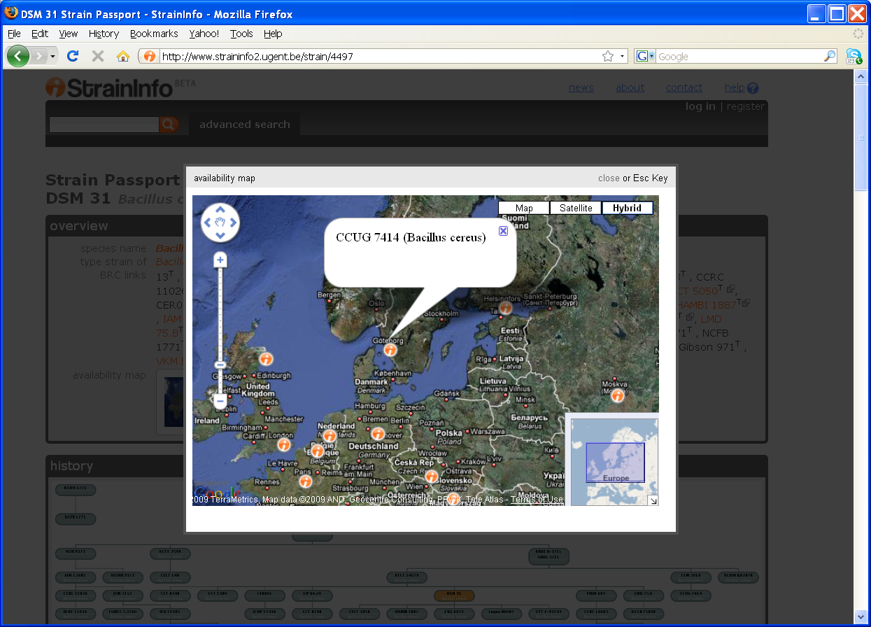
Strain distribution

Slide 30
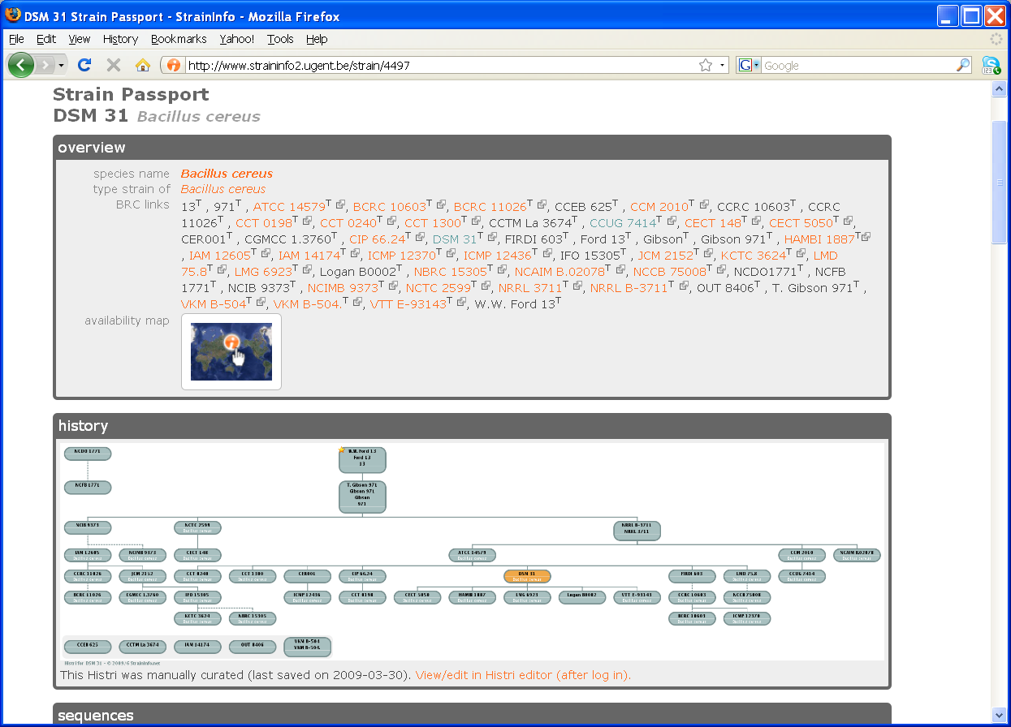
Strain passport

Slide 31
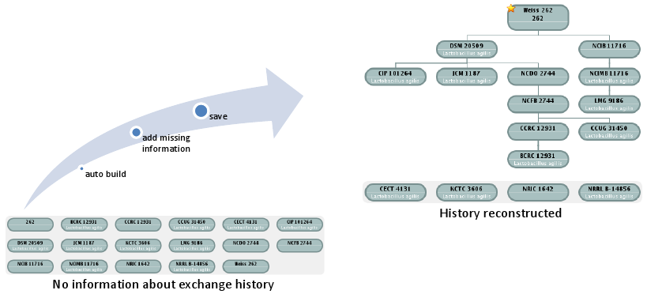
Strain exchange history

Slide 32
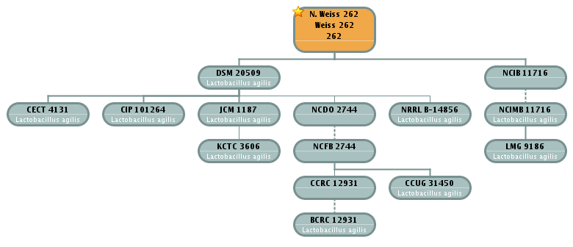
Strain exchange history

Slide 33

Strain exchange history

Slide 34

Strain exchange history

Slide 35
Strain passport

Slide 36
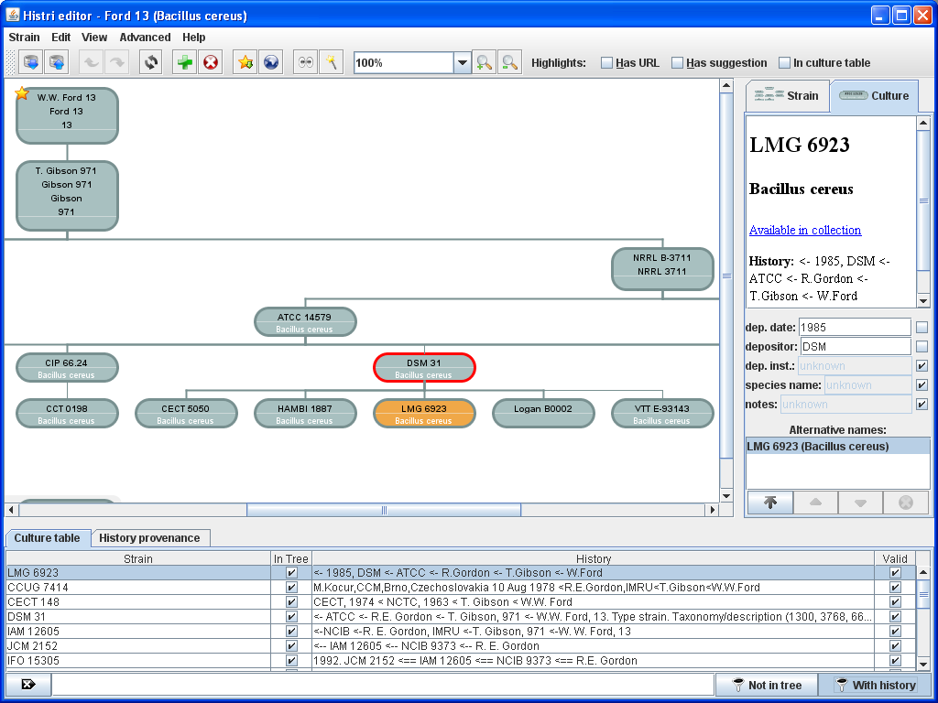
Strain passport

Slide 37
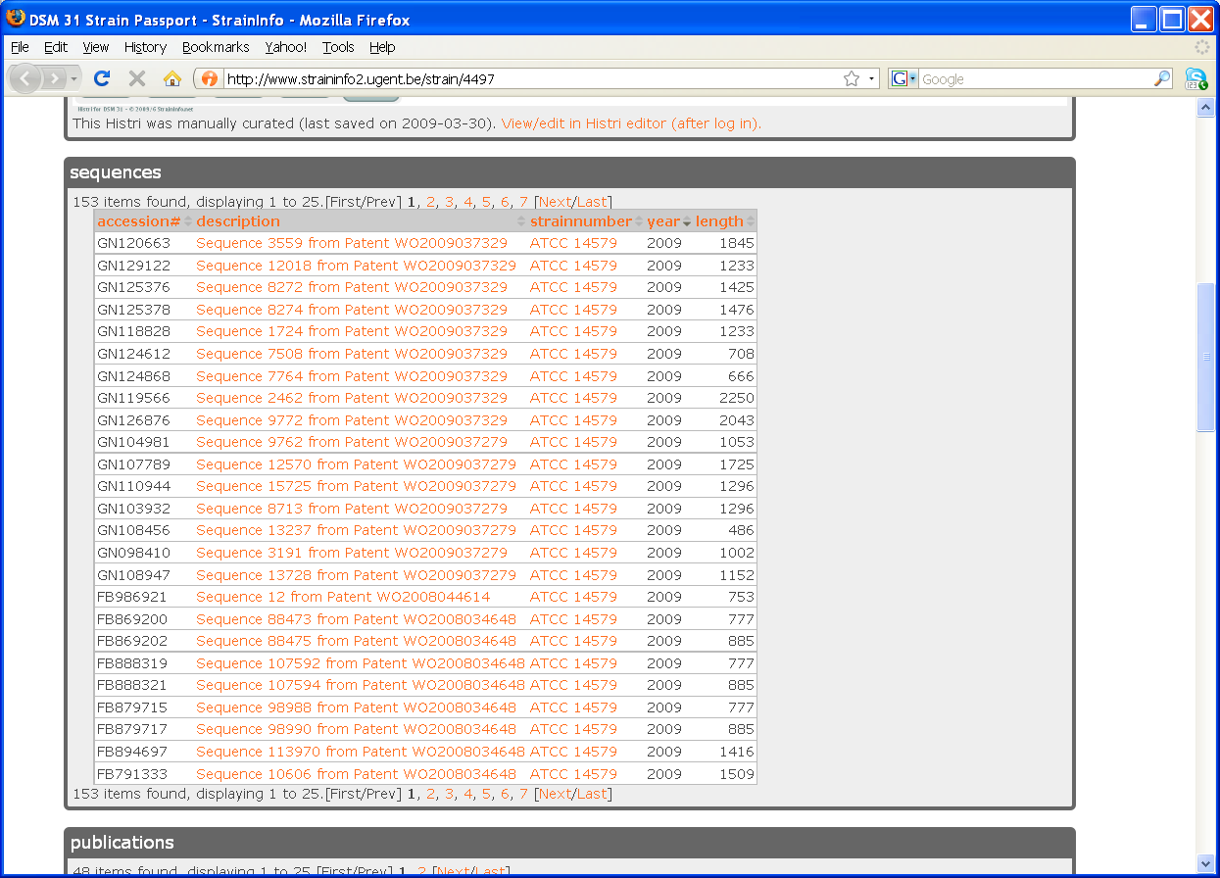
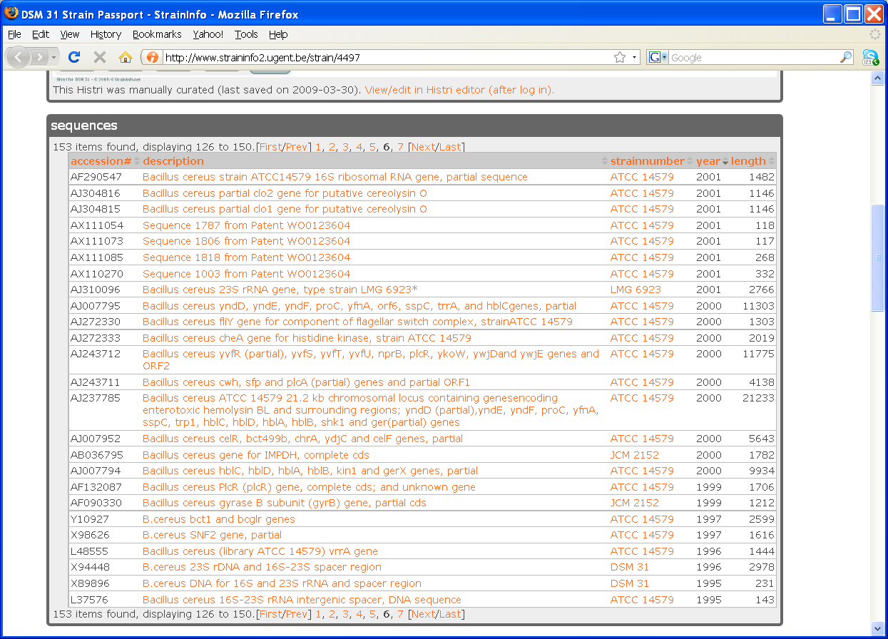
Strain passport

Slide 38
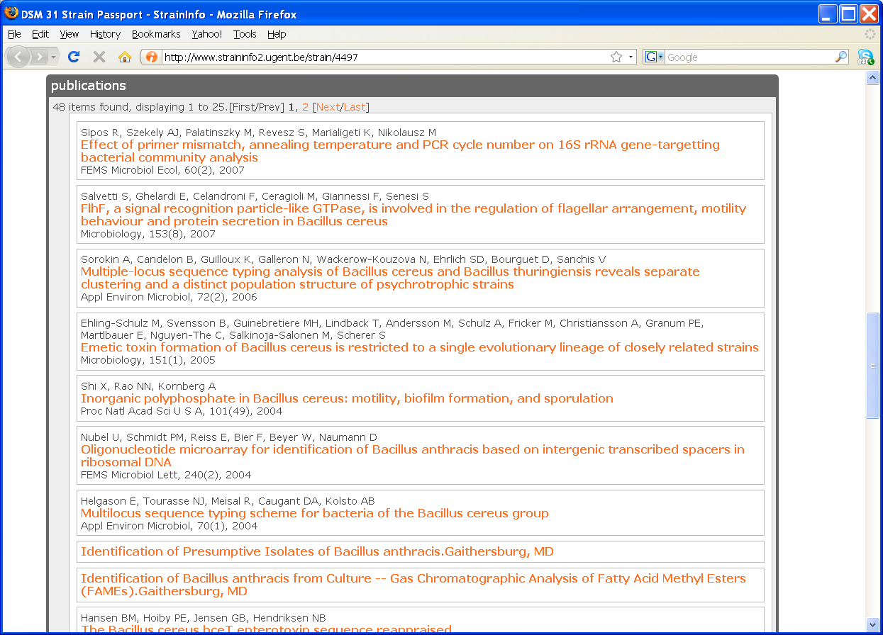
Strain passport

Slide 39
StrainInfo indexing
StrainInfo.net
sync-server

Slide 40
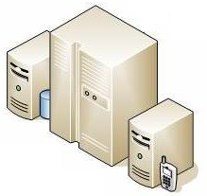
StrainInfo indexing (pull)
StrainInfo.net
sync-server

Slide 41
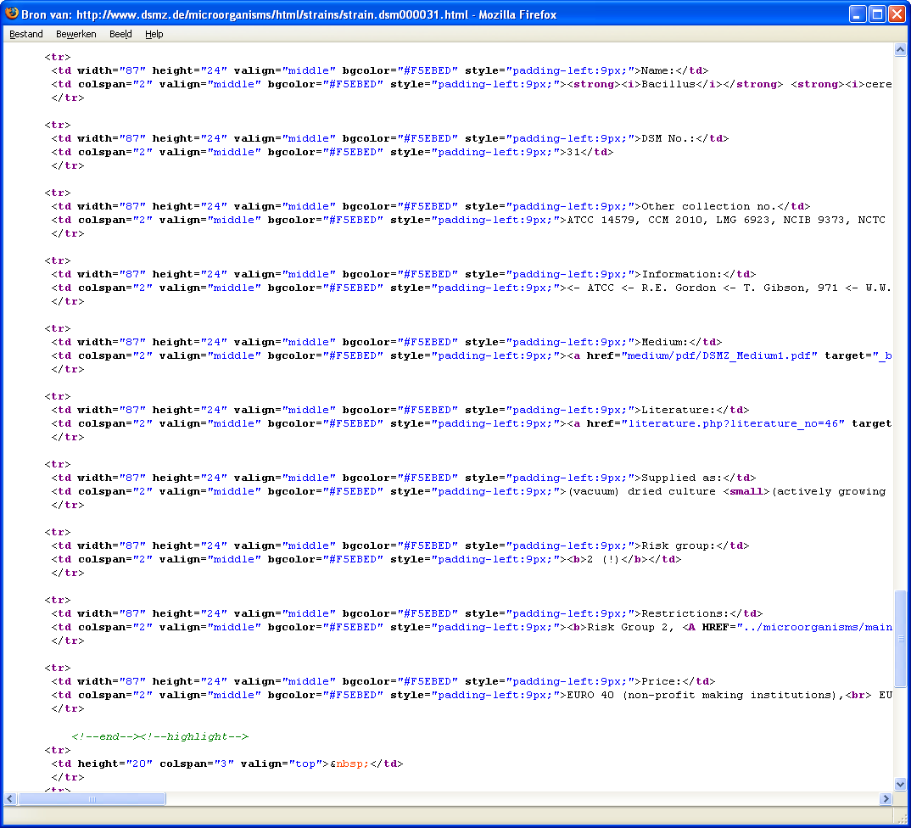
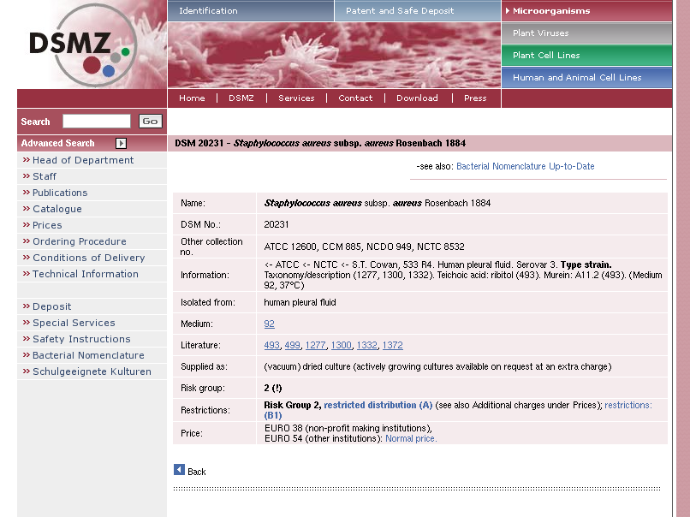
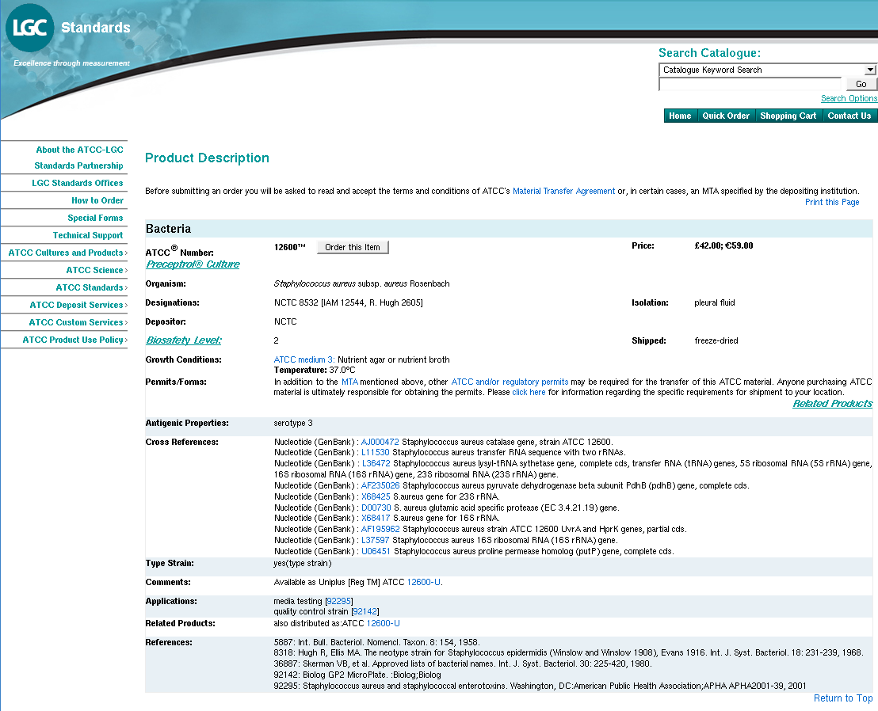
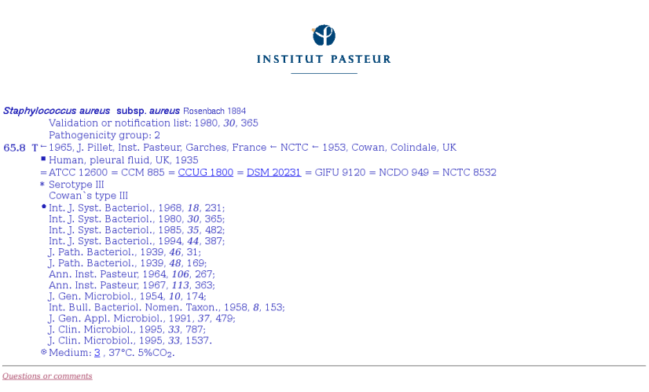
StrainInfo indexing (pull)
PULL
StrainInfo.net
sync-server

Slide 42
StrainInfo indexing (pull)
StrainInfo.net
sync-server

Slide 43
StrainInfo indexing (push)
StrainInfo.net
sync-server

Slide 44
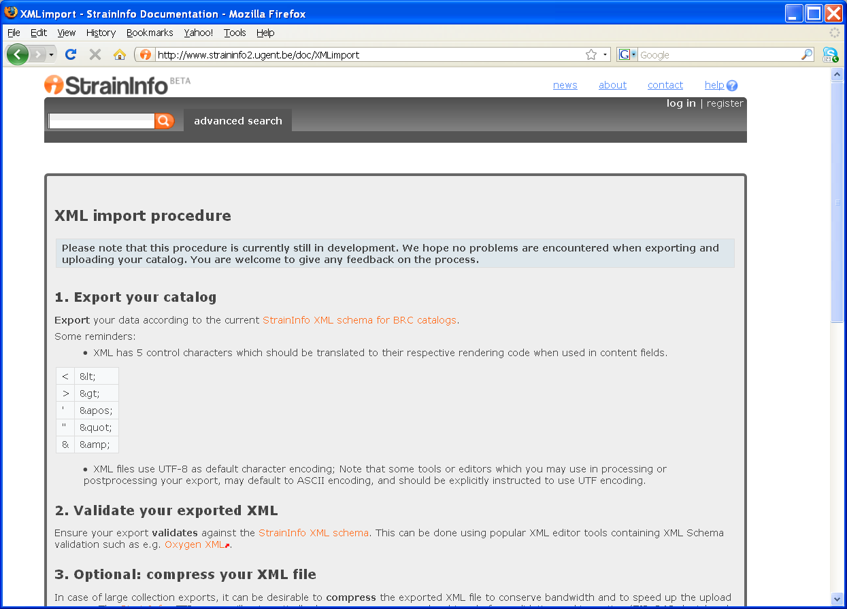
StrainInfo indexing (push)

Slide 45
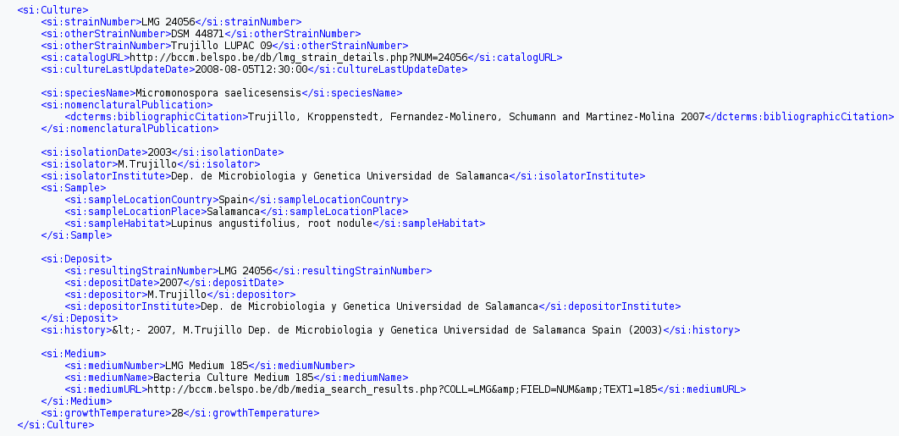
StrainInfo indexing (pull)
PUSH
StrainInfo.net
sync-server

Slide 46
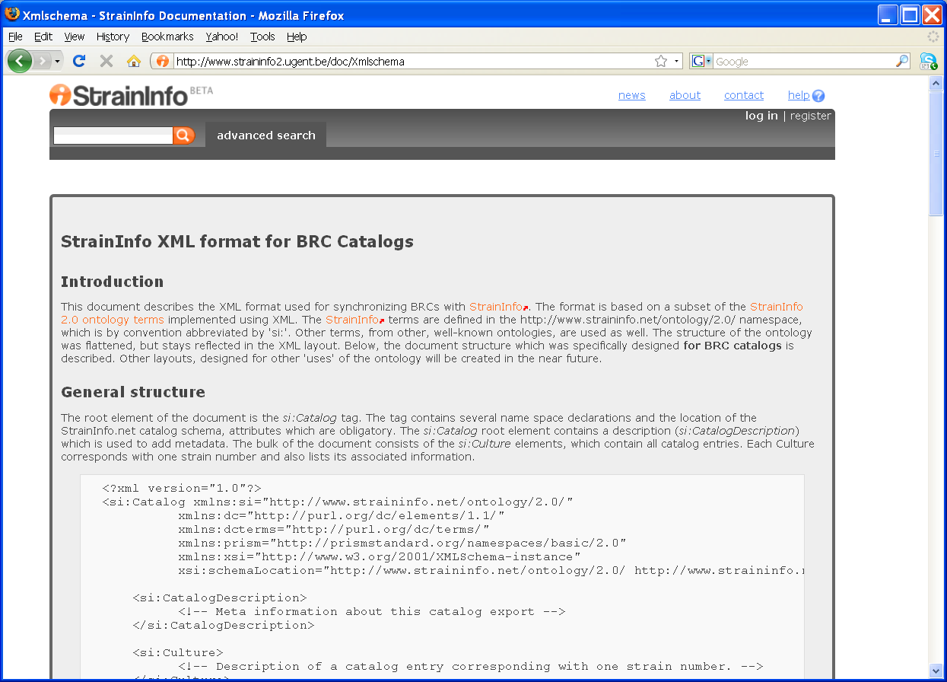
StrainInfo indexing (push)

Slide 47
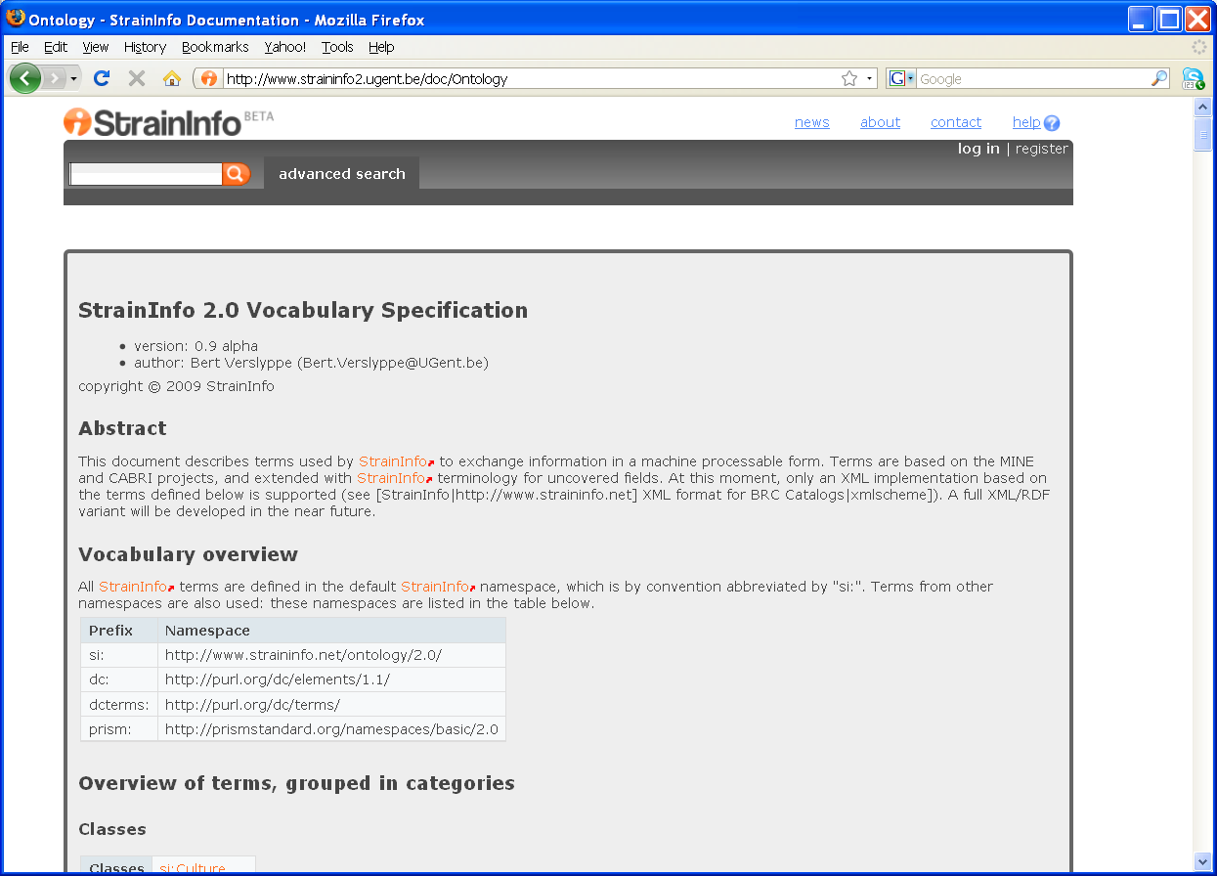
StrainInfo indexing (push)

Slide 48
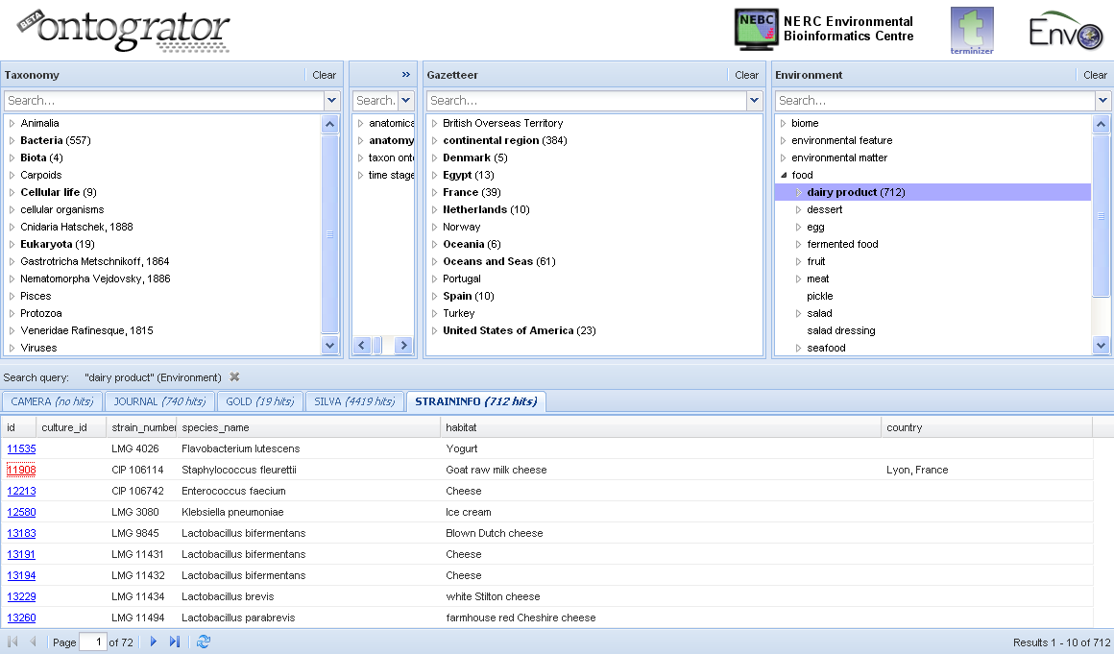
Ontogration

Slide 49

The End
StrainInfo.net team
Peter Dawyndt
Bernard De Baets
Paul De Vos
Wim De Smet
Wim Gillis
Bert Verslyppe
WEB
www.StrainInfo.net
If all microorganisms disappeared from earth,
within 50 years all life on earth would end
If all human beings disappeared from earth within 50 years all forms of life would flourish
— Jonas Sulk
Mohamed Amar
Laboratoire de Microbiologie et Biologie Moléculaire, Centre National pour la Recherche Scientifique et Technique, Morocco
David Ruiz Arahal
Colleccion Española de Cultivos Tipo,
Spain
Michael Ashburner
Department of Genetics, University of Cambridge,
UK
Christine Campbell
Culture Collection of Algae and Protozoa,
Scottish Association for Marine Science,
UK
Serge Casaregola
Centre International de Resources Microbiennes,
INRA,
France
Bernard De Baets
Research Unit Knowledge-based Systems
Ghent University,
Belgium
Tom Dedeurwaerdere
Centre for the Philosophy of Law,
Université Catholique de Louvain, Belgium
Tom Degroote
Laboratory of Microbiology, Ghent University, Belgium
Philippe Desmeth
Belgian Federal Science Policy, Belgium
Paul De Vos
Laboratory of Microbiology, Ghent University
Belgium
Jean Euzéby
International Committee on Systematics of Prokaryotes, France
Enevold Falsen
Culture Collection, University of Göteborg, Sweden
Dawn Field
Molecular Evolution and Bioinformatics Section, Oxford Centre for Ecology and Hydrology, United Kingdom
George Garrity NamesforLife,
USA
Frank Oliver Glöckner
Microbial Genomics Group, Max Planck Institute for Marine Microbiology, Germany
Tanya Gray
Molecular Evolution and Bioinformatics Section, Oxford Centre for Ecology and Hydrology, United Kingdom
Nicole Henry
Belgian Federal Science Policy, Belgium
Ian Jameson
CSIRO Microalgae Research,
Marine and Atmospheric Research, Australia
Danielle Janssens
BCCMTM/LMG Bacteria Collection, Ghent University, Belgium
Nikos Kyrpides
Department of Energy Joint Genome Institute,
USA
Mikah Krichevski
United States Federation of Culture Collections
USA
Frithjof Küpper
Culture Collection of Algae and Protozoa,
Scottish Association for Marine Science,
UK
José Miguel López-Coronado
Colección Española de Cultivos Tipo, Universidad de Valencia, Spain
Juncai Ma
Information Network Center, Institute for Microbiology
Chinese Academy of Sciences,
China
Kevin Mc Cluskey
Fungal Genetic Stock Center,
School of Biological Sciences,
USA
Ed Moore
Culture Collection, University of Göteborg, Sweden
Norman Morrison
School of Computer Science, University of Manchester,
UK
Antti Pesonen
VTT culture collection,
Finland
Vincent Robert
Centraalbureau voor Schimmelcultures, The Netherlands
Paolo Romano
Bioinformatica e Proteomica Strutturale, Istituto Nazionale per la Ricerca sul Cancro, Italy
Mark Segal
Environmental Protection Agency, USA
Jean Swings
Laboratory of Microbiology, Ghent University, Belgium
Marija-Liisa Suihko
VTT culture collection, Finland
Ken Ichiro Suzuki
NITE Biological Resource Center,
Japan
Hideaki Sugawara
Center for Information Biology, National Institute of Genetics, Japan
Masako Takashima
Japanese Collection of Microorganisms,
RIKEN Bioresource Center Japan
Brian Tindall
Deutsche Sammlung von Mikroorganismen und Zellkulturen, Germany
Paul Uhlir
U.S. National Committee for CODATA
USA
Bart Van Brabant
Laboratory of Microbiology, Ghent University
Belgium
Peter Vandamme
Laboratory of Microbiology, Ghent University, Belgium
Claudine Vereecke
BCCMTM/LMG Bacteria Collection, Ghent University, Belgium
Bert Verslyppe Department of Applied Mathematics and Computer Science Ghent University,
Belgium
John Wilbanks
Science Commons, USA
Anne Willems
Laboratory of Microbiology, Ghent University, Belgium
Xianhua Zhou
Information Network Center, Institute of Microbiology, Chinese Academy of Sciences,
China

Slide 50
microbial
commons

Slide 51
intellectual property
BRC
barcode of life
publish or perish
free software
web 2.0
biofuels
fungi
web services
interoperability
taxonomy
aggregation technology
habitat
microbial
bioinformatics
specimen
commons
archaea
MTA
algae
cell line
genome sequence
biodiversity
human computation
virus
semantic web
open access
encyclopedia of life
bacteria
DNA barcoding
metagenomics
phage
biotechnology
general public license
yeast
collaborative systems

