Slide 1
Science institutions and open data: opportunities and barriers
Paul N. Edwards
School of Information, University of Michigan

Slide 2
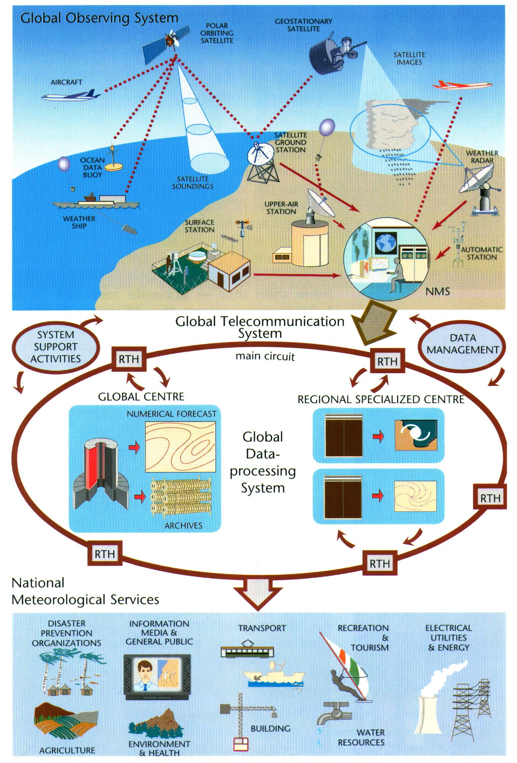
World
Weather
Watch
initial planning early 1960s
operational about 1968
satellites added ~1980
Notes:
free data sharing – historical tradition
very old

Slide 3
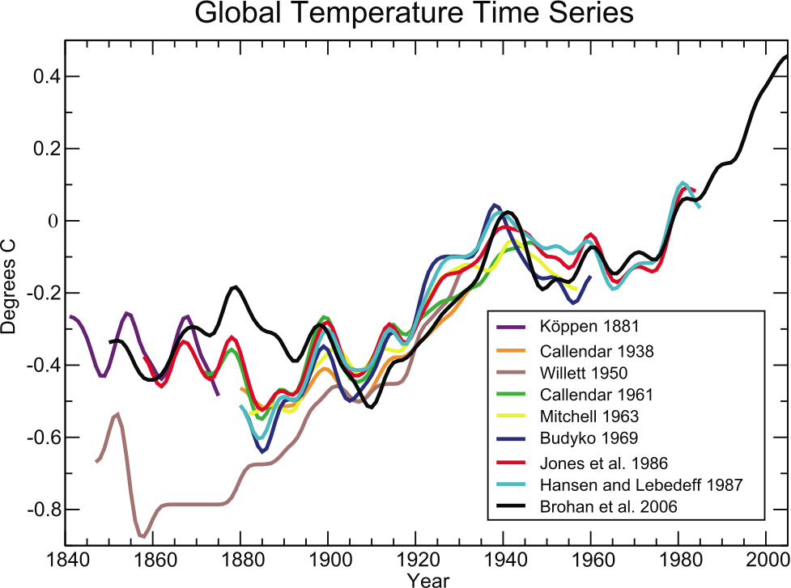
IPCC 4th assessment (2007)
Notes:
Point out difference between Willett and Brohan et al.
Figure 1.3. Published records of surface temperature change over large regions. Köppen (1881) tropics and temperate latitudes using land air temperature. Callendar (1938) global using land stations. Willett (1950) global using land stations. Callendar (1961) 60°N to 60°S using land stations. Mitchell (1963) global using land stations. Budyko (1969) Northern Hemisphere using land stations and ship reports. Jones et al. (1986a,b) global using land stations. Hansen and Lebedeff (1987) global using land stations. Brohan et al. (2006) global using land air temperature and sea surface temperature data is the longest of the currently updated global temperature time series (Section 3.2). All time series were smoothed using a 13-point filter. The Brohan et al. (2006) time series are anomalies from the 1961 to 1990 mean (°C). Each of the other time series was originally presented as anomalies from the mean temperature of a specific and differing base period. To make them comparable, the other time series have been adjusted to have the mean of their last 30 years identical to that same period in the Brohan et al. (2006) anomaly time series.

Slide 4
Infrastructural inversion
Making data global
Köppen 1881: fewer than 100 stations
Callendar 1938: about 200 stations
Willett 1950: 183 stations
Callendar 1961: 450 stations
Mitchell 1963: 183 stations
  Jones et al. 1986: 2194 stations
  Brohan et al. 2006: 4349 stations
  Muller et al. (in preparation): 39,340 stations (and climbing!)
Notes:
why so few stations? go on to discuss quality problems with past data – many more stations available but rejected due to discontinuity, length of record, etc.

Slide 5
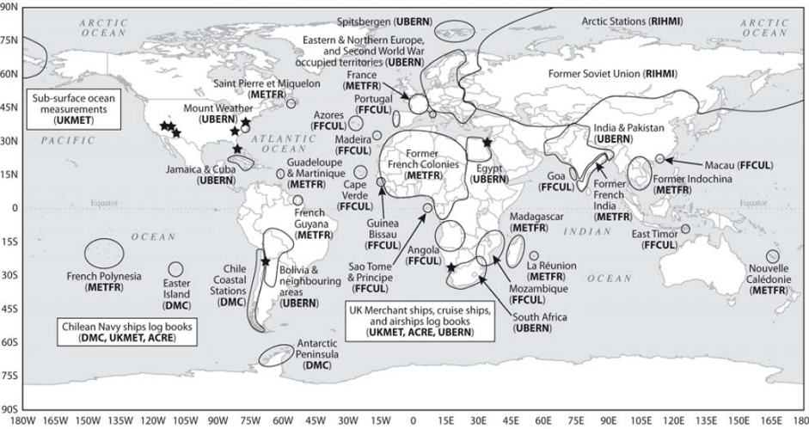

ERA-CLIM data recovery and digitization
focus on pre-1957 meteorological data in sensitive regions
Notes:
5

Slide 6
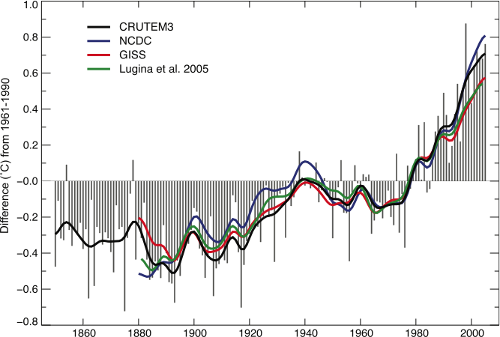
IPCC AR4 (2007), Fig. 3.1
Notes:
Figure 3.1. Annual anomalies of global land-surface air temperature (°C), 1850 to 2005, relative to the 1961 to 1990 mean for CRUTEM3 updated from Brohan et al. (2006). The smooth curves show decadal variations (see Appendix 3.A). The black curve from CRUTEM3 is compared with those from NCDC (Smithand Reynolds, 2005; blue), GISS (Hansen et al., 2001; red) and Lugina et al. (2005; green).

Slide 7
Distance matters (Olson & Olson, 2000)
Physical
  More likely to share and trust data with others in own lab
  Face-to-face work is more efficient
  Local concerns usually trump remote ones
Temporal
  Software ecologies change
  Metadata may not exist, or be insufficient
Figurative
  Distant disciplines understand less about what data represent, potential problems or virtues
Notes:
now the bad news

Slide 8
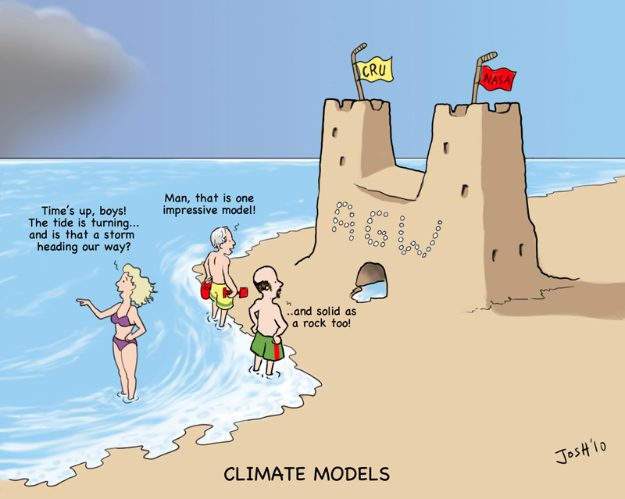
Trust
Notes:
talk about Google alerts
distance between audiences & communities

Slide 9

Notes:
Now some images - abstraction

Slide 10
Hierarchies and incentives
where your reputation matters most

Slide 11
Hierarchies and incentives
pays your salary
decides on your tenure

Slide 12
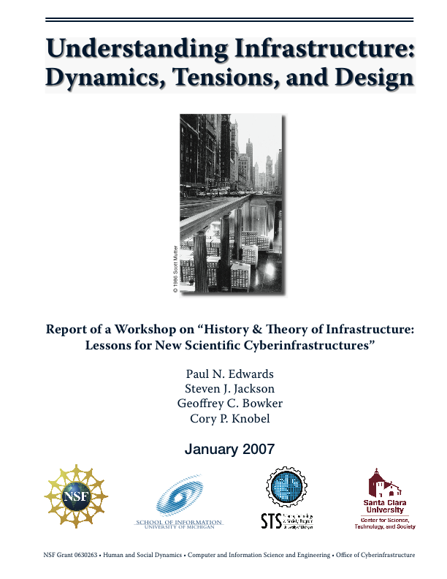
Infrastructure: a historical model
System building
Technology transfer and growth
  Locations, domains
  Variation and competition
Network formation: gateways
  The “modern infrastructural ideal”: universal service by a single monopoly provider
Internetworks or webs
Decentralization, fragmentation, tiering
time

Slide 13
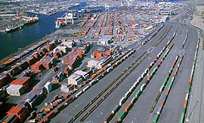
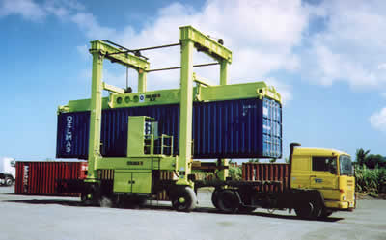
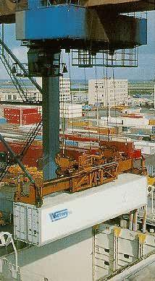
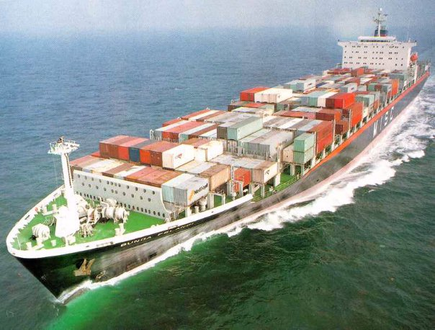
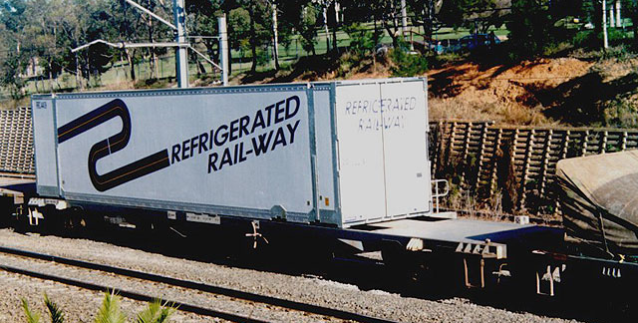
Gateways

Slide 14
Meta-institutions as data gateways
World Weather Watch
World Climate Research Program
Earth System Grid
Long Term Ecological Research Network
and hundreds of others…

Slide 15
Meta-meta-institutions
Global Earth Observing System of Systems (GEOSS)
Global Organization of Earth System Science Portals (GO-ESSP)
…and many others

Slide 16
“Metadata is nobody’s job” — S.L. Star
Scientists?
Data managers?
Crowds?
Young people?
Social scientists?
Metadata as product vs. metadata as process
  human communication, often informal, is still the most basic process for data sharing

Slide 17
Data aren’t data without software
Journal of Money, Credit and Banking
  required publication of code and data
McCullough, McGeary, & Harrison (2006)
  Examined ~150 articles
  58 had some data and/or code
  only 15 could be replicated using what was provided
Incentives and credit systems for data and software

Slide 18
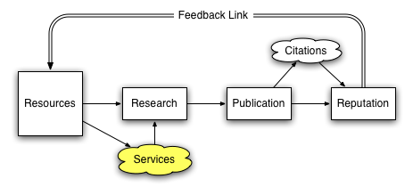
Incentives: current academic reputation system
data sharing
software
slide: James Howison
Notes:
“Republic of Science” Polanyi. Merton, Birnholtz

Slide 19
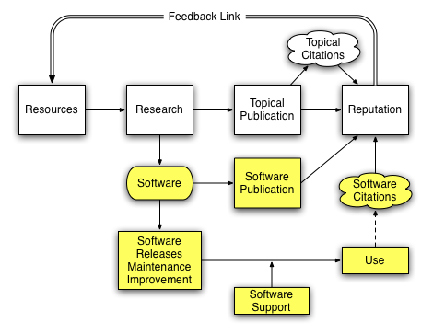
Incentives: crediting academic software and data work?
for software, also read “data”
slide: James Howison
Notes:
Logic of correctness: publication review, wide-spread use

Slide 20
Career incentives vs. external mandates
NSF, NIH, others mandate data publication…
…but career incentives are for research results
Building software for science
  by scientists
  by professional support services
Maintenance, maintenance, and more maintenance
  data curation

Slide 21
Solutions?
Virtual organizations?
Crowdsourcing?
Open source software as a model?
  dangers of reasoning by analogy
Metadata standards?
“Young people will know how to do it”?
  iSchools?
  Science departments?
  Science informatics programs (CS + iSchool + domain sciences)?

