Slide 1
Improving Data Access and Use for Sustainable Development in the South
Daniel Schaffer, Public Information Officer, TWAS, Italy
The Case for International Sharing of Scientific Data: Focus on Developing Countries
18-19 April 2011, NAS Keck Center, Washington, DC, USA

Slide 2
How to improve data access and use in the South?
ICTP library, journal area
Notes:
One of the major attractions for scientists from developing countries was ICTP's library.

Slide 3
Universal declaration of human rights
Article 27
“
Everyone has the right to share in scientific advancement and its benefits.
”

Slide 4
Scholarly journals are estimated to range between 25,000 and 50,000 worldwide.
ICTP library
Yuxuan.fishy.Wang/Flickr

Slide 5
Some 2.5 million scholary articles are published each year.
The output is doubling every 15 years.
jepoirrier/Flickr

Slide 6
Scientific information is experiencing its greatest transformation since the first scientific publication appeared more than four centuries ago.
Lawrence Berkeley National Laboratory Scientific Data on Demand NERSC’s High Performance Storage System

Slide 7
Data beanstalk
The amount of data generated each year is growing by nearly 60%.
In 2010, the world generated 1,250 Exabytes of data – a stack of CDs 3,750,000 km high (5 times to the Moon and back).
1,800 Exabytes: estimated amount of total electronic data in existence by 2011.
Frederic Vandaele
Notes:
1,250 Exabytes: a stack of CD's 3,750,000 km high ≈ 10 times the distance from Earth to Moon
The average distance from Earth to Moon is 384,403 km (3,750,000 : 384,403 = 9.8 times)
1 Exabyte = 1,000 Petabytes = 1,000,000 Terabytes = 1,000,000,000 Gigabytes
1 Gigabyte (one-billionth of an Exabyte) ≈ the bed of a pickup truck filled with paper
1 Petabyte ≈ 100 years of television ≈ a stack of CDs 3 km high
1,250 Exabytes = 125,000,000 years of TV

Slide 8
Global Challenges
Some are global
data deluge
data management
proprietary data
security
privacy
reluctance to share data
Some are particular to the South

Slide 9
Challenges in the South
Poor internet access
Limited accessibility to computers
Low bandwidth
Still a problem, although less so than 10 or even 5 years ago

Slide 10
Challenges in the South
Limited access to scientific literature
Historically, cost of subscriptions
More recently, under open access schemes, shifting financial burden from subscribers to authors
Notes:
Cost of subscription in part alleviated by Internet and subsidized subscription programmes (major publishers, such as HINARI => Bangladesh)
At the 2010 BioVisionNxt conference in Alexandria, Egypt, a major point of discussion among young scientists was precisely their lack of financial means => increasing gap between North and South.
PloS author's fees: USD 1,300 -2,850 per article

Slide 11
Challenges in the South
Factors hindering high-quality scientific research
inadequate training
poorly equipped laboratories
excessive teaching responsibilities
limited career opportunities
lack of funding

Slide 12
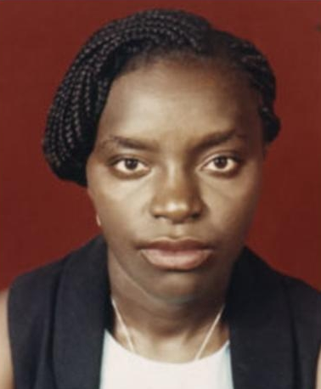
For the past three hours I have been trying to reply to your e-mail but the power has been going off and on every minute.
Yes, African science suffers from a lack of funds and expertise. But scientists in Africa also face the following problems:
Regular power failures. Power-cuts not only delay our work, but also lead to stored samples being damaged or degraded, thereby modifying our results.
Poor transportation infrastructure, bad roads, cancelled or delayed flights can lead to the thawing of frozen specimens.
Isolation and absence of library and database facilities. Access to the internet is impossible or difficult in many places due to both power failures and low connection speeds.
Lack of basic materials. Shortages of reagents occur on an almost daily basis.
I will send this message now in case power goes off again.
Aline Edith Mekeu Noutcha
Cellular Parasitology Laboratory Department of Zoology University of Ibadan, Nigeria
temporarily at the
Faculty of Medicine Malaria Research & Training Centre Bamako, Mali
under an OWSDW postgraduate fellowship

Slide 13
Global Knowledge Production
Two important recent reports on global science:
UNESCO World Science Report Published November 2010
The Royal Society Knowledge, Networks and Nations Published in March 2011

Slide 14
UNESCO's 2010 Science Report
The percentage of scientific articles published by authors from the developing world in international peer-reviewed journals rose from 30% in 2002 to 38% in 2010.
Notes:
But if we look more closely at these figures, a slightly different story emerges.
The progress is not evenly distributed

Slide 15
G6 of science in the South
G6
TWAS estimates that just 6 developing countries – China, India, South Korea, Brazil, Taiwan and Turkey – are responsible for 75% of the share of publications by scientists in developing countries.
China is now playing a role in the South similar to that played by the USA in the world.
Notes:
G6 of science in South
North-South divide in science publishing may be closing
But the shrinking is due to just a few large countries with rapidly developing economies
Many smaller, poorer developing countries remain science-deprived

Slide 16
China is on course to overtake the US in scientific output possibly as soon as 2013 – far earlier than expected.
Notes:
Not in quality or impact but in sheer quantity
Another indicator: The city of São Paulo in Brazil is now producing more papers than Cambridge.

Slide 17
G80 of science in the South
G80
TWAS also estimates that scientists in 80 of the world's scientifically most lagging countries collectively account for less than 1% of the world's scientific output.
These countries have some 1.6 billion people – nearly one-quarter of the world's population.
Notes:
On the other side of the spectrum
All LDCs, plus several that the World Bank considers Low Income countries, plus several that the RAND Forum considers scientifically lagging, plus a few others that we, TWAS, included.
44 in Africa (and the whole of Africa = 53 countries)

Slide 18
TWAS
the academy of sciences for the developing world

Slide 19
TWAS, the academy of sciences for the developing world
Founded 1983 in Trieste, Italy, by 42 eminent scientists from developing countries, under the leadership of Abdus Salam
Inaugurated 1985 by the Secretary General of the United Nations, Javier Perez de Cuellar
Operates under administrative umbrella of UNESCO

Slide 20
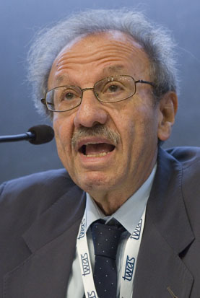
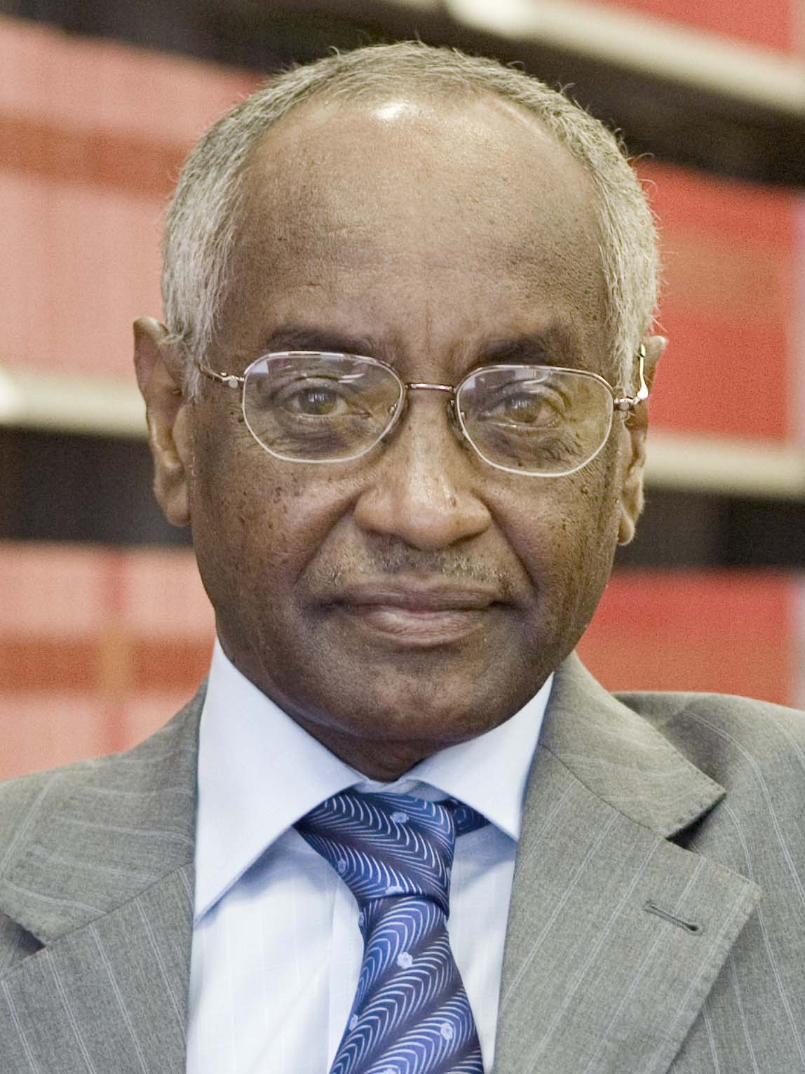
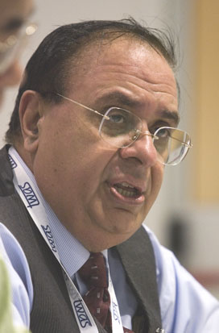
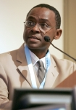
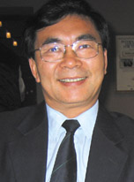
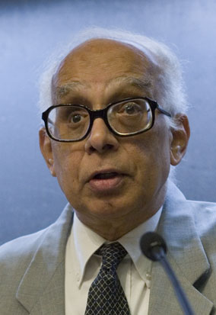
TWAS, the academy of sciences for the developing world
995 Members in 91 countries
853 “Fellows” in 74 countries in the South
142 “Associate Fellows” in 17 countries in the North
15 Nobel Laureates

Slide 21
TWAS Objectives
Promote excellence in scientific research in developing countries
Strengthen South-South collaboration
Encourage South-North cooperation between individuals and centres of excellence
Respond to needs of young scientists working under unfavourable conditions
Engage in dissemination of scientific information and sharing of innovative experiences
Notes:
4
As I've mentioned previously….

Slide 22
Capacity-building action by TWAS
Sponsor fellowships for students in developing countries, particularly in Africa, to pursue postgraduate and postdoctoral studies at best universities and research institutions in other developing countries (South-South)
TWAS postgraduate and postdoctoral fellowships: supported by Brazil, China, India, Kenya, Malaysia, Mexico, Pakistan and Thailand (some 175 fellowships per year, costing US$2.7 million per year in local expenses)
OWSDW postgraduate training fellowships for women students in Africa and LDCs (supported by Sida, Sweden)
Notes:
get numbers from leena
Organization for Women in Science for the Developing World [women scientists' organization] OuSD

Slide 23
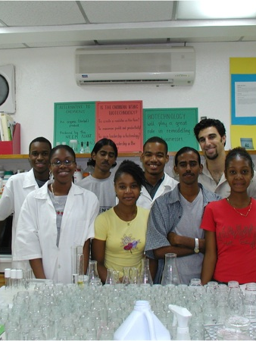
Capacity-building action by TWAS
Grants for individual scientists
Small research grants of USD15,000, largely for equipment and supplies
Focus on young African scientists returning after PhD training under TWAS and OWSDW postgraduate fellowships

Slide 24
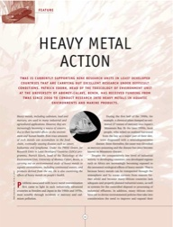
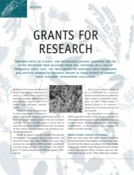
Capacity-building action by TWAS
Grants (up to USD100,000 over 3 years) for research groups selected on merit.
Examples of the 40 TWAS research units:
Toxicology Group, Environment Unit, University of Abomey-Calavi, Benin
Electrochemistry and Polymer Science Group, Department of Chemistry, University Cheikh Anta Diop, Senegal
Institute of Endemic Diseases, University of Khartoum, Sudan

Slide 25
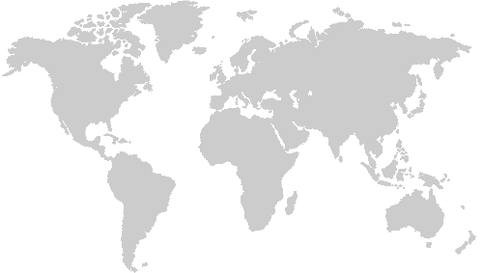
TWAS’s HQ and Regional Offices
Trieste
ICTP
Beijing
Chinese Academy of Sciences
Alexandria Bibliotheca Alexandrina
Bangalore
J.N. Centre for Advanced Scientific Research
Nairobi
African Academy of Sciences
Rio de Janeiro
Brazilian Academy of Sciences
Notes:
Recognizing the growing strength of science in South, over the past decade TWAS has established and supplied increasing funding for five regional offices.
TWAS spanning the globe...

Slide 26
How can we manage the growth of data and information for the benefit of all?
wetwebwork/Flickr
Notes:
So what can professional societies do – and here I'm talking as a TWAS person, i.e. coming from a science academy with a Southern viewpoint – to improve access to data in the developing world at a time of unprecedented change in international science?
I have some modest proposals that are based largely on what is already happening.

Slide 27
Recommendations
Support open access
Public Library of Science (PLoS)
BioMed Central
Research4Life
Health Internet Access to Research Initiative (HINARI)
Access to Global Research in Agriculture (AGORA)
Online Access to Research in the Environment (OARE)
Gideon Burton/Flickr
Notes:
Including speaking out against efforts to reduce open access in poor countries such as what occurred last month to scientists in Bangladesh.

Slide 28
Recommendations
Support efforts to expand bandwidth and ICT infrastructure
Notes:
Announcement in February that West Africa Cable System will soon bring direct high-speed internet connections to West Africa – a boon to scientific community.
Major announcements over the past two months that the cable has arrived.

Slide 29
Recommendations
Support expanded participation of scientists in developing world in international projects
Intergovernmental Panel on Climate Change
Large Hadron Collider
Notes:
LHC involves 140 computer centres in 34 countries and processes more than 1 million calculations each day.
IPCC has made concerted effort to involve developing world scientists (but still a minority and still playing a secondary role [IAC report])

Slide 30
Recommendations
Support indigenous data and improved data management strategies
Notes:
INBio has established the most extensive data bases for biodiversity in this biodiversity rich country (booklet).

Slide 31
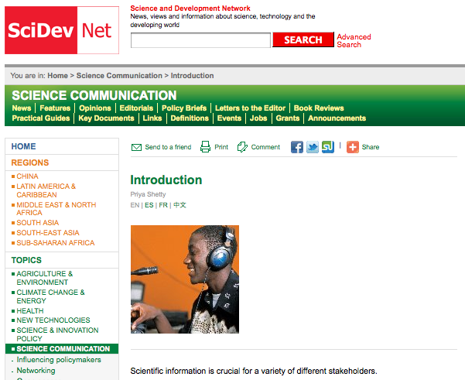
Recommendations
Support quality and availability of journals, data and information produced in the South
SciDev.Net also hosts science communication workshops to train journalists from developing regions.
Notes:
Both were conceived at TWAS:
- INASP in 1992
- SciDevNet in 2000

Slide 32
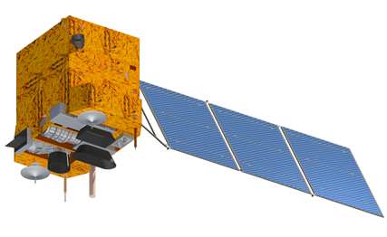
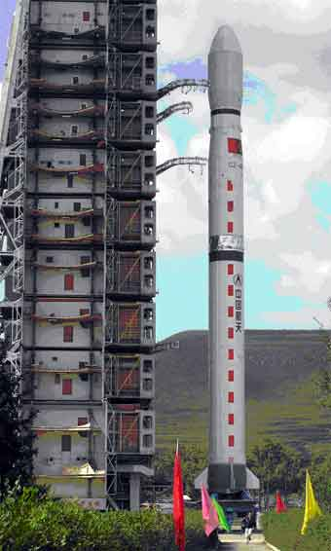
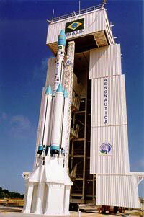
Recommendations
Support South-South data collection and exchange
China–Brazil Earth Resources Satellite (CBERS) programme
Notes:
CBERS is a technological cooperation programme between Brazil and China to develop and operate Earth observation satellites.

Slide 33
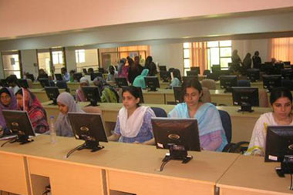
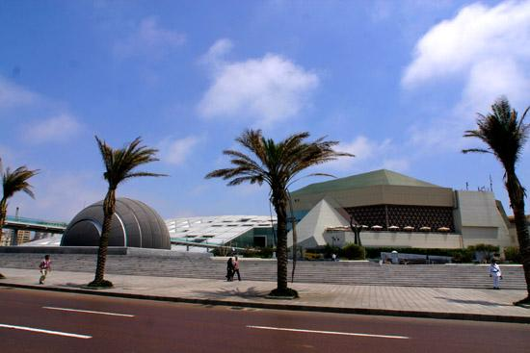
Recommendations
L.E.J. National Science Information Center, Karachi, Pakistan (H.E.J. Research Institute of Chemistry International Center for Chemical and Biological Sciences University of Karachi, Pakistan)
Bibliotheca Alexandrina, Egypt
Support regional repositories and mirrors in the South
Notes:
The Latif Ebrahim Jamal National Science Information Center at the Husein Ebrahim Jamal Research Institute of Chemistry (International Center for Chemical and Biological Sciences, University of Karachi) serves as a hub of information for the dissemination of knowledge in frontier sciences in Pakistan. It provides full access to the world's largest library resources.
- Digital Library at the Center is organizing regular training courses and focused workshops (video lecture and video conferencing).
-High speed internet connectivity (16Mb) through NTC
-Educational intranet connectivity with all major universities of Pakistan through PERN (Pakistan Educational Research Network)
-Online literature survey through SciFinder Scholar and over 11,500 full-text journals
-Computer terminals for 188 simultaneous users, connected through a local area network
Bibliotheca Alexandrina offers (among other things not mentioned here): Internet Archive, 6 specialized libraries, 4 Museums, 1 Planetarium, an interactive Virtual Reality environment (allowing researchers to transform two-dimensional data sets into 3-D simulations, and to step inside them), 8 academic research centers -- one is the International School of Information Studies (ISIS).

Slide 34
Recommendations
Support developing-world engagement in discussions on data management and use
Southern viewpoint
CODATA
Berlin 9 Open Access Conference
Notes:
The mission of CODATA (Committee on Data for Science and Technology) is to strengthen international science for the benefit of society by promoting improved scientific and technical data management and use.
Policy – Ethics – Rights
Berlin 9 Open Access Conference scheduled for November 2011 in Washington, DC => excellent forum for discussions involving developing countries

Slide 35
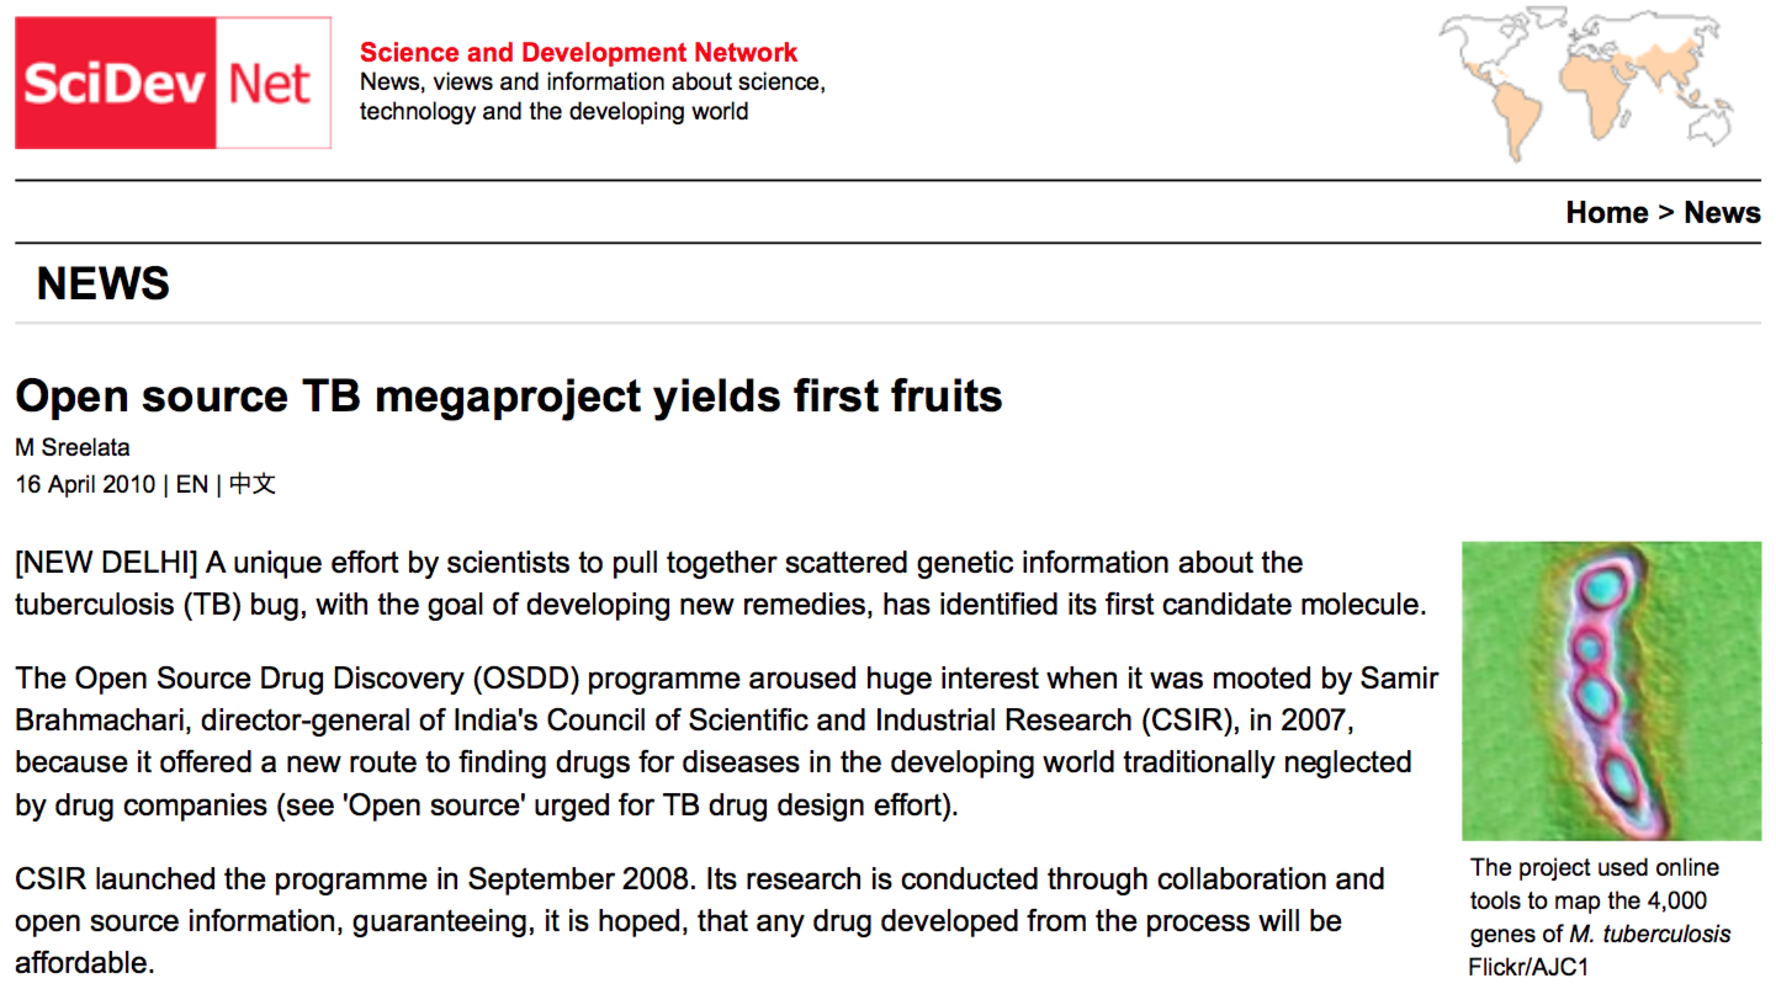
Recommendations
Support best practices in data management in the South
India's open source drug discovery (OSDD) programme
India-Brazil-South Africa (IBSA) forum
Notes:
India-Brazil-South Africa (IBSA)
Fosters collaboration in STI in various areas of research cooperation
HIV/AIDS and Nanotechnology (India)
Malaria and Oceanography (Brazil)
Tuberculosis and Biotechnology (South Africa)

Slide 36
Universal declaration of human rights
Article 27
“
Everyone has the right to share in scientific advancement and its benefits.
”

Slide 37
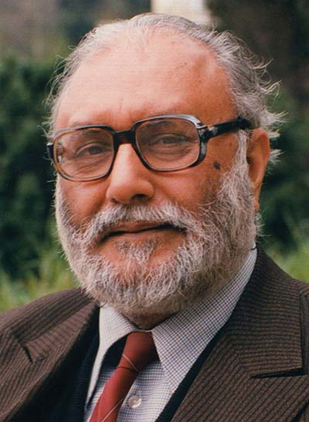
Universality of science
Abdus Salam
“
Scientific thought is the common heritage of mankind.
”

Slide 38
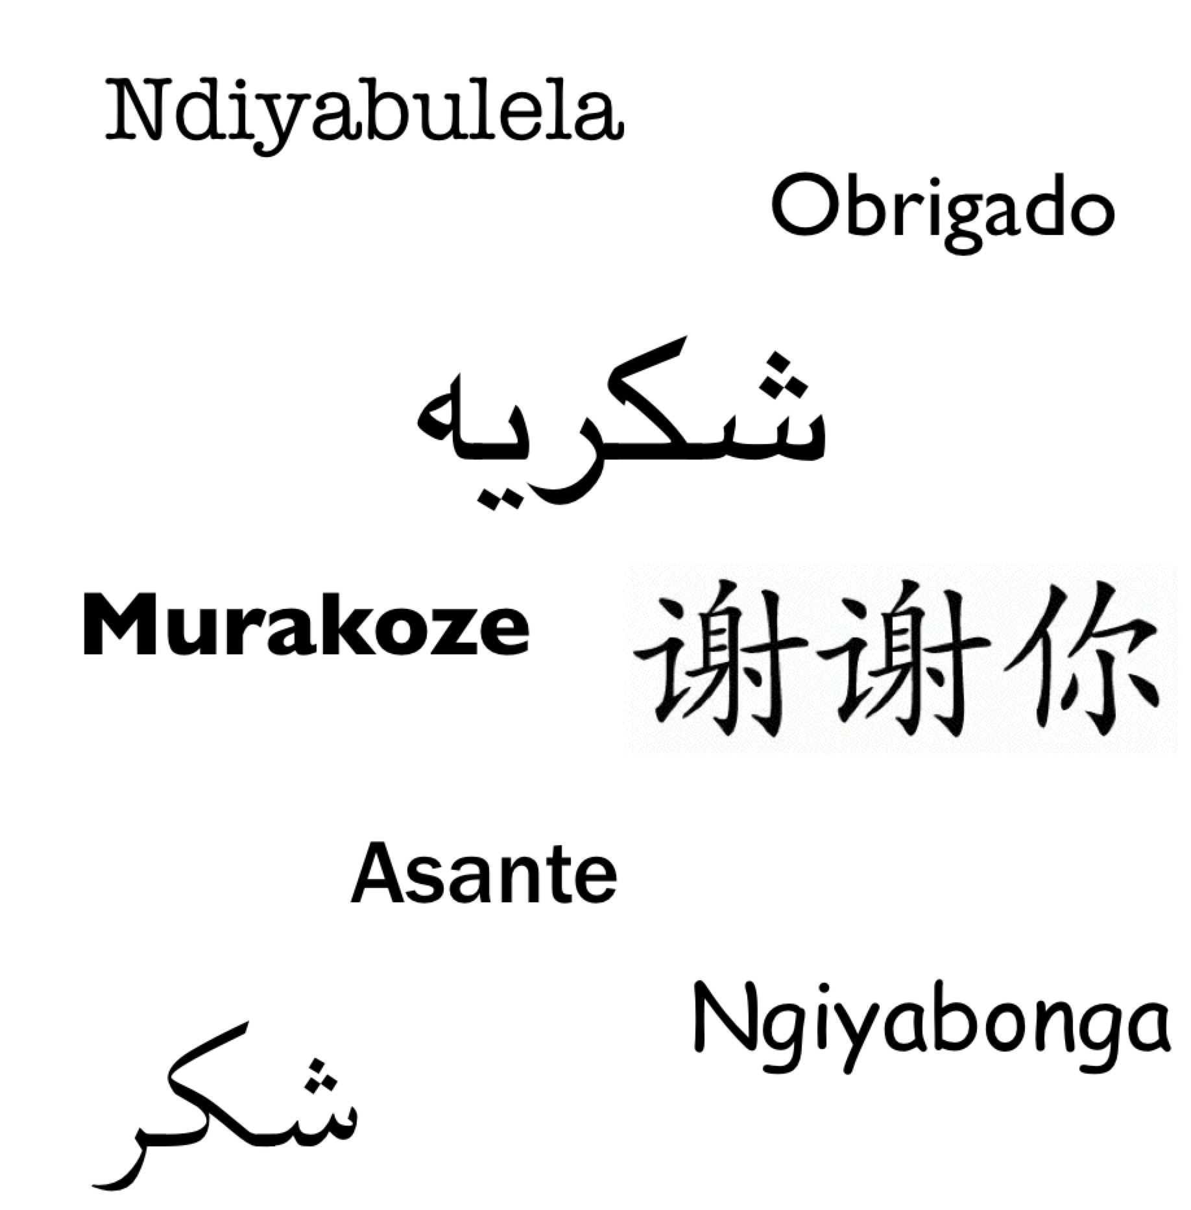
Thank you
Daniel Schaffer Public Information Officer TWAS, the academy of sciences for the developing world
schaffer@twas.org
www.twas.org
Notes:
From top to bottom:
Xhosa (Ndiyabulela)
Portuguese (Obrigado)
Urdu (Shukria)
Rwandese (Murakoze)
Chinese (Xie Xie Ni)
Swahili (Asante)
Zulu (Ngiyabonga)
Arabic (Shukran)

