Slide 1
Parse this: Developing Data Attribution and Citation Practices and Standards
Christine L. Borgman, UCLA
Chair’s Welcome and Keynote
22 August 2011
Notes:
Greetings everyone. We’ve assembled an amazing group of speakers and participants for this very focused meeting. We have much to accomplish in two days, so will dig right in.

Slide 2
Attribution
NAS Staff: Paul Uhlir, Daniel Cohen, Cheryl Levey
CODATA Task Group: Bonnie Carroll (Co-Chair), Jan Brase (Co-Chair), Sarah Callaghan (Co-Chair), Micah Altman, Elisabeth Arnaud, Christine Borgman, Dora Ann Lange Canhos, Todd Carpenter, Vishwas Chavan, Nathan Cunningham, Michael Diepenbroek, John Helly, Jianhui Li, Brian McMahon, Karen Morgenroth, Yasuhiro Murayama, Soren Roug, Helge Sagen, Eefke Smit, Martie van Deventer, John Wilbanks, Koji Zettsu; Paul Uhlir and Dan Cohen (Consultants)
Symposium Steering Committee: Christine Borgman (Chair), Allen Renear, Herbert van de Sompel, Gary King, Steven Jackson, David Kochalko, John Wilbanks
Sponsors: Alfred P. Sloan Foundation, the Institute for Museum and Library Services, CODATA, Microsoft Research, National Science Foundation
Notes:
The smoother the event, the more advance planning was involved! And that’s the case here -

Slide 3
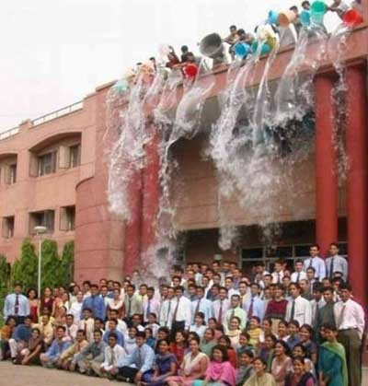
Deluge!!!
Data!
Scientists
Social Scientists
Humanists
Funding agencies
Policy makers
Librarians
Publishers
Internet architects
http://www.guzer.com/pictures/suprise_suprise.jpg
Notes:
We are all familiar with the metaphor of the data deluge … we are all being drowned in data
And we all may be drowning, period….
Concerns with data capture the prior trends in significant ways
And yet, much of that data is runoff – it is not curated, and maybe should not be kept
We need to identify what is the “right stuff” to keep
The right way to keep it
And the right tools and services to make it useful
**
Data have become a critical focus for scholarly communication – but we cannot address ALL, or even very many, of those issues here.
Will try to stay as narrowly focused on the issues of data citation and attribution as we can.

Slide 4
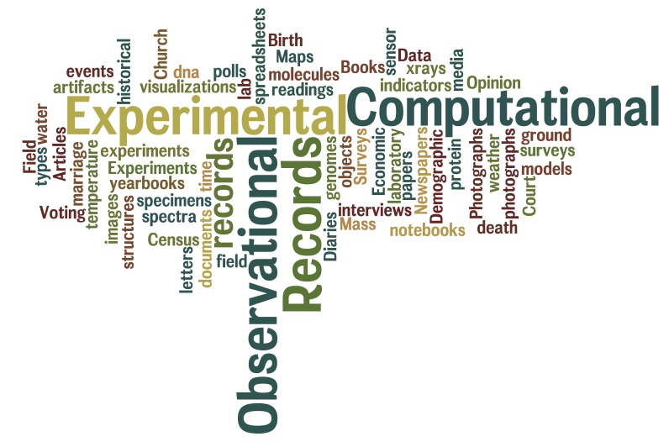
Data
Notes:
First is the question of what ARE data?! We’ll set that messy question aside also – acknowledging that data are many things to many people.
Further, what are data and what data may be shared, reused, or citable, is a separable question.
We won’t spend much time on these definitional issues either, except to note that data are in the eye of the beholder – as are data worth citing or making citable!

Slide 5
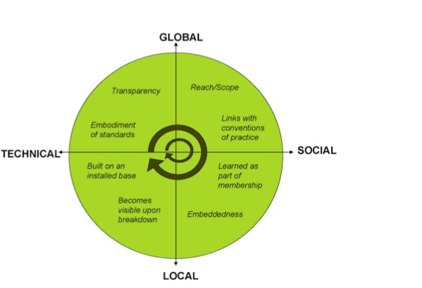
Infrastructure
Star, S. L. & Ruhleder, K. (1996). Steps toward an ecology of infrastructure: Design and access for large information spaces. Information Systems Research, 7(1): 111-134.
Figure: Bowker, G. C., Baker, K., Millerand, F., Ribes, D., Hunsinger, J., Klastrup, L. & Allen, M. (2010). Toward Information Infrastructure Studies: Ways of Knowing in a Networked Environment. In Hunsinger, J., Klastrup, L. & Allen, M. (Eds.). International Handbook of Internet Research. Dordrecht, Springer Netherlands: 97-117.
Notes:
Much of our concern with data citation and attribution is about building an infrastructure for data practices, policy, and curation.
Let’s look more specifically what is meant by infrastructure
The 8 dimensions of infra from the seminal paper by Star & Ruhleder are nicely captured along two dimensions by Florence Millerand –
At the technical end of the spectrum, infra is the embodiment of stds, and it builds upon an installed base
At the social end, infra is linked with conventions of practice – whether cataloging or data mgt, and learned as part of membership in a community, whether libns or literary scholars
At the local end, infra is very much embedded in activities and arrangements such as how libs are managed; it may not be visible until it breaks down – online catalog goes offline, the systems that cease to interoperate
At the global end, infra may have very broadr each, and be transparent – the inverse of visibility; (Japanese have learned how deeply interconnected and interdependent their power and transportation networks are, sadly)

Slide 6
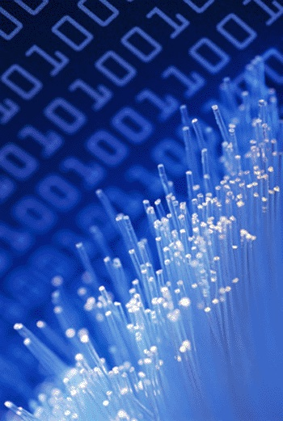
Infrastructure for digital objects
Social practice
Usability
Identity
Persistence
Discoverability
Provenance
Relationships
Intellectual property
Policy
http://datalib.ed.ac.uk/GRAPHICS/blue_data.gif
Notes:
An infrastructure for digital objects has many features – we’re concerned at this meeting with how they apply to data, attribution, and citation – but must remember that they are part of a larger internet architecture of digital objects
I will spend the rest of my time today on a brief overview of these relationships, as background to the issues we will address this week

Slide 7
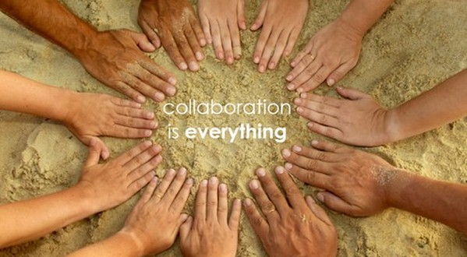
Social practice
Why cite data?
Reproduce research
Replicate findings
Reuse data
Why attribute data?
Social expectation
Legal responsibility
How to cite data?
Bibliographic reference
Identifier
Link
http://farm2.static.flickr.com/1207/707625876_46aa44851f_o.jpg
Notes:
Central concern and driver is why cite data in the first place?
Citation and attribution are not the same thing, as should become very clear in today’s presentations.
The means to cite also vary widely, and the technical infra is developing rapidly.

Slide 8

Usability of cited objects
Identify the form and content
Interpret
Evaluate
Open
Read
Compute upon
Reuse
Combine
Describe
Annotate…
Notes:
Usability – really reusability – how valuable is an object if you can’t open it? Need software? Locked up in PDF?
Related to discoverabilty
Usability is really messy notion –not much point in citing data that are not usable by others.
Usability could mean any or all of these things
It also has notions of TRUST, which are very hard to define or to document
A trust fabric is important for usability also.

Slide 9
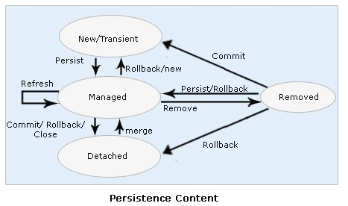
Identity and persistence of digital objects
Identity
Identifiers
DOI, Handles, URI, PURL…
Naming and namespaces
Authors/creators: ORCID, VIAF…
Generic/specific: registry number…
Description
Self-describing
Metadata augmentation
Persistence
Permanent
Long-lived
Scratch spaces
http://web-interview-questions.blogspot.com/2010_06_21_archive.html
Notes:
Let’s look more closely at each of these
Identity and persistence are characteristics of the containers of data rather than of the data per se – how we package, name, and label them all will influence the ability to identify them and to ensure (or not) whether they persist.
Identity – unique, and in what space should it be?
Generic or field specific?
Persistence – not all data should be available forever – what needs to be identified and why?

Slide 10
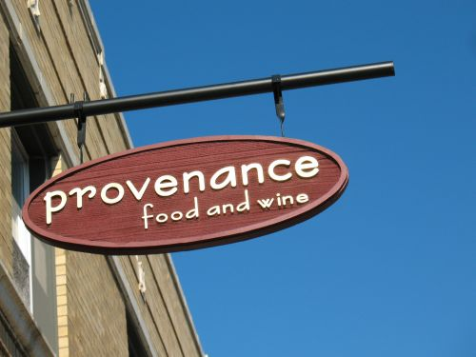
Finding and following digital objects
Discoverability
Identify existence
Locate
Retrieve
Provenance
Chain of custody
Transformations from original state
Relationships
Units identified
Links between units
Actions on relationships
http://chicagoist.com/2008/10/09/a_gourmet_oasis_provenance_food_and.php
Notes:
The ability to discover the existence of data is a critical requirement for a data-sharing infrastructure. We can define discovery as being the ability to determine the existence of a set of data objects with specified attributes or characteristics. The attributes of interest include aspects such as the producer of the data, the date of production, the method or production, a description of its contents, its representation. Discovery may also include aspects such as levels of quality, certification, or validation by third parties.
Discoverability depends both on the description and representation of data and on tools and services to search for data objects. Data rarely are self-describing . Description and representation usually take the form of metadata, some of which may be automated if data are generated by instruments such as sensor networks or telescopes. Much metadata creation requires human intervention, making it an expensive process that is often avoided by researchers. The lack of standards and practices for citing data, akin to citing publications, is a barrier to discoverability].
A variety of approaches to discovery are possible. Web search engines that walk the visible internet are one possibility assuming that data descriptions are reachable via standard web protocols. With the introduction of semantic web technologies and associated crawlers and search engines, location of data-sets of interest based on semantic content becomes possible. Alternatively, more discipline-specific and structured catalogs can be created.
Provenance, which will be discussed in the first panel, has different meanings in the archival and computer science community
Following objects requires that they be in some units, that we can make relations between those units, and often some actions thereby.

Slide 11
Intellectual property
What can I do with this object?
What rights are associated?
Reuse
Reproduce
Attribute
Who owns the rights?
How open are data?
Open data
Open bibliography
http://datalib.ed.ac.uk/GRAPHICS/blue_data.gif
Notes:
IP is a broad topic, even with regard to data.
Again, we’ll try to get our focus on the relationship between data IP and citation
These are some of the issues at that intersection.
IP
If we could release everything under CC0 licenses, the world would be a simpler place. That won’t happen
Need to know what rights are attached, what you can do with it.
Open data – in sense of no rights attached, in sense of reusable (structured vs pdf)
Open bib – citations per se are facts, and generally not copyrightable.
Movement toward open bib – let the descriptions, the metadta go free, then others can map the world of content and ideas. Separate from the payrwalls.

Slide 12
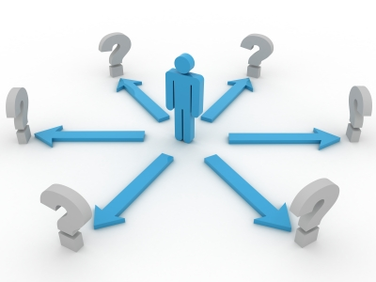
Policy for digital objects
Whose policy?
Funding agencies
Publishers
Data repositories
Universities
Investigators…
Types of policy
What to release
What description
What citation
What attribution
Who can describe, annotate…
http://www.dlorg.eu/index.php/publications/ec-policy/ec-publications-policy
Notes:
Data policy is another thorny thicket.
These are a few of the issues at the intersection of data policy and data citation that we hope to address at this meeting. Will be the tues morning session, but will arise throughout.

Slide 13
Driving questions for symposium
What are the major technical issues that need to be considered in developing and implementing scientific data citation standards and practices?
What are the major scientific issues that need to be considered in developing and implementing scientific data citation standards and practices? Which ones are universal for all types of research and which ones are field- or context- specific?
What are the major institutional, financial, legal, and socio-cultural issues that need to be considered in developing and implementing scientific data citation standards and practices? Which ones are universal for all types of research and which ones are field- or context-specific?
What is the status of data attribution and citation practices in individual fields in the natural and social (economic and political) sciences in United States and internationally? Case Studies.
Institutional Roles and Perspectives: What are the respective roles and approaches of the main actors in the research enterprise and what are the similarities and differences in disciplines and countries? The roles of research funders, universities, data centers, libraries, scientific societies, and publishers will be explored.
Notes:
These are very wordy – you have them in your agenda; won’t parse them further here! Highlighted key phrases in blue.
Origins: months of discussion within BRDI, CODATA, Task Group, and Steering committee to arrive at these.
The steering cmte, in consultation with the task group, assembled the distinguished group of speakers from around the world
Data management, use, reuse, and incentives to share and reuse are hot topics. We cannot address all of them in two days – we have tried to keep our attention narrowly focused on these questions – we are not ignoring the other ones; just taking this rare opportunity to identify answers to key questions that will help the community move forward on standards, practices, and policy.

Slide 14

Next steps
Symposium
5 panels, Monday morning to noon Tuesday
Workshop
Tuesday afternoon breakouts
Reports
BRDI/NAS meeting report
Data Citation Best Practices
Future meetings and activities
CODATA-ICSTI Task Group
Standardization work
http://cof-interspiritual-mindfulness.blogspot.com/2011/07/from-daily-om-most-fulfilling-road.html
Notes:
Where do we go from here? What do we expect the outcomes of the symposium to be?
Chris, the reports bullet is misleading. BRDI will issue an NAS report from this symposium/workshop in 2012, not the CODATA-ICSTI TG. The latter will only do the White Paper in 2012, based on input from the Berkeley meeting (and a survey/questionnaire that is being prepared as well).
This is OK, Chris. Just to be clear, under Reports, the Data Citation Best Practices white paper will be by the TG, not the BRDI/NAS.

