Slide 1
Developing Data Attribution and Citation Practices and Standards An Institutional Perspective
Deborah L. Crawford
Sr. Vice Provost for Research
Drexel University
International Symposium and Workshop

Slide 2
Responsible Conduct of Research
Leverage efficiencies and economies afforded by data sharing, attribution and citation
Stewardship of science/scientific data
Community-based practices
vis a vis
Independent investigator-focused practices
Explicit policies on data sharing, attribution and citation establish expectation
Notes:
Responsible Conduct of Research
Economies and efficiencies - explicit value added to scientific process (some data unique, expensive to collect or create, not thoroughly explored)
Meta-stewardship of science/scientific data
Community-based
Investigator-based

Slide 3
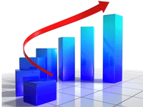
T & P Policies & Practices
Culture really matters
Investigators in communities accustomed to data sharing more readily value data attribution and citation in T&P decisions
Institutional policies define expectations
Deans and Department Heads set tone
Mid-career faculty play essential role

Slide 4
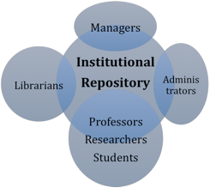
Institutional Repository
Active management of intellectual products
Manage intellectual property with appropriate controls
Explore new forms of scholarly communications
BUT researchers not routinely depositing content in IRs

Slide 5
Lack of University-Level Change Mandate (and/or Champion(s))
Faculty, Researchers and Students
Deans and Colleges and Schools
VPR and Research Office
Library
CIO and IT Organization

Slide 6
Its About
Reputation

