Slide 1

Authenticity, provenance, and trust
Developing Data Attribution and Citation Practices and Standards
Berkeley Aug. 22 – 23, 2011
Maintaining the scholarly value chain
Paul Groth
@pgroth
http://www.few.vu.nl/~pgroth

Slide 2
“
In content, as creation becomes overabundant and as value shifts from creator to curator, it becomes all the more vital to properly cite and link to sources [...]. Good curation demands good provenance. [...] Provenance is no longer merely the nicety of artists, academics, and wine makers. It is an ethic we expect.
– Jeff Jarvis
Notes:
Jeff Jarvis, media company consultant and associate professor at the City University of New York's Graduate School of Journalism, in The importance of provenance on his BuzzMachine blog, June, 2010

Slide 3
Separation of CONCERNS

Slide 4
Notes:
The citation serves a number of purposes. My goal is to convince you in that we can do better
From: A Truth Maintenance System John Doyle

Slide 5
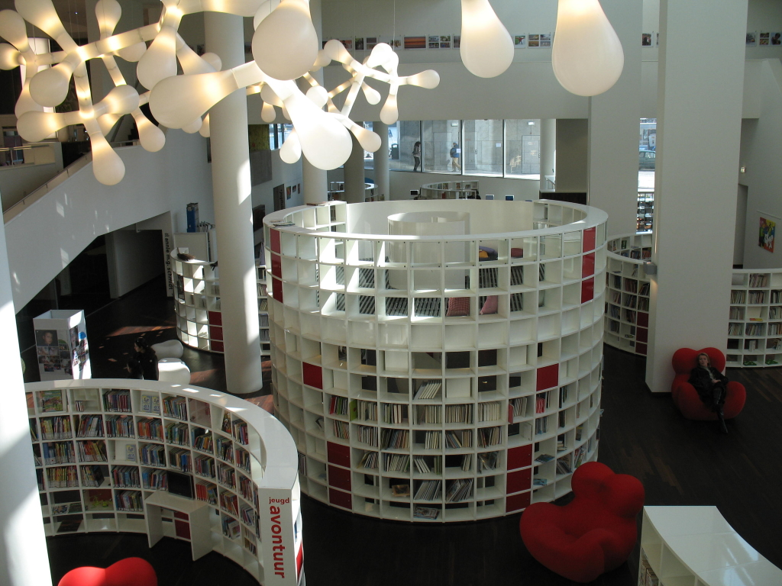
Notes:
It provides a way to find the document somewhere…

Slide 6
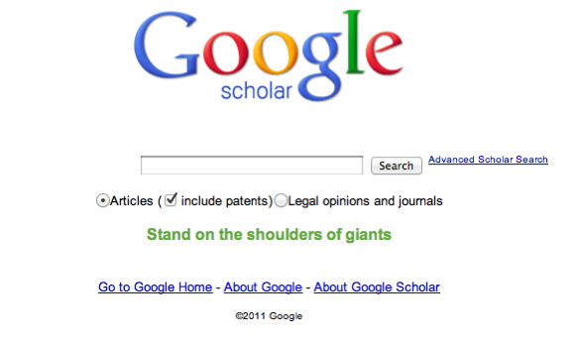
Notes:
It provides a way to find the document somewhere…

Slide 8
Basic provenance
Notes:
Citations provide basic provenance….

Slide 9
provenance + background knowledge = trust
I know Pat => it must be good
IJCAI is a famous conference => tough to get it => it must be good
Notes:
Citations provide basic provenance….

Slide 10
What’s wrapped up in this citation?
Lookup
Identity
Provenance
Trustworthiness

Slide 11
Search
Trust
Metrics
Provenance
Persistence Identity for Research Objects
Technical Capabilities
Technical Issues

Slide 12
Search
Trust
Metrics
- Not developed and deployed at scale with research data
- Different for different Actors
Provenance
Scale
How much is computer understandable?
Persistence Identity for Research Objects
- Computer understandable
- Persistence
- Lookup vs. identity
Technical Capabilities
Technical Issues
Notes:
Lookup and identity are mixed in citations
What are you actually identifying?
What are we actually referring to?
See FRBR and W3C Provenance Model

Slide 13
Appeal
The citation does not have to contain everything.
Simple machine understandable pointers maybe all we need
Notes:
We CAN RebUILD IT, WE HAVE The Technology

Slide 14
Related Work
W3C Provenance Incubator Final Report
  http://www.w3.org/2005/Incubator/prov/XGR-prov-20101214/
  Slides: http://www.w3.org/2005/Incubator/prov/wiki/File:Provenance-XG-Overview.pdf
W3C Provenance Working Group Standardization Activity
  http://www.w3.org/2011/prov/wiki/Main_Page
Surveys
  Donovan Artz and Yolanda Gil. A Survey of Trust in Computer Science and the Semantic Web, Journal of Web Semantics, Volume 5, Issue 2, 2007.
  Rajendra Bose and James Frew. Lineage Retrieval for Scientific Data Processing: A Survey. ACM Computing Surveys, Volume 37, Issue 1, 2005).
  J. Cheney, L. Chiticariu and W.-C. Tan. Provenance in databases: Why, where and how, Foundations and Trends in Databases, 1(4):379-474, 2009.
  Juliana Freire, David Koop, Emanuele Santos, Claudio Silva. Provenance for Computational Tasks: A Survey, Computing Science and Engineering, Vol 10, No 3, pp 11-21, 2008.
  Luc Moreau, The Foundations for Provenance on the Web, 2010, Foundations and Trends® in Web Science: Vol. 2: No 2-3, pp 99-241. http://dx.doi.org/10.1561/1800000010
  Yogesh L. Simmhan, Beth Plale, Dennis Gannon. A survey of data provenance in e-science. ACM SIGMOD Vol 34 , No 3, 2005. See also a longer version.
Replacing the Paper: The Twelve Rs of the e-Research Record (David DeRoure)
  http://blogs.nature.com/eresearch/2010/11/27/replacing-the-paper-the-twelve-rs-of-the-e-research-record

