Slide 1
Formal publication of data: an idea whose time has come? Persistent data archives, data publication, authorship and scientific recognition
J.B. Minster
on behalf of …

Slide 2
Mark Parsons, Ruth Duerr
Michael Diepenbroek, Michael Zgurovsky
Kari Raivio, Brian McMahon
AGU Data Policy Panel
World Data System Scientific Committee
ICSU Strategic Coordinating Committee on information and Data
CODATA and GEOSS working groups
…. and now …
Tom Hanks, Bob Webb, Karen Underhill, Diane Boyer

Slide 3
An issue for the scientific community!
“The Importance of Long-term Preservation and Accessibility of Geophysical Data” AGU, May 2009
The cost of collecting, processing, validating, and submitting data to a recognized archive should be an integral part of research and operational programs. Such archives should be adequately supported with long-term funding. Organizations and individuals charged with coping with the explosive growth of Earth and space digital data sets should develop and offer tools to permit fast discovery and efficient extraction of online data, manually and automatically, thereby increasing their user base. The scientific community should recognize the professional value of such activities by endorsing the concept of publication of data, to be credited and cited like the products of any other scientific activity, and encouraging peer-review of such publications.

Slide 4
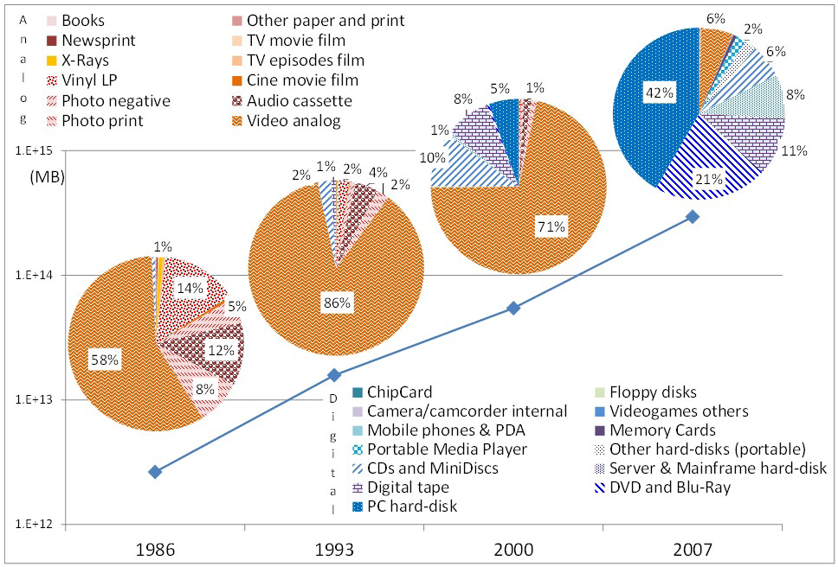
Information storage: Hilbert and Lopez 2011

Slide 5
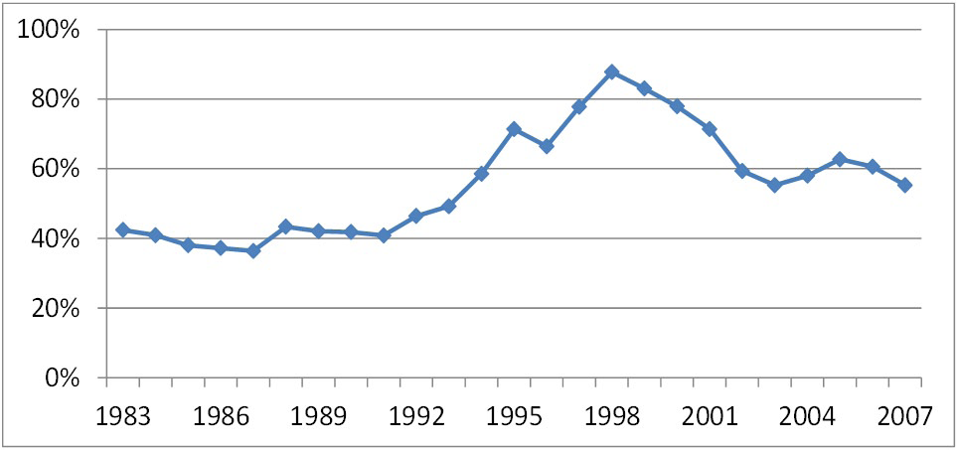
Per capita annual growth rate in world technological capacity
to compute information: Hilbert and Lopez 2011

Slide 6

Boom’
‘INFORMATION
Information Size > Storage Available
ZB
Source: IDC Digital Universe Study 2010
Link: http://www.emc.com/collateral/demos/microsites/idc-digital-universe/iview.htm
35 ZB
2020
Gap=20 ZB
15 ZB
Zeta Byte = 10²¹ bytes
0,9 ZB
0,25 ZB
Notes:
I would like to draw your attention just to one of these challenge, connected with information boom. The increasing gap between the volume of information created by mankind (annually doubling) and possibilities to its storage, processing and use – means there has been an «information boom». By 2020, the amount of digital information created and replicated in the world will grow to 35 ZB. At the same time mankind can operate, accumulate, process and use only 15 ZB information.

Slide 7
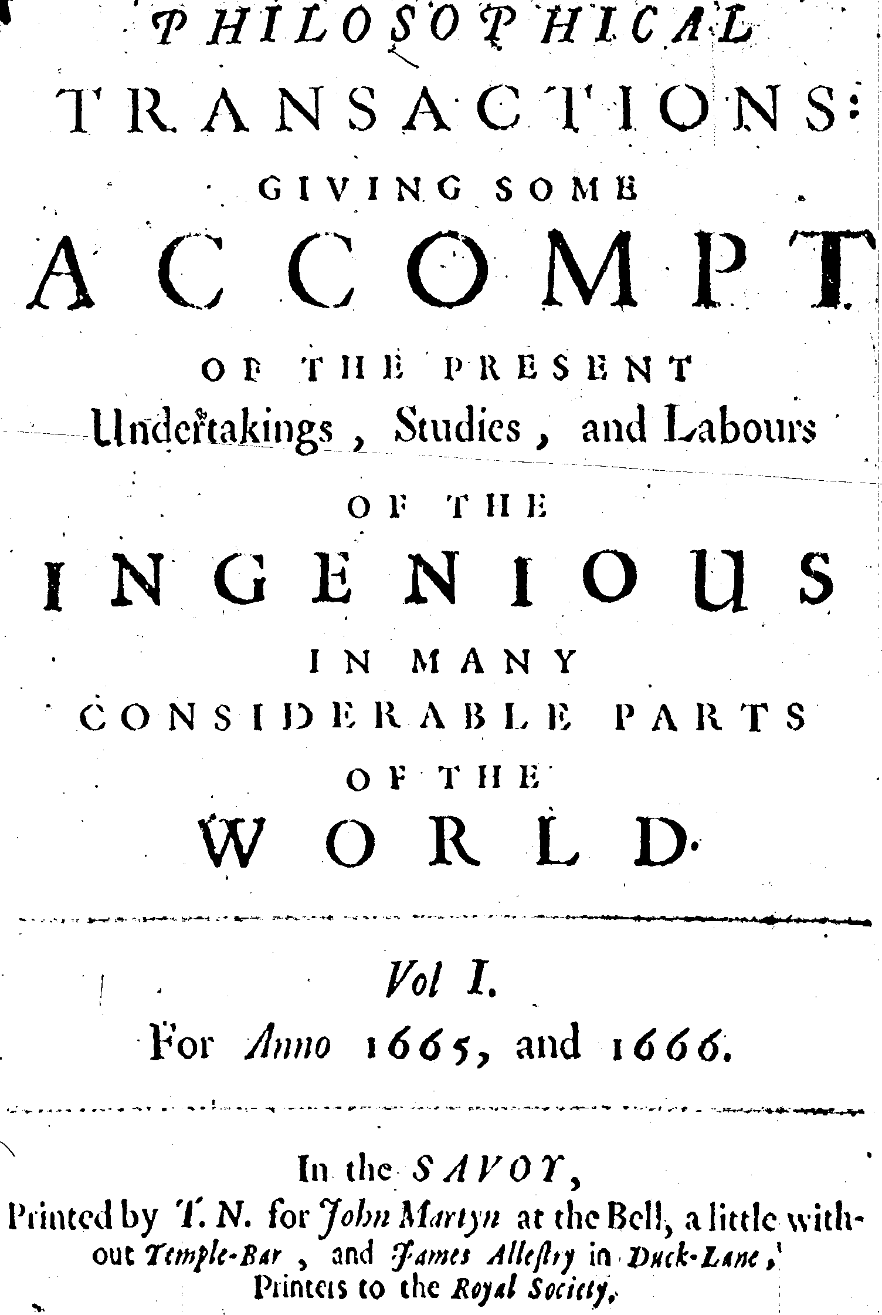


Data Citation
Mark Parsons, Ruth Duerr and the Federation of Earth Science Information Partners (ESIP)

Slide 8
“Data Publication” is a very current concept
…townhall meeting at 2009 AGU fall meeting.
Best practices and critical research needs are beginning to emerge.
CODATA special session (October 2010)
New CODATA tasks groups
Features in major journals (Nature, Science, etc.)
World Data System Science Symposium, Kyoto, 2011

Slide 9

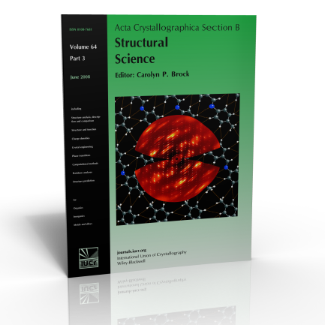


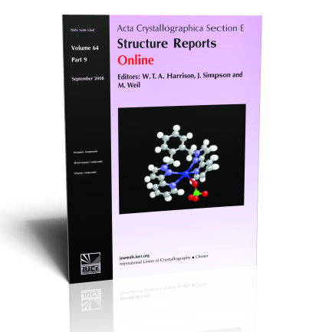

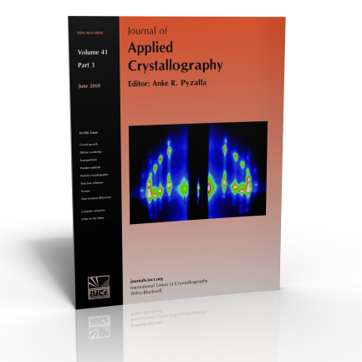

International Union of Crystallography
International Scientific Union
Publishes 8 research journals:
Acta Crystallographica Section A: Foundations of Crystallography
Acta Crystallographica Section B: Structural Science
Acta Crystallographica Section C: Crystal Structure Communications
Acta Crystallographica Section D: Biological Crystallography
Acta Crystallographica Section E: Structure Reports Online
Acta Crystallographica Section F:Structural Biology and Crystallization Communications
Journal of Applied Crystallography
Journal of Synchrotron Radiation
Publishes major reference work International Tables for Crystallography (8 volumes)
Promotes standard crystallographic data file format (CIF)
Brian McMahon, CODATA 2010
Notes:
Summary of IUCr journal publishing activities
The journals of the International Union of Crystallography are produced by the IUCr in Chester and published by Wiley-Blackwell. The print editions of the journals are distributed by Blackwell Publishing in Oxford, while electronic editions of all IUCr journals are available via Crystallography Journals Online (http://journals.iucr.org).
The IUCr has published journals since 1948. Eight titles are currently published:
Acta Crystallographica Section A: Foundations of Crystallography Acta Crystallographica Section B: Structural Science Acta Crystallographica Section C: Crystal Structure Communications Acta Crystallographica Section D: Biological Crystallography Acta Crystallographica Section E: Structure Reports Online
Acta Crystallographica Section F: Structural Biology and Crystallization Communications Online
Journal of Applied Crystallography Journal of Synchrotron Radiation
Acta Crystallographica Sections C and E (outlined in red) consist almost entirely of structure reports – data-rich publications that are submitted in CIF format (the text of the article is embedded as data fields within the CIF). Section F contains many similar reports of biological macromolecular structures, and is pioneering authoring tools based on the CIF format.

Slide 10
Technologies are available!
Archival Resource Key (ARK)
Digital Object Identifiers (DOI)
Extensible Resource Identifier (XRI)
HANDLE
Life Science ID (LSID)
Object Identifiers (OID)
Persistent Uniform Resource Locators (PURL)
URI/URN/URL
Universally Unique Identifier (UUID)

Slide 11
An Example Citation
Cline, D., R. Armstrong, R. Davis, K. Elder, and G. Liston. 2002, Updated July 2004. CLPX-Ground: ISA snow pit measurements. Edited by M. Parsons and M. J. Brodzik. Boulder, CO: National Snow and Ice Data Center. Data set accessed 2008-05-14 at http://nsidc.org/data/nsidc-0176.html.

Slide 12
An Example Citation
Cline, D., R. Armstrong, R. Davis, K. Elder, and G. Liston. 2002, Updated July 2004. CLPX-Ground: ISA snow pit measurements. Edited by M. Parsons and M. J. Brodzik. Boulder, CO: National Snow and Ice Data Center. Data set accessed 2008-05-14 at http://nsidc.org/data/nsidc-0176.html.

Slide 13
An Example Citation
Cline, D., R. Armstrong, R. Davis, K. Elder, and G. Liston. 2002, Updated July 2004. CLPX-Ground: ISA snow pit measurements. Edited by M. Parsons and M. J. Brodzik. Boulder, CO: National Snow and Ice Data Center. Data set accessed 2008-05-14 at http://nsidc.org/data/nsidc-0176.html.

Slide 14
An Example Citation
Cline, D., R. Armstrong, R. Davis, K. Elder, and G. Liston. 2002, Updated July 2004. CLPX-Ground: ISA snow pit measurements. Edited by M. Parsons and M. J. Brodzik. Boulder, CO: National Snow and Ice Data Center. Data set accessed 2008-05-14 at http://nsidc.org/data/nsidc-0176.html.

Slide 15
An Example Citation
Cline, D., R. Armstrong, R. Davis, K. Elder, and G. Liston. 2002, Updated July 2004. CLPX-Ground: ISA snow pit measurements. Edited by M. Parsons and M. J. Brodzik. Boulder, CO: National Snow and Ice Data Center. Data set accessed 2008-05-14 at http://nsidc.org/data/nsidc-0176.html.

Slide 16
An Example Citation
Cline, D., R. Armstrong, R. Davis, K. Elder, and G. Liston. 2002, Updated July 2004. CLPX-Ground: ISA snow pit measurements. Edited by M. Parsons and M. J. Brodzik. Boulder, CO: National Snow and Ice Data Center. Data set accessed 2008-05-14 at http://nsidc.org/data/nsidc-0176.html.

Slide 17
An Example Citation
Cline, D., R. Armstrong, R. Davis, K. Elder, and G. Liston. 2002, Updated July 2004. CLPX-Ground: ISA snow pit measurements. Edited by M. Parsons and M. J. Brodzik. Boulder, CO: National Snow and Ice Data Center. Data set accessed 2008-05-14 at http://nsidc.org/data/nsidc-0176.html.

Slide 18
Yet! …. What’s wrong?
MODIS-derived Snow Cover Data by NSIDC Citations (Google Scholar)

Slide 19
Purpose of Data Citation
Credit and accountability for data authors
Aids reproducibility of science, i.e. direct, unambiguous connection to the precise data used.

Slide 20
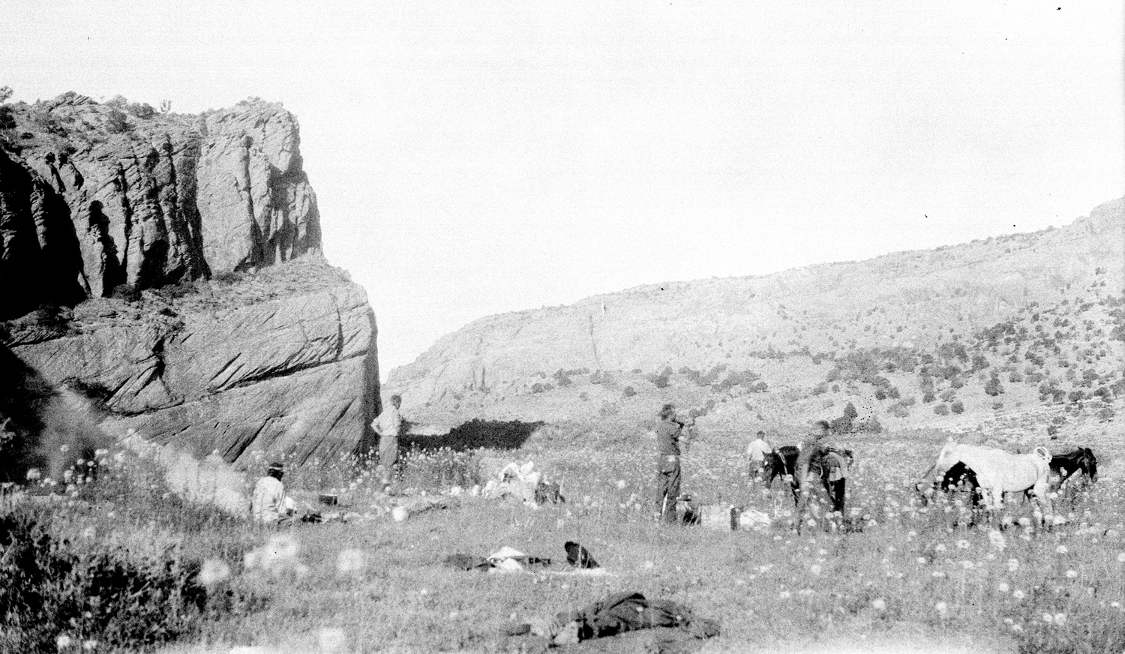
James J. Hanks Collection, Special Collections and Archives, Cline Library, Northern Arizona University, NAU.PH.2005.3.1.2.3c. Metadata at http://archive.library.nau.edu/ item 45552
Tsegi Canyon, 1927

Slide 22
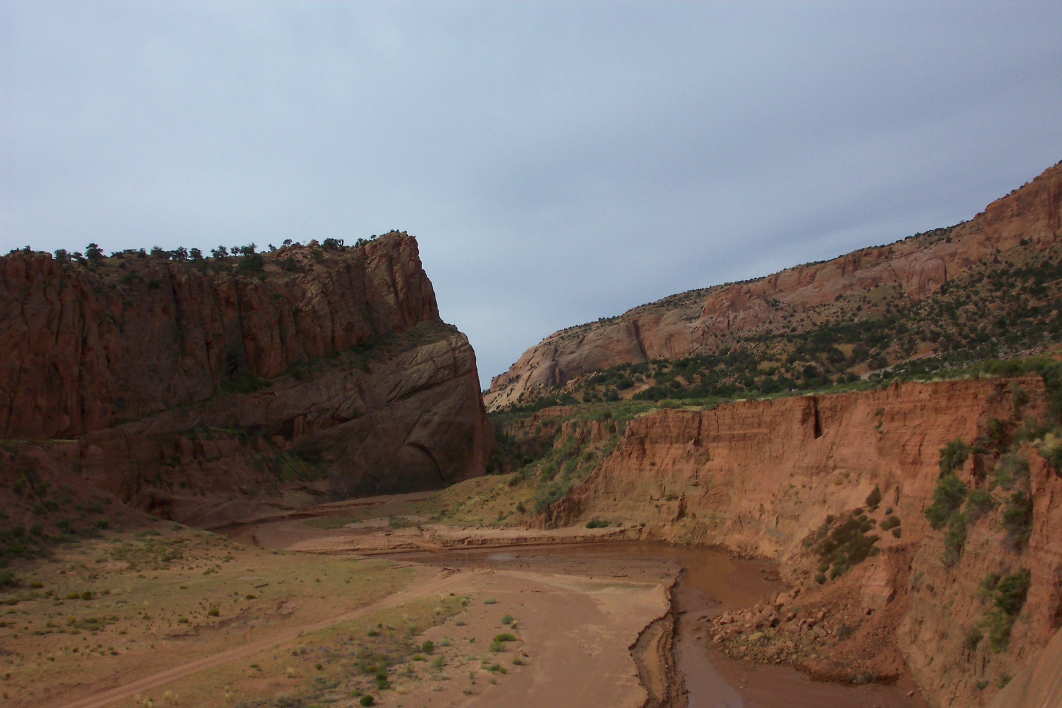
Bob Webb
Tsegi Canyon, 2005

Slide 25
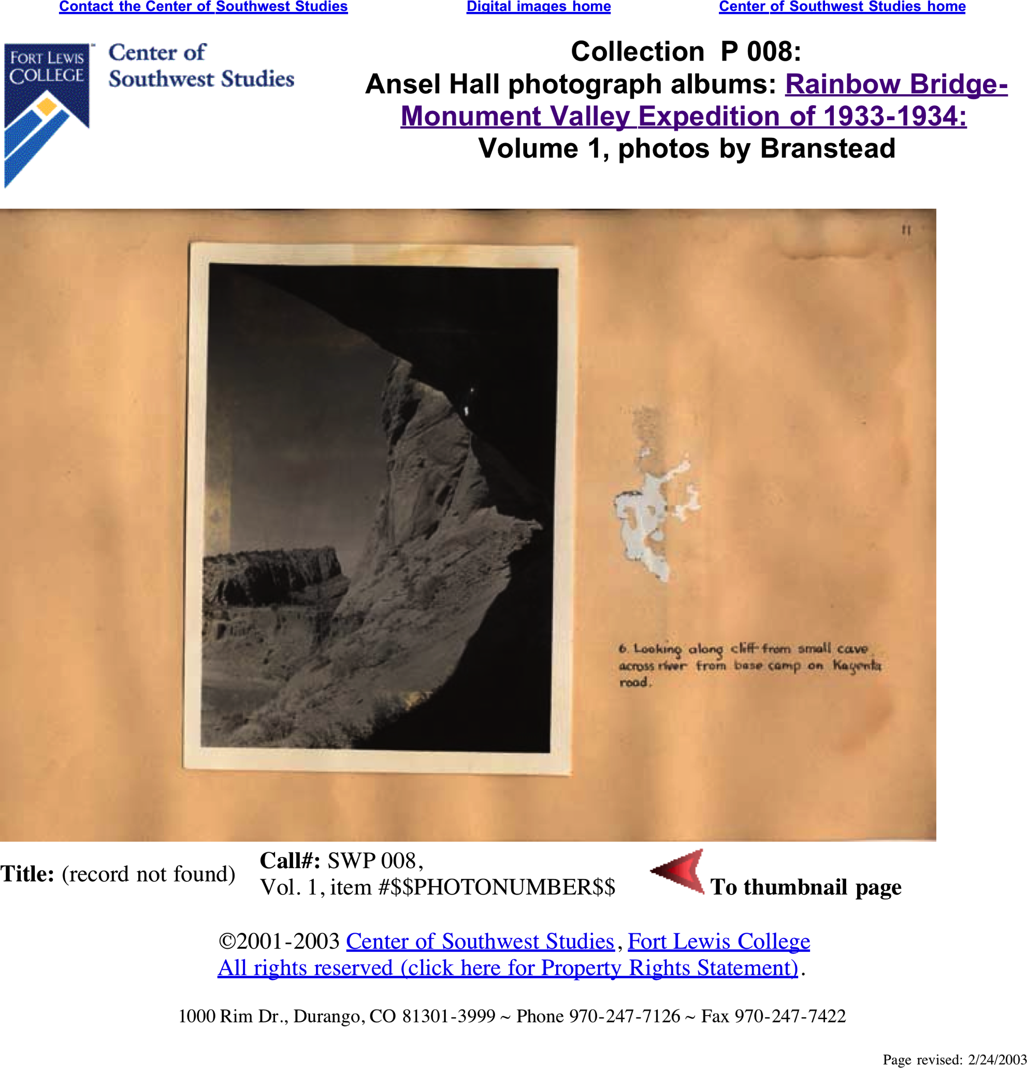

Slide 26
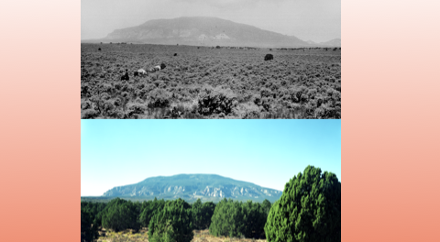

Slide 27
The needs
Data collection coupled with quality control
Quality assurance (a function of the data)
Peer review -> authoritative source, assessed data
Ease of publication
Easily understood standards (especially metadata)
Simple steps to place data in the public domain (e.g. PIC)
Secure repository and long term data curation
Preferred use of this reliable source by data users

Slide 28
The needs
Preservation of long-term time series
Repositories that adapt to evolving technology
Collaboration with Libraries and publishing communities
EASE OF CITATION
Credit given to data authors and proper recognition and citation by users
Professional recognition (besides credit)
perhaps a change in academic mind-set

Slide 29
ICSU-SCID vision
The International Council for Science envisions a
Global World Data System, in order to:
emphasize the critical importance of data in global science activities
further ICSU strategic scientific outcomes by addressing pressing societal needs (e.g. sustainable development, digital divide)
highlight the very positive impact of universal and equitable access to data and information
support services for D&I long-term stewardship
promote and support data publication and citation

Slide 30
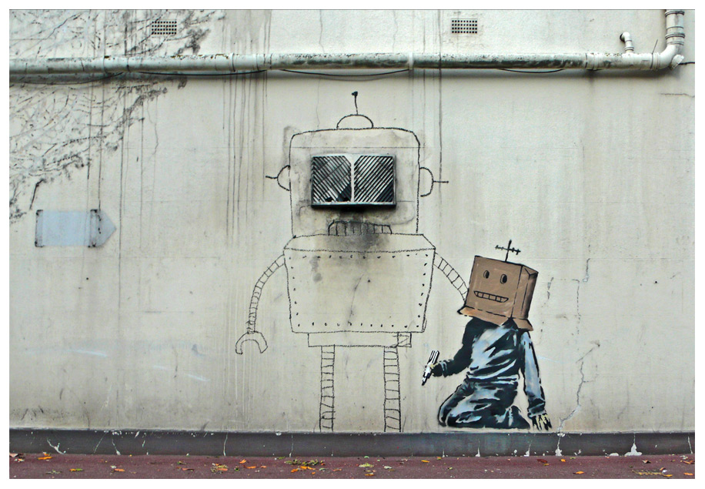
Thank you !
Notes:
DOI registry at TIB -> European Consortium, interest from Library of Congress, National Canadian Library, Thompson Reuter -> longer term -> crossref for scientific data
Peer review for scientific data -> example workflow from SCOR working group

Slide 31
