Slide 1

OPERATING A BSL-3 FACILITY IN KOREA The IVI Experience
International workshop on Anticipating Biosecurity Challenges
of the Global Expansion of High Containment Biological Laboratories
Istanbul, Turkey
July 11, 2011
Lee, Soh jin
General Manager of absl-3/bsl-3
International Vaccine Institute

Slide 2
CONTENTS
The International Vaccine Institute(IVI)
BSL-3 facilities in Korea
The IVI BSL-3 facility
IVI BSL-3 Management systems and practices
BioSafety culture: Training in BSL-3 practices
Maintenance issues
Systems upgrade and improvements
Conclusions & Prospects

Slide 3
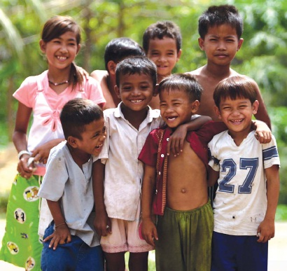
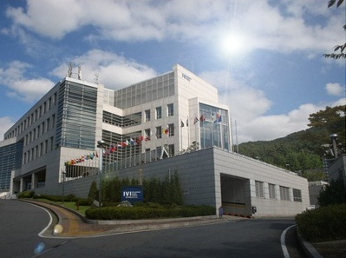
Introduction of International Vaccine Institute(IVI)
“To promote the health of people in developing countries by the development, introduction and use of new and improved vaccines”
- From: Constitution of IVI (1996)
IVI is a non-profit international organization, headquartered in Seoul, South Korea, and created under the auspices of the United Nations Development Program.

Slide 4


BioSafety & BSL-3 facilities in Korea
Since 2005: Korean government enforces national pathogen control & BioSafety
Acts on the Prevention of Infectious Diseases,
for “Highly dangerous pathogens”
Amended in 2005 to create a controlling system.
Amended in 2010 to update & amend the list of risk pathogens
Act on the Prohibition of Biological or Chemical Weapons and the Control of the Production, Export and Import of Special Biologicals or Chemical agents in 2006
for “Selective agents” (Biologicals & Toxins)
Act on Transnational Transportation of Living Modified Organisms, enacted in 2008
BSL-3/4 facility certification requires inspection every half year & reaccreditation every 3 years by KCDC
At present, 20 certified BSL-3 facilities in Korea

Slide 5
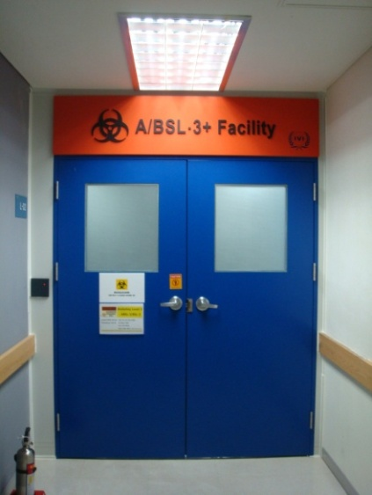
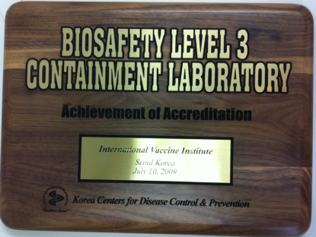
Introduction of BSL-3 facility of IVI
History of “BSL-3+ Project”
: Initiated in 2005, 3 yrs before the issuance of Korean regulations (LMO Act)
: A call for tender in 2006
: Construction began in 2007
: Validation with international standards in 2008
: Certified by Korea Center of Disease Control & Prevention in 2009
: Certified & passed the KCDC inspections in 2010
: Opened ABSL-3/BSL-3 labs in 2010
: Annual revalidation in 2011
PACEMAKER OF BIOSAFETY in Korea
Area : 349.9m²
Consists of ABSL-3 and BSL-3 areas

Slide 6
BSL-3 Management system
Internal regulations
: BSL-3 Manual & 19 SOPs
Internal approval system
: Institutional BioSafety Committee approval required
For adopting new infectious substance, animal and new or
change experimental protocols into ABSL-3/BSL-3
: General Manager of ABSL-3/BSL-3 approval required
For authorization of ABSL-3 / BSL-3 user’s accessibility
Risk assessment

Slide 7
Institutional BSL-3 regulations : BSL-3 Manual & SOP
BIOSAFETY LEVEL 3 MANUAL (English)
: Document no. L-BS-1-BL3-01
: provides the general knowledge on BioSafety, recommended work practices, safety equipment, operation & maintenance of BSL-3 and administrative considerations to minimize the risk of staff injury or illness.
ABSL-3/BSL-3 Standard Operation Procedures (SOPs)
: 19 SOPs written in bilingual, English & Korean
: Document no. L-BS-4-BL3-01 ~19

Slide 8
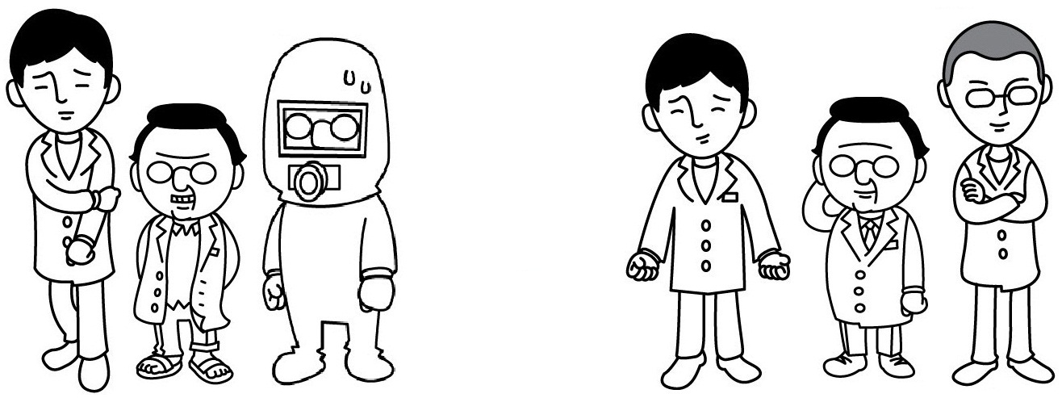
Purpose of BioSafety Level 3 Training
BIOSAFETY TRAINING
Gives researchers CONFIDENCE to work in a safe environment

Slide 9

BioSafety culture: Trainings
Trainees
: scientists, research assistants, maintenance engineers, institutional safety committee (ISC) members, etc.
“HAPPY & SAFE LAB LIFE”

Slide 10
BioSafety culture : STANDARD Trainings
For BSL-3 users
BioSafety lecture including General BioSecurity
BSL-3 training (Theoretical /Practical)
Cleaning & Decontamination (Theoretical / Practical)
ABSL-3 training including animal training
Equipment training (ex. Autoclave)
Training on Emergency
: e.g. biological spills, clean-up & fire evacuation (Practical drills)

Slide 11
BioSafety culture: Trainings
For Maintenance
BioSafety lecture (Summary)
BSL-3 training for engineers
Cleaning & Decontamination procedures
Emergency procedures: e.g. fire evacuation

Slide 12
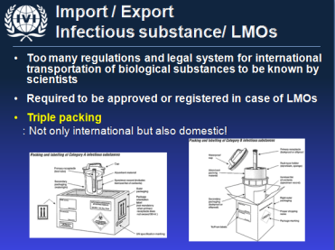
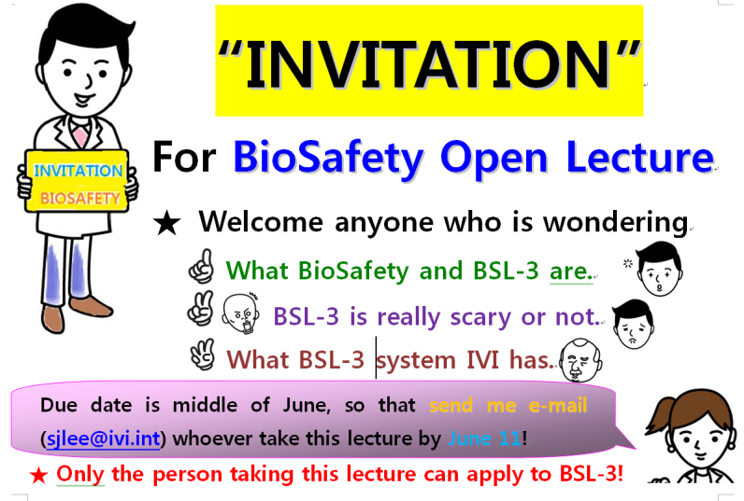
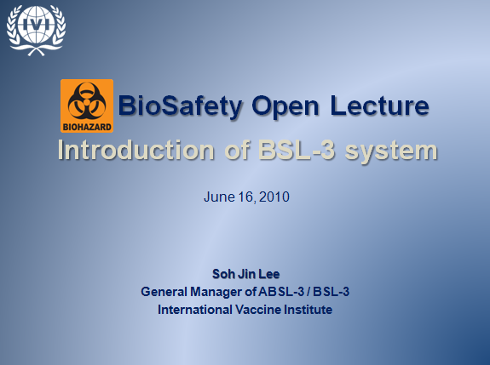
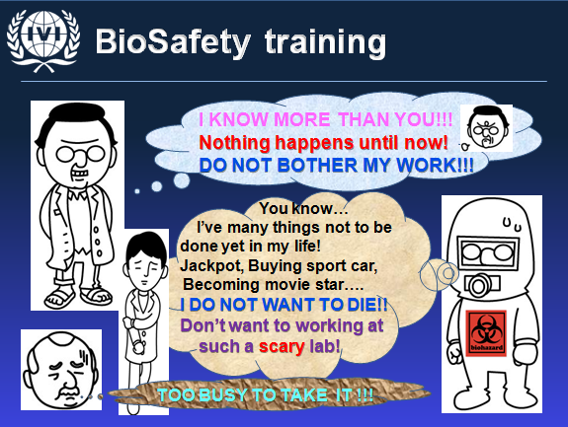
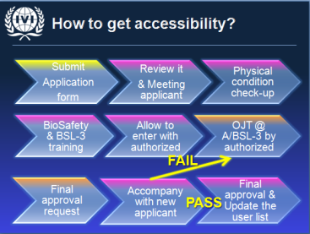
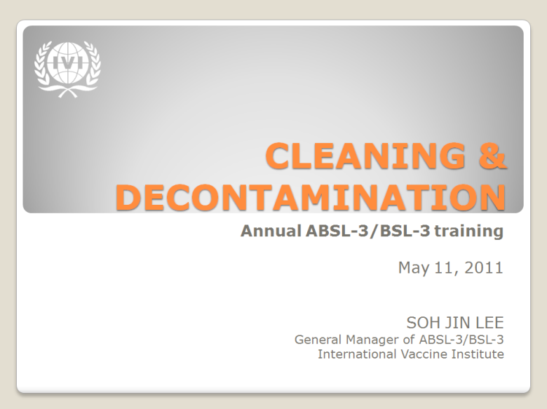
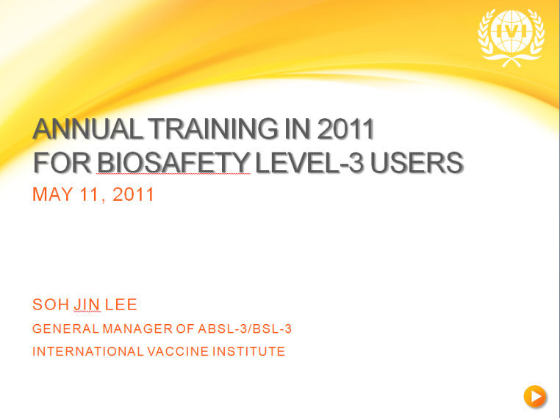
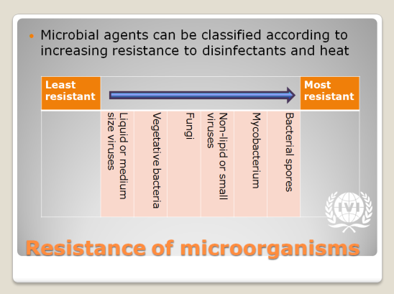
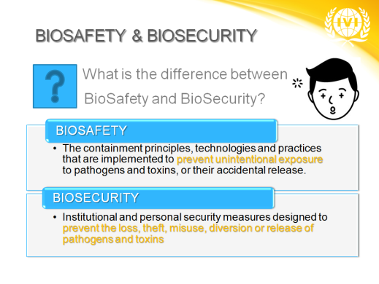
Example of BSL-3 trainings

Slide 13
Facility & Equipment maintenance
Facility & Equipment
IQ/ OQ/ PQ
Periodic check-up & maintenance service
Daily / Weekly / Monthly / Annual
Annual revalidation with general decontamination
Shut down the facility = Close experiment
At least 6 month notice to users
Chemical decontamination
Revalidation of Facility & Equipment
Renewal of BSL-3 training

Slide 14
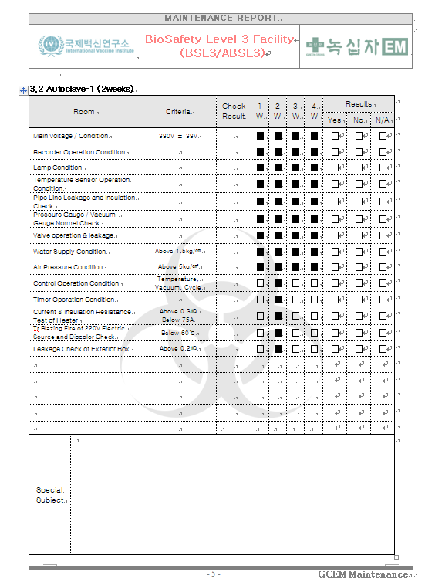
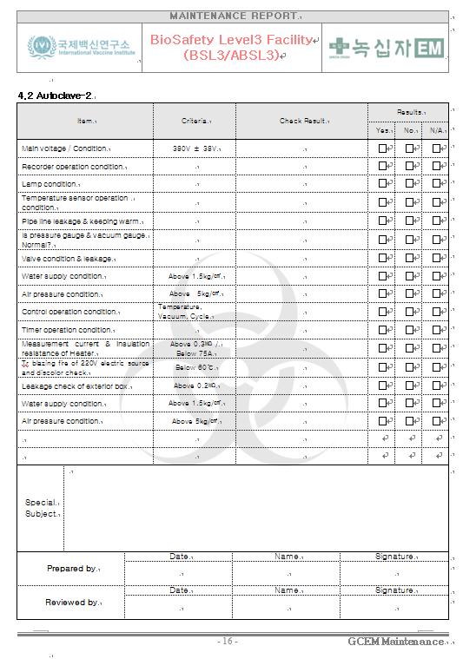
ExampleS of Facility Maintenance REPORT
Weekly report Monthly report

Slide 15
System upgrade by running BSL-3 facility
Enforce liquid waste treatment system
Basic thermal treatment system + Chemical back-up
Emergency SMS system
Basic CCTV & Automatic central monitoring system
+ Paging system (sending mobile message in emergency)
Preparing User Protection Program
Revising SOPs
Upgrade training
Follow up new national regulations and international guidelines

Slide 16
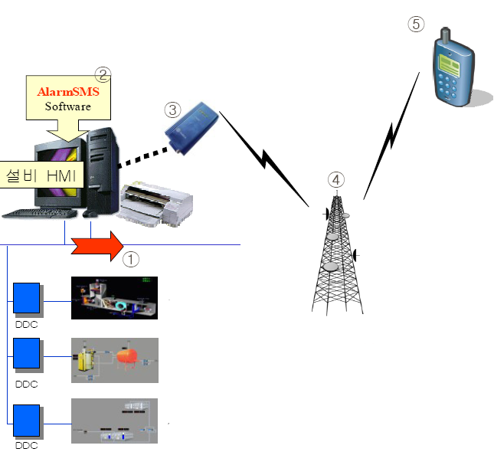
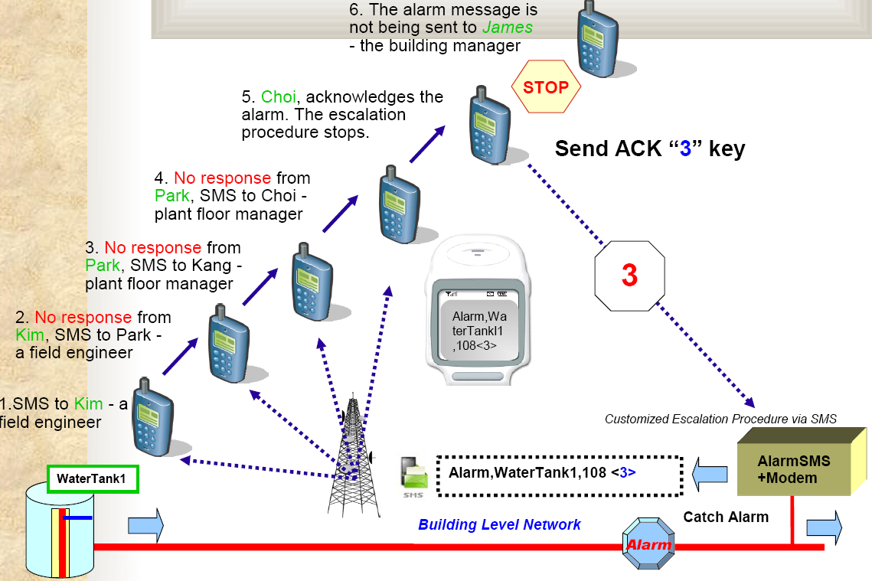
Alarm SMS (short message Service) system for emergency
Escalation function

Slide 17
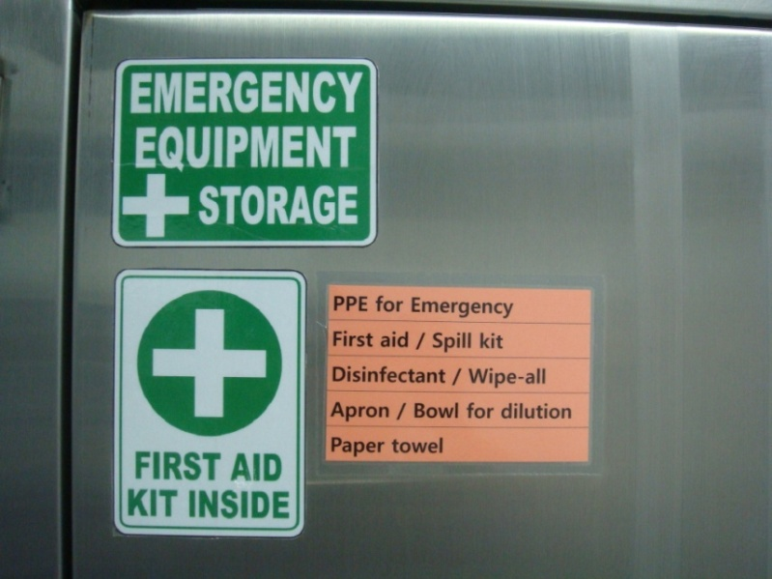
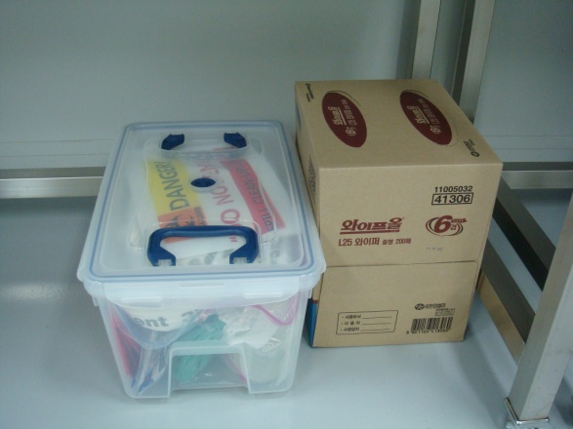
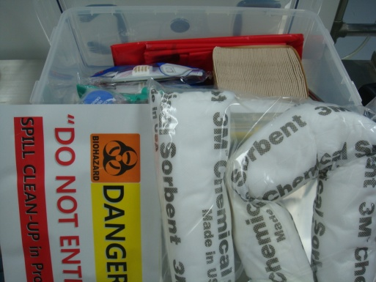
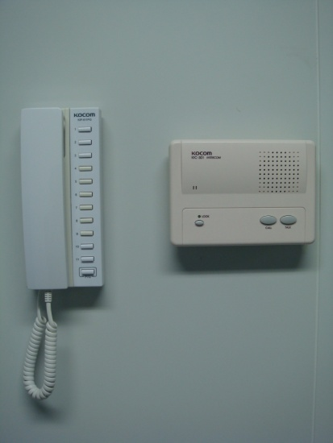
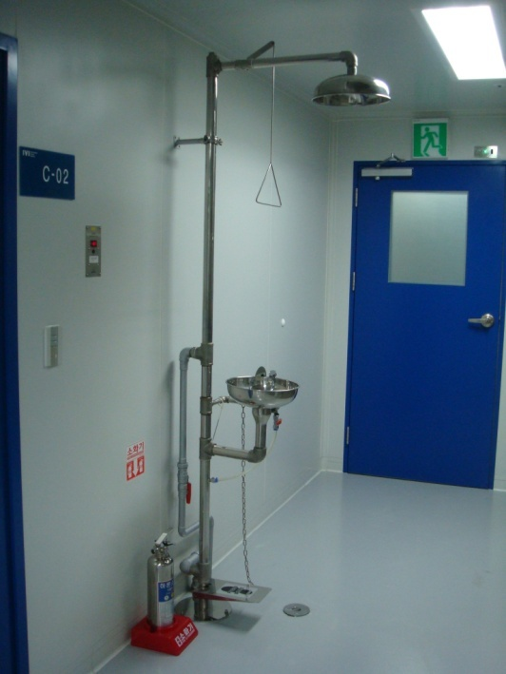
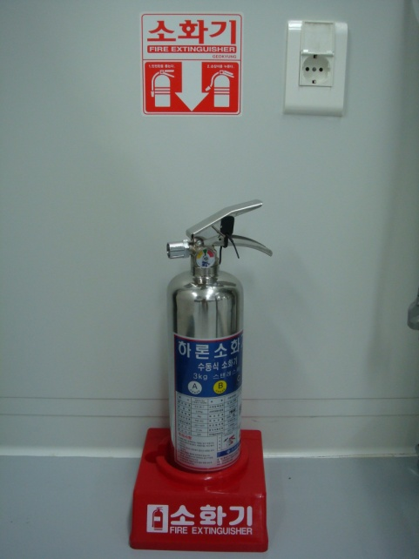
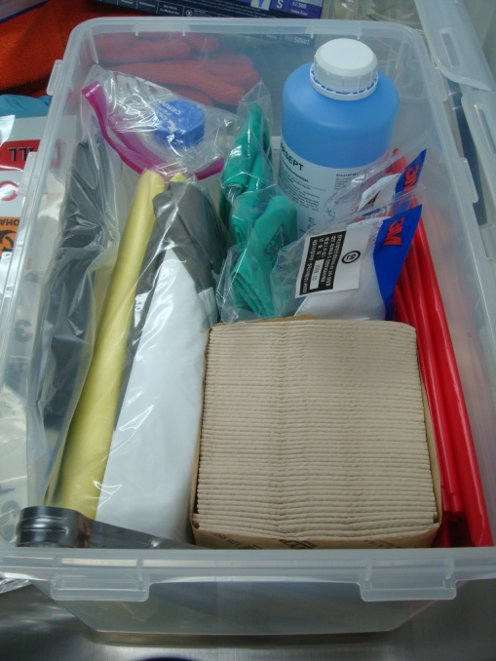
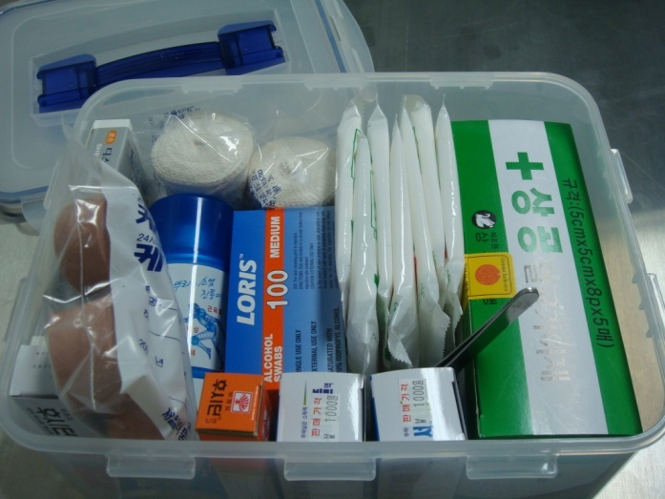
User protection system against Emergency

Slide 18
Conclusion
Assess the potential risk and correct defects by operating the facility for a year.
Nurture a BioSafety culture by regular trainings and sustained communication between BSL-3 staff and end-users.
Enforce emergency systems and procedures.
Ensure regular maintenance
PROSPECTS
REGULATORY REACCREDITATION of BSL-3 facility: 2012

Slide 19
THANK YOU for your attention

