Slide 1
Biocontainment for clinical and research activities
Sunee Sirivichayakul, Ph.D.
Faculty of Medicine, Chulalongkorn University,
Bangkok, Thailand

Slide 2


Background
Chula MRC
Chula Medical Research Centre
Faculty of Medicine, Chulalongkorn University
(Medical school, working on both research and service)
King Chulalongkorn Memorial Hospital,
The Thai Red Cross Society
Other BSL-3 facilities in Thailand : Mahidol University, Thai NIH, MOPH

Slide 3

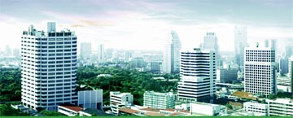
Faculty of Medicine
Chulalongkorn University &
King Chulalongkorn Memorial Hospital
Thai Red Cross Society
King Rama 8
King Rama 9
Queen

Slide 4
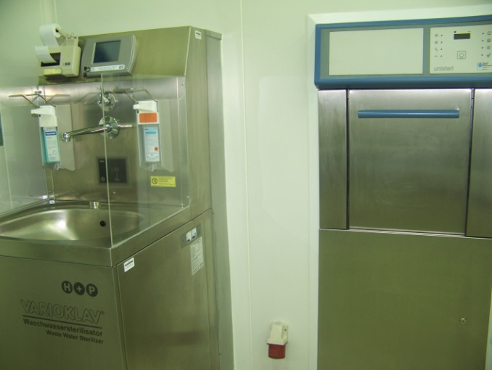
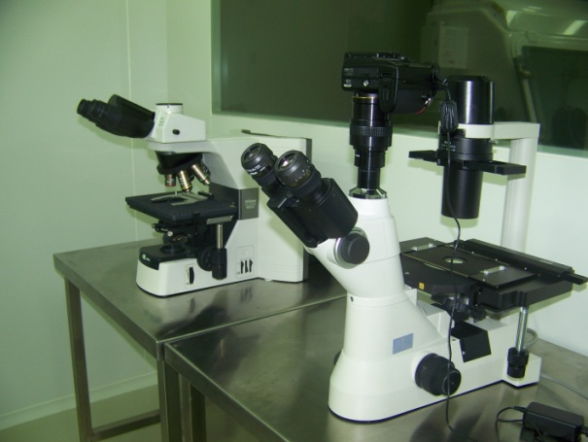
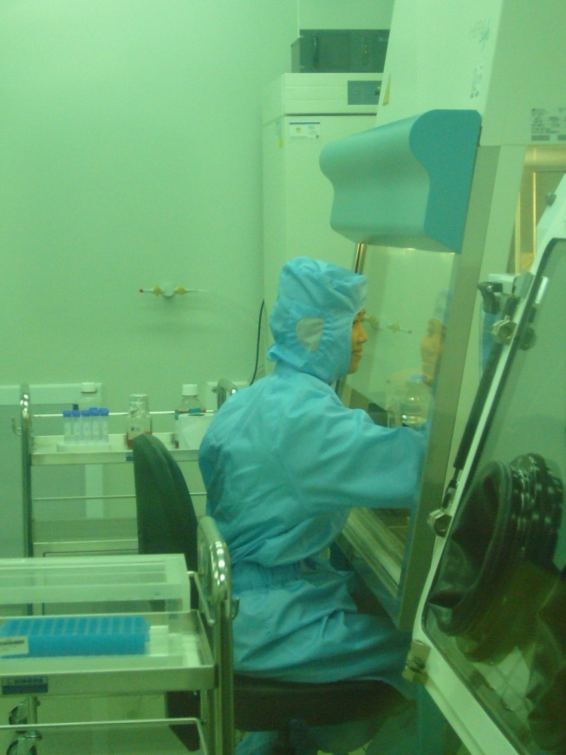
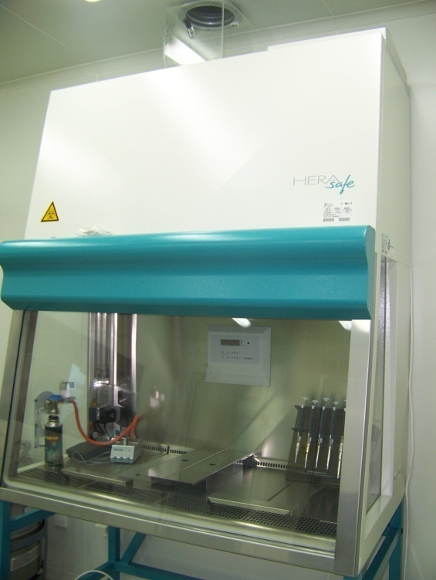
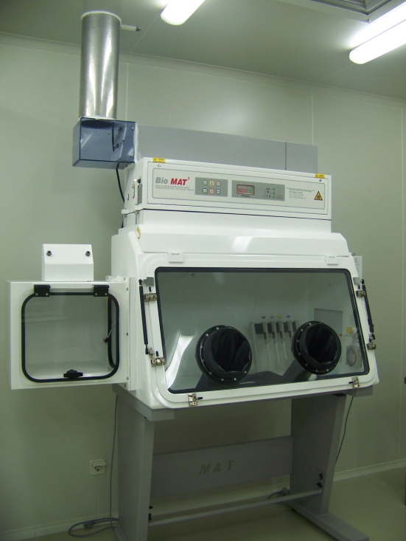
Biosafety Level 3 Laboratory at Chula

Slide 5
Objective
To provide safety environment for working with biological agents that
- Pose a risk to national security because they can be easily disseminated or transmitted from person to person
- Result in high mortality rates and have the potential for major public health impact
- Might cause public panic and social disruption; and
- Require special action for public health preparedness
Examples are SARS (Severe Acute Respiratory Syndrome), bird flu or Avian influenza, swine flu (H1N1)

Slide 6
BSL-3 at Chula
Biosafety Level 3 Laboratory, operated since 2008, after the bird flu epidemic in Thailand
Offers regular training for those who would like to use the facility (to provide knowledge, safety information and guidelines for working properly in BSL-3)

Slide 7
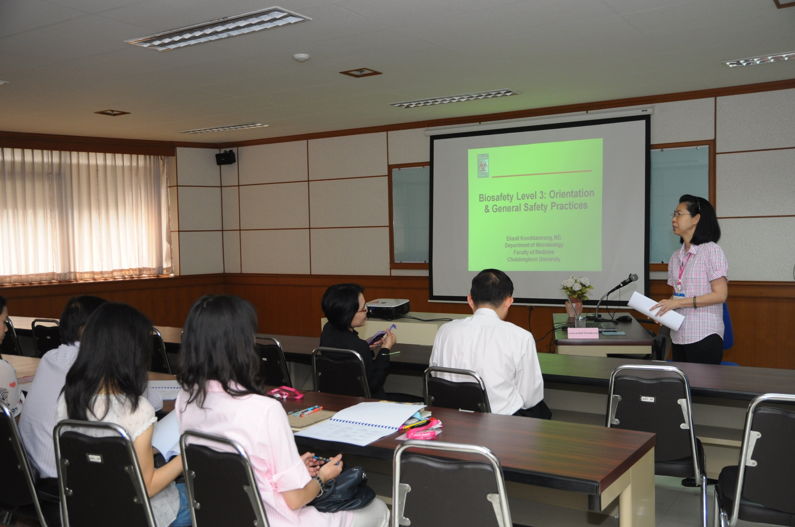

Slide 8
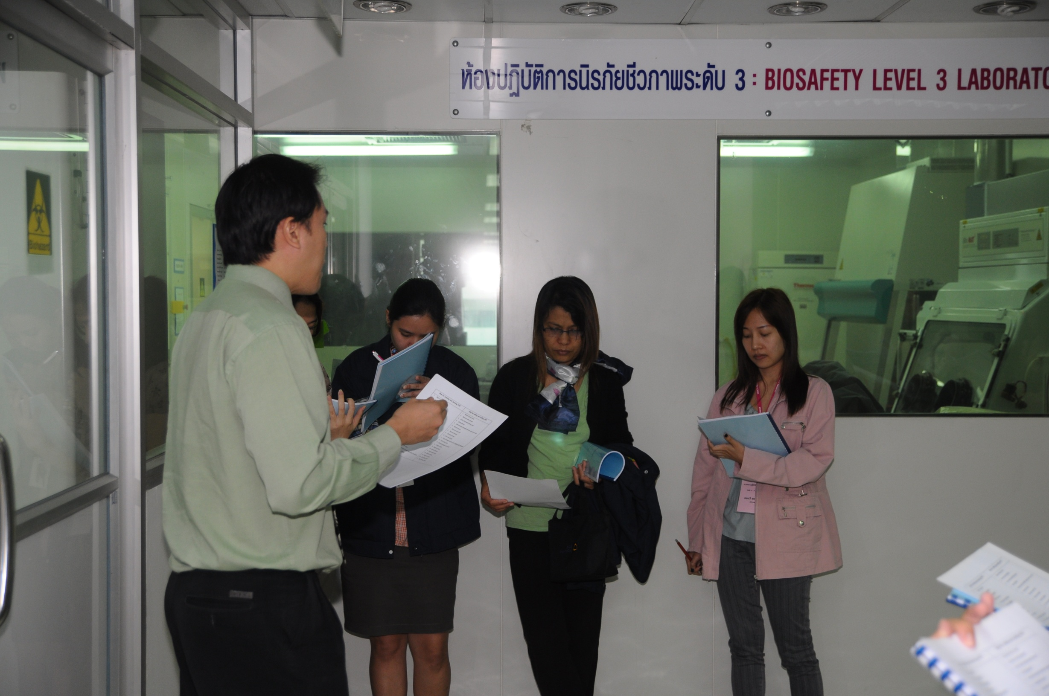

Slide 9
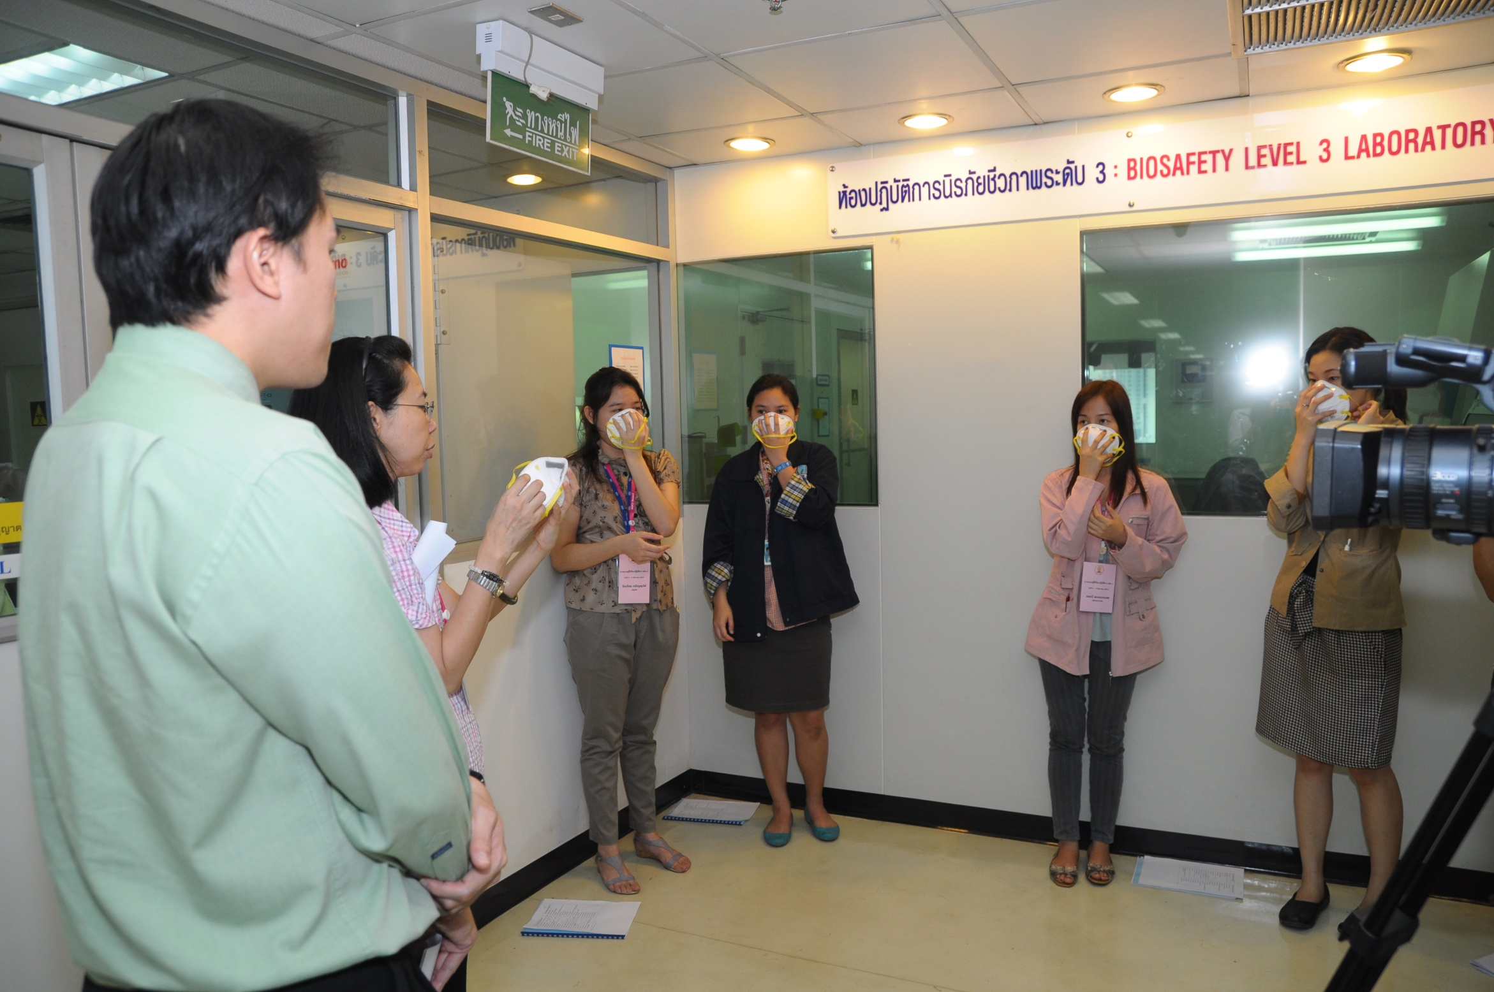

Slide 10
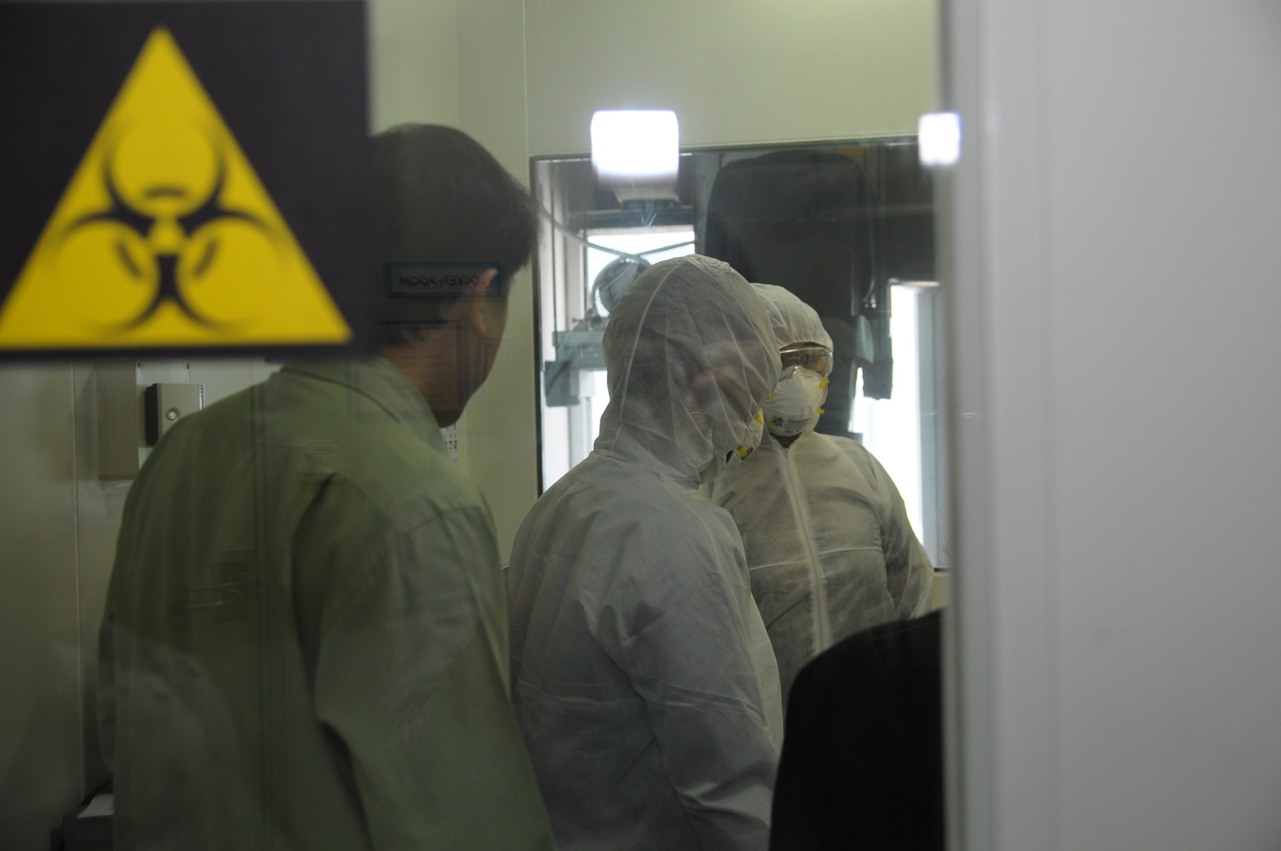

Slide 11
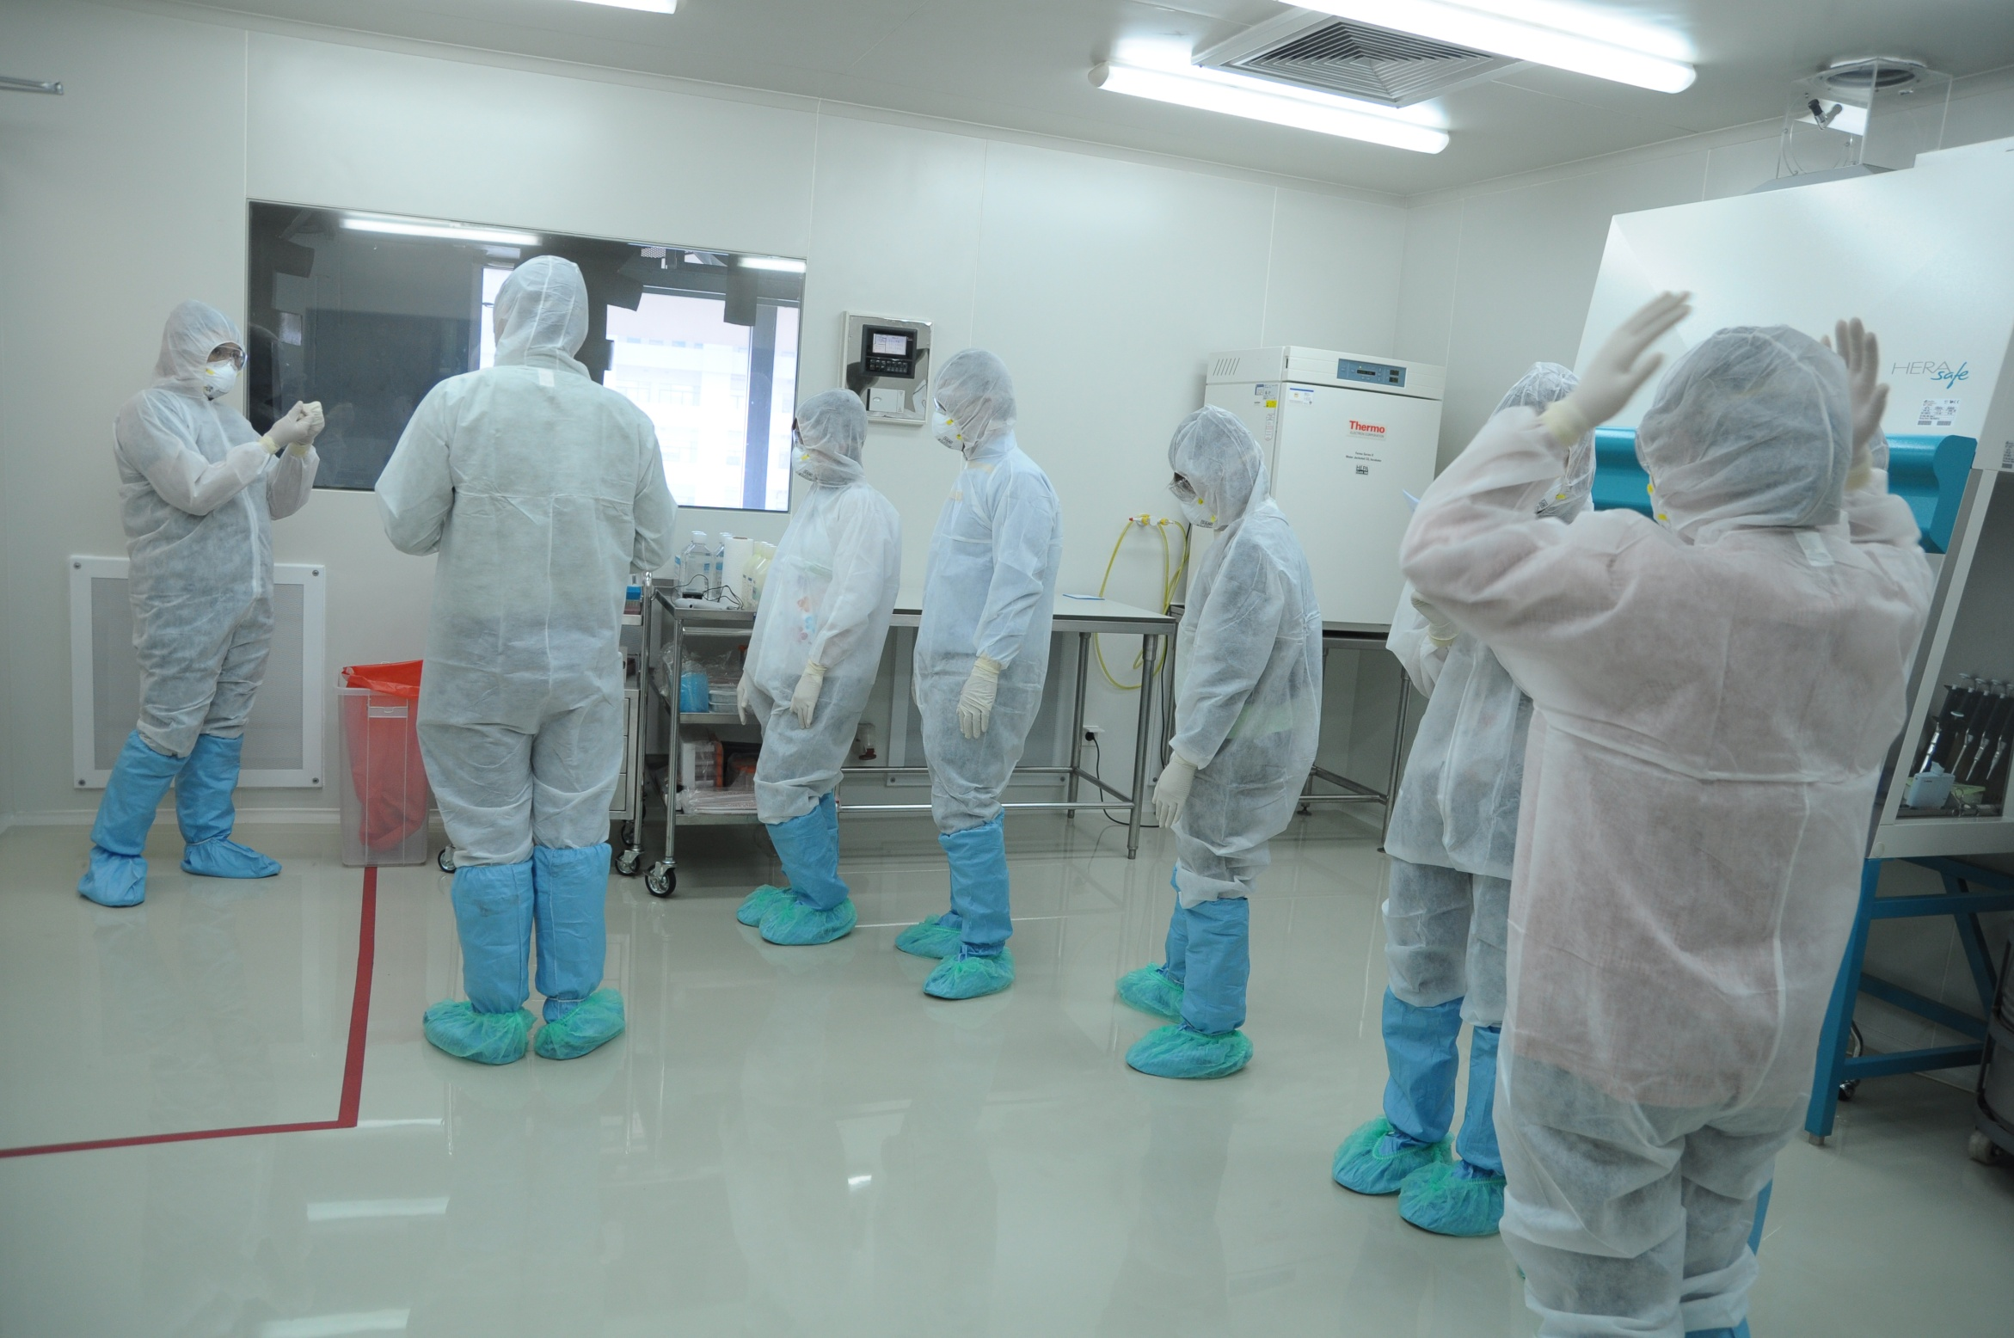

Slide 12
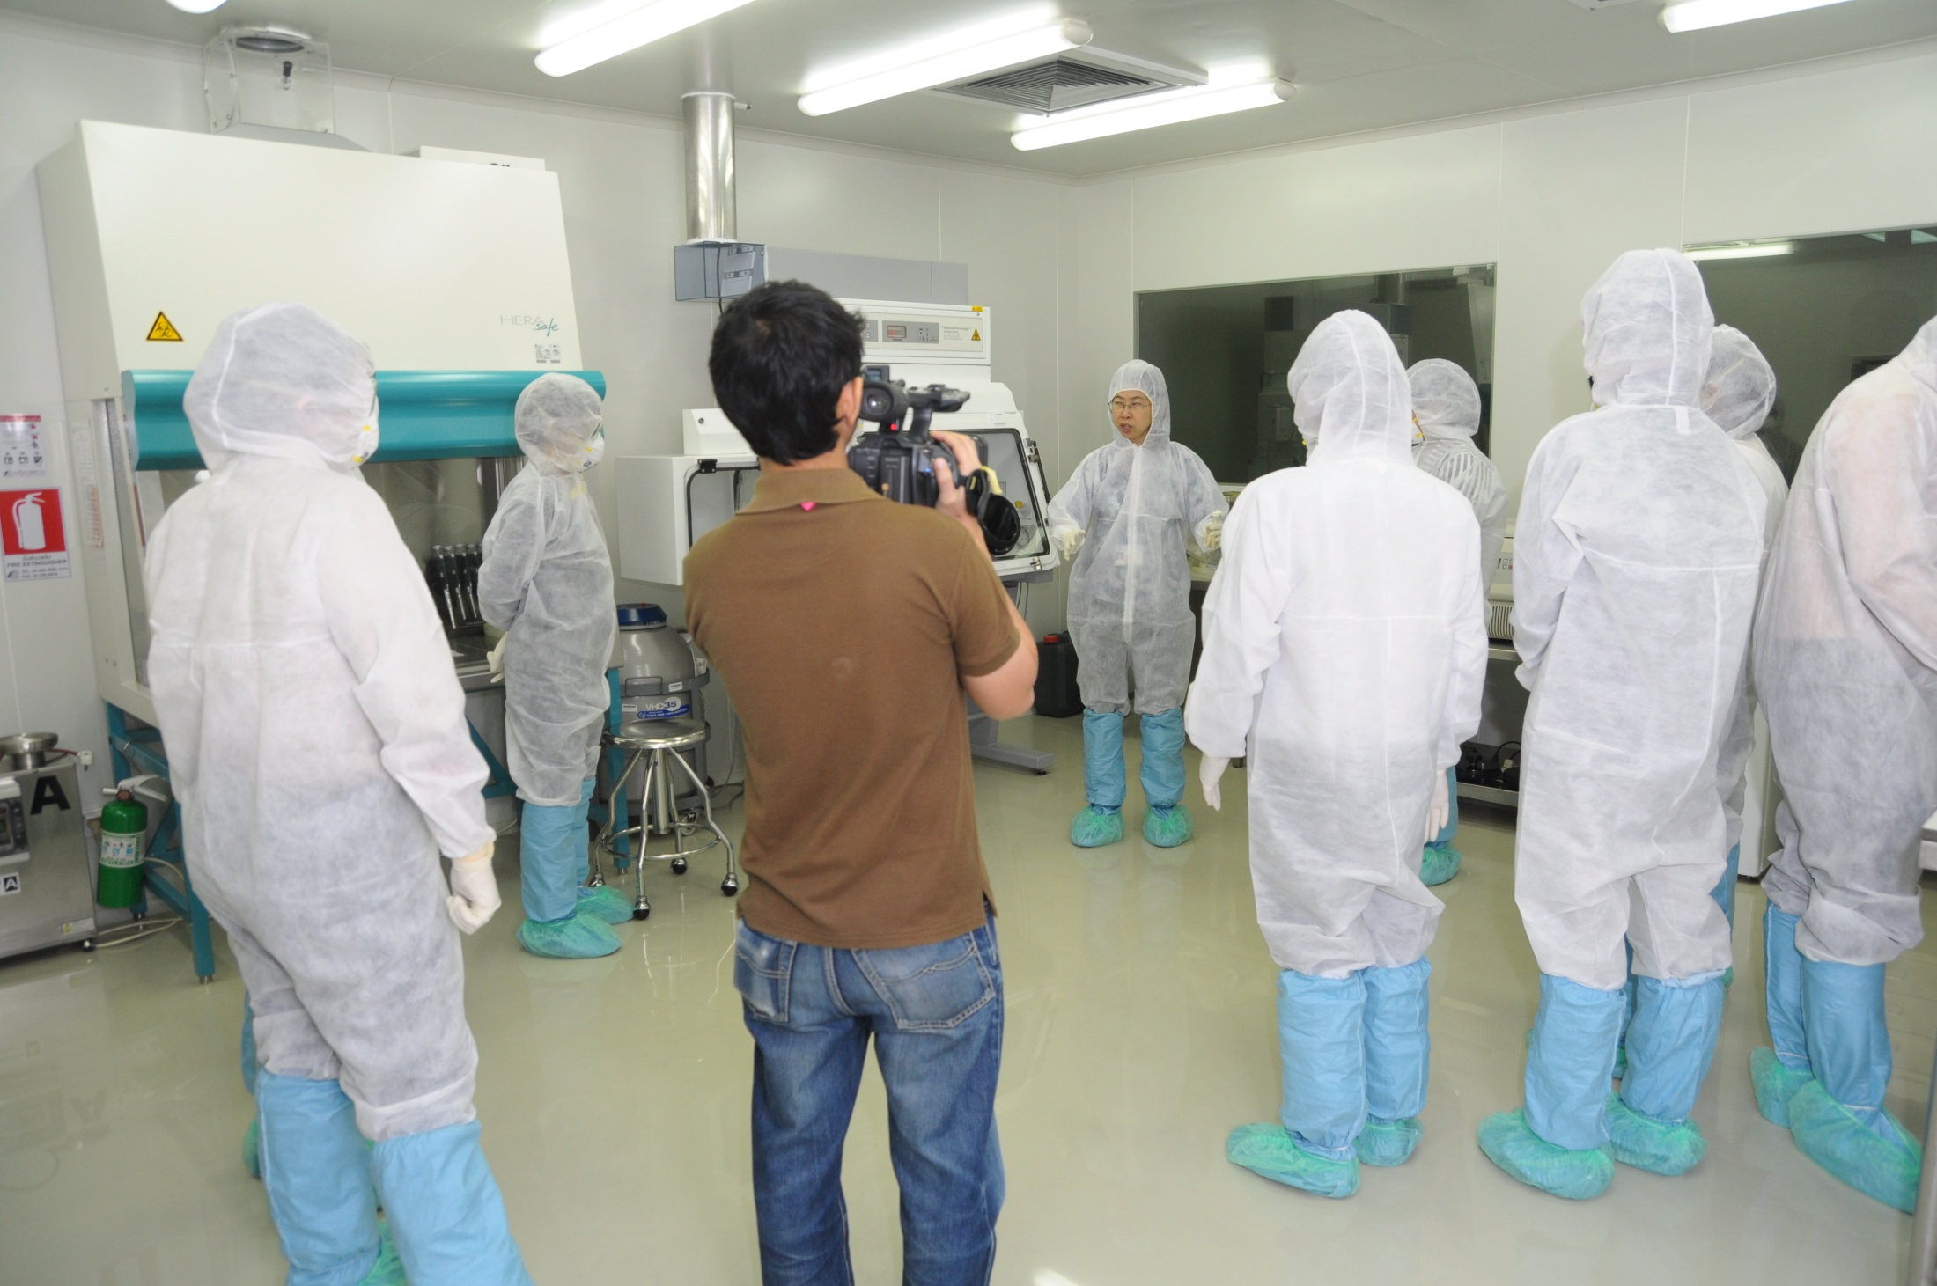

Slide 13
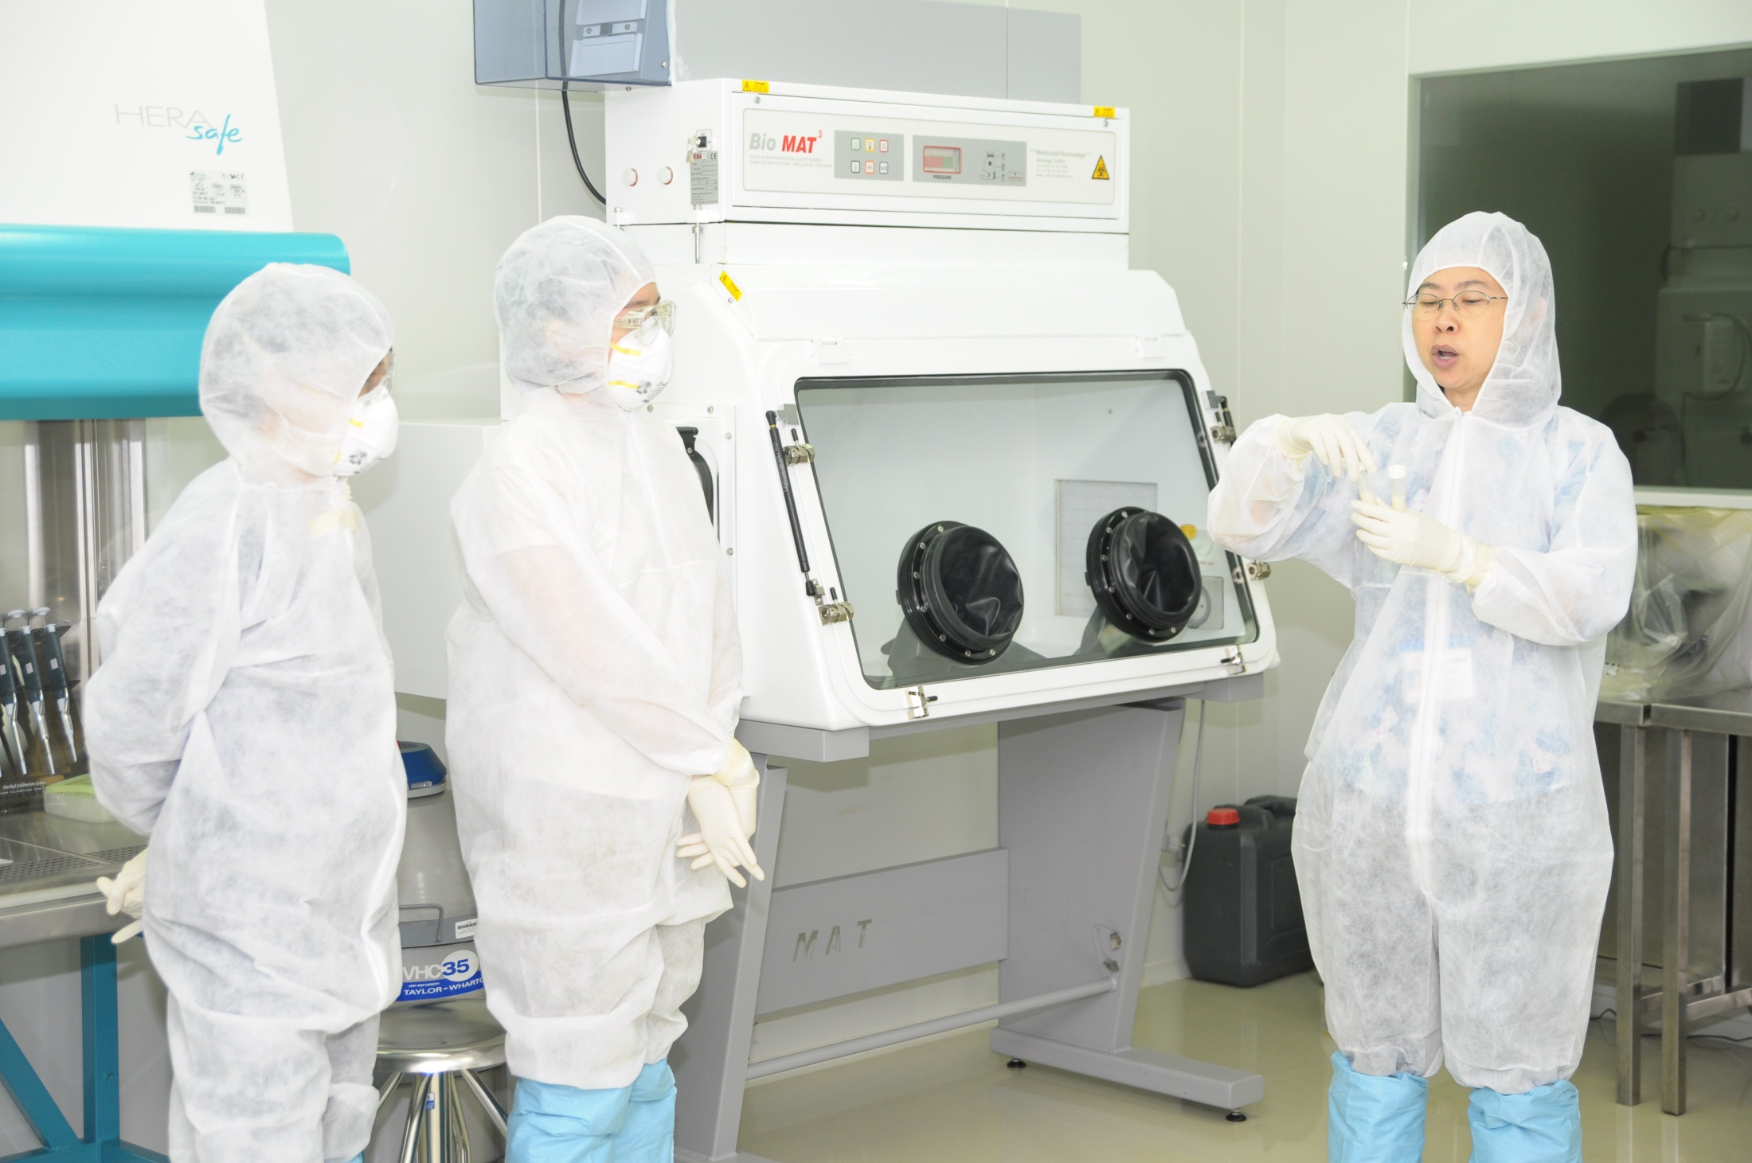

Slide 14
Lab’s strengths
Working group consists of at least 5 knowledgeable committee members
One full-time staff to take care of the facility and equipments
Regular maintenance of BSL-3 facility
No more than 3 persons will be allowed to work in the BSL-3 at the same time
If only 1 person is working, there should be 1 accompanying person outside BSL-3, in case of emergency

Slide 15
Ongoing efforts to sustain and improve capabilities
Widely opened for submission of proposal to work in the BSL-3
Once approved by the BSL-3 committee, operators must go through the BSL-3 training course.
Operators must strictly follow the BSL-3 regulations.

Slide 16
Key obstacles and challenges
High operational and maintenance costs, especially if the facilities have not been frequently used.
This has been supported by the Faculty of Medicine so far.
Operational cost sharing (disposable items, i.e., N95, disposable gown, etc.) by individual operator if only one operator will work in BSL-3.

Slide 17
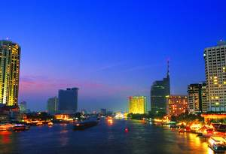
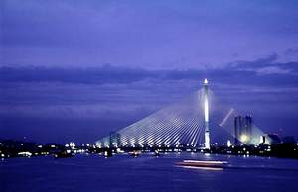


Thank You
“Kob-koon-ka” ขอบคุณค่ะ

