Slide 1

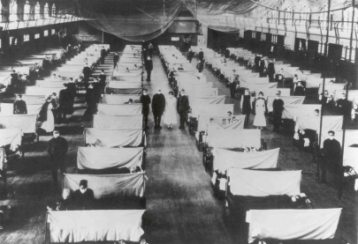
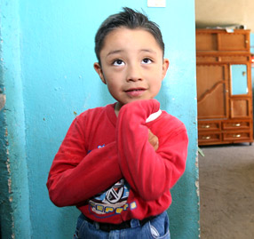
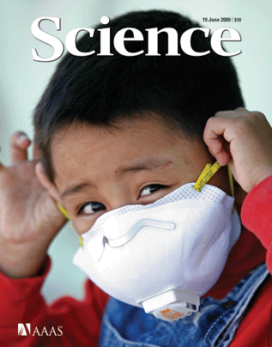
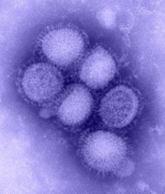
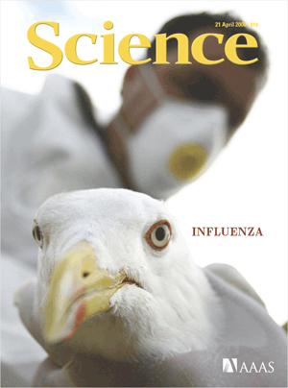
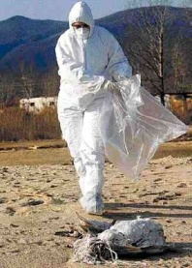
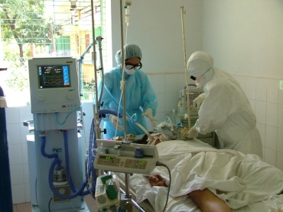


Biosafety and the Southeast Asian Clinical Infectious Diseases Network (SEAICRN)
Rogier van Doorn
Clinical Microbiologist
Wellcome Trust Major Overseas Program
Oxford University Clinical Research Unit ^{VN}

Slide 2
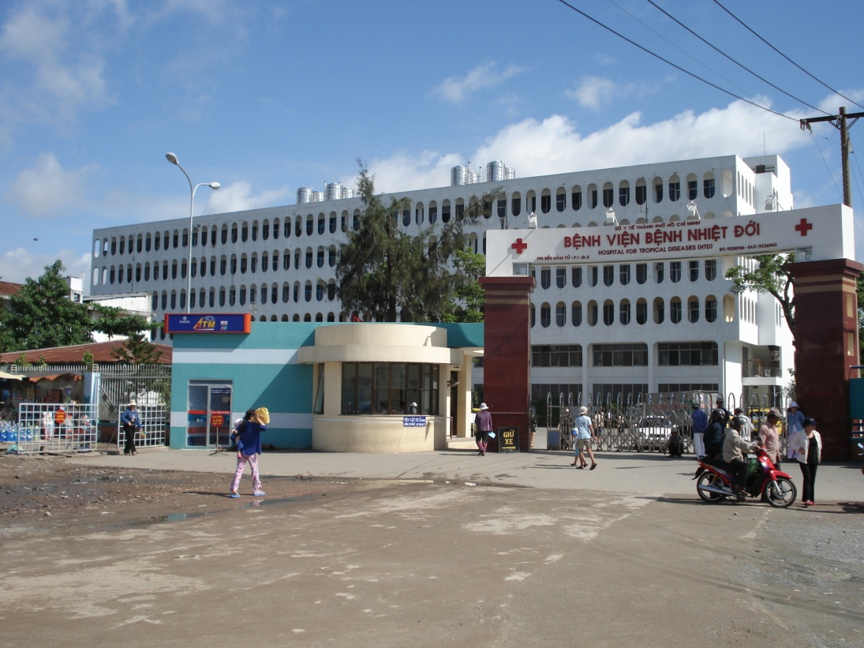
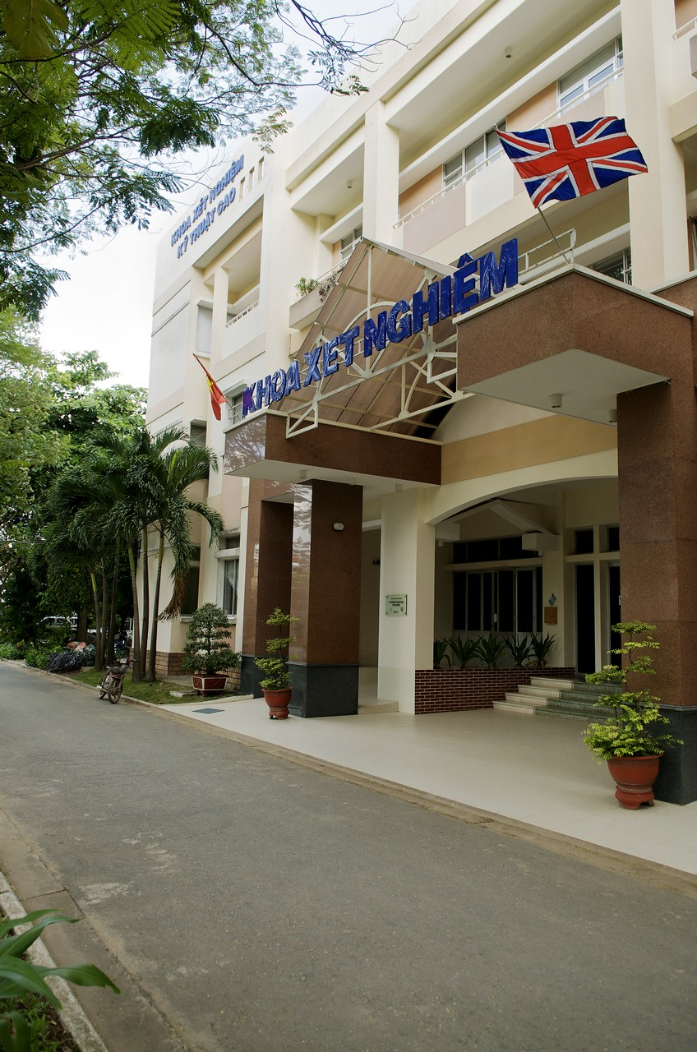
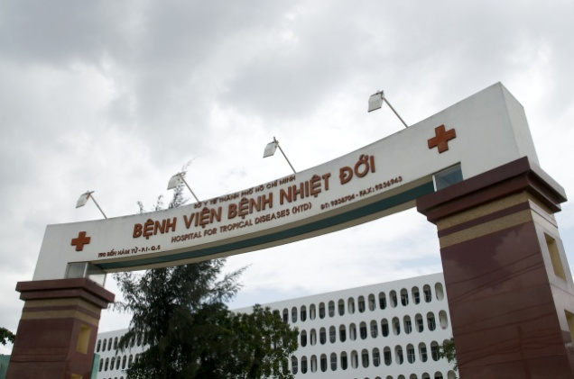
Oxford University Clinical Research Unit
First collaboration started in 1991
Core funding from Wellcome Trust
New laboratory office opened in 2002
Currently around 200 staff
Project based external funding

Slide 3
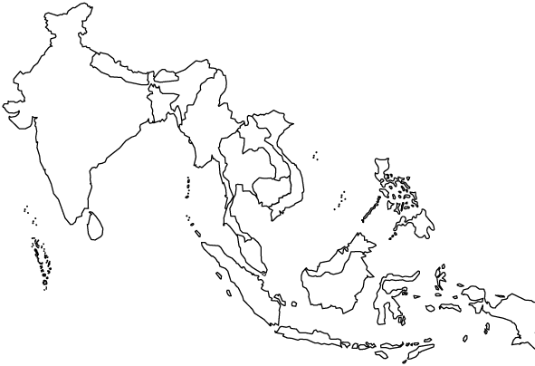

Oxford University Clinical Research Unit
OUCRU-VN
Ho Chi Minh City
Ha Noi
Influenza
Antimicrobial drug resistance
Klebsiella pneumonia
Community acquired pneumonia
Tuberculosis
Dengue
Jakarta, Indonesia
Plasmodium vivax
Kathmandu, Nepal
Salmonella enterica Serovar Typhi
Shantou, China
Respiratory viruses

Slide 4
Research agenda
Basic research
Clinical trials
Meet local health needs
Malaria
Dengue
Tuberculosis and Tuberculous meningitis
Influenza and Respiratory infections
Typhoid fever and Enteric infections
CNS infections
Zoonotic and emerging infections
HIV and opportunistic infections

Slide 5
Laboratories
Diagnostic labs
BSL2 Bacteriology
BSL2 Serology
BSL2 Molecular Virology
Research labs
BSL2 Virology culture
BSL2 Molecular diagnostic lab
BSL2 Molecular post-amplification lab
BSL2 Insectary
BSL2 Mycology
BSL3 Mycobacterial culture
BSL3 Virology
SAPO4 Virology

Slide 6
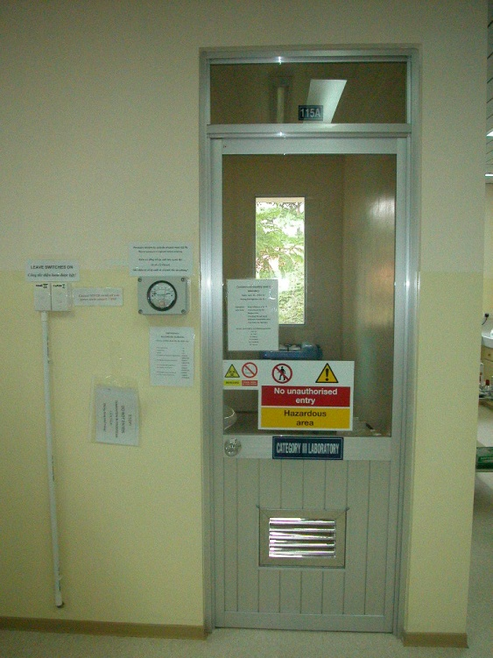
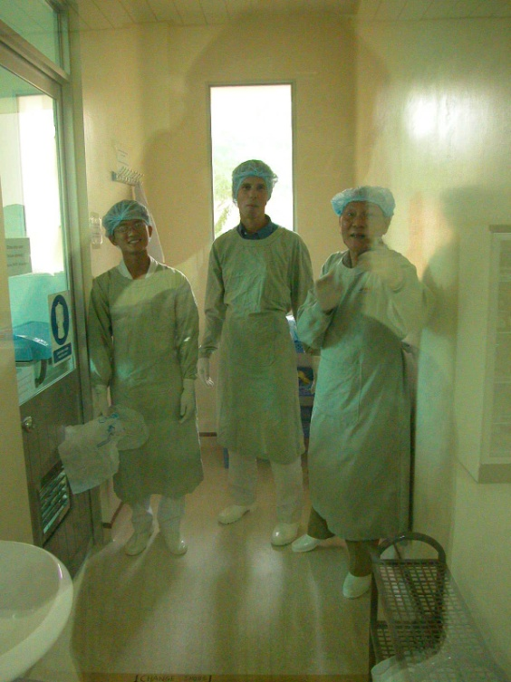
BSL3 Facilities
2002 building
BSL3 infrastructure for TB/Virology
Virology not operational until H5N1 2003
Audited and certified by WHO
Access / Signage / CCTV
Influenza – CSF culture
2008-2011 Design, construction, certification of multifunctional BSL3 suite

Slide 7
BSL3 Facilities
Funded by NIH/NIAID through the Southeast Asian Infectious diseases Clinical Research Network (SEAICRN)
In accordance with UK laws and guidelines:
COSHH: Control of Substances Hazardous to Health Regulations
Department of Health
HSE: Health & Safety Executive
ACDP: Advisory committee on dangerous pathogens
DEFRA: Department of Environment, Food and Rural Affairs
SAPO: Specified Animal Pathogens Order
Oxford University Health and Safety Policy
Certified by independent party, Oxford University and Vietnam MoH
CDC certification for selected agents ….

Slide 8
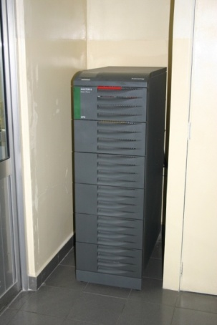
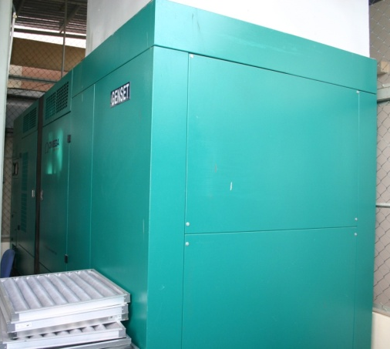
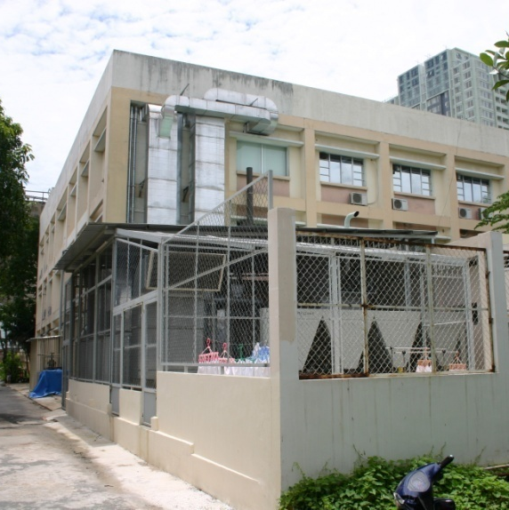
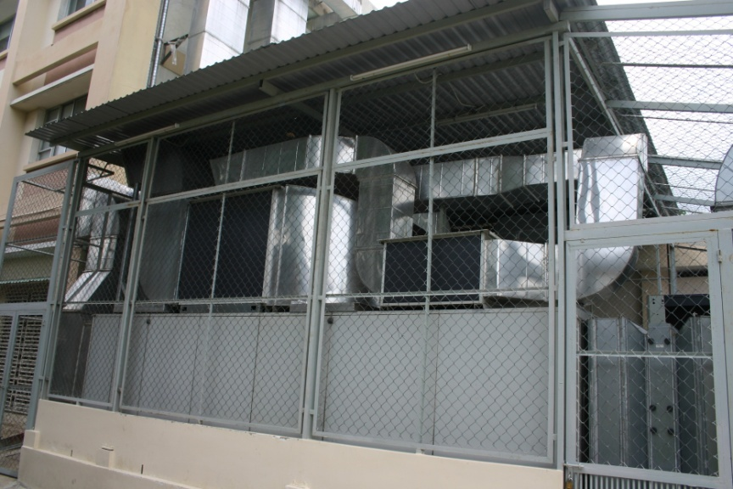
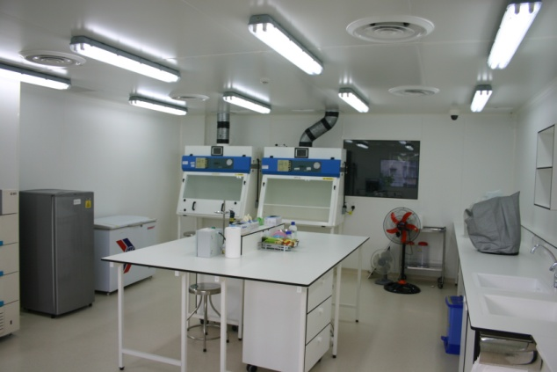
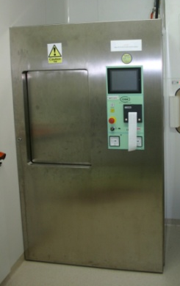
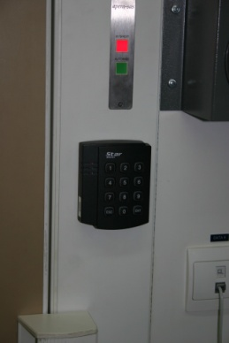
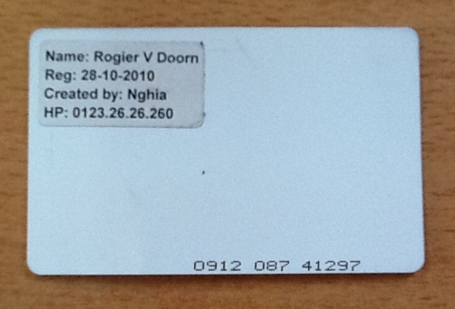
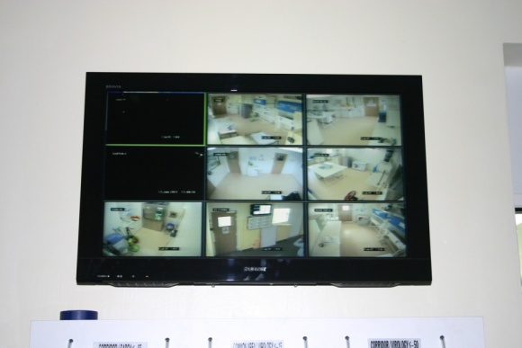

Slide 9
Nonthaburi, Thailand
Chest Disease Institute,
Bamrasnaradura Infectious Disease Hospital
Hanoi, Vietnam
National Hospital for Tropical Diseases
National Pediatric Hospital
Bangkok, Thailand
Faculty of Tropical Medicine, Mahidol University
Queen Sirikit National Institute of Child Health
Siriraj Hospital
Ho Chi Minh City, Vietnam
Hospital for Tropical Diseases
Pediatric Hospital 1
Pediatric Hospital 2
Singapore
National University Hospital
Jakarta, Indonesia
Persahabatan Hospital
Sulianti Saroso Hospital
National Institute for Health
Research and Development
Bandung, Indonesia
Hasan Sadikin Hospital

Slide 10



advance the scientific knowledge and clinical management of influenza and emerging infectious disease through integrated, collaborative clinical research
related to diagnosis, pathogenesis, treatment, and prevention of human influenza and emerging infectious disease in the region
to produce evidence that will help to inform health policies and clinical practice

Slide 11
Scope
Initially focused on influenza
Emerging infections in the region
Capacity building and maintenance
Pandemic preparedness
2nd 5 year grant period

Slide 12
Virology reference lab
Building state-of-the-art molecular diagnostic units
Disseminating low-biorisk diagnostics
Centralized development of assays, SOPs and ordering of reagents
Training laboratory staff on site
Uniform EQA programs
Centralized high-risk diagnostics involving culture

Slide 13
Influenza diagnostics
Focus on molecular diagnostics
USCDC real-time RT-PCR
Inhouse resistance associated mutation testing
Sanger and pyrosequencing
Culture and culture based susceptibility testing
Microneutralization assays
International collaborations for further experiments

Slide 14
Other infectious diseases
‘Fever ‘
Hand Foot and Mouth Disease
Viral encephalitis
Outbreak investigations
Pathogen discovery program
Zoonoses program

Slide 15
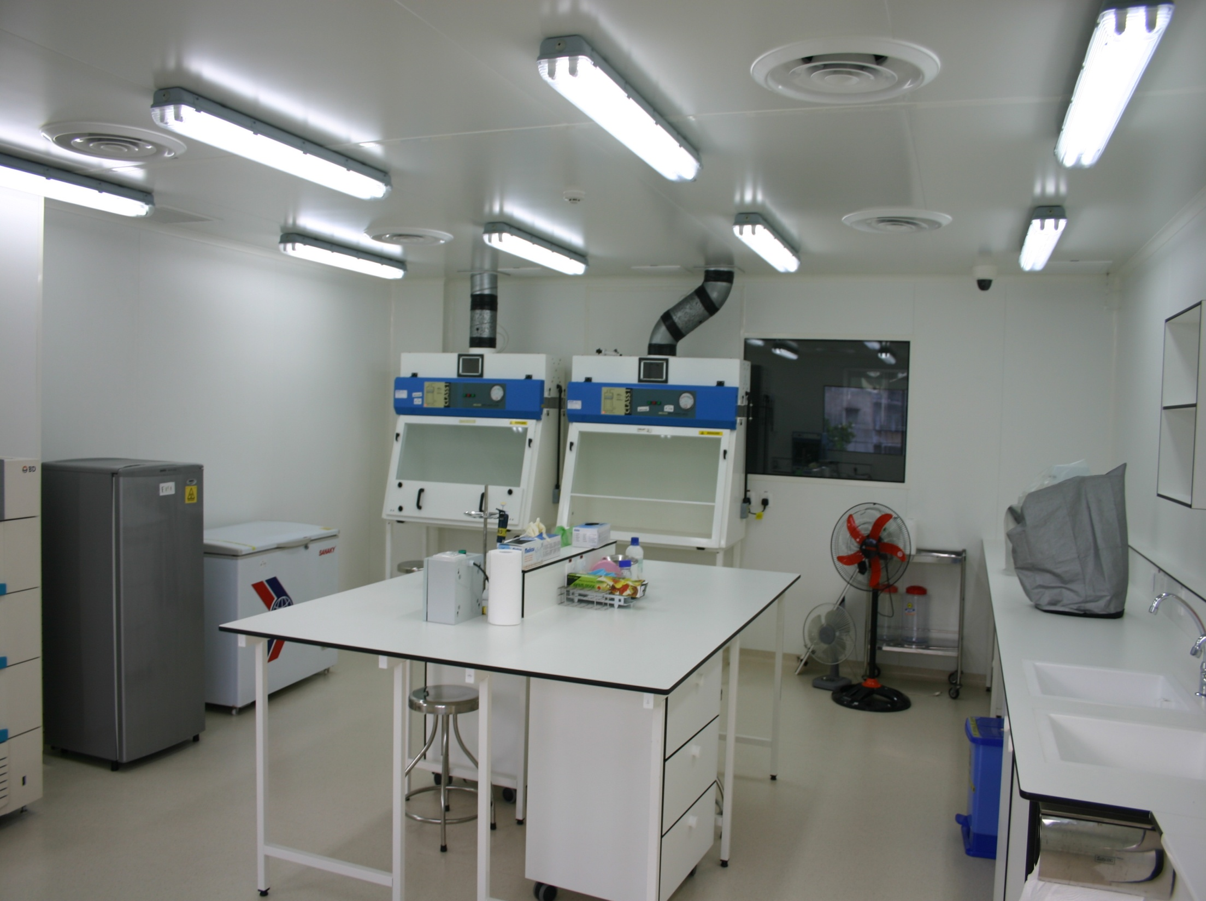


Slide 16
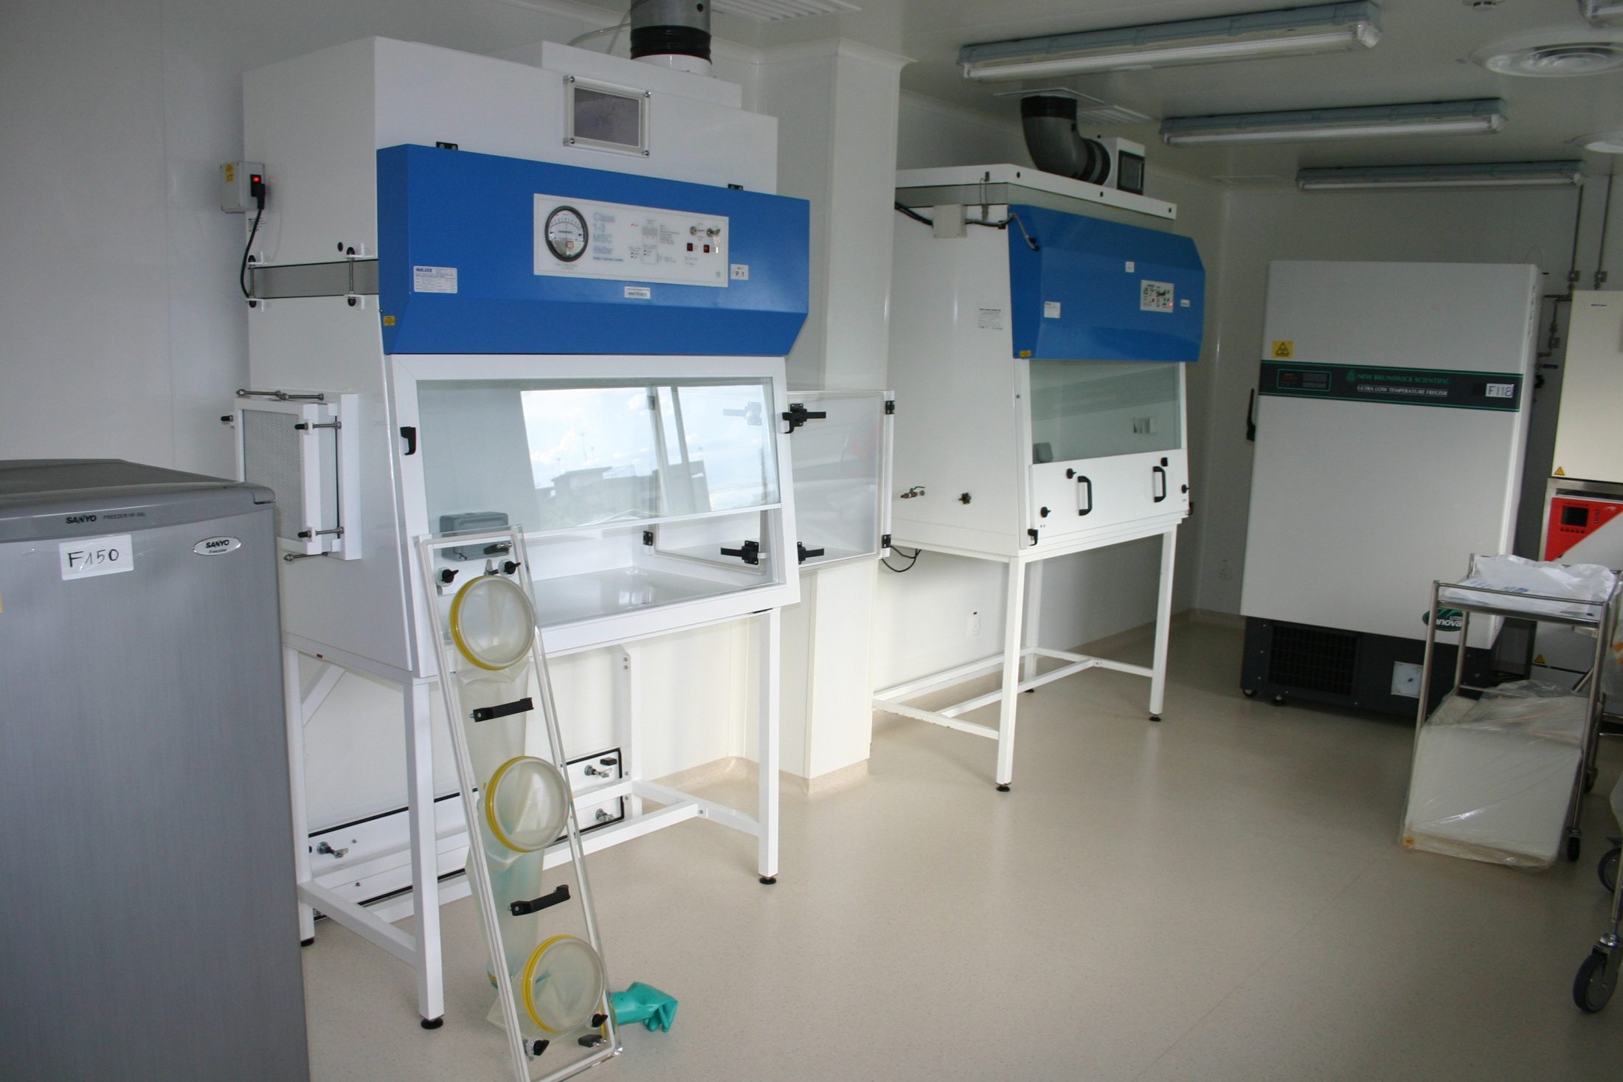
First influenza cultures inoculated on 11 July 2011

