Slide 1

The Case for a Data Decadal Survey
A community-driven initiative to harmonize data practices, research priorities and infrastructure for 2025
Carol B. Meyer
Foundation for Earth Science
September 23, 2013

Slide 2
Overview
1. About ESIP
2. The Case for a Data Decadal Survey
  History
  Observations
  The time is now
  Grand vision needed
  Rationale for moving forward
3. Next steps
4. Q&A

Slide 3
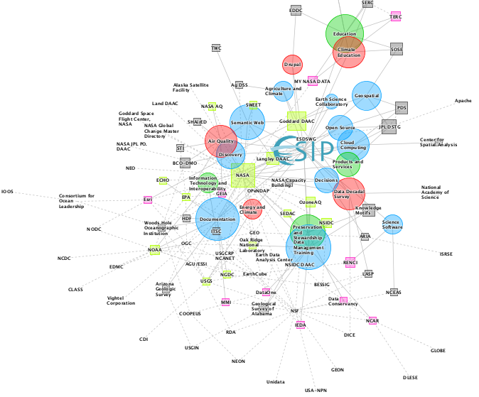
About ESIP
A broad-based, distributed community of Earth science data and information technology practitioners
Notes:
Created in response to an NRC recommendation to NASA
Crossing Domains, Agencies, Sectors, Data Life Cycle & Other Data-related networks (CODATA, NCDS, RDA…)
ESIP provides:
Forum for open, science data-centric community collaboration
Voluntary participation
Trusted authority, built by the community
Infrastructure for community collaboration
Collaborative workspace on web (Drupal, wiki, listservs)
Communications (coordinated, ad hoc, open)
Governance
Formal (constitution, bylaws, strategic plan)
Informal (cluster-based governance for consensus building)
Forum for open, science data-centric community collaboration
Voluntary participation
Community of Practice – practitioners share expertise & technologies
Trusted authority, built by the community
Infrastructure for community collaboration
Collaborative workspace on web (Drupal, wiki, listservs)
Communications (coordinated, ad hoc, open)
Governance
Formal (constitution, bylaws, strategic plan)
Informal (cluster-based governance for consensus building)
*

Slide 4



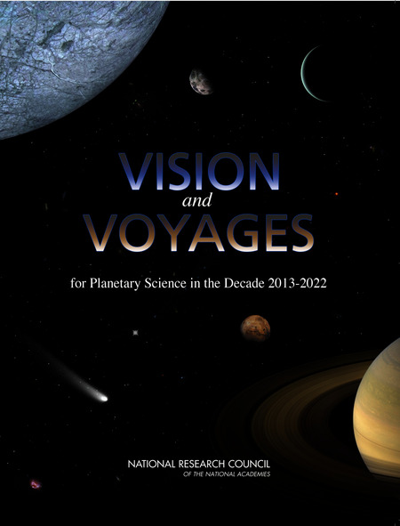
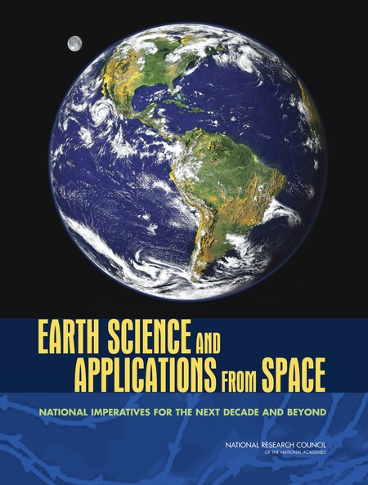
Case for a Data Decadal Survey: History
Academy has produced many domain decadal surveys
Dan Baker (Chair, 2013 Heliophysics Decadal Survey) planted seed of an idea
Touted the process, its stakeholder engagement, the neutrality of recommendations and the authority it conveys
Notes:
October 2012, Boulder Earth and Space Science Informatics Group (BESSIG) panel discussion on "Science Policy for Scientists and Engineers", where Dan suggested a data decadal Survey. Dan is the Director Laboratory for Atmospheric and Space Physics (LASP), member of the National Academy of Engineering
Is the Decadal Survey the only vehicle? – not sure – but its process, expert inputs and status at the Academy makes it seem like a good approach. However, we would be open to other avenues that meet the neutrality & authoritative tests.

Slide 5
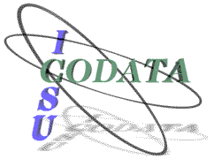
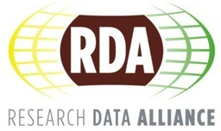


Case for a Data Decadal Survey: Observations
Data-focused organizations are ubiquitous
Initiatives within single agencies don’t always coordinate, much less cut cross agencies
Good work being done but most efforts are responsive to current needs, not long term ones
Notes:
To name a few:
White House initiatives such as NITRD and BIG DATA
Also agency specific initiatives at NASA (ESDSWG), NOAA (EDMC), USGS (CDI) and NSF (EarthCube).n While these efforts provide some level of coordination, none has the authority to bring communities into compliance AND the overall vision for a long-term strategy is still lacking

Slide 6
Case for a Data Decadal Survey:
The Time Is Now (2008)
The challenges of organizing and using data effectively expand as data volumes, data complexity, the need for interoperability, and our ability to access data and information increase. In particular, there remains great reluctance among research scientists and others to invest time in good data management practices and thereby ensure that publicly funded data are openly available for use and reuse. The reason is simple: Research scientists are rewarded only for doing research…Despite the informatics revolution, the traditional challenges of data preservation, data discovery, data release, and education/outreach remain.
From: Eos, Vol. 89, No. 48, 25 November 2008
Notes:
eGY article calling for more sharing of data
Issues:
New data sources constantly emerging
Ubiquity of sensors; kickstarter for EO satellites
Large volumes of data
NASA data archives; DOE, NOAA, EPA, USGS data holdings; small data stores; dark data
Changing computing environment
Computing power; software defined networks; analytics storage capacity
How science is conducted
Open data
Open science
Unstructured data
Transdiciplinary science
…

Slide 7
Case for a Data Decadal Survey:
The Time Is Now (2013)
Ever-increasing amounts of data are out there, waiting for interpretation. Learning from these data in a manner that is organized and interpretable requires enhanced computation abilities to detect patterns within data. This will enable scientists and decision makers to gain greater confidence in newly discovered knowledge of the fundamental causes of change to the environment. The advancement of such fundamental knowledge will assist in quantifying how these changes affect society and may help identify future sustainability options that can be used for the development of adaptation and mitigation strategies to protect society.
From: Eos, Vol. 94, No. 32, 6 August 2013
Notes:
This EOS article recognizes the grand challenge questions that might be met by leveraging new data sources and trends in computational power.
The Time is Still now -
Since Dan first introduced the idea in Oct. 2012 during a local ESIP meet up, momentum has been building.
January 2013 ESIP Winter meeting session, "Is it time for a Data decadal survey?" Paul Uhlir, BRDI Director, attended.
Held monthly telecons, developed wiki, planned panel discussion
July 2013 ESIP Summer meeting panel discussion - current assessment by knowledgeable people with a complementary set of perspectives (Renci/NCDS, RedHat, LASP, Dryad/Sesync/UNC) . All agreed something was needed. Those that knew what a decadal survey was thought it was a good vehicle.
July 2013 ESIP Summer meeting working session
January 2014 ESIP Workshop on scoping the survey

Slide 8
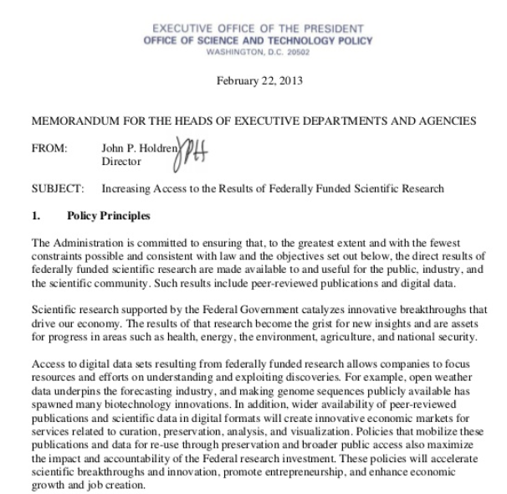
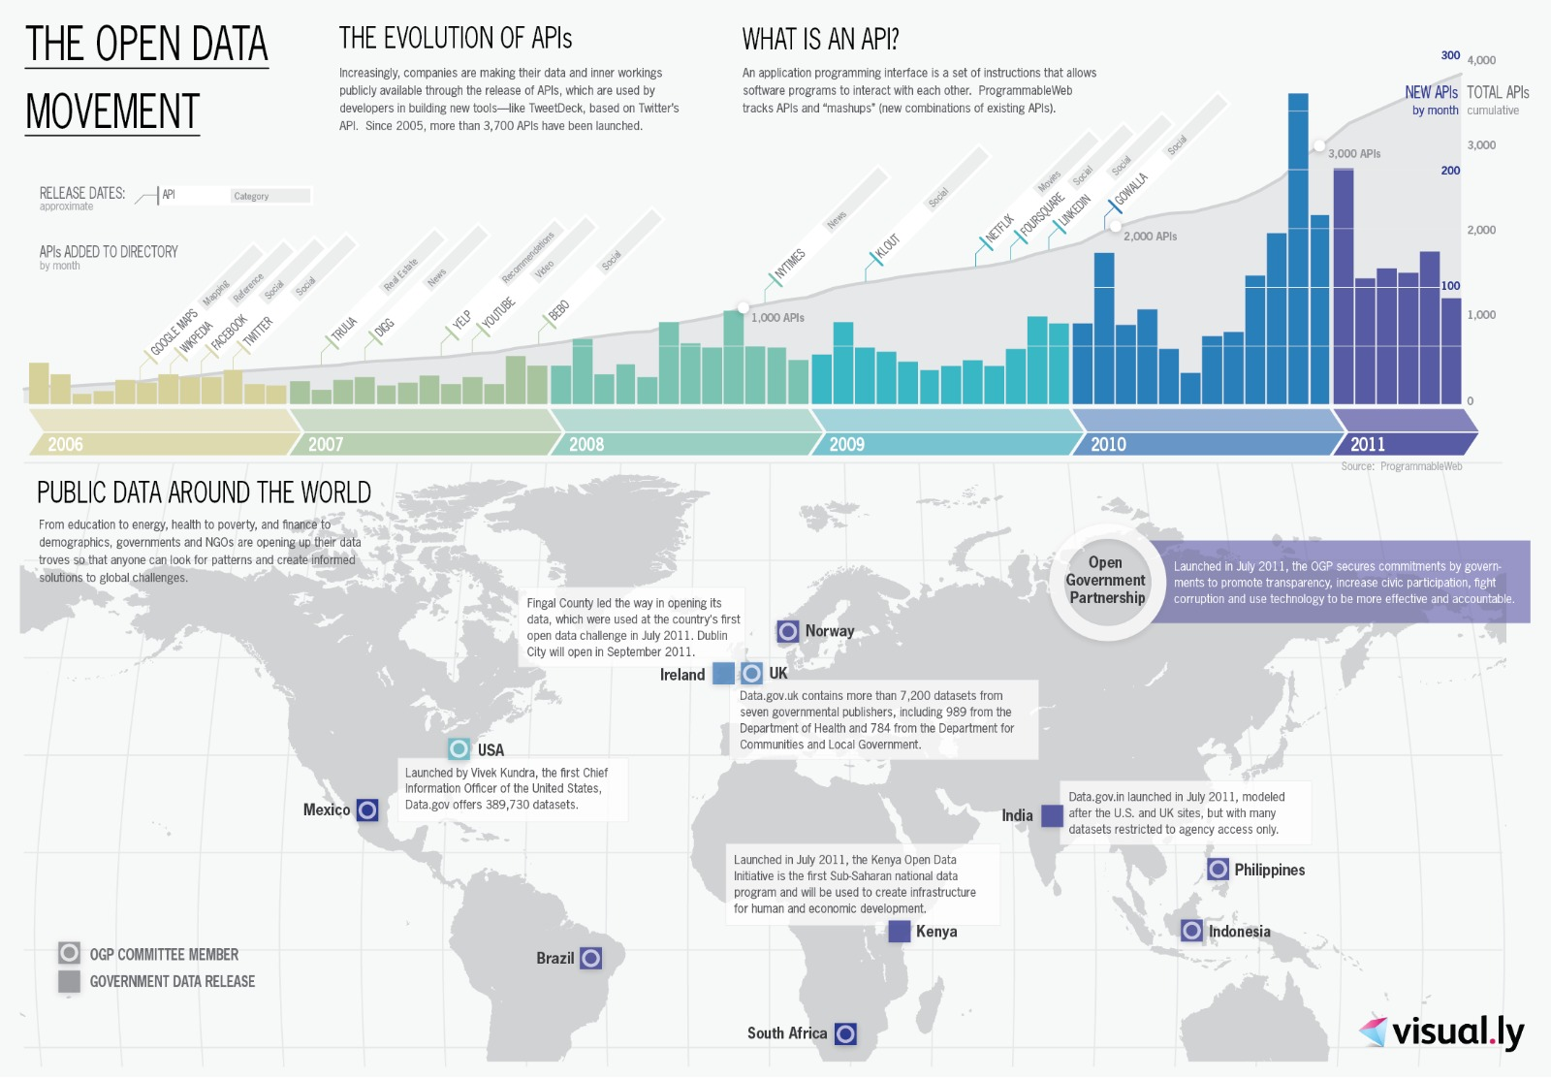
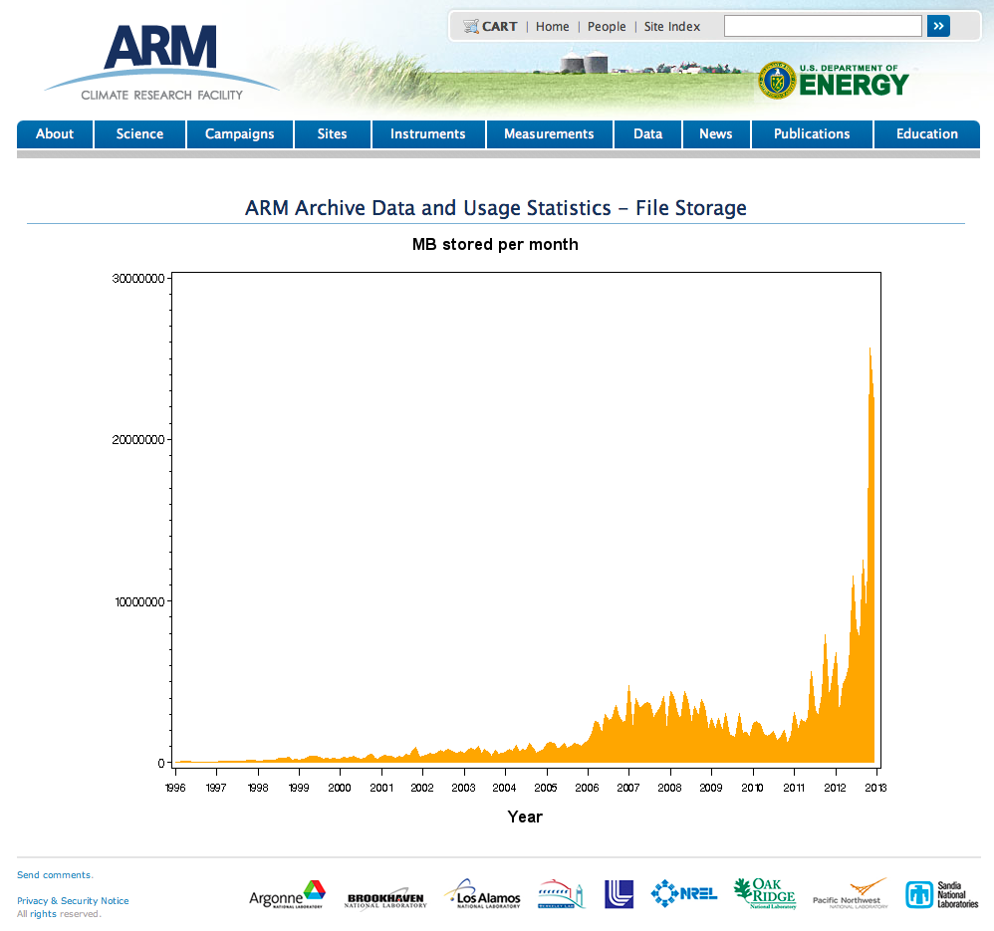

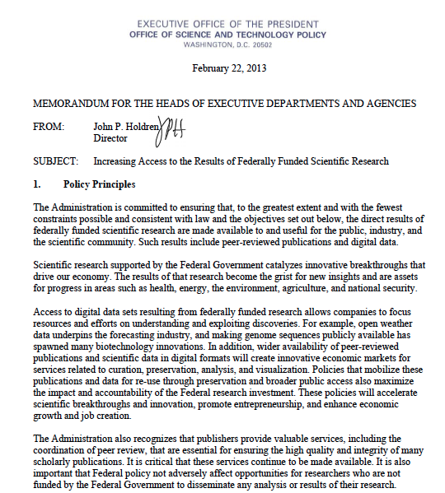
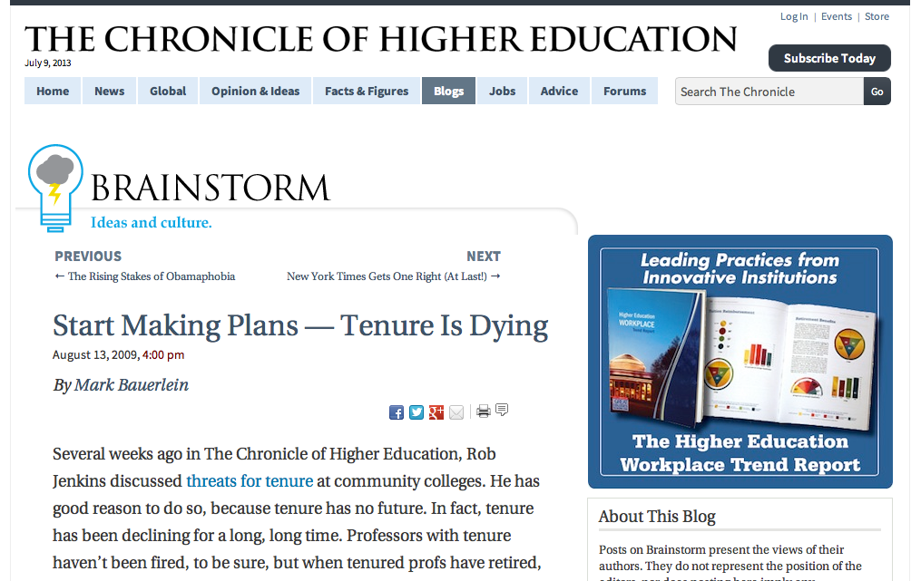
Case for a Data Decadal Survey: Grand Vision Needed
Trends Need Convergence
  Data Technologies Advance
  Data Intensive Science
  Greater Computational Resources
  Open Data
Good News & Bad News
Notes:
The case has already been made by others - technological changes are impacting science and society.
The Good News:
New OSTP/White House policy pronouncements – open and machine readable data; access to federally-funded research
The Bad News:
But, flat or declining budgets = unfunded mandate
Potential for inadvertent loss of data
Data contributions still largely unrewarded
- We need studies at the intersection of today's trends: data, information science, computer science, and domain science
Can we position the agencies to respond proactively, leverage efforts across agencies to support the overarching governmental goals of economic vitality, national security, health, and well-being of the US?

Slide 9
Case for a Data Decadal Survey: Rationale for Moving Forward
Vehicle for focusing resources and priorities for data science
A Data Decadal Survey would provide a
  Comprehensive, synthetic study
  Long-term vision for science data and coordination across agencies
  Neutral venue that taps ‘the best minds’ to work with US agencies on crafting a proactive, long-term data science strategy (practice, research, infrastructure & funding priorities)
Existing efforts are focused on the near- and mid-term – not visionary.
Notes:
current approach is piecemeal (as before)
Duplication of effort
- progress is incremental, while the change is exponential
-We would want a data decadal survey to: harmonize data practices, research priorities and infrastructure for 2025

Slide 10
Next Steps
Promoting the idea to the broader community
Scoping Workshop: January 7, 2014 (in DC)
Issue Report on Workshop Findings and Recommendations
Decadal Survey in late 2014 - 2015

Slide 11
Thank you!
Carol B. Meyer
carolbmeyer@esipfed.org
Notes:
Invite BRDI to be part of the process as expert contributors
And special thanks to Anne Wilson (University of Colorado/LASP), Chris Lenhardt (UNC/Renci) & Paul Uhlir for advising me.

