Slide 1
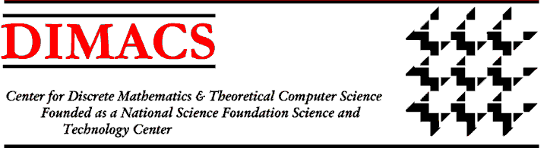

The Changing Landscape of Privacy in a Big Data World
Rebecca Wright
Rutgers University
www.cs.rutgers.edu/~rebecca.wright
Privacy in a Big Data World
A Symposium of the Board on Research Data and Information
September 23, 2013

Slide 2

The Big Data World
Internet, WWW, social computing, cloud computing, mobile phones as computing devices.
Embedded systems in cars, medical devices, household appliances, and other consumer products.
Critical infrastructure heavily reliant on software for control and management, with fine-grained monitoring and increasing human interaction (e.g., Smart grid).
Computing, especially data-intensive computing, drives advances in almost all fields.
Users (or in the medical setting,
patients) as content providers, not
just consumers.
Everyday activities over networked
computers.

Slide 3
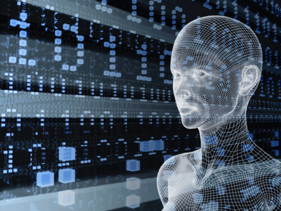
Privacy
Means different things to different people, to different cultures, and in different contexts.
Simple approaches to “anonymization” don’t work in today’s world where many data sources are readily available.
Appropriate uses of data:
What is appropriate?
Who gets to decide?
What if different stakeholders disagree?
There are some good definitions for some specific notions of privacy.

Slide 4
Personally Identifiable Information
Many privacy policies and solutions are based on the concept of “personally identifiable information” (PII).
However, this concept is not robust in the face of today’s realities.
Any interesting and relatively accurate data about someone can be personally identifiable if you have enough of it and appropriate auxiliary information.
In today’s data landscape, both of these are often available.
Examples: Sweeney’s work [Swe90’s], AOL web search data [NYT06], Netflix challenge data [NS08], social network reidentification [BDK07], …

Slide 5
Reidentification
Sweeney: 87% of the US population can be uniquely identified by their date of birth, 5-digit zip code, and gender.
AOL search logs released August 2006: user IDs and IP addresses removed, but replaced by unique random identifiers. Some queries provide information about who the querier is, others give insight into the querier’s mind.
“Innocuous” database
with names.
Allows complete or partial reidentification of individuals in sensitive database.
Birth date
Zip code
Gender

Slide 6
Differential Privacy [DMNS06]
The risk of inferring something about an individual should not increase (significantly) because of her being in a particular database or dataset.
Even with background information available.
Has proven useful for obtaining good utility and rigorous privacy, especially for “aggregate” results.
Can’t hope to hide everything while still providing useful information.
Example: Medical studies determine that smoking causes cancer. I know you’re a smoker.

Slide 7
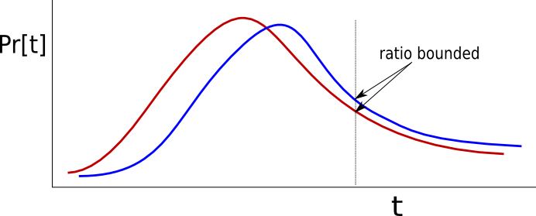
Differential Privacy [DMNS06]
A randomized algorithm A provides differential privacy if for all neighboring inputs x and x’, all outputs t, and privacy parameter ε:
is a privacy parameter.

Slide 8
Differential Privacy [DMNS06]
Outputs, and consequences of those ouputs, are no more or less likely whether any one individual is in the database or not.
is a privacy parameter.

Slide 9
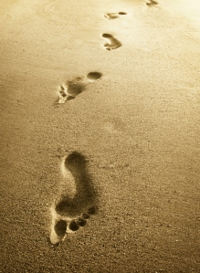
Differentially Private Human Mobility Modeling at Metropolitan Scales [MICMW13]
Human mobility models have many applications in a broad range of fields
Mobile computing
Urban planning
Epidemiology
Ecology

Slide 10
Goals
Realistically model how large populations move within different metropolitan areas
Generate location/time pairs for synthetic individuals moving between important places
Aggregate individuals to reproduce human densities at the scale of a metropolitan area
Account for differences in mobility patterns across different metropolitan areas
While ensuring privacy of individuals whose data is used.
Notes:
Not enough to simply “deanonymize” by stripping obvious identifiers. If adding noise, need to do so in a principled way.

Slide 11
WHERE modeling approach [Isaacman et al.]
Identify key spatial and temporal properties of human mobility
Extract corresponding probability distributions from empirical data, e.g., “anonymized”Call Detail Records (CDRs)
Intelligently sample those distributions
Create synthetic CDRs for synthetic people

Slide 12
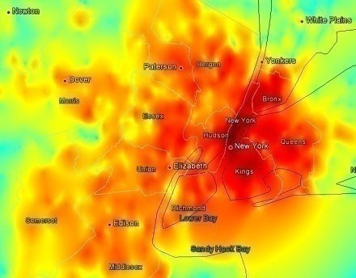

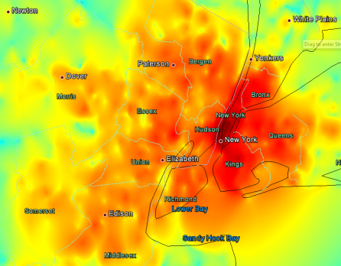
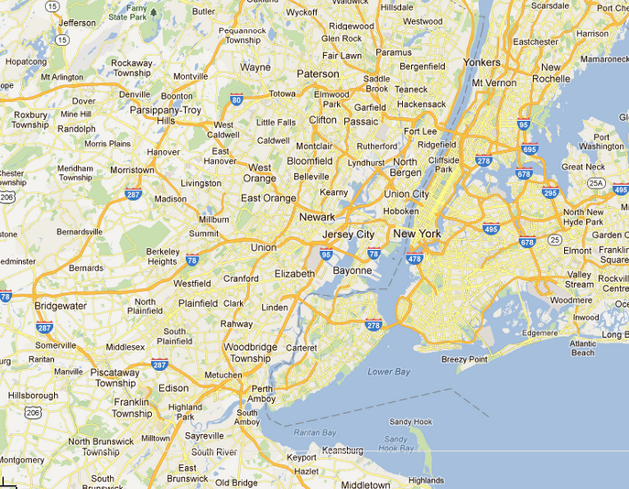
WHERE modeling procedure
d
Select work conditioned on home.
Locate person and calls according to activity times at each location.
Repeat as needed to produce a synthetic population and desired duration.
Home Distribution
Commute Distribution
Work Distribution
d
Home
Work

Slide 13
WHERE modeling procedure
Select
Home (lat, long)
Distribution of home locations
Distributions of commute distances per home region
Form a circle with radius c around Home
Select commute distance c
Distribution of work locations
Select
Work
(lat, long)
Select # of calls q in current day
Distribution of # of calls in a day
Assign Home or Work location to each call to produce a synthetic CDR with appropriate
(time, lat, long)
Probability of a call at each minute of the day
Select times of day for q calls
Probabilities of a call at each location per hour

Slide 14
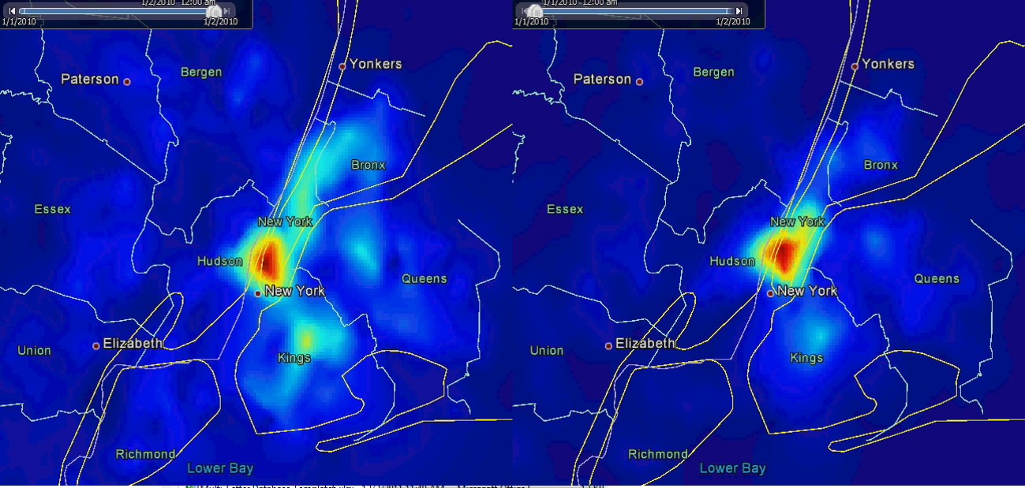
WHERE models are realistic
Typical Tuesday in the NY metropolitan area
Real CDRs
WHERE2 synthetic CDRs
WHERE synthetic CDRs

Slide 15
One way to achieve differential privacy
Measure the biggest change to the Home distribution that any one user can cause
Add Laplace noise to the Home distribution proportional to this change [DMNS06]
Example: Home distribution (empirical)
ID | Date-time | Lat, Long | Home
1020 | 04/04/13-02:00 | 40.71, -74.01 | 40.71, -74.01
1020 | 04/04/13-14:00 | 41.09, -74.22 | 40.71, -74.01
1040 | 04/03/13-16:00 | 42.71, -73.05 | 41.71, -75.23
1060 | 02/02/13-00:00 | 40.72, -74.02 | 41.71, -75.86
1060 | 02/03/13-15:01 | 40.82, -74.98 | 41.71, -75.86

Slide 16
DP version of Home distribution

Slide 17
DP-WHERE modeling procedure
WHERE modeling procedure
Add noise
Select
Home (lat, long)
Distribution of home locations
DP Home distribution
Distributions of commute distances per home region
DP Commute Distance distributions
Form a circle with radius c around Home
Select commute distance c
Distribution of work locations
DP Work distribution
Select
Work
(lat, long)
Select # of calls q in current day
Distribution of # of calls in a day
DP CallsPerDay distribution
Assign Home or Work location to each call to produce a synthetic CDR with appropriate
(time, lat, long)
Probability of a call at each minute of the day
DP CallTime distribution
Select times of day for q calls
Probabilities of a call at each location per hour
DP HourlyLoc distributions

Slide 18
DP-WHERE reproduces population densities
Earth Mover’s Distance error in NY area

Slide 19
DP-WHERE reproduces daily range of travel

Slide 20
DP-WHERE Summary
Synthetic CDRs produced by DP-WHERE mimic movements seen in real CDRs
Works at metropolitan scales
Capture differences between geographic areas
Reproduce population density distributions over time
Reproduce daily ranges of travel
Models can be made to preserve differential privacy while retaining good modeling properties
achieve provable differential privacy with “small” overall ε
resulting CDRs still mimic real-life movements
We hope to make models available

Slide 21
Conclusions
The big data world creates opportunities for value, but also for privacy invasion
Emerging privacy models and techniques have the potential to “unlock” the value of data for more uses while protecting privacy.
biomedical data
location data (e.g. from personal mobile devices or sensors in automobiles)
social network data
search data
crowd-sourced data
Important to recognize that different parties have different goals and values.

Slide 22
The Changing Landscape of Privacy in a Big Data World
Rebecca Wright
Rutgers University
www.cs.rutgers.edu/~rebecca.wright
Privacy in a Big Data World
A Symposium of the Board on Research Data and Information
September 23, 2013

