Slide 1
Out of Cite, Out of Mind: USNC Work on Data Citation Practices and Standards
BRDI
23 September 2013
Bonnie C. Carroll
Information International Associates, Inc.

Slide 2
INTERNATIONAL CONTEXT: CODATA/ICSTI TG on Data Citation
Approved at CODATA General Assembly 2010, renewed 2012
Co sponsored by ICSTI and supported by the US National Committee for CODATA
Objectives:
Examine key issues related to data identification, attribution citation and linking
Help coordinate activities internationally
Promote common practices and standards

Slide 3
CODATA Data Citation Task Group
Co-Chairs:
Jan Brase,(Director, DataCite, and ICSTI representative), Technische Informations Bibliothek (TIB)/German National Library of Science and Technology, GERMANY
Sarah Callaghan (U.K. CODATA), The NCAS British Atmospheric Data Centre, STFC Rutherford Appleton Laboratory, UNITED KINGDOM
Christine Borgman, University of California, Los Angeles, USA
CODATA Ex Com Liaison: Bonnie C Carroll , Information International Associates, Inc
Support: Paul Uhlir, US NC
Members:
28 Members
12 Countries
4 Continents

Slide 4
TG Work Products
Inventory and analysis of existing literature on data citation and attribution
Interviews with a sample of identified stakeholders concerning data citation and attribution practices
Data Repositories
Publishers
Researchers
Funding Organizations
Public web presence on the CODATA site
Symposium and Workshop, Berkeley, CA August 2011: For Attribution: Developing Data Attribution and Citation Practices and Standards
3 Track session at CODATA 2012 on Data Publishing and Data Citation in Cooperation with the WDS
Report on Current Activities and Best Practices in Data Citation

Slide 5
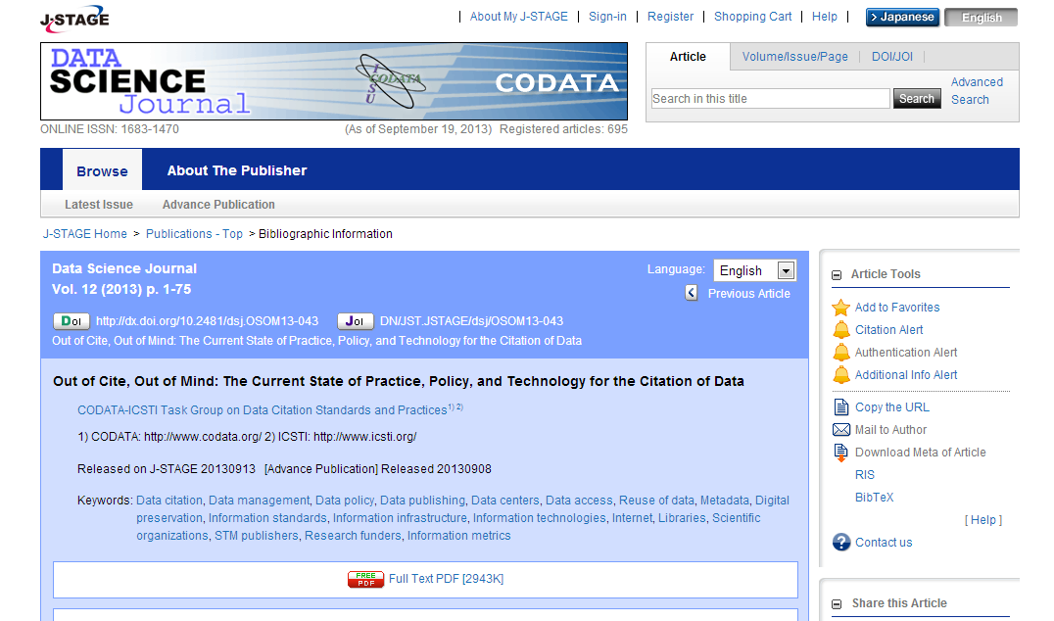
Out of Cite, Out of Mind: Report of the CODATA Task Group on Data Citation
The report was published by the CODATA Data Science Journal on 13 September 2013
Free and open at: https://www.jstage.jst.go.jp/article/dsj/12/0/12_OSOM13-043/_article

Slide 6
First Principles for Data Citation
Considerable International Interest
Amsterdam Manifesto on Data Citation Principles from Force11
DCC Guide
DataCite Metadata Core
RDA focus
Synthesis Group Formed
Consensus Principles and Broad Dissemination Planning In Process
Status of Data
Attribution
Persistence
Access
Discovery
Provenance
Granularity
Verifiability
Metadata Standards
Flexibility

Slide 7
What next for the Task Group and USNC?
Continue work on harmonisation of existing data citation principles with Force11 Synthesis
Compile examples of best practice in data citation
Focus first on Data Citation Principles
Produce a short consensus document for policy and decision makers world-wide.
Focus on dissemination and follow up
Continue interactions with DataCite, Force 11, RDA and others
CODATA General Assembly, New Delhi, Autumn 2014

Slide 8
We are grateful to the following funders of this project:
CODATA
Sloan Foundation
Institute for Museum and Library Services
Library of Congress
Microsoft Research
**************
Further information:
borgman@gseis.ucla.edu
Jan.Brase@tib.uni-hannover.de
sarah.callaghan@stfc.ac.uk
bcarroll@iiaweb.com
puhlir@nas.edu

