Slide 1
Expanded Measures of IP in GDP
J. Steven Landefeld
Director

Slide 2
IP Investment in GDP
Intellectual property products (new category including R&D, software and entertainment, literary and artistic originals) increased the growth rate of real GDP by .19 percentage point, a 7.6% share of growth.
From 1995-2012, incorporating R&D investment increased the growth rate of real GDP by.07 percentage point, a 2.8% share of growth.
Even if IP spillovers are as large as direct effects, the contribution of IP appears to explain only about half of the 1/3 of long-term share of growth accounted for by multi-factor productivity.

Slide 3
IP Investment in GDP
In comparison, private investment in commercial and other types of structures accounted for just over .4 percent of average real GDP growth from 1995-2012.
The contribution to average real GDP growth from IP products is larger than private investment in computers and peripheral equipment.
Recognition of private R&D as investment raises private fixed investment by 10 percent in 2012.

Slide 4
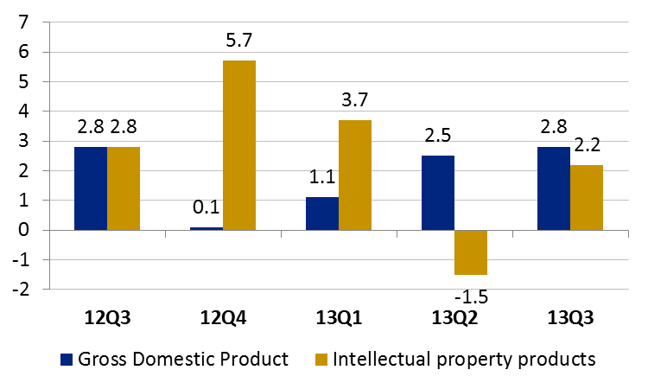
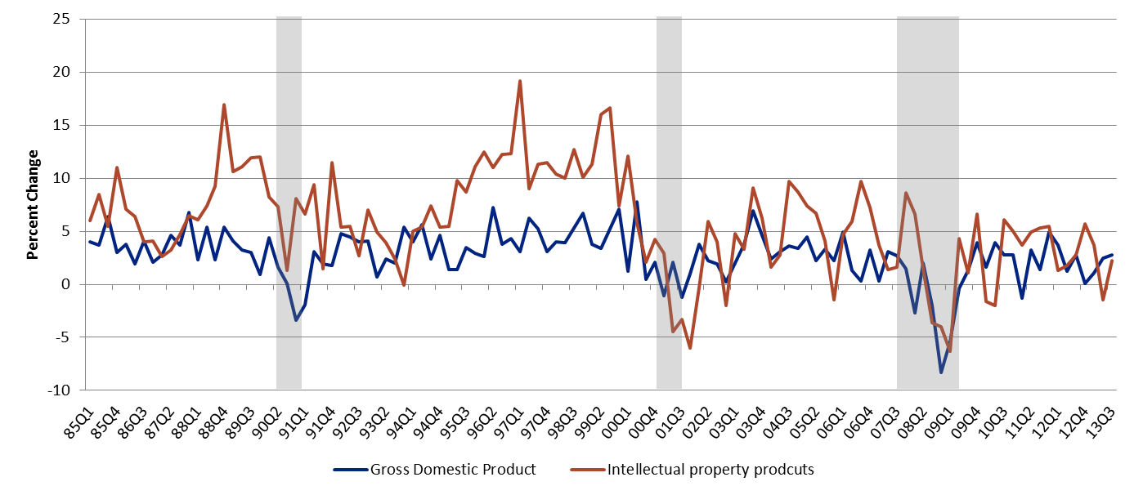
New quarterly detail
[% chg]
Percent Change from preceding period in Real GDP

Slide 5
Performance During Recessions

Slide 6
Performance During Expansions

Slide 7
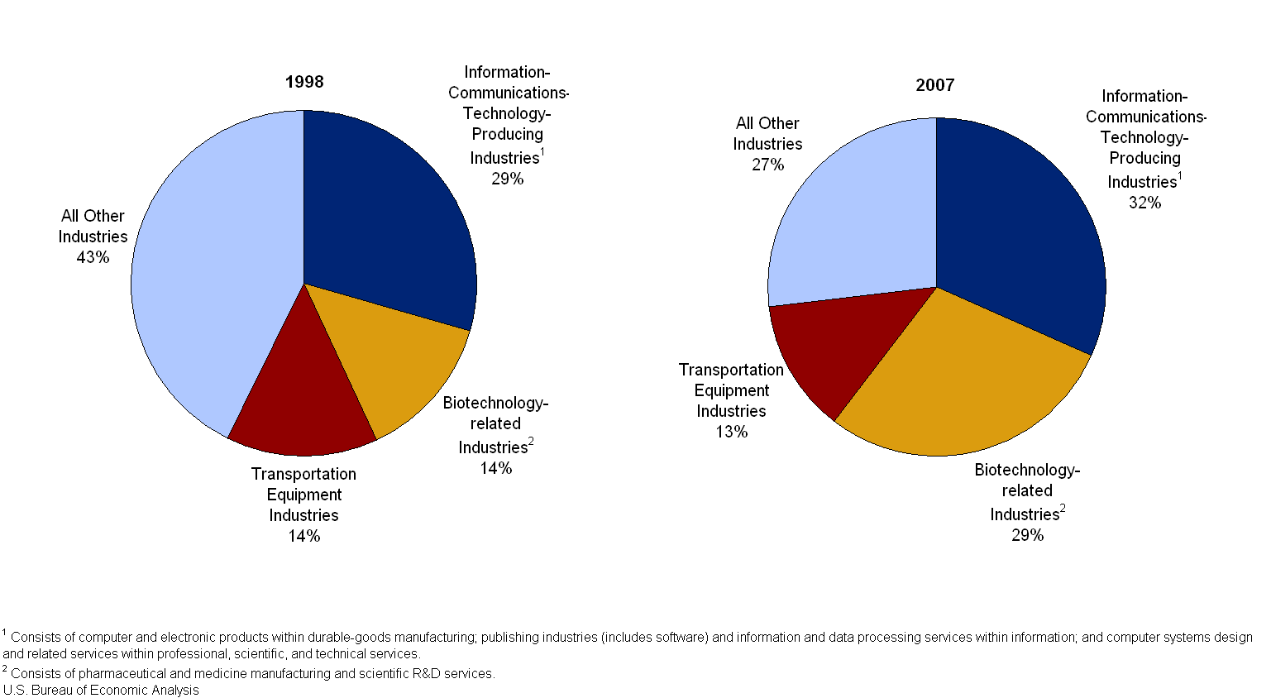
Shares R&D Investment by Industry

Slide 8
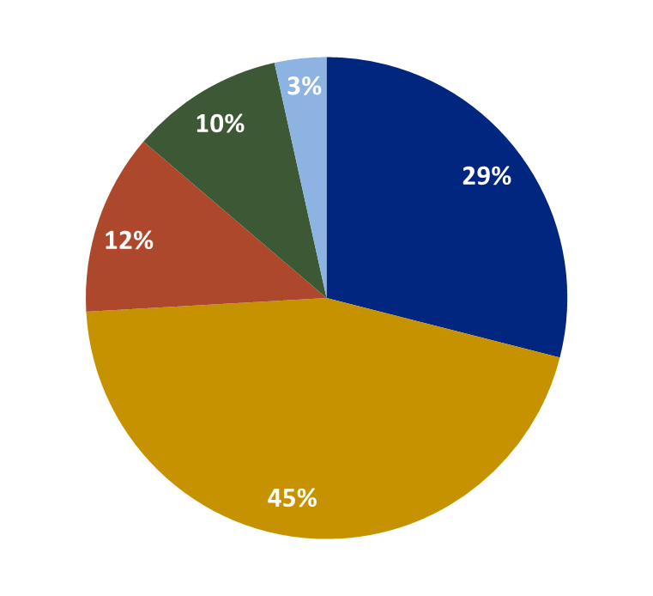
New detail by type of IP
Share of Investment in Entertainment, literary and Artistic Originals by Type
Misc.
Music
Theatrical Movies
Books
Long-Lived Television
Source: BEA
Total Investment in 2012: $74.8 billion

