Slide 1
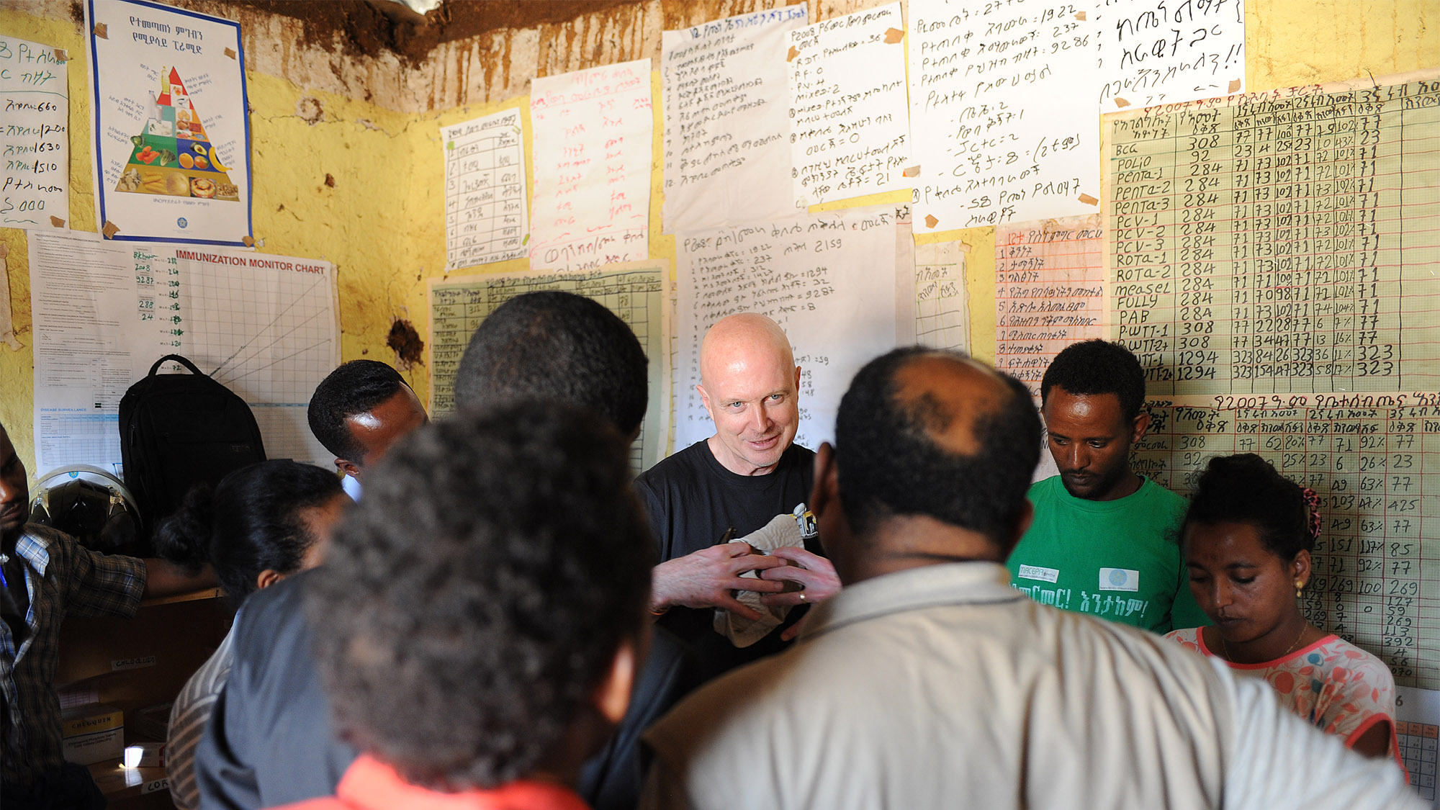
Steve Davis
President and CEO, PATH
May 19, 2016
PATH/Mark Murray

Slide 2
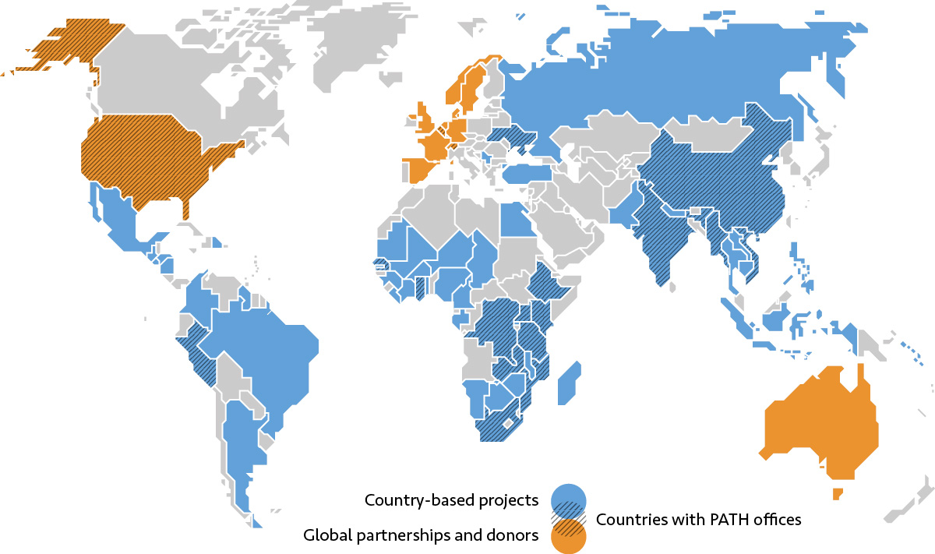
PATH’s global impact
Work in nearly 70 countries; ~1,500 employees
160 million people served in 2014 alone
2016 revenue: ~$310 million
6 billion vaccine vials
monitors ensuring that vaccines are potent when given
221 million children
protected from Japanese encephalitis
6.2 million lives saved
with PATH-pioneered approaches to malaria control

Slide 3
Accelerating global health innovations
Expertise and programs across five platforms
Vaccines
Drugs
Diagnostics
Devices
System & Service
Innovations
Working across the value chain, focusing on the middle
Research /
Design
Develop /
Validate
Approve /
Recommend
Introduce /
Optimize
Scale up /
Apply

Slide 4
PATH’s Center for Vaccine Innovation and Access
PATH vaccine portfolio
(Current highlights)
Shigella Ipa DB Fusion (OSU)
ETEC ST (EntVac)
Transgenic P. berghei (RUMNC, IMM-Lisboa
COLOR KEY
PRECLINICAL
ETEC/Shigella
Influenza
Japanese encephalitis
Live attenuated rotavirus
Malaria
Pneumococcus/ meningococcus
Polio
HPV
Pertussis
MVP Polyvalent (SIIL)
Shigella Invaplex (NMRC)
nOPV2 (Bio Farma)
Pfs25-EPA/AS01 & Pfs230-EBA/As01 (LMIV, GSK)
PHASE 1
Maternal Pertussis
Split Seasonal (IVAC)
Split Seasonal (Torlak)
Fx RTS,S/AS01 (GSK, WRAIR)
Whole Virion H5N1 (IVAC)
SWC Trivalent (PATH)
PCV10+Protein (GSK)
P2-VP8 Monovalent (NIH)
PCV-10 (SIIL)
Shigella WRSS1 (WRAIR)
ETEC ETVAC+dmLT (UG/SBioPharm)
PHASE 2
PATH-wSP (PATH/BCH)
ETEC ACE527+dmLT (PATH)
Pentavalent Hib/HepB/DTP/IPV (BioE)
ETEC FTA+mLT (NMRC)
MR combination (BioE)
PHASE 3 / Registration
BRH (SIIL)
bOPV (BTB)
RTS,S/AS01 pediatric indication(GSK)
Launch and Scale-up
ROTAVAC© (BBIL)
JE (CDIBP)
Maternal Influenza
Meningitis A Sustainability
HPV
*Portfolio snapshot 1Q2016; does not include new/ongoing proposal development work in Dengue, Zika, or Ebola, technical assistance projects in RSV, and ongoing support to EPI in multiple countries.

Slide 5
Drug development & access platform highlights
Malaria: Semisynthetic artemisinin WHO-prequalified, commercially available
HIV:
Long-acting injectable
Microbicide fast-dissolving tablet
Alternative delivery technologies for rilpivirine
Visceral leishmaniasis: PMIM (post-approval/introduction) Registered in India and Nepal, included in national VL elimination programs
Pneumonia: Amoxicillin
Women’s health:
Injectable Depo-Provera®
Oxytocin fast-dissolving tablets
Chlorhexidine for umbilical cord care
New delivery method for treatment of preeclampsia/eclampsia
Notes:
Malaria: Semisynthetic artemisinin (post-approval/introduction). WHO-prequalified, commercially available
HIV:
Long-acting injectable (phase 2)
Microbicide fast-dissolving tablet (discovery/preclinical)
Alternative delivery technologies for rilpivirine (discovery/preclinical)
Visceral leishmaniasis: PMIM (post-approval/introduction). Registered in India and Nepal, included in national VL elimination programs
Pneumonia: Amoxicillin (post-approval/introduction)
Women’s health:
Injectable Depo-Provera® (post-approval/introduction)
Oxytocin fast-dissolving tablets (discovery/preclinical)
Chlorhexidine for umbilical cord care (post-approval/introduction)
New delivery method for treatment of preeclampsia/eclampsia (discovery/preclinical)

Slide 6
Diagnostics platform current highlights
Malaria Diagnostics - G6PD Dx Project:
Collaborating with GSK to accelerate the development of tests for G6PD deficiency
NTD Endgame Project:
Catalyzing Dx industry involvement in new Dx tools for NTDs
Onchocerciasis-Lymphatic Filariasis:
Launched onchocerciasis rapid test in November 2014
Launched oncho-LF biplex test in December 2015
Malaria Diagnostics - DIAMETER-IDT:
Advancing new tools for the elimination
Diabetes:
Exploring low-cost diagnostics
Polio:
Advancing development of diagnostic tests to support eradication
Notes:
Malaria Diagnostics - G6PD Dx Project: Collaborating with GlaxoSmithKline to accelerate the development of tests for G6PD deficiency (develop/validate)
NTD Endgame Project: Catalyze Dx industry involvement in the development of new Dx tools for NTDs (research/design)
Onchocerciasis-Lymphatic Filariasis: Launched onchocerciasis rapid test in November 2014 (introduce/optimize) and launch oncho-LF biplex test in April 2016 (develop/validate)
Malaria Diagnostics - DIAMETER-IDT: Advance new tools for the elimination of malaria (research/design)
Diabetes: Exploration of low-cost diagnostics (develop/validate)
Polio: Advance the development of diagnostic tests to support eradication (research/design)

Slide 7
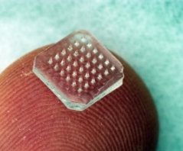
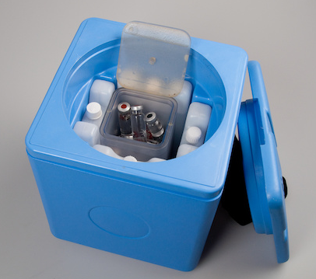
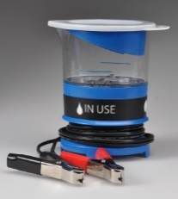
Devices and tools platform current highlights
AREAS OF FOCUS
Vaccine formulation & stabilization technologies
EXAMPLES OF CURRENT WORK
Formulation and assay assistance to manufacturers
Heat/freeze stabilization
Sublingual immunization
Vaccine packaging and delivery devices
Novel primary containers
Multi-mono dose
Micro-needle patches
Prefilled and safety syringes
Vaccine supply/cold chain systems and equipment
Bar codes
Freeze-free vaccine carriers
Solar-powered equipment
Refrigerator and passive cold box testing
Temperature monitoring
RMNCH
SILCS diaphragm
Woman’s Condom
Uterine balloon tamponade
Newborn oxygen blender
WASH
Smart electro-chlorinator
C1 water filter

Slide 8
System and service innovations platform highlights
Essential medicines & technologies for diabetes (Kenya and Senegal)
Urban health TB delivery system designs (India)
Integrated maternal & child health in first 1000 days (South Africa, Mozambique, Ghana)
Immunization data initiative (Zambia, Tanzania, multiple countries)
Digital tools for community-based behavior change (India, Ethiopia, Vietnam)
Human milk banking tools & operational models (multiple countries)
New operational models for malaria control and elimination - MACEPA & Malaria Care (multiple countries)
Community-based HIV & other infectious disease prevention & treatment - ProVIC and APHIAplus (DRC & Kenya)
Injectable contraceptive operational research for community-based distribution (multiple sub-Saharan African countries)
Advocacy for improving quality, availability and accessibility of health services (Uganda)

Slide 9
Notes:
To give you a snapshot of how the global health innovation landscape looks today, I’d like to tell you about IC2030, a PATH-led initiative, creating a platform to identify, assess, and showcase high-impact innovations that could help accelerate progress toward global goals and transform global health by 2030. The platform brings together some of the world’s leading experts to identify, evaluate, discuss, and collaborate on exciting innovations that could be game-changers.
Last year we published Reimagining Global Health, featuring 30 high-impact innovations selected by independent global experts for their promise to save lives, as well as commentaries by health, technology, and business leaders on the essential role of innovation in driving health impact.
IC2030 complements other innovation initiatives by looking across the traditional siloes of global health to identify broad opportunities and potential gaps in the innovation pipeline.

Slide 10
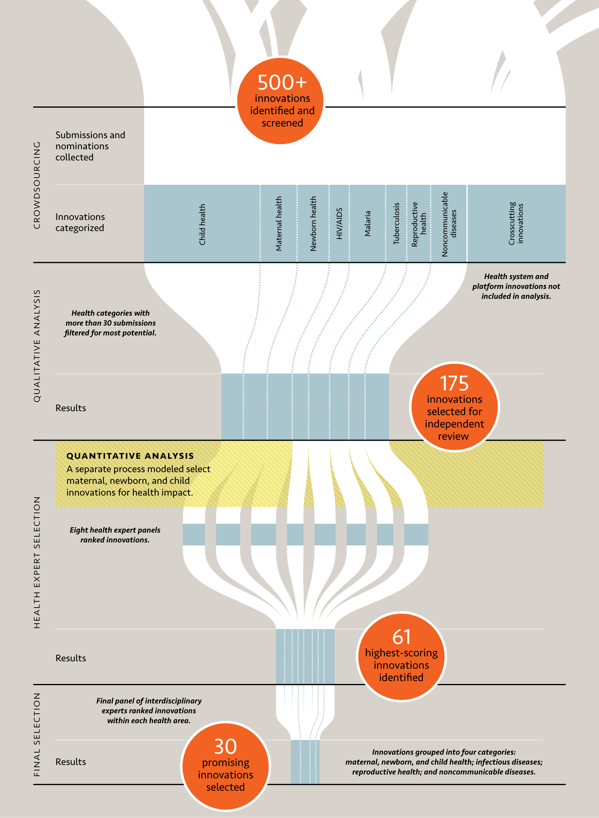
Notes:
IC2030 method:
Crowdsourced innovations from around the world resulting in 500+ innovation nominations.
Developed and utilized a qualitative methodology to narrow the list of submitted innovations to a more manageable number.
Engaged over 60 thought leaders to select innovations.
Performed health impact modeling to estimate costs and lives saved for select maternal, newborn, and child innovations.
Share findings at global events.

Slide 11
High-impact health innovations
can save lives.
“Rapid adopters” achieve an additional decrease in their under-five mortality rate of about 2% per year
PATH/Gabe Bienczycki
Notes:
Now we’re at the starting line of a new era in global health. The new health goals will allow the global community to build on that progress by being more intentional about our approach and prioritizing innovations with the greatest potential to save lives.
According to the Lancet Commission's Global Health 2035 report “Empirical research has shown that countries that adopt such innovations see acceleration in their health progress. These ‘rapid adopters’ achieve an additional decrease in their under-five mortality rate of about 2% per year, compared with countries that do not take up these technologies. Only with this ‘accelerator’ effect was convergence achieved.” Achieving a grand convergence in global health within a generation would avert about 10 million deaths annually from 2035 onward.

Slide 12
Trends in Global Health Innovation
Shifting issues & burdens:
NCDS; pandemic response & preparedness; climate
Increased multisector solutions, especially in LMICs
Shifting geographic ecosystem
Data, data, data &
digital health solutions
End-to-end approaches and platform models
Scale matters

Slide 13
Highlighted PATH – USAID Innovation Program Collaborations
Health Tech Program
Three decade collaboration has evaluated over 100 technologies, bringing to scale products that have reached tens of millions
Chlorhexidine Working Group
PATH leads an international collaboration committed to advancing the use of chlorhexidine for cord care across more than a dozen countries
Saving Lives at Birth
Through this Grand Challenge, PATH has advanced technologies to address the greatest causes of maternal and neonatal death
Malaria Vaccine Development Program
10 year collaboration to advance malaria vaccines
Innovations across numerous other programs
10 year collaboration to advance malaria vaccines
Notes:
HealthTech is a cooperative USAID agreement with PATH that develops, adapts, evaluates and/or facilitates the introduction of affordable and appropriate technology solutions for safe, effective, and more equitable distribution of health care services in low-resource countries. This project is addressed implementation barriers (e.g., issues with technical design, supply chain management, and policy) that typically prevent innovative technologies from reaching the most vulnerable populations.
PATH, as the secretariat of the Chlorhexidine Working Group, leads an international collaboration of organizations committed to advancing the use of 7.1% chlorhexidine digluconate for umbilical cord care through advocacy and technical assistance. PATH is working to establish manufacturing in selected African countries to increase availability of the product at affordable pricing.
PATH has received a number of awards through Saving Lives at Birth to advance technologies such as the UBT and new formulations of drugs to treat eclampsia/preeclampsia and post partum hemorrhage.
For 10 years, USAID supported PATH’s work to advance new malaria vaccines.

Slide 14
Observations & Suggestions
Photo courtesy of Zimba
Notes:
Investments must be made not just in individual technologies or processes, but in strengthening the entire system that supports innovation—including regulatory systems, research infrastructure, and human resources capacity.
Innovation opportunities must better drive user-centric solutions that are demand- driven, relevant, and provide affordable solutions.
USAID should examine strengthening the entire system, ranging across goal setting, design, implementation, intellectual property, and distribution.

Slide 15
@SteveDavisPATH
@PATHtweets
PATHglobalhealth
www.path.org
PATH/Eric Becker
Notes:
A recent journal article* stated: “Eliminating diseases requires not only the right tools, but also the system to deliver them in a timely and efficient manner. This requires a different type of innovation that is dependent on local capacity and implementation science, where we move from the question of ‘can this work’ to ‘how can it work here?’ We have learned that new tools will not deliver themselves.”
* Eliminating the Neglected Tropical Diseases: Translational Science and New Technologies

