Slide 1

Slides
Steve C. Gold
Professor of Law
Rutgers School of Law-Newark
Michael D. Green
Williams Professor of Law
Wake Forest University School of Law
Joseph Sanders
A.A. White Professor of Law
University of Houston Law Center
The copyright in this module is owned by the authors of the module, and may be used subject to the terms of the Creative Commons Attribution-NonCommercial 4.0 International Public License. By using or further adapting the educational module, you agree to comply with the terms of the license. The educational module is solely the product of the authors and others that have added modifications and is not necessarily endorsed or adopted by the National Academy of Sciences, Engineering, and Medicine or the sponsors of this activity.
The content of the slides is the authors’ own except where indicated otherwise.

Slide 2
A “but For” cause
Y
X

Slide 3
Multiple But-for causes (Necessary element of a sufficient set)
Lit Room
E.g., Working Bulb
Light Switch

Slide 4
FRAMING THE CAUSAL ISSUE
Stubbs’ Typhoid
(outcome)
Holly/Hemlock Intermingling
(Cause)

Slide 5
Multiple Competing causes
Lung Cancer
Unknown Causes
Smoking
Radon
Asbestos

Slide 6
Multiple Competing causes
Stubbs’ Typhoid
Unknown Causes
Flies
Raw Fruits
Holly/Hemlock Intermingling
Etc.

Slide 7
FRAMING THE CAUSAL ISSUE
Stubbs’ Typhoid
(outcome)
Δ’s Negligence in Holly/Hemlock Intermingling
(Cause)

Slide 8
FRAMING THE CAUSAL ISSUE
Stubbs’ Typhoid
(outcome)
Holly/Hemlock Intermingling
(Cause)

Slide 9
The causal role of susceptibility
Typhoid
Susceptible Victim
Exposure to Infected Individual

Slide 10
SOURCES OF DISEASE

Slide 11
SOURCES OF TYPHOID
Shell Fish
Raw Fruits
Milk
Flies
Polluted Water
Others Infected
Ice
Unknown

Slide 12
TYPHOID AS A SIGNATURE DISEASE OF BACILLUS SALMONELLA TYPHI
Typhi Bacteria

Slide 13
EPIDEMIOLOGY
The study, through empirical methodology, of the causes of human disease.
Epidemiology studies disease in groups of human beings.
Epidemiology is not an examination of causation for a single individual.

Slide 14
GOALS
What is epidemiology?
What types of epidemiology studies exist? How are they different?
What are the outputs of an epidemiology study?; What do they mean?
Why might those outputs be erroneous or invalid?
When do those outputs support an inference of causation?
How does epidemiology translate into proving cause in fact in toxic substances cases?

Slide 15
Epidemiology’s Causal Inquiry
Greater Incidence of Disease in a Studied Group Exposed to an Agent
Greater Incidence of Disease in a Studied Group
Exposure to the Agent

Slide 16
EXPERIMENTAL STUDY
All variables controlled by investigators.
Gold Standard: Randomized; Double Blind; Prospective
Unethical for known or suspected toxic substances.

Slide 17
OBSERVATIONAL
No control over exposure to agent being studied.
“Observe” those who are exposed to agent.
Compare with control group not exposed.
May be either retrospective or prospective.

Slide 18
TYPES OF EPI STUDIES
Cohort: Comparison of exposed and unexposed populations for disease incidence.
Case-control: Comparison of exposure rate among those with disease and control group without disease.
Cross-sectional: Comparison at single point in time.
Ecological: Population data about exposure and disease, e.g., incidence of colon cancer in the U.S. compared to Italy.

Slide 19
COHORT STUDY DESIGN
DEFINED
POPULATION
EXPOSED
NOT EXPOSED
DEVELOP
DISEASE
DO NOT DEVELOP DISEASE
DEVELOP
DISEASE
DO NOT DEVELOP DISEASE
SOURCE: National Research Council. Reference Manual on Scientific Evidence: Third Edition. Washington, DC: The National Academies Press, 2011, p. 558. Copyright © 2011 National Academy of Sciences.

Slide 20
Table 1. Cross-Tabulation of Exposure by Disease Status
 | No Disease | Disease | Totals | Incidence Rates of Disease
Not Exposed | a | c | a + c | c / (a + c)
Exposed | b | d | b + d | d / (b +d)
SOURCE: National Research Council. Reference Manual on Scientific Evidence: Third Edition. Washington, DC: The National Academies Press, 2011, p. 558. Copyright © 2011 National Academy of Sciences.

Slide 21
CASE-CONTROL STUDY DESIGN
Cases
Controls
Disease
No Disease
Exposed
Not Exposed
Exposed
Not Exposed
SOURCE: Adapted from National Research Council. Reference Manual on Scientific Evidence: Third Edition. Washington, DC: The National Academies Press, 2011, p. 560. Copyright © 2011 National Academy of Sciences.

Slide 22
Table 2. Cross-Tabulation of Disease by Exposure Status
 | Exposure | No Exposure | Totals | Exposure Odds
Cases | a | c | a + c | a / c
Controls | b | d | c + d | b / d

Slide 23
Deaths and death rates from cholera i
n London 1854 in households supplied by the
Southwark and Vauxhall Water Company and by the Lambeth Water Company
Deaths
Cholera
per 10,000
Houses
deaths
houses
---------------------------------------------------------------------------------------
---------
Southwark and Vauxhall
40,046
1,263
315
Lambeth Company
26,107
98
37
Rest of London
256,423
1,422
59
------------------------------------------------------------------------------------------------
SOURCE: Republished with permission of Oxford University Press – Journals, from W. Winkelstein, Jr., “A New Perspective on John Snow’s Communicable Disease Theory,” Am J Epidemiol. 142 (9 Suppl): S8 (1995); permission conveyed through Copyright Clearance Center, Inc.

Slide 24
ASSOCIATION
Exists when there is a difference in the incidence (of disease or exposure) in the two groups being studied.
Suggests, but does not prove, a causal relationship.

Slide 25
What Does the Existence of an Association Mean?
First, and most important, it is not sufficient for an inference of causation.
It is necessary for an inference of causation but not sufficient for one.
Thus, while an association may reflect a causal relationship, it may be the result of error:
Random error
Bias
Confounding

Slide 26
RELATIVE RISK
Rate of disease in exposed group divided by rate in non-exposed (control) group.
^{I}e
^{I}c
RR =

Slide 27
^{I}e
^{I}c
^{d}
^{b + d}
=
RR =
^{c}
^{a + c}
=

Slide 28
EXAMPLE OF RR
EXPOSED GROUP
40 Disease cases per 100 persons per year: I_{e} = .4
CONTROL GROUP
20 Disease cases per 200 persons per year: I_{c} = .1
.4
= 4.0
RR =
= 4.0
.1

Slide 29
ODDS RATIO
Odds that case (one with the disease) was exposed to the agent divided by the odds that a control (one without the disease) was exposed
EO_{ca}
OR =
EO_{co}
ca = cases
co = controls

Slide 30
Table 2. Cross-Tabulation of Disease by Exposure Status
 | Exposure | No Exposure | Totals | Exposure Odds
Cases | a | c | a + c | a / c
Controls | b | d | c + d | b / d
^{EO}ca
^{EO}co
d
b
=
OR =
c
a
=

Slide 31
EXAMPLE OF OR
Cases
40 Cases exposed; 60 unexposed:
Controls
20 Control exposed; 80 unexposed:
EO_{ca} = 40/60 = .67
EO_{co} = 20/80 = .25
.67
= 4.0
OR =
= 2.67
.25

Slide 32
APR CONCEPT
Risks in Exposed and Unexposed Groups
Incidence Due to Exposure
Incidence Not Due to Exposure
Exposed Group
Unexposed Group
SOURCE: National Research Council. Reference Manual on Scientific Evidence: Third Edition. Washington, DC: The National Academies Press, 2011, p. 570. Copyright © 2011 National Academy of Sciences.

Slide 33
SOURCES OF DISEASE

Slide 34
RR For AGENT X
3
10,000
2
10,000
^{I}e
^{I}c
RR = = = 1.5

Slide 35
APR FORMULA
RR - 1
RR
APR =
EXAMPLE
RR = 1.5
1.5 - 1
1.5
APR = = .33

Slide 36
AR from RR
Rate of disease in exposed group divided by rate in non-exposed (control) group.
^{I}e ^{- I}c
^{I}e
AR =

Slide 37
Adjustment
Necessary when two study populations have different characteristics that relate to the risk of disease outcome, e.g., age and death.
Used during data analysis to “tease out” the effect of those different characteristics, such as age.

Slide 38
The Problem Requiring Adjustment

Slide 39
Population 1
Group | Age (years) | Total Population | Deaths | Death Rate per 100
1 | 0-24 | 150 | 5 | 3
2 | 25-49 | 100 | 9 | 9
3 | 50-74 | 100 | 14 | 14
4 | 75+ | 170 | 24 | 12
Total |  | 520 | 52 | 10
Population 2
Group | Age (years) | Total Population | Deaths | Death Rate per 100
1 | 0-24 | 230 | 13 | 6
2 | 25-49 | 125 | 13 | 10
3 | 50-74 | 85 | 13 | 15
4 | 75+ | 70 | 13 | 19
Total |  | 520 | 52 | 10

Slide 40
Group | Age | Population age-specific death rate | Population 2 age-specific death rate
1 | 0-24 | 3 | 6
2 | 25-49 | 9 | 10
3 | 50-74 | 14 | 15
4 | 75+ | 12 | 19

Slide 41
Adjustment
Direct adjustment: Use the two study populations to create a reference/standard population for each that then removes age from consideration. Enables the researcher to determine comparable outcome rates as if age distribution in both populations were the same
Standard/Reference population can be the two study populations combined or national (U.S.) population

Slide 42
Adjustment
Indirect Adjustment: Employed when the age distribution of the study population is unknown and employs age specific rates from a standard/reference (e.g., U.S.) population.
The result is a Standardized Mortality (or Morbidity) Rate, abbreviated SMR that is equivalent to the Relative Risk.

Slide 43
SOURCES OF ERROR
Sampling Error
Bias
Confounding

Slide 44
SIGNIFICANCE TESTING
Concerned only with random error.
Assesses plausibility the test outcome would occur if no difference exists.
Designed to avoid conclusions that there is a difference when no difference exists (false positives).

Slide 45
Some Definitional Preliminaries
False positives
False negatives
The “true” or “real” association
The “study outcome”

Slide 46
What is p?
P is the probability of finding the study result or a greater one if there is no “true association,” i.e., the true case is that there is a relative risk of 1.0.

Slide 47
The Relationship Between Random Error and Statistical Significance
p ≠ Probability of Random Error

Slide 48
See Ethyl Corp. v. United States Envtl. Protection Agency, 541 F.2d 1, 28 n.58 (D.C. Cir.), cert. denied, 426 U.S. 941 (1976); Capizzano v. Sec'y of Health & Human Servs., 440 F.3d 1317 (Fed. Cir. 2006) (contrasting the medical research standard of “very near certainty--perhaps 95% probability” to the standard applied in civil cases, the preponderance standard); Hodges v. Secretary Dep’t Health & Human Servs., No. 92-5089, 1993 U.S. App. LEXIS 29590, at *29, 41 (Fed. Cir. Nov. 15, 1993) (Newman, J., dissenting); Almeida v. Secretary, DHHS, No. 96-412V, 1999 U.S. Claims LEXIS 294 (Ct. Fed. Claims Dec. 20, 1999); In re Ephedra Products Liability Litigation, 393 F. Supp. 2d 181 , 192-93 (S.D.N.Y. 2005); Marmo v. IBP, Inc., 360 F. Supp. 2d 1019 (D. Neb. 2005) (expert toxicologist who stated that science requires proof with 95 percent certainty while expressing his understanding that the legal standard to require more probable than not); Liable v. Sec'y of Health & Human Servs., 98-120V, 2000 WL 1517672 (Fed. Cl. Sept. 7, 2000) (“The crucial fact is that the statements were being made in a medical/scientific journal, a context in which attribution of causation is typically not made until a level of very near certainty—perhaps 95% probability—is achieved.16 In this context, the statements are not surprising at all. I certainly do not believe that the available evidence justifies any conclusions about causation—in general or as to specific cases—at anywhere near that 95% level of scientific certainty. But it seems unlikely that the authors of the quoted articles had in mind the lower standard of probability necessary in legal proceedings such as this one—i.e., the requirement that causation be shown to be merely ‘more probable than not.’”); Exxon Corp. v. Makofski, 116 S.W.3d 176 (Tex. Ct. App. 2003) (expert testified that while science requires proof to a 95 percent certainty, appropriate standard for testifying in court is 51 percent); Richard Goldberg, Causation and Risk in the Law of Torts: Scientific Evidence and Medicinal Product Liability 105 (1999); Larry Laudan, Truth, Error, and Criminal Law: An Essay in Legal Epistemology 64-65 (2006); K.S. Shrader-Frechette, Risk and Rationality: Philosophical Foundations for Populist Reforms 132-34 (1991); Ronald J. Allen, Expertise and the Daubert Decision, 84 J. Crim. L. & Criminology 1157 (1994); Margaret A. Berger What Has a Decade of Daubert Wrought?, 95 Am. J. Pub. Health S59, S62 (2005); Margaret A. Berger & Aaron D. Twerski, Uncertainty and Informed Choice: Unmasking Daubert, 104 Mich. L. Rev. 257 (2005) ("despite the fact that researchers use a stringent scientific standard of proof that far exceeds the preponderance of the evidence standard that applies in civil litigation"); Neil B. Cohen, Confidence in Probability: Burdens of Persuasion in a World of Imperfect Knowledge, 60 N.Y.U. L. Rev. 385 (1985); Mark P. Denbeaux & D. Michael Risinger, Kumho Tire and Expert Reliability: How the Question You Ask Gives the Answer You Get, 34 Seton Hall L. Rev. 15, 46-47 (2003); Edward J. Imwinkelried, The Admissibility of Expert Testimony in Christophersen v. Allied-Signal Corp.: The Neglected Issue of the Validity of Nonscientiﬁc Reasoning by Scientiﬁc Witnesses, 70 Denv. U. L. Rev. 473, 478 (1993); Harvey S. Frey, Letter, When Scientific Data Become Legal Evidence, 324 Sci. 335 (Apr. 17, 2009); James E. Hulverson, Jr., Reasonable Degree of Medical Certainty: A Tort et a Travers, 31 St. Louis U. L.J. 577, 590 (1987); Jeff L. Lewin, The Genesis and Evolution of Legal Uncertainty about "Reasonable Medical Certainty", 57 Md. L. Rev. 380, 400 (1998); Andrew A. Marino & Lawrence E. Marino, The Scientific Basis of Causality in Toxic Tort Cases, 21 U. Dayton L. Rev. 1, 23-24 & n. 57 (1995); Paul R. Rice, The Quagmire of Scientific Expert Testimony: Crumping the Supreme Court’s Style, 68 Mo. L. Rev. 53, 58-60 (2003) (“In fact, most quantitative sciences impose something in the neighborhood of a 95% confidence level. In evidence parlance, this might be the equivalent of establishing . . . admissibility . . . beyond a reasonable doubt.”); Wayne Roth-Nelson & Kathey Verdeal, Risk Evidence in Toxic Torts, 2 Envt’l Law. 405, 415-16 (1996) (authors, two Ph.D. scientists, endorse views of Judge Newman in Hodges); Carl Cranor has written an ambitious and illuminating book, Regulating Toxic Substances: A Philosophy of Science and the Law (1993); Erica Beecher-Monas, Blinded by Science: How Judges Avoid the Science in Scientific Evidence, 71 Temp. L. Rev. 55, 71 n. 110(1998) (citing Carl Cranor for “a discussion of the appropriateness of applying the 95% confidence interval to the regulatory context and tort law”); William M. Sage, Lessons from Breast Implant Litigation, 15 Health Affairs 206, 209 (1996) (preponderance of the evidence standard “suggests a p-value of roughly 0.49 (or a 51 percent confidence interval)”); Leslie J. Sheffield & Ron Batagol, The Creation of Therapeutic Orphans–or, What Have We Learned from the Debendox Fiasco, 143 Med. J. Australia 143, 146 (1985); Steven R. Weller, Book Review: Regulating Toxic Substances: A Philosophy of Science and Law, 6 Harv. J. L. & Tech. 435, 436, 437-38 (1993)(“only when the statistical evidence gathered from studies shows that it is more than ninety-five percent likely that a test substance causes cancer will the substance be characterized scientifically as carcinogenic. . . to determine legal causality, the plaintiff need only establish that the probability with which it is true that the substance in question causes cancer is at least fifty percent, rather than the ninety-five percent to prove scientific causality”); Raymond E. Gangarosa et. al., Suits by Public Hospitals to Recover Expenditures for the Treatment of Disease, Injury and Disability Caused by Tobacco and Alcohol, 22 Fordham Urb. L.J. 81, 139 (1994)(“Conversely, the probability that the attributable risk was not obtained by chance alone is 99.9%, which clearly exceeds the >50% “more likely than not” threshold. Thus, in establishing an epidemic, the P-value, and not the attributable risk, is the relevant measure to compare against standards of proof.”); Sheila Jasanoff, Science at the Bar: Law, Science, and Technology in America 10 (1995); Cornelia Dean, When Questions of Science Come to a Courtroom , Truth Has Many Faces, N.Y. Times, Dec. 5, 2006, at § F (“Typically, scientists don't accept a finding unless, statistically, the odds are less than 1 in 20 that it occurred by chance. This standard is higher than the typical standard of proof in civil trials (‘preponderance of the evidence’) and lower than the standard for criminal trials (‘beyond a reasonable doubt’)”); William Glaberson, The Courts vs. Scientific Certainty, N.Y. Times, June 27, 1999, at § 4, p. 5 (“Science, which never stops searching for answers, has a high threshold for reaching scientific conclusions: 95 percent certainty, some scientists say, is necessary to decide that one thing probably caused another. But the law must stop its search at the conclusion of each case. So juries in civil cases are told that a mere preponderance of the evidence–51 percent–is enough certainty to render a verdict.”); Michael J. Saks, Judging Admissibility, 35 J. Corp. L. 135, 153 (2009) (“Finally, why should studies, or opinions based on them, be admissible only if the studies show differences significant at below some conventional level of probability for research (such as p<.05 or p<.01) when the ultimate decision in the case is effectively set at a much different level (preponderance of the evidence being akin to p<.50)?"). Even the Carnegie Commission has made this error. See Carnegie Commission on Science, Technology, and Government, Science and Technology in Judicial Decision Making: Creating Opportunities and Meeting Challenges 28 (1993) (“But judicial decisions that appear to be based on ‘bad science’ may actually reflect the reality that the law requires a burden of proof or confidence level, other than the 95 percent confidence level that is often used by scientist to reject the possibility that chance alone accounts for observed differences.”).

Slide 49
Relative Risk

Slide 50
What is a confidence interval?
•A confidence interval is a range of possible values for the true association calculated from the study results.
•For a 95% confidence interval, the width of the interval reflects the results we would expect to get if we repeated the same study.
• Thus, the width reflects the range of results we would get due to random error in 95% of those repeated studies

Slide 51
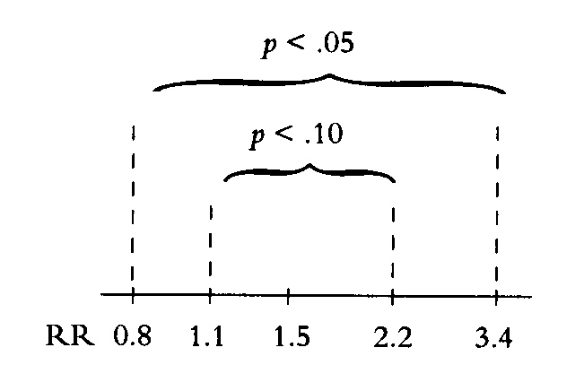
Figure III-4. Confidence Intervals
SOURCE: National Research Council. Reference Manual on Scientific Evidence: Third Edition. Washington, DC: The National Academies Press, 2011, p. 580. Copyright © 2011 National Academy of Sciences.

Slide 52
POWER
Expresses the ability of the study to find a specified relative risk with statistical significance.
For Epidemiologic studies that are not statistically significant, the confidence interval helps reveal whether the study should be interpreted as exonerative or inconclusive based on the role of chance.

Slide 53
TYPES OF BIASES
Selection Bias: Differences between selected cohorts produce skewed results.
Information Bias: information about exposure or disease in the study cohorts is inaccurate.
Conceptual Bias: Study design inadequate to find effect of interest.
Dozens of other biases have been identified and may exist in an epidemiologic study.

Slide 54
Agent Orange Potential Control Groups
1) all civilians of a similar age to those in the exposed cohort;
2) all civilian males of a similar age to those in the exposed cohort;
3) all comparable-age males in the military who did not serve in Vietnam when Agent Orange was being sprayed.

Slide 55
For one year, the pesticide malathion was sprayed by helicopter over two counties in the north bay area of California. Concerns were raised about the potential effect on pregnant women that might result in causing birth defects. Several investigators conducted a case-control study. Exposure was determined based on zip codes of residence at the time of birth coordinated with data on where and when spraying occurred with regard to both cases and controls.

Slide 56
CONFOUNDERS
Agent being studied and another agent are correlated (e.g., coffee drinking and smoking.
Other agent has the causal relationship, not the studied agent.
Can occur whenever the studied agent is differentially associated with another risk (or protective) factor.

Slide 57
Evaluating a Suspected Confounding Factor: Smoking in a Study of Alcohol and Emphysema
Table 4. Hypothetical Emphysema Study Data
Drinking Status | Total Cohort |  |  |  | Smokers |  |  |  | Nonsmokers
 | Total | Cases | Incidence | RR | Total | Cases | Incidence | RR | Total | Cases | Incidence | RR
Nondrinkers | 471 | 16 | 0.034 | 1.0* | 111 | 9 | 0.081 | 1.0* | 360 | 7 | 0.019 | 1.0*
Drinkers | 739 | 41 | 0.069 | 2.0 | 592 | 48 | 0.081 | 1.0 | 147 | 3 | 0.020 | 1.0
∗ ”RR” in Table 4 is the relative risk. The relative risk for each of the cohorts is determined based on reference to the risk among nondrinkers, that is, the incidence of disease among drinkers is compared with nondrinkers for each of the three cohorts separately.

Slide 58
HRT and CHD: Study Question
Numerous epidemiologic studies found that women taking hormone replacement therapy (“HRT”) had a lower than normal incidence of coronary heart disease (“CHD”), suggesting that HRT had a protective effect for CHD. Yet, randomized clinical trials showed that HRT caused a small increase in risk of CHD for the exposed cohort. Can these results be reconciled? If so, how?

Slide 59
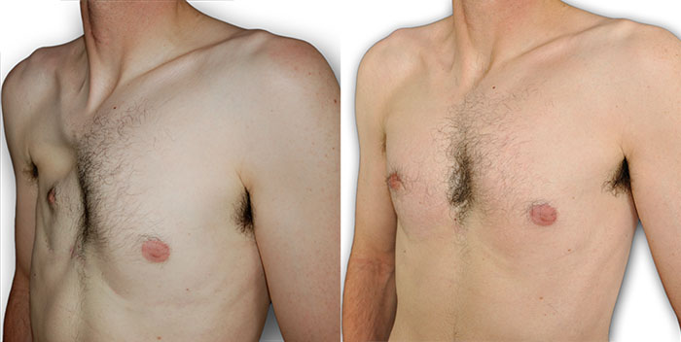
Poland’s Syndrome
SOURCE: https://commons.wikimedia.org/wiki/File:Photo_AvantApres_Poland_Homme_02_700x400.jpg
Images are in the public domain and licensed under the Creative Commons Attribution-Share Alike 4.0 International license.

Slide 60
Brock, 874 F.2d at 309:
Ultimately, the “correctness” of our decision that there was insufficient evidence presented by plaintiff on the issue of whether Bendectin caused Rachel Brock's limb reduction defect to enable a jury to draw a reasonable inference may be just a matter of opinion, but hopefully the reasoning below will persuade others of the insights of our perspective.

Slide 61
HILL CRITERIA FOR IMPLYING CAUSATION FROM AN ASSOCIATION
Temporal relationship
Strength of association
Dose-response relationship
Consistency of association
Biologic plausibility
Alternative explanations
Specificity of association
Consistency with other information

Slide 62
RED WINE DOSE-RESPONSE CURVE
MORTALITY
DOSE
RESPONSE ALL EFFECTS

Slide 63
Kutcher et al. Ecological Study on Bendectin and Birth Defects
SOURCE: Jeffrey S. Kutcher, “Bendectin and Birth Defects II: Ecological Analyses,” 67 Clin. & Molecular Teratology 88 (2003). © 2003 Wiley-Liss, Inc.

Slide 64
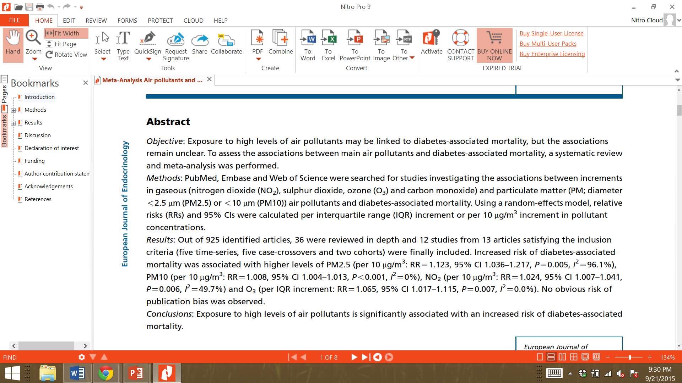
Li Abstract
SOURCE: Abstract from Chengqian Li et al., Main air pollutants and diabetes-associated mortality: a systematic review and meta-analysis, 171 Mechanisms in Endrocrinology 183 (2014). The abstract is Copyright © 2014, Bioscientifica, Ltd.

Slide 65
Furthermore, “[s]cientists believe that, in addition to smoke-related processes, there must be other factors that cause emphysema in the general population since only 15 to 20 percent of smokers develop emphysema.”

Slide 66

Lindquist: Other Factors causing emphysema
Emphysema
Factor X
Smoking
Factor Y

Slide 67
Lindquist: Other Factors causing emphysema
Emphysema
Factor X
Factor Y
Smoking

Slide 68
Lindquist: How smoke might be a cause of emphysema
Emphysema
Fire Smoke
Factor X
Factor Y
Factor Y
Smoking
Smoking

Slide 69
Those studies comparing populations of healthy workers, similar in all relevant respects except fire smoke exposure, present the strongest scientific support for the proposition that firefighting is a significant cause of lung disease.

Slide 70
Table 2 Seattle, Portland, and Tacoma firefighter mortality: 1945-89
Cause of death (ICD 9 codes) | Deaths | SMR | (95%)
All causes (001-999) | 1169 | 0·81 | (0·77-0·86)
All cancers (140-152-2, 156-9-165-9, 170-175, 179-208) | 291 | 0·95 | (0·85-1·07)
Oral and pharyngeal cancers (140-149) | 7 | 0·81 | (0·33-1·66)
Oseophageal cancer (150) | 6 | 0·83 | (0·30-1·80)
Stomach cancer (151) | 16 | 1·07 | (0·61-1·73)
Colon cancer (152, 153) | 24 | 0·85 | (0·54-1·26)
Rectal cancer (154) | 8 | 0·95 | (0·41-1·87)
Biliary passages and liver cancer (155-0-155-1. 156) | 6 | 1·19 | (0·44-2·59)
Pancreatic cancer (157) | 14 | 0·89 | (0·49-1·49)
Laryngeal cancer (161) | 2 | 0·47 | (0·06-1· 70)
Lung cancer (162) | 95 | 0·96 | (0·77-1·17)
Prostate cancer (185) | 30 | 1·34 | (0·90-1·91)
Kidney cancer (189-0-189-2) | 2 | 0·27 | (0·03-0·97)
Bladder and other urinary cancers (188, 189 3-189-9) | 2 | 0·23 | (0·03-0·83)
Skin cancer (172, 173) | 6 | 0·98 | (0·36-2·13)
Brain and nervous system tumours (191, 192, 237 5-237-9, 239-6-239-7) | 22 | 2·09 | (1·31-3·17)
Brain and nervous system cancers (191, 192) | 18 | 2·07 | (1·23-3·28)
Unspecified nervous system tumours (237-5-237-9, 239-6-239 7) | 4 | 2·20 | (0·60-5·62)
Lymphatic/haematopoietic cancers (200-208) | 37 | 1·31 | (0·92-1·81)
Lymphosarcoma and reticulosarcoma (200) | 7 | 1·42 | (0·57-2·93)
Hodgkin's disease (201) | 3 | 1·05 | (0·22-3·08)
Leukaemia(204-208) | 15 | 1·27 | (0·71-2·09)
Other lymphatic/haematopoietic (202, 203) | 12 | 1·40 | (0·72-2·44)
Heart disease (390-398, 402, 404, 410-414, 420-429) | 461 | 0·79 | (0·72-0·87)
Ischaemic heart disease (410-414) | 394 | 0·82 | (0·74-0·90)
Other circulatory disease (401, 403, 405, 415-417, 430-438, 440-459) | 131 | 0·96 | (0·80-1·14)
Cerebrovascular disease (430-438) | 79 | 0·85 | (0·67-1·06)
Diseases of arteries, veins and pulmonary circulation (415-417, 440-459) | 48 | 1·24 | (0·91-1·64)
Respiratory disease (460-466, 470-478, 480-487, 490-519) | 81 | 0·89 | (0·71-1·10)
Acute upper respiratory infection (460-466) | 2 | 3·57 | (0·43-12·9)
Pneumonia (480-486) | 22 | 0·67 | (0·42-1·01)
Chronic respiratory diseases (470-478, 490-519) | 56 | 1·00 | (0·76-1·30)
Emphysema (492) | 20 | 1·19 | (0·72-1·83)
Asthma (493) | 3 | 1·05 | (0·22-3·08)
COPD and other respiratory disease (470-478, 494-519) | 32 | 0·98 | (0·67-1·38)
COPD = Chronic obstructive pulmonary disease.
SOURCE: Paul A. Demers et al., Mortality Among Firefighters from Three Northwestern United States Cities, 49(9) BRITISH J. OF INDUS. MED. 664-670 (1992). Reproduced with permission.

Slide 71
Table 3 Seattle, Portland, and Tacoma firefighter mortality compared with police and police mortality compared with United States white male rates: 1945-89
 | Firefighters v police |  |  |  | Police v United States white men
Cause of death | Deaths | IDR | (95% CI) |  | Deaths | SMR | (95% CI)
All causes | 1169 | 0·87 | (0·79-0·95) |  | 714 | 0·87 | (0·81-0·93)
All cancers | 291 | 0·97 | (0·80-1·17) |  | 169 | 0·95 | (0·81-1·11)
Colon cancer | 24 | 1·58 | (0·73-3·3) |  | 8 | 0·50 | (0·22-0·99)
Rectal cancer | 8 | 0·89 | (0·30-2·66) |  | 5 | 1·11 | (0·36-2·59)
Biliary passages and liver cancer | 6 | 0·71 | (0·19-2·71) |  | 4 | 1·40 | (0·38-3·59)
Trachea, bronchus, and lung cancer | 95 | 0·95 | (0·67-1·33) |  | 55 | 0·92 | (0·69-1·19)
Prostate cancer | 30 | 1·43 | (0·71-2·85) |  | 11 | 1·02 | (0·51-1·82)
Bladder cancer | 2 | 0·16 | (0·02-1·24) |  | 4 | 0·91 | (0·25-2·34)
Emphysema | 20 | 1·45 | (0·54-3·88) |  | 5 | 0·63 | (0·20-1·46)
COPD and miscellaneous lung disease | 32 | 0·89 | (0·47-1·69) |  | 15 | 0·83 | (0·47-1·37)
SOURCE: Paul A. Demers et al., Mortality Among Firefighters from Three Northwestern United States Cities, 49(9) BRITISH J. OF INDUS. MED. 664-670 (1992). Reproduced with permission.

Slide 72
Table 4 Seattle, Portland, and Tacoma firefighter mortality by duration of exposed employment: 1945-89
 | < 10 years |  |  |  | 10-19 years |  |  |  | 20-29years |  |  |  | ≥ 30years
Cause of death | Deaths | SMR | (95% CI) |  | Deaths | SMR | (95% CI) |  | Deaths | SMR | (95% CI) |  | Deaths | SMR | (95% CI)
Colon cancer | 4 | 1·40 | (0·4-3·6) |  | 2 | 0·54 | (0·1-2·0) |  | 9 | 0·62 | (0·3-1·2) |  | 9 | 1·21 | (0·6-2·3)
Prostate cancer | 3 | 2·42 | (0·5-7·1) |  | 2 | 1·12 | (0·1-4·1) |  | 14 | 1·23 | (0·7-2·1) |  | 11 | 1·36 | (0·7-2·4)
Brain and nervous system tumours | 5 | 2·57 | (0·8-6·0) |  | 8 | 3·53 | (1·5-7·0) |  | 6 | 1·24 | (0·5-2·7) |  | 3 | 2·04 | (0·4-5·9)
Lymphatic/haematopoietic cancers | 4 | 0·91 | (0·2-2·3) |  | 7 | 1·46 | (0·06-3·0) |  | 14 | 1·06 | (0·6-1·8) |  | 12 | 2·05 | (1·1-3·6)
Leukaemia | 2 | 1·13 | (0·1-4·1) |  | 2 | 1·04 | (0·1-3·7) |  | 4 | 0·73 | (0·2-1·9) |  | 7 | 2·60 | (1·0-5·4)
Diseases of the arteries, veins, and pulmonary circulation | 4 | 1·36 | (0·4-3·5) |  | 4 | 0·94 | (0·3-2·4) |  | 15 | 0·79 | (0·4-1·3) |  | 25 | 1·99 | (1·3-2·9)
Chronic respiratory diseases | 2 | 0·42 | (0·1-1·5) |  | 5 | 0·82 | (0·3-1·9) |  | 34 | 1·15 | (0·8-1·6) |  | 15 | 0·97 | (0·5-1·6)
Emphysema | 1 | 0·92 | (0·1-5·1) |  | 3 | 1·83 | (0·4-5·3) |  | 12 | 1·35 | (0·7-2·4) |  | 4 | 0·76 | (0·2-1·9)
SOURCE: Paul A. Demers et al., Mortality Among Firefighters from Three Northwestern United States Cities, 49(9) BRITISH J. OF INDUS. MED. 664-670 (1992). Reproduced with permission.

Slide 73
Figure IV-1.
Concentration
Time
Elimination Rate affected by Concentration

Slide 74
Figure IV-2.
Concentration
Time
Elimination is a Constant Over Time

Slide 75
Figure IV-3.
Rate of absorption = rate of elimination
Rate of absorption < rate of elimination
Concentration
Rate of absorption = 0
Rate of absorption >
Rate of elimination
Time
Absorption and Elimination of an Oral Dose
SOURCE: Republished with permission of Taylor and Francis Group LLC Books, from Karen E. Stein and Thomas M. Brown, Principles of Toxicology, Third Edition, 2015; permission conveyed through Copyright Clearance Center, Inc.

Slide 76
Table IV-1 Acute Oral LD₅₀ In Rats: Various Substances
Ethanol 7,000 mg/kg
Sodium chloride 3,000
Salt 3,000
Aspirin 1,000
Caffeine 200
Nicotine 50
Vitamin D 10
Cyanide 10
Botulin toxin 0.00001
SOURCE: Republished with permission of National Science Teachers Association, from Nancy M. Trautmann, Assessing Toxic Risk, Student's Edition, 2001; permission conveyed through Copyright Clearance Center, Inc.

Slide 77
Figure IV-4.
Control Response
Response
Dose
Linear No-threshold (LNT) Model

Slide 78
Figure IV-5.
Control Response
Response
Dose
Linear Threshold Model (LNM)

Slide 79
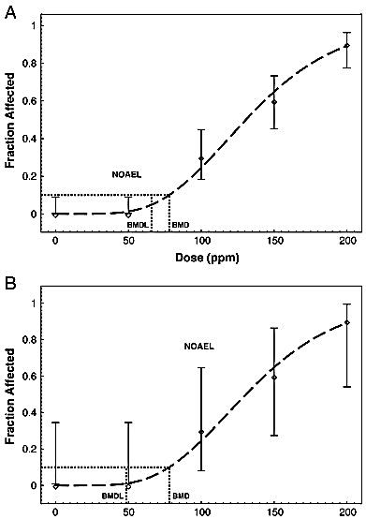
Figure IV-6.
SOURCE: Reprinted from Toxicology and Applied Pharmacology 254(2), J. Allen Davis, Jeffrey S. Gifta, Q. Jay Zhaob, “Introduction to benchmark dose methods and U.S. EPA's benchmark dose software (BMDS) version 2.1.1,” pp. 181-91, (2011), with permission from Elsevier.

Slide 80
Table IV-2.
SOURCE: Reprinted from Toxicology and Applied Pharmacology 254(2), J. Allen Davis, Jeffrey S. Gifta, Q. Jay Zhaob, “Introduction to benchmark dose methods and U.S. EPA's benchmark dose software (BMDS) version 2.1.1,” pp. 181-91, (2011), with permission from Elsevier.

Slide 81
Figure IV-7
MDT
ADVERSE RESPONSE
“Safe” dose
LOAEL
NOAEL
Safety Factors
DOSE
SOURCE: Laura N. Vandenberg et al., “Hormones and Endocrine-Disrupting Chemicals: Low-Dose Effects and Nonmonotonic Dose Responses,” 33(3) Endocrine Reviews 378 (2012). Copyright © 2012. The Endocrine Society.

Slide 82
Figure IV-8
Toxic
RESPONSE
Beneficial
DOSE
Hormesis Effect
SOURCE: Adapted from Edward Calabrese, “Hormesis: Principles & Applications,” Homeopathy (2015) 104, 69, Figure 1B. Copyright © 2015. The Faculty of Homeopathy.

Slide 83
Overview of Exposure, Dose, and Injury
Figure IV-9
Xenobiotic Concentration in the Environment or in a Drug
Route of
Absorption
Dose
Toxicokinetics:
Distribution,
Metabolism,
and Elimination
Toxicodynamics:
Dose to Cells and Organs
Toxic Response:
Susceptibility

Slide 84
Figure IV-10.
Empty stomach
Rate of absorption = rate of elimination
Full stomach
Rate of absorption < rate of elimination
Alcohol Concentration
Rate of absorption = 0
Rate of absorption >
Rate of elimination
Time
Absorption and Elimination Curve by food in stomach
SOURCE: Republished with permission of Taylor and Francis Group LLC Books, adapted from Karen E. Stein and Thomas M. Brown, Principles of Toxicology, Third Edition, 2015; permission conveyed through Copyright Clearance Center, Inc.

Slide 85
Figure IV-11.
Time of arrest
Time of test
Rate of absorption = rate of elimination
Rate of absorption < rate of elimination
Concentration
Rate of absorption = 0
Rate of absorption >
Rate of elimination
Time
Absorption and Elimination of an Oral Dose
SOURCE: Republished with permission of Taylor and Francis Group LLC Books, adapted from Karen E. Stein and Thomas M. Brown, Principles of Toxicology, Third Edition, 2015; permission conveyed through Copyright Clearance Center, Inc.

Slide 86
Figure IV-12.
Time of arrest
Time of test
Rate of absorption = rate of elimination
Rate of absorption < rate of elimination
Concentration
Rate of absorption = 0
Rate of absorption >
Rate of elimination
Time
Absorption and Elimination of an Oral Dose
SOURCE: Republished with permission of Taylor and Francis Group LLC Books, adapted from Karen E. Stein and Thomas M. Brown, Principles of Toxicology, Third Edition, 2015; permission conveyed through Copyright Clearance Center, Inc.

Slide 87
SPECIFIC CAUSATION: DID IT CAUSE THIS PLAINTIFF’S DISEASE?
Remember: Association ≠ Causation. First We Must Decide if Association is Truly Causal.
Converting Relative Risk to Preponderance of the Evidence
External Validity: Is Study Probability (APR) Applicable to Plaintiff?
Assumptions Involved in Converting APR to a a Probability of Specific Causation
Refining the Probability of Causation for a Plaintiff

Slide 88
APR AS A PROBABILITY
SOURCES OF DISEASE

Slide 89
APR FORMULA
RR - 1
RR
APR =
EXAMPLE
RR = 2.0
2.0 - 1
2.0
APR = = .50

Slide 90
SYNERGISTIC AGENTS
RISK FACTORS FOR LUNG CANCER

Slide 91
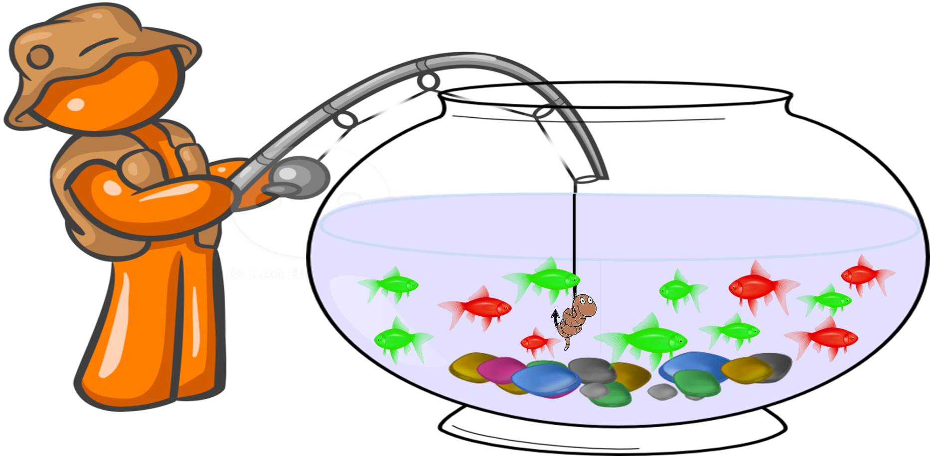
FREQUENTIST PROBABILITY
GREEN FISH: CAUSATION EXISTS RED FISH: CAUSATION DOES NOT EXIST

Slide 92
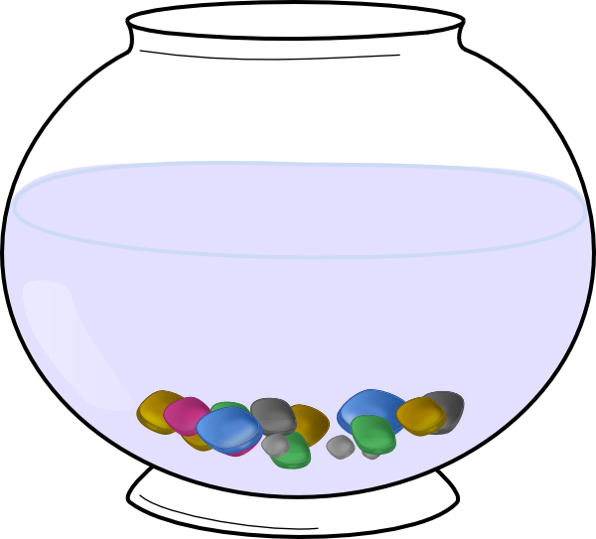





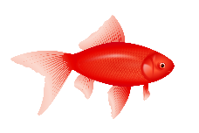




SUBJECTIVIST PROBABILITY
WHICH BOWL DID I COME FROM?

Slide 93
A hypothetical cohort study
 | Exposed |  |  |  | Unexposed
 | S | S | S | S | S | S | S | S | S | S | S | S | S | S | S | S | S | S | S | S | S | S
 | S | S | S | S | S | S | S | S | S | S | S | S | S | S | S | S | S | S | S | S | S | S
 |  |  | exposed, not sick |  |  |  |  |  |  |  |  |  | unexposed, not sick
 |  | S | exposed, sick |  |  |  |  |  |  |  |  | S | unexposed, sick

Slide 94
Hypothetical cohort study refined
 | Exposed |  |  |  | Unexposed
 | S | S | S | S | S | S | S | S | S | S | S | S | S | S | S | S | S | S | S | S | S | S
 |  |  | S | S | S | S | S | S | S | S | S | S | S | S | S | S | S | S | S | S | S | S
 | S | S
 |  |  | exposed subgroup 1, not sick |  |  |  |  |  |  |  |  |  |  | exposed subgroup 2, not sick |  |  |  |  |  |  |  |  |  |  |  |  | unexposed, not sick
 |  | S | exposed subgroup 1, sick |  |  |  |  |  |  |  |  |  | S | exposed subgroup 2, sick |  |  |  |  |  |  |  |  |  |  |  | S | unexposed, sick

Slide 95
Another cohort study hypothetical
 | Exposed |  |  |  | Unexposed
 | S | S | S | S | S | S | S | S | S | S | S | S | S | S | S | S | S | S | S | S | S | S | S | S | S | S | S | S | S
 | S | S | S | S | S | S | S | S | S | S | S | S | S | S | S | S | S | S | S | S | S | S | S | S | S | S | S | S | S
 |  |  | exposed, not sick |  |  |  |  |  |  |  |  |  | unexposed, not sick
 |  | S | exposed, sick |  |  |  |  |  |  |  |  | S | unexposed, sick

Slide 96
Another hypothetical, refined
 | Exposed |  |  |  | Unexposed
 | S | S | S | S | S | S | S | S | S | S | S | S | S | S | S | S | S | S | S | S | S | S | S | S | S | S | S | S | S
 | S | S | S | S | S | S | S | S | S | S | S | S | S | S | S | S | S | S | S | S | S | S | S | S | S | S | S | S | S
 |  |  | exposed subgroup 1, not sick |  |  |  |  |  |  |  |  |  |  | exposed subgroup 2, not sick |  |  |  |  |  |  |  |  |  |  |  |  | unexposed, not sick
 |  | S | exposed subgroup 1, sick |  |  |  |  |  |  |  |  |  | S | exposed subgroup 2, sick |  |  |  |  |  |  |  |  |  |  |  | S | unexposed, sick

Slide 97
Epidemiologic studies of firefighting and NHL in Estate of George

Slide 98
The Role of Information About the Individual Plaintiff
EXPOSURE
increases risk of
DISEASE
the probability that disease is caused by exposure varies among exposed individuals but . . .
The exposed group varies with respect to some other factor so . . .
the epidemiologic study reports the average relative risk . . .
HIGH
HIGH
HIGH
100%
RELATIVE RISK
OTHER FACTOR
50%
2.0
(50%)
This other factor affects the probability of causation
PROBABILITY OF CAUSATION
RELATIVE RISK
which may average to a relative risk that is >1 but <2.
95% CI
0%
1.0
LOW
LOW
LOW
Frequency in exposed group
Frequency in exposed group

Slide 99
The Role of Information About the Individual Plaintiff (Continued)
it can be inferred that exposure more likely than not caused plaintiff’s disease even though exposure caused fewer than half the cases in the exposed group.
therefore has an above-average probability of causation, so . . .
The plaintiff is relatively high in the other factor and . . .
HIGH
HIGH
HIGH
plaintiff is in this range
{
100%
}
}
plaintiff is in this range
and plaintiff is in this range
OTHER FACTOR
50%
2.0
(50%)
PROBABILITY OF CAUSATION
RELATIVE RISK
RELATIVE RISK
95% CI
0%
1.0
LOW
LOW
LOW

Slide 100
Individual Information in Estate of George
FIREFIGHTING
increases risk of
NHL
the probability that NHL is caused by firefighting varies among firefighters but . . .
epidemiologic studies report the average relative risk . . .
Firefighters experience varying amounts of combustion products
HIGH
HIGH
HIGH
100%
RELATIVE RISK
COMBUSTION PRODUCTS
2.0
(50%)
50%
The amount of exposure to combustion products affects the probability of causation
PROBABILITY OF CAUSATION
RELATIVE RISK
which may average to a relative risk that is >1 but <2.
95% CI
0%
1.0
LOW
LOW
LOW
Frequency among firefighters
Frequency among firefighters

Slide 101
Individual Information in Estate of George (Continued)
Mr. George experienced relatively high exposure to combustion products . . .
it can be inferred that firefighting more likely than not caused his NHL even if firefighting caused fewer than half of NHL cases in firefighters.
and therefore had an above-average probability of causation, so . . .
HIGH
HIGH
HIGH
Claimant is in this range
{
}
}
100%
Claimant is in this range
and claimant is in this range
COMBUSTION PRODUCTS
2.0
(50%)
50%
RELATIVE RISK
PROBABILITY OF CAUSATION
RELATIVE RISK
95% CI
0%
1.0
LOW
LOW
LOW

Slide 102
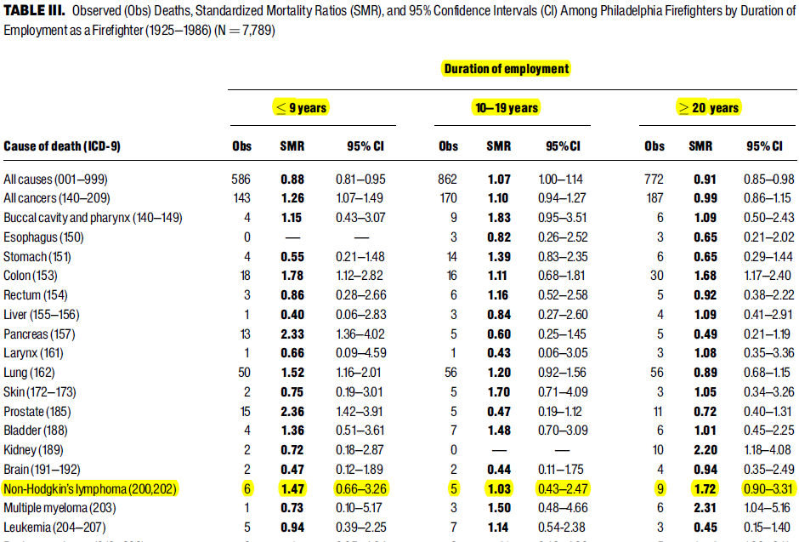
Part of Table III from Baris study.
SOURCE: Dalsu Baris et al., “Cohort Mortality Study of Philadelphia Firefighters,” 39 Am. J. Indus. Med. 463, 463 (2001). The article is a U.S. Government work and, as such, is in the public domain in the United States of America.

Slide 103
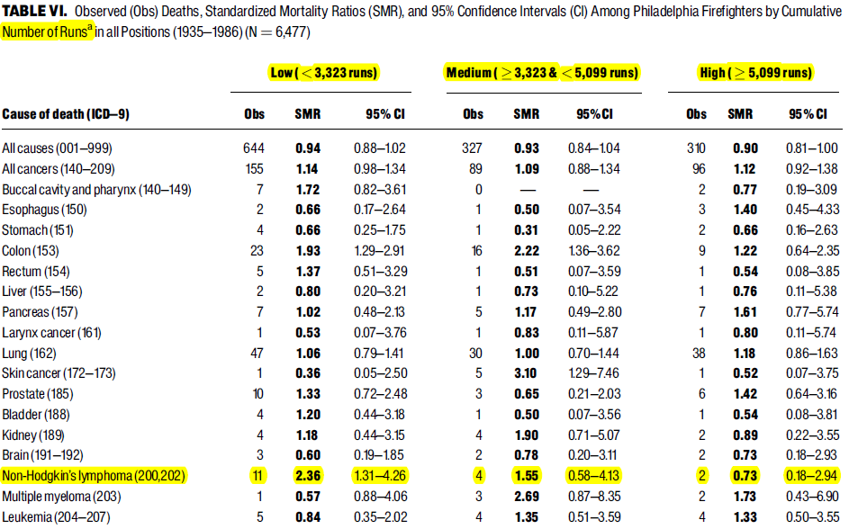
Part of Table VI from Baris study.
SOURCE: Dalsu Baris et al., “Cohort Mortality Study of Philadelphia Firefighters,” 39 Am. J. Indus. Med. 463, 463 (2001). The article is a U.S. Government work and, as such, is in the public domain in the United States of America.

Slide 104
Inheritance of ABO Blood Groups: Genotype
 | Gene inherited from father
Gene inherited from mother |  | A | B | O
 | A | AA | AB | AO
 | B | BA | BB | BO
 | O | OA | OB | OO

Slide 105
Inheritance of ABO Blood Groups: Genotype to Phenotype
If genotype includes: | Phenotype will be:
At least one A, no B | Blood Type A
At least one B, no A | Blood Type B
One A and one B | Blood Type AB
Neither an A nor a B | Blood Type O
 | Gene inherited from father
Gene inherited from mother |  | A | B | O
 | A | Type A | Type AB | Type A
 | B | Type AB | Type B | Type B
 | O | Type A | Type B | Type O

Slide 106
Penetrance
What if some people with the same genotype had different phenotypes? To put it another way: what if a change (mutation) in a gene only sometimes resulted in a change in the phenotype (e.g. a disease)?
Penetrance defined: The Proportion of individuals with a particular allele or genotype who exhibit the associated phenotype of interest
Calculating penetrance:
# of individuals with genotype who exhibit phenotype
divided by
Total # of individuals with genotype

Slide 107
Penetrance, illustrated
* | * | * | * | * | * | * | * | * | *
* | * | * | * | * | * | * | * | * | *
@ | @ | @ | @ | @ | @ | @ | @ | @ | @
@ | @ | @ | @ | @ | @ | @ | @ | @ | @
@ | @ | @ | @ | @ | @ | @ | @ | @ | @
@ | @ | @ | @ | @ | @ | @ | @ | @ | @
@ | @ | @ | @ | @ | @ | @ | @ | @ | @
@ | @ | @ | @ | @ | @ | @ | @ | @ | @
@ | @ | @ | @ | @ | @ | @ | @ | @ | @
@ | @ | @ | @ | @ | @ | @ | @ | @ | @
Most people have the “@” genotype but some have the “*” genotype
Frequency of the * genotype is 20/100 = 0.2 = 20%
Everyone with the @ genotype has the beige phenotype
Some with the * genotype have the purple phenotype
Penetrance of the * genotype with respect to the purple phenotype is 10/20 = 0.5 = 50%

Slide 108
Cystic Fibrosis: an Example of Varying Penetrance
The gene CFTR codes for a protein involved in transporting molecules across cell membranes
Thousands of variations of CFTR are known
Some variants produce cystic fibrosis
Almost all individuals (~ 99%) with certain variations have cystic fibrosis (high penetrance)
But for other variations, only a small percentage (<0.1%) of individuals have cystic fibrosis (low penetrance)

Slide 109
Why Does Penetrance Vary?
In addition to the polymorphic gene,
Regulators of gene expression
Other genes
Environmental factors
all may be involved in determining phenotype.

Slide 110
Why Does Penetrance Vary?
Instead of:
Sometimes
or
or
Polymorphic gene
(blue allele)
Phenotype
Regulator of this gene
Polymorphic gene
(blue allele)
Phenotype
Phenotype
Other genes (various alleles)
Phenotype
Environmental factors
(diet, infectious agents, toxins . . . .)

Slide 111
Genotype to Phenotype: The Sickle-Cell Trait
Gene: HBB – codes for hemoglobin subunit beta
Forms: A – typical; S – one amino acid changed
Genotype | Phenotype
AA | • Produces typical hemoglobin • Does not have symptoms of anemia • If infected by malaria, is relatively susceptible to dying of it
AS | • Produces both typical and variant hemoglobin • Does not have symptoms of anemia except in some conditions (e.g. high-altitude, low-oxygen environments) • If infected by malaria, is relatively resistant to dying of it
SS | • Produces variant hemoglobin • Has symptoms of anemia • If infected by malaria, is relatively susceptible to dying of it

Slide 112
What role might a genetic variation play in causing disease?
To be a but-for cause of a disease, a genetic variation must be a necessary element of a sufficient set that brings about the disease.

Slide 113
Necessary element of a sufficient set (Link in the chain)
Disease
Genetic variant
G0

Slide 114
How might the role of a genetic variation in causing disease affect a toxic tort claim?
Toxin & Gene are necessary elements of the same sufficient causal set

Slide 115
Necessary Elements of the Same Sufficient Causal Set: Concurring Causes
Disease
Genetic variant
G1
Toxic exposure
T1

Slide 116
How might the role of a genetic variation in causing disease affect a toxic tort claim?
Toxin & Gene are necessary elements of the same sufficient causal set
Toxin & Gene are necessary elements of different causal sets

Slide 117
Necessary Elements of Different Sufficient Causal Sets: Competing Causes
Disease
Toxic Exposure
Genetic variant
T1
G1
OR

Slide 118
Competing Causes: The Extreme Case of a Genetic Disease
Disease
G2
Genetic variant
Toxic Exposure
T1

Slide 119
Competing Causes: A More Complex Example (More than One Toxin)
Disease
Toxic Exposure
Genetic variant
T1
G3
OR
T2
Toxic Exposure

Slide 120
Necessary Elements of Different Sufficient Causal Sets: Multiple Sufficient Causes
Disease
Toxic Exposure
Genetic variant
T1
G1
AND

Slide 121
How might the role of a genetic variation in causing disease affect a toxic tort claim?
Toxin & Gene are necessary elements of the same sufficient causal set
Toxin & Gene are necessary elements of different causal sets
Protective effect: Causal set including toxic exposure

Slide 122
Protective Effect Against Causal Set that Includes a Toxic Exposure
Disease
Genetic variant
G4
Toxic exposure
T2

Slide 123
Protective Effect Against Causal Set Competing with Toxic Exposure
Disease
Toxic Exposure
Genetic variant
T1
G5

Slide 124
How might the role of a genetic variation in causing disease affect a toxic tort claim?
Toxin & Gene are necessary elements of the same sufficient causal set
Toxin & Gene are necessary elements of different causal sets
Protective effect: Causal set including toxic exposure
Risk modifier (causal or protective)

Slide 125
Genes as Risk Modifier (Among Others)
Unknown or Background Risk Factors (up or down)
Other Endogenous Risk Factors (up or down) (e.g. age, behavior, inflammation, hormones, immune system status, epigenetics)
Disease
Environmental Risk Factors
(up or down)
(e.g. exposures in diet, medications, pollutants, household products, occupation)
Genetic Risk Factors (up or down)
(e.g. different combinations of alleles at various loci)

Slide 126
One Way Genes Can Affect Toxic Response
Two Alleles for the SCT gene produce three genotypes
 | High | Low
High | High-High | High-Low
Low | High-Low | Low-Low
Exposure to substance S
which is metabolized to
via enzyme SAB
OR
Which result in three phenotypes
High-High | High-Low | Low-Low
High SCT activity | Medium SCT activity | Low SCT activity
via enzyme SCT
MA
MC
And different effects of the same exposure to S
High SCT activity | Medium SCT activity | Low SCT activity
High MT level | Medium MT level | Low MT level
High likelihood of toxic effect | Moderate likelihood of toxic effect | Low likelihood of toxic effect
MB
MT (toxic)

Slide 127
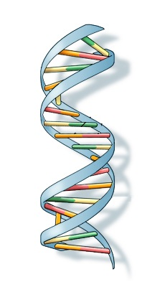
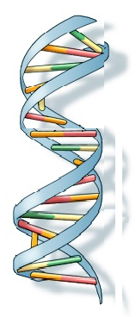
Another Way Genes Can Affect Toxic Response
Damaged DNA can lead to cancer
Toxin T
Repair enzyme RE
Expressed REG gene
SOURCE: Image of DNA Molecule courtesy U.S. National Library of Medicine. Image in the public domain. The remaining material in the slide is courtesy of the authors.

Slide 128
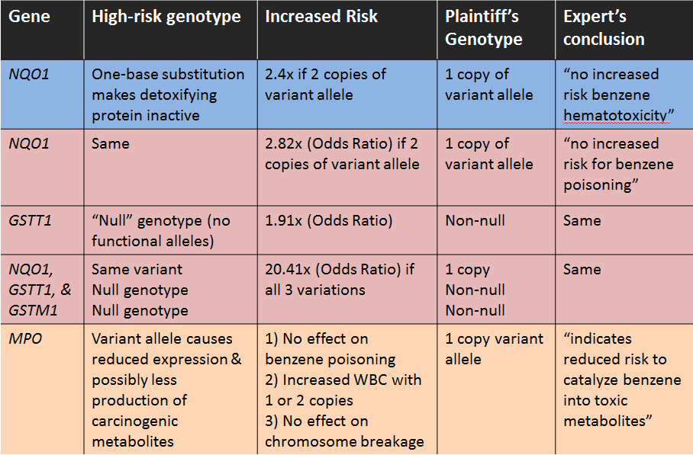
Studies in Expert Report of T. Toxicologist
This slide was prepared by the authors. The sources of the data summarized in the slide are the Len van Zyl report and references cited therein, as follows:
Rothman, N. et al. “Benzene Poisoning, a Risk Factor for Hematological Malignancy, Is Associated with the NQO1 ⁶⁰⁹C->T Mutation and Rapid Fractional Excretion of Chlorzoxazone.” 57 Cancer Research 2839-2842 (1997), p. 2841 Table 3; Chen, Y. et al. “Genetic polymorphisms involved in toxicant-metabolizing enzymes and the risk of chronic benzene poisoning in Chinese occupationally exposed populations.” 37 Xenobiotica 103-112 (2007), p. 103 (abstract); Wan, J. et al. “Association of Genetic Polymorphisms in CYP2E1, MPO, NQO1, GSTM1, and GSTT1 Genes with Benzene Poisoning.” 110 Envtl. Health Perspectives 1213-1218 (2002), p. 1216 Table 4; Lan, Q. et al. “Hematotoxicity in Workers Exposed to Low Levels of Benzene.” 306 Science 1774-1776, p. 1775; and Garte, S. et al. “Genetic Susceptibility to Benzene Toxicity in Humans.” 71 J. Toxicology Envtl. Health Part A 1482-1489 (2008), p. 1485.

Slide 129
Effect of NQO1 Genotype on risk for Benzene Poisoning in Shanghai, China, 1992
Attribute | Number (%) of Cases (workers exposed to benzene with benzene poisoning) | Number (%) of Controls (workers not exposed to benzene without benzene poisoning) | Odds Ratio (95% Confidence Interval)
Two copies of variant NQO1 allele | 20 (41%) | 11 (23%) | 2.4 (1.0 – 5.7)
One or no copy of variant NQO1 allele | 29 (59%) | 37 (77%) | 1.0
SOURCE: Courtesy of the authors based upon data from Nathaniel Rothman et al., “Benzene Poisoning, a Risk Factor for Hematological Malignancy, Is Associated with the NQO1 ⁶⁰⁹C→T Mutation and Rapid Fractional Excretion of Chlorzoxazone,” 57 Cancer Research 2839, 2841 Table 2 (1997).

Slide 130
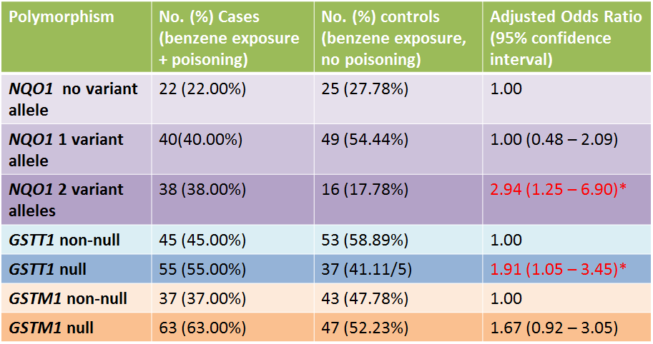
Effect of Genetic Polymorphisms on the Risk of Chronic Benzene Poisoning
Red print with * indicates statistically significant results.
SOURCE: Y. Chen et al., “Genetic Polymorphisms Involved in Toxicant-Metabolizing Enzymes and the Risk of Chronic Benzene Poisoning in Chinese Occupationally Exposed Populations,” 37 Xenobiotica 103, 108 Table III (2007). Reprinted by permission of Taylor & Francis Ltd, www.tandfonline.com.

Slide 131
NQO1, GSTT1, GSTM1 and Genetic Susceptibility to Chronic Benzene Poisoning
Genotype | No. Cases (benzene exposure + poisoning) | No. (%) controls (benzene exposure, no poisoning) | Adjusted Odds Ratio (95% confidence interval)
NQO1 no or 1 variant allele + GSTT1 non-null + GSTM1 non-null | 11 | 21 | 1.00
NQO1 2 variant alleles + GSTT1 null + GSTM1 null | 17 | 2 | 20.41 (3.79 – 111.11)*
Red print with * indicates statistically significant results.
SOURCE: Y. Chen et al., “Genetic Polymorphisms Involved inToxicant-Metabolizing Enzymes and the Risk of Chronic Benzene Poisoning in Chinese Occupationally Exposed Populations,” 37 Xenobiotica 103, 109 Table V (2007). Reprinted by permission of Taylor & Francis Ltd, www.tandfonline.com.

Slide 132
Effect of Genetic Polymorphisms on the Risk of Chronic Benzene Poisoning
Polymorphism | Adjusted Odds Ratio (95% confidence interval)
NQO1 2 variant alleles (compared to 1 or none) | 2.94 (1.25 – 6.90)*
GSTT1 null (compared to non-null) | 1.91 (1.05 – 3.45)*
GSSTM1 null (compared to non-null) | 1.67 (0.92 – 3.05) (not sig.)
NQO1 2 variant alleles + GSTT1 null + GSTM1 null (compared to 1 or non, non-null, and non-null) | 20.41 (3.79 – 111.11)*
Red print with * indicates statistically significant results.
SOURCE: Y. Chen et al., “Genetic Polymorphisms Involved inToxicant-Metabolizing Enzymes and the Risk of Chronic Benzene Poisoning in Chinese Occupationally Exposed Populations,” 37 Xenobiotica 103, 109 Table V (2007). Reprinted by permission of Taylor & Francis Ltd, www.tandfonline.com.

Slide 133
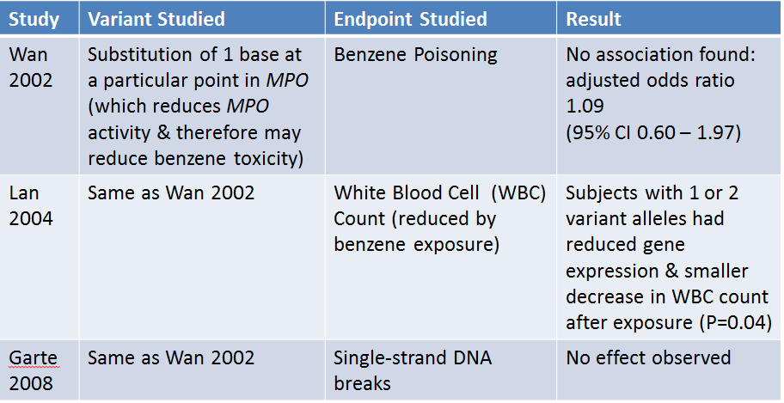
Summary of Three Studies on MPO and Benzene Toxicity
SOURCE: Courtesy of the authors based upon information from Junxiang Wan et al., “Association of Genetic Polymorphisms in CYP2E1, MPO, NQO1, GSTM1, and GSTT1 Genes with Benzene Poisoning,” 110 Envtl. Health Persp. 1213 (2002); Q. Lan et al., “Hematotoxicity in Workers Exposed to Low Levels of Benzene,” 306 Sci. 1774 (2004); and S. Garte et al., “Genetic Susceptibility to Benzene Toxicity in Humans,” 71 J. Toxicology Envtl. Health A. 1482 (2008).

Slide 134
Lifetime Breast Cancer Risk: BRCA1 High-risk Allele vs. General Population

Slide 135
BRCA1 High-risk Allele vs Other Alleles: Relative Risk
RELATIVE RISK = 60% / 12% = 5.0

Slide 136
High-risk BRCA1 allele & toxic exposure: assumption of independent, additive risk increments
Individual Probability of Causation
Population Proportion of Attributable Risk
Any exposure risk would be included here

Slide 137
High-risk BRCA1 allele & toxic exposure: assumption of interacting risk factors
Individual Probability of Causation
Population Proportion of Attributable Risk
Any exposure risk could be included here
or here

Slide 138
Variant FGFR2 allele & toxic exposure: assumption of independent, additive risk increments
Individual Probability of Causation
(RR=1.5 for 2 copies of variant allele)
Population Proportion of Attributable Risk
Any exposure risk would be included here

Slide 139
Variant FGFR2 allele & toxic exposure: assumption of interacting risk factors
Individual Probability of Causation
(RR=1.5 for 2 copies of variant allele)
Population Proportion of Attributable Risk
Any exposure risk could be included here
or here

Slide 140
Bowen time line
1994-1995: Emily Bowen & Darren Griffin born
2002-2003: Plaintiffs file expert reports
1997: Lawsuit filed

Slide 141
Bowen to 2003
Dr. Howard’s Causal Conclusion
Defendant’s experts’ diagnosis and causal conclusion
Benlate
Dr. Patton’s diagnosis
Non-CHARGE Birth Defect
CHARGE Birth Defect
Raw Fruits
Other causes
Unidentified genetic defect

Slide 142
Bowen time line
1994-1995: Emily Bowen & Darren Griffin born
2002-2003: Plaintiffs file expert reports
1997: Lawsuit filed
July 12, 2004: Defendant moves for genetic testing
Aug. 8, 2004: Vissers study of CHD7 mutations published online
Jan. 2005: Genetic testing results
March 23, 2003: Defendant moves to exclude plaintiffs’ experts; no ruling

Slide 143
Bowen After Genetic Testing Reveals Emily Bowen’s CHD7 Mutation
Dr. Patton’s and Defendant’s experts’ diagnosis
CHARGE Birth Defect
CHD7 Gene Variant
Benlate
CHD7 Gene Variant
Defendant’s experts’ causal conclusion
Dr. Howard’s revised causal conclusion

Slide 144
Another View of Dr. Howard’s Amended Opinion: Multiple Sufficient Causes
CHARGE
CHD7
Benlate
Either alone would have caused CHARGE syndrome

Slide 145
Exercise: Sources of a Birth Defect

Slide 146
Refining the probability of causation for subgroups
Plaintiff exposed to Shmenlate,
mentsch Genotype Unknown
Shmenlate exposure
Unknown causes
mentsch gene mutation
APR = .33, so apparent probability of specific causation is 33%

Slide 147
Refining the probability of causation for subgroups
Plaintiff exposed to Shmenlate
has mentsch Gene Mutation
Shmenlate exposure
Unknown causes
mentsch gene mutation
APR = .33, so apparent probability of specific causation is 33%

Slide 148
Refining the probability of causation for subgroups
Plaintiff exposed to Shmenlate does not have mentsch gene mutation
Unknown causes
Shmenlateexposure
APR = .50, so apparent probability of specific causation is 50%

Slide 149
Biomarker
An observable biological change that is associated with a characteristic of interest.

Slide 150


Biomarker of Susceptibility
Sick or healthy cells, by genotype
Healthy cells,
by genotype
TAT
TAT
TAT
TAT
TAT
TAT
EXPOSURE
TAT
TAT
TAT
TAT
TAT
TAT
TCT
TCT
TCT
TCT
TCT
EXPOSURE
TCT
TCT
TCT
TCT
TCT
TCT
TCT

Slide 151

Biomarker of Exposure
Unexposed Cells
Exposed Cells
EXPOSURE
EXPOSURE
Unexposed Cells

Slide 152
Biomarker of Effect
Exposed Cells
Unexposed Cells
EXPOSURE
EXPOSURE
Unexposed Cells

Slide 153
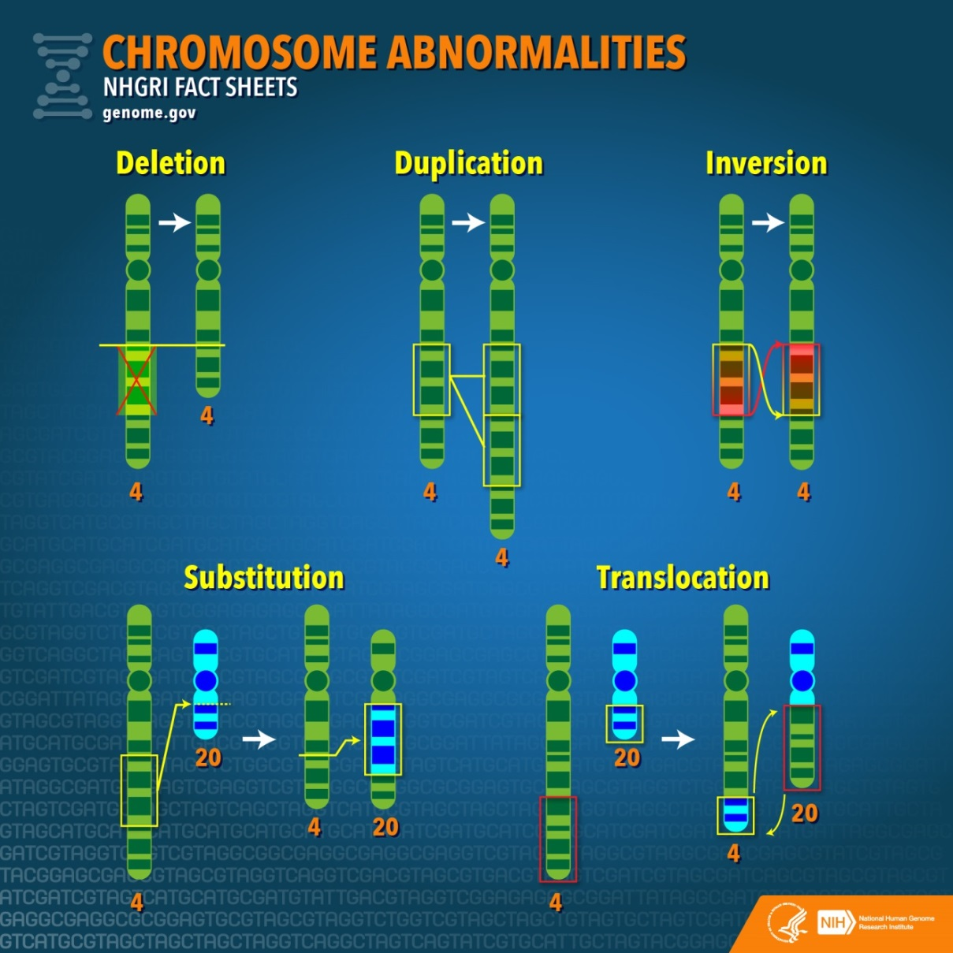
Potential biomarkers of exposure or effect: chromosome abnormalities
SOURCE: Image courtesy National Human Genome Institute, www.genome.gov. Image in the public domain.

Slide 154
Potential biomarkers of exposure or effect: DNA sequence changes
TTTTCCCAAAGTAGCATAGCCGGAAGAAACCCG
EXPOSURE
TTTTCCCAATGAAGCATAGCCGGAAGAACCCCG
e.g.,
Inversion: AGT becomes TGA
Substitution: AAC becomes ACC

Slide 155
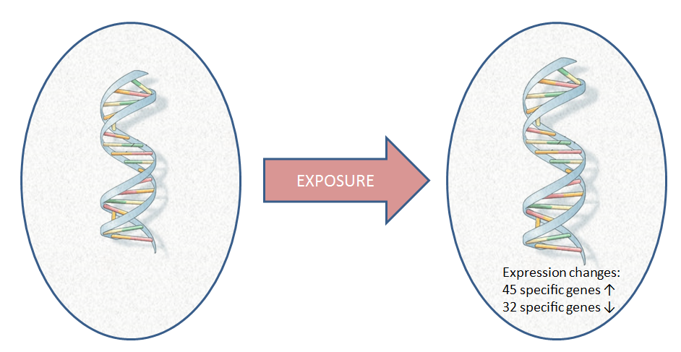
Potential biomarkers of exposure or effect: gene expression pattern changes
1000s of genes expressed to varying degrees
1000s of genes expressed to varying degrees
SOURCE: Image of DNA Molecule courtesy U.S. National Library of Medicine, http://ghr.nlm.nih.gov/handbook/basics/dna. Image in the public domain. The remaining material in the slide is courtesy of the authors.

Slide 156
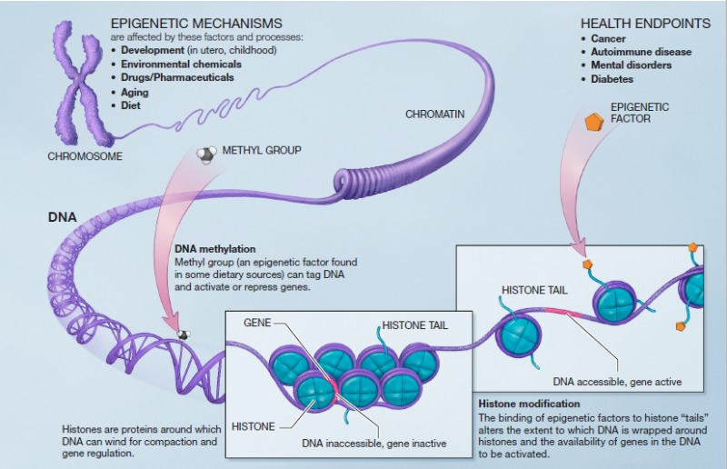
Potential biomarkers of exposure or effect: epigenetic changes
SOURCE: Image courtesy National Center for Biotechnology Information, National Library of Medicine, National Institutes of Health, www.ncbi.nlm.nih.gov. Image in public domain.

Slide 157


Example of an epigenetic change: altered methylation
methyl group
EXPOSURE
SOURCE: Portions of adapted image courtesy National Center for Biotechnology Information, National Library of Medicine, National Institutes of Health, www.ncbi.nlm.nih.gov. Image in public domain.

Slide 158

The Idealized Potential of Biomarkers
Benzene
Chlorinated solvents
PAH compounds
Radiation
Virus
RISK FACTORS FOR PLAINTIFF’S CANCER
Many Individuals Exposed to Various Risk Factors
What Their Cancer Cells Look Like on Biochemical Exam
Obesity
Metabolic gene
DNA repair gene
Background, unknown,
“de novo”

Slide 159
Biomarker Persistence and Toxic Tort Litigation
Exposure
Biomarker Formation
Diagnosis
Litigation
Is biomarker still present?
Induction and Latency Period
Treatment

Slide 160
Biomarkers of Effect (Causation): Specificity
A perfectly specific biomarker of causation would only appear if causation is true.
Unexposed Cells
Diseased Cells After Exposure
Cases caused by exposure
EXPOSURE
Cases not caused by exposure

Slide 161
Computing biomarker specificity
SPECIFICITY
measures how well the biomarker avoids misidentifying negative cases.
 | Cases Caused by Exposure | Cases Not Caused by Exposure
Biomarker Present | TRUE POSITIVES | FALSE POSITIVES
Biomarker Absent | FALSE NEGATIVES | TRUE NEGATIVES
SPECIFICITY =
TRUE NEGATIVES
(TRUE NEGATIVES + FALSE POSITIVES)

Slide 162
Biomarkers of Effect (Causation): Sensitivity
A perfectly sensitive biomarker of causation would always appear if causation is true.
Unexposed Cells
Diseased Cells After Exposure
Cases caused by exposure
EXPOSURE
Cases not caused by exposure

Slide 163
Computing biomarker sensitivity
SENSITIVITY
measures how well the biomarker avoids misidentifying negative cases.
 | Cases Caused by Exposure | Cases Not Caused by Exposure
Biomarker Present | TRUE POSITIVES | FALSE POSITIVES
Biomarker Absent | FALSE NEGATIVES | TRUE NEGATIVES
SENSITIVITY =
TRUE POSITIVES
(TRUE POSITIVES + FALSE NEGATIVES)

Slide 164
Specificity-Sensitivity Tradeoff: BMT expression hypothetical

Slide 165
Specificity-Sensitivity Tradeoff: Four Possible Biomarkers for T1 Exposure or Effect
D
C
B
A
People with D After Exposure to Tx
People with D After Exposure to T1
Unexposed People with D
Low Range of BMT expression High

Slide 166
Defendant’s Biomarker Testimony in Henricksen v. ConocoPhillips
 | “Secondary” AML | “De Novo” AML
Chromosome Aberrations Present | 90% of Secondary AML cases | 50% of De Novo AML CASES
Chromosome Aberrations Absent | 10% of Secondary AML cases | 50% of De Novo AML cases
SPECIFICITY of biomarker for secondary AML = 0.50
50% de novo w/o aberrations divided by
(50% de novo w/o aberrations +
50% de novo w/ aberrations)
SENSITIVITY of biomarker for secondary AML = 0.90
90% secondary w/ aberrations divided by
(90% secondary w/ aberrations
+
10% secondary w/o aberrations)

Slide 167
RELATIVE RISKS < 2.0

Slide 168
RELATIVE RISKS < 2.0
SOURCES OF DISEASE

Slide 169
Revised Probability after Differential Etiology

Slide 170
SOURCE: Michael D. Green, The Future of Proportional Liability, in “Exploring Tort Law,” Stuart Madden, ed. (Cambridge: Cambridge University Press, 2005). Reproduced courtesy of the author.

